Slide 1
Discussion 1 Introduction to Pthreads
CS391: Programming Massively Parallel Multiprocessors and Heterogenous Systems (Understanding and programming the devices powering AI)
Jonathan Appavoo

Slide 2
POSIX Threads
How to create
  pthread_create
How to join
How to pass “data/arguments”
  Single void *
  Shared memory to the rescue?
How to “barrier” synchronize
Timing if we have time ;-)

Slide 3
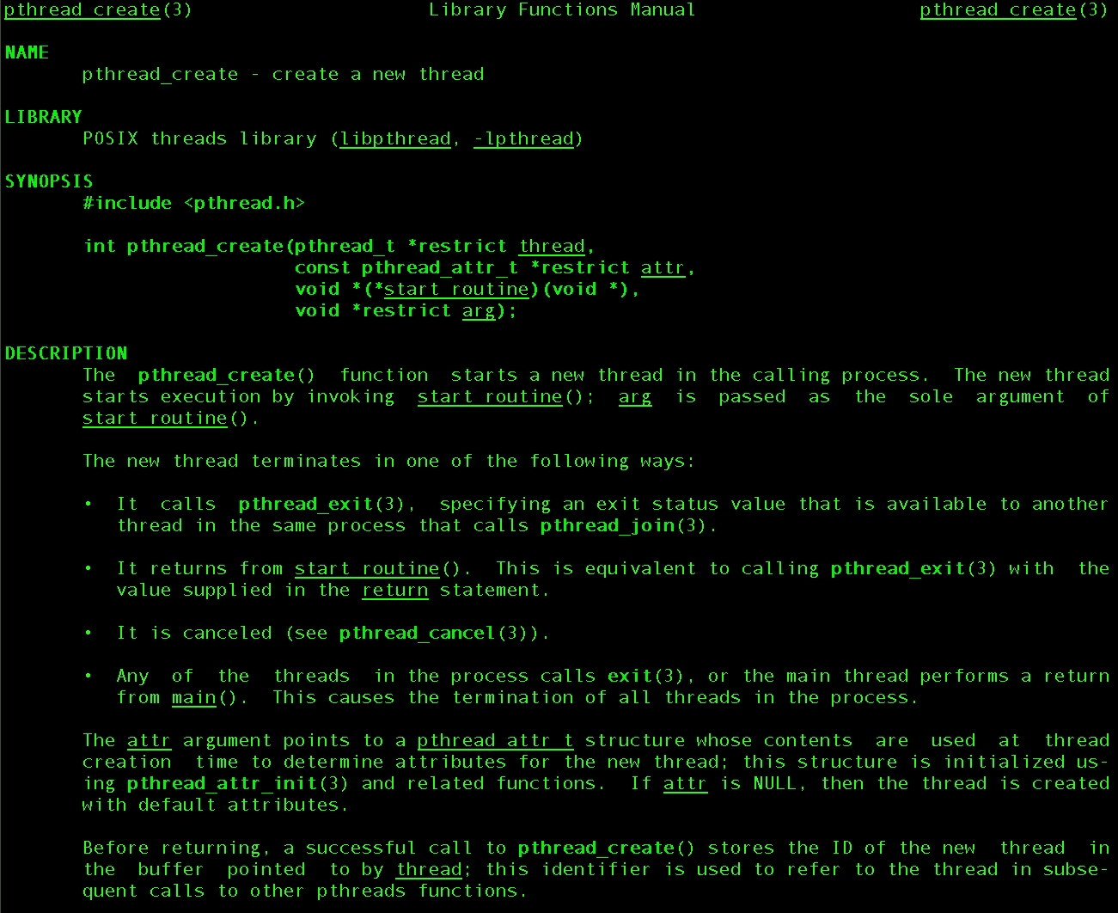
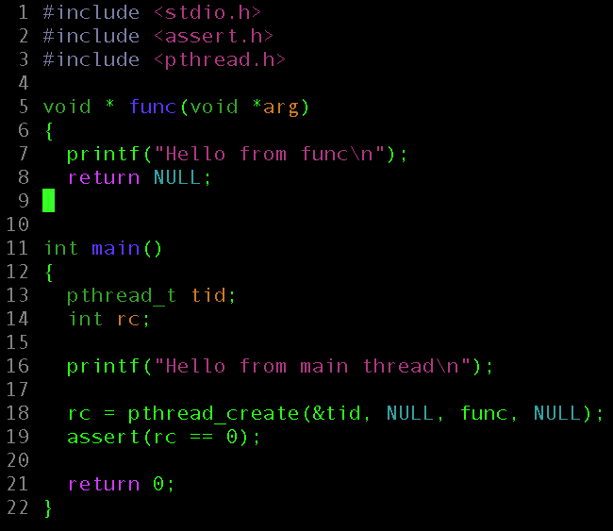
pthread_create

Slide 4
Give it a shot.
Does it do what you expect?

Slide 5
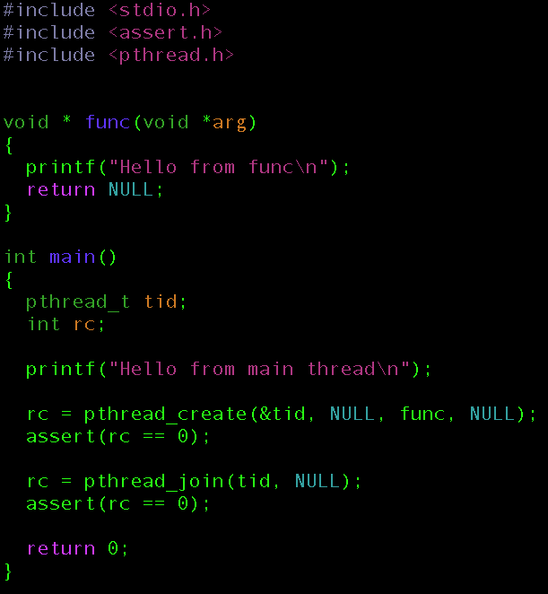
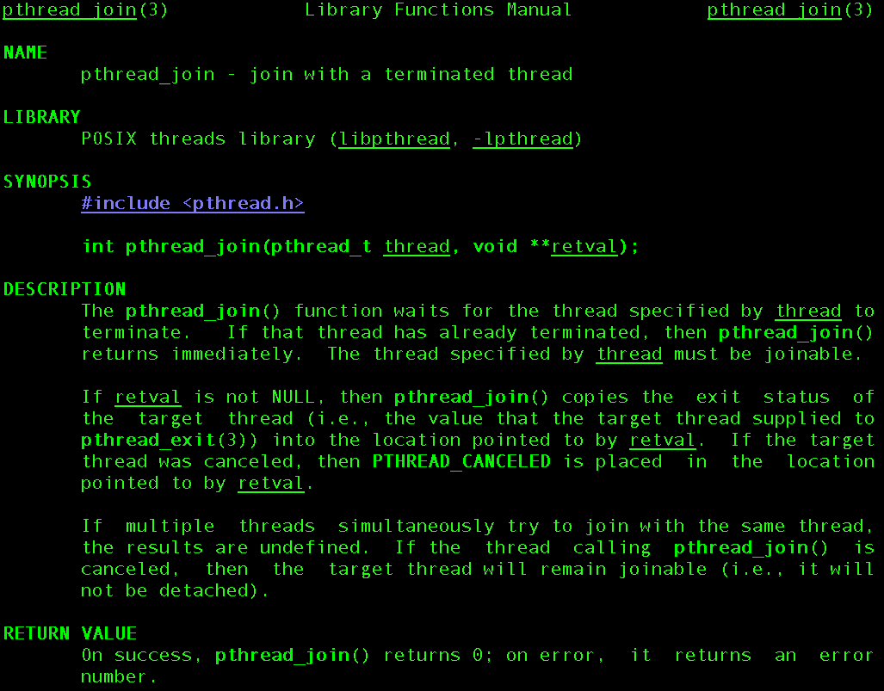
pthread_join

Slide 6
How do we start more than one thread?
Can you modify the code to start 10?
How do you “join” with all of them?

Slide 7
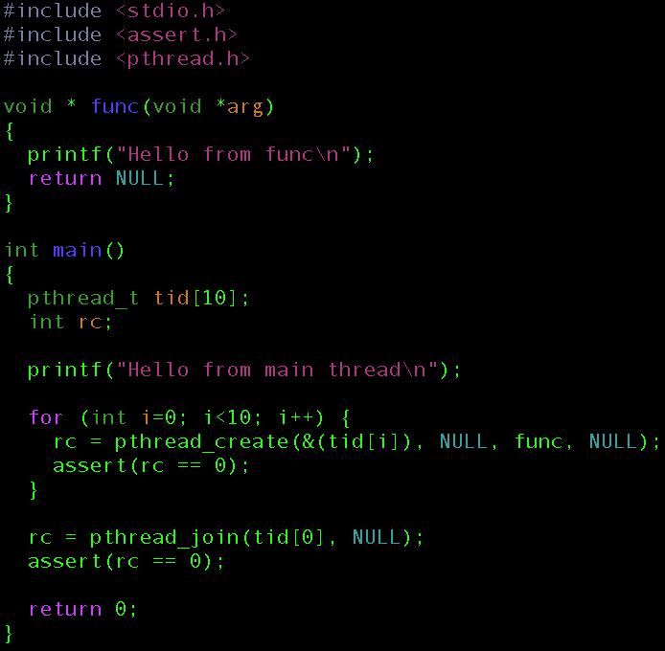
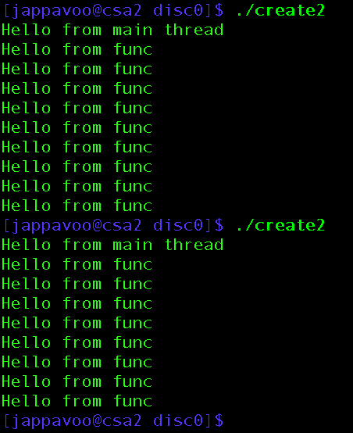

Slide 8
How do we fix this?

Slide 9
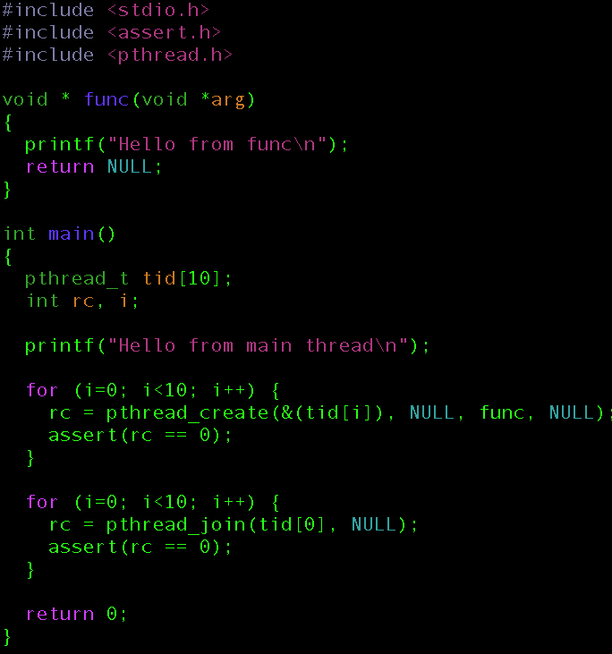

Slide 10
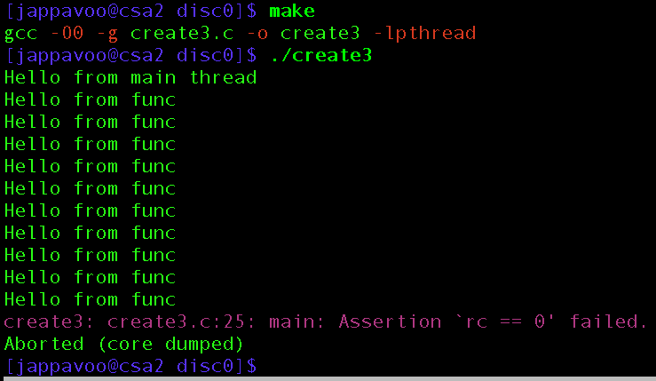
What’s the bug?

Slide 11
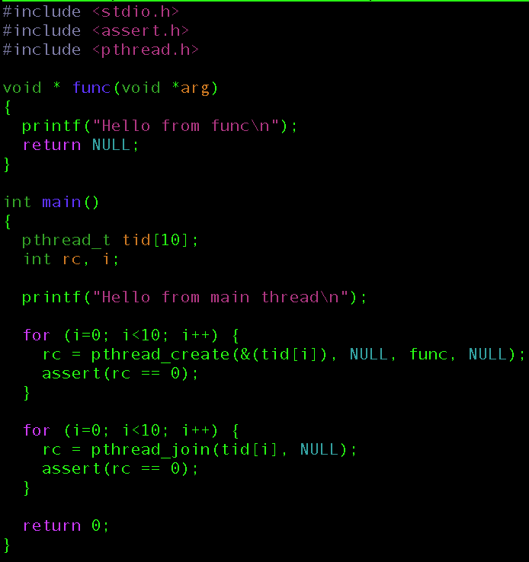
The difference one character can make ;-)

Slide 12
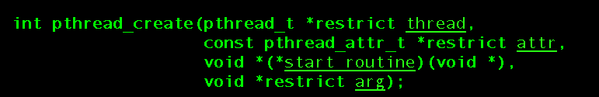
Passing Arguments and Data

Slide 13
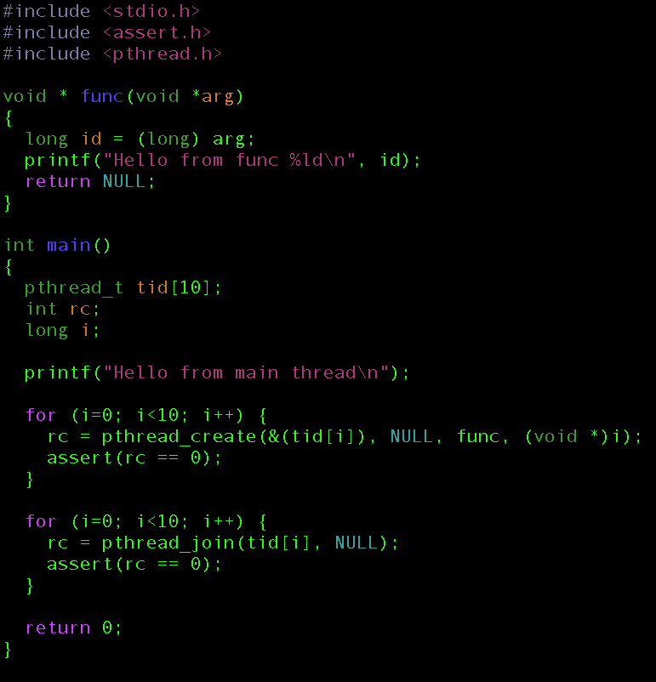

Slide 14
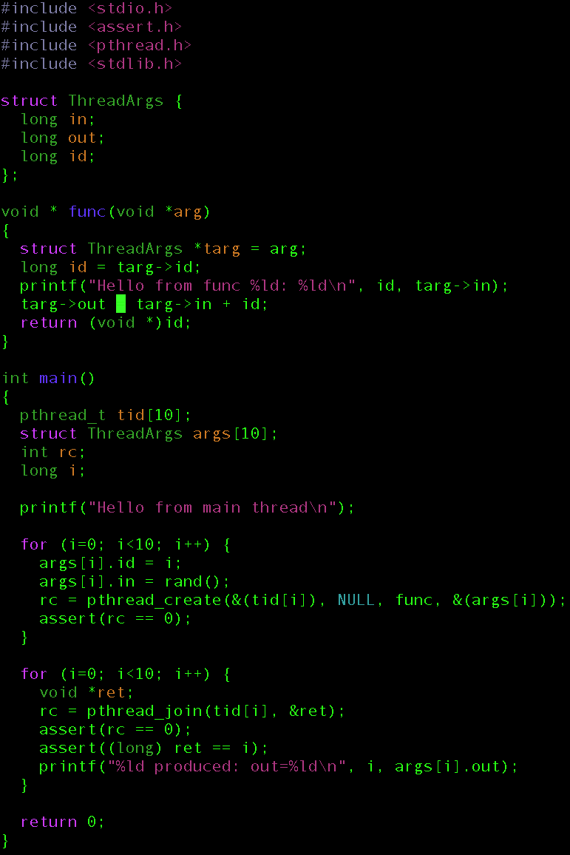
Something a little more complicated
Draw a picture!

Slide 15
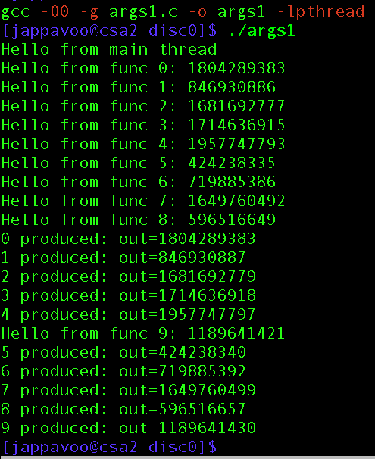
Remember no reliable ordering

Slide 16

Some times we what to synchronize all threads and not just at exit
Barriers -- pthread_barrier_t

Slide 17
DRAW A PICTURE

Slide 18
A program with several phases
An array of numbers split into chunks across n threads
First phase all “worker” threads zero their chunk
Second phase “main” thread check to see that all data is zeroed
Third phase “worker” threads fill their chunk with random numbers
Four phase “main” thread checks to see that all data is not zero & work thread exit
Fifth phase “main” thread waits for workers to exit and then cleans up and exit

Slide 19
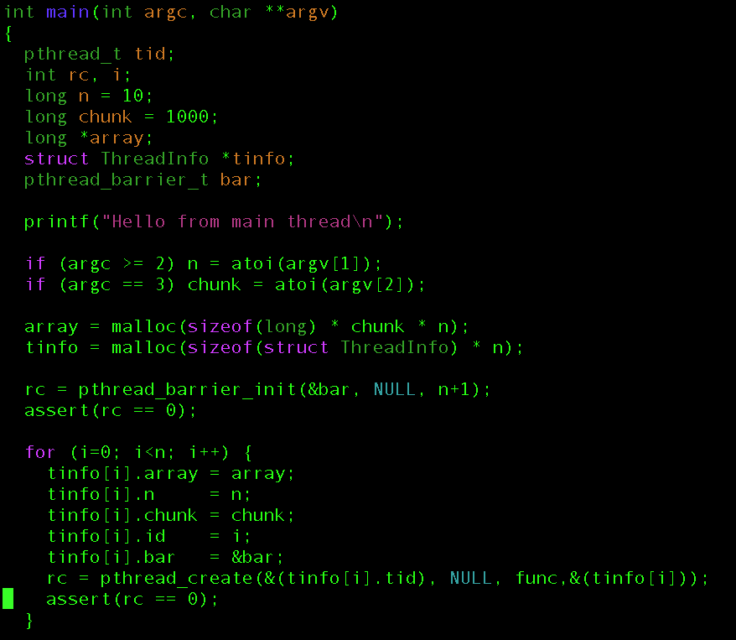
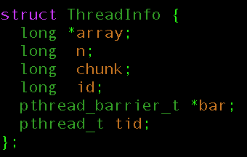

Slide 20
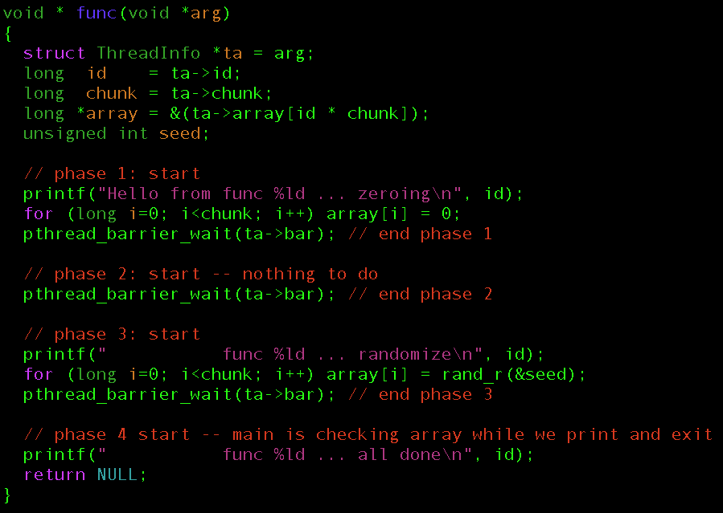
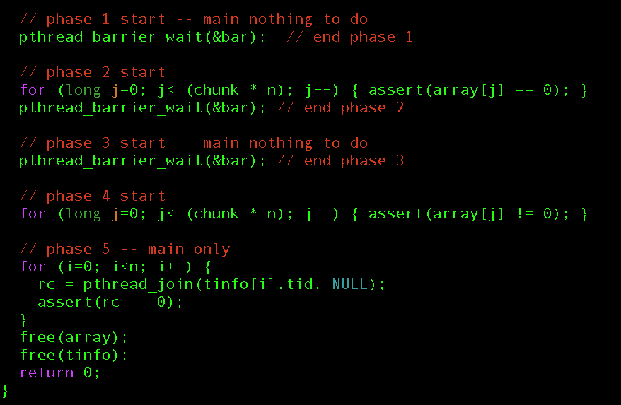
Worker thread
Main thread

Slide 21
Worker thread
Main thread

Slide 22
Worker thread
Main thread

Slide 23
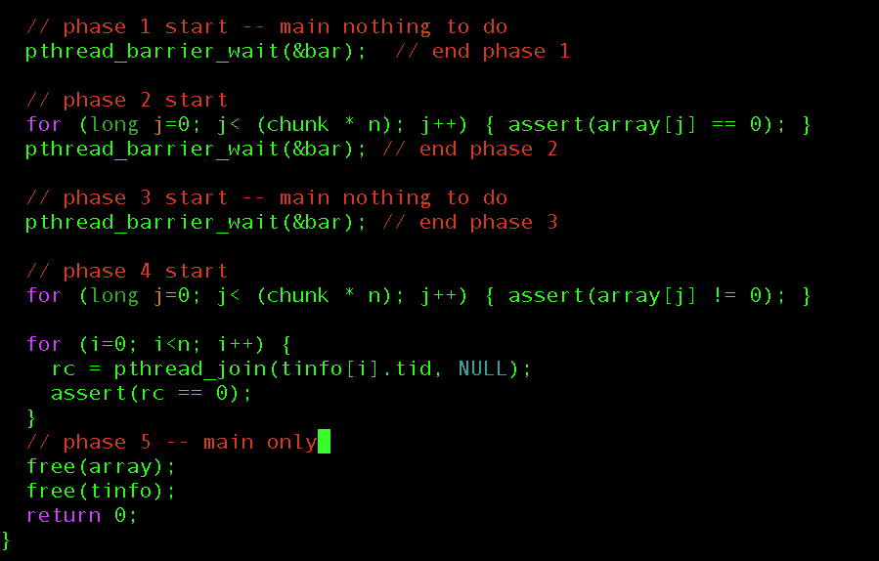
Worker thread
Main thread

Slide 24
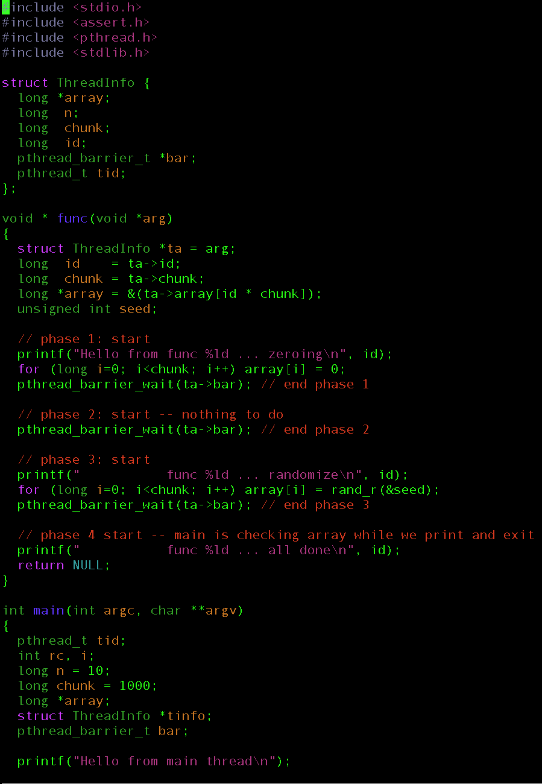
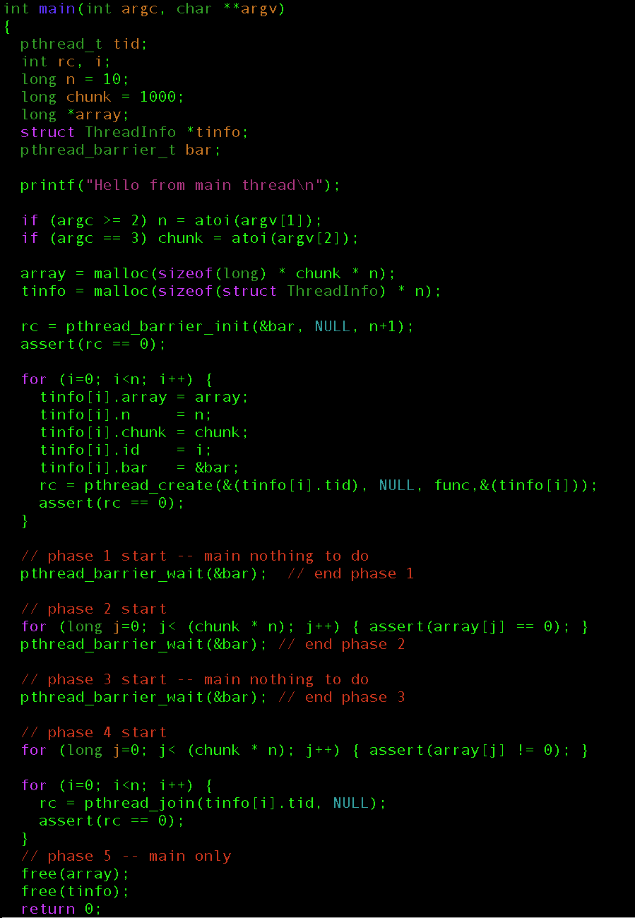

Slide 25
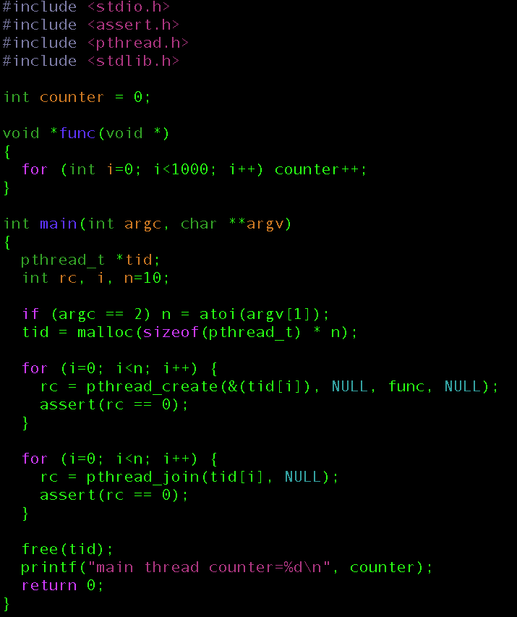
Be careful shared memory is both a blessing and a curse
Is this “safe”

Slide 26
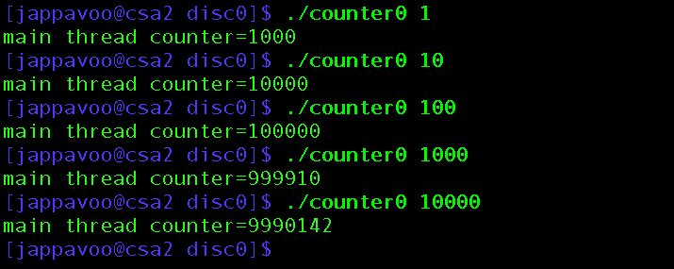
No, need to protect critical section eg. a lock/mutex
NOT “Trivially Parallel”

