Slide 1
Lecture 11: Recap & projects
Programming Massively Parallel Multiprocessors and Heterogeneous Systems (Understanding and programming the devices powering AI)
Jonathan Appavoo

Slide 2
GPU Programming
All about optimizations! (given that GPU is being used as accelerator)
Objective: maximize (relative to theoretical limit):
  Compute bandwidth utilization (arithmetic intensity)
  Memory bandwidth utilization
Objective: maximize overlap of:
  CPU ↔ GPU transfers
  GPU computations with I/O
  Async APIs

Slide 3
Key Optimizations
GMEM coalescing
  Padding where helpful
  Rearrangement of data
Using SMEM
Using registers and shuffle instructions
Using const memory
Eliminating thread divergence
Loop unrolling (& templates)
Reducing __sycnthread()s & their scope (see Cooperative Thread Group APIs)
Increase computation per thread “Thread coarsening”
Reducing bank conflicts
Explore new Tensor and Tensor Memory Accelerator features (and any others you can get you hands and head around)
Use fused instructions (Fused Multiple Add), vector instructions, lower precision, etc.

Slide 4
Projects
Objective:
  Gain more experience programming GPU’s on more substantive problems
Groups for 3-4 students working together
You pick your own problem to work on
  Ideally somehow related to your research or interests

Slide 5
Examples (from prior offerings)
Micro-benchmark key GPU modules: GMEM, SMEM, L2, TLBs, etc.
Micro-benchmark unified memory
Protein Crystallography Image Analysis to help beat cancer
Video block matching for compression
Video upscaling with bicubic interpolation
Analytic Placement for ASIC placement
N-body problem simulation
Particle-based fluid simulations
Crypto computations
Encryption
BLAS functions, FFT, Solvers
* Optimize any lecture example utilizing modern GPU features/techniques
Anything non-trivial that is embarrassingly parallel

Slide 6
Project Deliverables
Group and idea declaration (Thu 10/16/25)
Proposal submission (Thu 10/30/25)
In class progress review with the instructor to ensure you are on track (Tue 11/18/25)
Report and repository submission (Wed 12/10/25)
Presentation (TBD – Exam slot if we can fit it)
See Syllabus for details

Slide 7
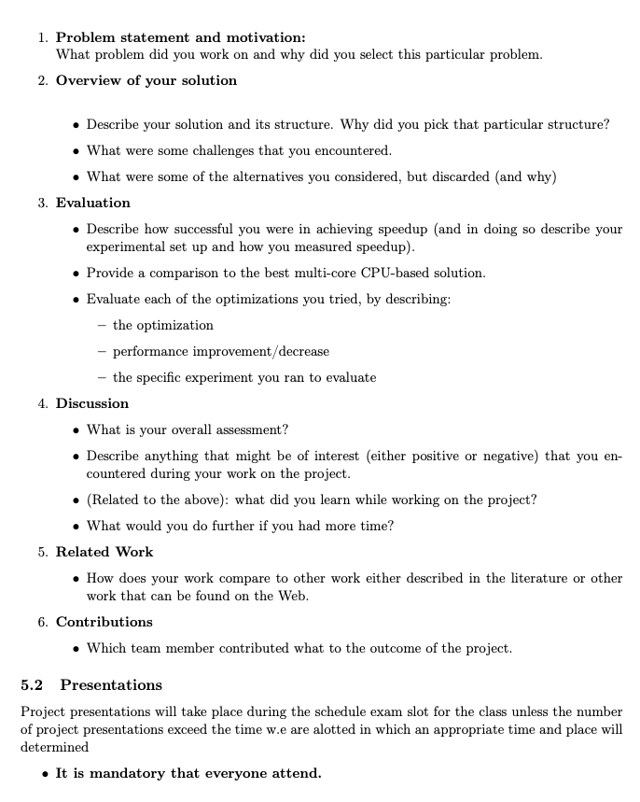
Use your repo to constantly
track ALL work – notes, references, diagrams, etc. Keep a log that chronologically documenting your meetings, discussions and decisions. This will make writing you report much easier.

Slide 8
Weekly Logistics
We will continue to meet in class at the schedule times
  I will be available and am happy to hack with you
  You are expected to attend and using the time to make project progress
If I can arrange a guest lecture or two I will do so

Slide 9
Guidelines
You can use any languages you like that has CUDA bindings
  However, you must be able to quantify the performance of you code
  Preference is C++/C
You can use any libraries and tools
  But you must be able to describe and explain them
You do not need to use the class GPU or development environment
  If you do plan on using them then please discuss you plans with me so that we can estimate the resources you will require

Slide 10
Weekly Logistics
We will continue to meet in class at the schedule times
  I will be available and am happy to hack with you
  You are expected to attend and using the time to make project progress
If I can arrange a guest lecture or two I will do so

Slide 11
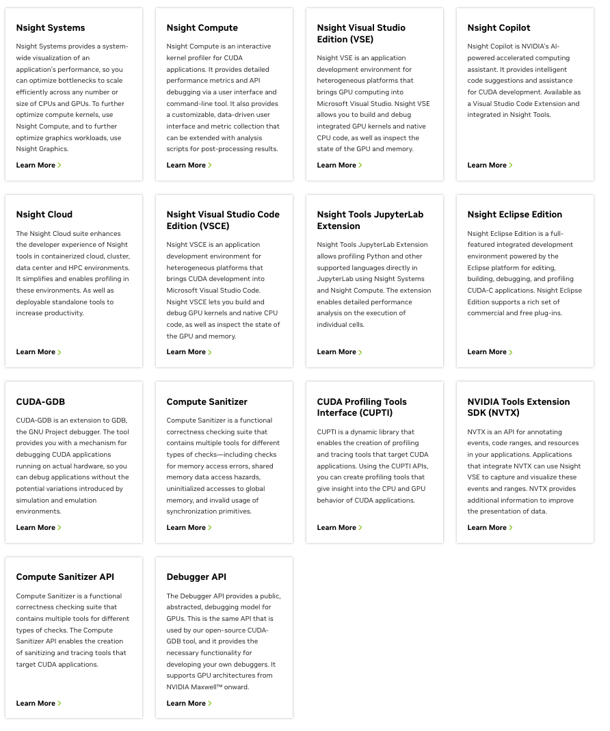
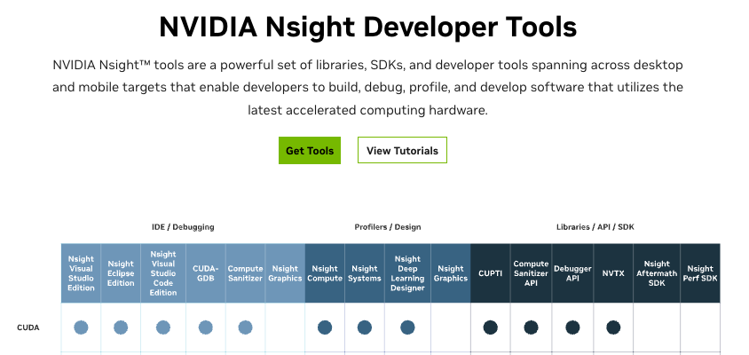
Useful tools
https://developer.nvidia.com/tools-overview

Slide 12
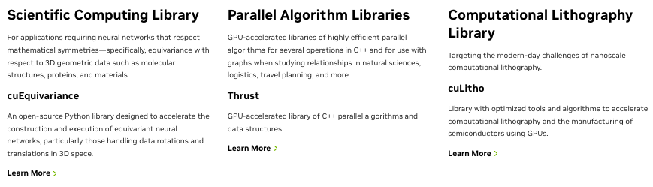
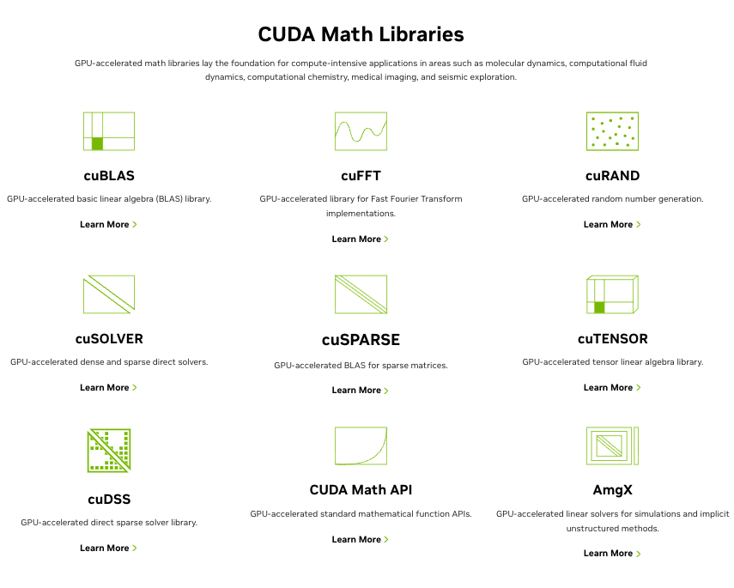
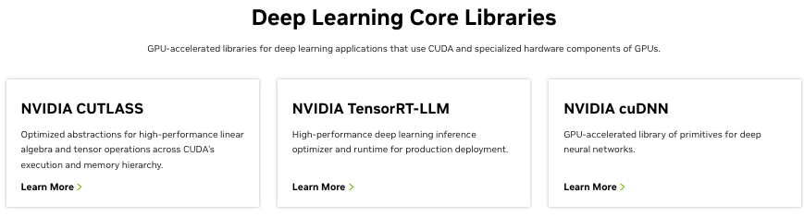
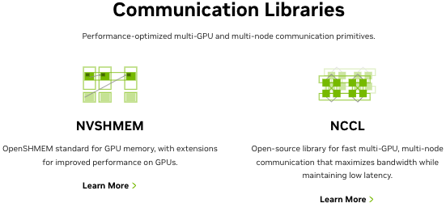
Libraries
https://developer.nvidia.com/gpu-accelerated-libraries

Slide 13
Libraries
https://developer.nvidia.com/gpu-accelerated-libraries
But your application has to do more than just make calls to these libraries!

Slide 14
A date library overview but gives you an idea of what is out there : I assume things have moved forward especially with respect to ML libraries

Slide 15
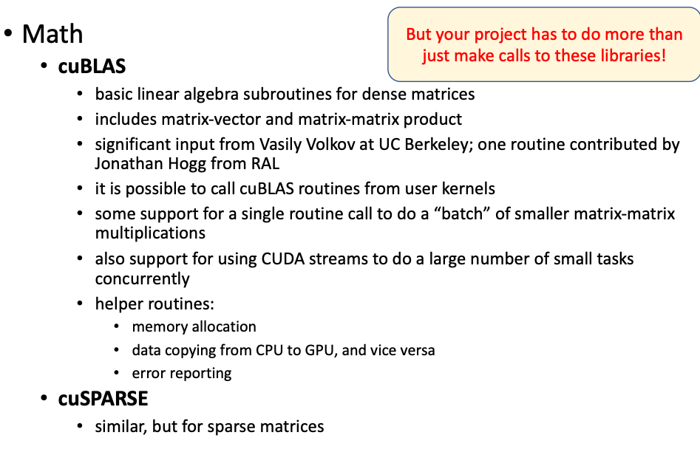

Slide 16
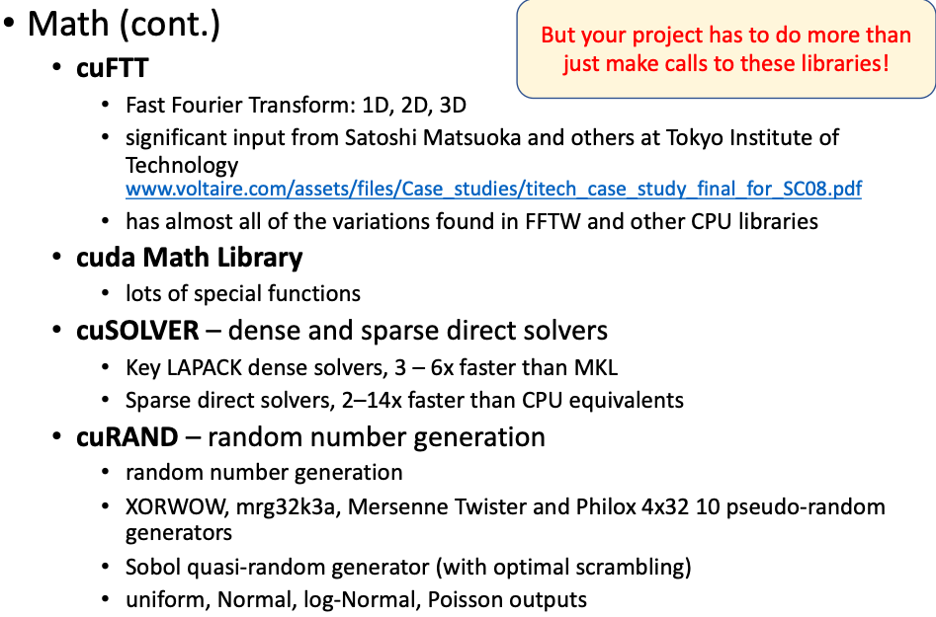

Slide 17
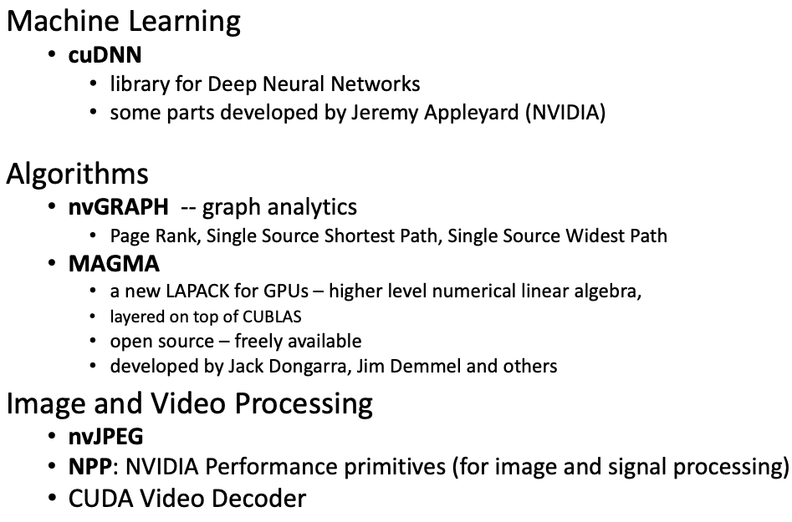

Slide 18
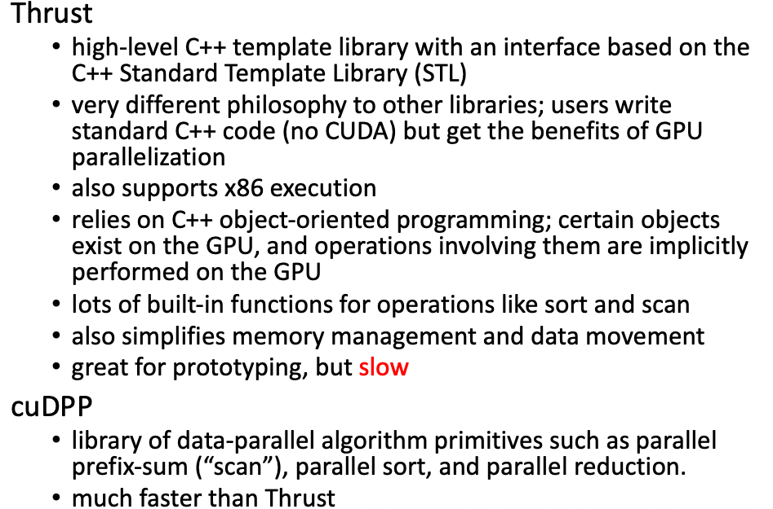

Slide 19
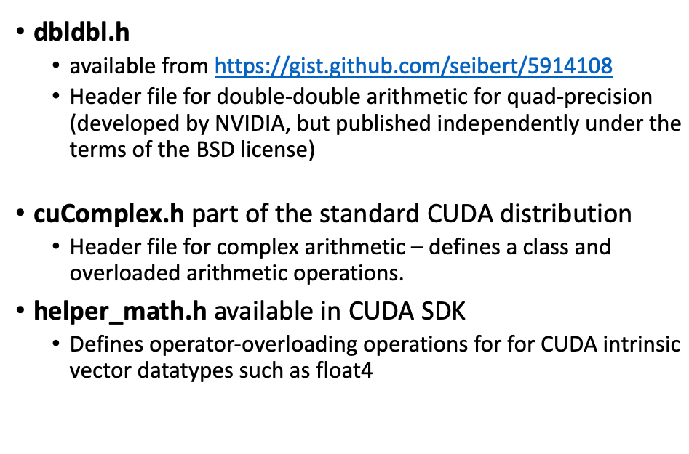

Slide 20
Assignment #2
Will be available by the end of the day
Due Thu 10/21/25 @ 12:59 PM

Slide 21
HAVE FUN!!!!
If you make money don’t forget I take donations ;-)

