Slide 1
Multiprocessors
Programming Massively Parallel Multiprocessors and Heterogeneous Systems (Understanding and programming the devices powering AI)
Jonathan Appavoo

Slide 2
Multiprocessor?

Slide 3
Multiprocessors
EASY: A computer with more than one processing unit (CPU/Core)
The Promise / Hope : Make things bigger (scale up) and things get better
  Amdhal’s Law Perspective : Reduce execution by adding more processors – get your work done faster
  Gustafson’s Law Perspective: Get more work done in the same time by adding more processors

Slide 4
Multiprocessors
HARD: How do we organize them and program them?
  How do we make them bigger? What is and what is not shared?
    Connect computers on a network – Distributed system
      Easy to scale
      But very different programming model
    Add more CPUs to an existing computer
      Hard to scale
      But a “familiar” programming model

Slide 5
Concurrency vs Parallelism?

Slide 6
Concurrency vs Parallelism
Concurrency:
  Computing: the ability to execute more that one program or task simultaneously
Parallelism:
  Computing: the use of parallel processing in computing systems

Slide 7
Forms of Parallel Processing
Obvious
And Not so Obvious
inst0
inst1
inst2
.
.
.

Slide 8
Multiprocessors: Spectrum

Slide 9
Multiprocessors: Spectrum
Tightly Coupled
HW Consolidation
Loosely Coupled

Slide 10
Multiprocessors: Spectrum
Tightly Coupled
HW Consolidation
Shared
Memory
(single system image)
Message
Passing
(distributed systems)
Pgming Model
Loosely Coupled

Slide 11
Multiprocessors: Spectrum
Tightly Coupled
SMMP
HW Consolidation
Shared
Memory
(single system image)
Message
Passing
(distributed systems)
Pgming Model
Loosely Coupled

Slide 12
Multiprocessors: Spectrum
Tightly Coupled
SMMP
HW Consolidation
Shared
Memory
(single system image)
Message
Passing
(distributed systems)
Pgming Model
Cluster
Loosely Coupled

Slide 13
Multiprocessors: Spectrum
Tightly Coupled
SMMP
HW Consolidation
Shared
Memory
(single system image)
Message
Passing
(distributed systems)
Pgming Model
DSM
Cluster
Loosely Coupled

Slide 14
Multiprocessors: Spectrum
Tightly Coupled
SMMP
SuperComputer
SMMP - SM =
=
Cluster + TC
HW Consolidation
Shared
Memory
(single system image)
Message
Passing
(distributed systems)
Pgming Model
DSM
Cluster
Loosely Coupled

Slide 15
Multiprocessors: Our Focus: SMMP
Tightly Coupled
SMMP
SuperComputer
SMMP - SM =
=
Cluster + TC
HW Consolidation
Shared
Memory
(single system image)
Message
Passing
(distributed systems)
Pgming Model
DSM
Cluster
Loosely Coupled

Slide 16
Multiprocessors: Our Focus: Hybrid SMMP**
Hybrid
Tightly Coupled
SMMP
GPU
SuperComputer
SMMP - SM =
=
Cluster + TC
HW Consolidation
Shared
Memory
(single system image)
Message
Passing
(distributed systems)
Pgming Model
DSM
Cluster
Loosely Coupled

Slide 17
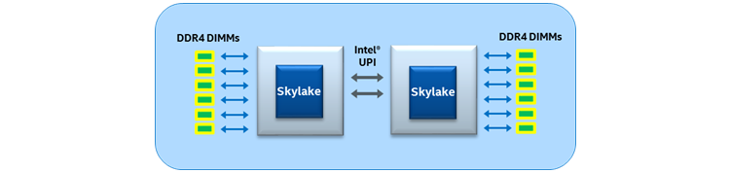
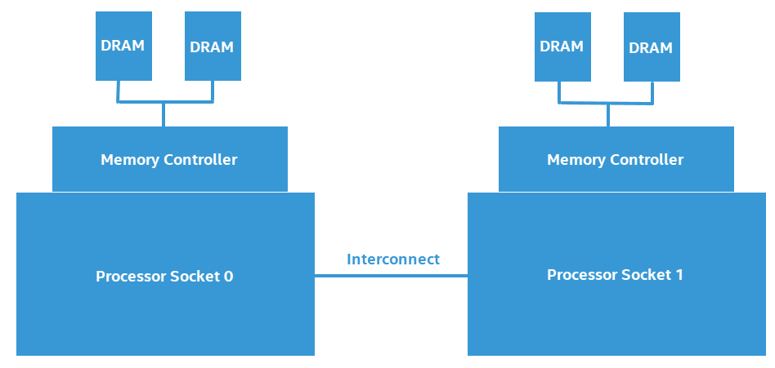
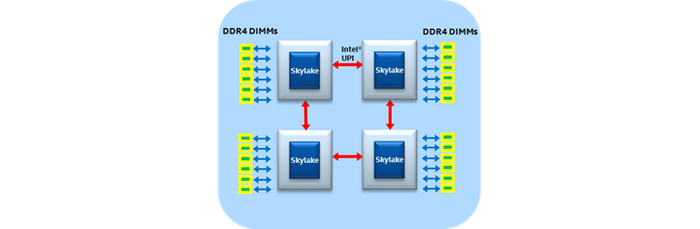
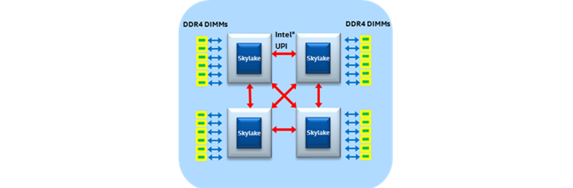
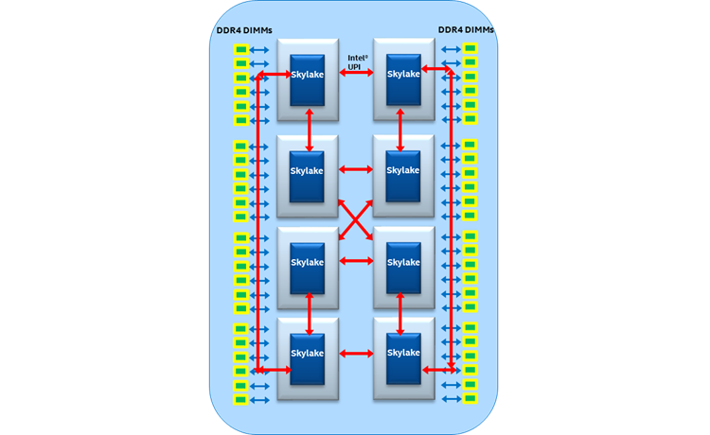
General Purpose Shared Memory Multiprocessors (SMMPs): Our Starting point
2 Socket
4 Socket
What are some of you observations?
8 Socket

Slide 18
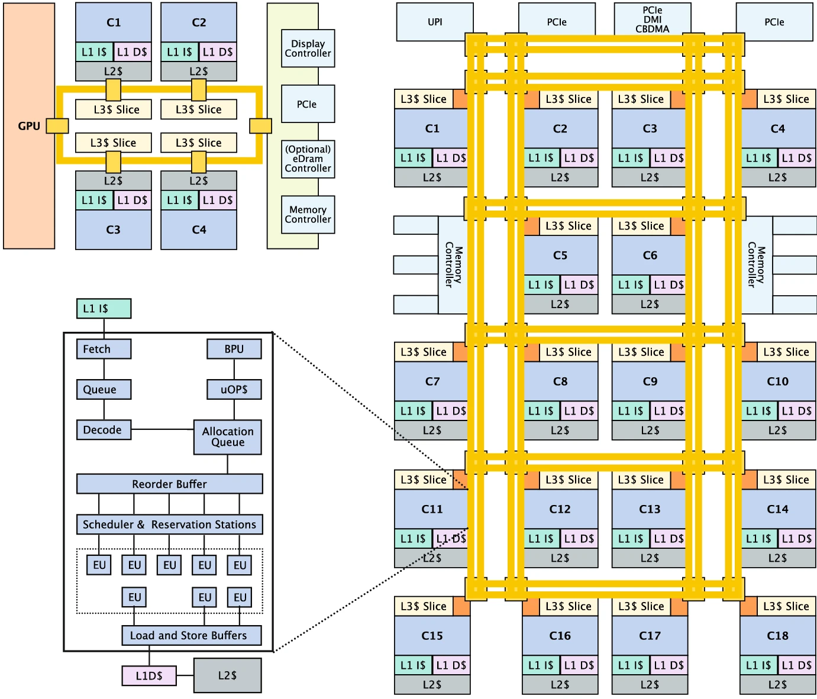
General Purpose Shared Memory Multiprocessors (SMMPs): Our Starting point
diagram of a 18-core Intel Skylake server Xeon W (2021)
https://link.springer.com/article/10.1007/s11227-021-03985-0/figures/4

Slide 19
What is a core?

Slide 20
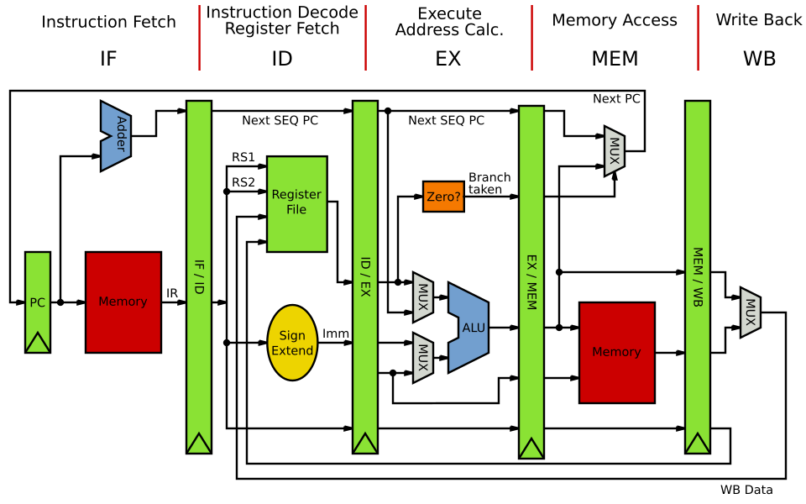
Instruction Level Parallelism: “execution”
https://en.wikibooks.org/wiki/Microprocessor_Design/Pipelined_Processors

Slide 21
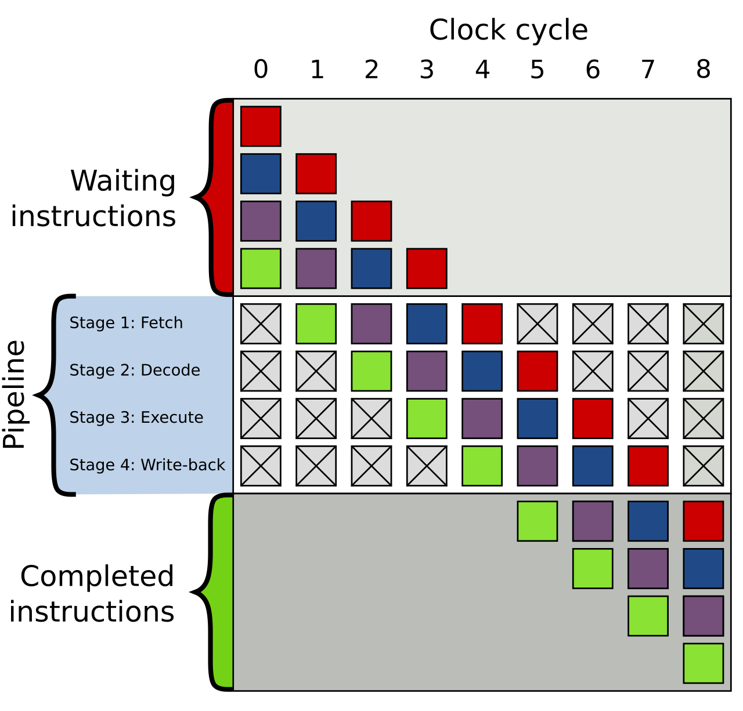
Instruction Level Parallelism: Pipelines
Cycle | Stage
0 | Four instructions are waiting to be executed
1 | Green fetch
2 | Green decode, Purple fetch
3 | Green execute, Purple decode, Blue fetch
4 | Green write-back, Purple execute, Blue decode, Red fetch
5 | Green completed, Purple write-back, Blue execute, Red decode
6 | Purple completed, Blue write-back, Red execute
7 | Blue completed, Red write-back
8 | Red completed
https://en.wikipedia.org/wiki/Instruction_pipelining

Slide 22
Instruction Level Parallelism: depth
Depth: Number of Stages
https://commons.wikimedia.org/wiki/File:Pipeline,_4_stage.svg#/media/File:Pipeline,_4_stage.svg

Slide 23
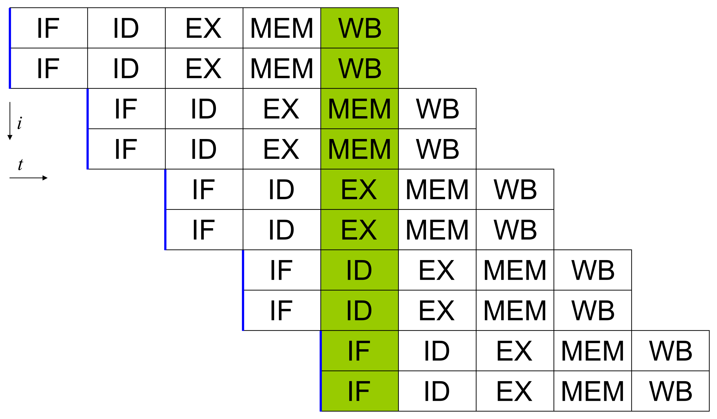
Instruction Level Parallelism: Super Scalar
Width: Number of pipelines – Super Scalar
By Amit6, original version (File:Superscalarpipeline.png) by User:Poil - Own work, CC BY-SA 3.0, https://commons.wikimedia.org/w/index.php?curid=9748747

Slide 24
Instruction Level Parallelism: Multi-Threading
S

Slide 25
Projects
Objective:
  Gain more experience programming GPU’s on more substantive problems
Groups for 3-4 students working together
You pick your own problem to work on
  Ideally somehow related to your research or interests

Slide 26
Examples (from prior offerings)
Micro-benchmark key GPU modules: GMEM, SMEM, L2, TLBs, etc.
Micro-benchmark unified memory
Protein Crystallography Image Analysis to help beat cancer
Video block matching for compression
Video upscaling with bicubic interpolation
Analytic Placement for ASIC placement
N-body problem simulation
Particle-based fluid simulations
Crypto computations
Encryption
BLAS functions, FFT, Solvers
* Optimize any lecture example utilizing modern GPU features/techniques
Anything non-trivial that is embarrassingly parallel

Slide 27
Project Deliverables
Group and idea declaration (Thu 10/16/25)
Proposal submission (Thu 10/30/25)
In class progress review with the instructor to ensure you are on track (Tue 11/18/25)
Report and repository submission (Wed 12/10/25)
Presentation (TBD – Exam slot if we can fit it)
See Syllabus for details

Slide 28
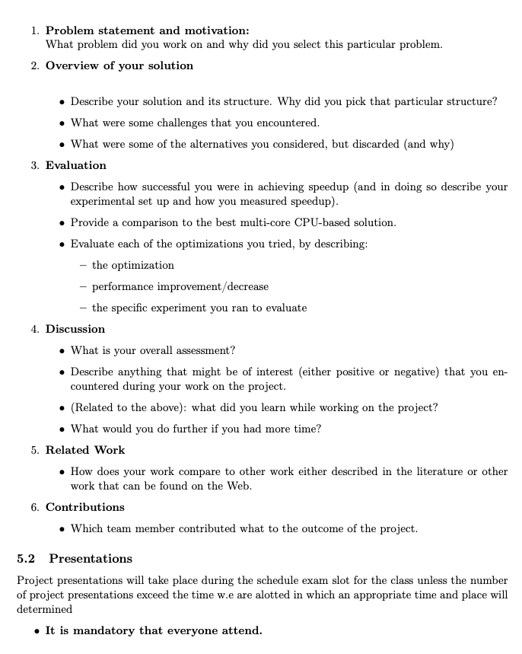
Use your repo to constantly
track ALL work – notes, references, diagrams, etc. Keep a log that chronologically documenting your meetings, discussions and decisions. This will make writing you report much easier.

Slide 29
Weekly Logistics
We will continue to meet in class at the schedule times
  I will be available and am happy to hack with you
  You are expected to attend and using the time to make project progress
If I can arrange a guest lecture or two I will do so

Slide 30
Guidelines
You can use any languages you like that has CUDA bindings
  However, you must be able to quantify the performance of you code
  Preference is C++/C
You can use any libraries and tools
  But you must be able to describe and explain them
You do not need to use the class GPU or development environment
  If you do plan on using them then please discuss you plans with me so that we can estimate the resources you will require

Slide 31
Weekly Logistics
We will continue to meet in class at the schedule times
  I will be available and am happy to hack with you
  You are expected to attend and using the time to make project progress
If I can arrange a guest lecture or two I will do so

Slide 32
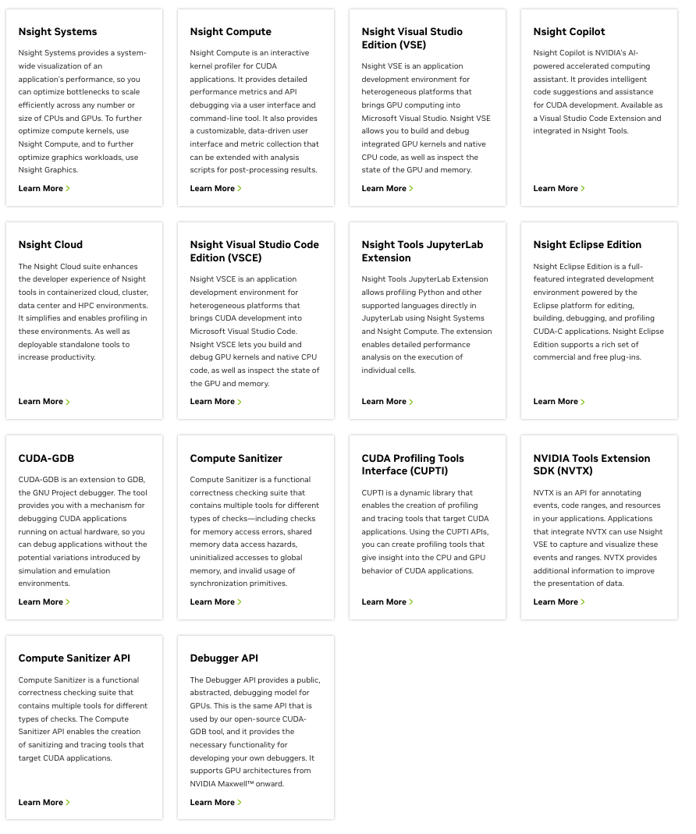
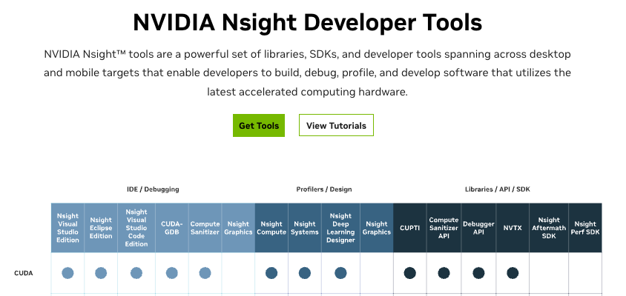
Useful tools
https://developer.nvidia.com/tools-overview

Slide 33

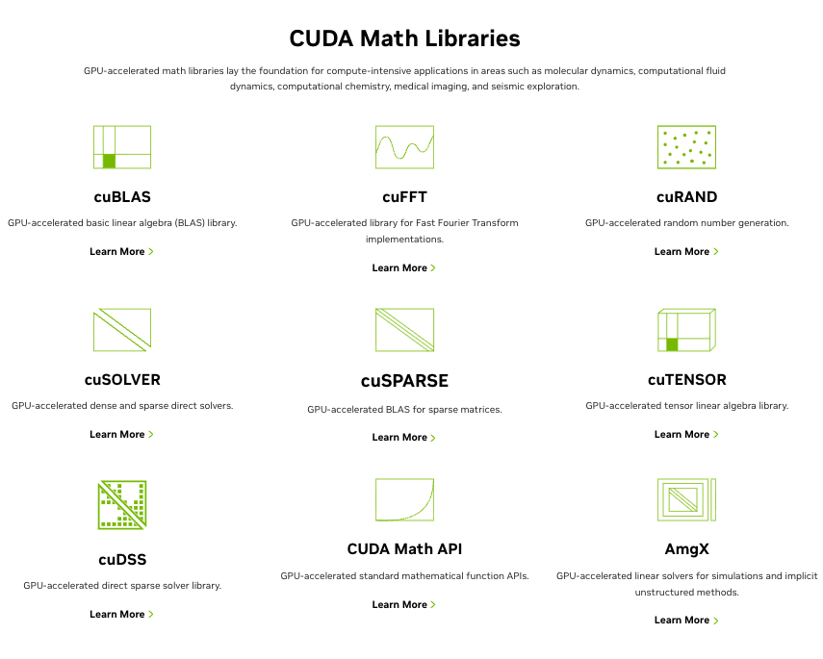
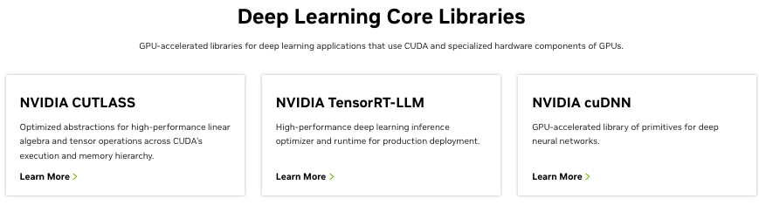
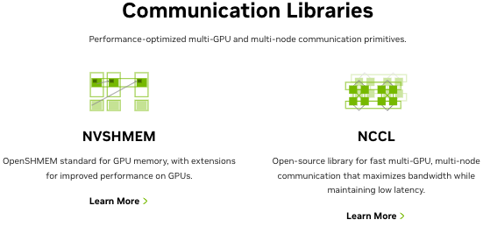
Libraries
https://developer.nvidia.com/gpu-accelerated-libraries

Slide 34
Libraries
https://developer.nvidia.com/gpu-accelerated-libraries
But your application has to do more than just make calls to these libraries!

Slide 35
A date library overview but gives you an idea of what is out there : I assume things have moved forward especially with respect to ML libraries

Slide 36
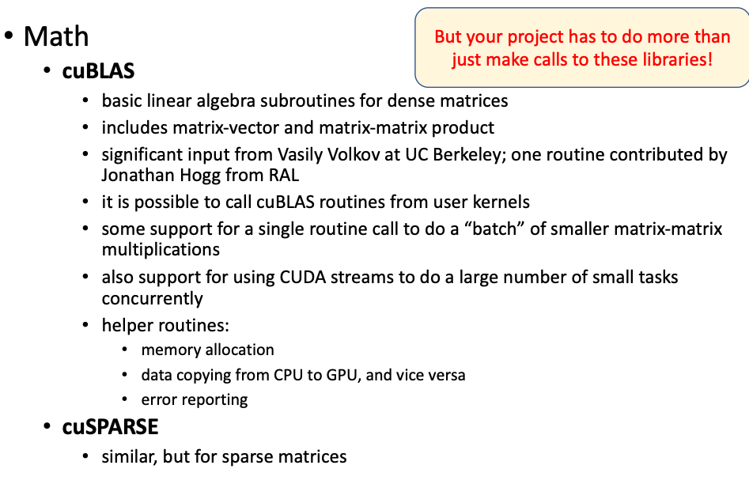

Slide 37
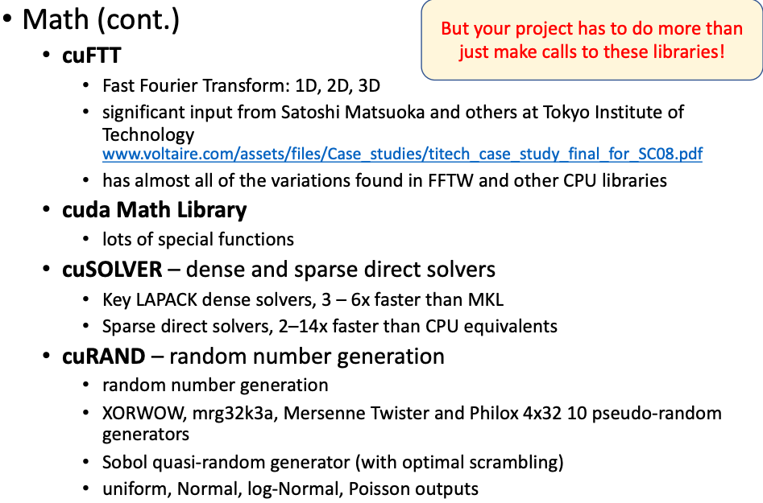

Slide 38
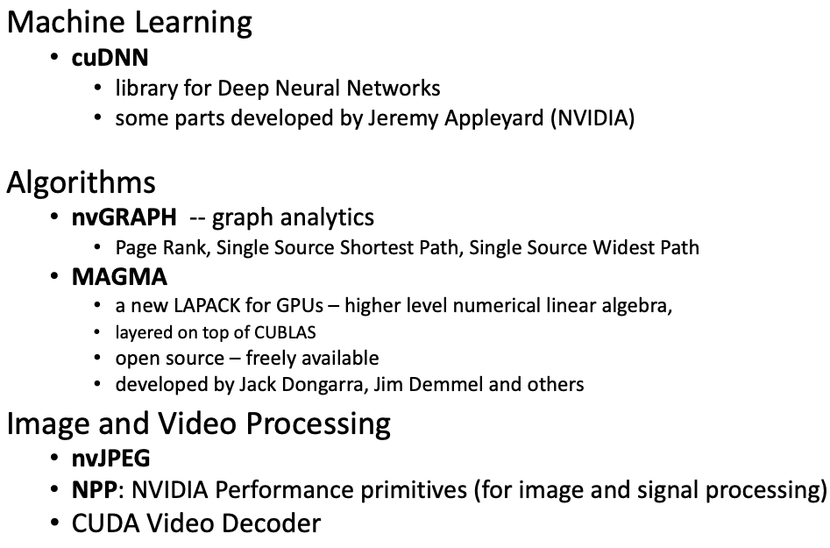

Slide 39
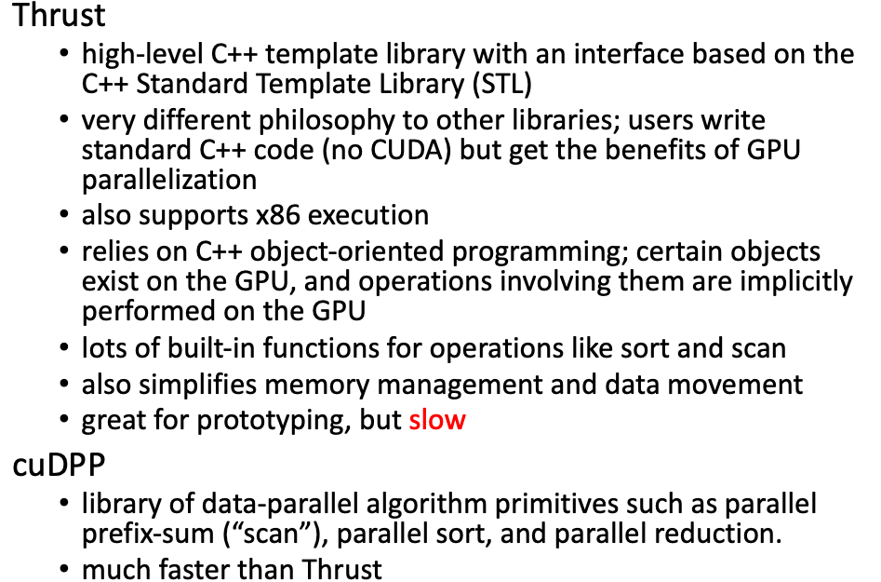

Slide 40
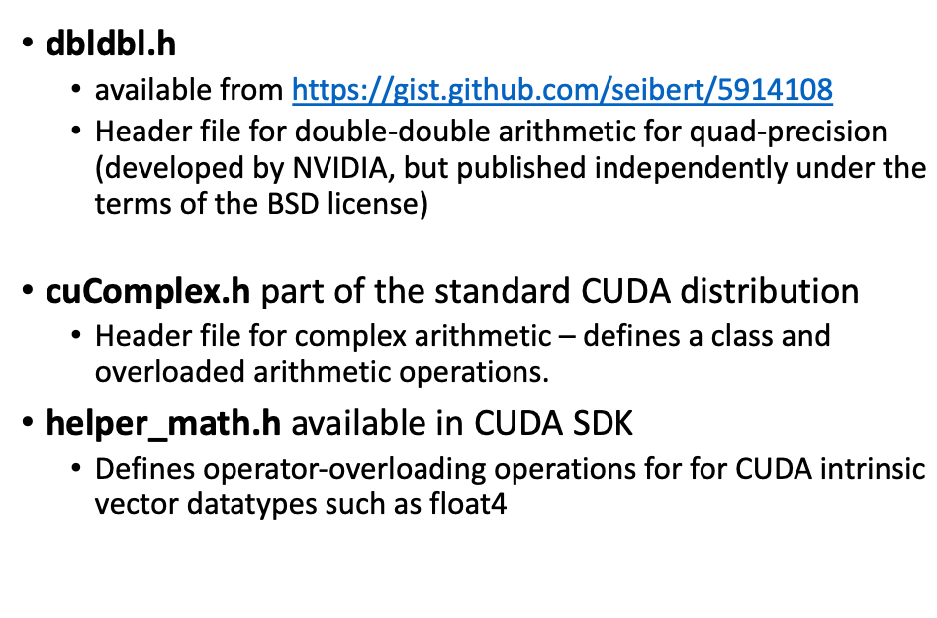

Slide 41
Assignment #2
Will be available by the end of the day
Due Thu 10/21/25 @ 12:59 PM

Slide 42
HAVE FUN!!!!
If you make money don’t forget I take donations ;-)

