Slide 1



Discussion 6:
CUDA Profiling

Slide 2

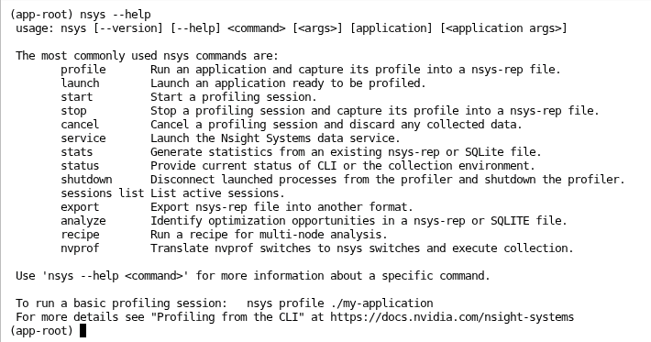
Nsight System
nsys - command line interface

Slide 4
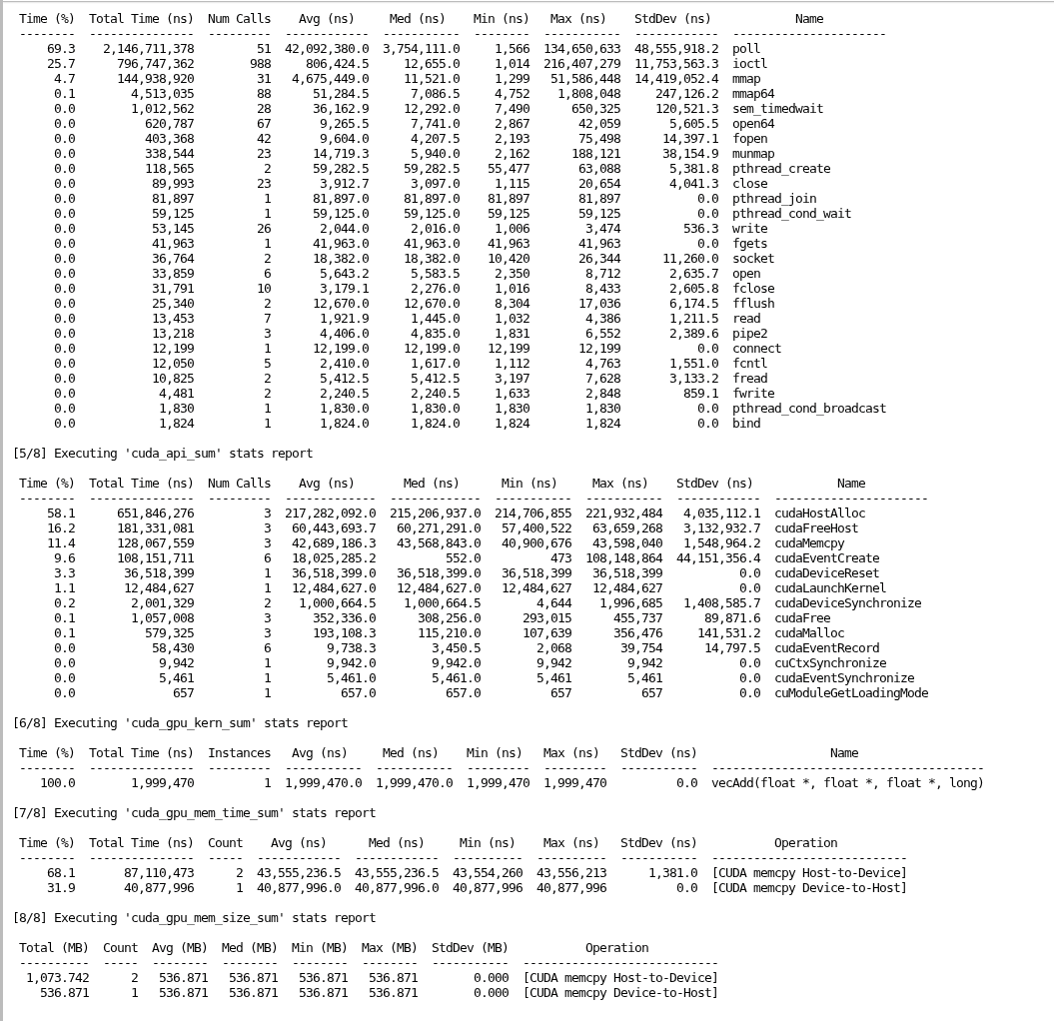

Slide 6
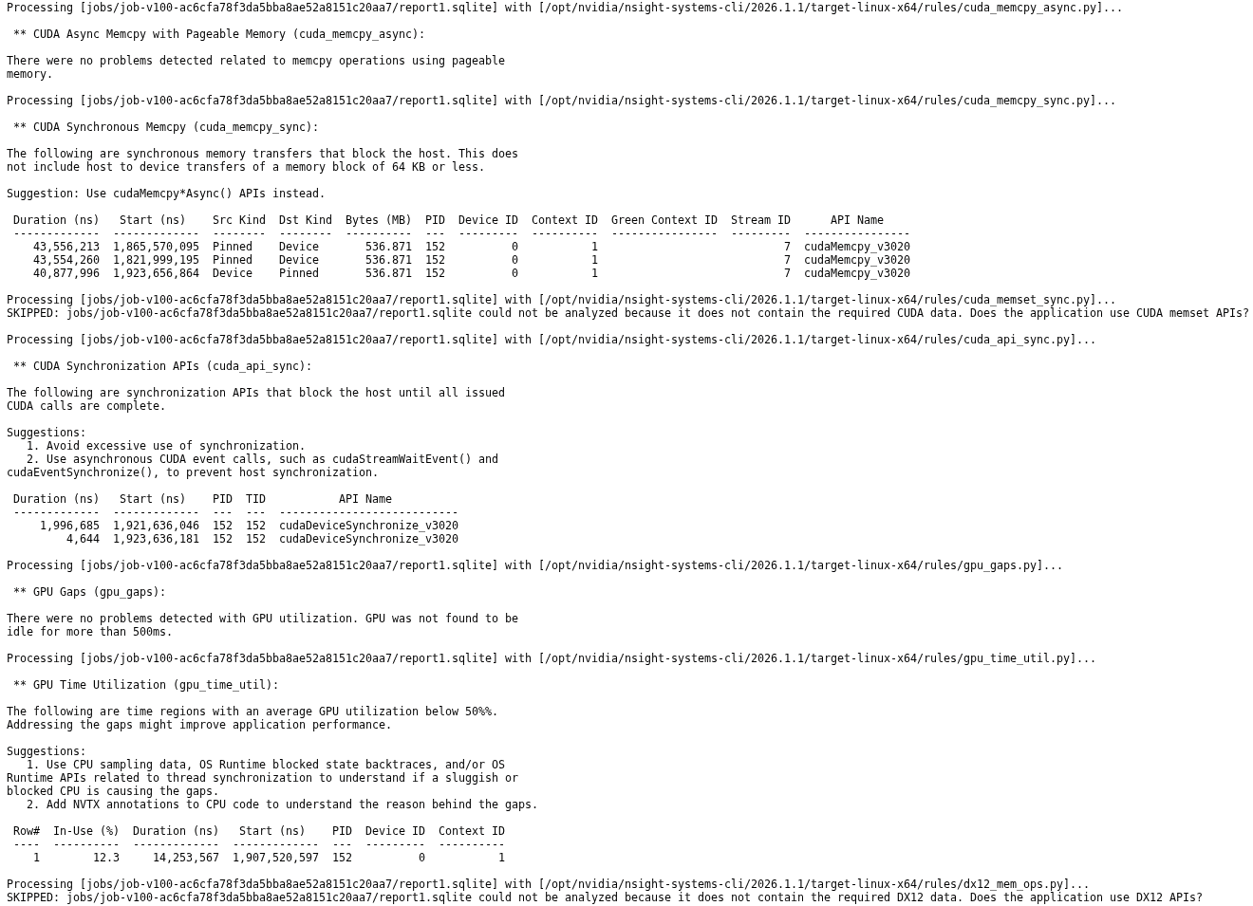

Slide 7
Nsight System
Using the GUI
Download and Install NVIDIA Nsight Systems:
https://developer.nvidia.com/nsight-systems/get-started

Slide 8
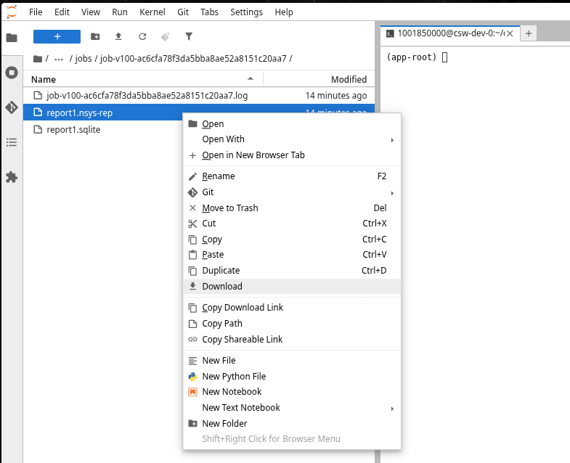
Nsight System
Using the GUI
Download and Install NVIDIA Nsight Systems:
https://developer.nvidia.com/nsight-systems/get-started
Use the file explorer in the container environment to locate the
.nsys-rep file generated by nsys
  Right click the file and Download it to your local machine

Slide 9
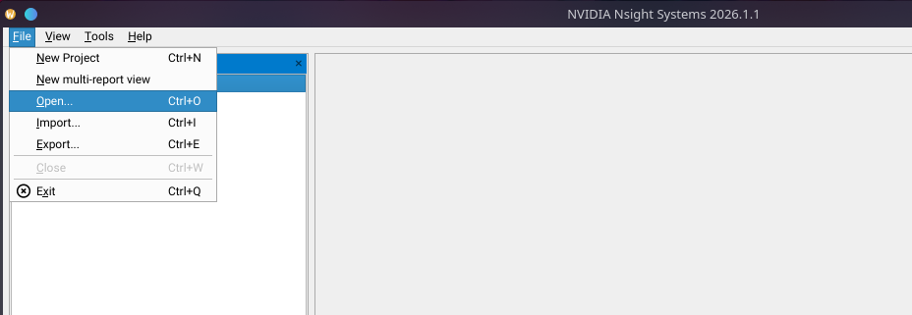
Nsight System
Using the GUI
Download and Install NVIDIA Nsight Systems:
https://developer.nvidia.com/nsight-systems/get-started
Use the file explorer in the container environment to locate the
.nsys-rep file generated by nsys
  Right click the file and Download it to your local machine
Open the report file in Nsight Systems

Slide 10

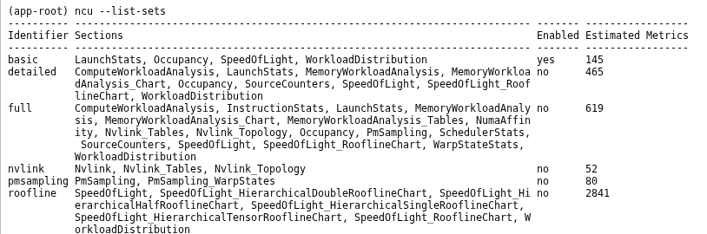
Nsight Compute
ncu – command line interface

Slide 11
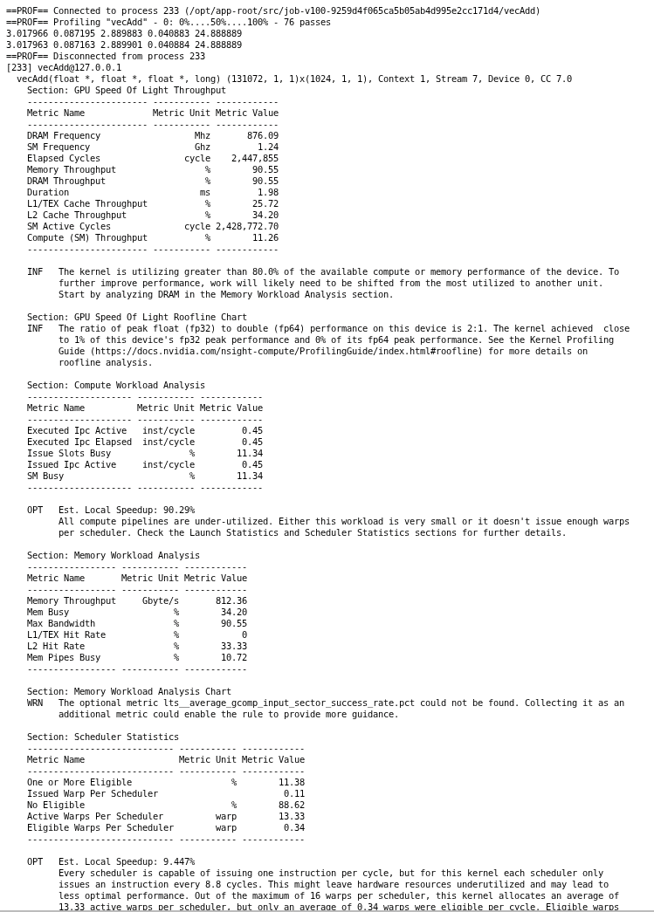
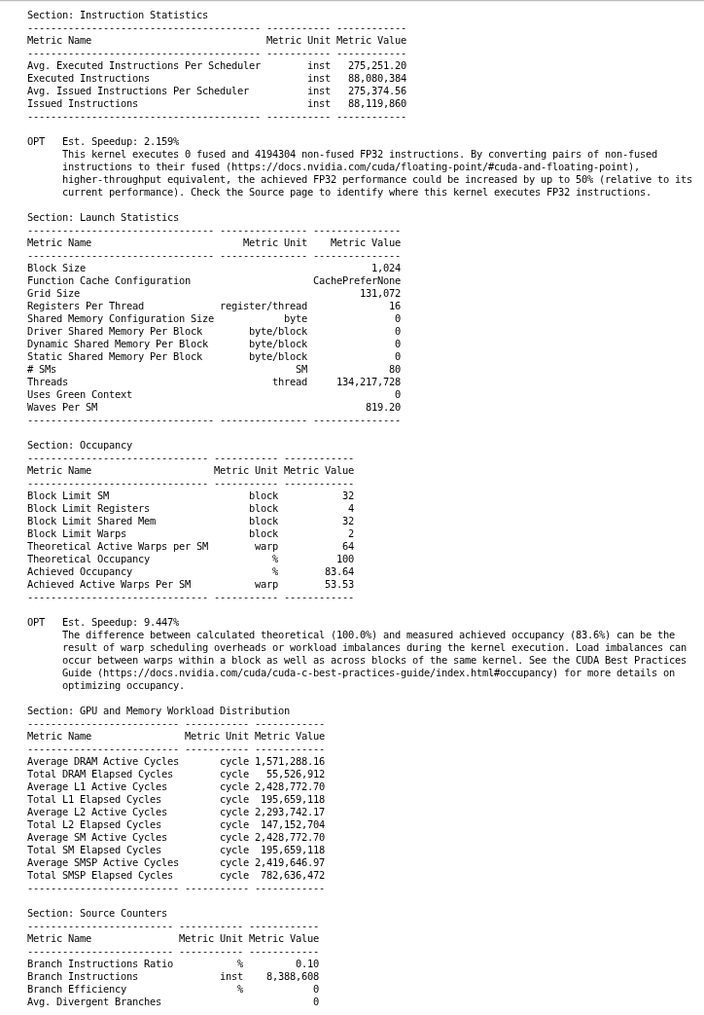

Slide 12
Nsight Compute
Nsight Compute GUI
Install NVIDIA Nsight Compute locally:
https://developer.nvidia.com/tools-overview/nsight-compute/get-started

Slide 13
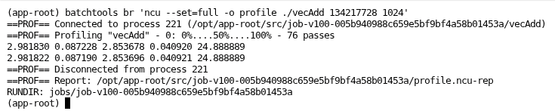
Nsight Compute
Nsight Compute GUI
Use the -o option to specify the name of the output file ncu should generate

Slide 14
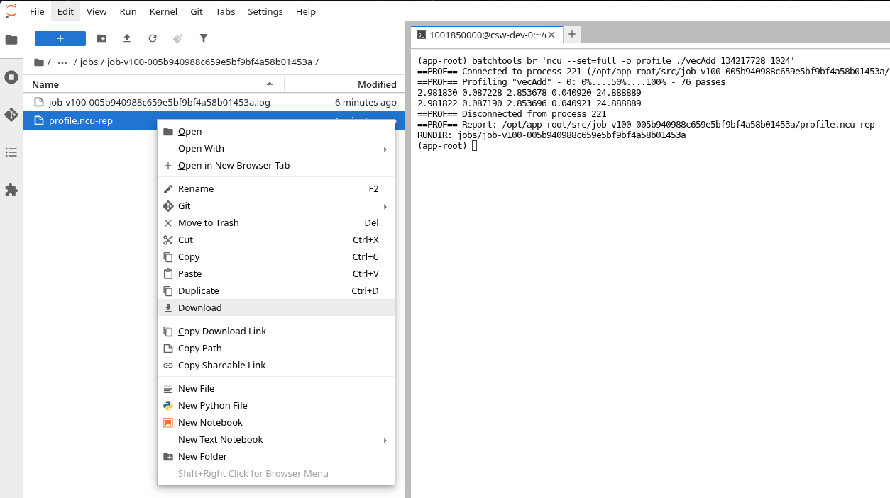
Nsight Compute
Nsight Compute GUI
Download the generated .ncu-rep file

Slide 15
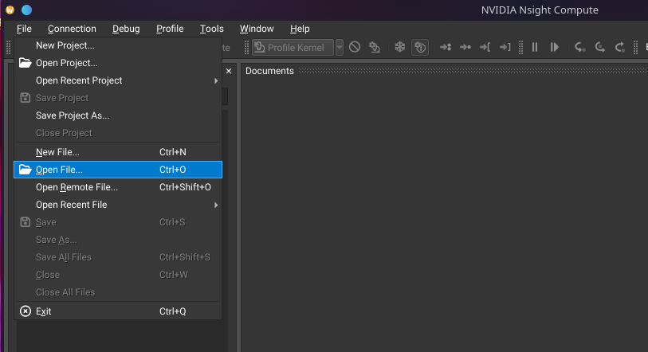
Nsight Compute
Nsight Compute GUI
Open the file in Nsight Compute

Slide 16
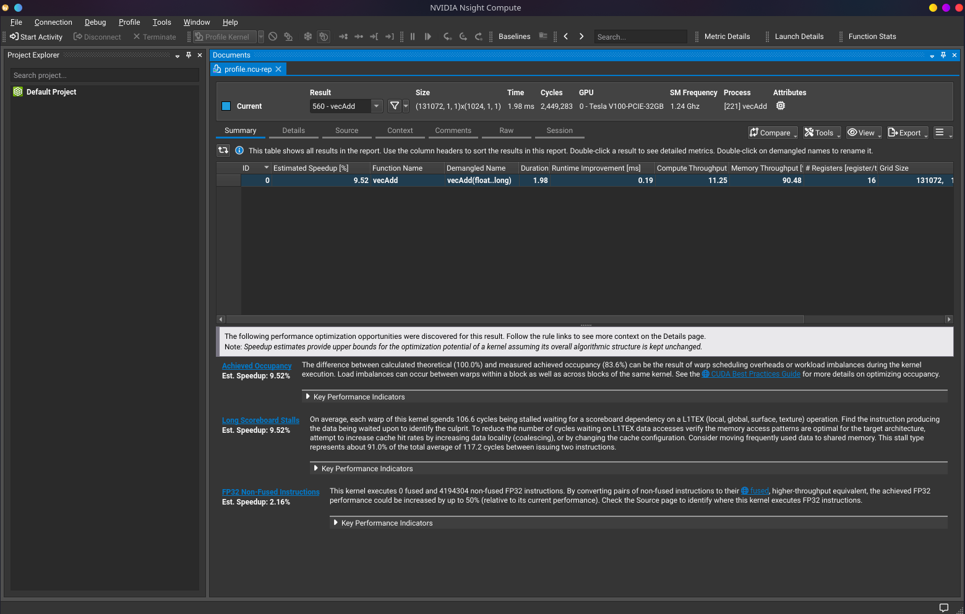

Slide 17



