Slide 1
Title

Slide 2
Sheet title
Bullet 1
Bullet 2

Slide 3
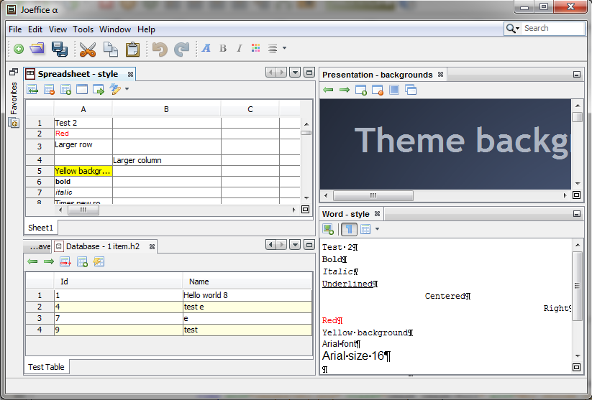
Image

