Slide 1
XINS
  A framework for
  distributed applications
Version 4. April 2006
Ernst de Haan

Slide 2

Audience
Intended for:
  managers
  developers
  system administrators
Experience with XINS is not required

Slide 3
Goals
Inform about:
frameworks:
  concept
  applicability, pros/cons
XINS:
  history
  design principles
  features
  qualification

Slide 4

Agenda
Frameworks
Fundamentals
Features
Qualification

Slide 5
Developing an application
Where do you start?
Requirements!

Slide 6
Frameworks
Application requirements
Functional:
  driven by the project
  specific per application
  cannot be generalized, only tunneled
Non-functional:
  typically equal for all applications

Slide 7
Frameworks
Non-functional requirements
For example:
  packaging
  deployment
  configuration management
  monitoring
  performance statistics
  transaction logging
  error detection
  ...

Slide 8
Frameworks
Non-functional requirements
Options:
  Rebuild every time
  Copy/paste
  Use libraries

Slide 9
Frameworks
Step 1: Libraries
Share functionality, avoid duplication
Application
Library
W
Library
X
Library
Y
Library
Z

Slide 10
Frameworks
Limitations of libraries
Only provide functionalities
Glue still needed
Libraries may overlap or even conflict
By definition cannot solve certain issues:
  unified packaging
  unified deployment
  unified testing
  ...

Slide 11
Frameworks
Step 2: Framework
Combine several libraries
Add some glue and tools
Ta-da! Unified approach
Framework
Application
Your
application
here

Slide 12
Frameworks
What is a framework?
Functionalities + glue + tools
No conflicts
Unified approach to certain
non-functional requirements
Best practices
It guides and supports,
from start to finish
Domain-specific

Slide 13

Frameworks
Definition
Frame'work (n) =
a systematic approach for developing a certain type of software applications,
typically including:
  support programs
  code libraries

Slide 14

Frameworks
Application architecture
Architecture borders predefined
Frozen spots:
  define overall architecture
  static: remain same with every application
Hot spots:
  dynamic to individual applications

Slide 15
Frameworks
Unification
Unified approach to certain non-functional requirements, for example:
coding
configuration management
logging
testing
monitoring
...

Slide 16
Frameworks
Having no framework
Features set of applications differ
Feature implementations differ
Time needed to build features that are required but non-functional
Project pushes, code/test period limited
Innovation expensive, limited
Duplication of code (copy/paste ?)

Slide 17

Frameworks
Pros
Quicker from idea to working code
Extensive feature set
Same features and behavior everywhere
Well-tested
Fuels innovation
(if the framework is controlled)

Slide 18

Frameworks
Cons
Framework is domain-specific
Enforces an approach
  process
  programming language
  packaging
  restricts use of other libraries?
  restricts use of other frameworks?

Slide 19
Agenda
Frameworks
Fundamentals
Features
Qualification

Slide 20
Fundamentals
History
Apr
Jan
Nov
Jan
May
Nov
Apr
May
2002
2003
2004
2005
"
"
2006
"
: Project initiated
: Open-sourced (SourceForge)
: 1.0 (after 212 pre-releases)
: 1.1
: 1.2
: 1.3
: 1.4.0-beta3
: 1.4.0-final

Slide 21
Fundamentals
XINS as a framework
Domain:
Distributed applications
Main constraints:
RPC style
HTTP
Java

Slide 22
Fundamentals
XINS goals
Easy to develop distributed applications
  easy to understand
  good time to market
  avoid bugs
Easy to monitor and operate
Consistent
High quality
Stable

Slide 23
Fundamentals
Separation of concerns
Separate:
specification and implementation
data and presentation
logging, code and translations

Slide 24
Fundamentals
Simplicity
Simplicity is key
Makes it easier to
  understand
  tune
  change

Slide 25
Fundamentals
Based on selected standards
All definitions in XML
All communication over HTTP
Avoid dependency on complex standards (e.g. SOAP)

Slide 26
Fundamentals
RPC
Function-oriented (e.g. “GetCart”)
Server-side:
  one XINS function
  = one Java method to implement
Client-side
  one XINS function
  = one Java method to invoke

Slide 27
Fundamentals
DOD
Definition-oriented development:
Focus on definitions, not on code
Definitions are mandatory
Definitions are leading
Start with definitions before coding

Slide 28
Fundamentals
Advantages of DOD
Easier to re-use:
  generate code
  use as run-time configuration
Examples:
  behavior (validation, business logic, etc.)
  documentation
  tools or tool configurations (test forms, etc.)
  other kinds of definitions (WSDL, etc.)

Slide 29
Fundamentals
DOD process
Write definitions first
Write
  From the definitions:
  generate code, docs and
  test tools (automatic)
Generate
Code
  Customize the generated
  example code and add
  your own code

Slide 30
Fundamentals
Example: Function definition
<function name="Hello">
<description>Greets the indicated person.</description>
<input>
<param name="name" required="true">
<description>Person to be greeted.</description>
</param>
</input>
<output>
<param name="greeting" required="true">
<description>Greeting for the person.</description>
</param>
</output>
</function>

Slide 31
Agenda
Frameworks
Fundamentals
Features
Qualification

Slide 32
Features
XINS components
Libraries
Application
container
Definition
formats
Logging
technology
Tools
RPC
protocol

Slide 33

Features
Libraries
Client-side 'caller'
  load-balancing
  fail-over
  logging
Regular expressions
XML encoding
...
Libraries
Application
container
Definition
formats
Logging
technology
Tools
RPC
protocol

Slide 34

Features
Definition formats
Interface
  APIs, functions, types, error codes
  parameters in/out
  validation rules
Implementation
Environments
Authors
...
Libraries
Application
container
Definition
formats
Logging
technology
Tools
RPC
protocol

Slide 35

Features
Tools
Generate from specs:
  Server- and client-side code
  Docs (HTML, ODF)
  Test forms
  etc.
Build package (WAR)
Run/test application
...
Libraries
Application
container
Definition
formats
Logging
technology
Tools
Tools
RPC
protocol

Slide 36
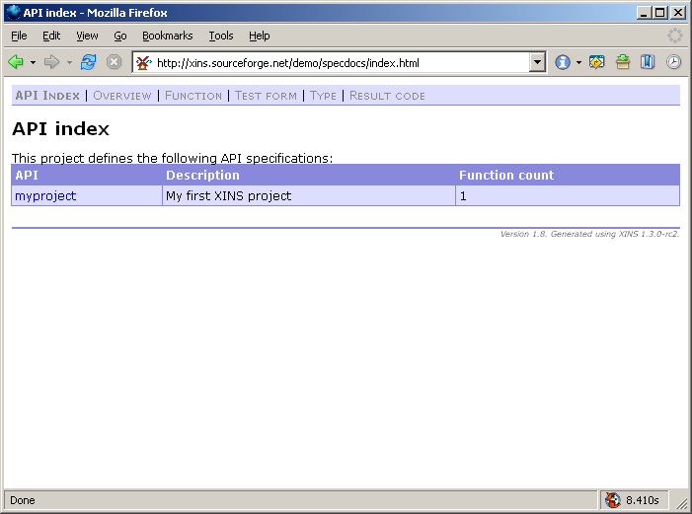
Features
Specdocs: API index

Slide 37
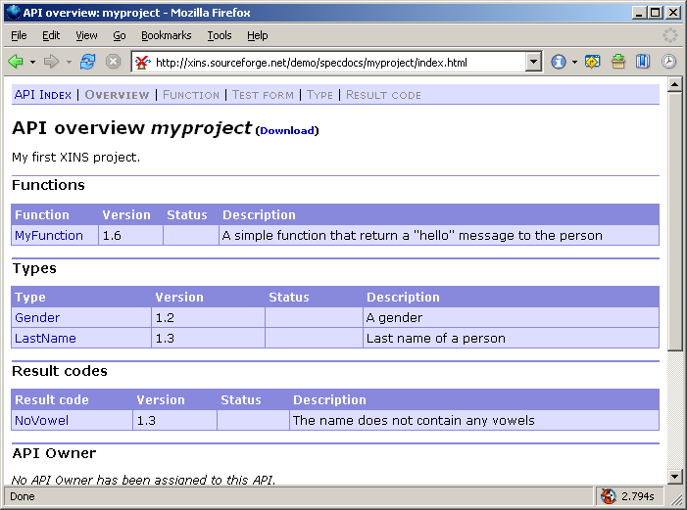
Features
Specdocs: API overview

Slide 38
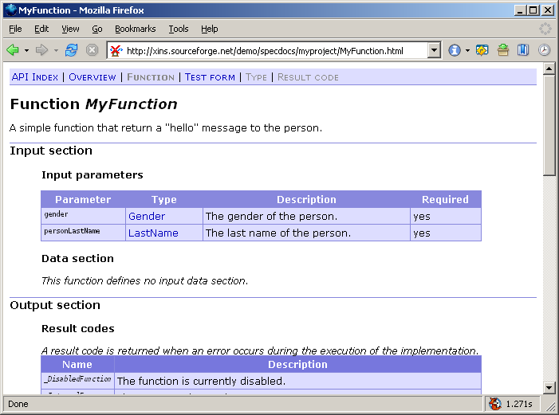
Features
Specdocs: Function

Slide 39
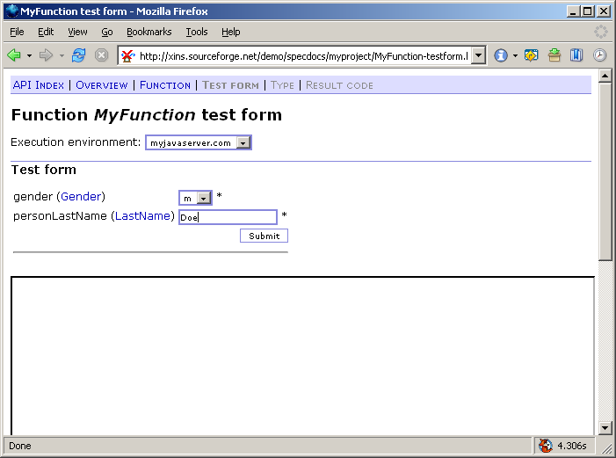
Features
Test form

Slide 40

Features
RPC protocol
“POX-RPC”
Simple
HTTP-based
Browser-compatible
Function-oriented
Params in/out
Error codes
  various standard codes
Libraries
Application
container
Definition
formats
Logging
technology
Tools
RPC
protocol

Slide 41
Features
POX-RPC call
GET /?_function=GetCart&cart=1563 HTTP/1.1
Host: test.rest-rpc.org
Accept: text/xml
Connection: close
request
response
HTTP/1.1 200 OK
Content-Length: 114
Content-Type: text/xml
Connection: Close
<result>
<param name="id">10732</param>
<param name="remainder">60.5</param>
<data>
<item product="8923" price="12" amount="3"/>
<item product="2108" price="24.5" amount="1"/>
</data>
</result>

Slide 42

Features
Logging technology
“Logdoc”
Separates:
  code
  log entries
  translations
  log levels
Docs for all log entries
Filter any log entry
Libraries
Application
container
Definition
formats
Logging
technology
Tools
RPC
protocol

Slide 43
Features
Logdoc
Log entries
(XML)
Translations
(XML)
Logdoc transformation tool
Documentation
(HTML)
Generated code
(Java)
Packager
Javadoc
Package
(JAR)
API docs
(HTML)

Slide 44
Features
Log4J vs Logdoc: Code
Log4J:
Logger log = Logger.getLogger("connect.init");
log.error(exception,
+ "Connection "
+ connID
+ " could not be created. Received error "
+ errorID
+ '.');
Logdoc:
Log.log_30012(exception, connID, errorID);

Slide 45
Features
Example: Log definition
<log>
<translation-bundle locale="en_US"/>
<group id="conn" name="Connection initialization">
<entry id="31000" level="INFO">
<description>Connection succeeded.</description>
<param name="id"/>
<param name="num" nullable="false" type="int32"/>
</entry>
<entry id="31001" level="ERROR" exception="true">
<description>Connection failed.</description>
<param name="id"/>
</entry>
</group>
</log>

Slide 46
Features
Application container
In servlet container
Sandbox
Runtime config
ACLs
Calling conventions
Meta-functions
Logging
Context identifiers
Libraries
Application
container
Definition
formats
Logging
technology
Tools
RPC
protocol

Slide 47
Features
Validation of input
Request
error
if not
OK
Check
if OK
Application
Application container

Slide 48
Features
Validation of output
if OK
error
if not
OK
Check
Response
Application
Application container

Slide 49
Features
Sandbox
Input checked against specs
  Invalid? _InvalidRequest error
Application code is encapsulated
  Exception thrown? _InternalError error
  Invalid response? _InvalidResponse error
Everything is logged

Slide 50
Features
Runtime config
External to application
  tested package unchanged to production
Text file
Key-value pairs
Automatically reloaded

Slide 51
Features
Calling conventions
Abstraction of protocol
HTTP-based
Built-in:
  POX-RPC
  SOAP
  XML-RPC
  XSLT
Custom:
  extend Java class: CustomCallingConvention

Slide 52
Features
Meta-functions
_NoOp
_GetVersion
_GetSettings
_GetStatistics and _ResetStatistics
_ReloadProperties
_CheckLinks
_GetFunctionList
_EnableFunction and _DisableFunction

Slide 53
Features
Logging
Logging in application container:
  Extensive
  Completely Logdoc-based
  Transaction logging
  Fine-tuned during last 3 years

Slide 54
Features
Example: Start-up log
3200 NOTICE Bootstrapping XINS/Java Server Framework 1.4.0-beta3-dev. Servlet container: "Orion/2.0.3". JVM: "Sun Microsystems Inc. Java HotSpot(TM) Client VM 1.5.0_06-b05". OS: "Linux 2.6.12-gentoo-r9/i386".
3227 WARN XINS/Java Server Framework 1.4.0-beta3-dev is not a production release.
3212 INFO Package for "allinone" API, version "1.6", was built on zaphod at 2006.04.06 14:58:04.891, using XINS 1.4.0-beta3-dev.
3228 WARN Package was built with XINS 1.4.0-beta3-dev, which is not a production release.
3245 INFO Default calling convention is "_xins-soap".
3225 INFO XINS/Java Server Framework 1.4.0-beta3-dev is bootstrapped.
3405 INFO Initializing API.
3429 INFO Access rule 0 is "allow 127.0.0.1/24 *".
3429 INFO Access rule 1 is "allow 10.0.0.0/24 *".
3427 INFO Successfully loaded access rule list with 2 rule(s).
3406 INFO Initialized API.
3441 INFO XSLT template cache in the XSLT calling convention is disabled.

Slide 55
Features
Transaction logging
Logs every incoming request
  Timestamp
  Source IP
  Function name
  Performance
  Result code (0 for success)
Choose:
  3540: with params in/out
  3541: without

Slide 56
Features
Example: Transaction log
3521 INFO Received HTTP GET request from 194.134.168.69, path is "/", query string is "_function=_GetVersion&_convention=_xins-std".
3552 DEBUG Request from 194.134.168.69 to function _GetVersion does not match access rule 0 ("allow 127.0.0.1/24 *").
3552 DEBUG Request from 194.134.168.69 to function _GetVersion does not match access rule 1 ("allow 10.0.0.0/24 *").
3550 DEBUG Allowing call from 194.134.168.69 to function _GetVersion. Request matches access rule 2 ("allow 194.134.168.69/32 *").
3540 INFO 20060407-135658472 194.134.168.69 _GetVersion 1 0 java.version=1.5.0_06&xins.version=1.4.0-beta3-dev&api.version=1.6
3541 INFO 20060407-135658472 194.134.168.69 _GetVersion 1 0

Slide 57
Features
Example: Transaction log
3521 INFO Received HTTP GET request from 194.134.168.69, path is "/", query string is "_function=_GetVersion&_convention=_xins-std".
3552 DEBUG Request from 194.134.168.69 to function _GetVersion does not match access rule 0 ("allow 127.0.0.1/24 *").
3552 DEBUG Request from 194.134.168.69 to function _GetVersion does not match access rule 1 ("allow 10.0.0.0/24 *").
3550 DEBUG Allowing call from 194.134.168.69 to function _GetVersion. Request matches access rule 2 ("allow 194.134.168.69/32 *").
3540 INFO 20060407-135658472 194.134.168.69 _GetVersion 1 0 java.version=1.5.0_06&xins.version=1.4.0-beta3-dev&api.version=1.6
3541 INFO 20060407-135658472 194.134.168.69 _GetVersion 1 0
Logdoc
message
ID
Log
level
Time-
stamp
Source
IP
Function
Performance
in ms
Result
code

Slide 58
Features
Context identifiers
For diagnosing issues across systems
Front system generates ID
ID is passed to all underlying systems
Systems log ID with selected messages

Slide 59
Features
Example: Context identifier
        strop@dog.company.nu:060410-132419876:b4611
application
name
machine
name
time-
stamp
random
number

Slide 60
Agenda
Frameworks
Fundamentals
Features
Qualification

Slide 61
History and qualification
Java and XSLT files
300
271
255
227
206
200
189
100
XINS 1.0
XINS 1.1
XINS 1.2
XINS 1.3
XINS 1.4

Slide 62
History and qualification
Unit tests
309
300
268
200
175
131
100
87
XINS 1.0
XINS 1.1
XINS 1.2
XINS 1.3
XINS 1.4

Slide 63
History and qualification
Relative: Unit tests per file
1,14
1,05
0,77
0,64
0,46
XINS 1.0
XINS 1.1
XINS 1.2
XINS 1.3
XINS 1.4

Slide 64
History and qualification
Release process
Before a final release (e.g. 1.4.0):
Alpha releases:
  Implementation of critical new features
Beta releases:
  Testing, documentation, profiling/tuning
Release candidates:
  Cool-off period, only bug fixes
  Testing on various architectures

Slide 65
History and qualification
Testing
Automatic: 309 unit tests (1.4.0-beta3)
Various manual tests
Java: 1.3, 1.4, 1.5, 1.6 EA
JDK: IBM, Sun
OS: Solaris, Linux, Win2000, WinXP
Arch: SPARC, Intel

Slide 66
Qualification
Conclusion
XINS:
framework for distributed applications
high-quality, mature
easy and feature-rich
for both Dev and Ops
actively maintained and supported

Slide 67
XINS
  A framework for
  distributed applications
Version 4. April 2006
Ernst de Haan

