Slide 1
Measure the dimension of an Object within an 2D image and determining the shape of the object.
Group 7:
Name | Roll Number
Jap Purohit | AU1940109
Purvam Sheth | AU1940151
Nihar Patel | AU1940119
Raj Gariwala | AU1940118
Mohit Prajapati | AU1940171

Slide 2
Objective of the project
Measuring objects within an image or frame can be an important capability for many applications where computer vision is required instead of making physical measurements.
This application note will cover a basic step-by-step algorithm for isolating a desired object and measuring its diameter/dimension.
It will also try to determine the 2D shape it has using OpenCV shape detection library.
This application can be used in determining the dimension and shape of space objects using the 2D image we are available with.

Slide 3
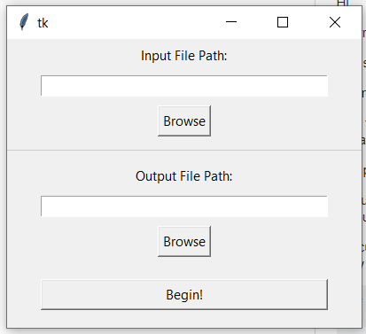
User Interface-INPUT
The user interface will majorly allow user to provide the path of the image and at last the result will be showed determining the 2D shape and dimension of the object and image with dimension will be saved at given path.
The interface will be developed using the Python and will also try to determine shape and size using Python only otherwise we will be using MATLAB and then link interface and determining.

Slide 4
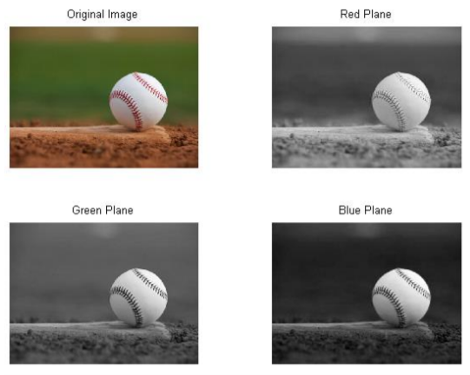
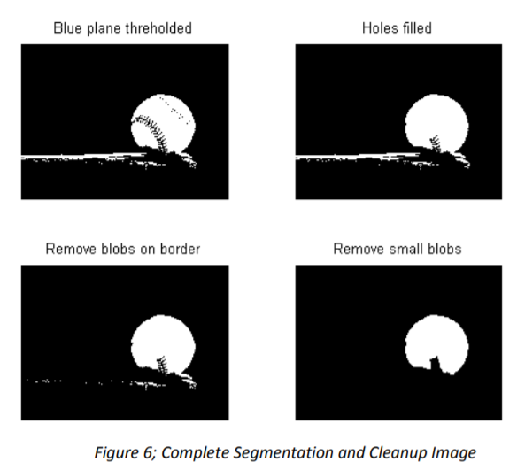
Processing technique
The first step taken is to divide the image into three images based on the intensities of each red, green and blue component within the image.
This is Color Based Image Segmentation.
Now Image Thresholding is required to be done because it provides the most contrast between the desired object (foreground) and the background.
Image Thresholding takes an intensity image and converts it into a binary image based on the level desired.
A value between 0 and 1 determines which pixels (based on their value) will be set to a 1 (white) or 0 (black)).

Slide 5
Processing technique
The image in the bottom-right corner of is the result of all image segmentation and cleanup procedures to provide one distinct and cohesive blob, which represents the ball in the original image.
Now using the inbuilt function we can measure maximum length and determine the dimension of the object.
And for shape we will use inbuilt OpenCV shape detector library which is based on CNN (Convolutional Neural Network)

Slide 6
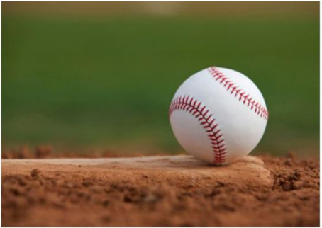
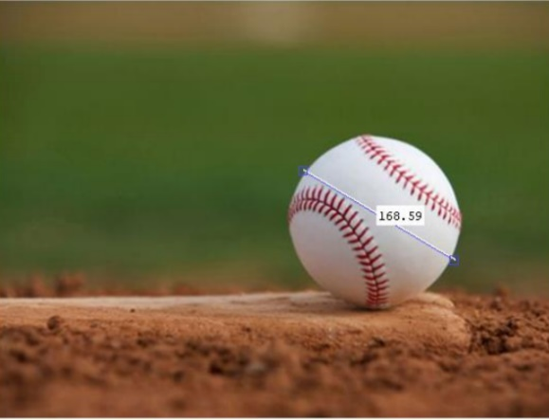
Result
The format of results expected to be obtained:
Input : Output:
The diameter of the object within object. And the shape as circle
Circle

