Slide 1
Kubernetes

Slide 2
Agenda
Kubernetes Introduction
Kubernetes Architecture
Components of Kubernetes (Master & Node)
Core concepts of Kubernetes
Demo
Copyright © Capgemini 2017. All Rights Reserved
Containerization
2
2

Slide 3
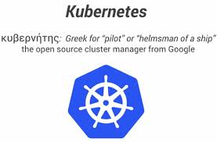
Kubernetes Introduction
Its started by Google.
Based on over 10 years experience(“Borg”)
Kubernetes v1.0 was released on July 21st,2015
Open-source Container management tool which automates deployment, scaling and load balancing.
Supports for Google GCE, rackspace, Azure providers, AWS
Deployable on Core Operating System
Written in GO language.
Donated to Cloud Native Container Foundation(CNCF)

Slide 4
Kubernetes Architecture
IMAGE REGISTRY
UI
User interface
KUBERNETES MASTER
NODE 1
NODE 2
API
Calls
NODE 3
CLI
NODE N

Slide 5
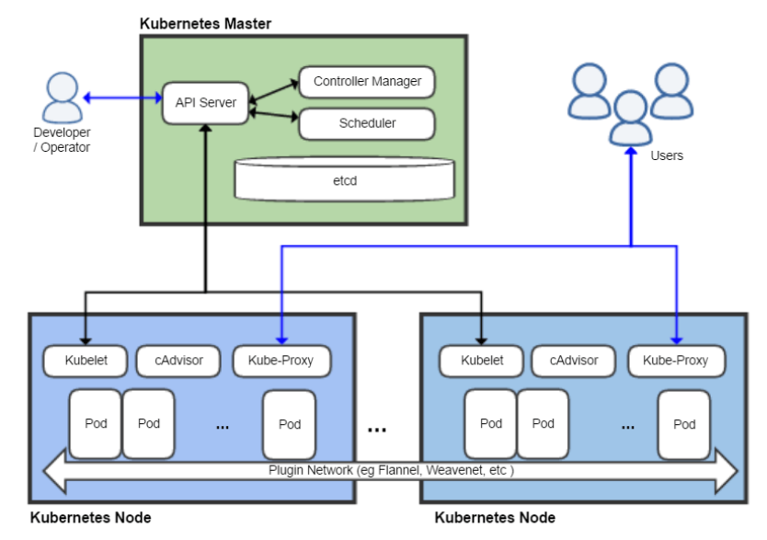
Components of Kubernetes (Master & Node)

Slide 6

Master components:
The control plane on the master node(s) consists of the API Server, the Controller Manager and Scheduler(s).
Master maintains the state of the Kubernetes Server runtime.
State is maintained in the backend which etcd. Its entry point for all the client calls to configure and manage kubernetes (like Nodes, Pods, Replication Controller, Services)
kube-apiserver:
kube-scheduler
kube-controller-manager
Node Controller:
Replication Controller:

Slide 7
Node Components:
The Node, also known as Worker or Minion, is a machine where containers (workloads) are deployed.
kubelet
kube-proxy
cAdvisor

Slide 8
Core components of Kubernetes
Pods
Deployments
Replica Set
Services
Namespaces
Label

Slide 9
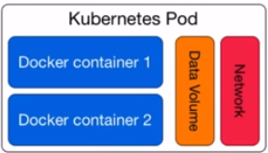
Pods
Smallest deployable unit.
Small group of tightly coupled containers.
Shared network and data volumes
Routable IP address

Slide 10
Deployments
It contains declaration of your application
which containers (image/tag)
environment variables
data volumes
Its responsible for creating and updating pods
Can scale up and down to meet demand
Can roll back to an older version or roll forward

Slide 11
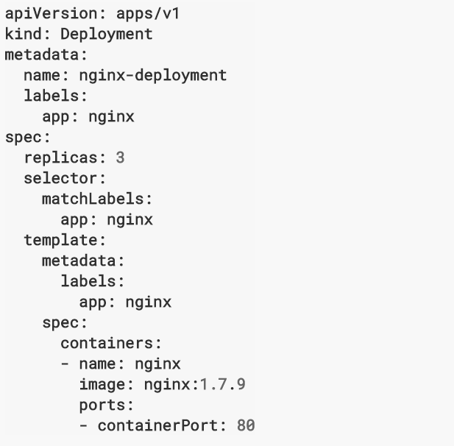
Deployment (continued)
kubectl create -f deployment.yaml

Slide 12
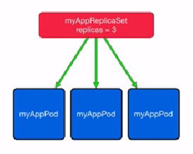
Replica Set
It manages lifecycle of pods and ensures specified number of pods are running.
Pods are created by replica sets. Starts or kills pods if necessary.
Replica Sets are intended for running specified number copies(replicas) of a pod.

Slide 13
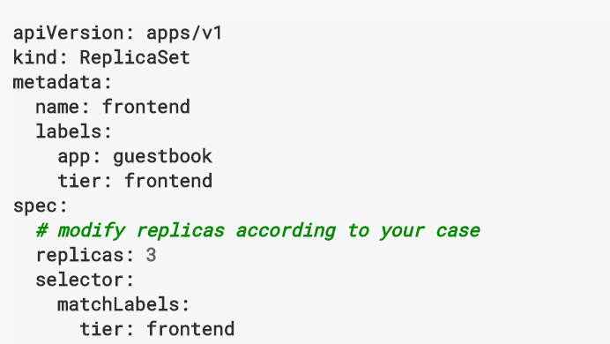
Replica Set(continued)
Example for Replica Set:

Slide 14
Services
Pods are mortal.
It acts as intermediary for pods to talk to each other.
Service is an object in kubernetes – similar to Pods and Replication controller.
Services will provide load balancing including session affinity
Kubernetes services support TCP and UDP protocols

Slide 15
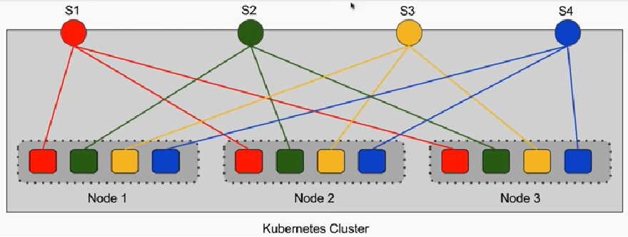
Services (Continued)
Service Types
Cluster IP – service is reachable only from inside of the cluster.
NodePort - service is reachable through NodePort address.
LoadBalancer – service is reachable through an external load balancer mapped to
NodePort address.

Slide 16
Namespaces
Namespaces are intended for use in environments with many users spread across
multiple teams, or projects
By default everything is in the “default” namespace
Restrict access to specific namespaces for k8s users.
Namespaces types
default
kube-system
kube-public
Command to create NameSpace:
kubectl create namespace namespace_name

Slide 17
Labels
A method to keep things organized and to help you and kubernetes identify resources to act upon
Labels are key/value pairs that you can attach objects like pods.

Slide 18
Demo
Deploying sample application in Kubernetes with services.
Platform : AWS
Exercise:
1) Deployment of an application in kubernetes
2) Definition of replicas in deployments and Scaling
3) Creation of Services access type with NodePort
4) Creation of NameSpace and deploy an application

Slide 19
Reference Links
https://kubernetes.io/docs/tutorials/
https://www.tutorialspoint.com/kubernetes/
https://kubernetes.io/docs/reference/kubectl/cheatsheet/

Slide 20
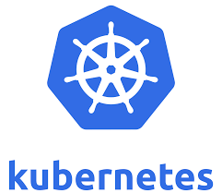


Slide 21
Thank You

