Slide 1
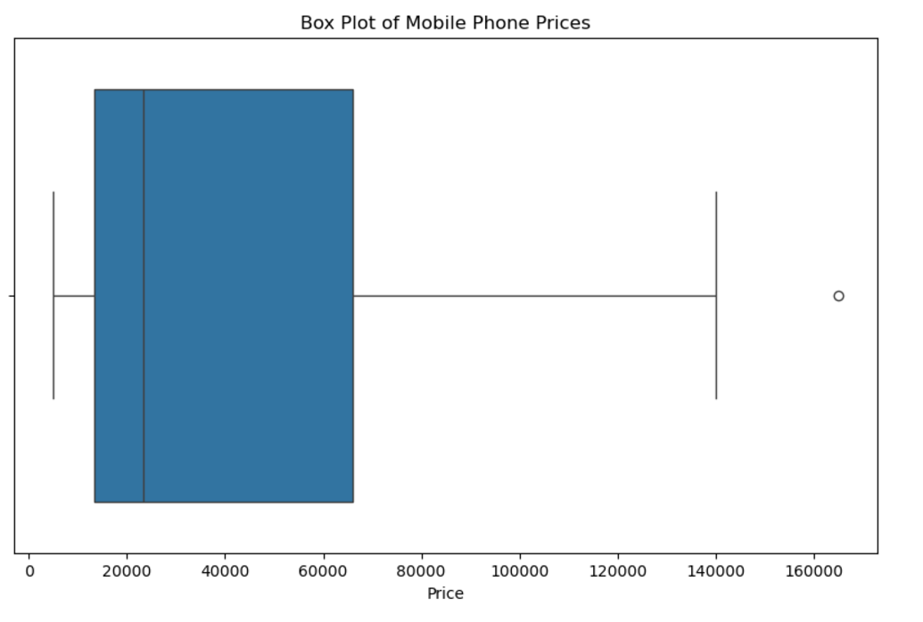
Price Distribution
The box plot visualizes the distribution of the Price column in the dataset. The box represents the interquartile range (IQR), which spans from the 25th percentile (₹13,452.5) to the 75th percentile (₹65,999.0).
The line within the box indicates the median price (₹23,244.5). The whiskers extend to show the range of the data, excluding outliers.
There are potential outliers visible as points beyond the whiskers, representing prices significantly higher than the typical range (e.g., close to ₹1,64,900.0).

Slide 2
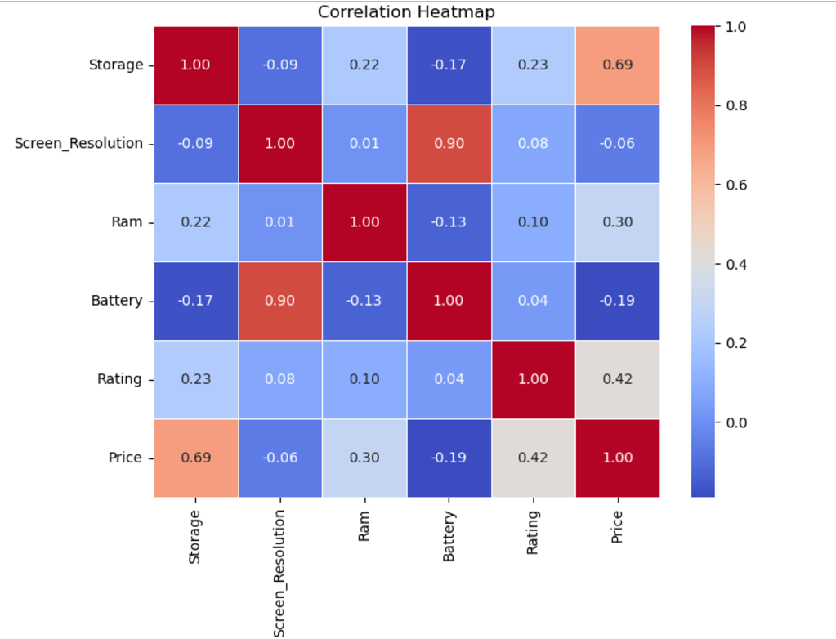
Based on the correlation heatmap:
Price has the strongest positive correlation with Storage (correlation = 0.69). This indicates that as storage increases, price tends to increase significantly.
It also has a moderate positive correlation with Rating (correlation = 0.42) and RAM (correlation = 0.30), suggesting a weaker but still positive relationship.
The correlations with Screen_Resolution (-0.06) and Battery (-0.19) are weak or slightly negative, meaning these features are not strongly related to price.

Slide 3
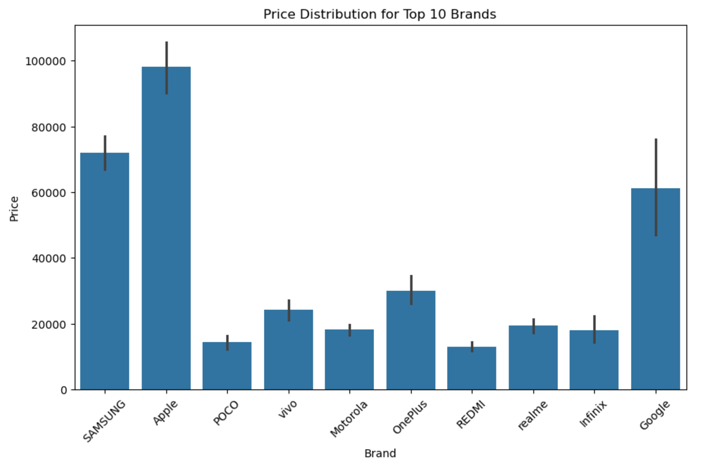
Price Distribution for Top 10 Brands
Observations:
Samsung and Apple Have the widest price ranges among all brands.
The median price for Apple is higher than Samsung, indicating Apple mostly sells premium devices
Google shows a wide price range, similar to Samsung and Apple, though with fewer models compared to these brands.
POCO, Redmi, and Realme represents brands with budget-friendly devices.
OnePlus and Motorola Positioned as mid-range brands, with prices generally higher than POCO, Redmi, and Realme.
Brands like Samsung, Apple, and Google have greater price variability, indicating diverse offerings across different market segments. Budget brands show less variability, focusing on specific price-sensitive customers.

Slide 4
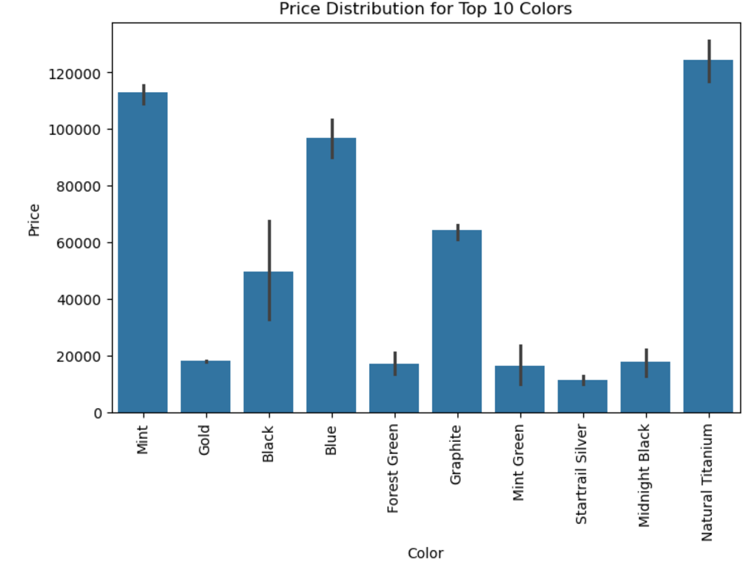
Price Distribution for Top 10 Colors
Insights:
Most Expensive Colours:
Natural Titanium stands out as the most expensive, with an average price above 120,000, and relatively small variation in prices. Mint is also among the high-end colors, with prices nearing 100,000.
Mid-Range Colours:
Graphite, Black, and Blue fall in the mid-price range, with average prices around 50,000–80,000. Graphite has the largest error bar among these, indicating significant price variability.
Conclusion:
This plot helps identify the relationship between color options and price ranges. Colors like Natural Titanium and Mint cater to the premium segment, while others like Gold and Forest Green are more budget-friendly. This data could guide customers' color choices based on budget considerations.
Budget Colors:
Gold, Forest Green, Mint Green, and Startrail Silver are at the lower end of the price spectrum, with average prices below 30,000.

Slide 5
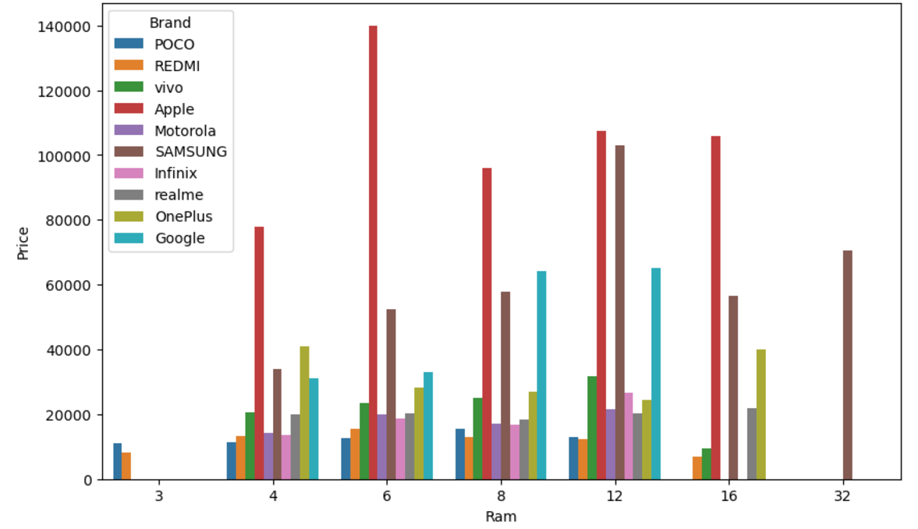
Average RAM size (in GB) and Price across different Brands
Observations:
Phones with larger RAM (e.g., 12GB, 16GB, or 32GB) tend to have significantly higher average prices than those with smaller RAM (e.g., 3GB or 4GB)
Apple consistently has the highest prices across RAM capacities, suggesting that brand value significantly impacts price, even for lower RAM sizes.
Other brands like Samsung, Google, and OnePlus generally occupy mid-to-high price ranges for larger RAM sizes.
Budget brands like POCO, REDMI, and Infinix tend to offer lower-priced options for similar RAM capacities.

Slide 6
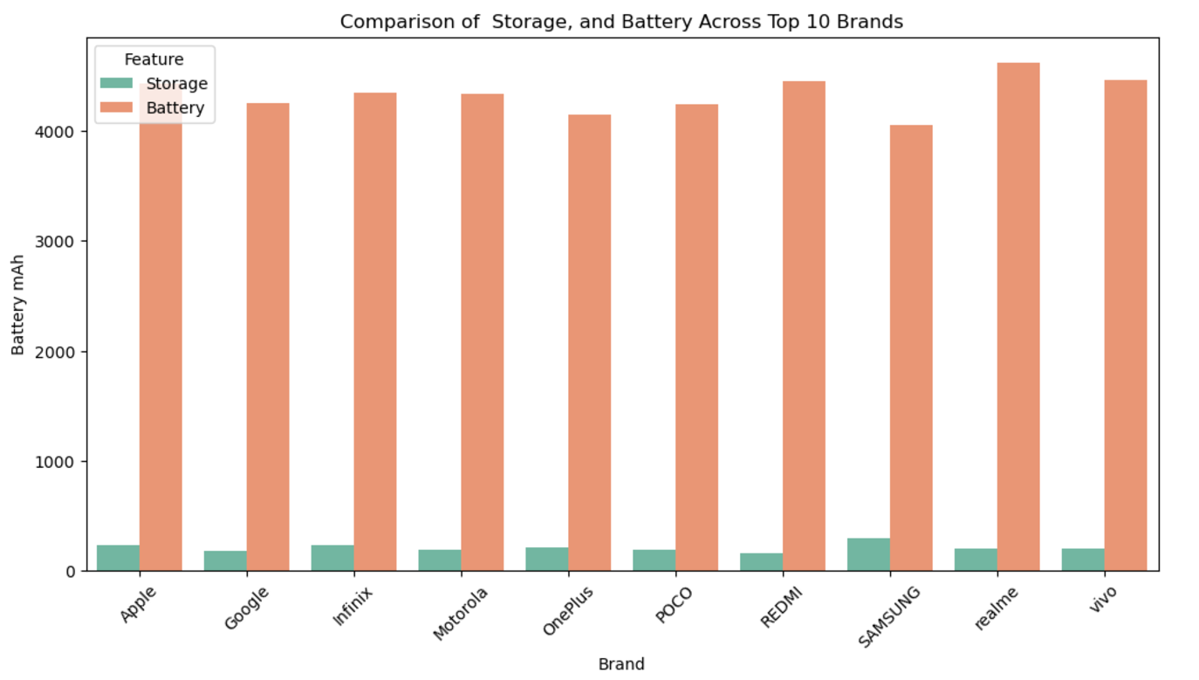
Comparison of Storage, and Battery Across Top 10 Brands
Key Observations:
Battery (Orange): All brands exhibit significantly higher average battery capacities compared to storage values. Realme, Vivo, and Samsung lead in average battery capacities, consistently above 4,400 mAh.
Storage (Green): Storage capacities are relatively smaller in comparison to battery averages. Samsung stands out with the highest average storage, followed by Apple and Infinix. Google and Redmi have lower storage averages, aligning with their focus on cloud-based services or budget segments.
Brands like Samsung and Apple perform well in both storage and battery capacity, making them ideal for users looking for balanced premium devices.
Realme and Vivo focus on delivering higher battery capacities, targeting consumers who prioritize endurance.

