Slide 1


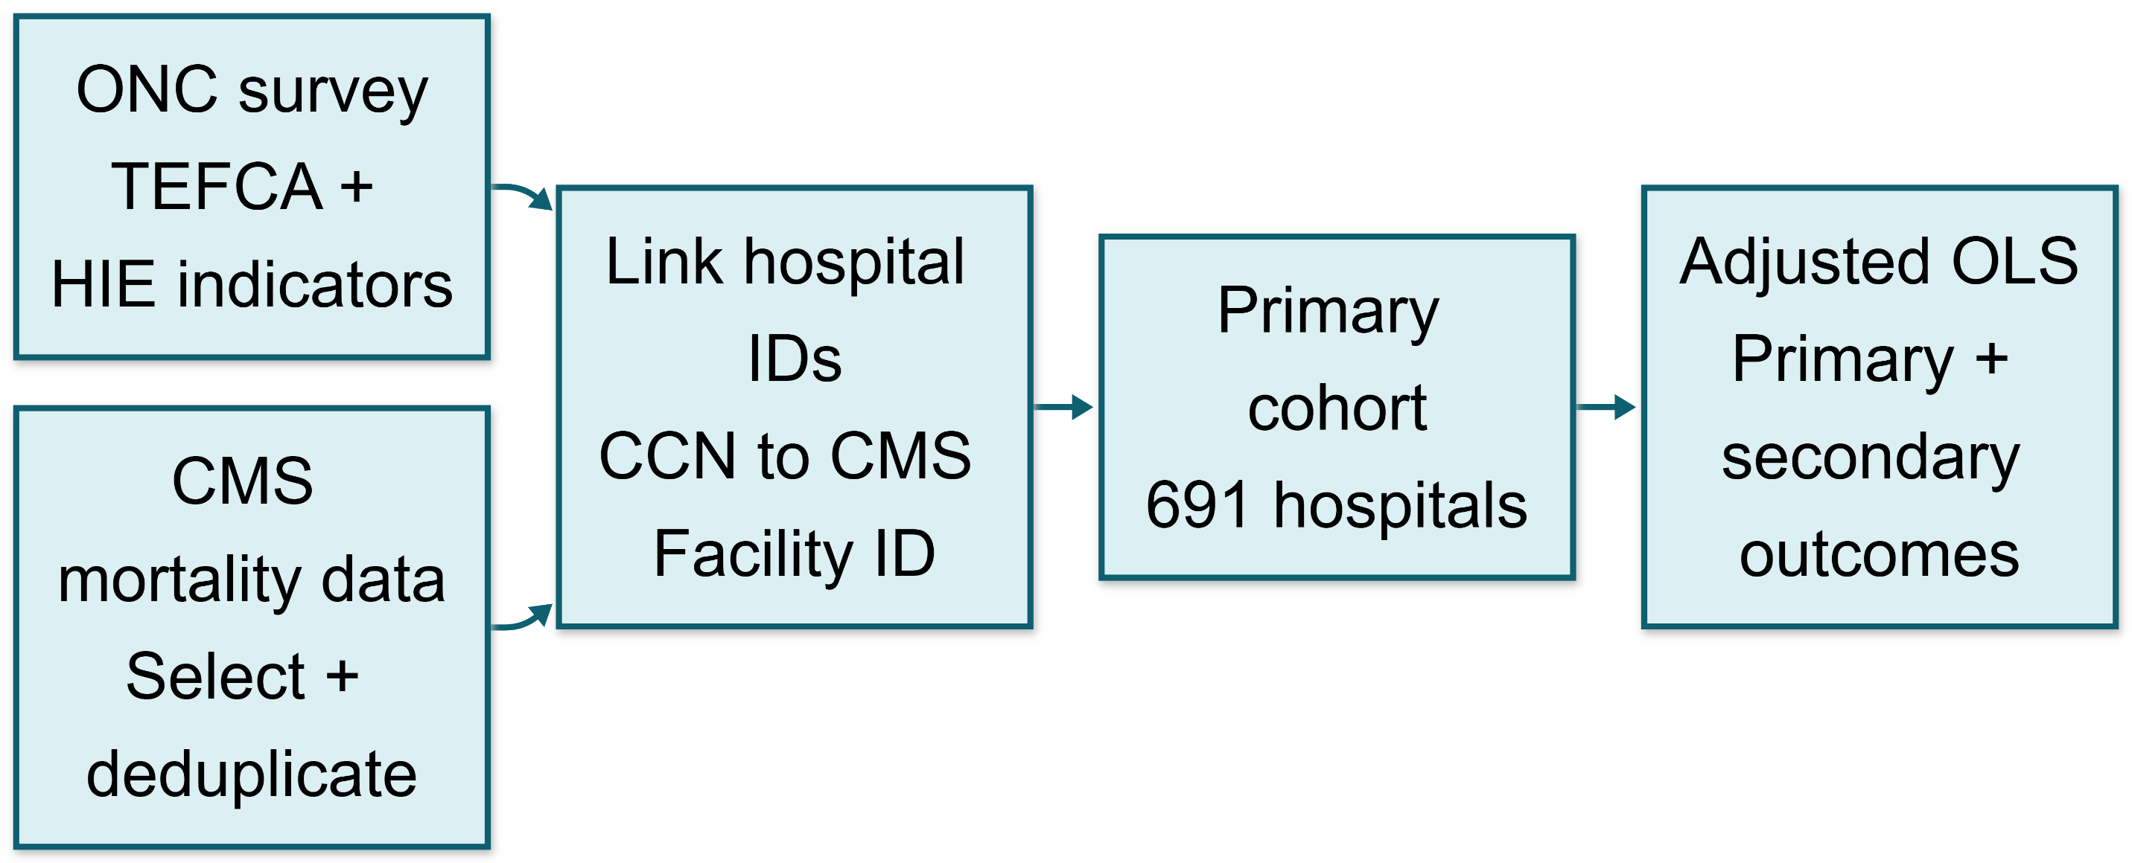
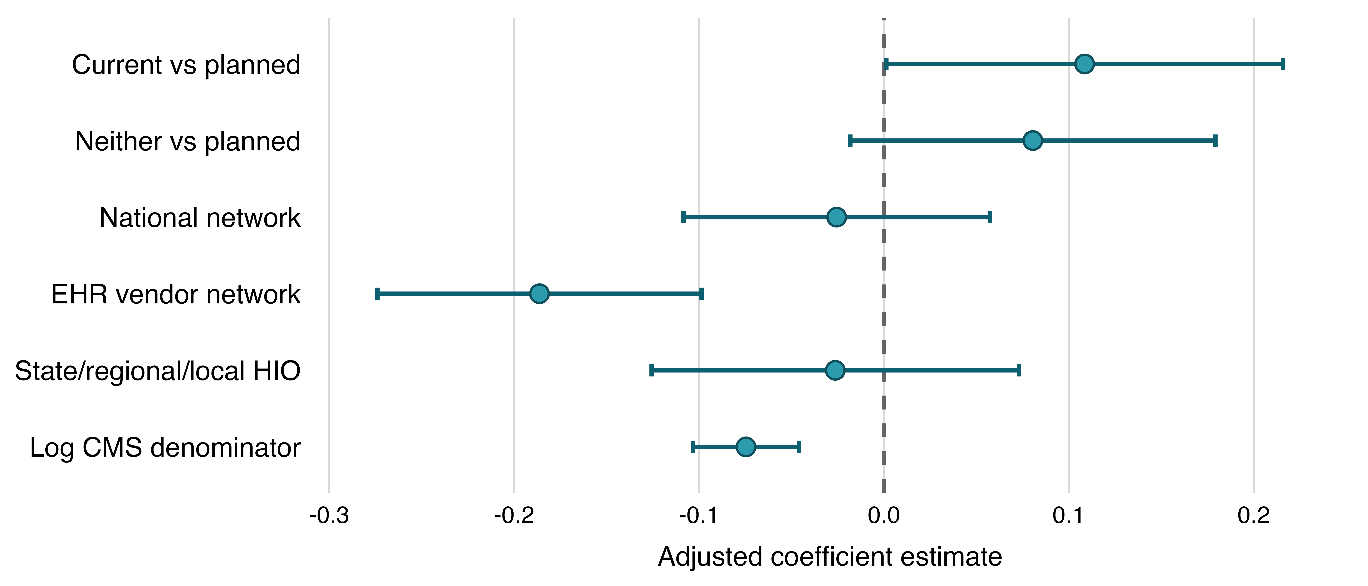
Early TEFCA Participation Was Not Associated With Lower Hospital Mortality
A Cross-sectional analysis of 691 U.S. hospitals
Jordan Pulaski
BMI 6313: Scientific Writing in Healthcare
McWilliams School of Biomedical Informatics at UTHealth Houston
Background & Objective
Methods
Code, methods, and materials
Results
The Trusted Exchange Framework and Common Agreement (TEFCA) is a national framework for electronic health information exchange (HIE). It connects separate networks through Qualified Health Information Networks (QHINs).¹
Evidence gap. Prior HIE research has reported operational and utilization benefits, but evidence of lower mortality remains limited and largely observational.^{2–11} TEFCA’s relationship with mortality during early implementation is unclear.
Objective. Determine whether U.S. non-federal acute care hospitals participating in TEFCA (current), versus hospitals with planned participation (planned), were associated with lower mortality. The primary outcome was CMS Hybrid Hospital-Wide Mortality (Hybrid HWM); heart failure and pneumonia mortality were secondary outcomes
Primary analysis.
691 hospitals
112 (16.2%) currently in TEFCA
289 (41.8%) planned TEFCA
290 (42.0%) neither
In the adjusted primary model, current participation was associated with a 0.108-point higher Hybrid HWM score than planned participation (95% CI, 0.001–0.216; p = .047).
Robustness and secondary outcomes. With HC3 robust standard errors, the 95% confidence interval included zero (-0.010 to 0.227; p = .072). Current-versus-planned estimates also not significant for heart failure (β = −0.024; p = .927) or pneumonia mortality (β = 0.479; p = .114). Participation in EHR vendor networks and larger CMS denominators was associated with lower Hybrid HWM scores.
Figure 1. Data linkage and analytic workflow.
Hospital-level ONC survey data (2023–2024)¹² were linked to CMS Hybrid HWM data (7/1/2023–6/30/2024) and heart failure/pneumonia mortality data (7/1/2021–6/30/2024).¹³ Adjusted OLS models compared current TEFCA and neither-current-nor-planned TEFCA hospitals with planned hospitals, controlling for national network, EHR vendor network, and HIO participation, log CMS denominator (total eligible patient population), state, and survey year. Note. Missing TEFCA and other network participation responses were coded as nonparticipation.
TEFCA: Common Framework for Nationwide Exchange
Key finding: The analyses did not provide robust evidence that early current TEFCA participation was associated with lower hospital mortality than planned participation.
QHIN 1
QHIN 2
QHIN 3
Hospitals, HIOs, and EHR vendor networks connect through QHINs
Interpretations & Limitations
Conclusion
Tables & Charts
Table 1. TEFCA Participation Estimates Across Mortality Analyses
Interpretation. Early TEFCA participation was not robustly associated with lower mortality than planned participation. The small positive estimate was sensitive to the standard-error method and absent for secondary outcomes; it should not be interpreted as evidence of harm. Effects may require longer, fuller adoption and routine exchange use.
EHR vendor network participation was associated with lower Hybrid HWM, possibly reflecting more established infrastructure or workflow integration, but this secondary finding does not establish causality.
Limitations.
Cross-sectional hospital comparisons cannot establish causality or within-hospital change.
Surveys measured reported participation, not HIE volume, quality, or workflow integration.
Planned hospitals may already use other networks, narrowing the contrast.
Unmeasured hospital characteristics may confound estimates.
The primary outcome window was not fully post-TEFCA; secondary windows largely predated implementation.
Future work. Longitudinal studies should evaluate sustained TEFCA use, actual exchange activity, and later clinical outcomes (e.g., difference-in-differences).
In this early hospital-level analysis, current TEFCA participation was not robustly associated with lower mortality than planned participation, and the small positive Hybrid HWM estimate was not reproduced across secondary outcomes. Because planned hospitals could already use other exchange networks, this was not a comparison with no electronic exchange. EHR vendor-network participation was associated with lower Hybrid HWM, but this observational finding does not establish causality. Longitudinal studies should evaluate sustained TEFCA use and actual exchange activity as implementation matures.
Analysis: current vs planned TEFCA hospitals | β | 95% CI | P-value
Primary Hybrid HWM model | 0.108 | 0.001 to 0.216 | .047
Primary model, HC3 robust SEs | 0.108 | −0.010 to 0.227 | .072
Heart failure mortality | −0.024 | −0.545 to 0.497 | .927
Pneumonia mortality | 0.479 | −0.115 to 1.073 | .114
Note. Positive coefficients indicate higher mortality values; planned TEFCA participation was the reference category.
SELECTED REFERENCES
Figure 2. Adjusted associations with Hybrid HWM
Office of the National Coordinator for Health IT. TEFCA. 2026.
Dupont S, et al. J Gen Intern Med. 2022;38:1046–1053.
Everson J, et al. Health Aff Sch. 2024;2:qxae098.
Frisse ME, et al. J Am Med Inform Assoc. 2012;19:328–333.
Hersh WR, et al. JMIR Med Inform. 2015;3:e39.
Hincapie A, Warholak T. Appl Clin Inform. 2011;2:499–507.
Janakiraman R, et al. Manage Sci. 2022;69:791–811.
Kim HJ, Choi S. J Korean Acad Fundam Nurs. 2025;32:243–252.
Menachemi N, et al. J Am Med Inform Assoc. 2018;25:1259–1265.
Sadoughi F, et al. Comput Methods Programs Biomed. 2018;161:209–232.
Turbow S, et al. JMIR Aging. 2023;6:e41936.
ONC. US Hospital Participation in Health Information Networks [data set]. 2026.
CMS. Complications and Deaths—Hospital [data set]. 2026.
ACKNOWLEDGEMENTS
I thank the BMI 6313 instructor and teaching assistant for instruction in scientific writing, motivation, and recommendations for publicly available data resources; the peer reviewers for their feedback; and ONC and CMS for making their datasets publicly available.
Generative AI disclosure. ChatGPT (OpenAI) assisted with statistical analysis and code development, interpretation, and editing; all outputs were reviewed and verified by the author.
Note. Points represent adjusted OLS coefficients; error bars represent 95% confidence intervals. Planned TEFCA participation was the reference category.
Contact: jordan.a.pulaski@uth.tmc.edu

