Slide 1
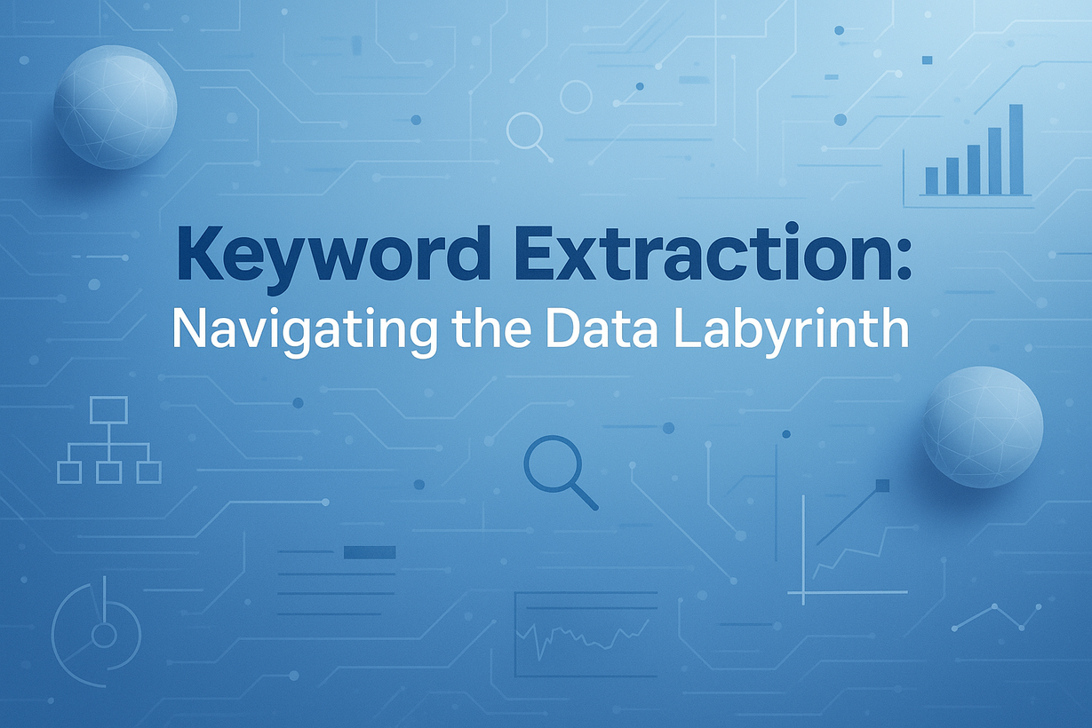

Keyword Extraction
Navigating the Data Labyrinth

Slide 2
GROUP MEMBERS
Meet Jaiswal - AP23110010913
Yasodhar Gubba - AP23110010512
Naveed Ahammed - AP23110010269
Jaqueen Agneshia Christy - AP23110011238
Christina Evangelin - AP23110011273

Slide 3
Problem Statement and Objective
PROBLEM
OBJECTIVE
Many documents contain essential ideas that are difficult to notice because they are surrounded by large volumes of text. Manually reading and skimming through articles, research papers, and reports is time-consuming and often leads to missing important points. With the rapid growth of digital content, there is a strong need for a faster way to understand the main topics without going through every line in detail.
The objective of this project is to automatically extract the most relevant keywords from any given text using the TF-IDF technique. To make this process accessible, a simple web interface is provided for users to paste or upload documents, while a REST API enables automated extraction for developers and external systems. This allows both technical and non-technical users to quickly identify key ideas and understand the core meaning of long text.

Slide 4
Proposed Solution & Workflow
PROPOSED SOLUTION
WORKFLOW
A TF-IDF based keyword extraction
system that preprocesses text,
converts it into vector form,
ranks terms by importance, and
outputs the most relevant keywords.
Input
↓
Preprocessing
↓
TF-IDF Vectorization
↓
Ranking
↓
Output

Slide 5
DATASET & METHODOLOGY
DATASET
  User-provided text input
  Custom text samples
  No external dataset required — works on dynamic input
METHODOLOGY
1. Preprocessing
  Convert text to lowercase
  Remove unwanted characters using regex
  Optional normalization/stemming to reduce word suffixes
  (e.g., “running” → “run”, “studies” → “study”)
2. Vectorization
  Apply TfidfVectorizer(stop_words="english", ngram_range=(1,2))
  Converts text into numerical TF-IDF scores
  Captures important words and short key phrases
3. Ranking
  TF-IDF score determines word importance
  Higher TF-IDF = more relevant term
4. Keyword Selection
  User-defined controls:
    Max Keywords (e.g., 25)
    Keyword Density (e.g., 35%)
  Final keywords are selected based on ranking + thresholds

Slide 6
Technologies Used
    Programming & Frameworks:
      Python, Flask, FastAPI, Starlette
    NLP & ML:
      Scikit-learn (TF-IDF Vectorizer)
    Frontend:
      HTML, CSS, JavaScript
    Server & Tools:
      Uvicorn, Pydantic validation, pytest testing

Slide 7
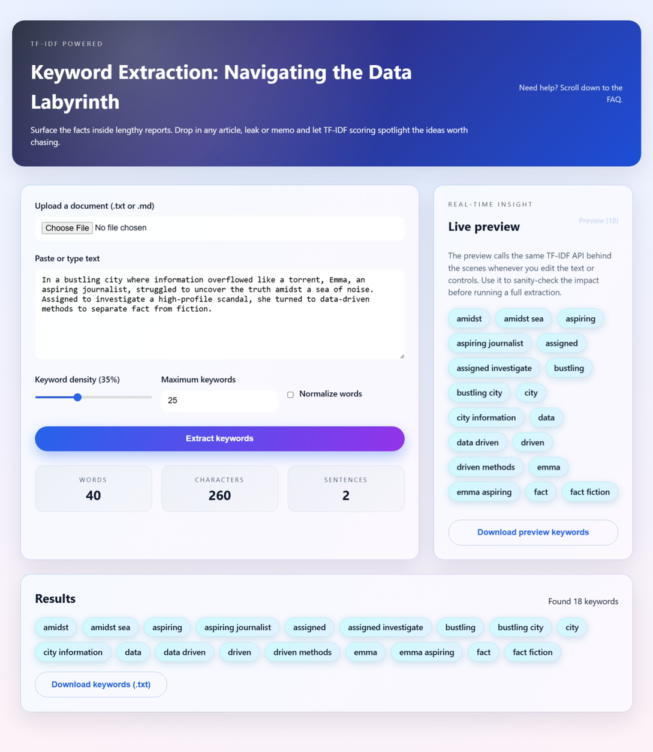
Results & Findings
RESULTS
    Successfully extracts relevant keywords from long documents
    Captures meaningful single and double-word phrases
    Works well for articles, blogs, and project summaries
    Helps quickly identify main topics and concepts
FINDINGS
    TF-IDF effectively identifies the most relevant and important keywords from the text.
    Preprocessing steps like cleaning and stop-word removal significantly improve keyword accuracy.
    The system provides fast and consistent results, even for moderately large text inputs.
    The approach is domain-independent, working well for different types of documents and content.

Slide 8
Conclusion & Future Sc0pe
CONCLUSION
The project accomplishes its goal of extracting meaningful keywords using a TF-IDF-based approach. The system is fast, reliable, and user-friendly, making it suitable for summarization, search optimization, and content analysis
FUTURE SCOPE
    Add spaCy-based lemmatization for better linguistic accuracy
    Support multi-document corpus keyword extraction
    Allow export formats like CSV/JSON
    Add custom stopword list and UI theme enhancements

Slide 9
Thank You

