Slide 1
doott.
UdbhavX 2.0 · 25 Aug 2026
Your AI Sales Team. Always On. Always Working.
AI-Powered B2B Lead Generation & Sales Automation
🤖 AI-Native
📊 B2B SaaS
🇮🇳 India-First
Akshat Verma
Founder & CEO · doott.in
10,000+
1L+
6
6
Leads/Week
Email Open Rate
AI Agents
Modules
Startup Pitch · UdbhavX 2.0 · IE Cell, SAIT Indore · 25th August 2026

Slide 2

01 / THE PROBLEM
B2B Sales Teams Are Stuck in 2010
Sales reps spend only 27% of their time actually selling — the rest is costly manual busywork
ONE-LINE DESCRIPTION
"Doott is the AI that finds your customers, writes their emails, and scores every lead — automatically."
🔍
📋
✍️
Finding Companies
Finding Contacts
Writing Cold Emails
3 hrs/day
2 hrs/day
4 hrs/day
Scanning directories, LinkedIn & Google manually every day
Hunting for verified decision-maker emails & phones
Crafting unique personalized emails one by one from scratch
₹10L/year
40 leads/wk
27%
18 months
Cost of 1 SDR
SDR Capacity
Time Selling
SDR Tenure

Slide 3
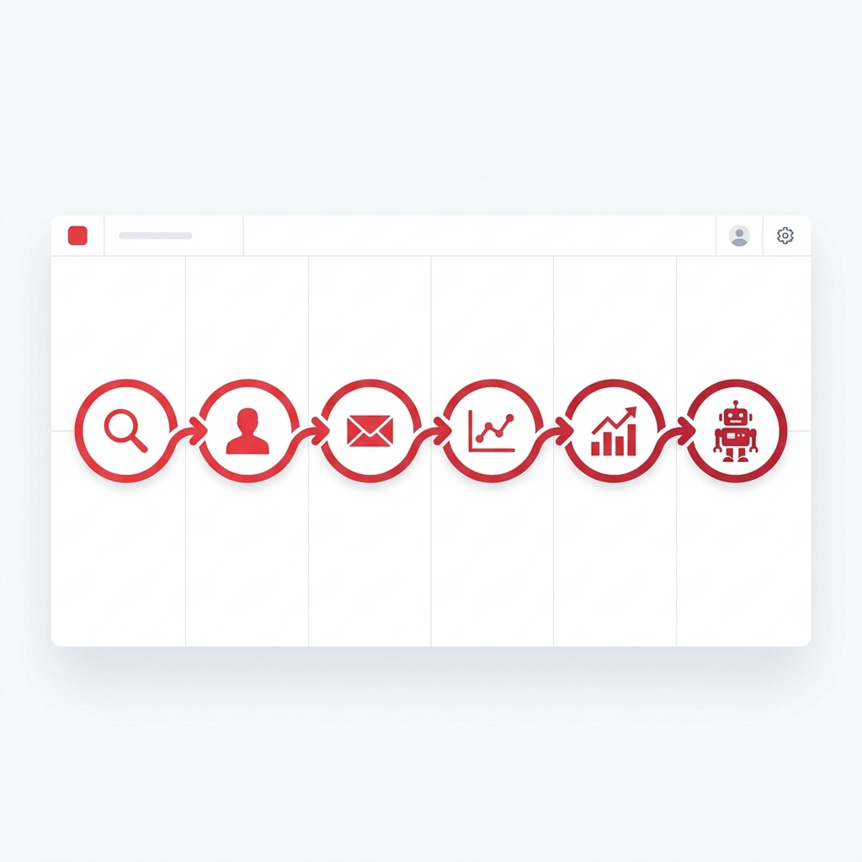
02 / SOLUTION
Meet Doott — Your B2B Intelligence, Instantly.
Companies · People · Emails · Numbers · Categories · AI Chatbot — live today
🏢
👥
📧
📞
🔲
💬
COMPANIES
PEOPLE
EMAILS
NUMBERS
CATEGORIES
ASK DOOTT
Search 1L+ verified Indian B2B companies
Find decision-makers: CTOs, VPs, founders
Verified emails ready to use — zero bounces
Direct-dial numbers for Indian B2B contacts
Browse any industry vertical for targeted leads
AI chatbot answers sales questions 24/7
⚡ Result: What takes a sales team 1 full week — Doott does in 5 minutes. Doott surfaces it in seconds.

Slide 4
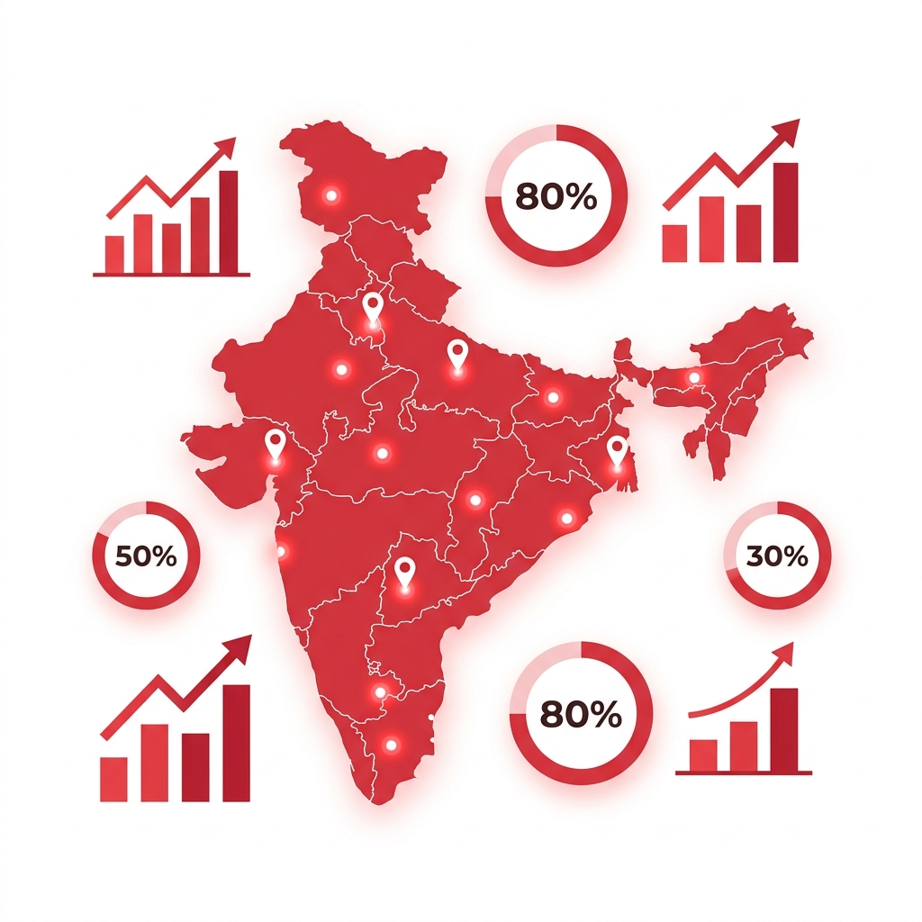
03 / MARKET OPPORTUNITY
A $5.9B Market — 97% Still Untapped in India
22% CAGR · 63 million Indian SMBs · no end-to-end AI sales solution exists for India
TAM
$5.9B
SAM
$800M
SOM
$40M
India SMB Segment Year 1–2 Target
India B2B SaaS Sales Market 2026
63 Million
22% CAGR
3%
ZERO
Global B2B Lead Gen Market by 2030
SMBs in India
Market Growth Rate
Use Any Automation
End-to-End AI for India

Slide 5
04 / BUSINESS MODEL
SaaS — High-Margin Recurring Revenue
Monthly subscriptions · Pay-per-lead credits · Enterprise white-label · API access
STARTER
★ POPULAR
GROWTH
SCALE
ENTERPRISE
₹2,999
₹7,999
₹19,999
Custom
/mo
/mo
/mo
✓ 500 leads/month
✓ 2,000 leads/month
✓ Unlimited leads
✓ White-label platform
✓ AI email writing
✓ Everything in Starter
✓ Everything in Growth
✓ Dedicated infra
✓ Lead scoring 0–100
✓ Google Places scraper
✓ Custom AI tuning
✓ SLA guarantee
✓ Sheets dashboard
✓ Priority support
✓ Full API access
✓ On-premise option
₹3,000 · CAC
₹72,000 · LTV
24x · LTV:CAC
>80% · Gross Margin

Slide 6
05 / COMPETITIVE ADVANTAGE
Every Competitor Solves 1 Step. Doott Solves All 6.
10x cheaper · India-native data · only all-in-one AI sales platform in India
Capability
Apollo.io
ZoomInfo
Clay
Hunter.io
DOOTT ✦
Company Discovery
✓
✓
Partial
✗
✓
Contact Enrichment
✓
✓
✓
Email only
✓
AI Email Writing
✗
✗
✗
✗
✓
Automated Sending
✗
✗
✗
✗
✓
Lead Scoring AI
Basic
✗
✗
✗
✓ AI
India-Native Data
Partial
✗
✗
Partial
✓ Native
Monthly Price
$99+
$1,250+
$149+
$49+
₹2,999
🏆 10x cheaper than ZoomInfo · Only all-in-one for India · AI reads each target's website

Slide 7
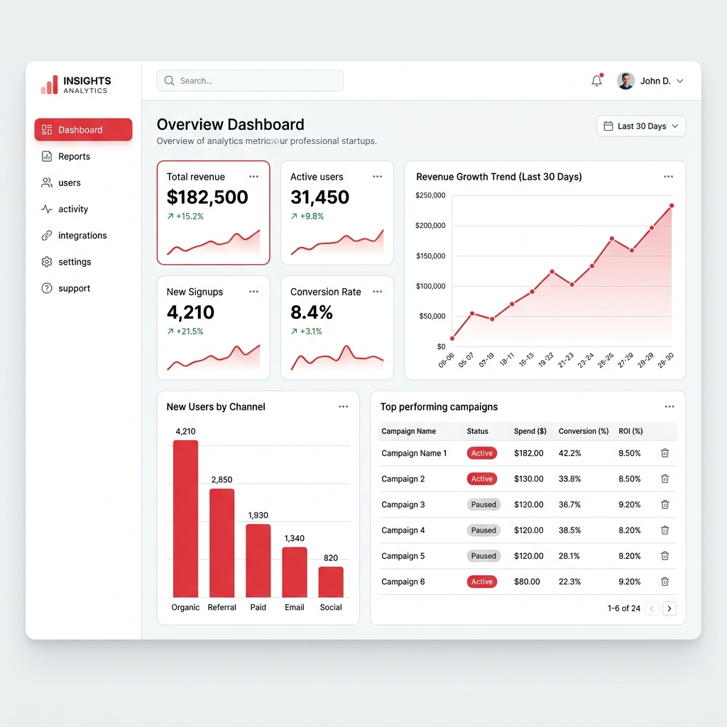
06 / TRACTION
Not an Idea — A Working Product, Live Today
Built, deployed, and processing real Indian B2B data right now
1,00,000+
6
Indian B2B Contacts Indexed
Live Features In the Product
1L+
6
Indian B2B Contacts Indexed & Verified
Live Core Features Shipped to Users
CURRENT REVENUE STATUS
Early traction · Pilot users onboarded · Pre-revenue → target ₹16L MRR by Q4 2026
✅ Companies DB ✅ People DB ✅ Emails Lookup ✅ Numbers Lookup ✅ Categories ✅ Ask Doott AI Chatbot

Slide 8
07 / VISION & THE ASK
Building India's AI Sales Intelligence Platform
The Salesforce of the AI era — India first, Southeast Asia next
"Every B2B company in India will use Doott the same way they use email — an invisible engine running underneath their growth."
12-MONTH ROADMAP
Q3 2026
Q4 2026
Q1 2027
2028
🚀 Public Launch
📈 Scale Revenue
🌏 Regional Push
🏆 Category Leader
50 paying customers Product-market fit
200 customers ₹16 Lakh MRR
Southeast Asia 1,000 customers target
$100M ARR Vision 10,000+ customers
RAISING ₹50 LAKHS — SEED ROUND
40%
35%
15%
10%
Engineering & AI
Sales & Marketing
Team — 2 Key Hires
Operations & Legal
Akshat Verma · Founder & CEO · doott.in

