Slide 1
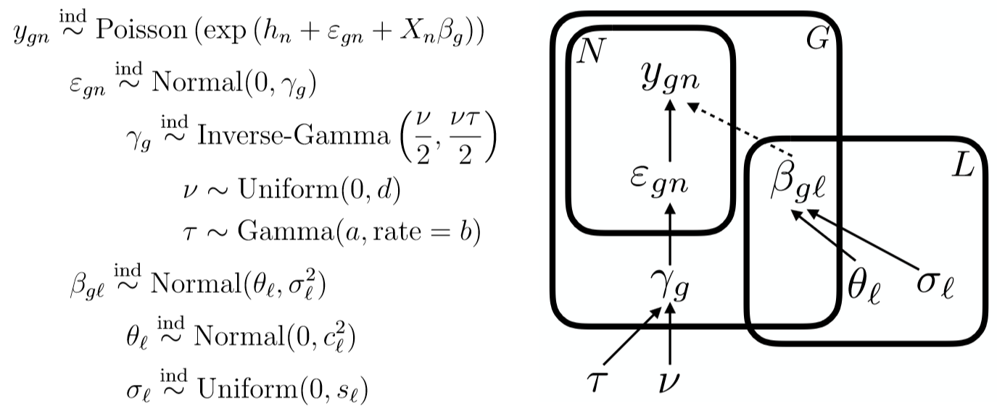
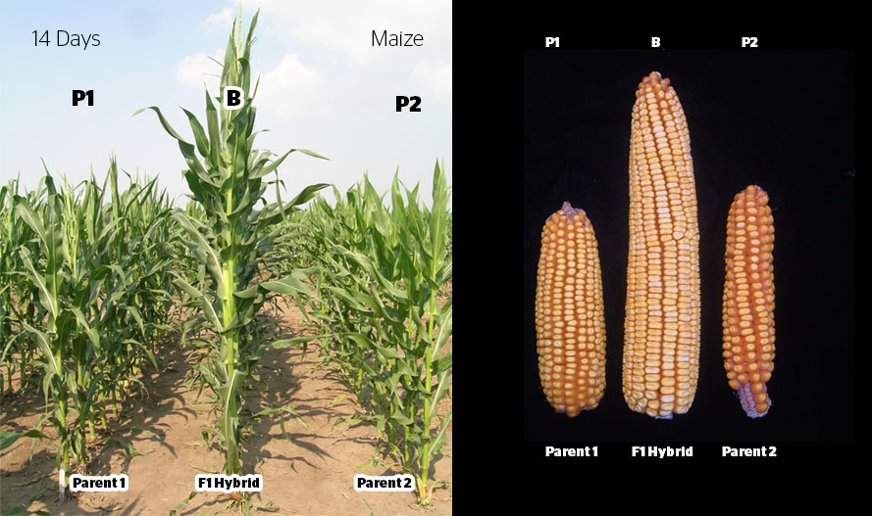
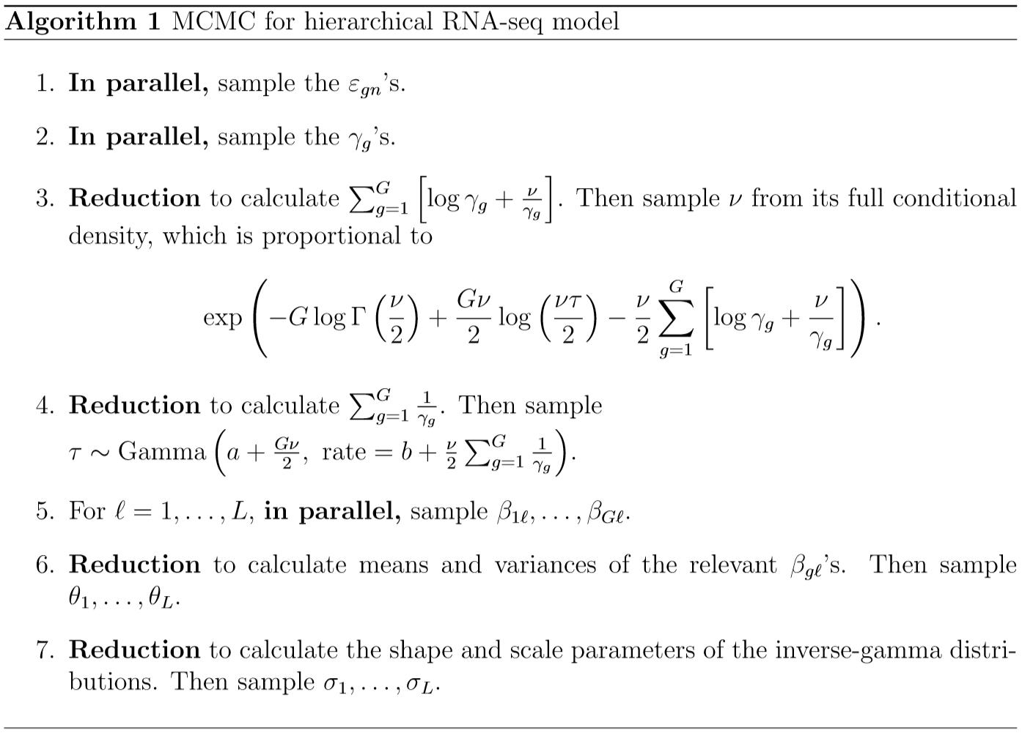
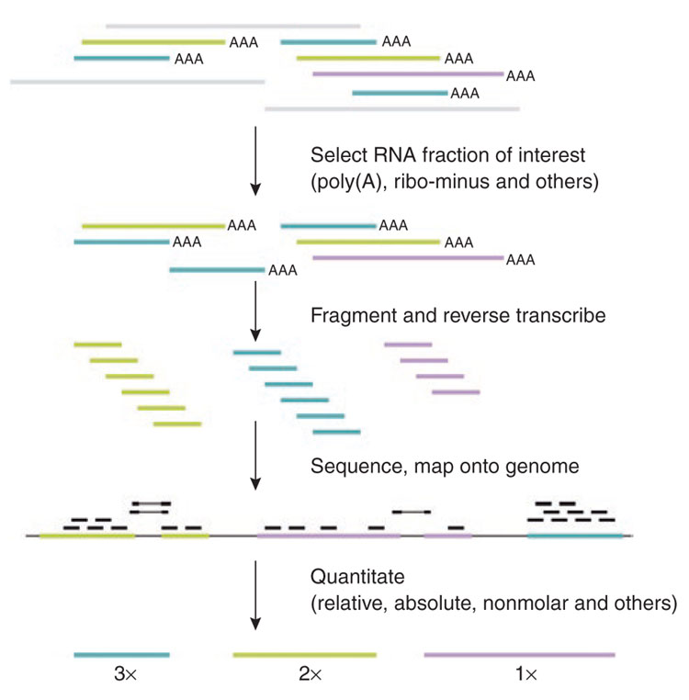
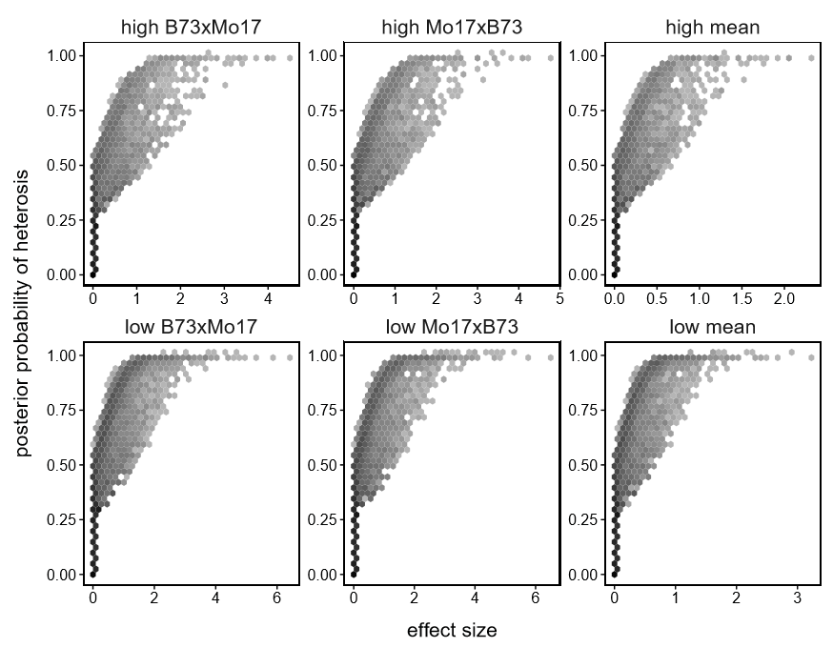
Department of Statistics
2018 ISBA World Meeting
26 June 2018
Jarad Niemi, Will Landau, and Dan Nettleton
Fully Bayesian analysis of hierarchical count regression models applied to RNA-seq
Hierarchical Count Regression Model
Heterosis (hybrid vigor)
RNA-seq expression counts
GPU-accelerated Markov chain Monte Carlo algorithm
RNA-seq experiments
Heterosis detection
(Pepke, Wold, and Mortazavi (2009)
http://www.nature.com/nmeth/journal/v6/n11s/fig_tab/nmeth.1371_F5.html)
Will Landau, Jarad Niemi, and Dan Nettleton (2018) Fully Bayesian analysis of RNA-seq counts for the detection of gene expression heterosis. to appear Journal of the American Statistical Association
Acknowledgements: This research was supported by National Institute of General Medical Sciences (NIGMS) of the National Institutes of Health and the joint National Science Foundation / NIGMS Mathematical Biology Program under award number R01GM109458. The content is solely the responsibility of the authors and does not necessarily represent the official views of the National Institutes of Health or the National Science Foundation.

