Slide 1

Bayesian Success in
Disease Severity Forecasting
Jarad Niemi
Professor in Department of Statistics
Statistical Consulting Director
Data Science Program Director

Slide 2


Slide 3
Best of Statistical Science
Massively Collaborative
Probabilistic Forecasts
Expert Opinion
Bayesian Hierarchical Models

Slide 4
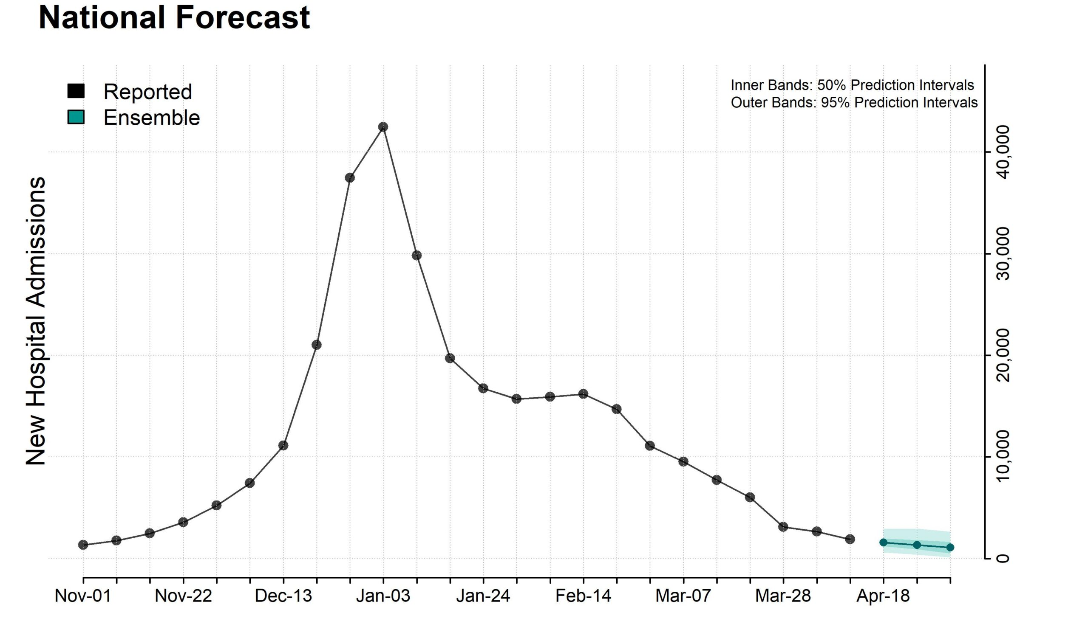
https://www.cdc.gov/flu-forecasting/data-vis/current-week.html

Slide 5
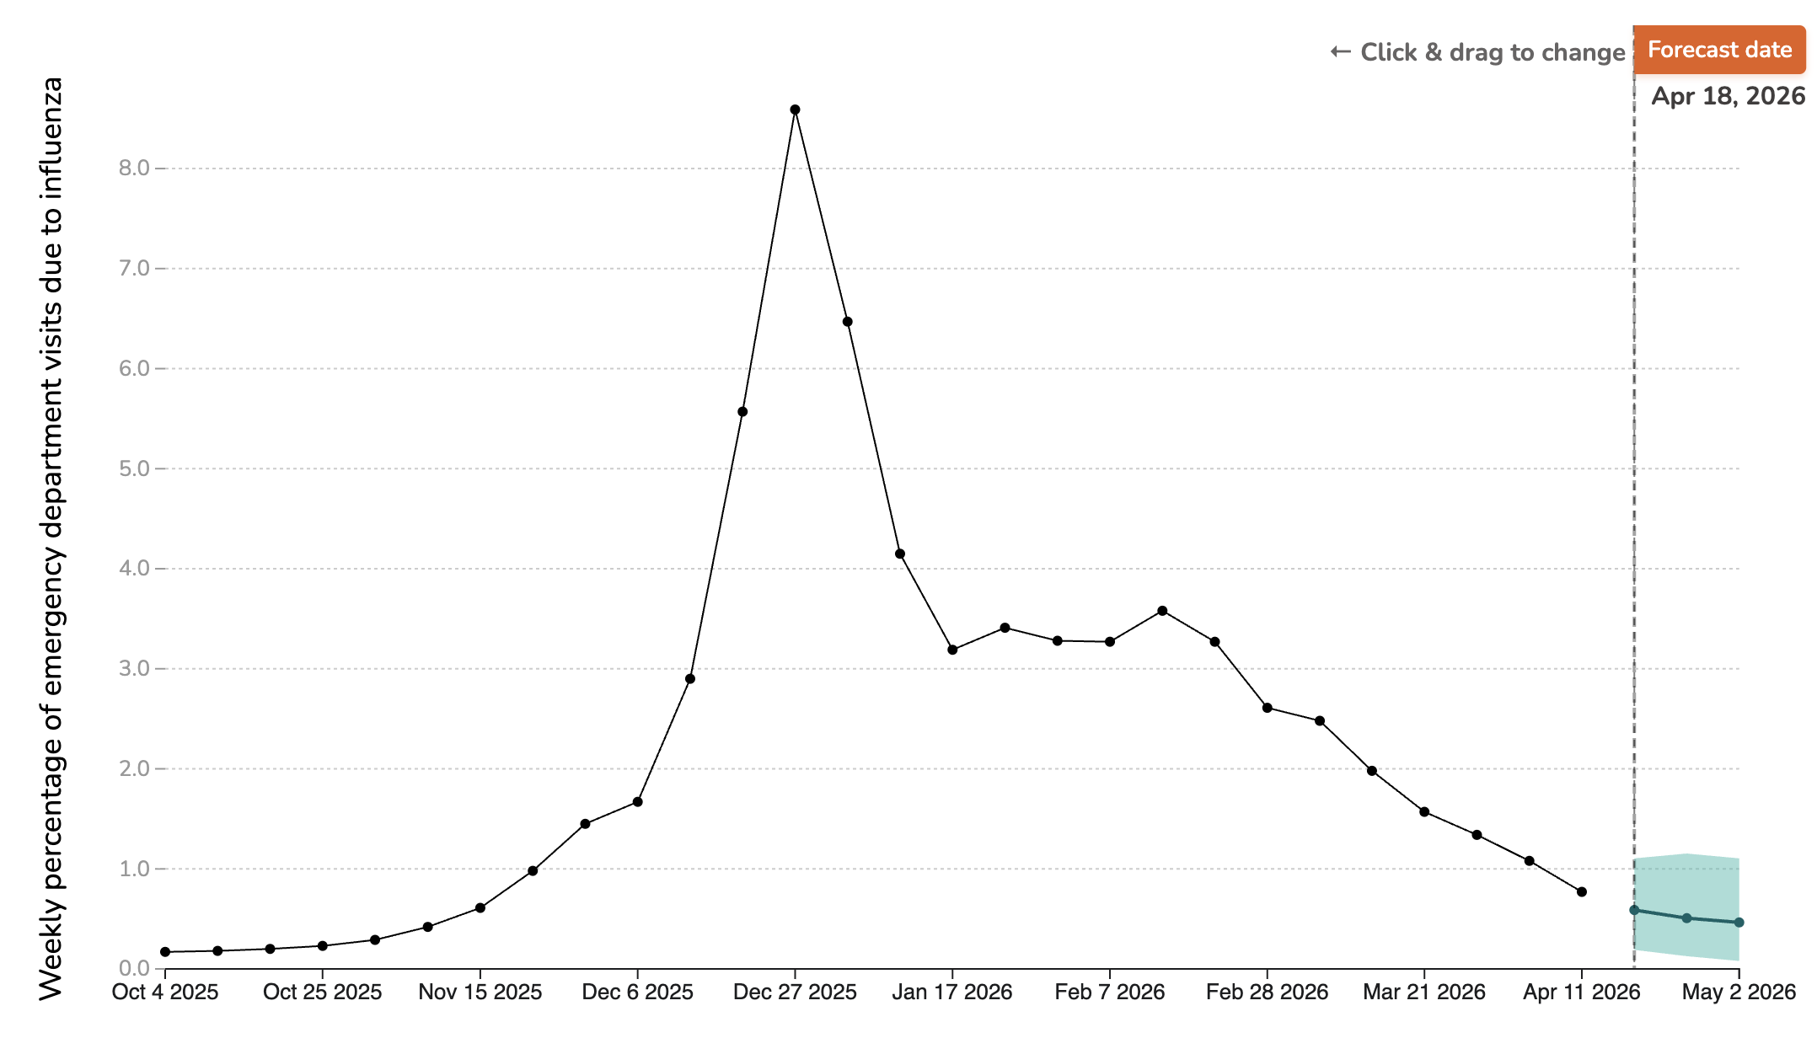
https://www.cdc.gov/flu-forecasting/data-vis/emergency-department-visits.html

Slide 6
Massively Collaborative

Slide 7
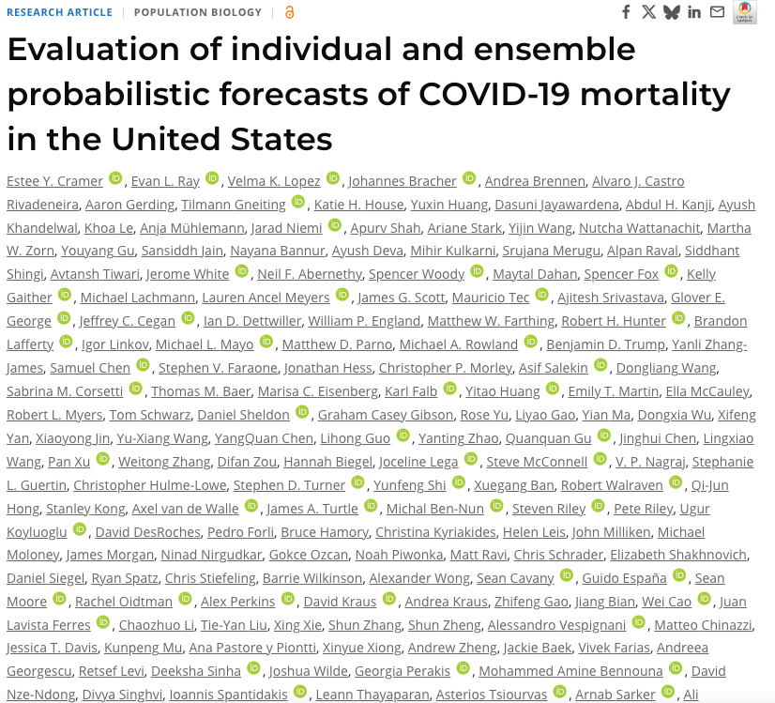
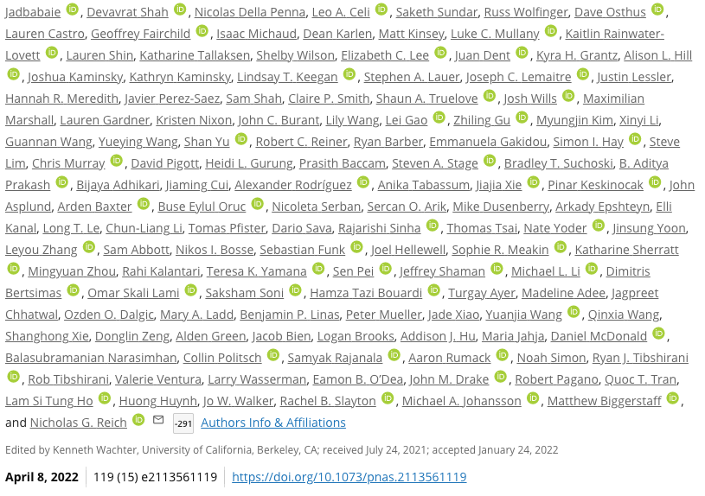
Collaborative Manuscripts
https://www.pnas.org/doi/10.1073/pnas.2113561119

Slide 8
CDC Forecasting
https://www.cdc.gov/flu-forecasting/data-vis/current-week.html
https://reichlab.io/flusight-dashboard/
https://github.com/reichlab/flusight-dashboard
https://viz.covid19forecasthub.org/
https://github.com/reichlab/covid19-forecast-hub
https://zoltardata.com/

Slide 9
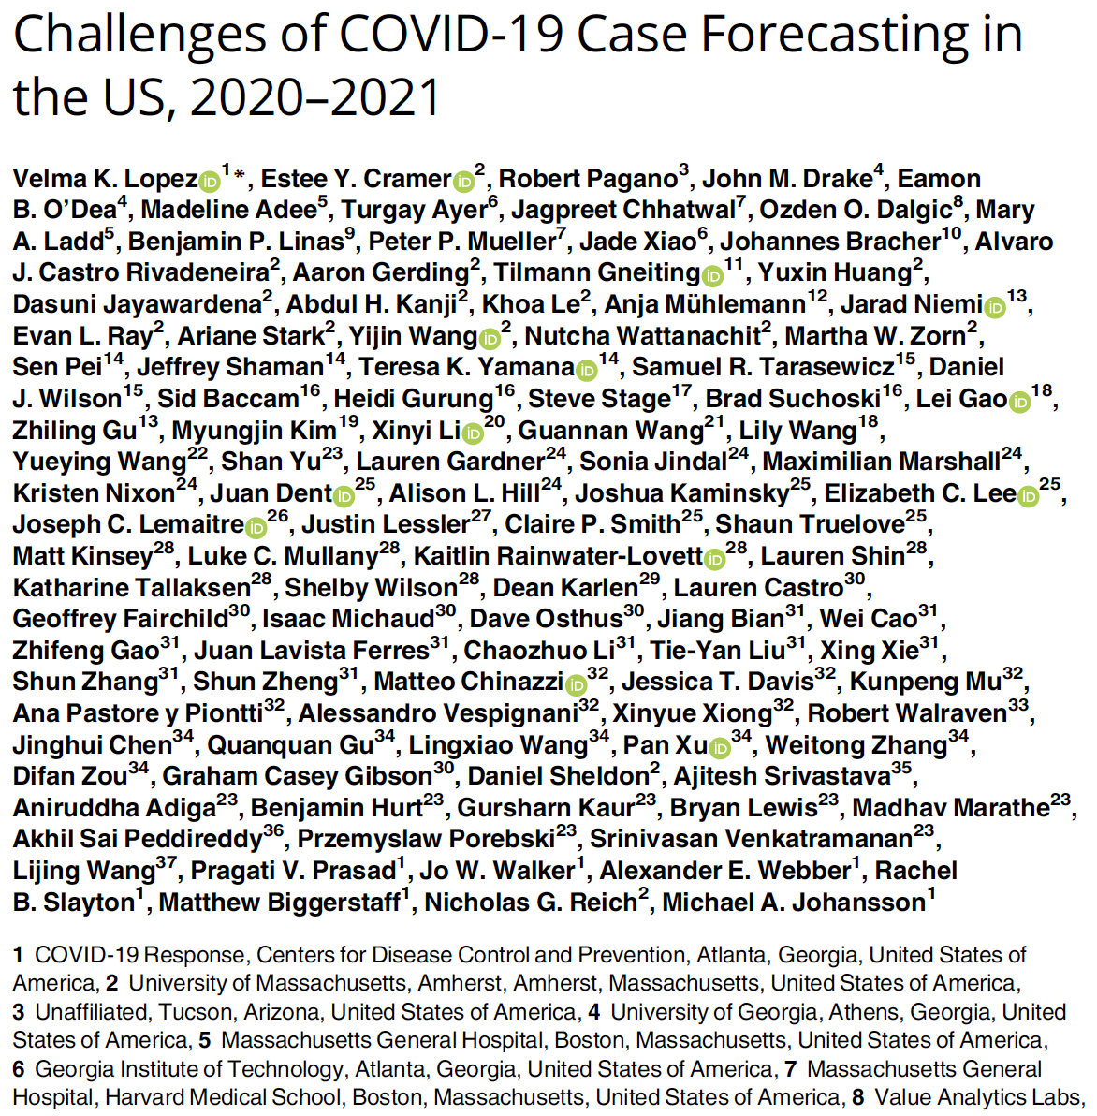
https://doi.org/10.1371/journal.pcbi.1011200

Slide 10
Probabilistic Forecasts

Slide 11
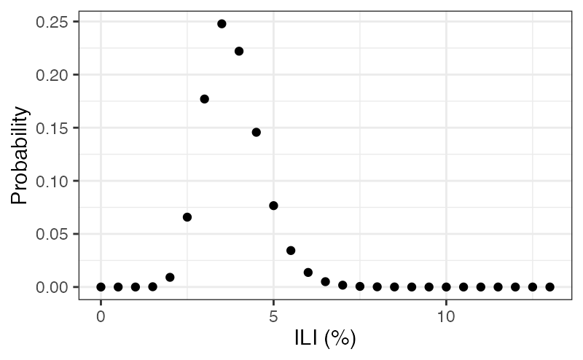
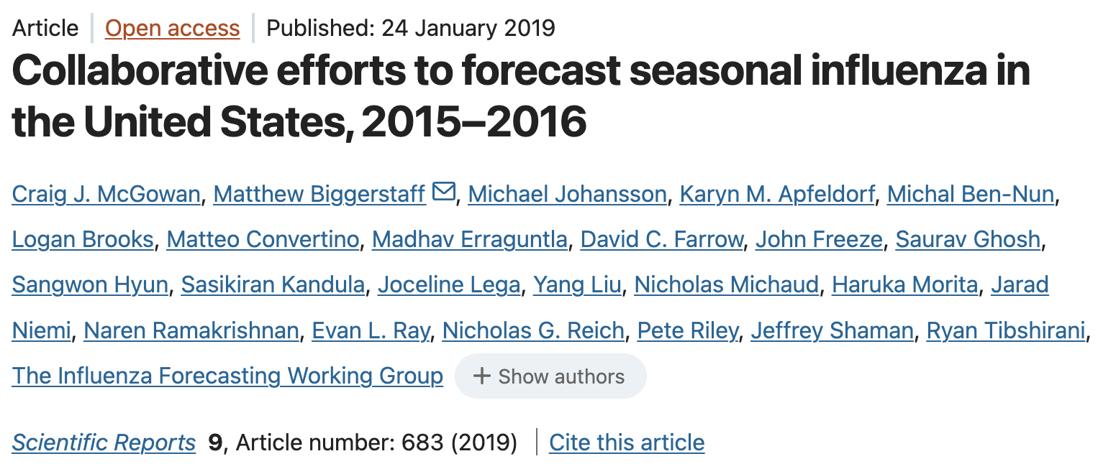
Probabilistic Forecasts pre-2016
Notes:
Page fades in, red pops up. Only this page

Slide 12
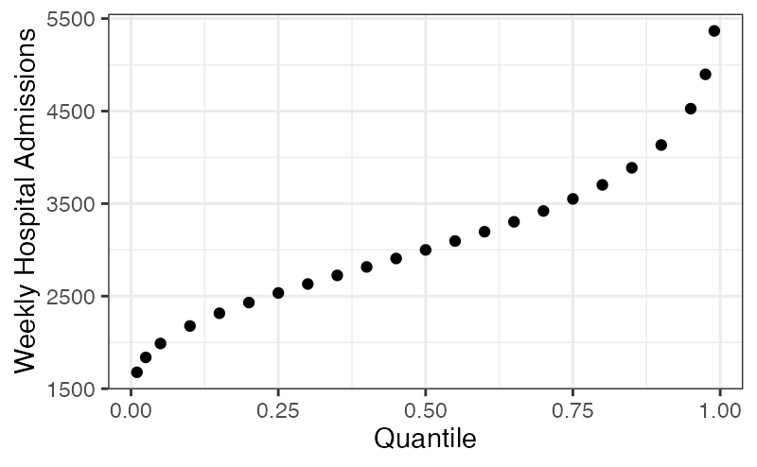
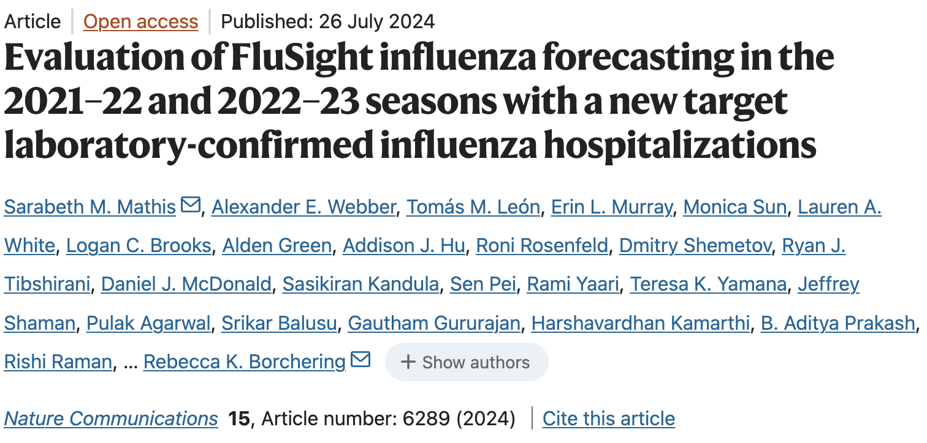
Probabilistic Forecasts during/post COVID
Notes:
Page fades in, red pops up. Only this page

Slide 13
Expert Opinion

Slide 14
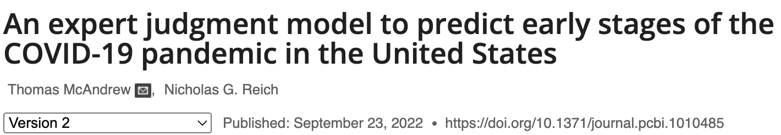
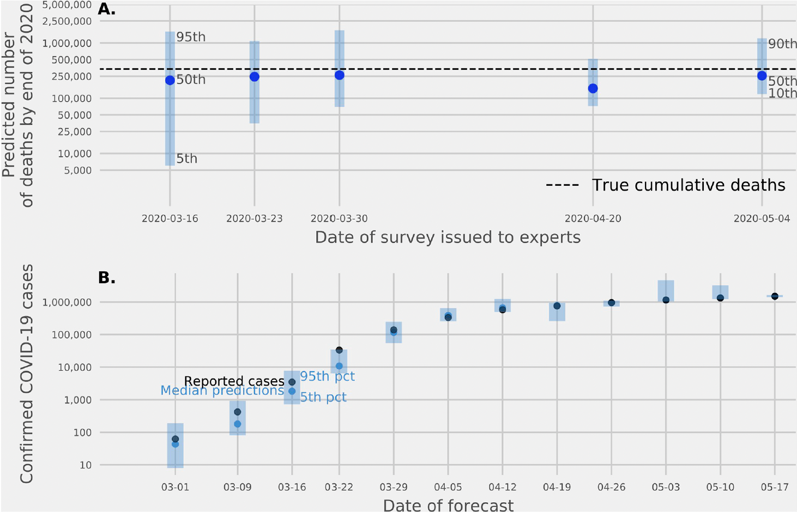
Expert Opinion
Notes:
Page fades in, red pops up. Only this page

Slide 15
Bayesian Hierarchical Modeling

Slide 16
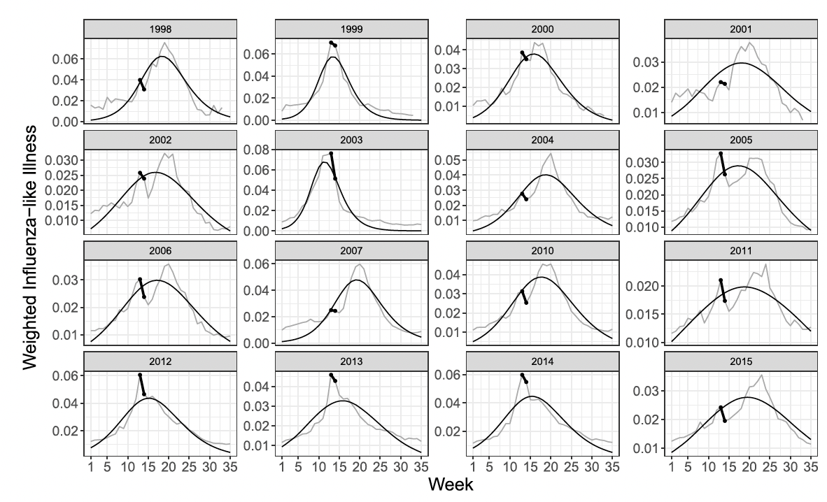
Influenza-like Illness (ILI) %
Notes:
Page fades in, red pops up. Only this page

Slide 17
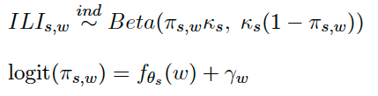

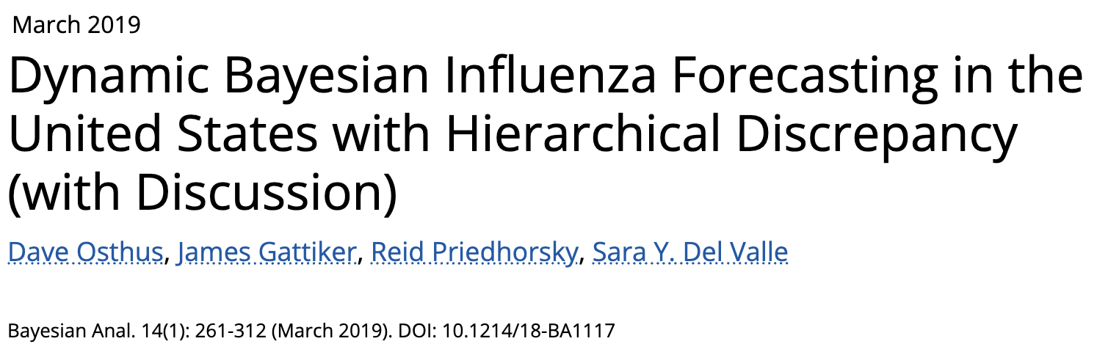
Hierarchical Bayesian Model
SIR
Notes:
Page fades in, red pops up. Only this page

Slide 18
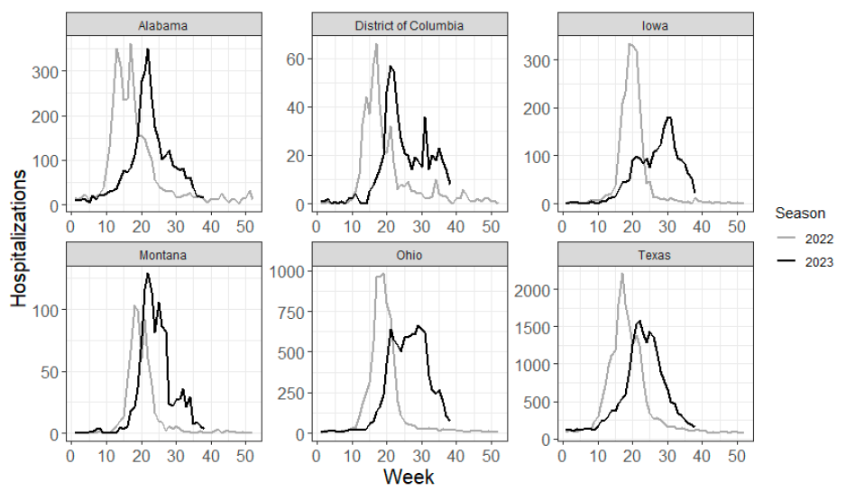
Influenza Hospitalizations
Notes:
Page fades in, red pops up. Only this page

Slide 19
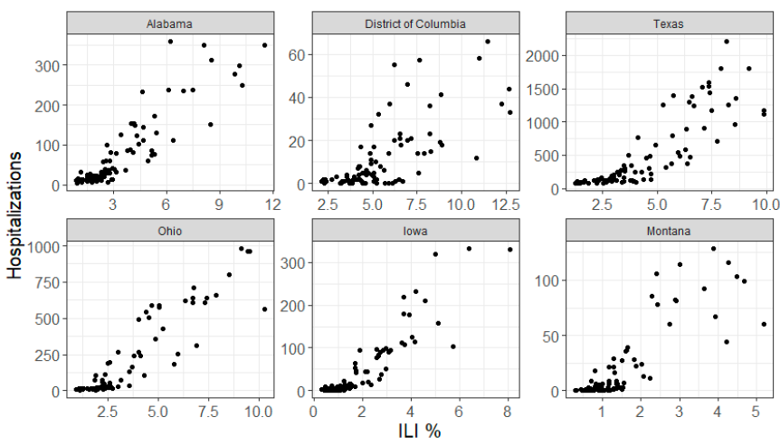
ILI % v Hospitalizations
Notes:
Page fades in, red pops up. Only this page

Slide 20
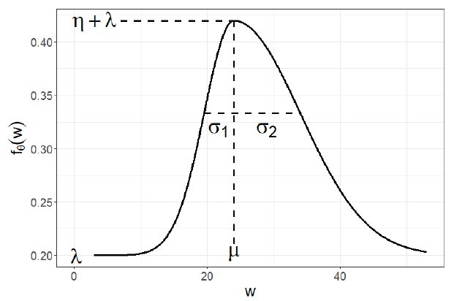
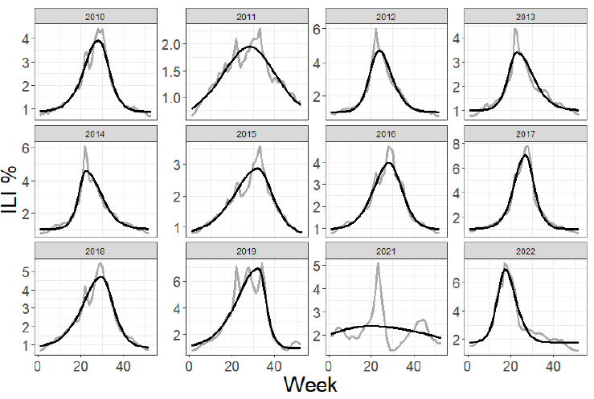
Modeling ILI % - Asymmetric Gaussian
Notes:
Page fades in, red pops up. Only this page

Slide 21
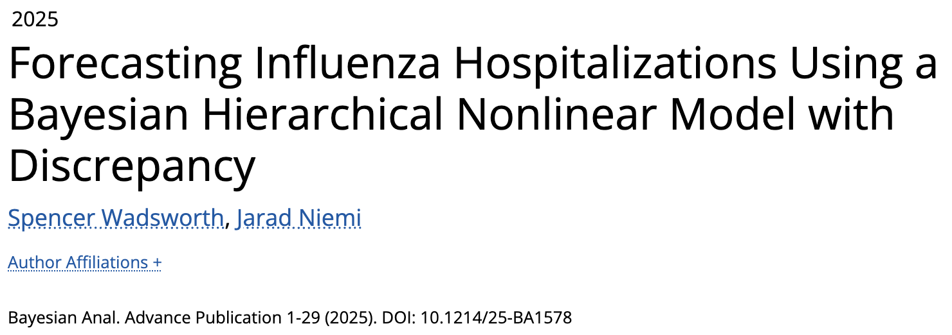
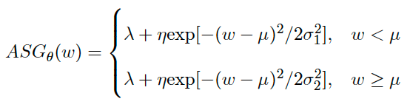

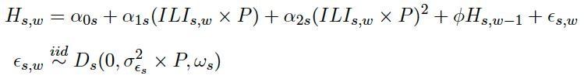
Hierarchical Bayesian Model
Hospitalizations
Notes:
Page fades in, red pops up. Only this page

Slide 22
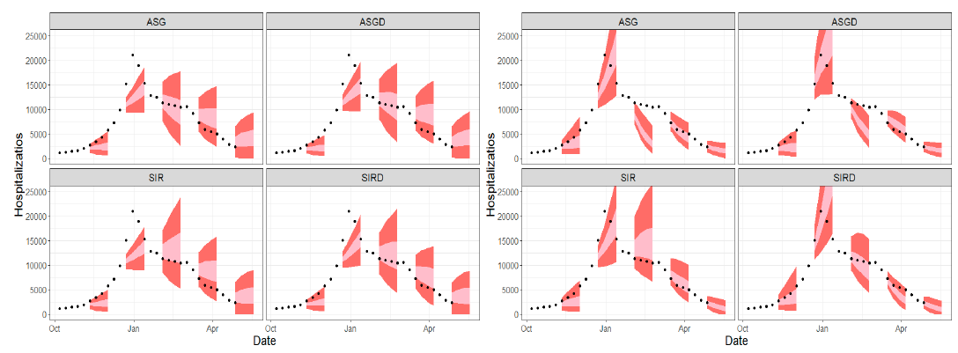
Model Performance
Linear
Quadratic
Notes:
Page fades in, red pops up. Only this page

Slide 23
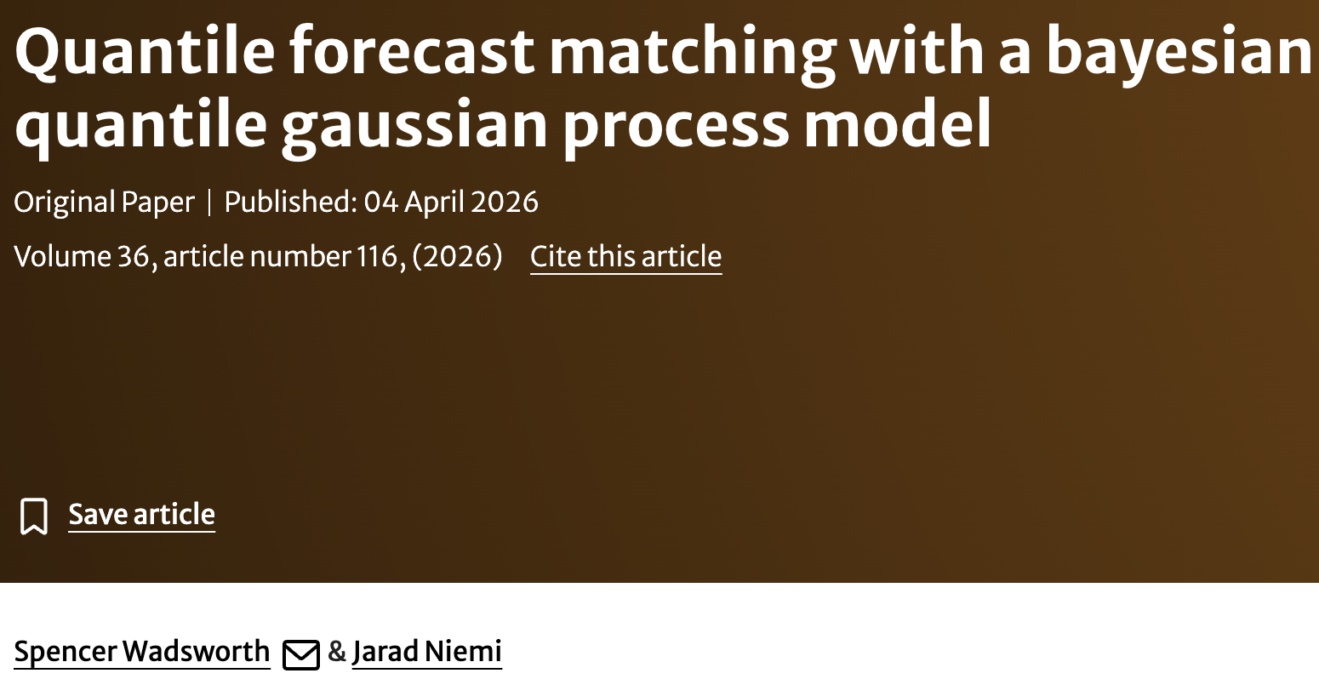
Recover true distribution from a set of quantiles?

Slide 24
Making Best Even Better
Massive Collaborations
Probabilistic Forecasts
Forecast Next Pandemic
Individual Models
Utilizing Outside Data
Ensembles

Slide 25
Thank You
Jarad Niemi
Professor of Statistics
Statistical Consulting Director
Data Science Program Director
niemi@iastate.edu
(515)-294-8679
www.stat.iastate.edu/people/jarad-niemi
Spencer Wadsworth
Postdoctoral Associate w/ Ofer Harel (UConn)
Joining BYU as an Assistant Professor in Fall 2026
iac25002@uconn.edu
statistics.uconn.edu/person/spencer-wadsworth/
Notes:
New names

