Slide 1

Bayesian Methodology for Disease Severity Forecasting
Jarad Niemi, Spencer Wadsworth

Slide 2
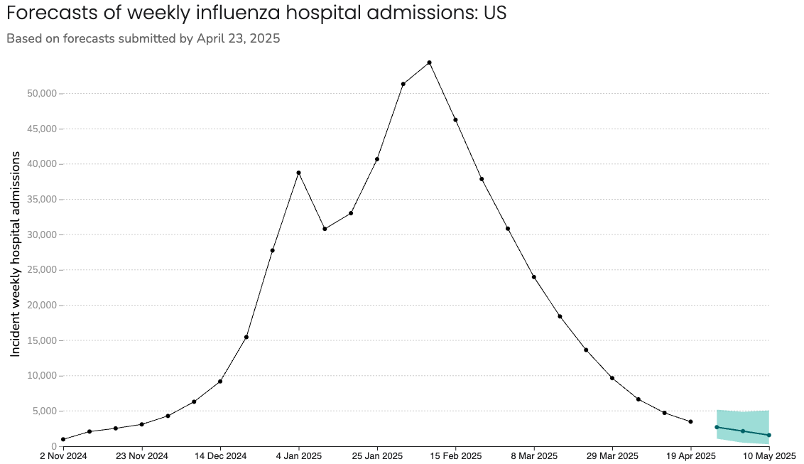
Outline
CDC Flu Forecasting
Bayesian Modeling
Quantile GP
Bayesian Stacking

Slide 3
CDC Forecasting
https://www.cdc.gov/flu-forecasting/data-vis/current-week.html
https://reichlab.io/flusight-dashboard/
https://github.com/reichlab/flusight-dashboard
https://viz.covid19forecasthub.org/
https://github.com/reichlab/covid19-forecast-hub
https://zoltardata.com/

Slide 4
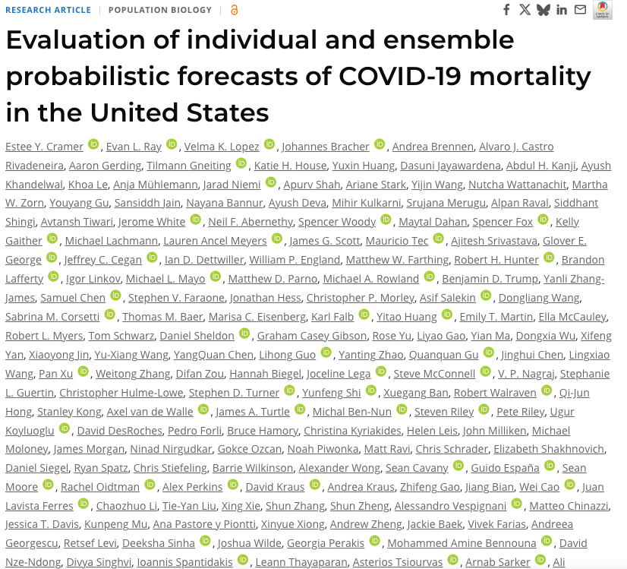
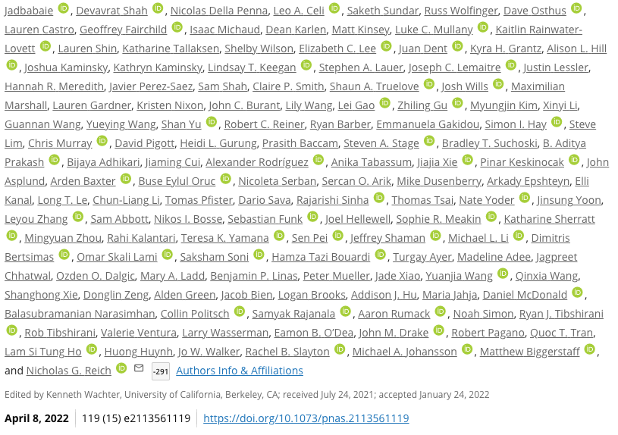
Collaborative Manuscripts
https://www.pnas.org/doi/10.1073/pnas.2113561119

Slide 5
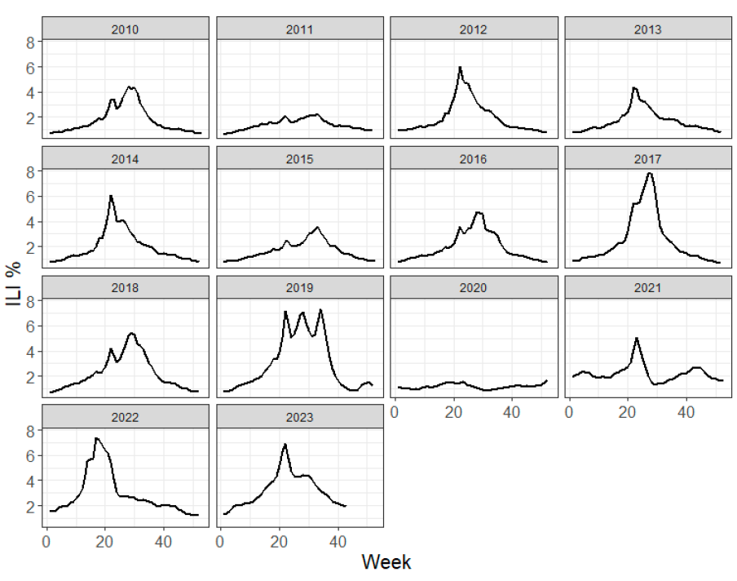
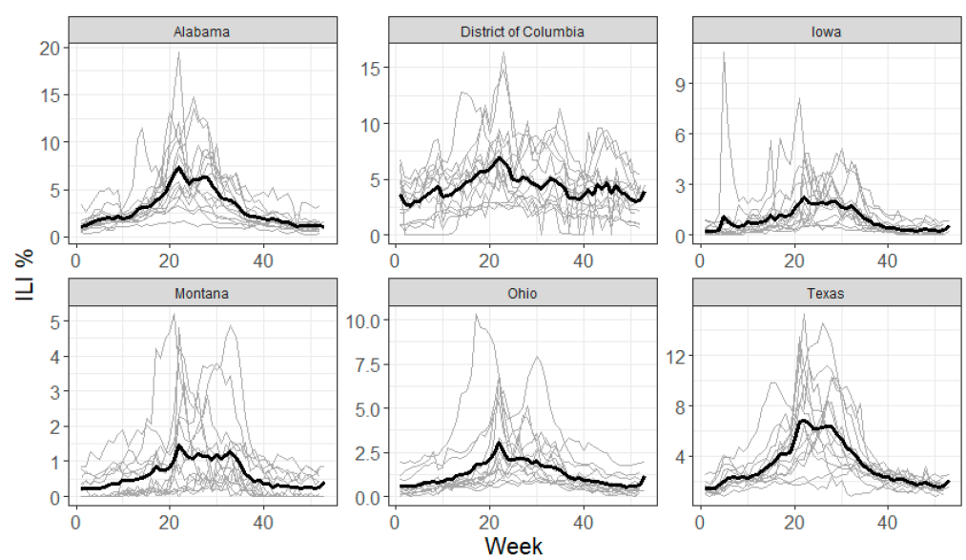
Influenza-like Illness (ILI) %
Notes:
Page fades in, red pops up. Only this page

Slide 6
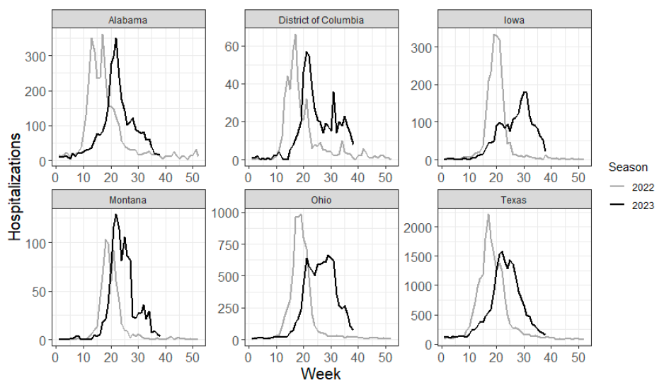
Influenza Hospitalizations
Notes:
Page fades in, red pops up. Only this page

Slide 7
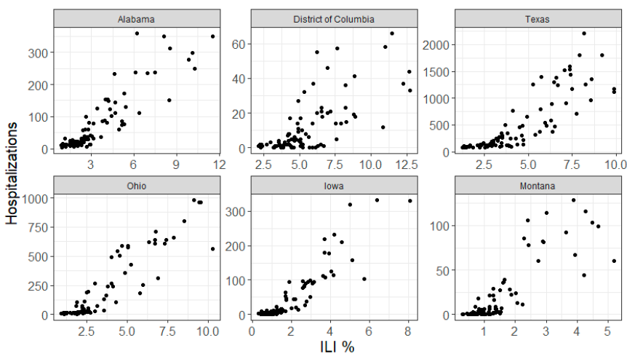
ILI % v Hospitalizations
Notes:
Page fades in, red pops up. Only this page

Slide 8
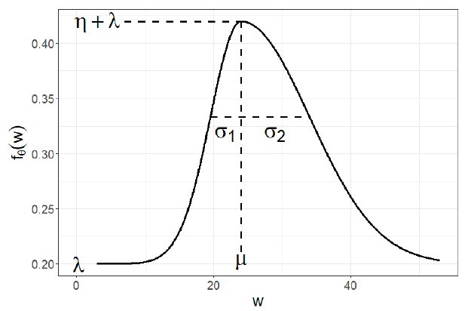
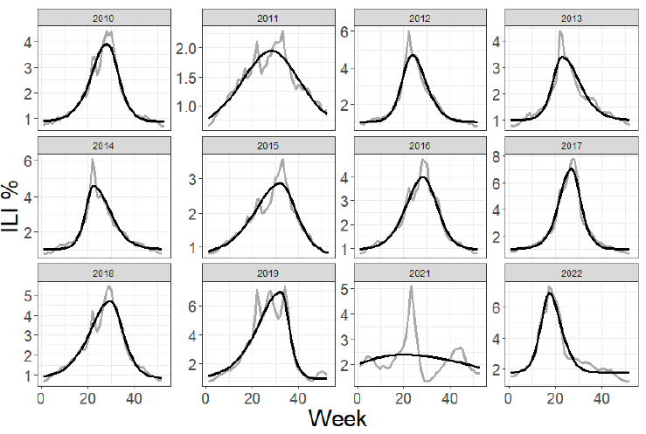
Modeling ILI % - Asymmetric Gaussian
Notes:
Page fades in, red pops up. Only this page

Slide 9
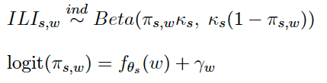

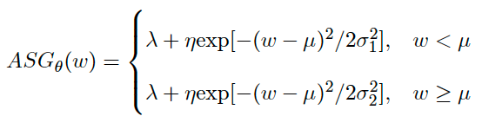

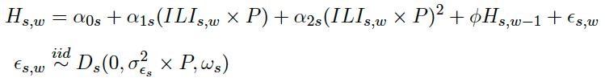
Hierarchical Bayesian Model
ILI%
Hospitalizations
Notes:
Page fades in, red pops up. Only this page

Slide 10
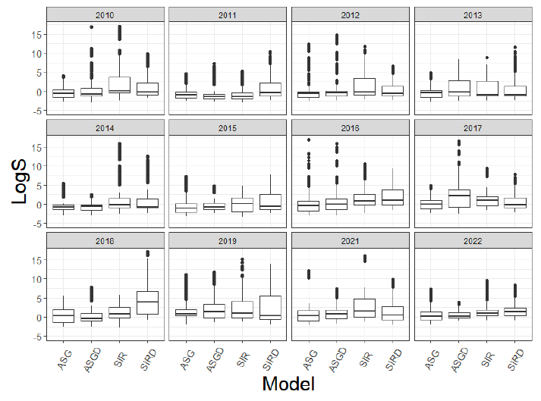
Bayesian Model Performance
Notes:
Page fades in, red pops up. Only this page

Slide 11
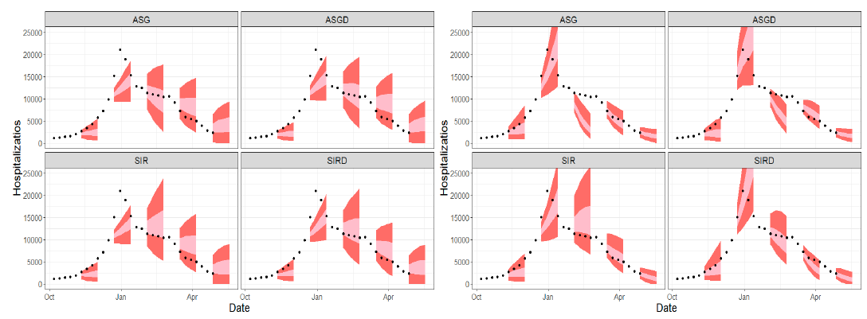
Model Performance
Linear
Quadratic
Notes:
Page fades in, red pops up. Only this page

Slide 12
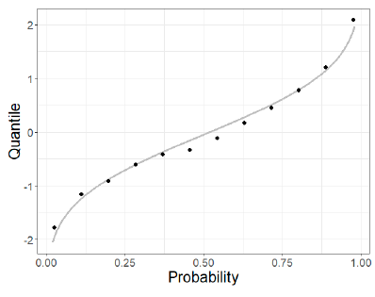
Quantile Gaussian Process
Recover true distribution from a set of quantiles?

Slide 13
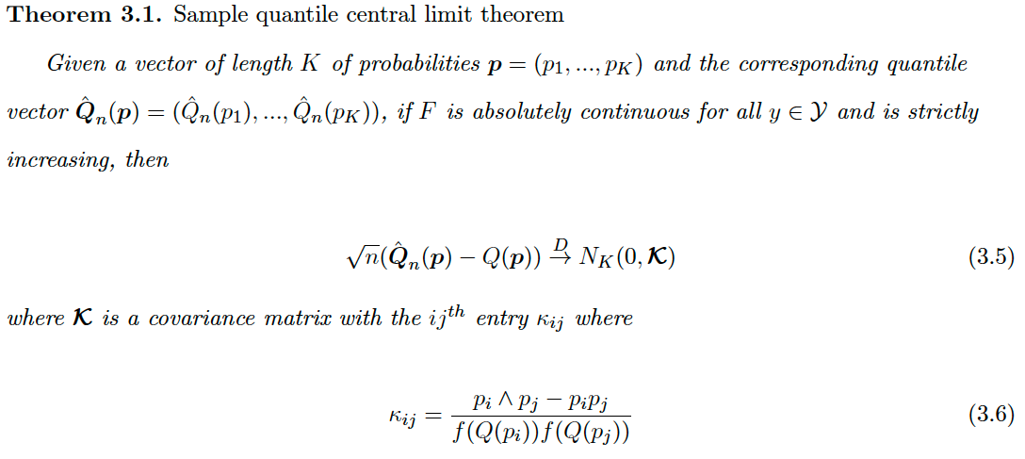
Quantile Central Limit Theorem
Notes:
Page fades in, red pops up. Only this page

Slide 14






Quantile Gaussian Process (QGP)
If location-scale family:
Normal QGP
Notes:
Page fades in, red pops up. Only this page

Slide 15
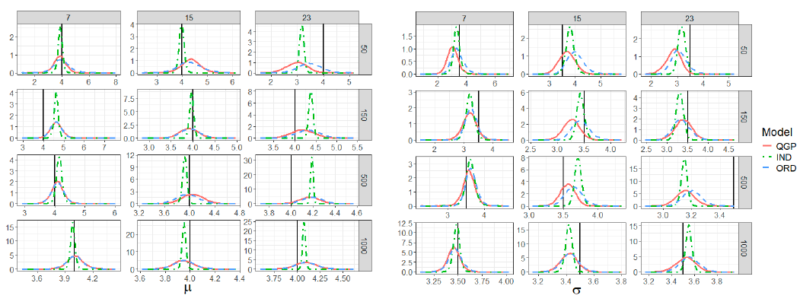
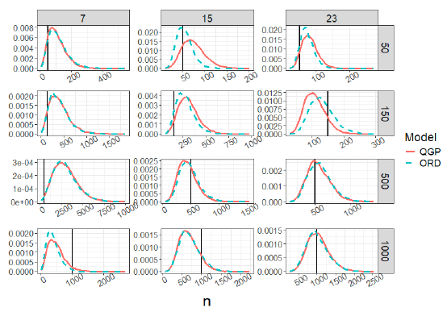
Simulation Study: Recovery of Parameters
Notes:
Page fades in, red pops up. Only this page

Slide 16
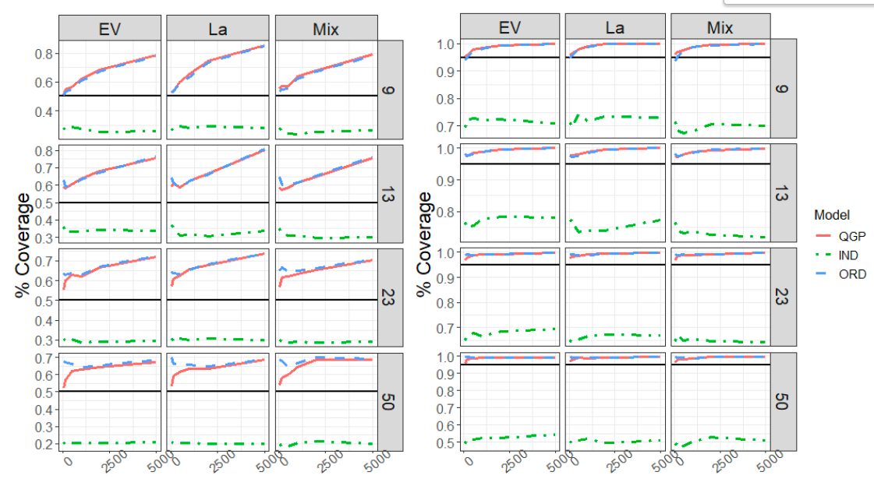
Simulation Study: Coverage of True Quantiles
Notes:
Page fades in, red pops up. Only this page

Slide 17
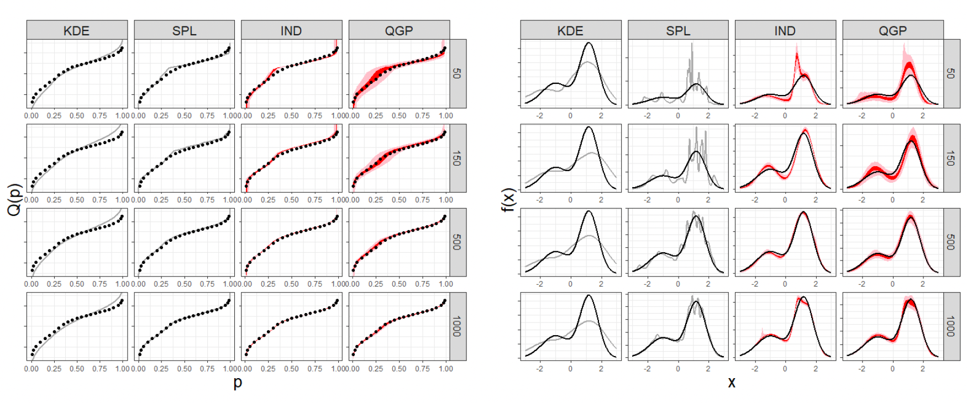
Simulation Study: Estimating Two-Component Normal Mixture
Notes:
Page fades in, red pops up. Only this page

Slide 18
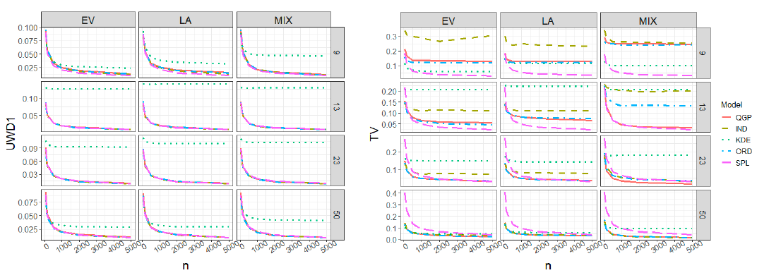
Simulation Study: Distance from True Distribution
Notes:
Page fades in, red pops up. Only this page

Slide 19
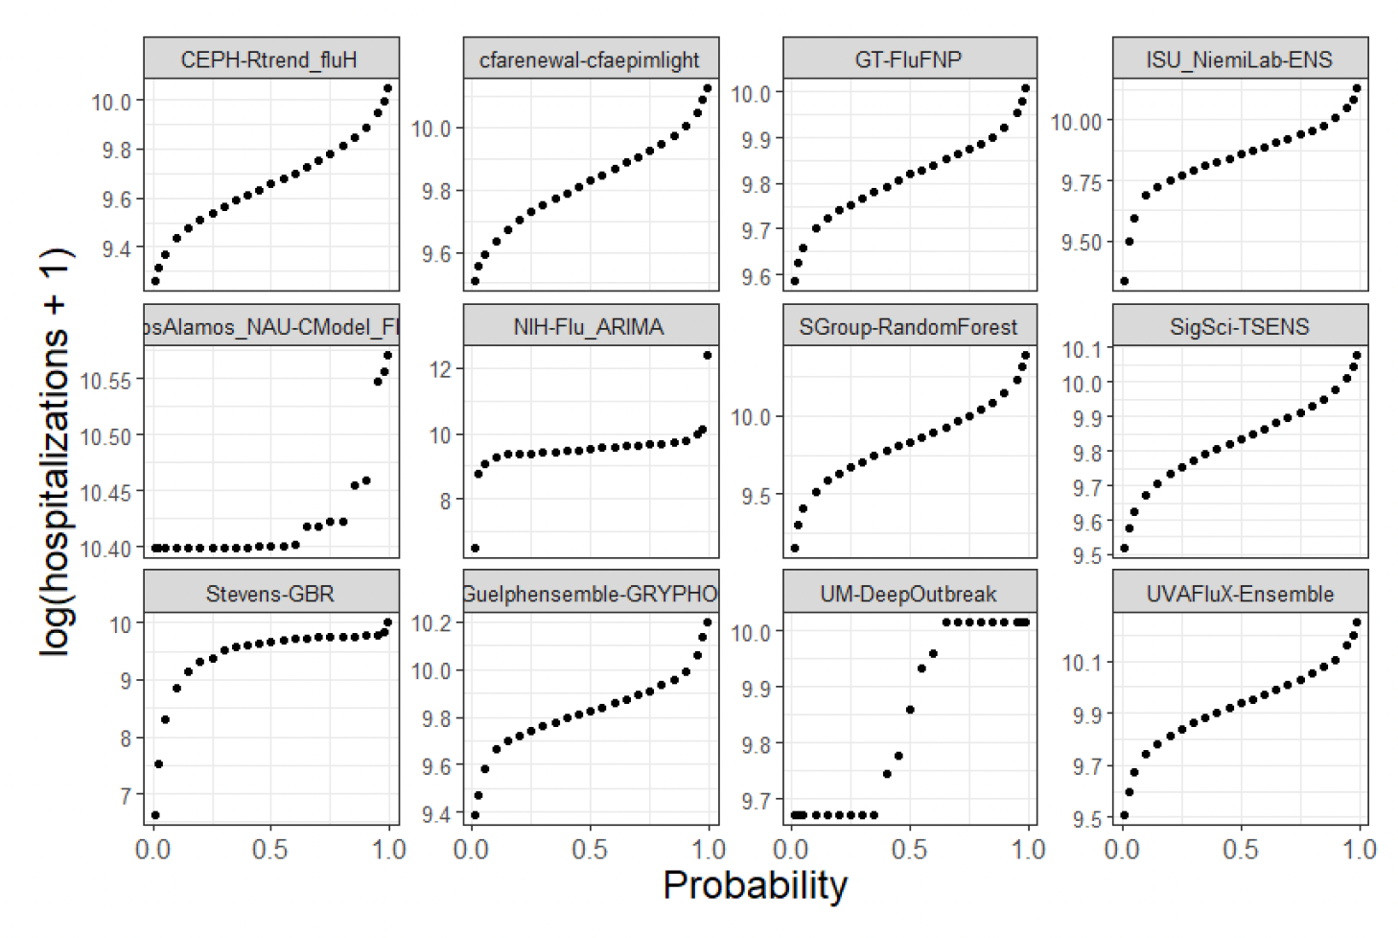
Ensembling
Notes:
Page fades in, red pops up. Only this page

Slide 20
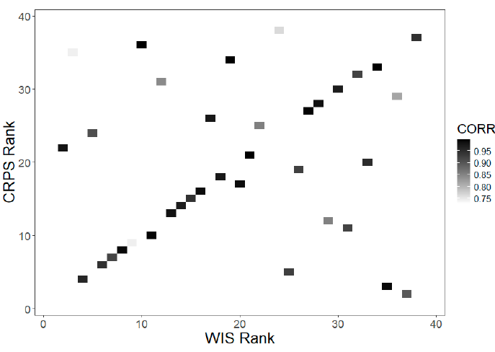
CDC Flu Forecasting Model Rank
Notes:
Page fades in, red pops up. Only this page

Slide 21
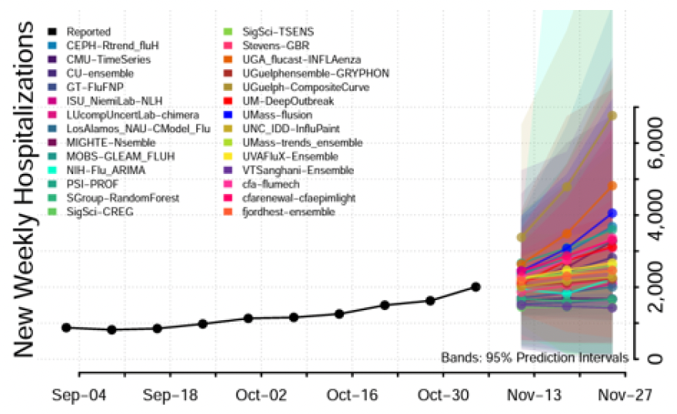
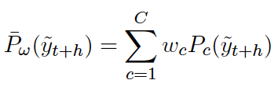
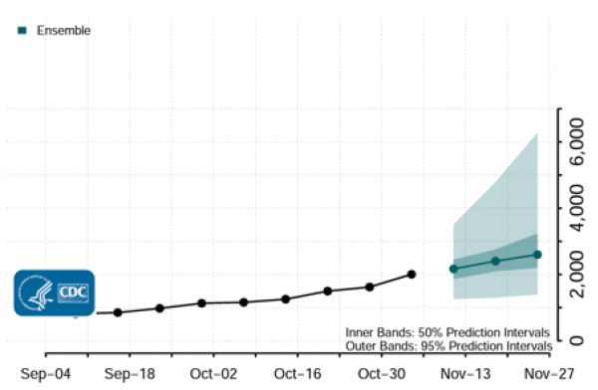
Bayesian Stacking
How can we create better ensemble forecasts?

Slide 22

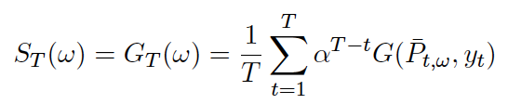
Stacked Gibbs Posterior
posterior
prior
Likelihood?
Discount Factor
CDF of Ensemble
Proper Scoring Rule
Notes:
Page fades in, red pops up. Only this page

Slide 23
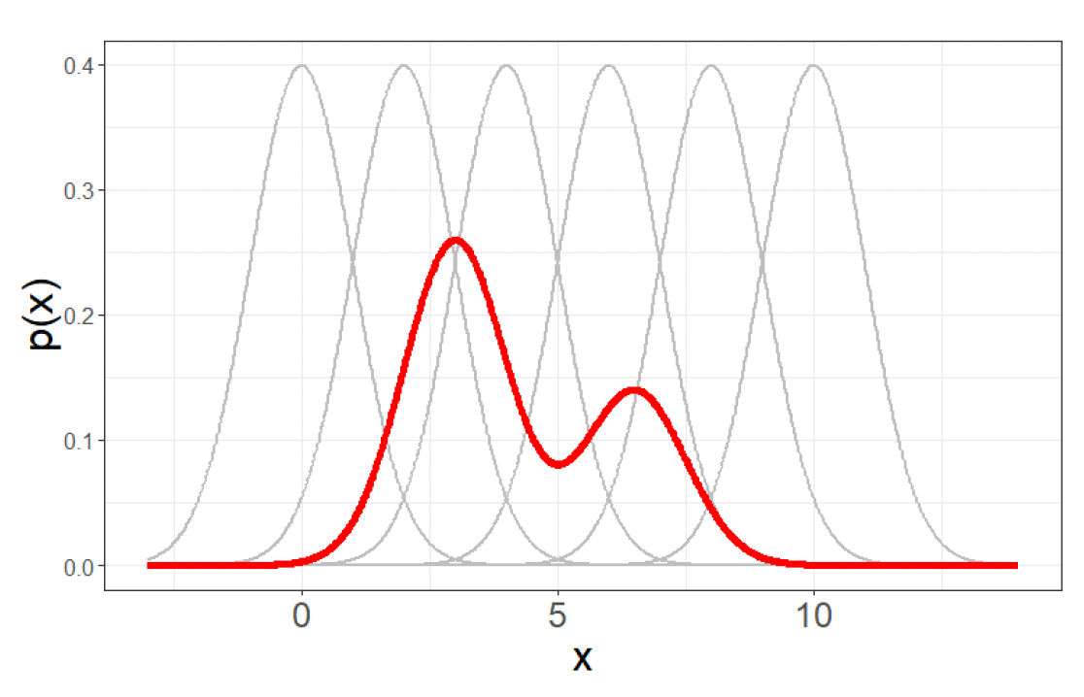
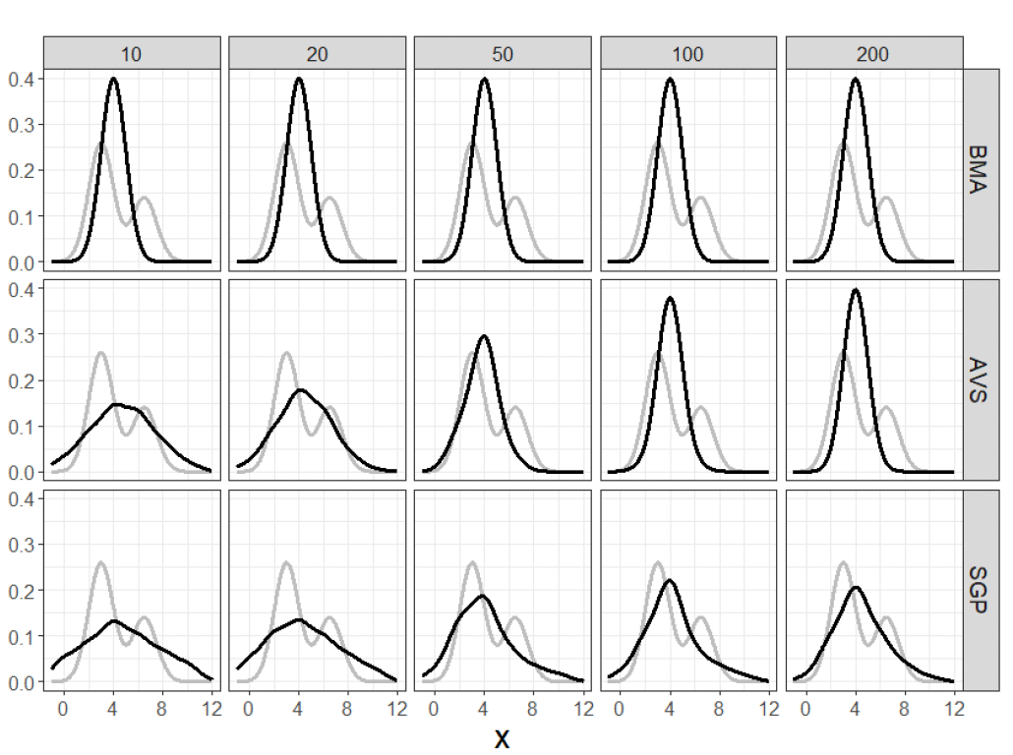
Simulation Study
Notes:
Page fades in, red pops up. Only this page

Slide 24
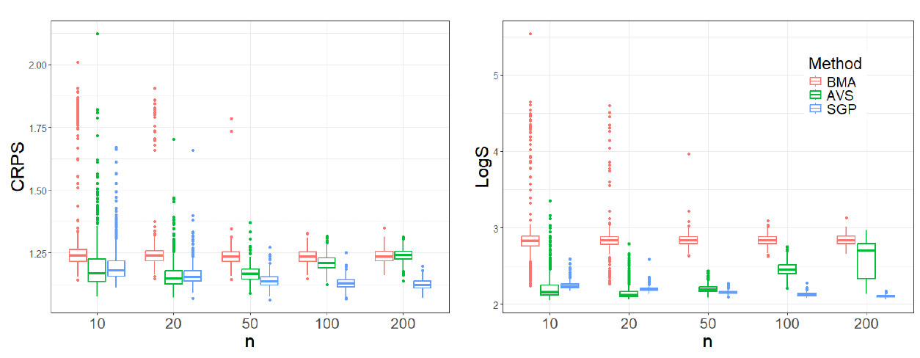
Simulation Study
Notes:
Page fades in, red pops up. Only this page

Slide 25
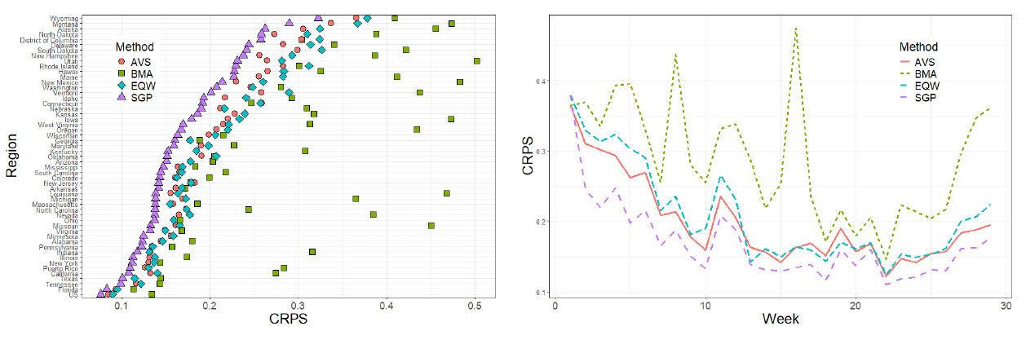
Application
Notes:
Page fades in, red pops up. Only this page

Slide 26
Section Title
This is a content page with a sidebar photo on the right-hand side. This type of page is useful for larger bodies of text, namely paragraph length pieces. Use this type of page for certain types of content such as extended quotes, introductory paragraphs for presentations, and other long-format pieces when absolutely necessary.

Slide 27
Section Title
This is a normal content page. This type of page is useful for bulleted lists.
Information for bullet one
Information for bullet two
Information for bullet three
Information for bullet four

Slide 28
Insert background photo in gray area
“This area is meant to be used for a quote/information of emphasis, preferably no more than two full length sentences.” – Quote Reference Here

Slide 29
Thank You
Jarad Niemi
Professor of Statistics
Professor in Charge of Data Science
niemi@iastate.edu
(515)-294-8679
www.stat.iastate.edu/people/jarad-niemi
Spencer Wadsworth
Visiting Assistant Professor at Carleton College
Postdoctoral Associate w/ Ofer Harel (UConn)
sgw96@iastate.edu
www.stat.iastate.edu/people/spencer-wadsworth
Spencer’s Dissertation: https://dr.lib.iastate.edu/handle/20.500.12876/jw27nbOv
Notes:
New names

