Slide 1

Specifying Prior Distributions in Reliability Applications
Qinglong Tian, Colin Lewis-Beck, Jarad Niemi, and William Meeker

Slide 2
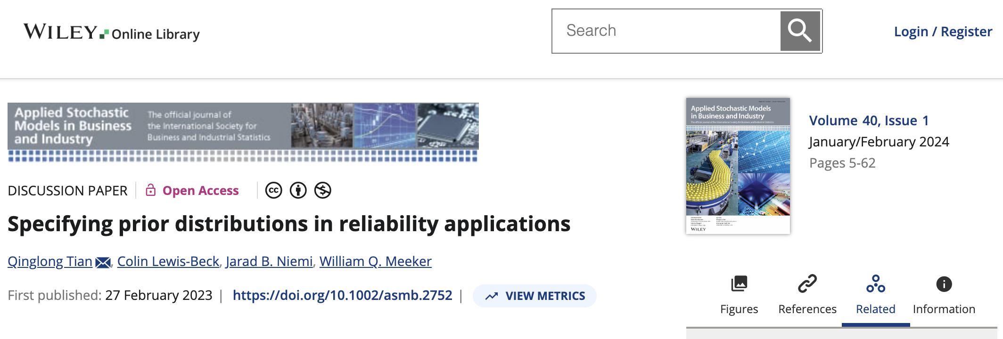

Slide 3




Authors
Qinglong Tian
University of Waterloo
Colin Beck
Google
Jarad Niemi
Iowa State
University
Bill Meeker
Iowa State
University

Slide 4
Aircraft Engine - Bearing Cage Failure
Notes:
Design specifications that the 0.1-quantile was 8000 Hours

Slide 5
Missile – Rocket Motor Failure

Slide 6
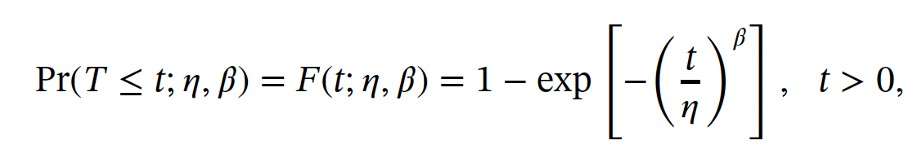


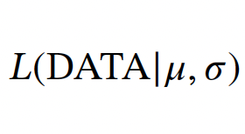
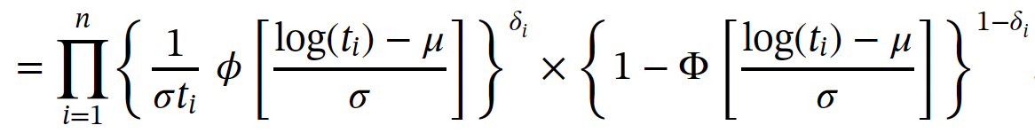
Weibull Distribution
Failure time quantile:
Right-Censored Likelihood
Exact
Right-censored
Notes:
Beta is shape, eta is scale, eta is ~= 0.63 quantile

Slide 7
Weibull Likelihood – Bearing Cage

Slide 8
Weibull Likelihood – Rocket Motor
Notes:
Page fades in, red pops up. Only this page

Slide 9
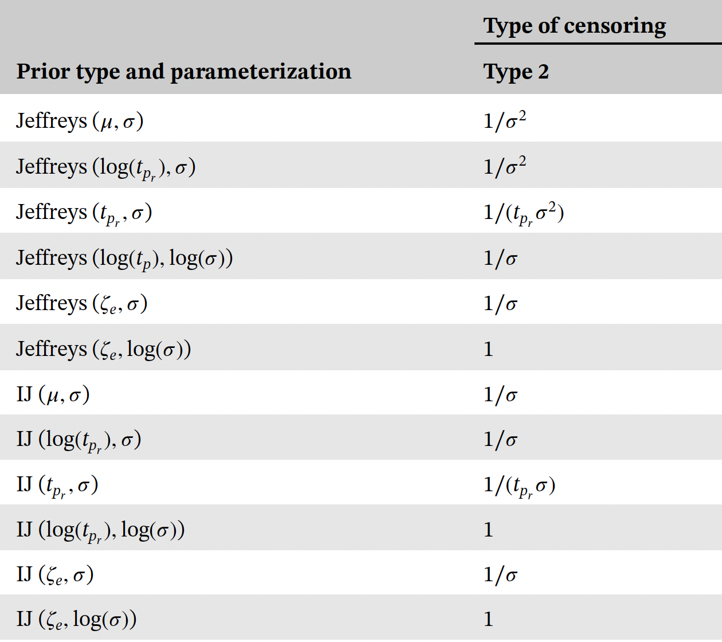
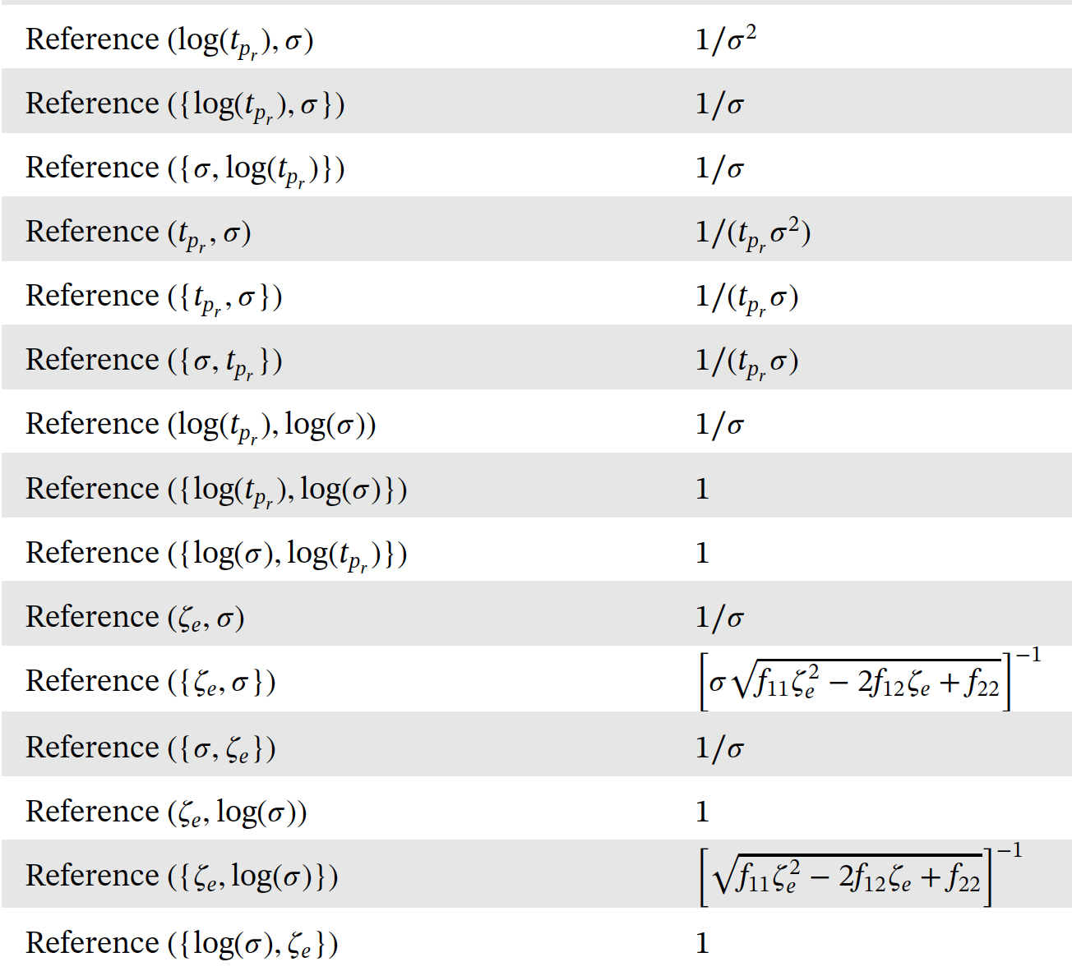
Non-informative Priors

Slide 10
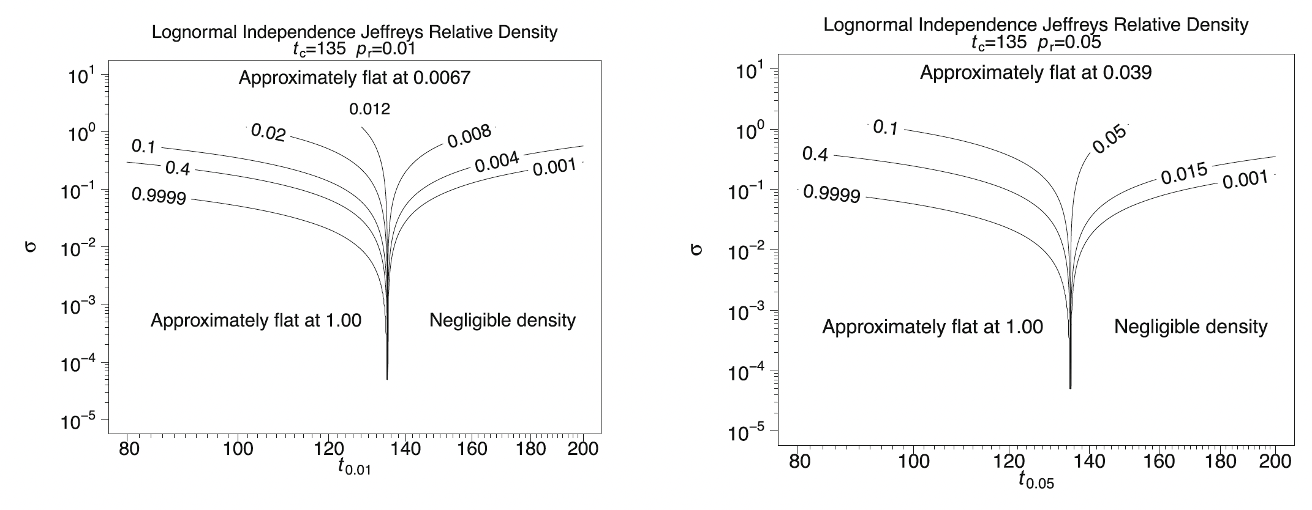
Independent-Jefferys Priors

Slide 11
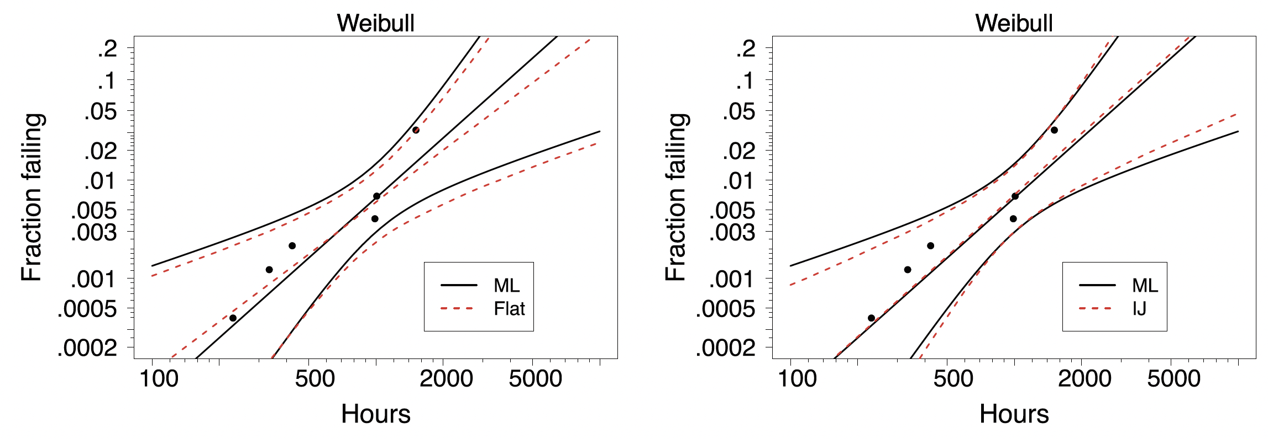
Bearing Cage – Posteriors (default prior)
Notes:
Page fades in, red pops up. Only this page

Slide 12
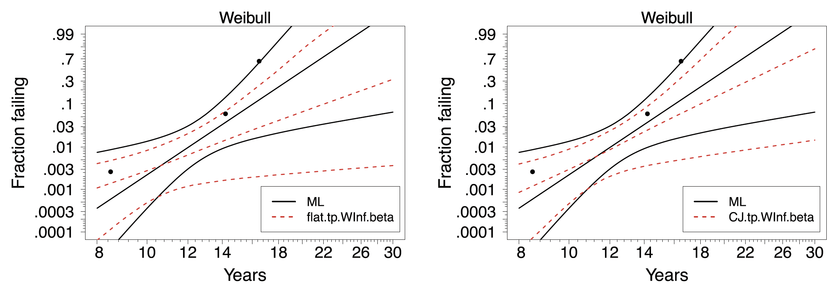
Rocket Motor – Posteriors (weakly informative prior)
Notes:
Page fades in, red pops up. Only this page

Slide 13
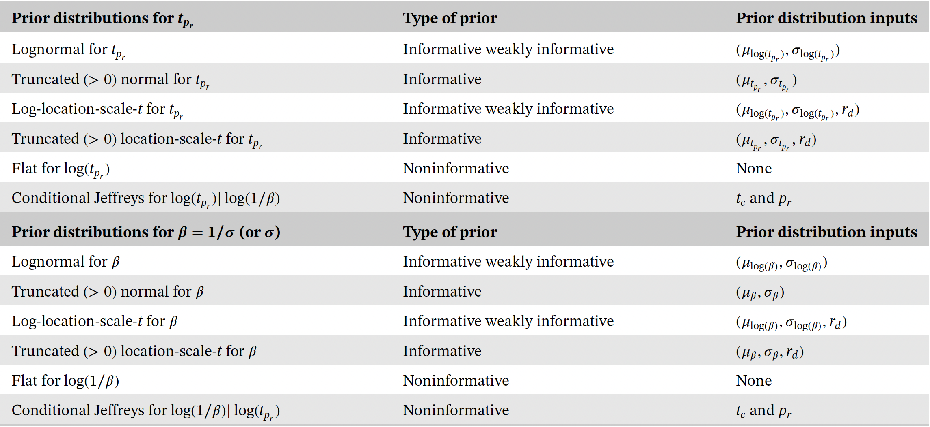
Informative Prior Distributions
Notes:
Page fades in, red pops up. Only this page

Slide 14
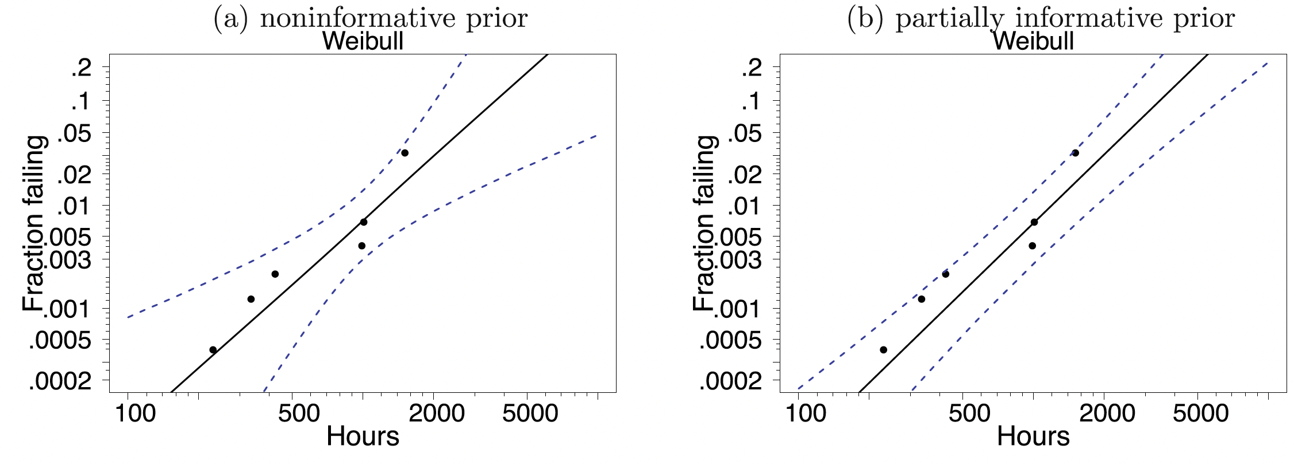
Bearing Cage – Posteriors (Informative Prior)
Notes:
Page fades in, red pops up. Only this page

Slide 15
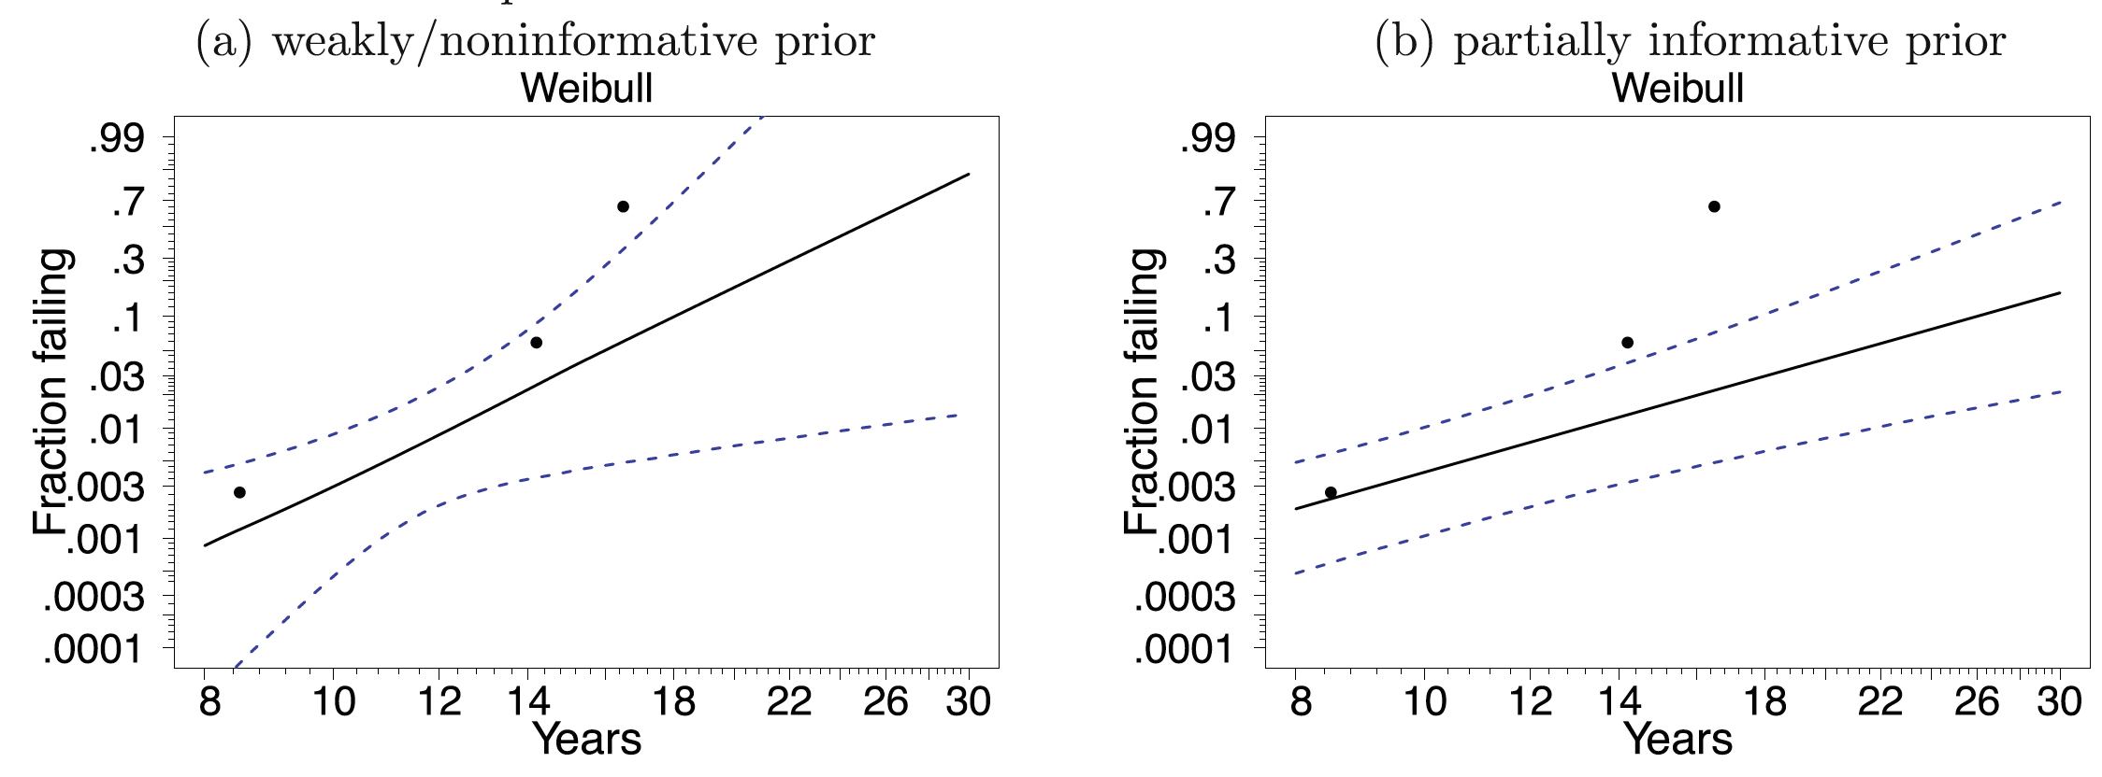
Rocket Motor – Posteriors (Informative Prior)
Notes:
Page fades in, red pops up. Only this page

