Slide 1
Triplet Matching: Propensity Score Matching with 3 Groups
Jaron Arbet

Slide 2
Outline
Review of propensity score matching
Triplet matching
Alternative approaches

Slide 3
Propensity Score Review
Goal: causal inference on a treatment/exposure variable X, observational study
For binary X, PS is “the probability of treatment assignment conditional on observed baseline characteristics” - Austin 2011
PS typically estimated by logistic regression, although machine learning can be used
“Balancing score”: conditional on PS, distribution of baseline covariates should be balanced between treatment groups, similar to an RCT
Austin, Peter C. "An introduction to propensity score methods for reducing the effects of confounding in observational studies." Multivariate behavioral research 46.3 (2011): 399-424.

Slide 4
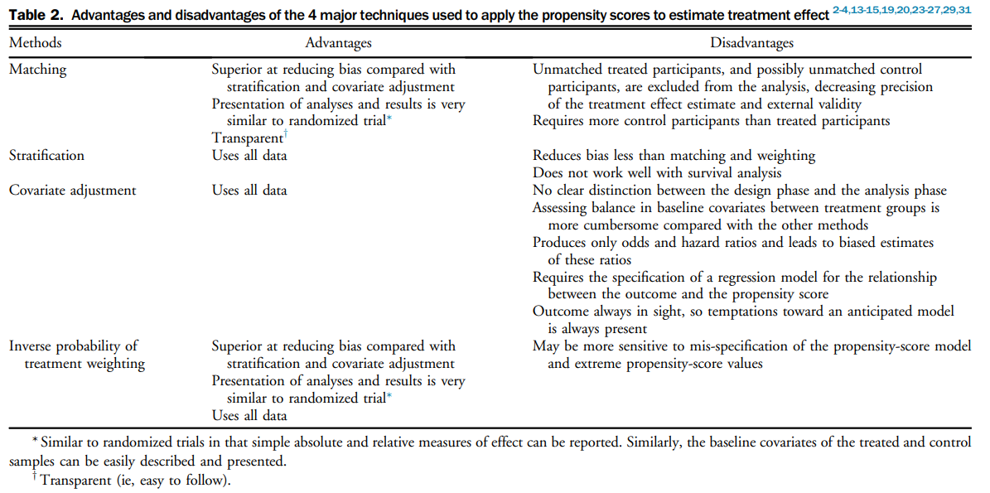
4 main PS methods
For review:
Deb, Saswata, et al. "A review of propensity-score methods and their use in cardiovascular research." Canadian Journal of Cardiology 32.2 (2016): 259-265.
Austin, Peter C. "An introduction to propensity score methods for reducing the effects of confounding in observational studies." Multivariate behavioral research 46.3 (2011): 399-424.

Slide 5
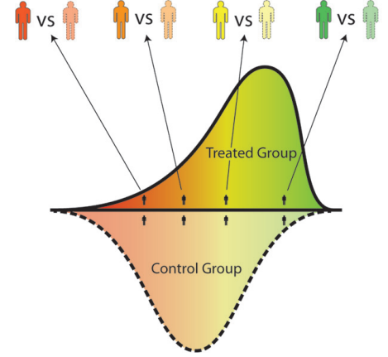
1:1 PS Matching
Can think of PS as a univariate composite summary of all baseline covariates
Matched patients must have similar PS value
McDonald, Robert J., et al. "Behind the numbers: propensity score analysis—a primer for the diagnostic radiologist." Radiology 269.3 (2013): 640-645.

Slide 6
Matching: many choices
Austin 2014 performed extensive simulations and made the following recommendations:
Optimal vs greedy nearest neighbor matching?
Caliper or no caliper?
Match with or without replacement?
Order in which treated subjects are selected (e.g. lowest to highest propensity score, highest to lowest propensity score, best match first, or random order)
Austin, Peter C. "A comparison of 12 algorithms for matching on the propensity score." Statistics in medicine 33.6 (2014): 1057-1069.

Slide 7
Triplet Matching

Slide 8
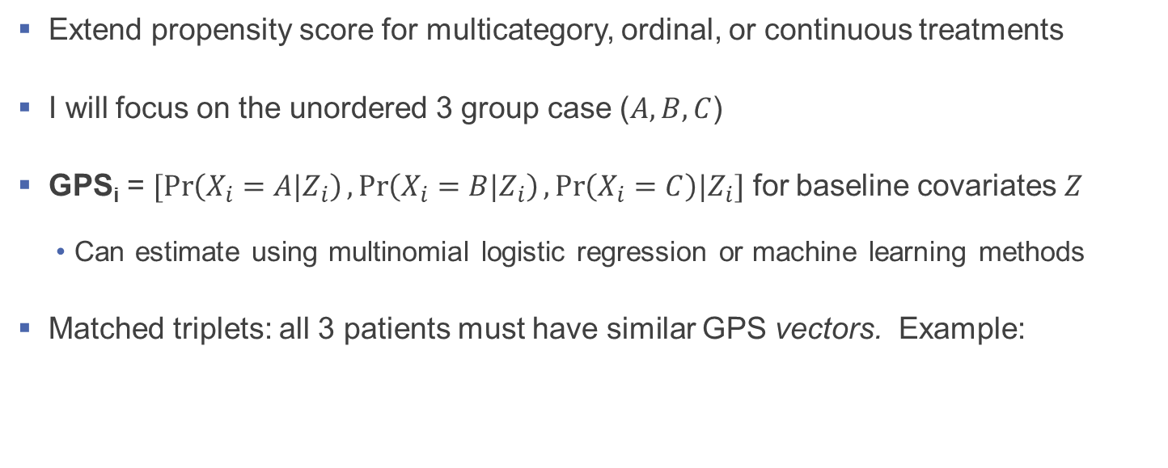
Generalized propensity score (GPS)
Extend propensity score for multicategory, ordinal, or continuous treatments
I will focus on the unordered 3 group case ($A, B, C$)
GPS_{i} = $[\operatorname{Pr}\left(X_{i}=A|Z_{i}\right),\operatorname{Pr}\left(X_{i}=B|Z_{i}\right),\operatorname{Pr}\left(X_{i}=C\right)|Z_{i}]$ for baseline covariates $Z$
Can estimate using multinomial logistic regression or machine learning methods
Matched triplets: all 3 patients must have similar GPS vectors. Example:
Subject | True Group | Pr(X=A|Z) | Pr(X=B|Z) | Pr(X=C|Z)
1 | A | 0.30 | 0.60 | 0.10
2 | B | 0.29 | 0.59 | 0.12
3 | C | 0.31 | 0.61 | 0.08
Imai, Kosuke, and David A. Van Dyk. "Causal inference with general treatment regimes: Generalizing the propensity score." Journal of the American Statistical Association 99.467 (2004): 854-866.

Slide 9
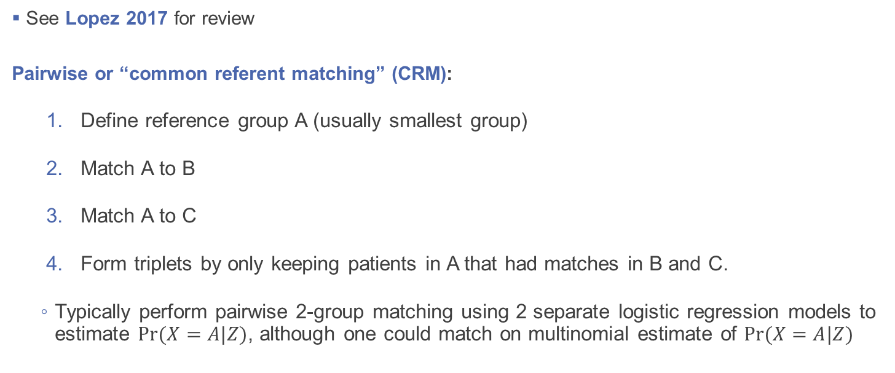
Matching with 3 groups
See Lopez 2017 for review
Pairwise or “common referent matching” (CRM):
Define reference group A (usually smallest group)
Match A to B
Match A to C
Form triplets by only keeping patients in A that had matches in B and C.
Typically perform pairwise 2-group matching using 2 separate logistic regression models to estimate $Pr⁡(X=A|Z)$, although one could match on multinomial estimate of $Pr⁡(X=A|Z)$
B
A
C
Lopez, Michael J., and Roee Gutman. "Estimation of causal effects with multiple treatments: a review and new ideas." Statistical Science (2017): 432-454.

Slide 10
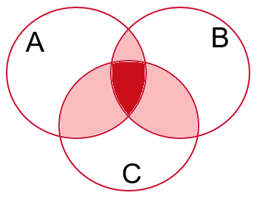
Pairwise matching
Pros:
Straightforward to implement using existing 2-group matching software (e.g. SAS PSMATCH, or R packages MatchIt, matching)
Cons:
Lopez 2017 argues that “transitive property” not guaranteed: even if covariates are balanced for A vs B and A vs C, it’s possible that B vs C is unbalanced
Lopez, Michael J., and Roee Gutman. "Estimation of causal effects with multiple treatments: a review and new ideas." Statistical Science (2017): 432-454.

Slide 11
Example
“Real World Outcomes of TAVR with the SAPIEN-3 Valve in Intermediate Risk Patients: Comparison of Data from the TVT Registry with PARTNER S3 Studies” 2018 https://www.tctmd.com/slide/real-world-outcomes-tavr-sapien-3-valve-intermediate-risk-patients-comparison-data-tvt
Patients with severe aortic stenosis, intermediate surgical risk (IR), treated with SAPIEN 3 TAVR
The PARTNER II S3i trial demonstrated safety and efficacy
It remains unknown whether TAVR with the S3 valve can be performed with similar safety and efficacy in real-world practice
Goal: compare 30-day outcomes in IR patients from 3 data sources: S3i trial, S3i continued access registry (S3iCAP), ACC/STS Transcatheter Valve Therapeutics Registry (TVT-R). Use pairwise triplet matching to adjust for baseline covariates

Slide 12
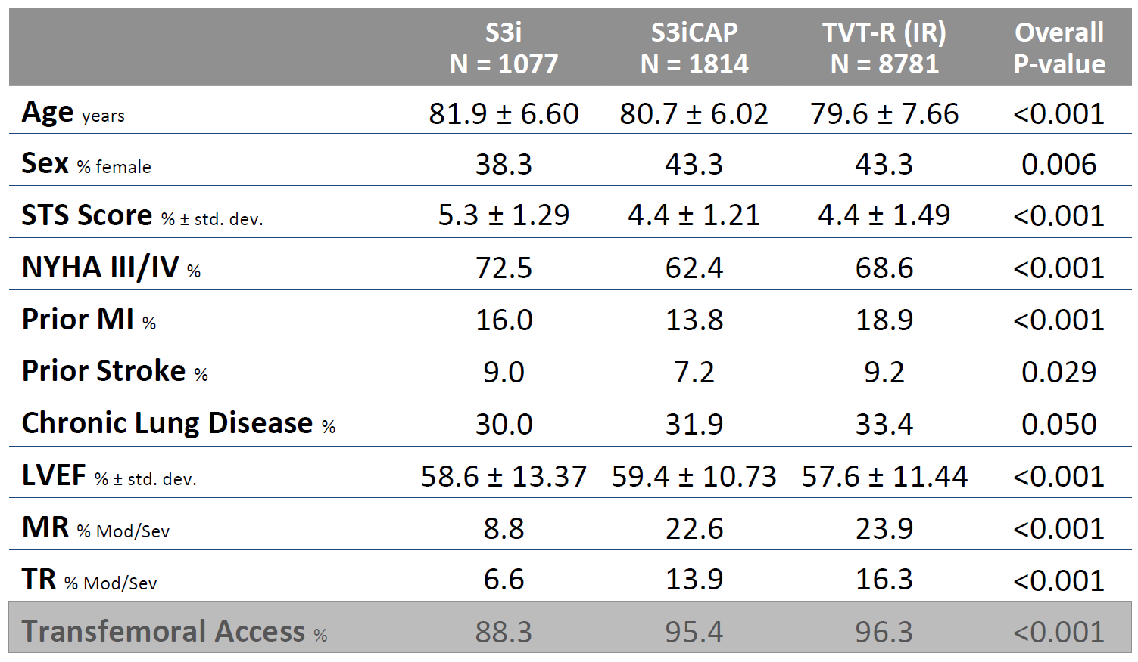
Baseline characteristics
*
* did not match on STS Score, since one of the outcomes of interest was 30 day O:E ratio (observed 30 day mortality rate / STS score)
https://www.tctmd.com/slide/real-world-outcomes-tavr-sapien-3-valve-intermediate-risk-patients-comparison-data-tvt

Slide 13
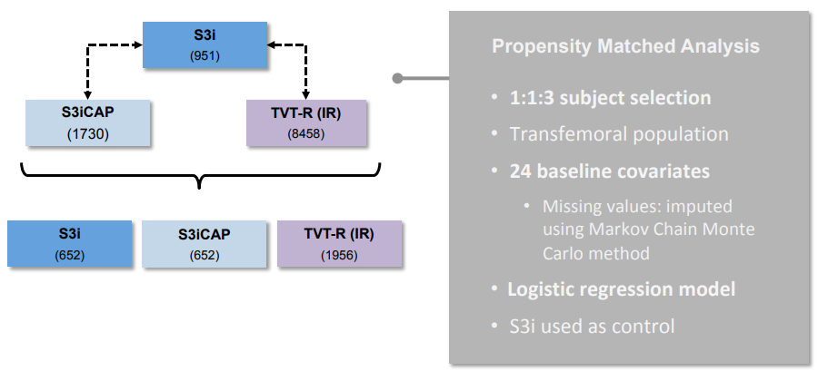
Pairwise Triplet Matching
https://www.tctmd.com/slide/real-world-outcomes-tavr-sapien-3-valve-intermediate-risk-patients-comparison-data-tvt

Slide 14
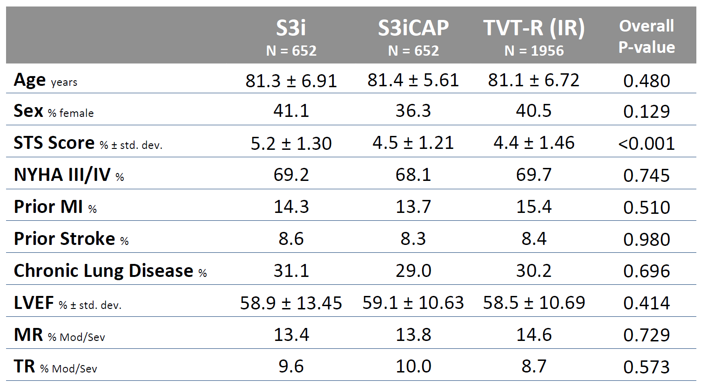
Baseline characteristics after matching
*
* did not match on STS Score, since one of the outcomes of interest was 30 day O:E ratio (observed 30 day mortality rate / STS score)
https://www.tctmd.com/slide/real-world-outcomes-tavr-sapien-3-valve-intermediate-risk-patients-comparison-data-tvt

Slide 15
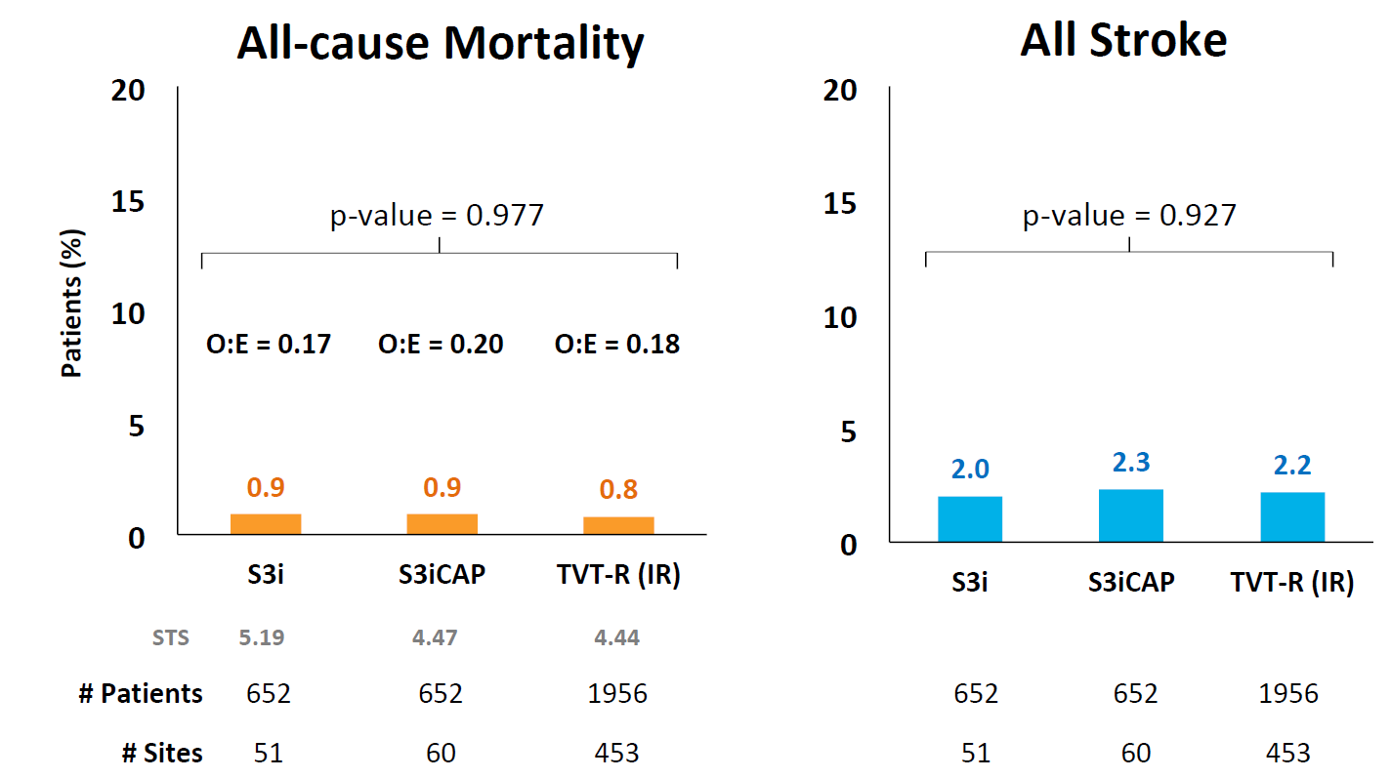
Results
Conclusion: after propensity matching, the 3 data sources (clinical and real world data) are comparable for the outcomes of interest
https://www.tctmd.com/slide/real-world-outcomes-tavr-sapien-3-valve-intermediate-risk-patients-comparison-data-tvt

Slide 16
Simultaneous matching
Simultaneously form triplets that are close on all 3 elements of GPS vector
How to define “close”?
One could constrain the total distance between each pair of vectors, or the sum
Instead, I used 3 separate “caliper widths” to ensure all patients within a triplet are close on each element of the GPS vector
Pro: unlike Pairwise, one can directly control distance between each element of GPS vector, which may lead to better covariate balance
Con: more computationally challenging to implement, limited available software

Slide 17
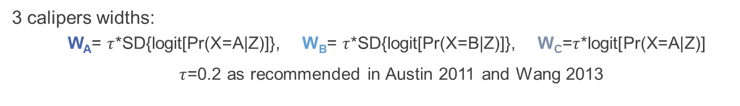
3 calipers widths:
W_{A}= $τ$*SD{logit[Pr(X=A|Z)]}, W_{B}= $τ$*SD{logit[Pr(X=B|Z)]}, W_{C}=$τ$*logit[Pr(X=A|Z)]
$τ$=0.2 as recommended in Austin 2011 and Wang 2013
Subject: 1
2
3
LPr(X₁=A|Z₁)
LPr(X₁=B|Z₁)
LPr(X₁=C|Z₁)
<W_{A}
<W_{B}
<W_{C}
LPr(X₂=A|Z₂)
LPr(X₂=B|Z₂)
<W_{B}
LPr(X₂=C|Z₂)
<W_{A}
<W_{A}
<W_{B}
<W_{C}
LPr(X₃=A|Z₃)
LPr(X₃=B|Z₃)
LPr(X₃=C|Z₃)
Austin, Peter C. "Optimal caliper widths for propensity‐score matching when estimating differences in means and differences in proportions in observational studies." Pharmaceutical statistics 10.2 (2011): 150-161. Wang, Yongji, et al. "Optimal caliper width for propensity score matching of three treatment groups: a Monte Carlo study." PloS one 8.12 (2013): e81045.

Slide 18
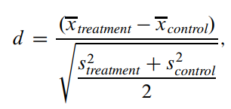
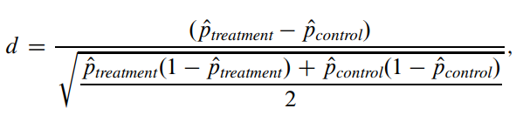
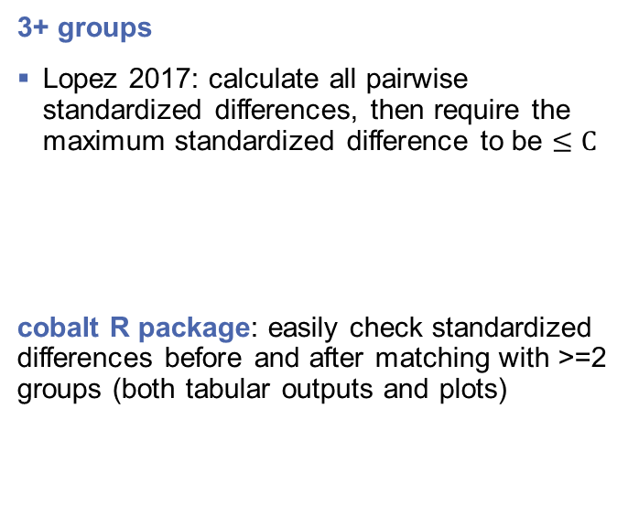
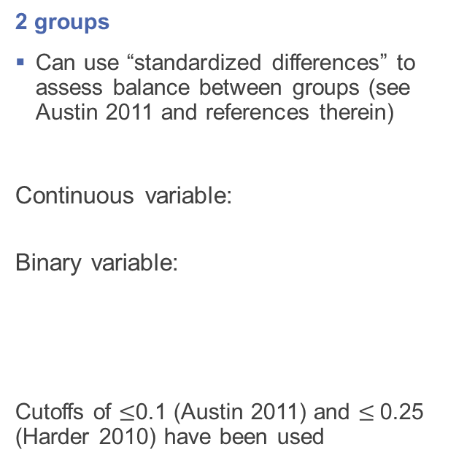
Checking covariate balance
2 groups
Can use “standardized differences” to assess balance between groups (see Austin 2011 and references therein)
Continuous variable:
Binary variable:
Cutoffs of $≤$0.1 (Austin 2011) and $≤$0.25 (Harder 2010) have been used
3+ groups
Lopez 2017: calculate all pairwise standardized differences, then require the maximum standardized difference to be $≤C$
cobalt R package: easily check standardized differences before and after matching with >=2 groups (both tabular outputs and plots)
Austin, Peter C. "An introduction to propensity score methods for reducing the effects of confounding in observational studies." Multivariate behavioral research 46.3 (2011): 399-424. Harder, Valerie S., Elizabeth A. Stuart, and James C. Anthony. "Propensity score techniques and the assessment of measured covariate balance to test causal associations in psychological research." Psychological methods 15.3 (2010): 234. Lopez, Michael J., and Roee Gutman. "Estimation of causal effects with multiple treatments: a review and new ideas." Statistical Science (2017): 432-454.

Slide 19
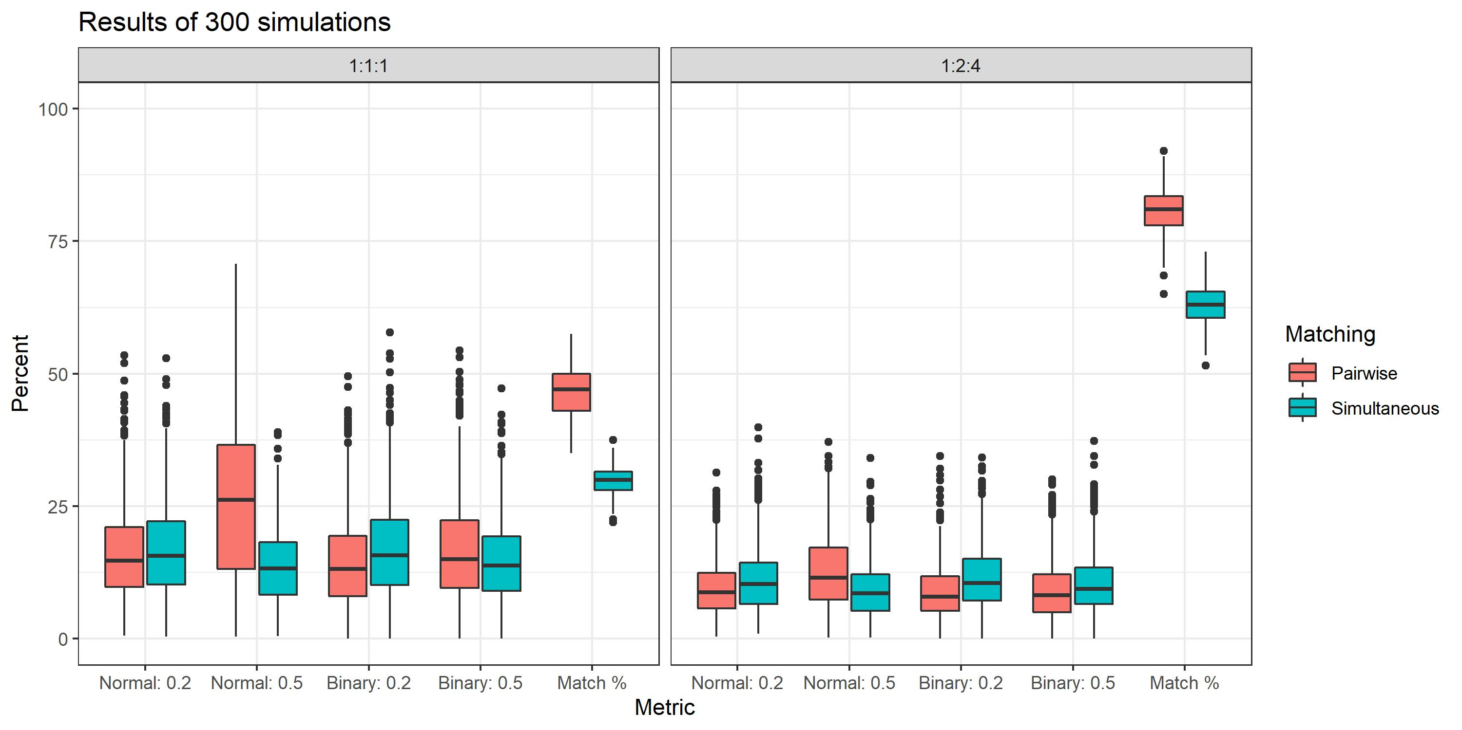
Simulations: Pairwise vs Simultaneous matching
Pairwise results in better Match % (% matched in smallest group)
Other boxplots show standardized diffs after matching (lower=better) for Normal & Binary covariates, simulated with standardized diffs of 0.2 or 0.5. Simultaneous is better for Normal 0.5

Slide 20
Alternative approaches
Weighting:
weightit R package supports 3+ groups and can check covariate balance using cobalt R package
Lu 2019: “Propensity score inverse weighting and regression approaches… are generally not optimal for use in pre-market medical device applications…”
Stratification:
How to stratify on a multivariate vector (GPS)? Imai 2004 and Brown 2020
Lopez 2017 proposes a clustering + stratified pair matching approach (no code)
Brown, Derek W., et al. "A novel approach for propensity score matching and stratification for multiple treatments: Application to an electronic health record–derived study." Statistics in medicine 39.17 (2020): 2308-2323.
Imai, Kosuke, and David A. Van Dyk. "Causal inference with general treatment regimes: Generalizing the propensity score." Journal of the American Statistical Association 99.467 (2004): 854-866.
Lu, Nelson, Yunling Xu, and Lilly Q. Yue. "Good statistical practice in utilizing real-world data in a comparative study for premarket evaluation of medical devices." Journal of biopharmaceutical statistics 29.4 (2019): 580-591. Lopez, Michael J., and Roee Gutman. "Estimation of causal effects with multiple treatments: a review and new ideas." Statistical Science (2017): 432-454.

Slide 21
Conclusion
One can easily implement pairwise matching in practice and use when covariate balance is achieved (e.g. max standardized pairwise diff < 0.1 or 0.25)
Simultaneous matching may be better in theory, but need more research and software development
Nattino 2021 seems promising
Nattino, Giovanni, et al. "Triplet matching for estimating causal effects with three treatment arms: a comparative study of mortality by trauma center level." Journal of the American Statistical Association 116.533 (2021): 44-53.

Slide 22
References
Austin, Peter C. "Optimal caliper widths for propensity‐score matching when estimating differences in means and differences in proportions in observational studies." Pharmaceutical statistics 10.2 (2011): 150-161.
Austin, Peter C. "An introduction to propensity score methods for reducing the effects of confounding in observational studies." Multivariate behavioral research 46.3 (2011): 399-424.
Austin, Peter C. "A comparison of 12 algorithms for matching on the propensity score." Statistics in medicine 33.6 (2014): 1057-1069.
Brown, Derek W. Austin, Peter C. "A comparison of 12 algorithms for matching on the propensity score." Statistics in medicine 33.6 (2014): 1057-1069., et al. "A novel approach for propensity score matching and stratification for multiple treatments: Application to an electronic health record–derived study." Statistics in medicine 39.17 (2020): 2308-2323.
Deb, Saswata, et al. "A review of propensity-score methods and their use in cardiovascular research." Canadian Journal of Cardiology 32.2 (2016): 259-265.
Harder, Valerie S., Elizabeth A. Stuart, and James C. Anthony. "Propensity score techniques and the assessment of measured covariate balance to test causal associations in psychological research." Psychological methods 15.3 (2010): 234.
Imai, Kosuke, and David A. Van Dyk. "Causal inference with general treatment regimes: Generalizing the propensity score." Journal of the American Statistical Association 99.467 (2004): 854-866.
McDonald, Robert J., et al. "Behind the numbers: propensity score analysis—a primer for the diagnostic radiologist." Radiology 269.3 (2013): 640-645.
Nattino, Giovanni, et al. "Triplet matching for estimating causal effects with three treatment arms: a comparative study of mortality by trauma center level." Journal of the American Statistical Association 116.533 (2021): 44-53.
Lopez, Michael J., and Roee Gutman. "Estimation of causal effects with multiple treatments: a review and new ideas." Statistical Science (2017): 432-454.
Lu, Nelson, Yunling Xu, and Lilly Q. Yue. "Good statistical practice in utilizing real-world data in a comparative study for premarket evaluation of medical devices." Journal of biopharmaceutical statistics 29.4 (2019): 580-591. Lopez, Michael J., and Roee Gutman. "Estimation of causal effects with multiple treatments: a review and new ideas." Statistical Science (2017): 432-454.
Ternacle, Julien, et al. "Impact of Predilation During Transcatheter Aortic Valve Replacement: Insights From the PARTNER 3 Trial." Circulation: Cardiovascular Interventions 14.7 (2021): e010336.
Wang, Yongji, et al. "Optimal caliper width for propensity score matching of three treatment groups: a Monte Carlo study." PloS one 8.12 (2013): e81045.

