Slide 1
Analyzing multi-omics cancer data
Jaron Arbet

Slide 2
Contents
TCGA data
Exploratory dimension reduction
Machine learning for survival data

Slide 3
TCGA
The Cancer Genome Atlas Program

Slide 4
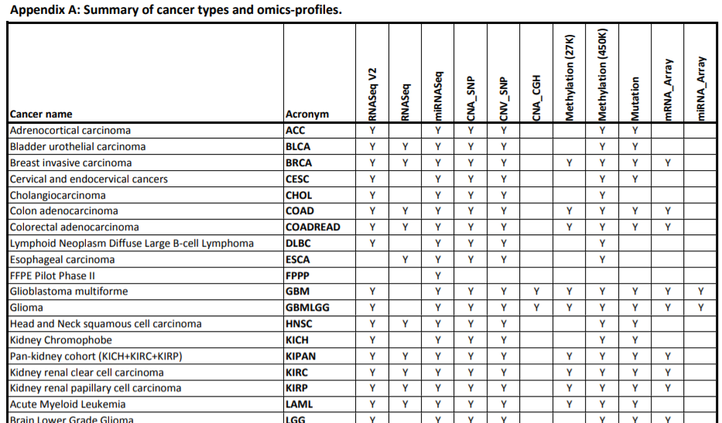
TCGA2STAT R package¹: available cancer types and omics data
~90% of kidney cancers are renal cell carcinoma (RCC)²
~70% of RCC are “clear cell” type²
¹ Wan et al "TCGA2STAT: simple TCGA data access for integrated statistical analysis in R." Bioinformatics 32.6 (2016): 952-954. http://www.liuzlab.org/TCGA2STAT/
² https://www.cancer.org/cancer/kidney-cancer/about/what-is-kidney-cancer.html

Slide 5
RNA-Seq Gene Expression
Download raw counts: TCGA2STAT::getTCGA(disease=“KIRC”, data.type="RNASeq", type="count", clinical=T)
Remove low expressed genes: edgeR::filterByExpr()
Normalize using TMM (trimmed mean of M-values) and log-CPM (edgeR package)
207 samples, 16518 genes
Why TMM? Comparison of 7 normalization methods¹ found only TMM and DESeq robust to heterogeneity in library size and composition; controlled FPR while maintaining power
¹ Dillies et al. "A comprehensive evaluation of normalization methods for Illumina high-throughput RNA seq..." Briefings in bioinformatics 14.6 (2013): 671-683.

Slide 6
DNA Methylation
Clinical data
Download beta values: TCGA2STAT:: getTCGA(disease==“KIRC”, data.type="Methylation", type="27K")
Remove features with missing values
Age at diagnosis
Time until death (or censoring)
Cancer stage (1-4)
Gender
Race
Total data: 207 samples with 16518 genes and 23166 CGs (39684 features)

Slide 7
Exploratory dimension reduction

Slide 8
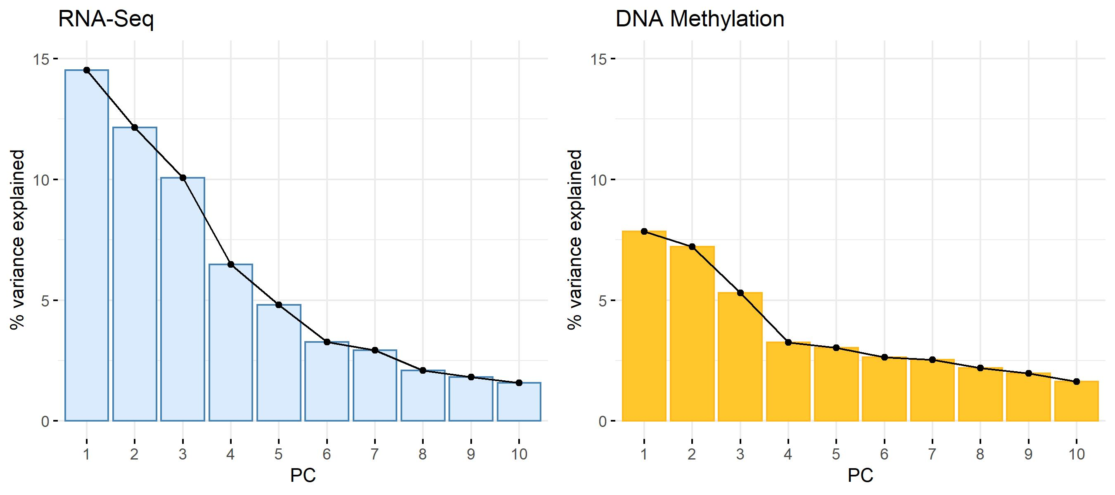
Principal component analysis (PCA)

Slide 9
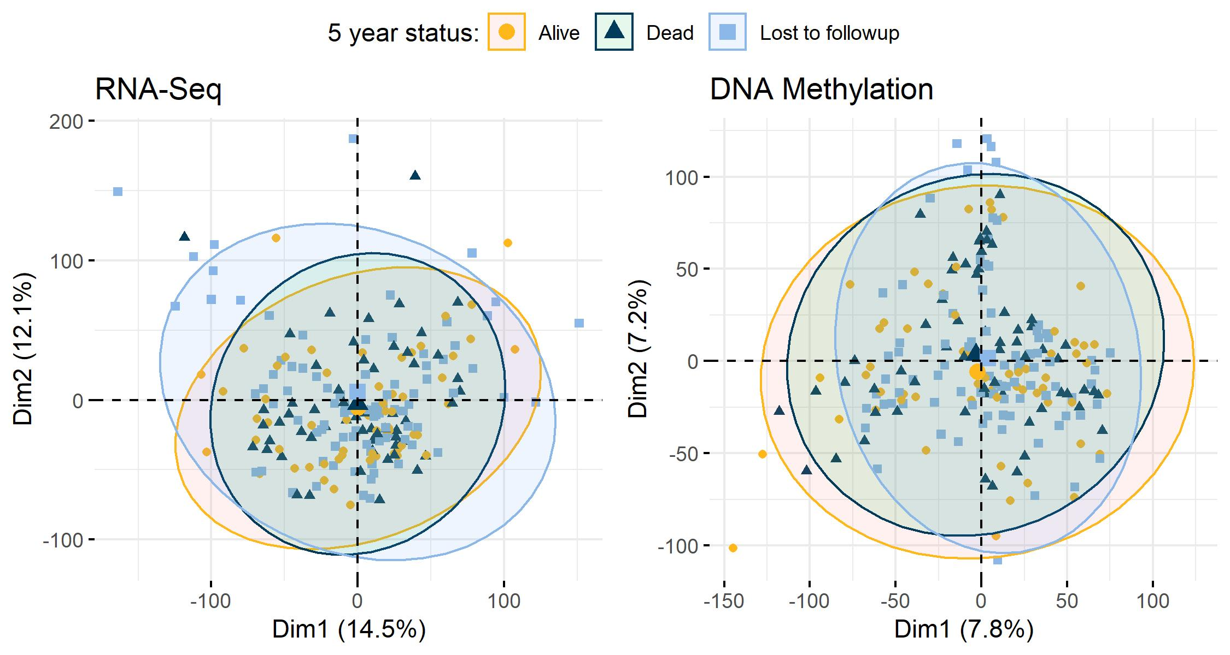
Principal component analysis (PCA)

Slide 10
Association between genes and CGs
Partial least squares (PLS) and Canonical Correlation Analysis (CCA)
Identify correlated sets of features between multi-omics data types
Derives “latent features” that are linear combinations of original features
Features are assigned weights to maximize the covariance (PLS) or correlation (CCA) between new latent features
“sparse” versions perform variable selection

Slide 11










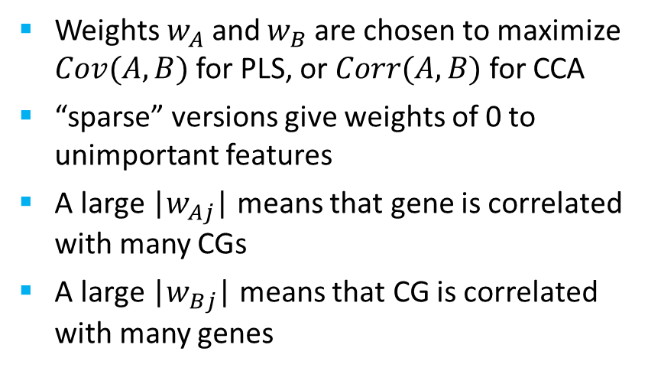
A
B
Gene 1
CG 1
$w_{A1}$* Gene 1
$w_{B1}$* CG 1
Create new latent features A and B (linear combos of original features)
Gene 2
CG 1
$w_{A2}$* Gene 2
$w_{B2}$* CG 2
Gene 3
CG 3
$w_{A3}$* Gene 3
$w_{B3}$* CG 3
$$⋮$$
$$⋮$$
$$⋮$$
$$⋮$$
Could look at pairwise correlations, not feasible in high dimensions (e.g. 10k genes vs 10k CGs = 100 million correlations between data types)
Weights $w_{A}$ and $w_{B}$ are chosen to maximize $Cov(A, B)$ for PLS, or $Corr(A,B)$ for CCA
“sparse” versions give weights of 0 to unimportant features
A large |$w_{Aj}$| means that gene is correlated with many CGs
A large |$w_{Bj}$| means that CG is correlated with many genes

Slide 12
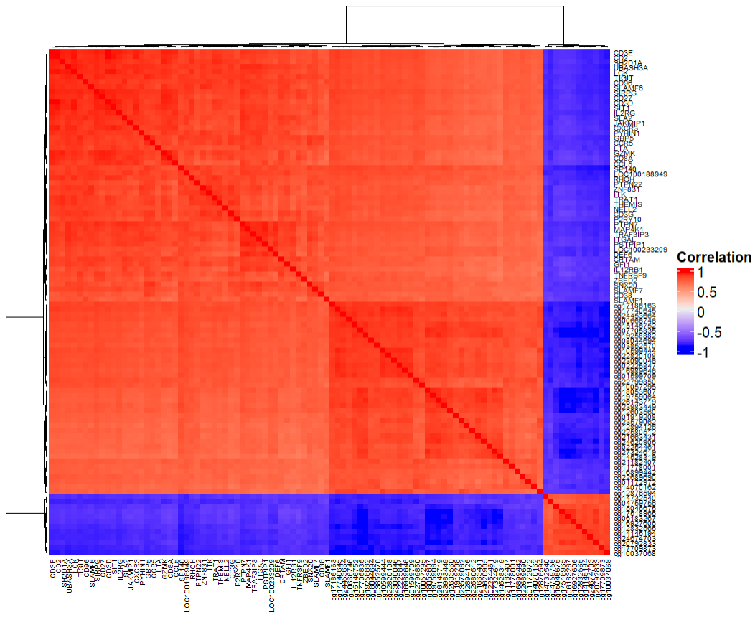
sPLS Results
mixOmics R package
Must specify # latent features (LFs) and # variables for each LF
For exploratory purposes, I chose 1 LF, with 50 genes and 50 CGs
Spearman correlation heatmap of the 100 selected variables:

Slide 13
Positively correlated gene expression

Slide 14
Positively correlated genes-CGs

Slide 15
Negatively correlated genes-CGs

Slide 16
Positively correlated CGs

Slide 17
Negatively correlated DM

Slide 18
Extensions and other ideas for sPLS/CCA
Supervised sPLS/CCA: latent feature weights are chosen to maximize covariance/correlation between multi-omics data types and with an outcome (mixOmics and PMA R packages)
Use unsupervised sPLS/CCA as a filtering step before network analysis (e.g. WGCNA)
Dimension reduction: only keep top X variables with non-zero weights
Pathway enrichment analysis to assess functional importance of any “modules”

Slide 19
Machine learning with survival data

Slide 20
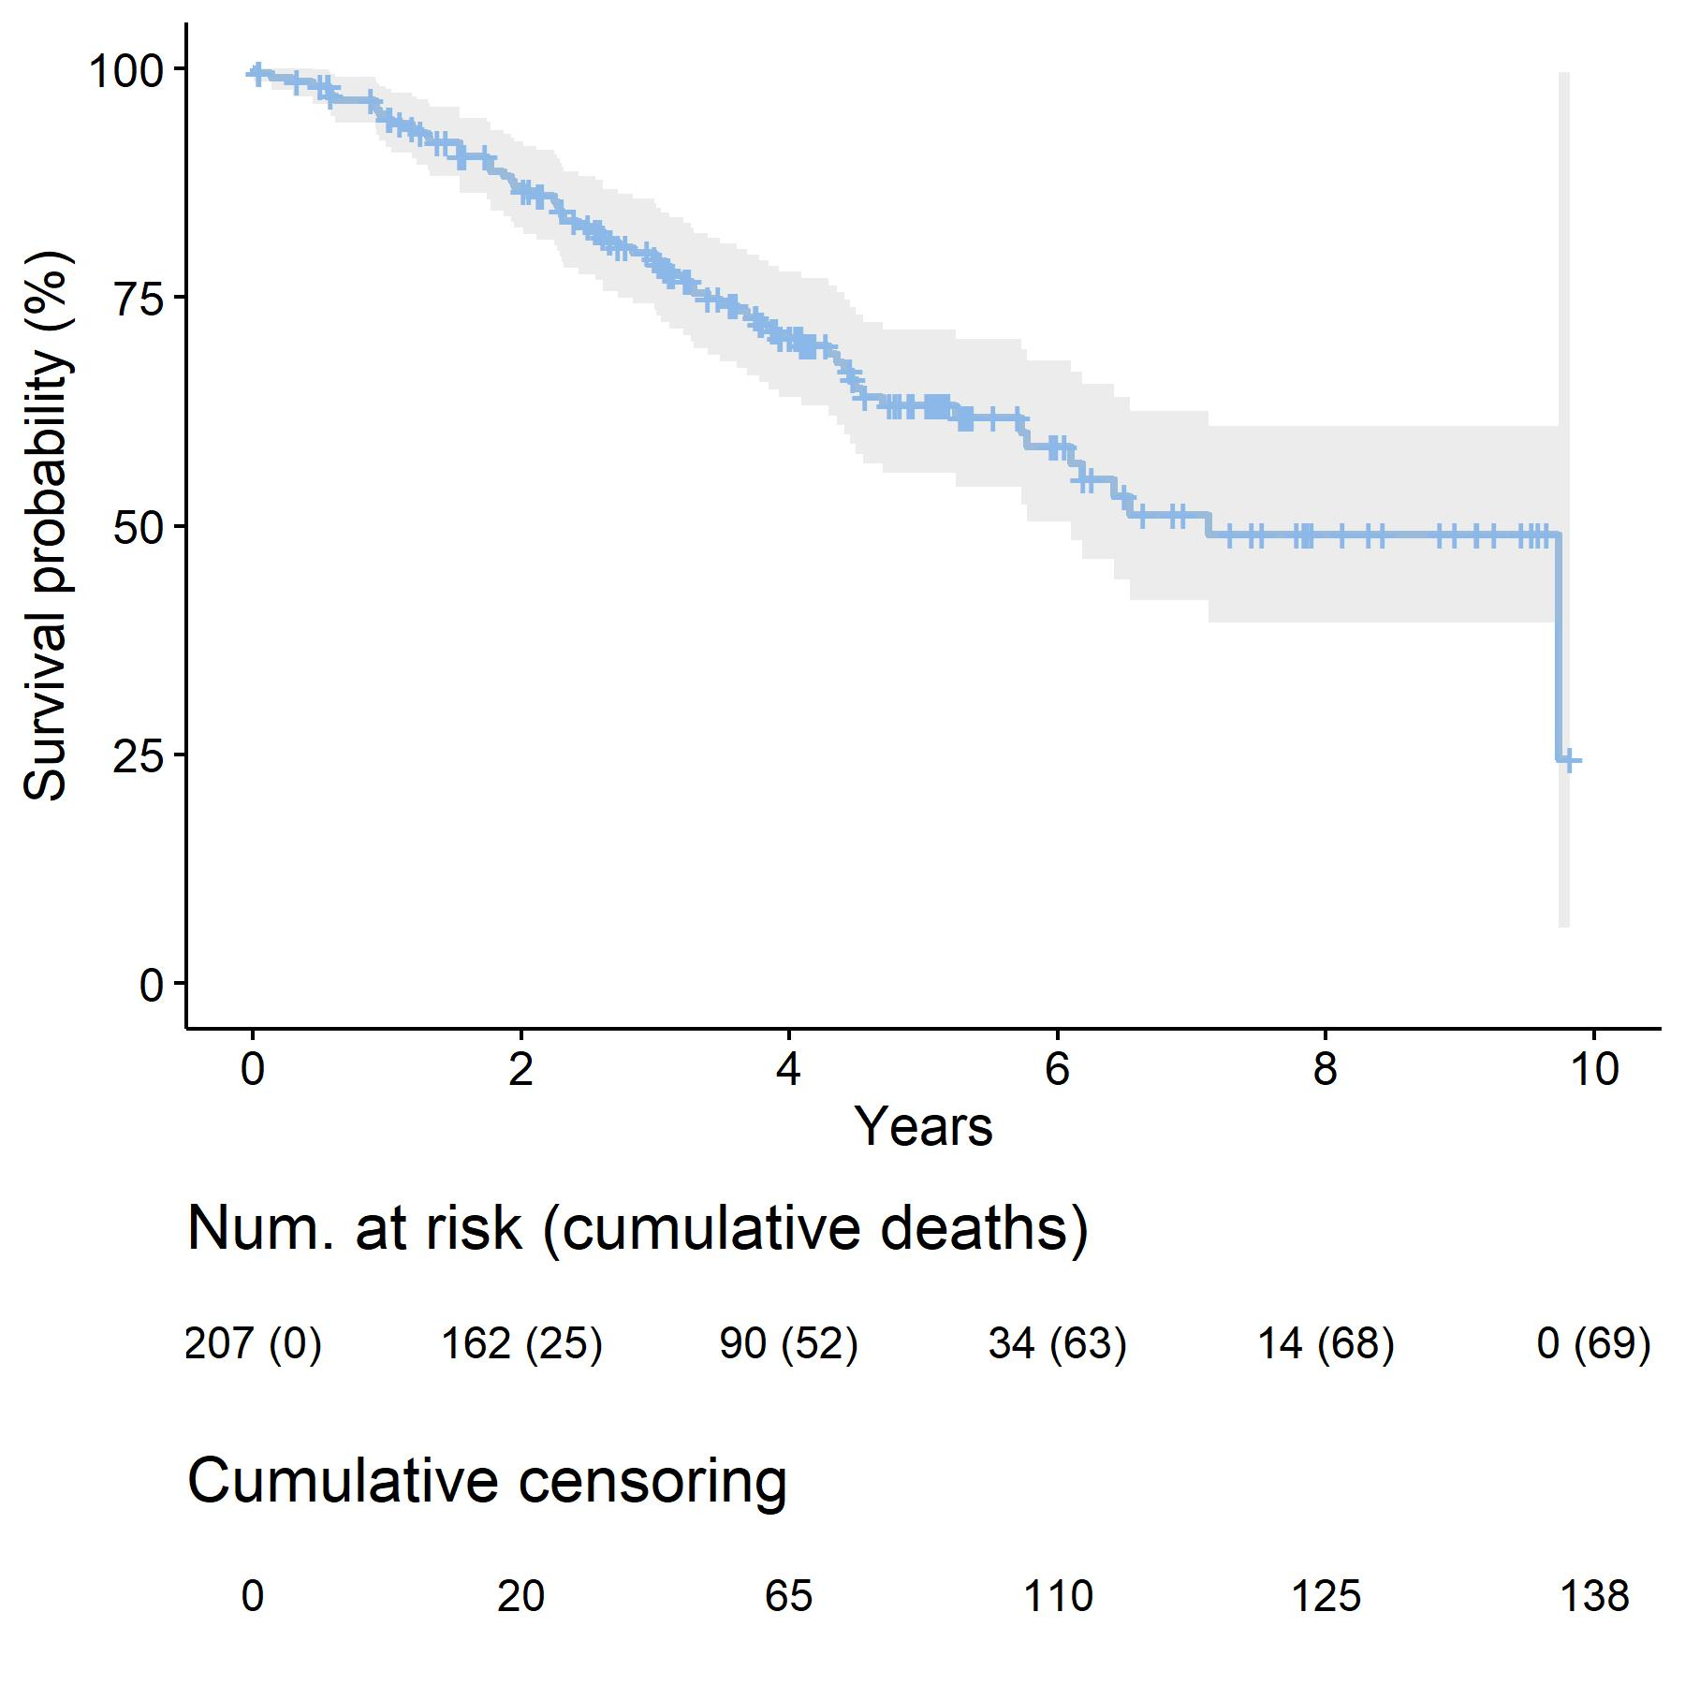
Kaplan-Meier survival curve
5 year survival rate = 63%

Slide 21
2 ML methods for survival analysis
Regularized Cox model¹
Extends Cox model with variable selection
R packages: glmnet, penalized
Pros
Easy interpretation (hazard ratios)
LASSO/Elastic-net identify important variables (logHR ≠ 0) vs unimportant variables (logHR=0)
Cons
Proportional hazards assumption
Assumes linear and additive effects
Random survival forests²
Extends random forests for survival outcome
R packages: randomforestSRC, ranger, party
Pros
Nonparametric (less assumptions)
Automatically allow for non-linear and interaction effects
Variable importance scores
Some software allows for missing values
Bootstrap gives estimate of generalization error (cross-validation not necessary)
Cons: harder to interpret
1 Simon et al. "Regularization paths for Cox’s proportional hazards model via coordinate descent." Journal of statistical software 39.5 (2011): 1.
2 Bou-Hamad, Imad, Denis Larocque, and Hatem Ben-Ameur. "A review of survival trees." Statistics surveys 5 (2011): 44-71.

Slide 22
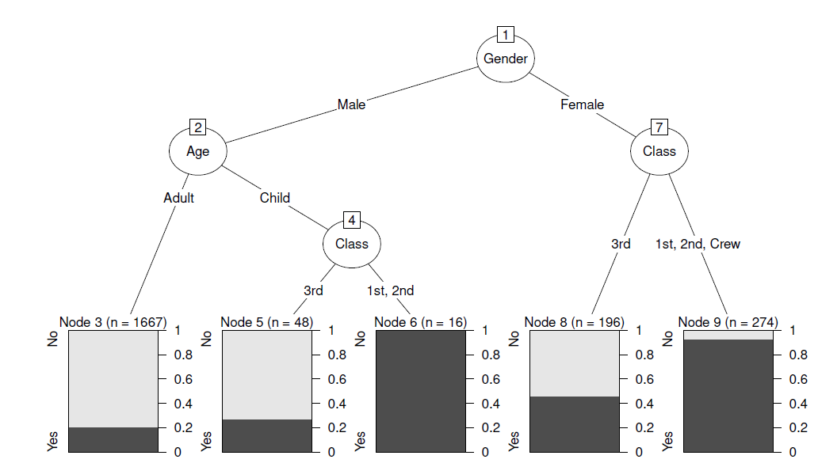
Decision trees and forests?
Example¹: want to know the probability that a particular person survived the Titanic:
Starting at the top of the tree, sequentially ask each question… whatever final “leaf” the person ends in gives their predicted outcome
¹ https://cran.r-project.org/web/packages/partykit/vignettes/constparty.pdf

Slide 23
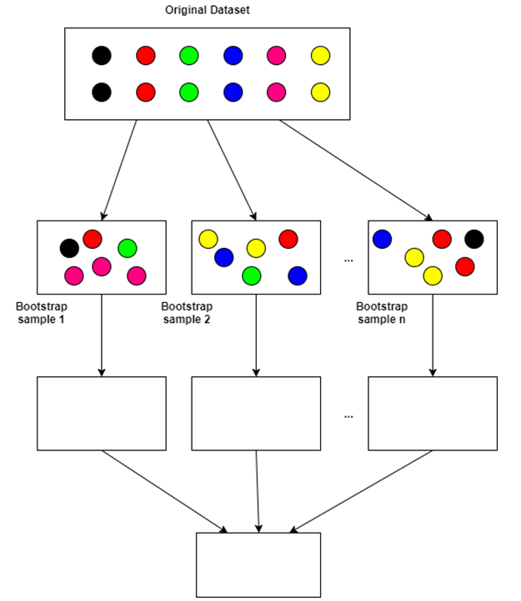
Random forest
A single tree is often unstable (high variance); random forests average predictions across heterogeneous trees to reduce variance
Tree 1
Tree 2
Tree n
Figure modified from: https://towardsdatascience.com/decision-trees-and-random-forests-for-classification-and-regression-pt-2-2b1fcd03e342
Average prediction

Slide 24
Prediction accuracy for survival data
Harrell’s concordance index (C-index)¹
“probability that, in a randomly selected pair of cases, the case that fails first had a worse predicted outcome”²
C-index = AUC for classification problems
Model | Average C-index | Method
LASSO | 0.70 | 10 fold CV with 5 repeats
Random Forest | 0.64 | Bootstrap 3000 times
¹ Harrell, Frank E., et al. "Evaluating the yield of medical tests." Jama 247.18 (1982): 2543-2546 ² Ishwaran, Hemant, et al. "Random survival forests." The annals of applied statistics 2.3 (2008): 841-860.

Slide 25
LASSO selected 3 variables
Variable | Hazard Ratio for 1 SD increase
OTOF | 1.16
RGS17 | 1.14
PINK1 | 0.99

Slide 26
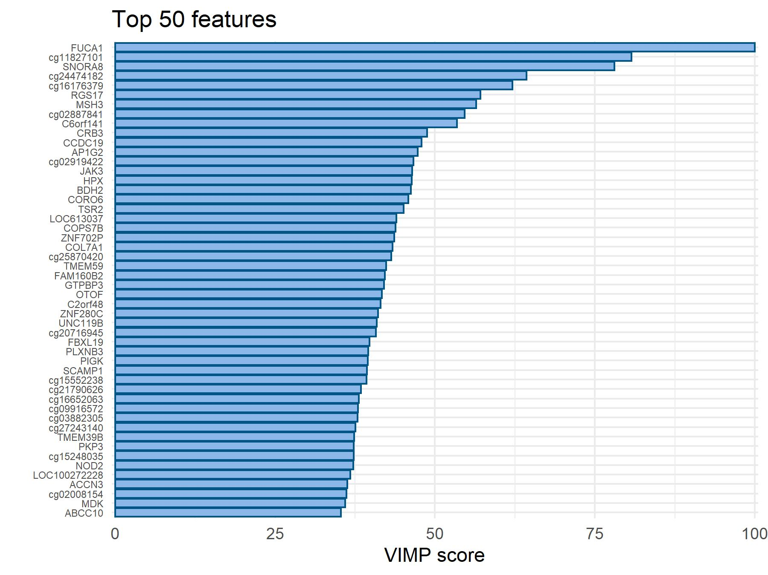

Random Forest Variable Importance (VIMP)
Permutation VIMP: compare prediction error of original model to prediction error after permuting (noising) $X_{j}$

Slide 27
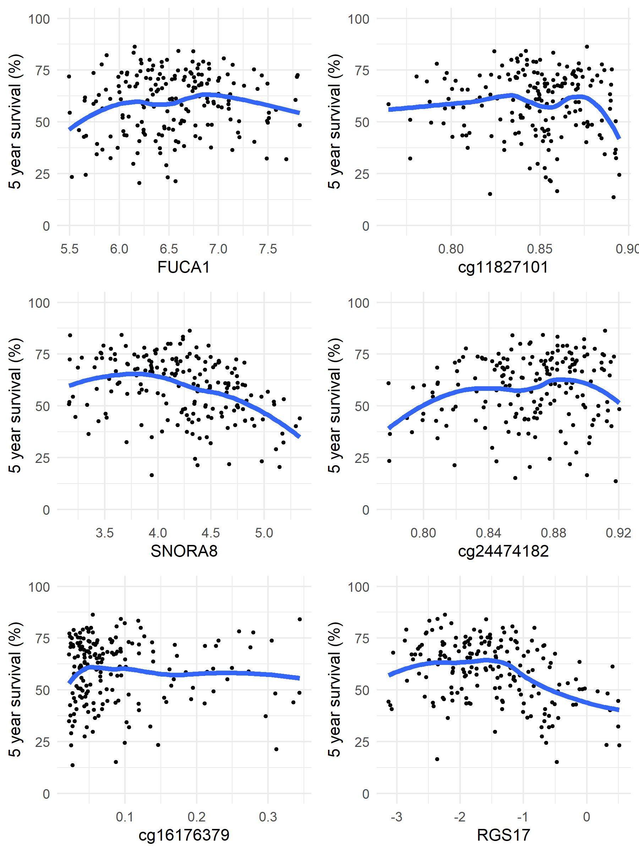
RF variable effects on 5-year survival

Slide 28
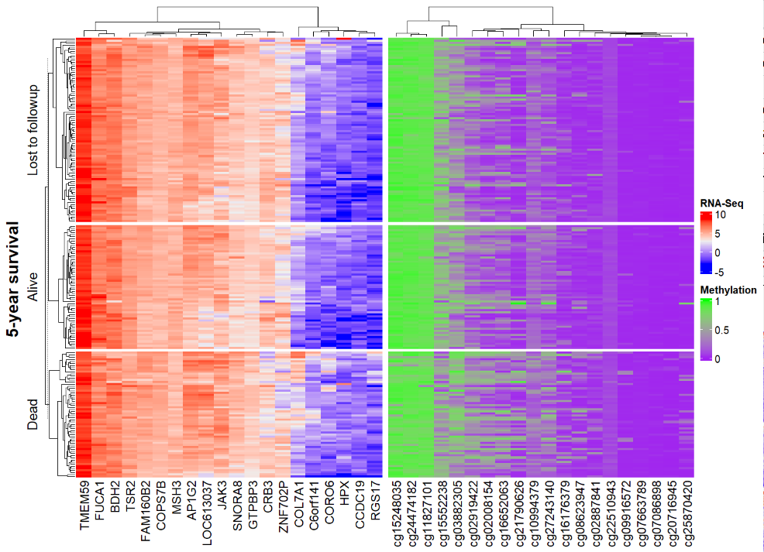
RF top 20 genes and top 20 CGs vs 5-year survival

Slide 29
Summary
PCA: dimension reduction and visualize samples in 2-D space
sPLS/CCA: identify sets of genes that are correlated with CGs; could use as filtering step before network analysis
ML for survival:
Regularized Cox model: easy to interpret (HRs and variable selection), more assumptions
Random forests: more flexible but harder to interpret (use VIMP, partial dependence plots)

Slide 30
Other ideas for analyzing multi-omics
Clustering to derive disease subtypes - 2 recent review papers:
Pierre-Jean, Morgane, et al. "Clustering and variable selection evaluation of 13 unsupervised methods for multi-omics data integration." Briefings in bioinformatics 21.6 (2020): 2011-2030.
Chauvel, Cécile, et al. "Evaluation of integrative clustering methods for the analysis of multi-omics data." Briefings in bioinformatics 21.2 (2020): 541-552.
Network analysis – derive correlated multi-omics “modules”
Yan, Jingwen, et al. "Network approaches to systems biology analysis of complex disease: integrative methods for multi-omics data." Briefings in bioinformatics 19.6 (2018): 1370-1381.
Shi, W. Jenny, et al. "Unsupervised discovery of phenotype-specific multi-omics networks." Bioinformatics 35.21 (2019): 4336-4343.

