Slide 1
Interpretable Machine Learning
JARON aRBET

Slide 2
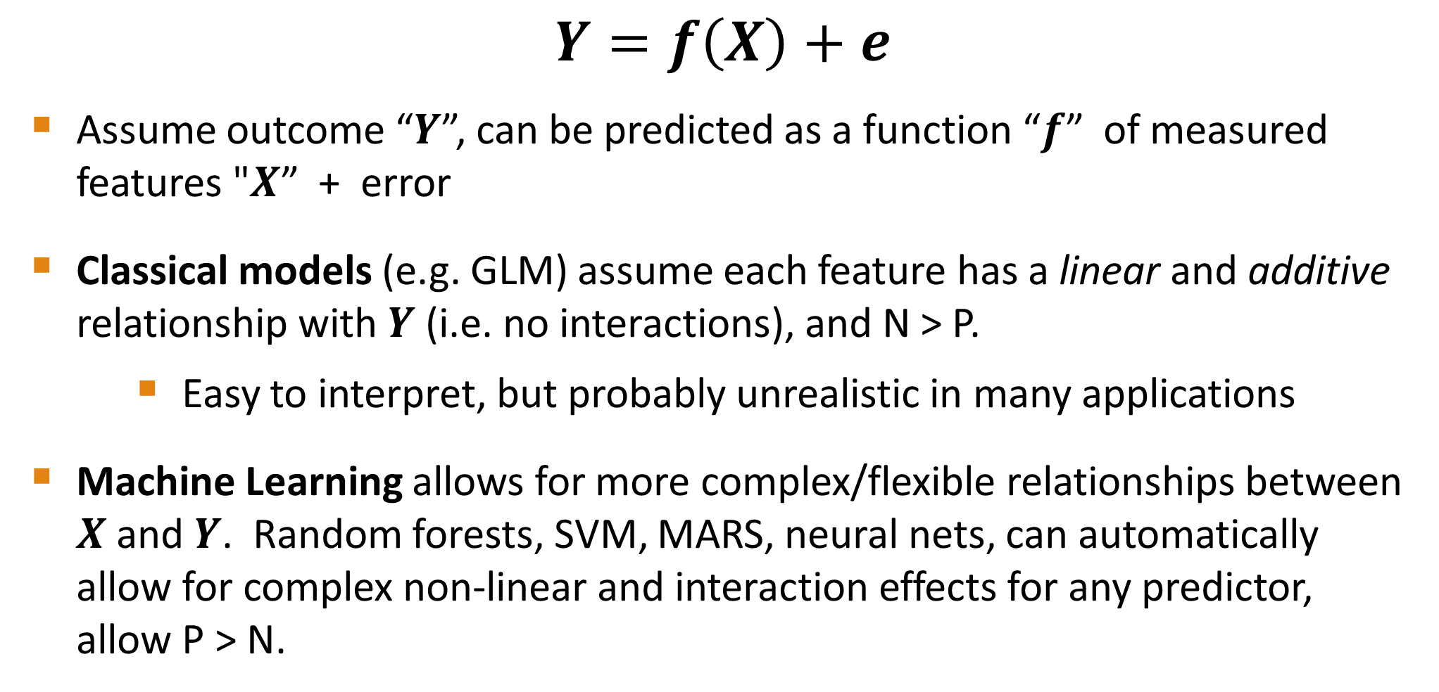
Predictive Modeling
$$Y=f\left(X\right)+e$$
Assume outcome “𝒀”, can be predicted as a function “𝒇” of measured features "𝑿” + error
Classical models (e.g. GLM) assume each feature has a linear and additive relationship with $Y$ (i.e. no interactions), and N > P.
Easy to interpret, but probably unrealistic in many applications
Machine Learning allows for more complex/flexible relationships between 𝑿 and 𝒀. Random forests, SVM, MARS, neural nets, can automatically allow for complex non-linear and interaction effects for any predictor, allow P > N.

Slide 3

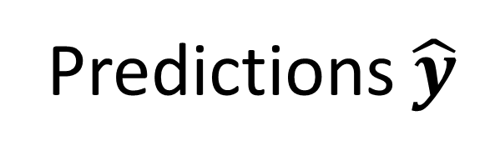
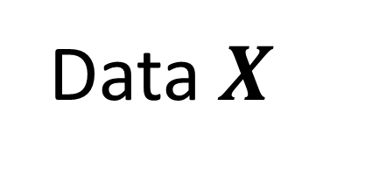
Although machine learning can often produce more accurate predictions, the price is that they are usually much harder to interpret
ML Model
???
Data $X$
Predictions $\hat{y}$

Slide 4
iml R package: “interpretable machine learning”
https://cran.r-project.org/web/packages/iml/index.html
Tutorial: https://cran.r-project.org/web/packages/iml/vignettes/intro.html
Free book: https://christophm.github.io/interpretable-ml-book/
Supports any ML model from the caret R package (>200 models)

Slide 5
Implements many state of the art methods for interpreting ML models:
Visualize relationships btwn X and Y (partial dependence plots, ICE plots)
Variable Importance scores
Interaction scores: identify predictors that interact
LIME: explain how a ML model makes a prediction for a given subject
Shapley Values: uses game theory to explain how a prediction is made

Slide 6
Example: Heart Disease study

Slide 7
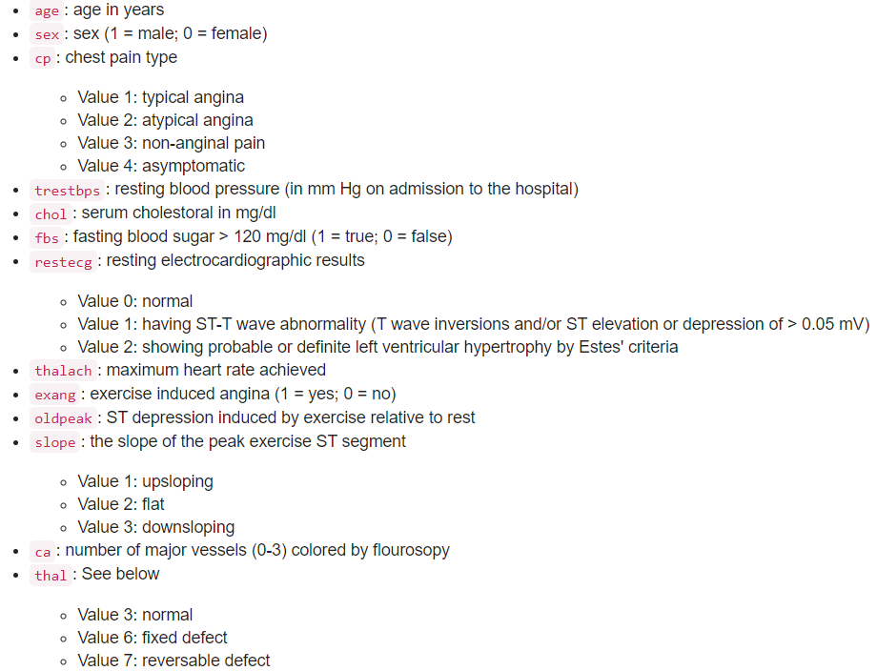
297 subjects
Outcome is heart disease (137 have, 160 do not)
13 possible predictors
I fit a random forest model and will show how iml R package can help interpret the model
https://rdrr.io/github/coatless/ucidata/man/heart_disease.html

Slide 8
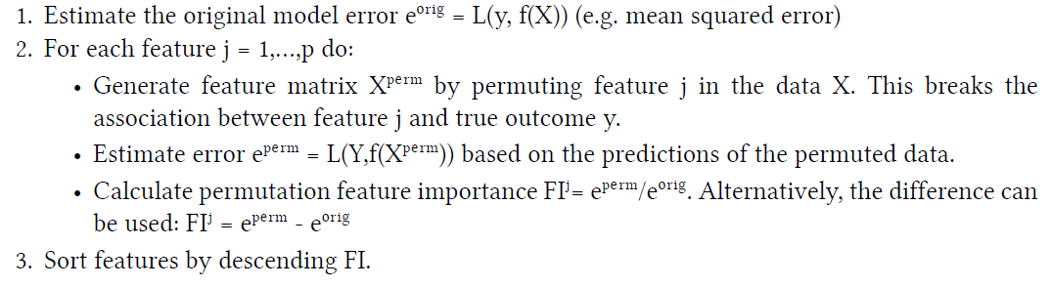
Variable Importance
How important is each variable in predicting heart disease status?
Permutation-based method

Slide 9
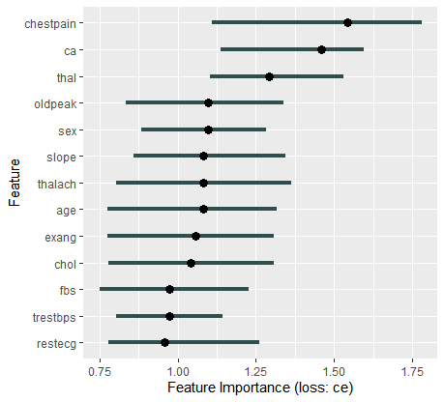

FI near 1 means predictor is not important
FI for chestpain=1.54, the prediction error increased 54% after permuting chestpain.

Slide 10
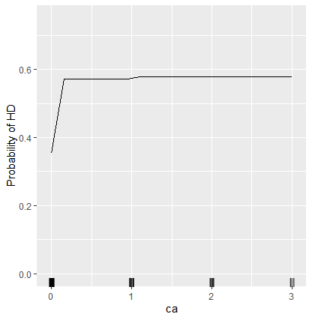
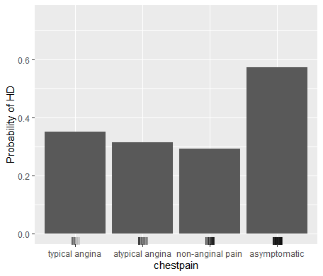
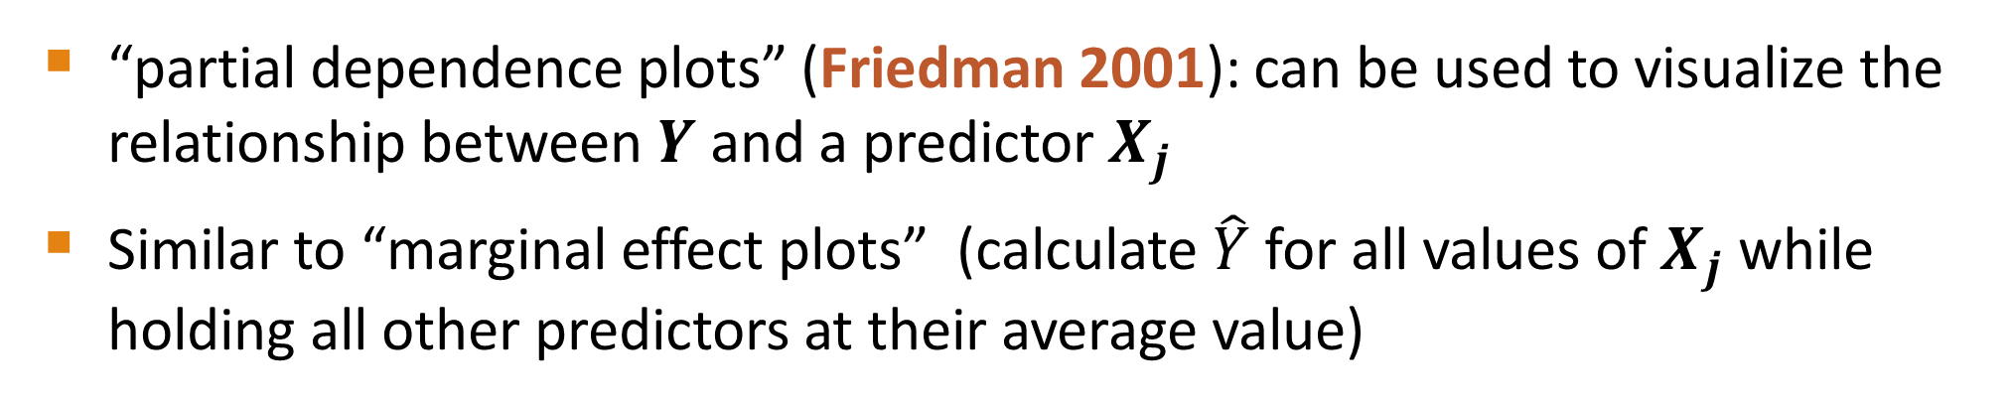
Visualize Effects
“partial dependence plots” (Friedman 2001): can be used to visualize the relationship between $Y$ and a predictor $X_{j}$
Similar to “marginal effect plots” (calculate $\hat{Y}$ for all values of $X_{j}$ while holding all other predictors at their average value)

Slide 11
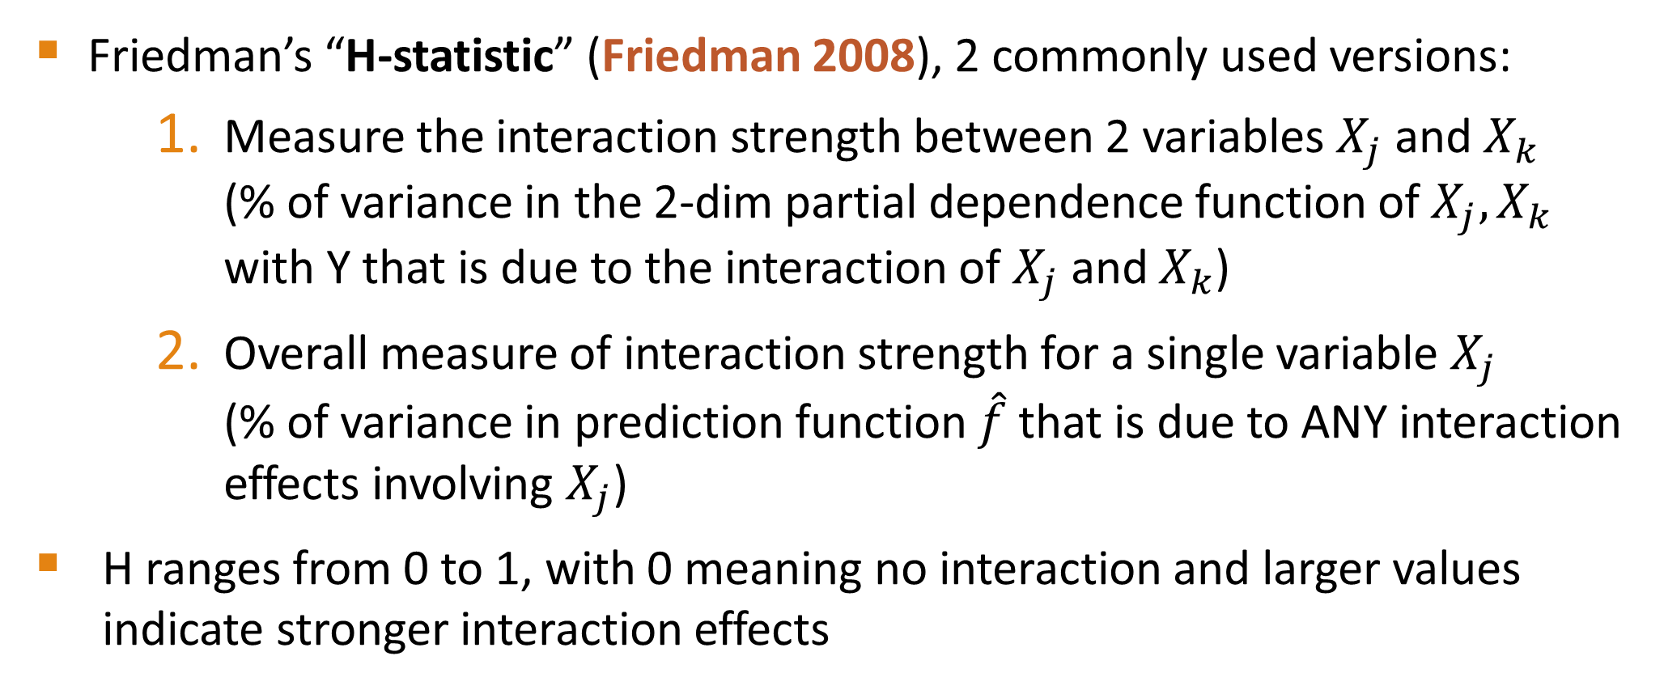
Interactions
Friedman’s “H-statistic” (Friedman 2008), 2 commonly used versions:
Measure the interaction strength between 2 variables $X_{j}$ and $X_{k}$ (% of variance in the 2-dim partial dependence function of $X_{j},X_{k}$ with Y that is due to the interaction of $X_{j}$ and $X_{k}$)
Overall measure of interaction strength for a single variable $X_{j}$ (% of variance in prediction function $\hat{f}$ that is due to ANY interaction effects involving $X_{j}$)
H ranges from 0 to 1, with 0 meaning no interaction and larger values indicate stronger interaction effects

Slide 12
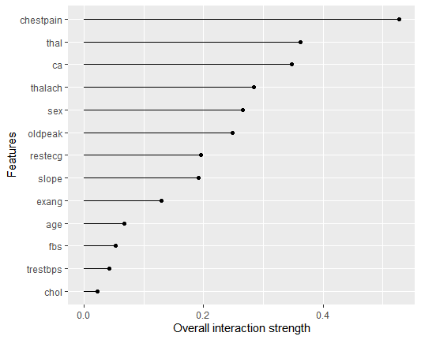
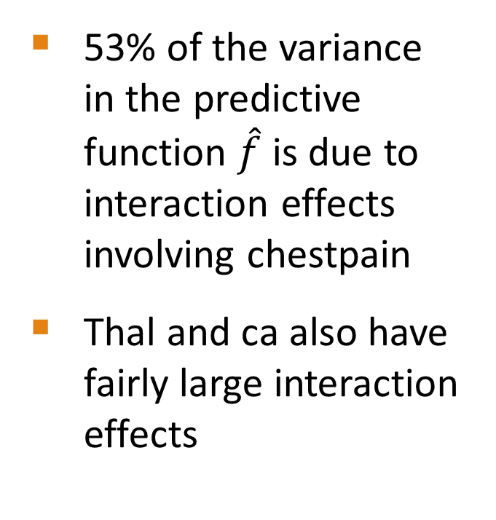
53% of the variance in the predictive function $\hat{f}$ is due to interaction effects involving chestpain
Thal and ca also have fairly large interaction effects

Slide 13
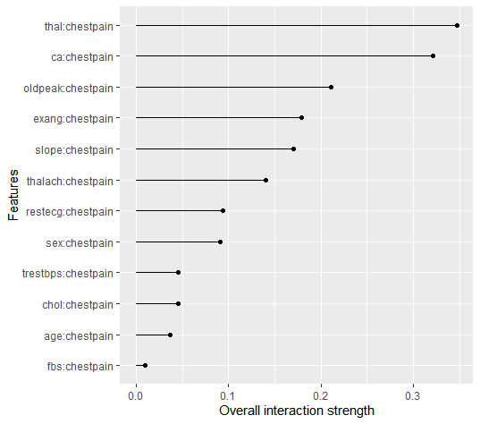
All 2-way interaction effects with chestpain

Slide 14
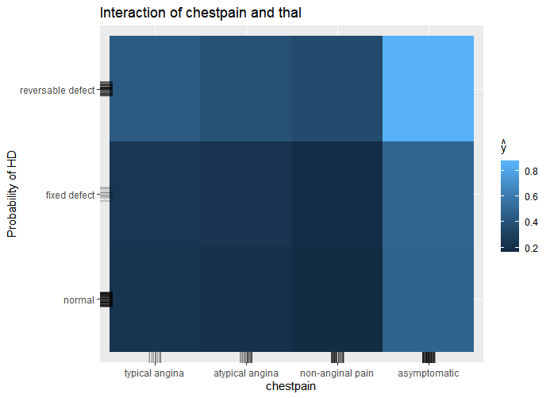
2-Dim partial dependence plots can then be used to visualize interaction effects

Slide 15
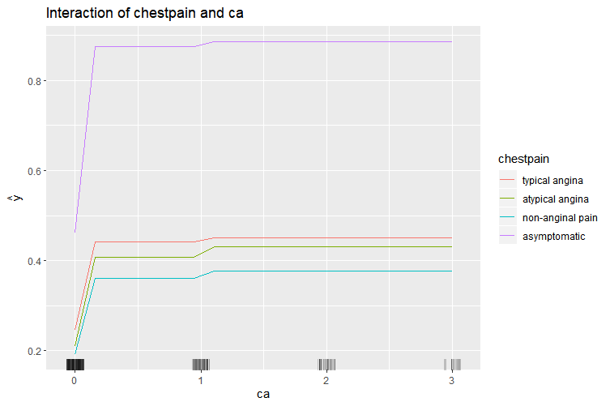

Slide 16
LIME: “Local Interpretable model explanations”
Tulio Ribeiro 2016: “‘Why Should I Trust You?’ Explaining the Predictions of Any Classifier”
Goal: explain why a black box ML model made the prediction it did for a particular subject
Use simpler more interpretable models (e.g. linear regression, logistic regression) locally to explain how the subject’s feature values affected their prediction
Local? Use a distance/similarity function to weigh all subjects in your dataset by how close they are to the subject of interest. Then fit a weighted linear/logistic regression model.

Slide 17
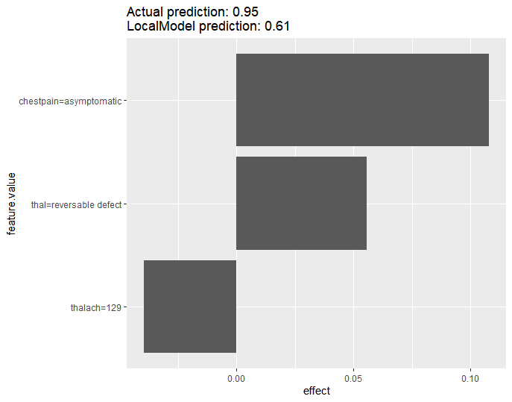
Here logistic regression is used with the top 3 predictors (chosen by Lasso)
Y-axis shows the feature values for this subject
X-axis shows how the subject’s feature values affected their log-odds of having HD

Slide 18

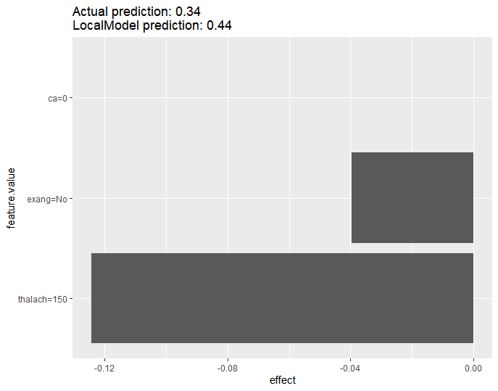

Slide 19
References
Friedman, Jerome H. "Greedy function approximation: a gradient boosting machine." Annals of statistics (2001): 1189-1232
Friedman, Jerome H., and Bogdan E. Popescu. "Predictive learning via rule ensembles." The Annals of Applied Statistics 2.3 (2008): 916-954.
Molnar, Christoph. Interpretable machine learning. Lulu. com, 2019.
Ribeiro, Marco Tulio, Sameer Singh, and Carlos Guestrin. "" Why should I trust you?" Explaining the predictions of any classifier." Proceedings of the 22nd ACM SIGKDD international conference on knowledge discovery and data mining. 2016.

