Slide 1
Bayesian Statistics
Jaron Arbet

Slide 2
Outline
Bayes Theorem
3 Key steps of Bayesian Analysis
Bayes vs Frequentist stats

Slide 3
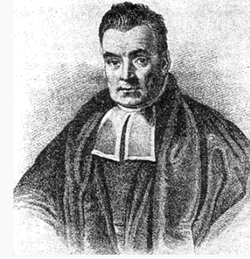
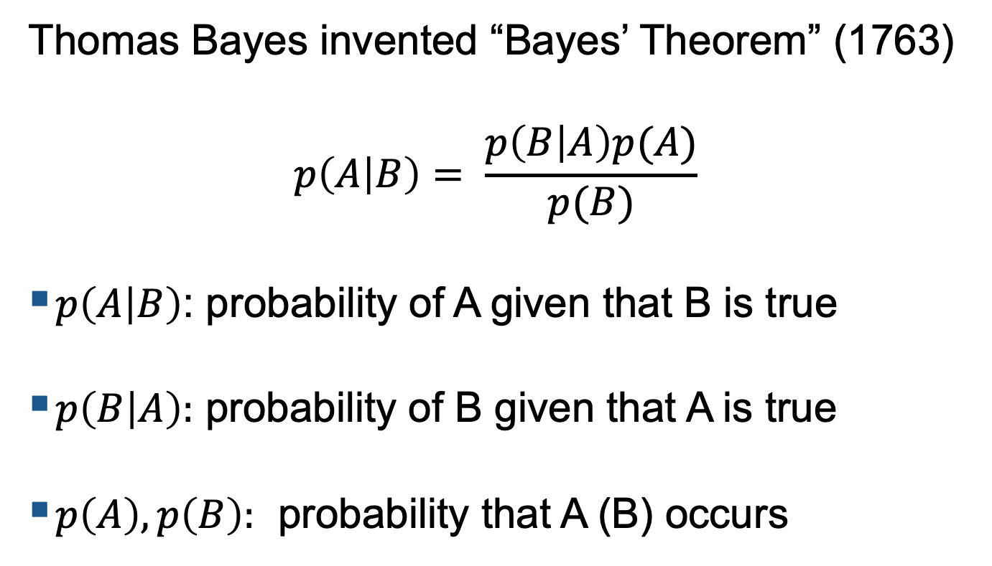
Bayes’ Theorem
Thomas Bayes invented “Bayes’ Theorem” (1763)
$$p\left(A | B\right)= \frac{p\left(B | A\right)p(A)}{p(B)}$$
$p\left(A | B\right)$: probability of A given that B is true
$p\left(B | A\right):$ probability of B given that A is true
$p\left(A\right), p\left(B\right):$ probability that A (B) occurs
https://en.wikipedia.org/wiki/Thomas_Bayes

Slide 4
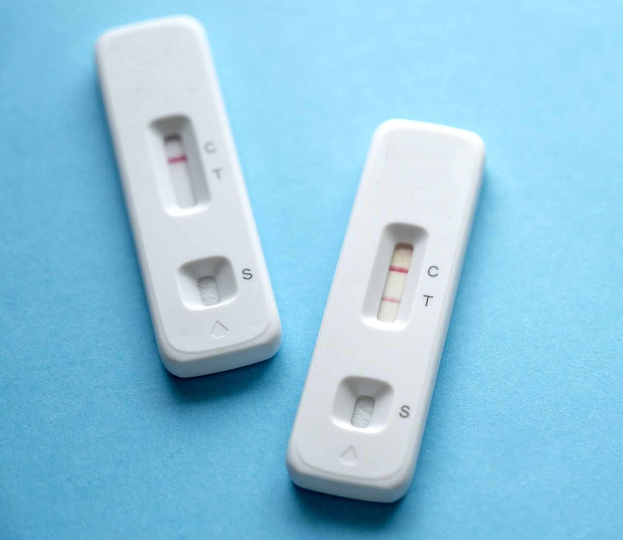
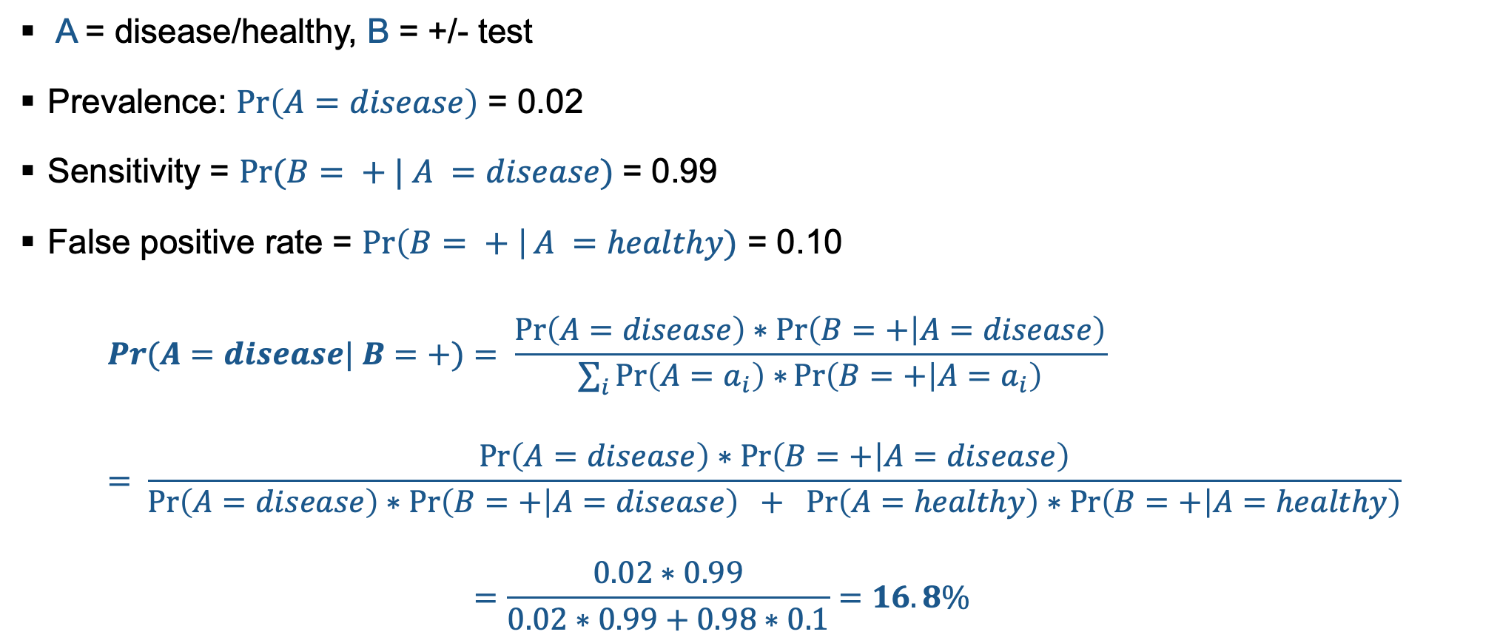
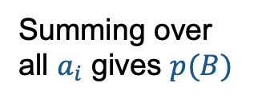
Example: Disease testing
A = disease/healthy, B = +/- test
Prevalence: $\operatorname{Pr}\left(A=disease\right)$ = 0.02
Sensitivity = $Pr⁡(B= + | A =disease)$= 0.99
False positive rate = $\operatorname{Pr}\left(B= + \right|A =healthy)$ = 0.10
$$Pr⁡(A=disease| B=+)= \frac{\operatorname{Pr}\left(A=disease\right)∗\operatorname{Pr}\left(B=+ | A=disease\right)}{\sum_{i}{\operatorname{Pr}\left(A=a_{i}\right)∗}\operatorname{Pr}\left(B=+ | A=a_{i}\right)} \\ = \frac{\operatorname{Pr}\left(A=disease\right)∗\operatorname{Pr}\left(B=+ | A=disease\right)}{\operatorname{Pr}\left(A=disease\right)∗\operatorname{Pr}\left(B=+ | A=disease\right) +\operatorname{Pr}\left(A=healthy\right)∗\operatorname{Pr}\left(B=+ | A=healthy\right)} \\ =\frac{0.02∗0.99}{0.02∗0.99+0.98∗0.1}=16.8\%$$
Summing over all $a_{i}$ gives $p(B)$

Slide 5
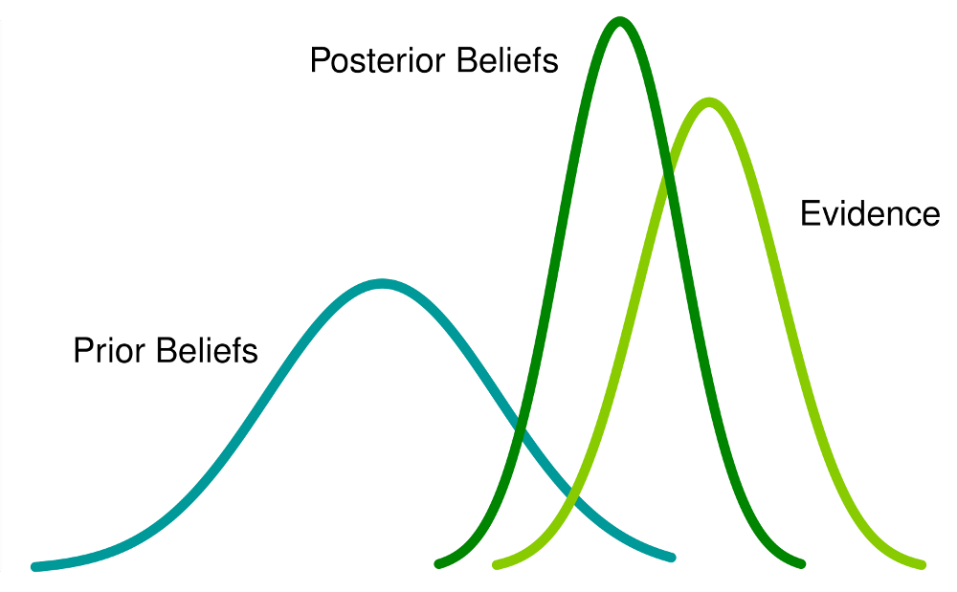
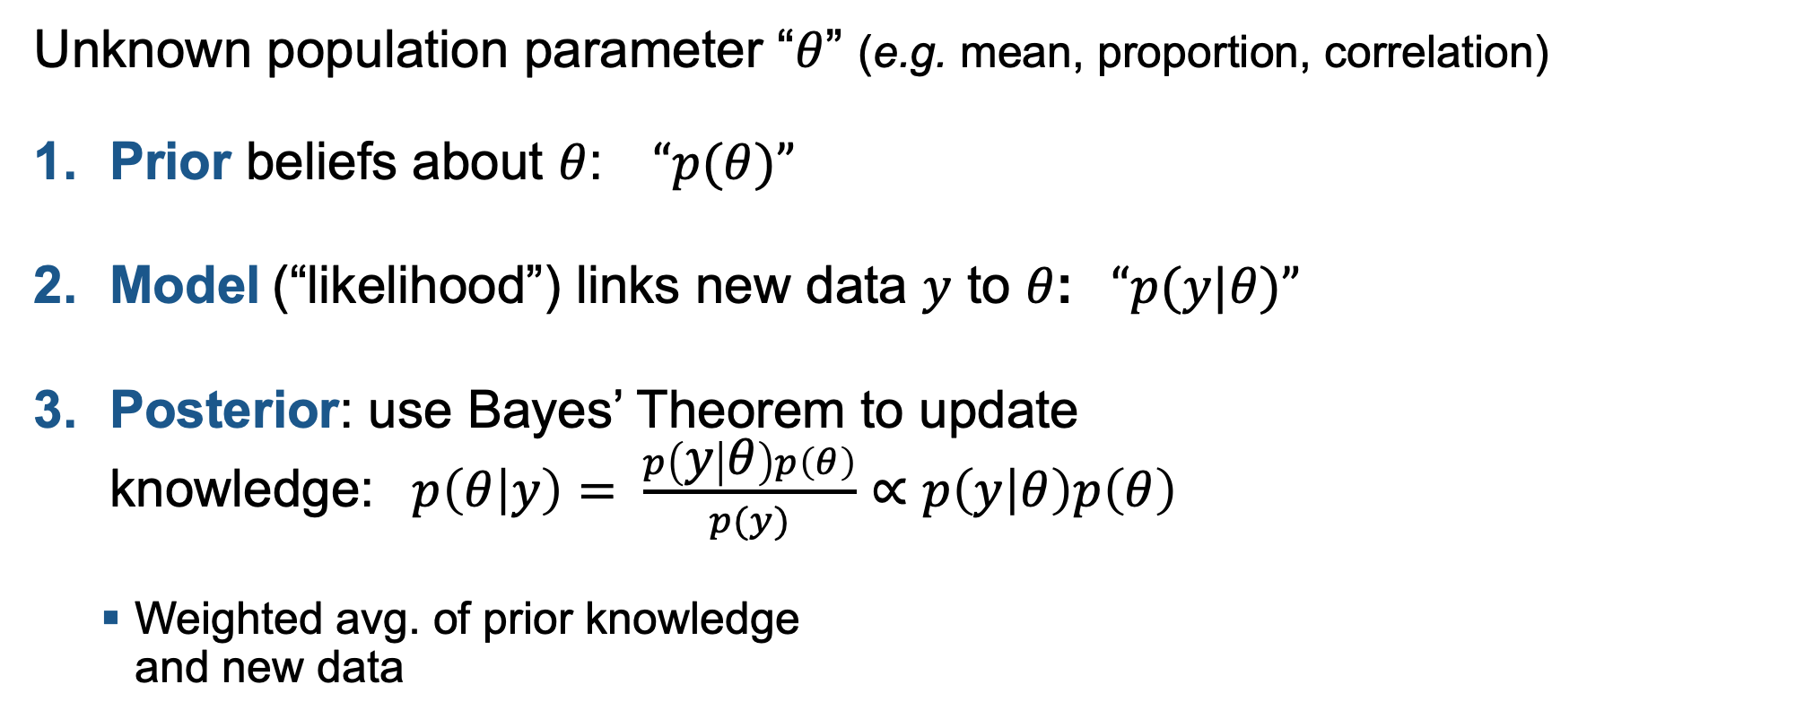



3 Key steps of Bayesian Analysis
Unknown population parameter “$θ$” (e.g. mean, proportion, correlation)
Prior beliefs about $θ$: $“p(θ)”$
Model (“likelihood”) links new data $y$ to $θ$: $“p(y|θ)”$
Posterior: use Bayes’ Theorem to update knowledge: $p\left(θ | y\right)= \frac{p\left(y | θ\right)p\left(θ\right)}{p(y)}∝p\left(y | θ\right)p\left(θ\right)$
Weighted avg. of prior knowledge and new data
$$p(θ|y)$$
$$p(y|θ)$$
$$p(θ)$$

Slide 6
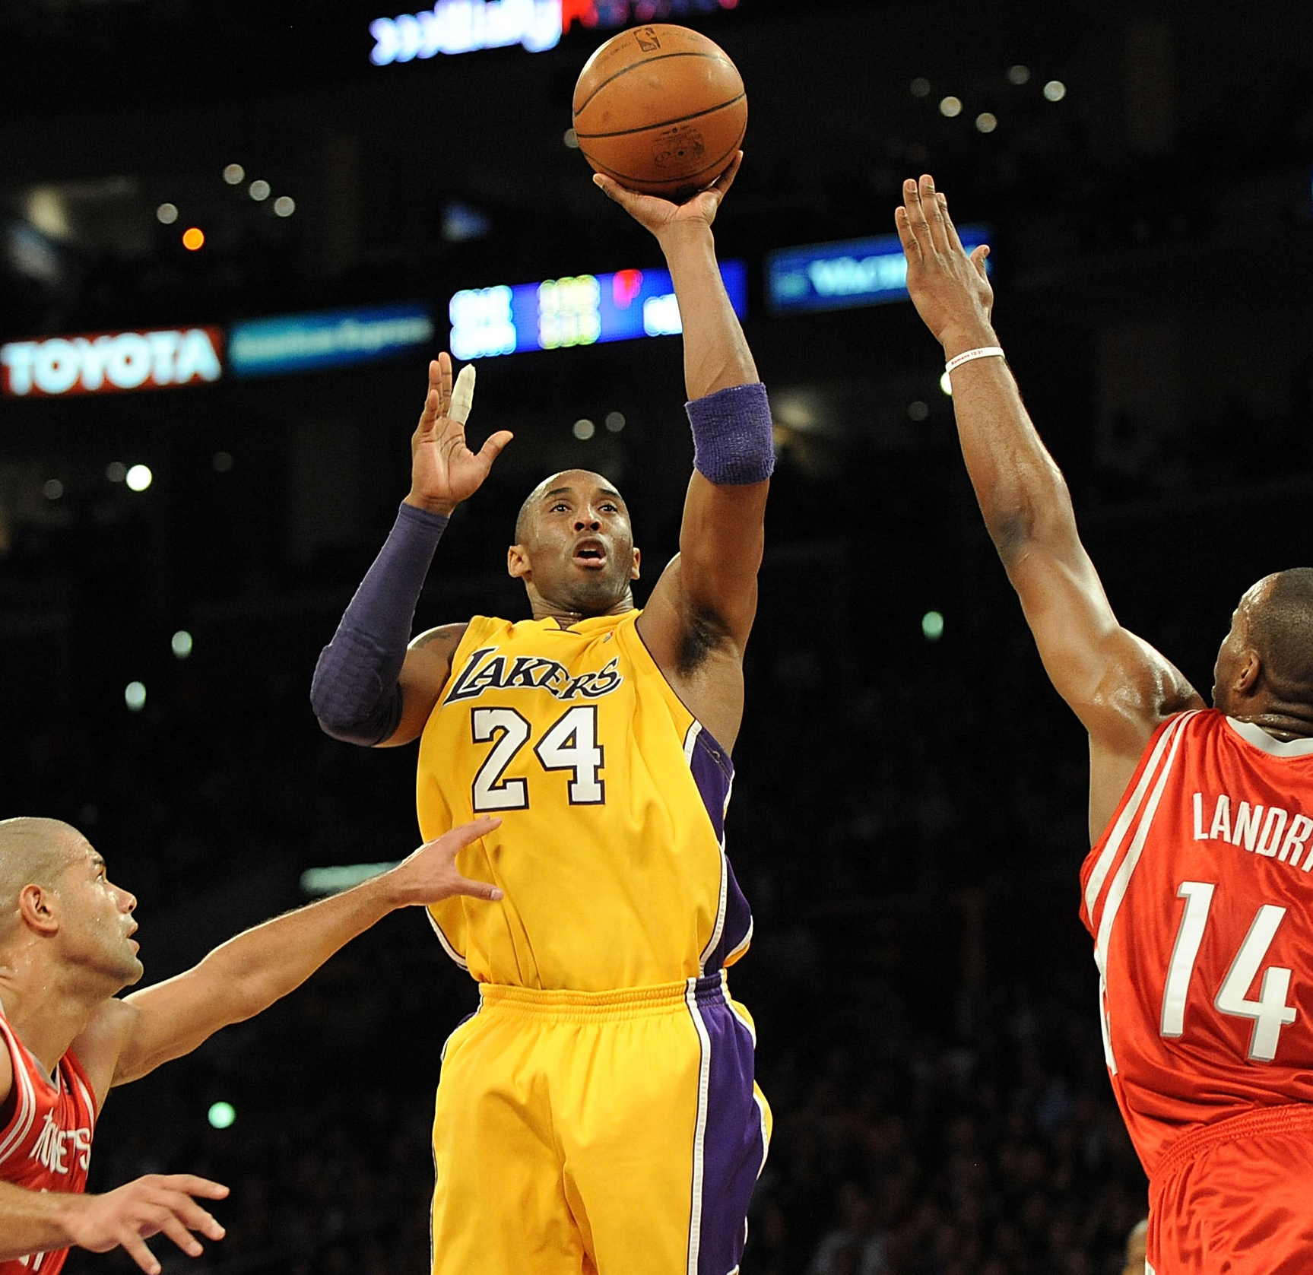
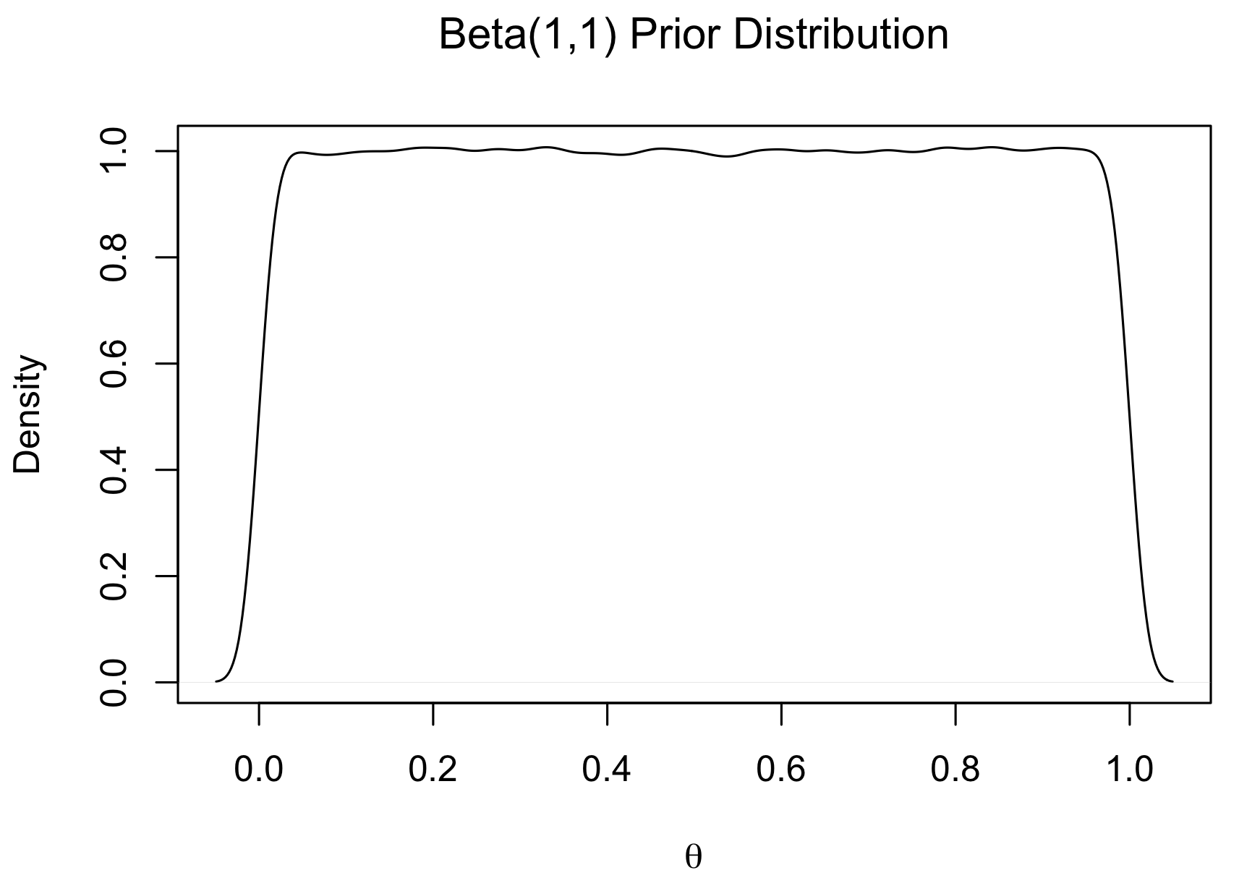

Proportion Example
$θ$ = Kobe Bryant’s field goal percentage 1999-2000
Step 1: $p\left(θ\right)\text{ = }\text{Beta}\text{(}\text{a}\text{,}\text{b}\text{)}= \frac{1}{B\left(a,b\right)}θ^{a−1}{(1−θ)}^{b−1}$
“Flat, non-informative prior”
a=1, b=1
Treat all values equally apriori: use when highly uncertain or want to let the data speak for itself
Similar results as traditional non-Bayes methods
Modified from: Ch1 of Ntzoufras, Ioannis. Bayesian modeling using WinBUGS. John Wiley & Sons, 2011.

Slide 7

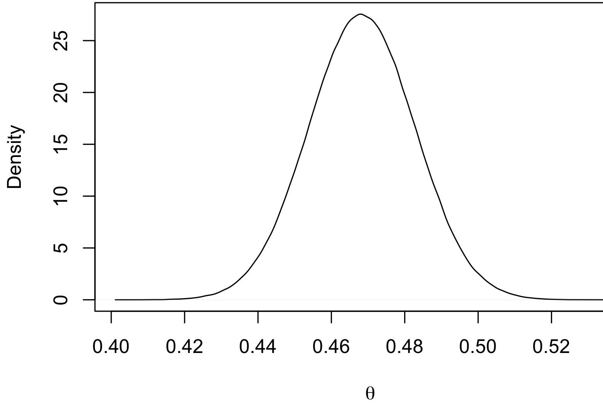
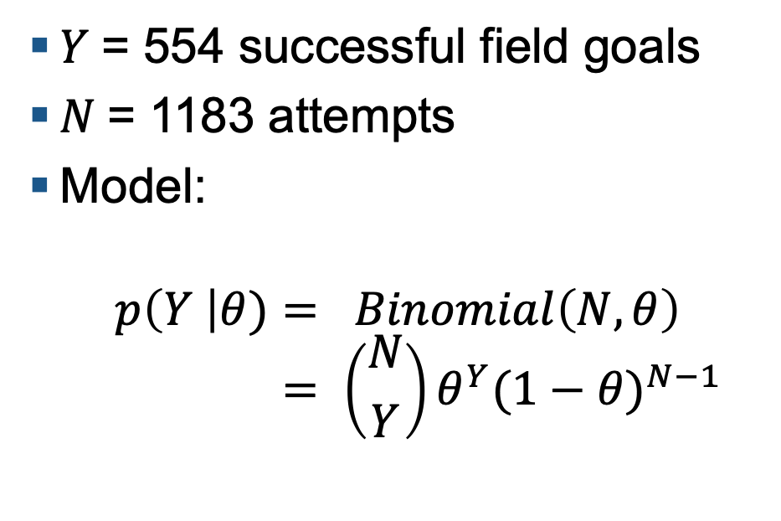
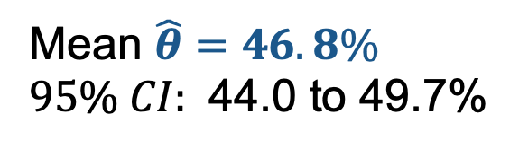
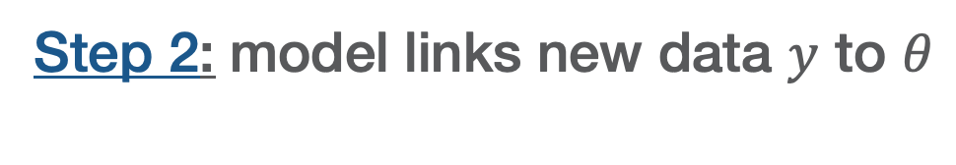
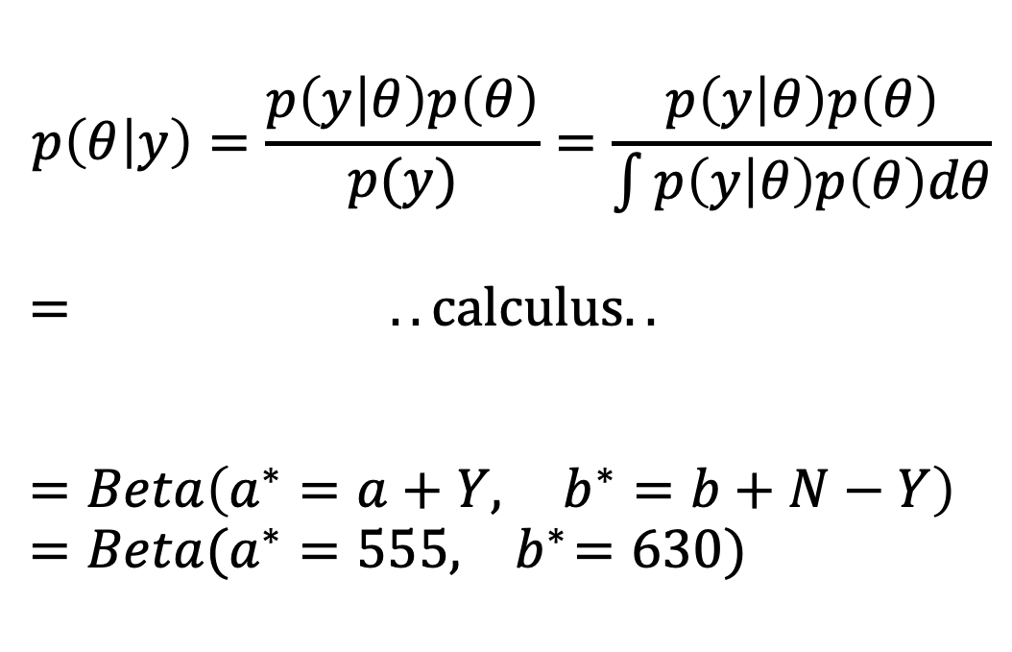
Step 2: model links new data $y$ to $θ$
Step 3: Bayes’ Thm update knowledge
$$p\left(θ | y\right)=\frac{p\left(y | θ\right)p\left(θ\right)}{p(y)}=\frac{p\left(y | θ\right)p\left(θ\right)}{\int{p\left(y | θ\right)p\left(θ\right)dθ}}$$
$$= ..calculus.. \\ = \\ =Beta\left(a^{∗}=a+Y, …b^{∗}=b+N−Y\right) \\ =Beta(a^{∗}=555,{ b}^{∗}=630)$$
$Y$= 554 successful field goals
$N$= 1183 attempts
Model:
$$p\left(Y \right|θ)= Binomial\left(N, θ\right) \\ = \left({N \atop Y}\right)θ^{Y}{(1−θ)}^{N−1}$$
Mean $\hat{θ}=46.8\%$ $95\% CI:$ 44.0 to 49.7%

Slide 8
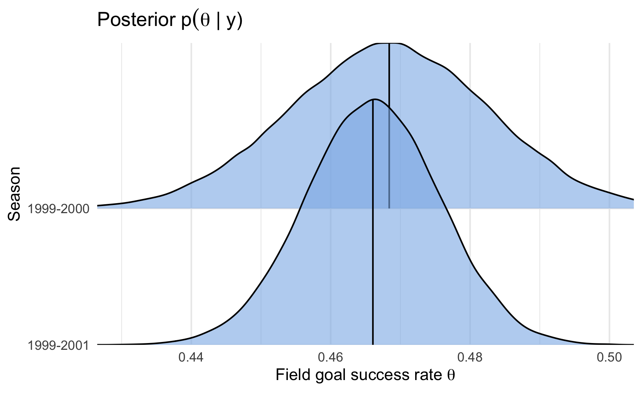
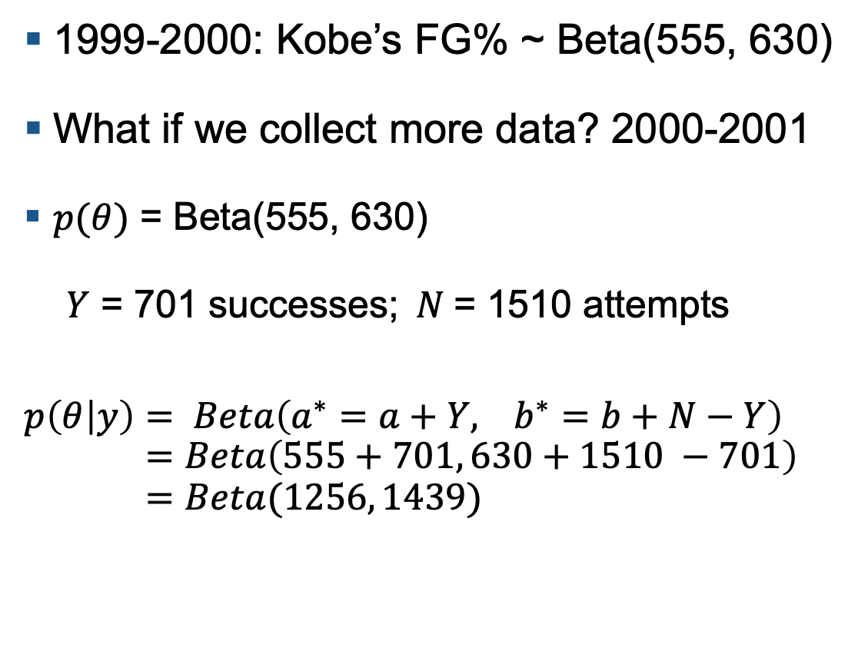
Continuous updating of knowledge
1999-2000: Kobe’s FG% ~ Beta(555, 630)
What if we collect more data? 2000-2001
$p(θ)$ = Beta(555, 630)
$Y$ = 701 successes;$N$= 1510 attempts
$$p\left(θ | y\right)= Beta\left(a^{∗}=a+Y, ..b^{∗}=b+N−Y\right) \\ =Beta\left(555+701, 630+1510 −701\right) \\ =Beta(1256, 1439)$$
“Today’s Posterior is tomorrow’s Prior”(Lindley 2000)
Lindley, Dennis V. "The philosophy of statistics." Journal of the Royal Statistical Society: Series D (The Statistician) 49.3 (2000): 293-337.

Slide 9
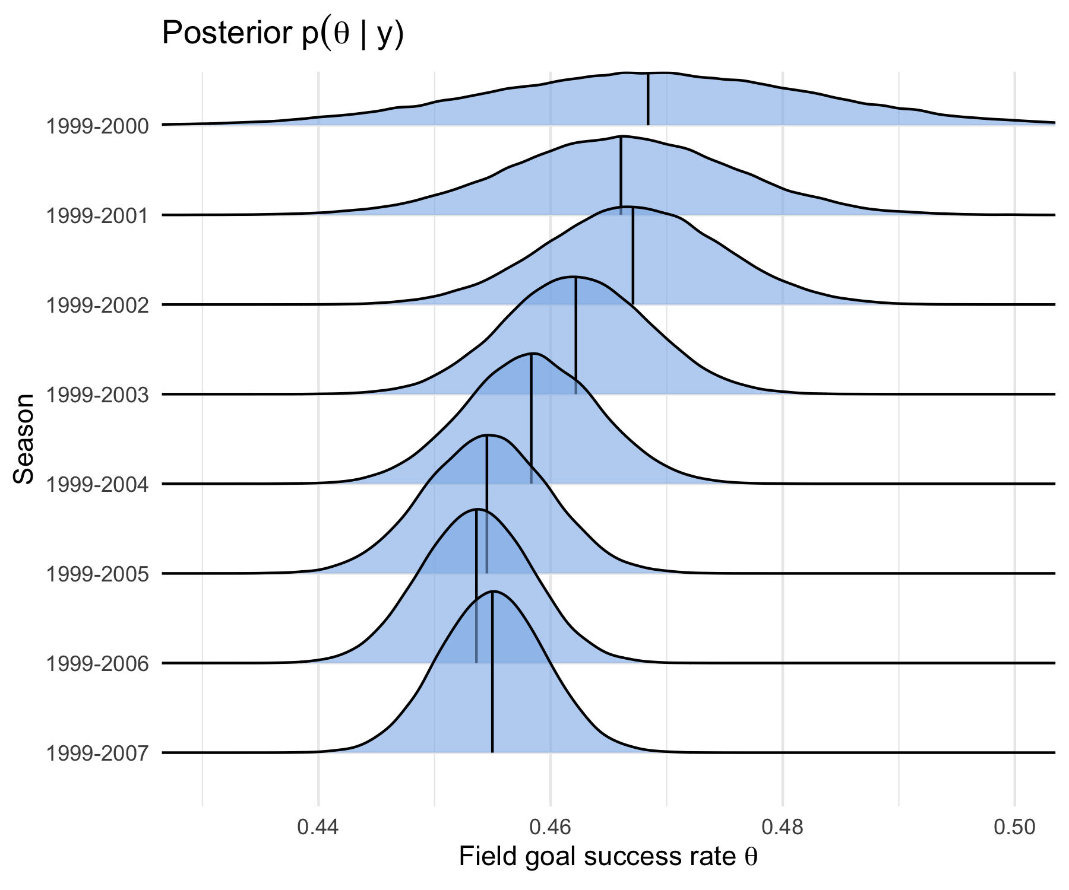

Slide 10
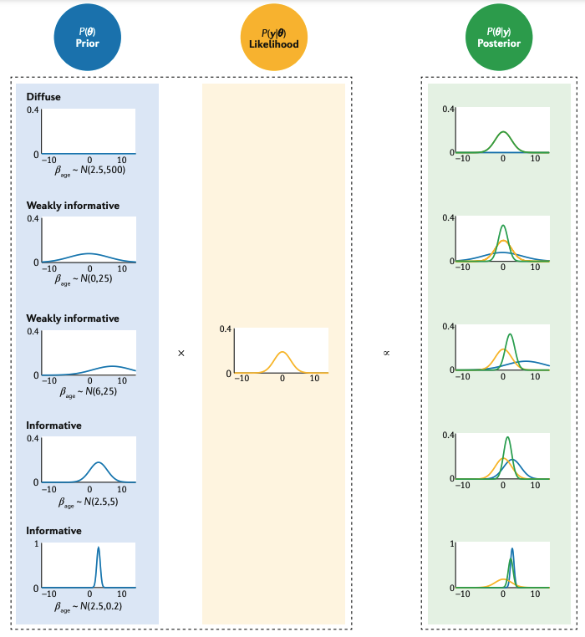
How Prior affects Posterior
“Flat/diffuse prior” → more weight to Likelihood (new data)
“Informative prior” (concentrated on smaller range) → more weight to prior
Although as N gets larger, the Likelihood gets more weight
van de Schoot, Rens, et al. "Bayesian statistics and modelling." Nature Reviews Methods Primers 1.1 (2021): 1-26.

Slide 11
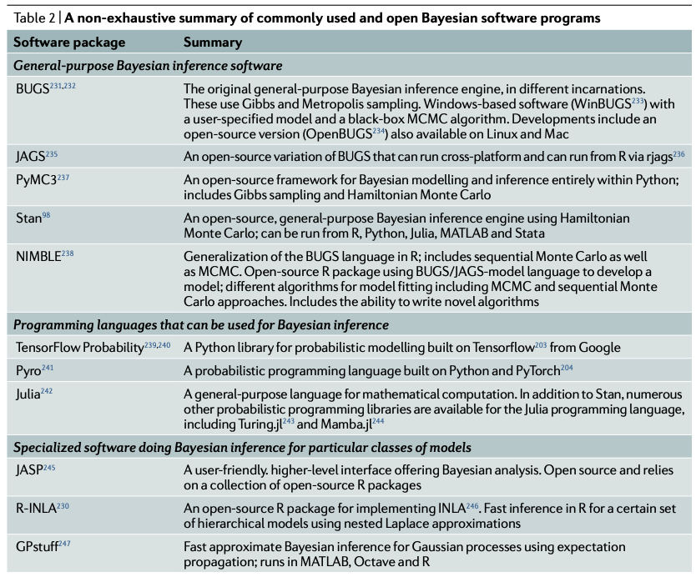
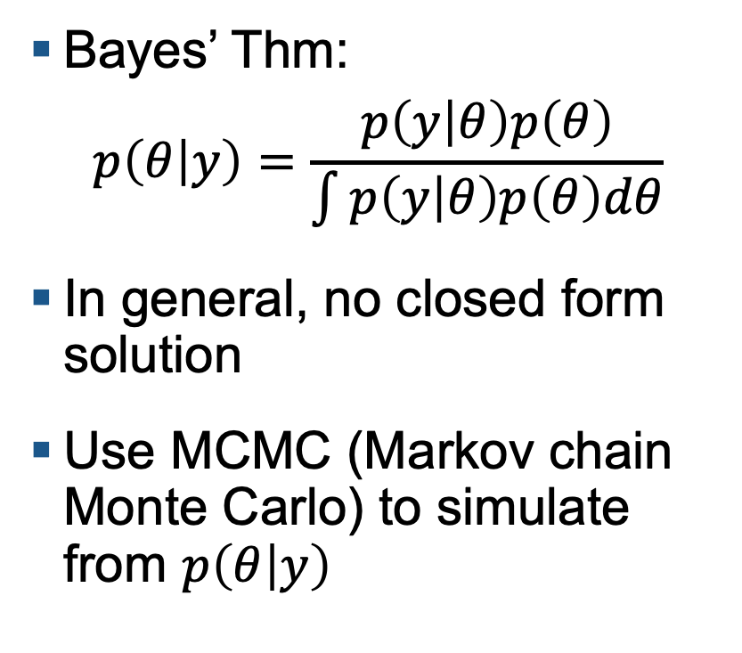
MCMC for general Bayesian models
Bayes’ Thm:
$$p\left(θ | y\right)=\frac{p\left(y | θ\right)p\left(θ\right)}{\int{p\left(y | θ\right)p\left(θ\right)dθ}}$$
In general, no closed form solution
Use MCMC (Markov chain Monte Carlo) to simulate from $p\left(θ | y\right)$
10
van de Schoot, Rens, et al. "Bayesian statistics and modelling." Nature Reviews Methods Primers 1.1 (2021): 1-26.

Slide 12

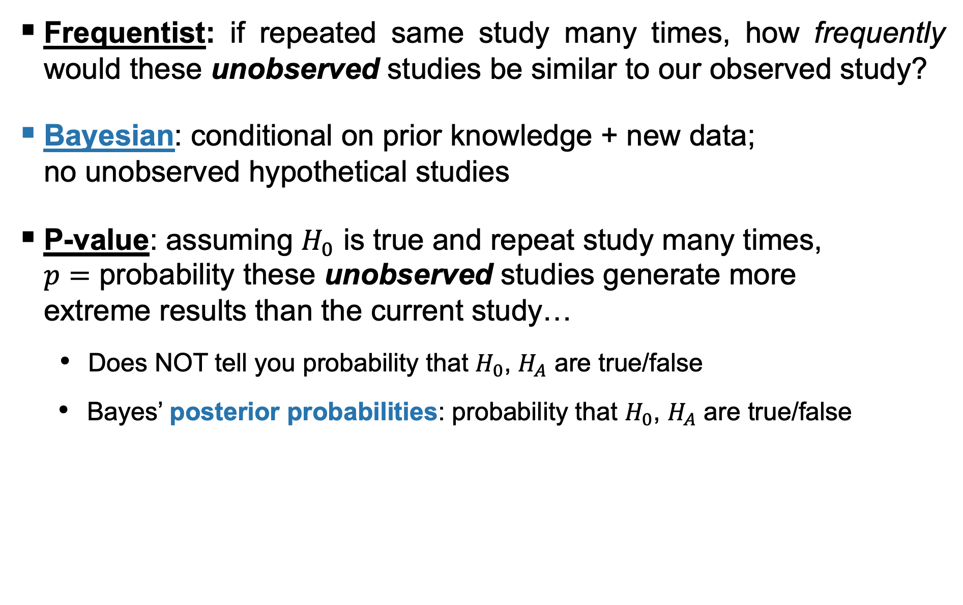
Frequentist vs. Bayesian
Frequentist: if repeated same study many times, how frequently would these unobserved studies be similar to our observed study?
Bayesian: conditional on prior knowledge + new data; no unobserved hypothetical studies
P-value: assuming $H_{0}$ is true and repeat study many times, $p=$ probability these unobserved studies generate more extreme results than the current study…
Does NOT tell you probability that $H_{0}$, $H_{A}$ are true/false
Bayes’ posterior probabilities: probability that $H_{0}$, $H_{A}$ are true/false

Slide 13

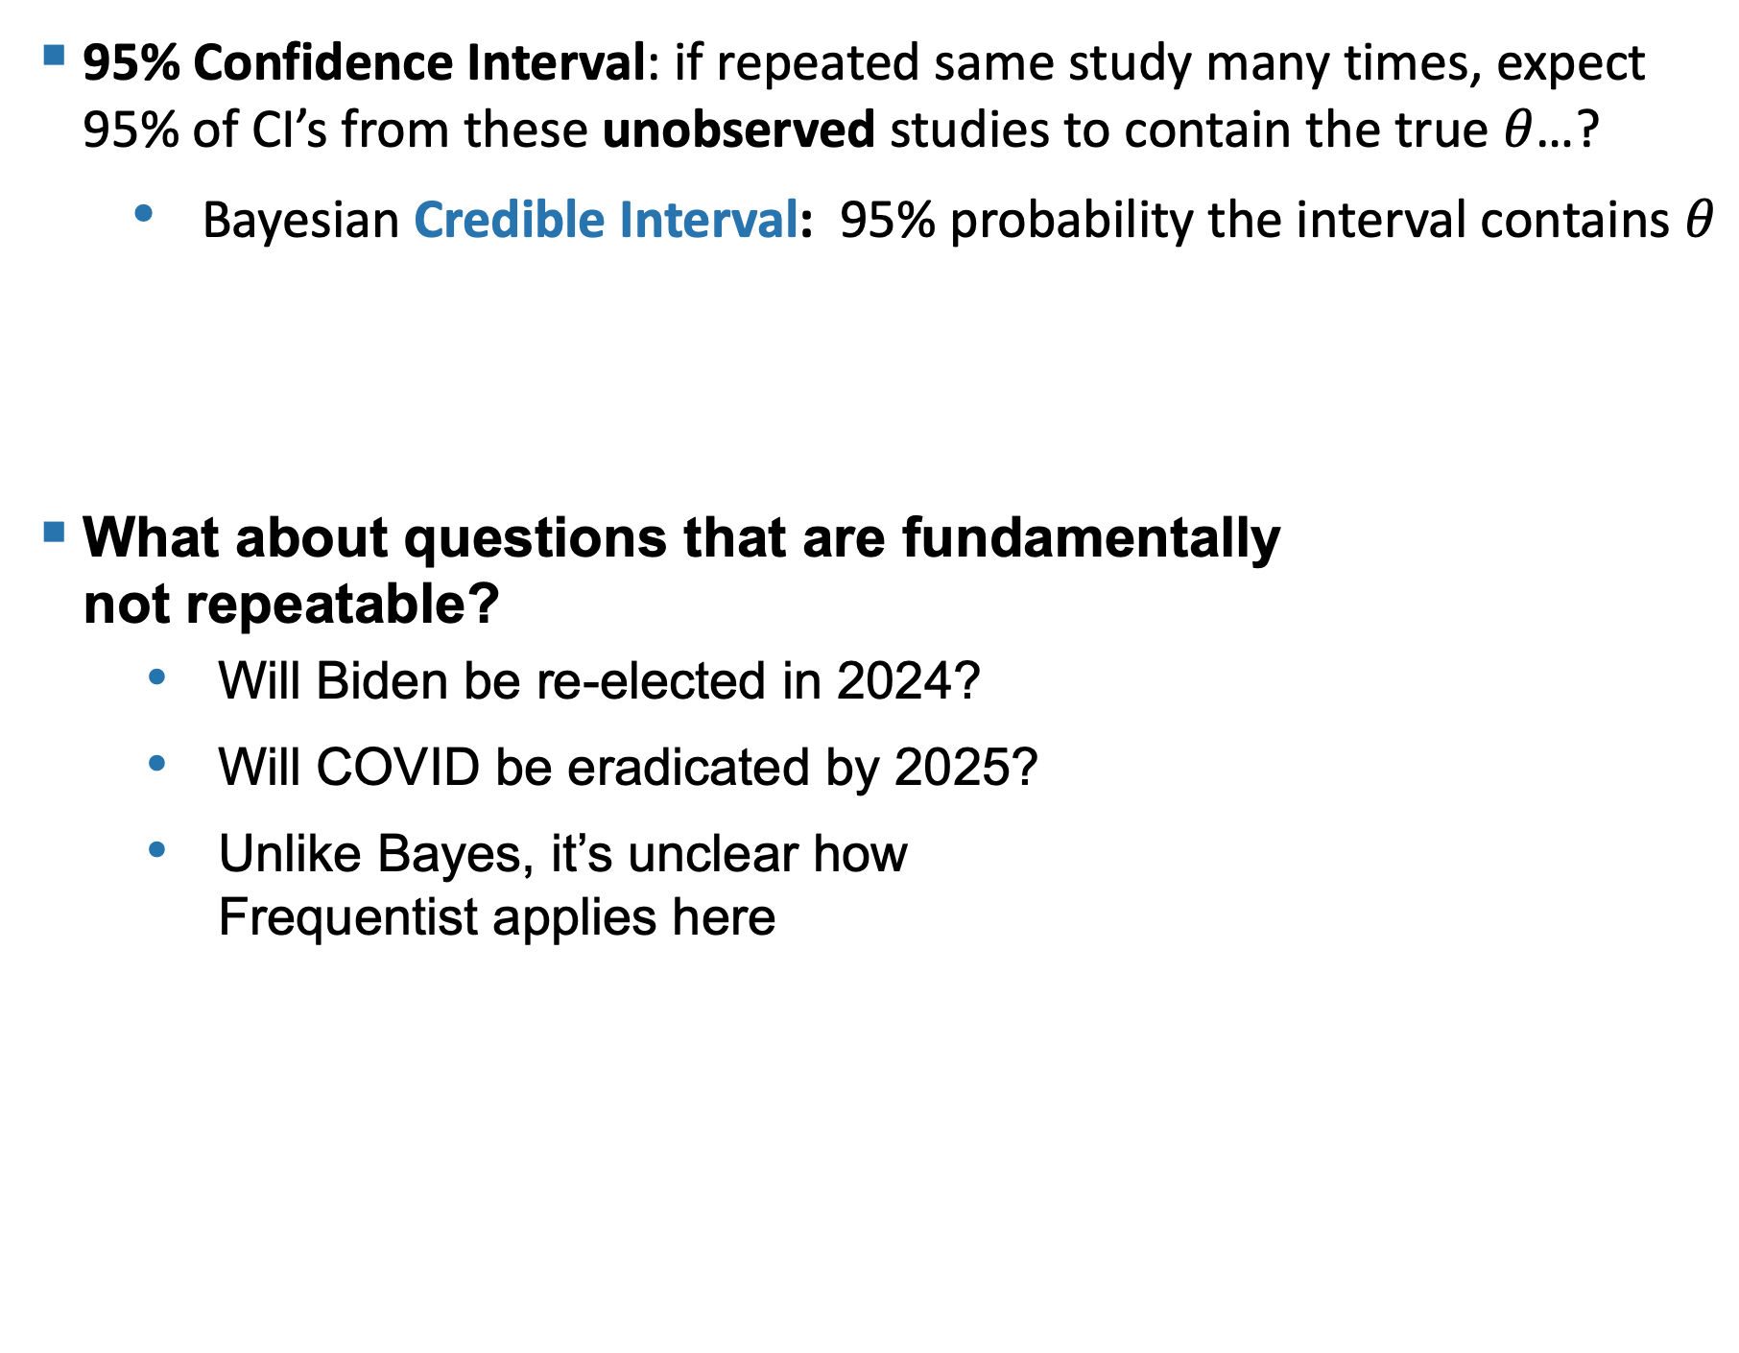
95% Confidence Interval: if repeated same study many times, expect 95% of CI’s from these unobserved studies to contain the true $θ$…?
Bayesian Credible Interval: 95% probability the interval contains $θ$
What about questions that are fundamentally not repeatable?
Will Biden be re-elected in 2024?
Will COVID be eradicated by 2025?
Unlike Bayes, it’s unclear how Frequentist applies here

Slide 14
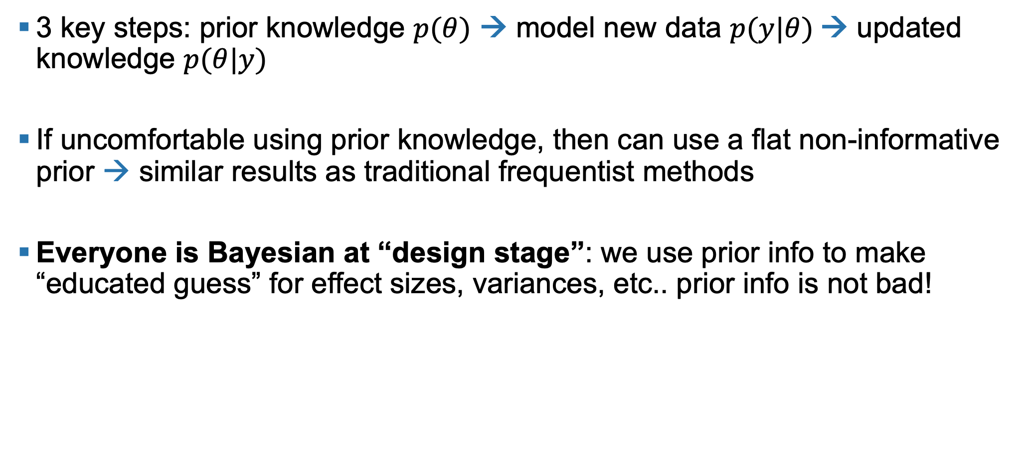
Summary
3 key steps: prior knowledge $p(θ)$ → model new data $p(y|θ)$→ updated knowledge $p(θ|y)$
If uncomfortable using prior knowledge, then can use a flat non-informative prior → similar results as traditional frequentist methods
Everyone is Bayesian at “design stage”: we use prior info to make “educated guess” for effect sizes, variances, etc.. prior info is not bad!

Slide 15
Learn more
van de Schoot, Rens, et al. "Bayesian statistics and modelling." Nature Reviews Methods Primers 1.1 (2021): 1-26.
Stephens, Matthew, and David J. Balding. "Bayesian statistical methods for genetic association studies." Nature Reviews Genetics 10.10 (2009): 681-690.
Kruschke, John. "Doing Bayesian data analysis: A tutorial with R, JAGS, and Stan."

Slide 16

Questions

