Slide 1
Project Detail Dashboard
User | IC / Project Owner
To view live dashboard type the following URL into your web browser:
https://abi-stg.akamai.com/analytics/saw.dll?Dashboard&PortalPath=%2Fshared%2FProjects%2F_portal%2FProjects&page=Fullfillment%20by%20Month

Slide 2
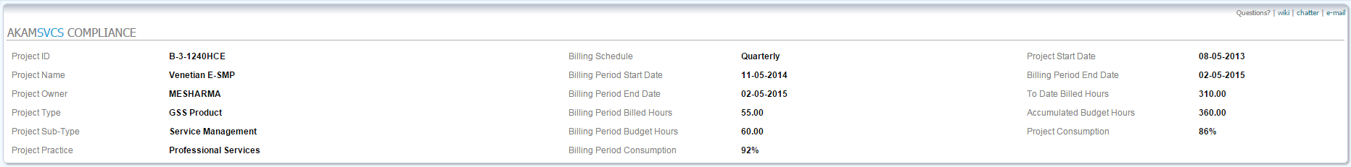
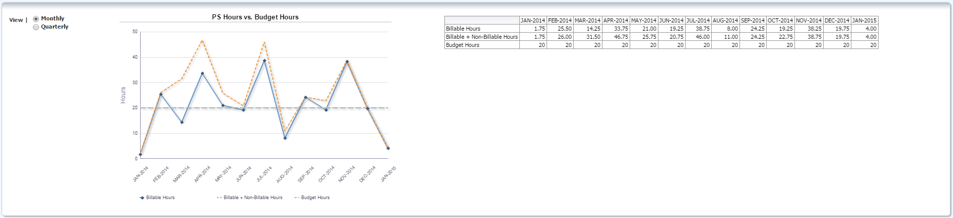
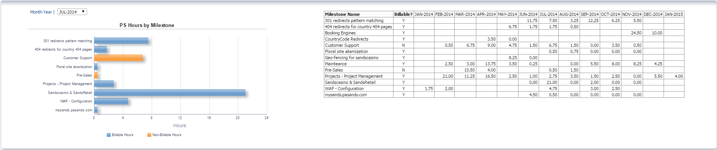
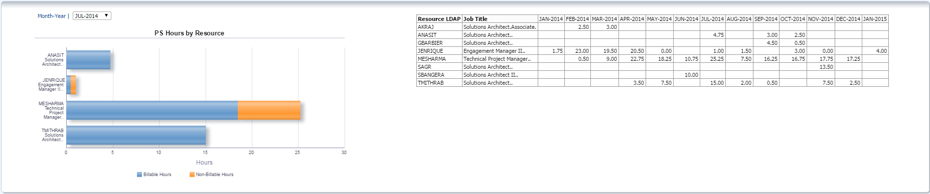
Project Detail | Overview
Metric Section
Time Series Section
Milestone Section
Resource Section

Slide 3
Project Detail | Metric Section
1st column has general project info
2nd column focuses on current billing period
Metric | Billing Period Consumption – billable hours in current billing period / total budget hours for period
3rd column focuses on project to-date metrics
Metric | Project Consumption – billable hours to-date / total accumulated budget hours thru current period
Period / Project Consumption need [case when billable hours is null then 0] for numerator to handle null value sets
Notes:
Period / Project Consumption need case when billable hours is null then 0 for numerator to handle null value sets

Slide 4
Project Detail | Time Series Graph
Graph should show consecutive time periods regardless of timesheet entries
Months are last rolling 12 months including current period (13 months total)
Qrtly view will need to encompass the same logic, however will need to show the entire qtr for first period

Slide 5
Project Detail | Milestone Section
Graph / table should show time periods based on View filter in Time Series Graph Section (i.e. month or quarter, with identical logic)
Filter should default to current period (month or quarter)

Slide 6
Project Detail | Resource Section
Graph / table should show time periods based on View filter in Time Series Graph Section (i.e. month or quarter, with identical logic)
Filter should default to current period (month or quarter)

Slide 7
Team Dashboard
User | Manager / PM
To view live dashboard type the following URL into your web browser:
https://abi-stg.akamai.com/analytics/saw.dll?Dashboard&PortalPath=%2Fshared%2FProjects%2F_portal%2FProjects&Page=Fulfillment%20Cover

Slide 8
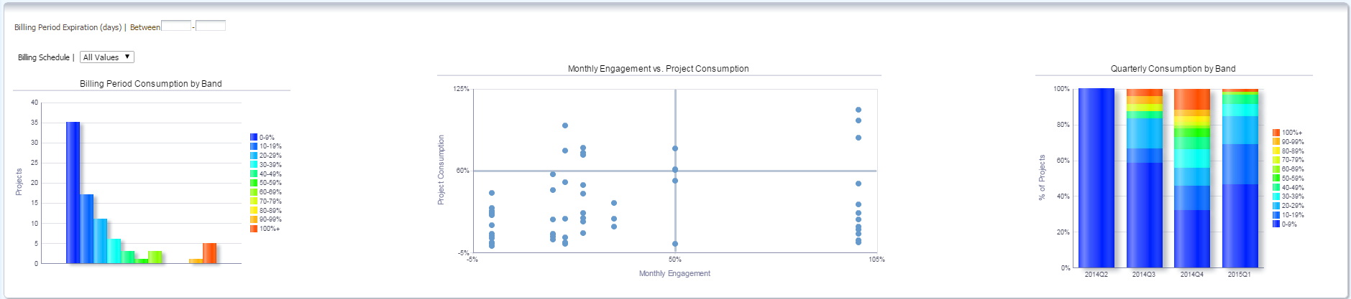
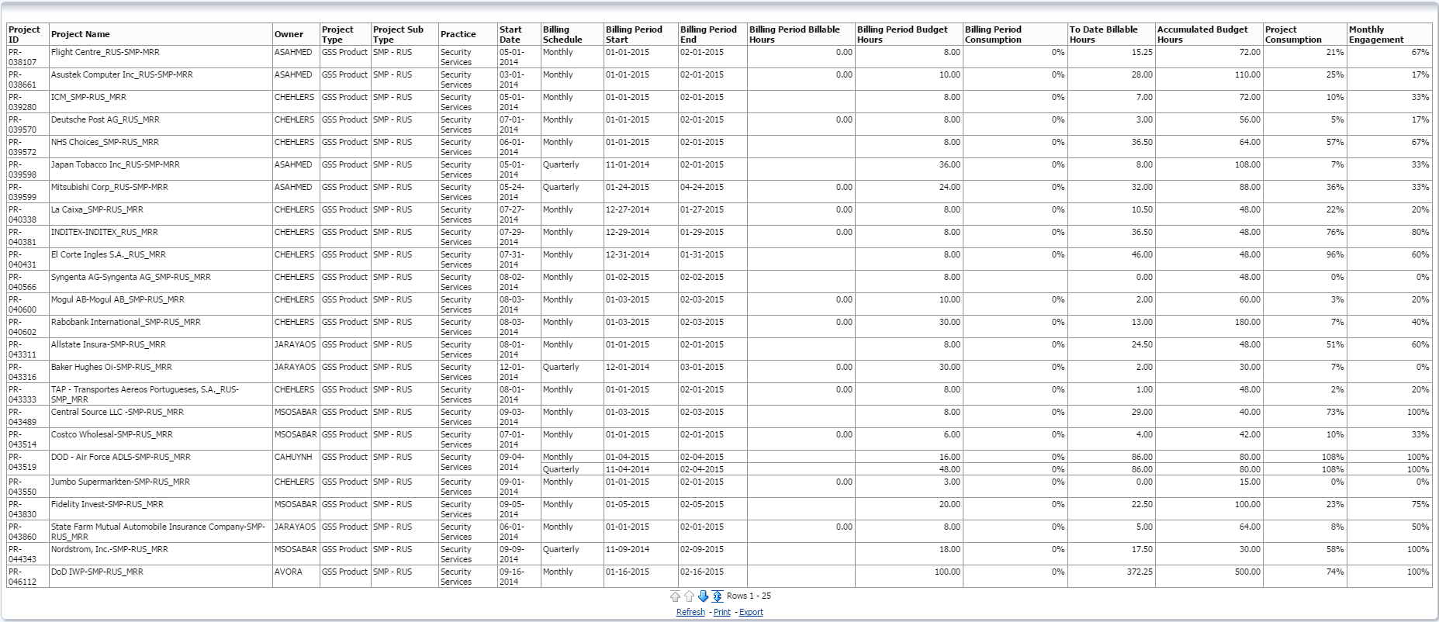
Team Dashboard | Overview
Metric Section
Visual Section
Project Section
Notes:
Once we have milestone compliance set up plan to use radar graphs to track billed time against budgeted activities

Slide 9
Team Dashboard | Metric Section
1st column dedicated to breadth of team
2nd column focuses on committed revenue and ESR
Metric | Effective Sell Rate – monthly budget amt / recurring budget hours
3rd column focuses on committed revenue and EBR
Metric | Effective Bill Rate – (period budget amt * periods expired) / total billed hours
4rd column focuses on Non-Billable Hours & OH
Metric | Non-Billable Overhead – total non-billable hours / total billed hours (rep. as a ratio of per billed hour)

Slide 10
Team Dashboard | Visual Section
1st graph illustrates current period consumption
Allows users to filter on periods expiring within XX days or day ranges
Allows users to filter btw monthly & qtrly billing schedules
Need to review formulas – 0-9% is currently a fixed value; does not contain projects w/o timesheets submitted for the billing period
2nd graph illustrates “project health” via monthly engagement and project consumption
Does not include projects with consumption metric > 125%; need to be able to customize size of bubbles and location of crosshairs
3rd graph illustrates project consumption over a time series (defaulted to qtrly?)
Does not contain projects w/o timesheets submitted for a given time period

Slide 11
Team Dashboard | Project Section
Pivot table showing all basic stats & metrics available in the Project Detail Dashboard
Monthly Engagement requires the col. “Month End Date” – this seems to be adversely affecting “Billing Period Consumption” calc
Notes:
Period / Project Consumption need case when billable hours is null then 0 for numerator to handle null value sets

