Slide 1

{{client_name}}

Slide 2
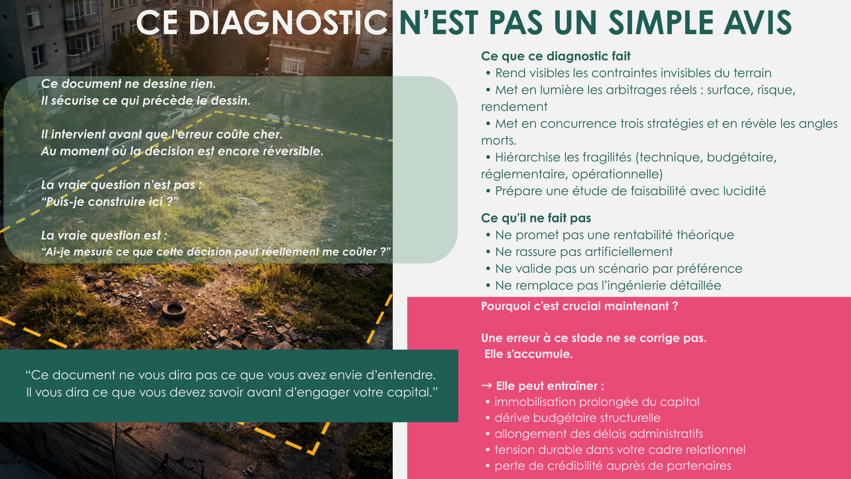

Slide 3

{{slide_3_text}}

Slide 4

{{slide_4_image}}
{{slide_4_text}}

Slide 5

{{slide_5_text}}
{{slide_4_axo_image}}

Slide 6

{{scenario_A_summary_text}}
{{scenario_A_massing}}

Slide 7

{{scenario_A_financial_text}}

Slide 8

{{scenario_A_risk_chart}}
{{scenario_A_risk_text}}
.

Slide 9

{{scenario_B_summary_text}}
{{scenario_B_massing}}

Slide 10

{{scenario_B_financial_text}}

Slide 11

{{scenario_B_risk_chart}}
.
{{scenario_B_risk_text}}

Slide 12

{{scenario_C_summary_text}}
.
{{scenario_C_massing}}

Slide 13

{{scenario_C_financial_text}}

Slide 14

{{scenario_C_risk_chart}}
{{scenario_C_risk_text}}

Slide 15

{{tableau comparative_charts}}

Slide 16

{{strategic_arbitrage_text}}
{{arbitrage_graph_}}

Slide 17

{{invisible_intro_text}}
{{invisible_technical_text}}
{{invisible_financial_text}}
{{invisible_strategic_text}}

Slide 18

{{success_intro_text}}
{{invisible_technical_text}}
{{invisible_financial_text}}
{{invisible_strategic_text}}

Slide 19
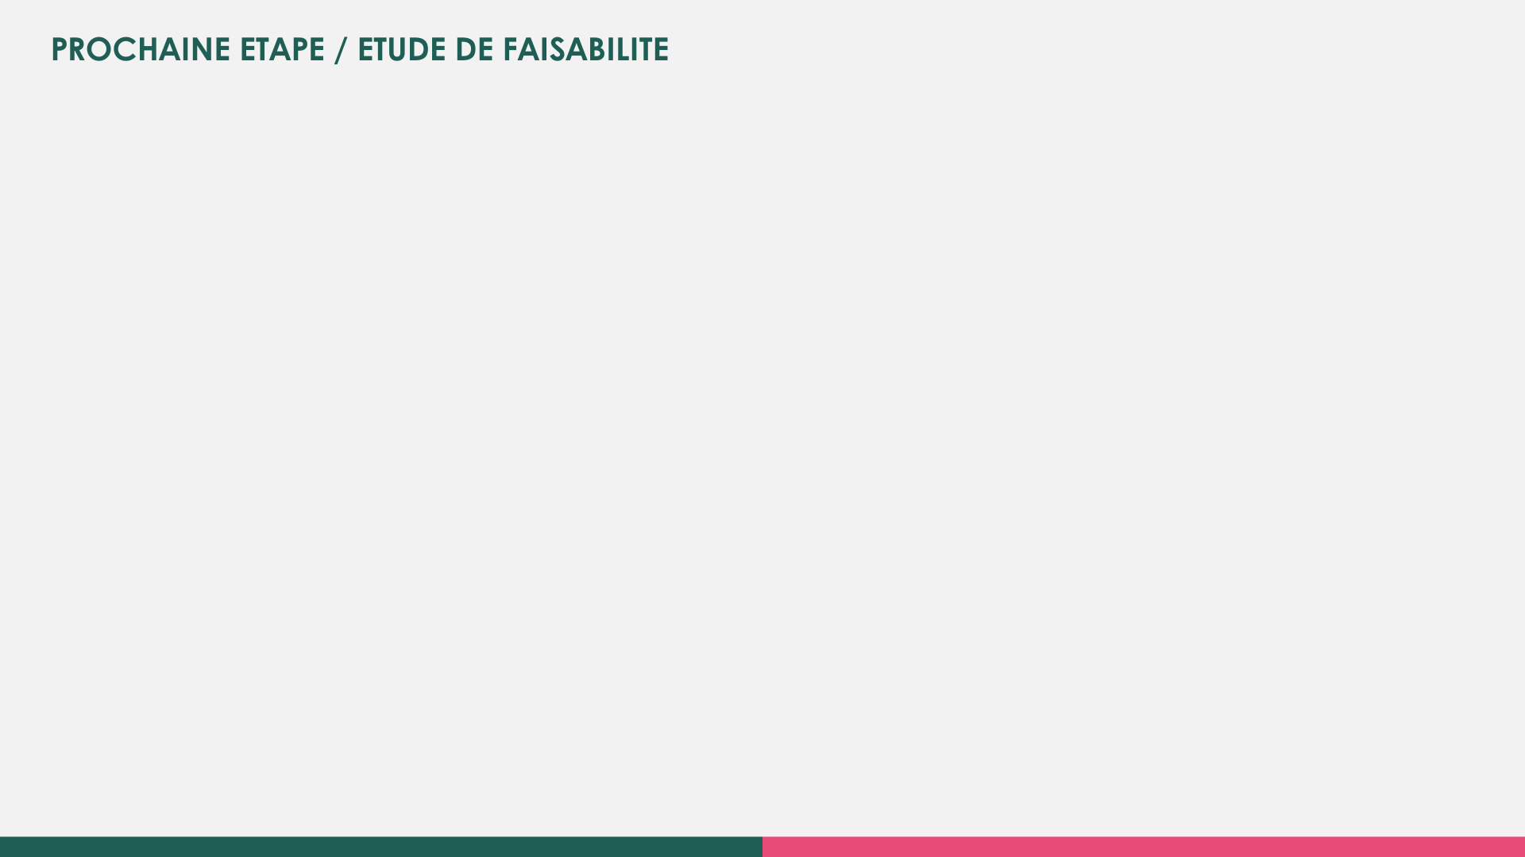
{{next_step_intro_text}}
{{next_step_scope_text}}

Slide 20

{{conclusion_summary_text}}
{{conclusion_positioning_text}
}

