Slide 1
RISCME Microarchitecture
(Reduced Instruction Set Cortex M Educational Microarchitecture)
Jardel Silveira
Jorge Reis
LESC/DETI/UFC

Slide 2
Requirements for RISCME
Architecture: Single Cycle
Instruction Set: Thumb 16 bits
  Supported instructions: B,BLX,LDR,STR,AND,ORR,ADD,SUB
Language: System Verilog
Synthesizable ? YES !!
Must be compatible with any assembler, like gcc or mdk, configured to generate cortex m0 binary
Datapath must be similar to Harris & Harris ARM7 Educational Single Cycle ARM

Slide 3
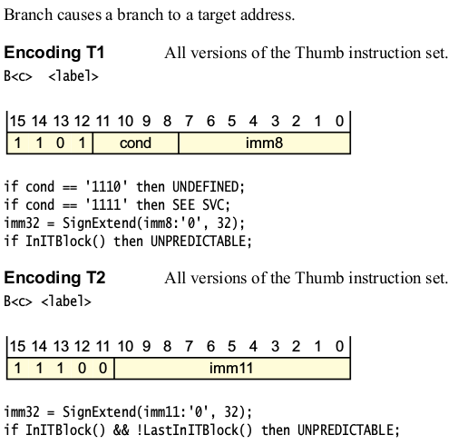
B

Slide 4
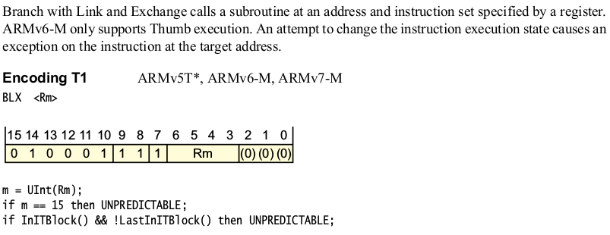
BLX (Register)

Slide 5
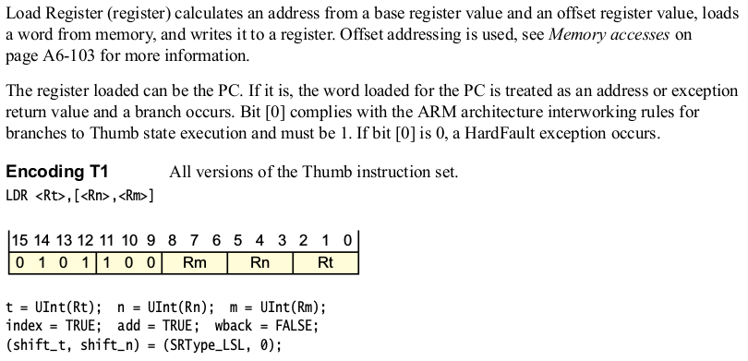
LDR (Register)

Slide 6
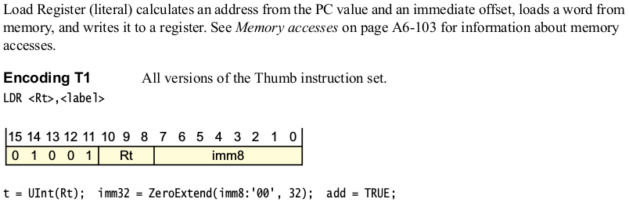
LDR (Literal)

Slide 7
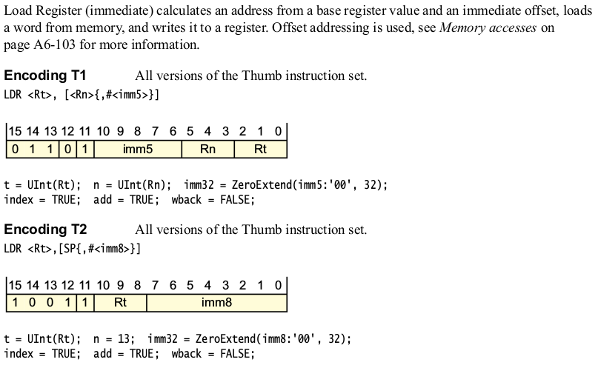
LDR (Immediate)

Slide 8
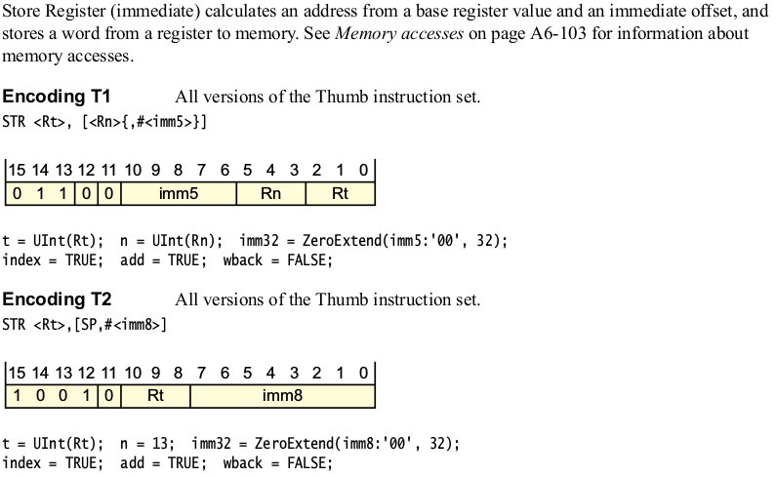
STR (Immediate)

Slide 9
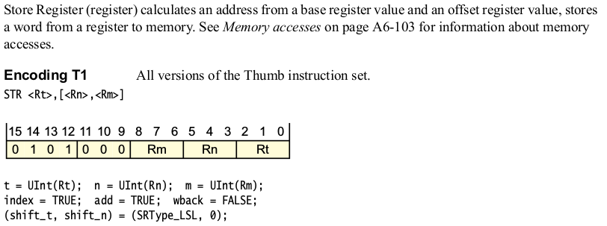
STR (Register)

Slide 10
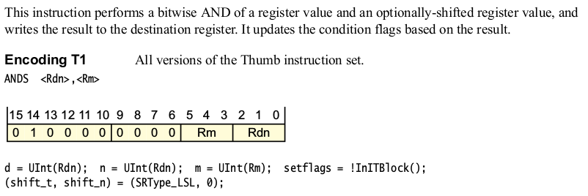
AND (Register)

Slide 11
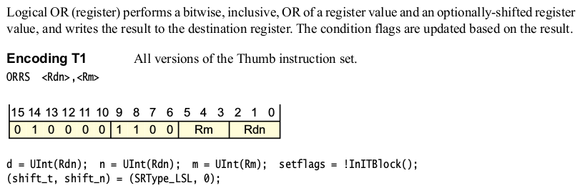
ORR (Register)

Slide 12
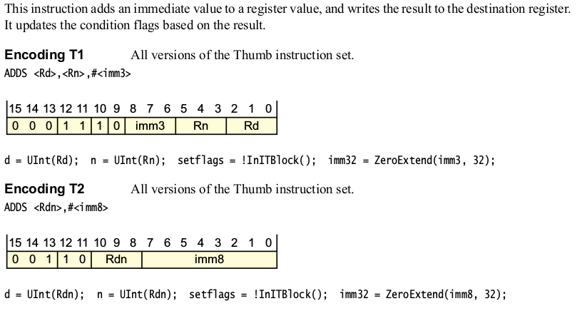
ADD (Immediate)

Slide 13
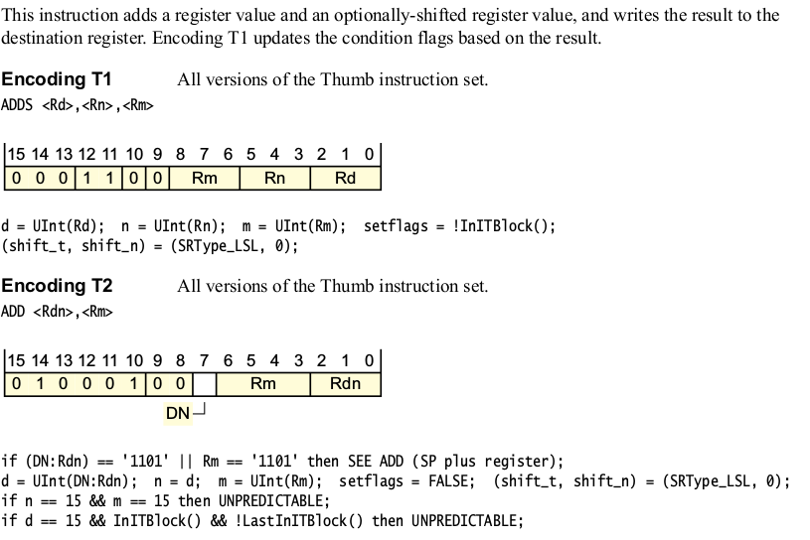
ADD (Register)

Slide 14
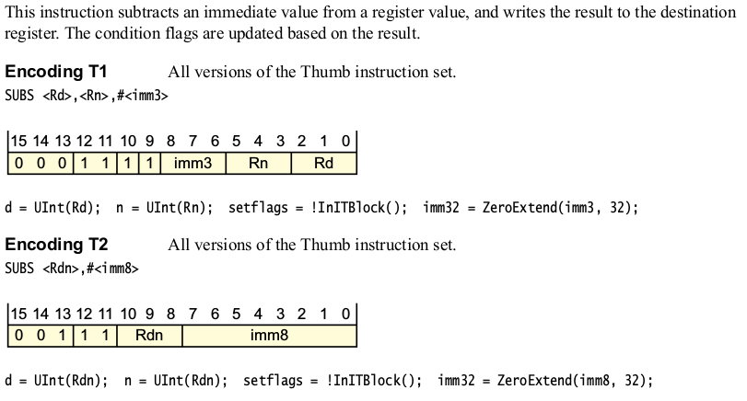
SUB (Immediate)

Slide 15
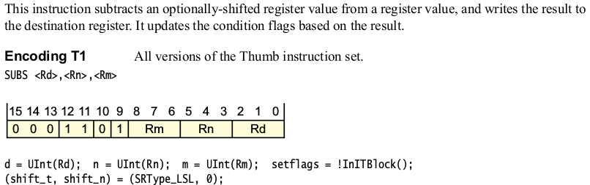
SUB (Register)

Slide 16
References
ARMv6-M Architecture Reference Manual
  http://infocenter.arm.com/help/index.jsp?topic=/com.arm.doc.ddi0419c/index.html
  https://imagecraft.com/pub/ARM/DDI0419C.pdf
http://pages.hmc.edu/harris/class/e85/arm_single.sv
http://pages.hmc.edu/harris/class/e85/DDCAarm_Ch7.pptx

