Slide 1
RISCME Microarchitecture (Reduced Instruction Set Cortex M Educational Microarchitecture)
Jardel Silveira
Jorge Reis
LESC/DETI/UFC

Slide 2
Requirements for RISCME
Micro Architecture: Single Cycle (So it’s not cycle accurate to ARMV6-M)
Instruction Set: ARMV6-M Thumb 16 bits
Supported instructions: B,BX,BLX,LDR,STR,ANDS,ORRS,ADDS,SUBS
Not All encoding of theses instructions are supported, but only listed one in this presentation
Accessible registers : R0-R7 and R15 and LR
Language: System Verilog
R0 hardwired to 0
Synthesizable ? YES !!
Stack pointer Instructions ? No !
Must be compatible with any assembler, like gcc or mdk, configured to generate cortex m0 binary
Datapath must be similar to Harris & Harris ARM7 Educational Single Cycle ARM

Slide 3
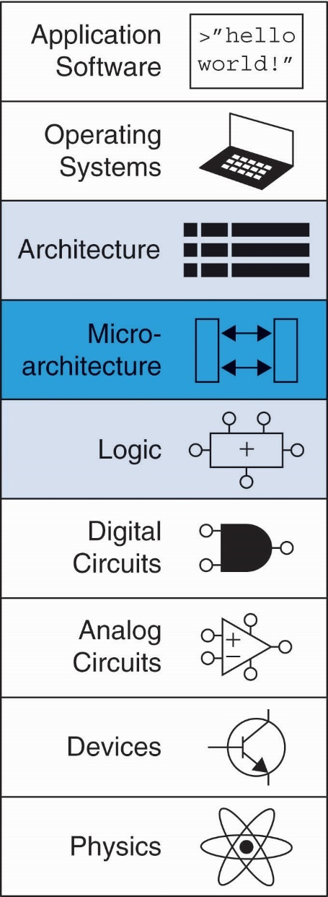
Introduction
Microarchitecture: how to implement an architecture in hardware
Processor:
Datapath: functional blocks
Control: control signals

Slide 4
Microarchitecture
Multiple implementations for a single architecture:
Single-cycle: Each instruction executes in a single cycle
Multicycle: Each instruction is broken up into series of shorter steps
Pipelined: Each instruction broken up into series of steps & multiple instructions execute at once

Slide 5
Processor Performance
Program execution time
Execution Time = (#instructions)(cycles/instruction)(seconds/cycle)
Definitions:
CPI: Cycles/instruction
clock period: seconds/cycle
IPC: instructions/cycle = IPC
Challenge is to satisfy constraints of:
Cost
Power
Performance

Slide 6
Architectural State Elements
Determines everything about a processor:
Architectural state:
16 registers (including PC)
Status register
Memory

Slide 7
ARM Architectural State Elements

Slide 8
Single-Cycle ARM Processor
Datapath
Control

Slide 9
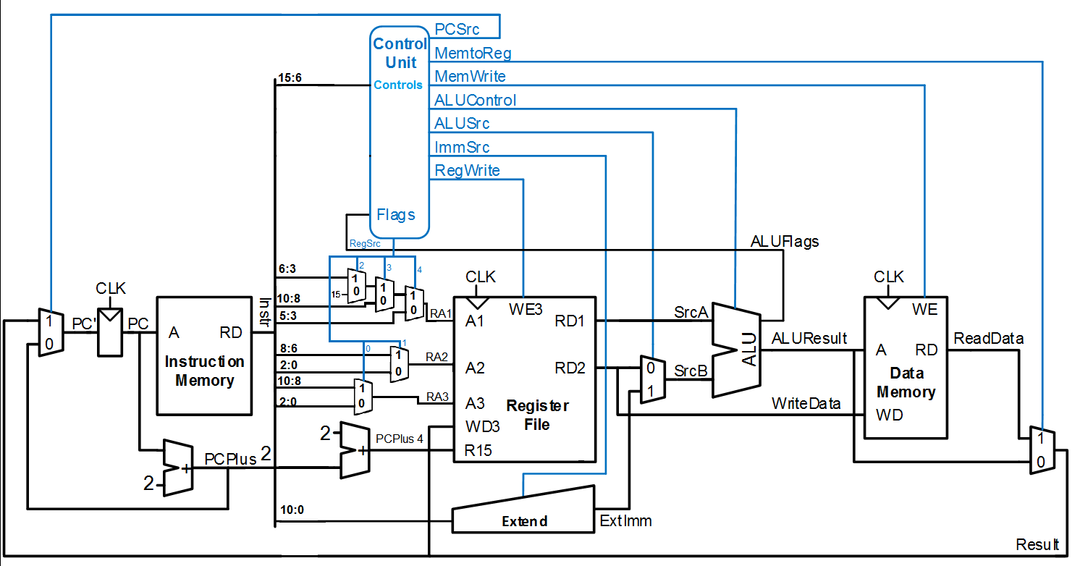
Microarchitecture

Slide 10
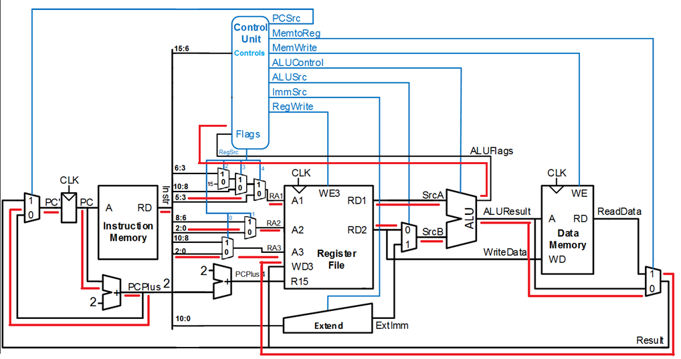

Slide 11
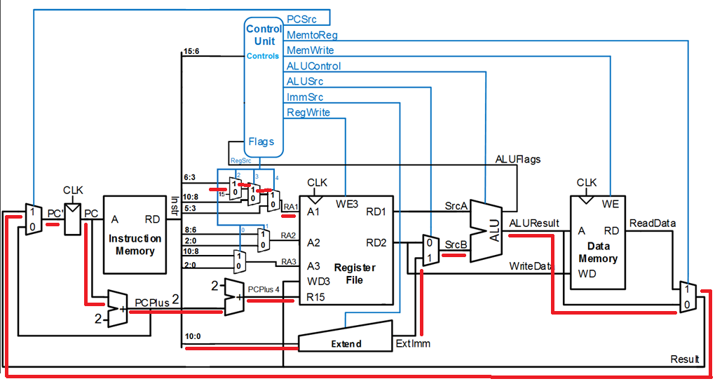

Slide 12
 | 15 | 14 | 13 | 12 | 11 | 10 | 9 | 8 | 7 | 6 | 5 | 4 | 3 | 2 | 1 | 0
DP Reg
ADDS <Rd>,<Rn>,<Rm> | 0 | 0 | 0 | 1 | 1 | 0 | 0 | Rm |  |  | Rn |  |  | Rd
SUBS <Rd>,<Rn>,<Rm> | 0 | 0 | 0 | 1 | 1 | 0 | 1 | Rm |  |  | Rn |  |  | Rd
ANDS <Rdn>,<Rm> | 0 | 1 | 0 | 0 | 0 | 0 | 0 | 0 | 0 | 0 | Rm |  |  | Rdn
ORRS <Rdn>,<Rm> | 0 | 1 | 0 | 0 | 0 | 0 | 1 | 1 | 0 | 0 | Rm |  |  | Rdn
DP Imm
ADDS <Rdn>,#<imm8> | 0 | 0 | 1 | 1 | 0 | Rdn |  |  | Imm8
SUBS <Rdn>,#<imm8> | 0 | 0 | 1 | 1 | 1 | Rdn |  |  | Imm8
LDR
LDR <Rt>, [<Rn>{,<imm5>}] | 0 | 1 | 1 | 0 | 1 | imm5 |  |  |  |  | Rn |  |  | Rt
STR
STR <Rt>, [<Rn>{,<imm5>}] | 0 | 1 | 1 | 0 | 0 | imm5 |  |  |  |  | Rn |  |  | Rt
Branch
B<c> <label> | 1 | 1 | 0 | 1 | cond |  |  |  | Imm8
B <label> | 1 | 1 | 1 | 0 | 0 | Imm11
BLX <Rm> | 0 | 1 | 0 | 0 | 0 | 1 | 1 | 1 | 1 | Rm |  |  |  | 0) | 0) | 0)
BX <Rm> | 0 | 1 | 0 | 0 | 0 | 1 | 1 | 1 | 0 | Rm |  |  |  | 0) | 0) | 0)

Slide 13

16-bit Thumb Instruction Enconding
opcode | Instruction class
00xxxx | Adds and Subs
010000 | Data processing (ands / orrs)
010001 | Branch and Exchange
0101xx 011xxx 100xxx | Load/store single data item
1101xx | Conditional branch
11100x | Unconditional Branch

Slide 14
Op | Type | Branch | MemtoReg | MemW | ALUSrc | ImmSrc | RegW | RegSrc | LRW | FlagW | ALUControl
0001100 0001101 | DPRSP | 0 | 0 | 0 | 0 | XX | 1 | 0XX10 | 0 | 11 | 0?
0100000000 0100001100 | DPRCM | 0 | 0 | 0 | 0 | XX | 1 | 0XX00 | 0 | 10 | 1?
00110 00111 | DP Imm | 0 | 0 | 0 | 1 | 01 | 1 | 10XX1 | 0 | 11 | 0?
01100 | STR | 0 | X | 1 | 1 | 00 | 0 | 0XX0X | 0 | 00 | 00
01101 | LDR | 0 | 1 | 0 | 1 | 00 | 1 | 0XXX0 | 0 | 00 | 00
11100 | B | 1 | 0 | 0 | 1 | 11 | 0 | 110XX | 0 | 00 | 00
1101 | B cond | 1 | 0 | 0 | 1 | 10 | 0 | 110XX | 0 | 00 | 00
010001110 | BX | 1 | 0 | 0 | 0 | XX | 0 | 1110X | 0 | 00 | 00
010001111 | BLX | 1 | 0 | 0 | 0 | XX | 0 | 1110X | 1 | 00 | 00

Slide 15
Adds and Subs
opcode | Instruction class
00xxxx | Add and Sub

Slide 16

ADDS e SUBS
opcode | Instruction
01100 | Adds Register
01101 | Subs Register
110xx | Adds 8-bit imm
111xx | Subs 8-bit imm

Slide 17
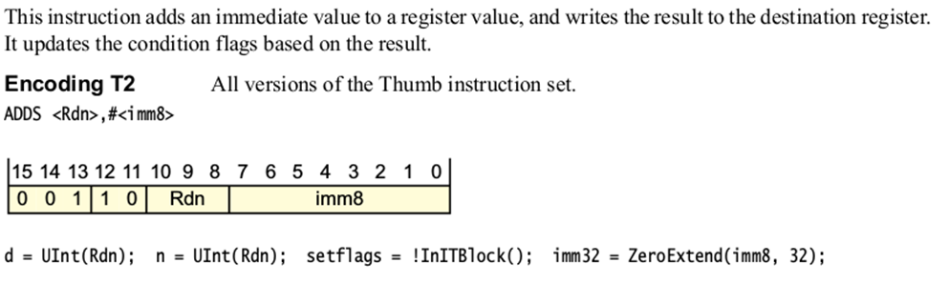
ADDS (Immediate)

Slide 18
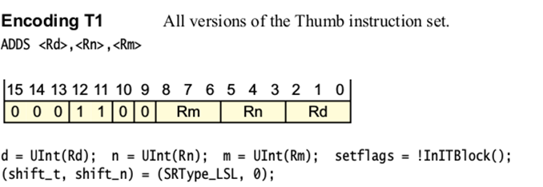
ADDS (Register)

Slide 19
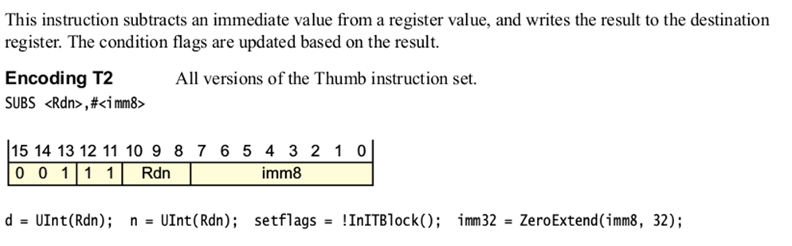
SUBS (Immediate)

Slide 20
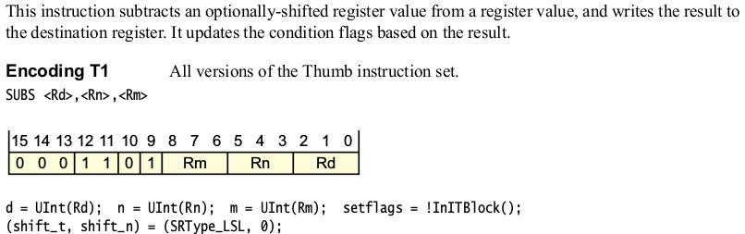
SUBS (Register)

Slide 21
Data Processing Instructions
opcode | Instruction class
010000 | Data processing

Slide 22

ORRS e ANDS
opcode | Instruction
0000 | Bitwise And
1100 | Logical or

Slide 23
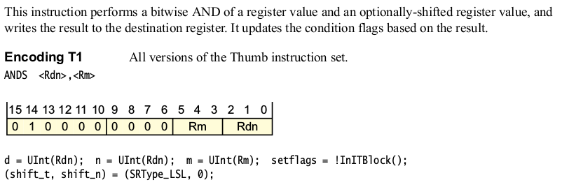
ANDS (Register)

Slide 24
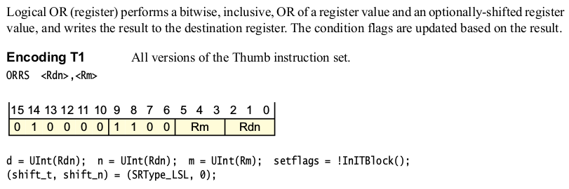
ORRS (Register)

Slide 25
Branch and Exchange
opcode | Instruction class
010001 | Branch and Exchange

Slide 26

BLX and BX
opcode | Instruction
110x | BX
111x | BLX

Slide 27
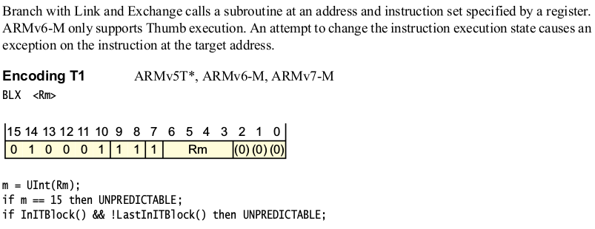
BLX (Register)

Slide 28
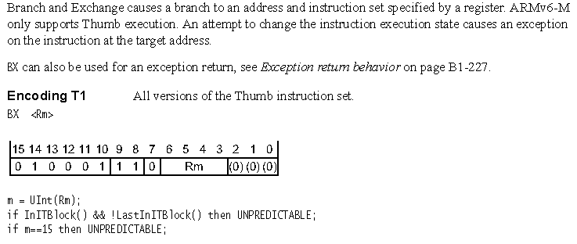
BX (Register)

Slide 29
Load/store single data item
opcode | Instruction class
0101xx 011xxx 100xxx | Load/store single data item

Slide 30

LDR e STR
opA | opB | Instruction
0110 | 0xx | STR Imm
0110 | 1xx | LDR Imm

Slide 31
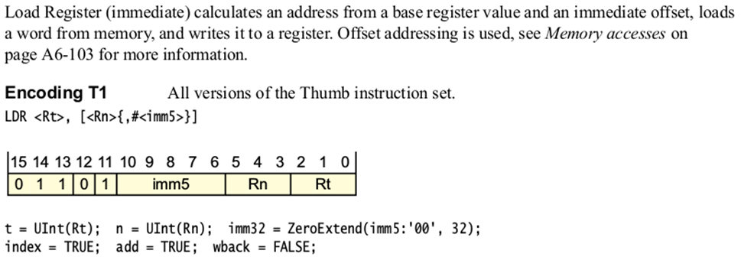
LDR (Immediate)

Slide 32
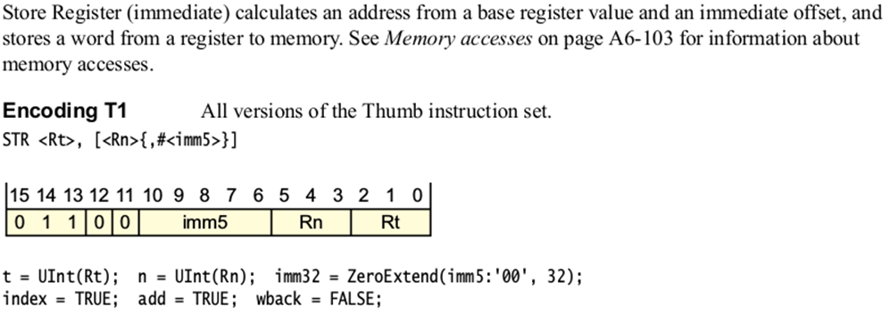
STR (Immediate)

Slide 33
Conditional branch
opcode | Instruction class
1101xx | Conditional branch

Slide 34

B

Slide 35
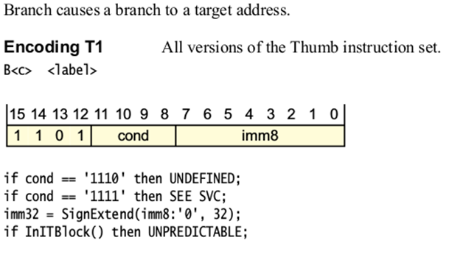
B

Slide 36
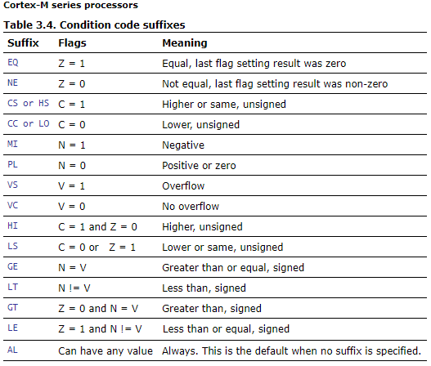
B

Slide 37
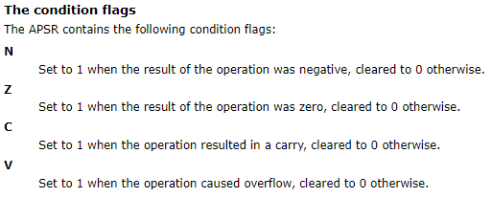

Slide 38
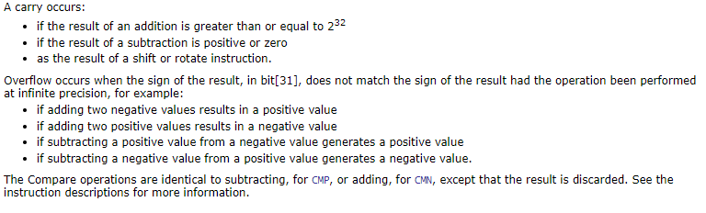

Slide 39
Unconditional Branch
opcode | Instruction class
11100x | Unconditional Branch

Slide 40
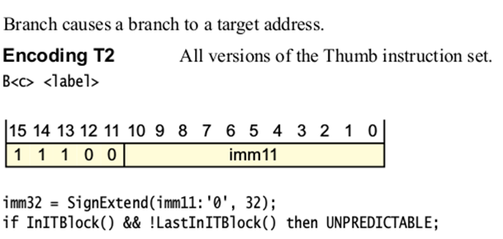
B

Slide 41
 | 15 | 14 | 13 | 12 | 11 | 10 | 9 | 8 | 7 | 6 | 5 | 4 | 3 | 2 | 1 | 0
DP Reg
ADDS <Rd>,<Rn>,<Rm> | 0 | 0 | 0 | 1 | 1 | 0 | 0 | Rm |  |  | Rn |  |  | Rd
SUBS <Rd>,<Rn>,<Rm> | 0 | 0 | 0 | 1 | 1 | 0 | 1 | Rm |  |  | Rn |  |  | Rd
ANDS <Rdn>,<Rm> | 0 | 1 | 0 | 0 | 0 | 0 | 0 | 0 | 0 | 0 | Rm |  |  | Rdn
ORRS <Rdn>,<Rm> | 0 | 1 | 0 | 0 | 0 | 0 | 1 | 1 | 0 | 0 | Rm |  |  | Rdn
DP Imm
ADDS <Rdn>,#<imm8> | 0 | 0 | 1 | 1 | 0 | Rdn |  |  | Imm8
SUBS <Rdn>,#<imm8> | 0 | 0 | 1 | 1 | 1 | Rdn |  |  | Imm8
LDR
LDR <Rt>, [<Rn>{,<imm5>}] | 0 | 1 | 1 | 0 | 1 | imm5 |  |  |  |  | Rn |  |  | Rt
STR
STR <Rt>, [<Rn>{,<imm5>}] | 0 | 1 | 1 | 0 | 0 | imm5 |  |  |  |  | Rn |  |  | Rt
Branch
B<c> <label> | 1 | 1 | 0 | 1 | cond |  |  |  | Imm8
B <label> | 1 | 1 | 1 | 0 | 0 | Imm11
BLX <Rm> | 0 | 1 | 0 | 0 | 0 | 1 | 1 | 1 | 1 | Rm |  |  |  | 0) | 0) | 0)
BX <Rm> | 0 | 1 | 0 | 0 | 0 | 1 | 1 | 1 | 0 | Rm |  |  |  | 0) | 0) | 0)

Slide 42
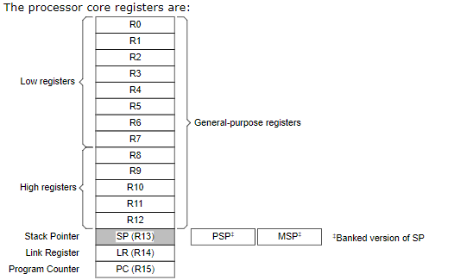

Slide 43
References
ARMv6-M Architecture Reference Manual
http://infocenter.arm.com/help/index.jsp?topic=/com.arm.doc.ddi0419c/index.html
https://imagecraft.com/pub/ARM/DDI0419C.pdf
http://pages.hmc.edu/harris/class/e85/arm_single.sv
http://pages.hmc.edu/harris/class/e85/DDCAarm_Ch7.pptx

