Slide 1
RISCME Microarchitecture (Reduced Instruction Set Cortex M Educational Microarchitecture)
Jardel Silveira
Jorge Reis
LESC/DETI/UFC

Slide 2
Requirements for RISCME
Micro Architecture: Single Cycle (So it’s not cycle accurate to ARMV6-M)
Instruction Set: ARMV6-M Thumb 16 bits
Supported instructions: B,BX,BLX,LDR,STR,ANDS,ORRS,ADDS,SUBS
Not All encoding of theses instructions are supported, but only listed one in this presentation
Accessible registers : R0-R7 and R15
Language: System Verilog
Synthesizable ? YES !!
Stack pointer Instructions ? No !
Must be compatible with any assembler, like gcc or mdk, configured to generate cortex m0 binary
Datapath must be similar to Harris & Harris ARM7 Educational Single Cycle ARM

Slide 3

16-bit Thumb Instruction Enconding
opcode | Instruction class
00xxxx | Adds and Subs
010000 | Data processing (ands / orrs)
010001 | Branch and Exchange
0101xx 011xxx 100xxx | Load/store single data item
1101xx | Conditional branch
11100x | Unconditional Branch

Slide 4
Op | Funct₅ | Funct₀ | Type | Branch | MemtoReg | MemW | ALUSrc | ImmSrc | RegW | RegSrc | ALUOp
Inst [15:10]=010000 000110 | 0 | X | DP Reg | 0 | 0 | 0 | 0 | XX | 1 | 00 | 1
000111 00110x 000110 00111x | 1 | X | DP Imm | 0 | 0 | 0 | 1 | 00 | 1 | X0 | 1
01010 01100 | X | 0 | STR | 0 | X | 1 | 1 | 01 | 0 | 10 | 0
01011 01101 | X | 1 | LDR | 0 | 1 | 0 | 1 | 01 | 1 | X0 | 0
010001 1101xx 11100x | X | X | B | 1 | 0 | 0 | 1 | 10 | 0 | X1 | 0

Slide 5
Adds and Subs
opcode | Instruction class
00xxxx | Add and Sub

Slide 6

ADDS e SUBS
opcode | Instruction
01100 | Adds Register
01101 | Subs Register
01110 | Adds 3-bit imm
01111 | Subs 3-bit imm
110xx | Adds 8-bit imm
111xx | Subs 8-bit imm

Slide 7
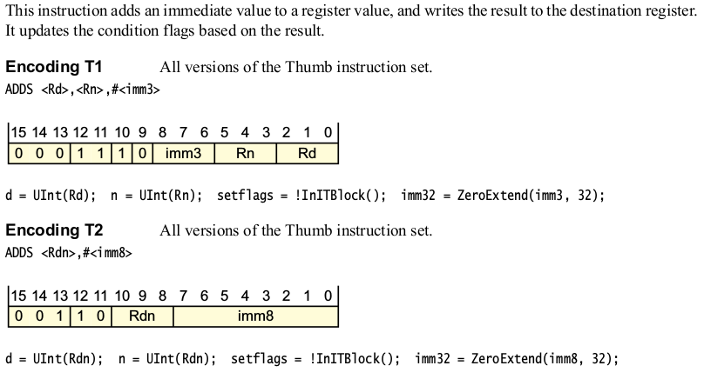
ADDS (Immediate)

Slide 8
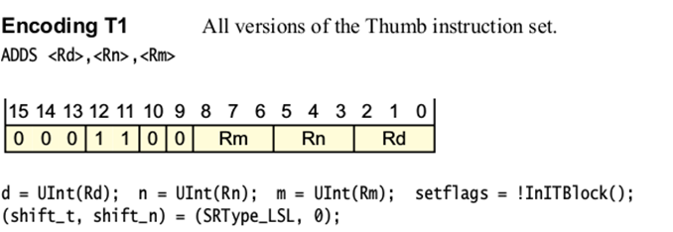
ADDS (Register)

Slide 9
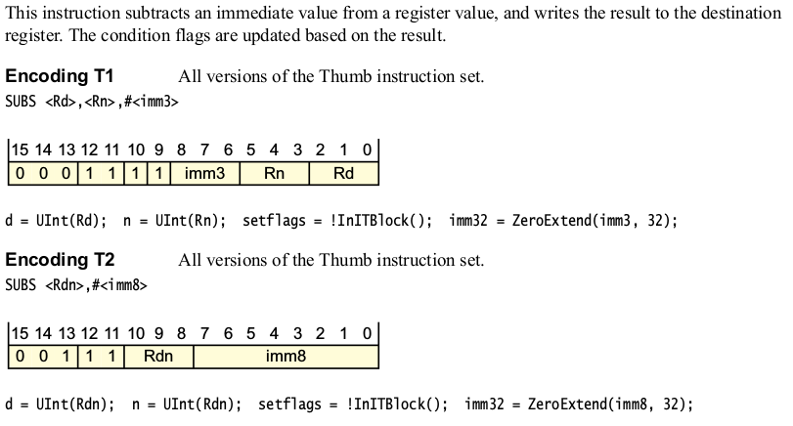
SUBS (Immediate)

Slide 10
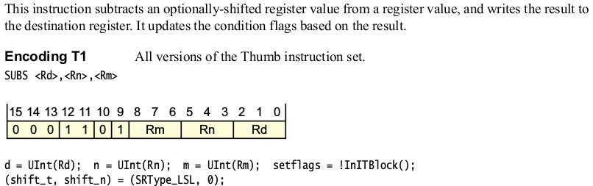
SUBS (Register)

Slide 11
Data Processing Instructions
opcode | Instruction class
010000 | Data processing

Slide 12

ORRS e ANDS
opcode | Instruction
0000 | Bitwise And
1100 | Logical or

Slide 13
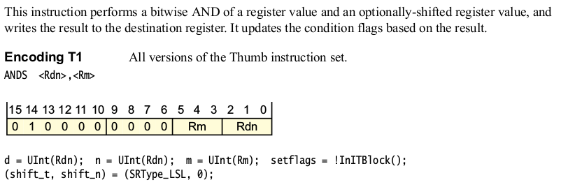
ANDS (Register)

Slide 14
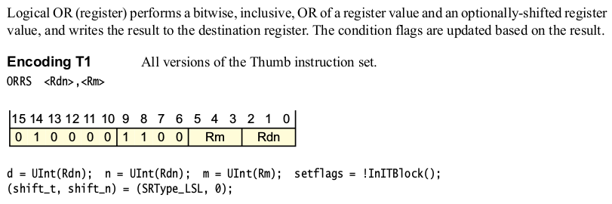
ORRS (Register)

Slide 15
Branch and Exchange
opcode | Instruction class
010001 | Branch and Exchange

Slide 16

BLX and BX
opcode | Instruction
110x | BX
111x | BLX

Slide 17
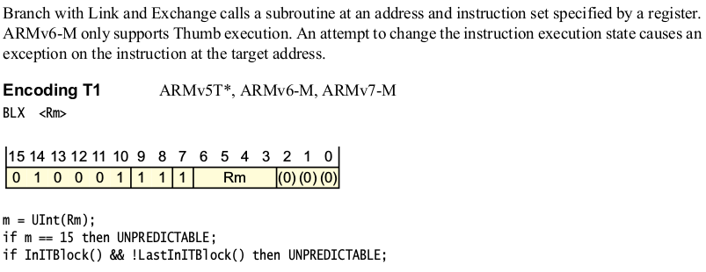
BLX (Register)

Slide 18
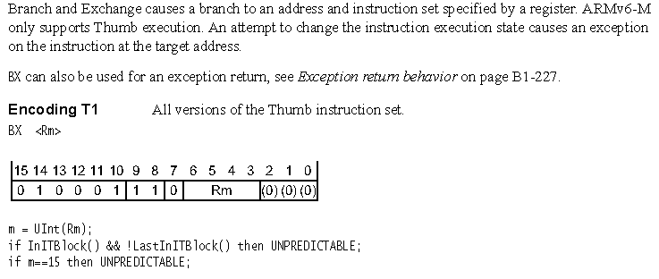
BX (Register)

Slide 19
Load/store single data item
opcode | Instruction class
0101xx 011xxx 100xxx | Load/store single data item

Slide 20

LDR e STR
opA | opB | Instruction
0101 | 000 | STR (Register)
0101 | 100 | LDR (Register)
0110 | 0xx | STR Imm
0110 | 1xx | LDR Imm

Slide 21
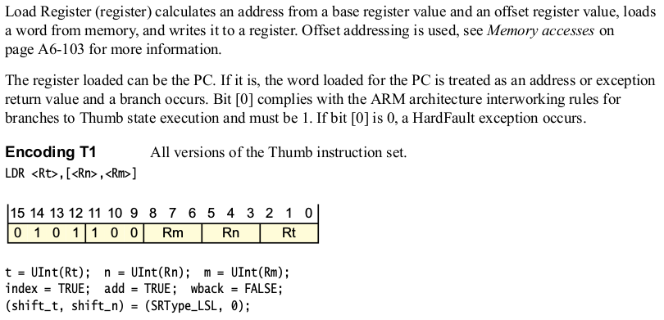
LDR (Register)

Slide 22
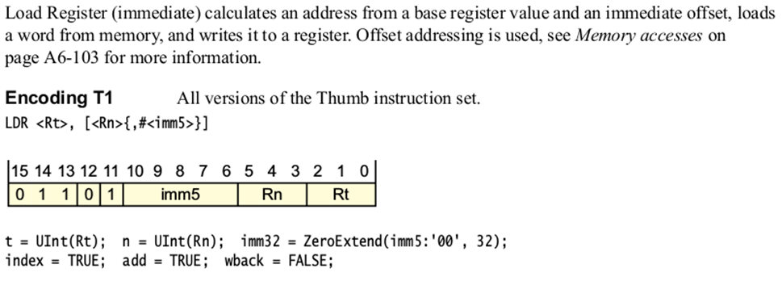
LDR (Immediate)

Slide 23
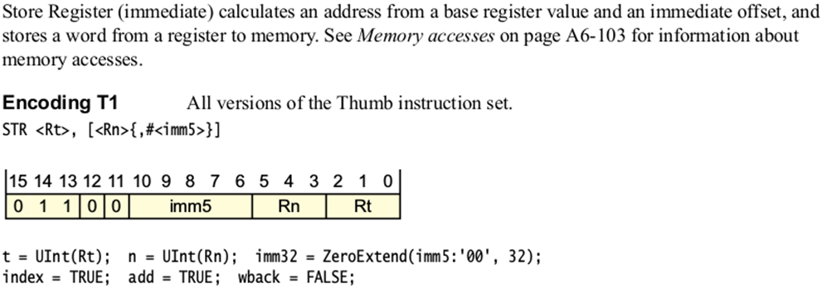
STR (Immediate)

Slide 24
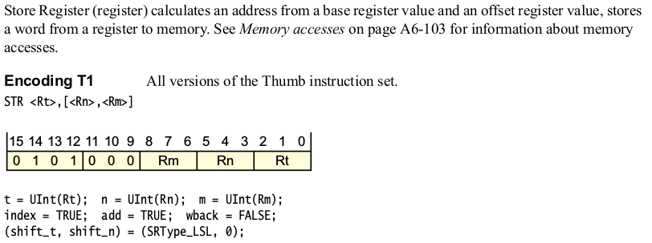
STR (Register)

Slide 25
Conditional branch
opcode | Instruction class
1101xx | Conditional branch

Slide 26

B

Slide 27
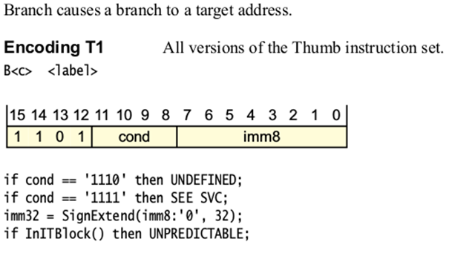
B

Slide 28
Unconditional Branch
opcode | Instruction class
11100x | Unconditional Branch

Slide 29
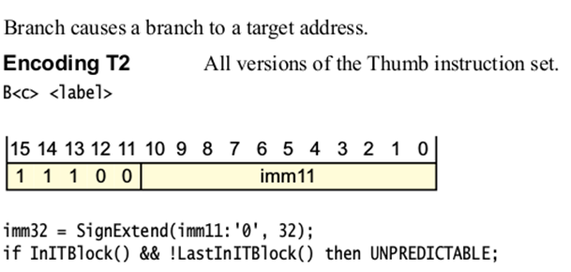
B

Slide 30
 | 15 | 14 | 13 | 12 | 11 | 10 | 9 | 8 | 7 | 6 | 5 | 4 | 3 | 2 | 1 | 0
ADDS <Rd>,<Rn>,#<imm3> | 0 | 0 | 0 | 1 | 1 | 1 | 0 | imm3 |  |  | Rn |  |  | Rd
SUBS <Rd>,<Rn>,#<imm3> | 0 | 0 | 0 | 1 | 1 | 1 | 1 | imm3 |  |  | Rn |  |  | Rd
ADDS <Rd>,<Rn>,<Rm> | 0 | 0 | 0 | 1 | 1 | 0 | 0 | Rm |  |  | Rn |  |  | Rd
SUBS <Rd>,<Rn>,<Rm> | 0 | 0 | 0 | 1 | 1 | 0 | 1 | Rm |  |  | Rn |  |  | Rd
ADDS <Rdn>,#<imm8> | 0 | 0 | 1 | 1 | 0 | Rdn |  |  | imm8
SUBS <Rdn>,#<imm8> | 0 | 0 | 1 | 1 | 1 | Rdn |  |  | imm8
ANDS <Rdn>,<Rm> | 0 | 1 | 0 | 0 | 0 | 0 | 0 | 0 | 0 | 0 | Rm |  |  | Rdn
ORRS <Rdn>,<Rm> | 0 | 1 | 0 | 0 | 0 | 0 | 1 | 1 | 0 | 0 | Rm |  |  | Rdn
BLX <Rm> | 0 | 1 | 0 | 0 | 0 | 1 | 1 | 1 | 1 | Rm |  |  |  | 0) | 0) | 0)
BX <Rm> | 0 | 1 | 0 | 0 | 0 | 1 | 1 | 1 | 0 | Rm |  |  |  | 0) | 0) | 0)
LDR <Rt>, [<Rn>,<Rm>] | 0 | 1 | 0 | 1 | 1 | 0 | 0 | Rm |  |  | Rn |  |  | Rt
STR <Rt>, [<Rn>,<Rm>] | 0 | 1 | 0 | 1 | 0 | 0 | 0 | Rm |  |  | Rn |  |  | Rt
LDR <Rt>, [<Rn>{,<imm5>}] | 0 | 1 | 1 | 0 | 1 | imm5 |  |  |  |  | Rn |  |  | Rt
STR <Rt>, [<Rn>{,<imm5>}] | 0 | 1 | 1 | 0 | 0 | imm5 |  |  |  |  | Rn |  |  | Rt
B<c> <label> | 1 | 1 | 0 | 1 | cond |  |  |  | imm8
B <label> | 1 | 1 | 1 | 0 | 0 | imm11

Slide 31
References
ARMv6-M Architecture Reference Manual
http://infocenter.arm.com/help/index.jsp?topic=/com.arm.doc.ddi0419c/index.html
https://imagecraft.com/pub/ARM/DDI0419C.pdf
http://pages.hmc.edu/harris/class/e85/arm_single.sv
http://pages.hmc.edu/harris/class/e85/DDCAarm_Ch7.pptx

