Slide 1
RISCME Microarchitecture (Reduced Instruction Set Cortex M Educational Microarchitecture)
Jardel Silveira
Jorge Reis
LESC/DETI/UFC

Slide 2
Requirements for RISCME
Architecture: Single Cycle (So it’s not cycle accurate to ARMV6-M)
Instruction Set: ARMV6-M Thumb 16 bits
Supported instructions: B,BX,BLX,LDR,STR,AND,ORR,ADD,SUB
Language: System Verilog
Synthesizable ? YES !!
Must be compatible with any assembler, like gcc or mdk, configured to generate cortex m0 binary
Datapath must be similar to Harris & Harris ARM7 Educational Single Cycle ARM

Slide 3

16-bit Thumb Instruction Enconding
opcode | Instruction class
00xxxx | Add and Sub
010000 | Data processing (and / or)
010001 | Branch and Exchange
0101xx 011xxx 100xxx | Load/store single data item
1101xx | Conditional branch
11100x | Unconditional Branch

Slide 4
Add and Sub
opcode | Instruction class
00xxxx | Add and Sub

Slide 5

ADD e SUB
opcode | Instruction
01100 | Add Register
01101 | Sub Register
01110 | Add 3-bit imm
01111 | Sub 3-bit imm
110xx | Add 8-bit imm
111xx | Sub 8-bit imm

Slide 6
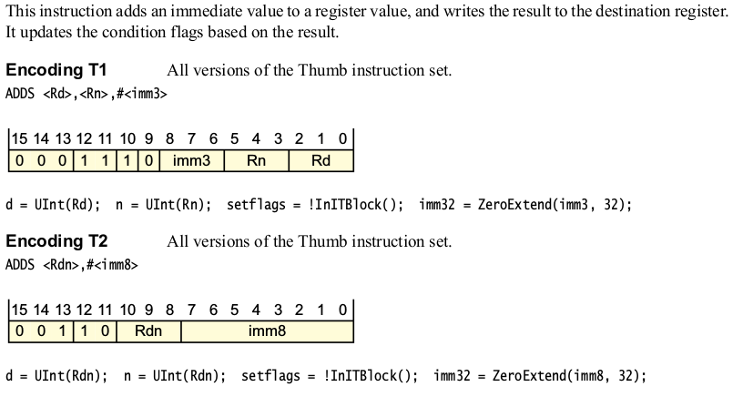
ADD (Immediate)

Slide 7
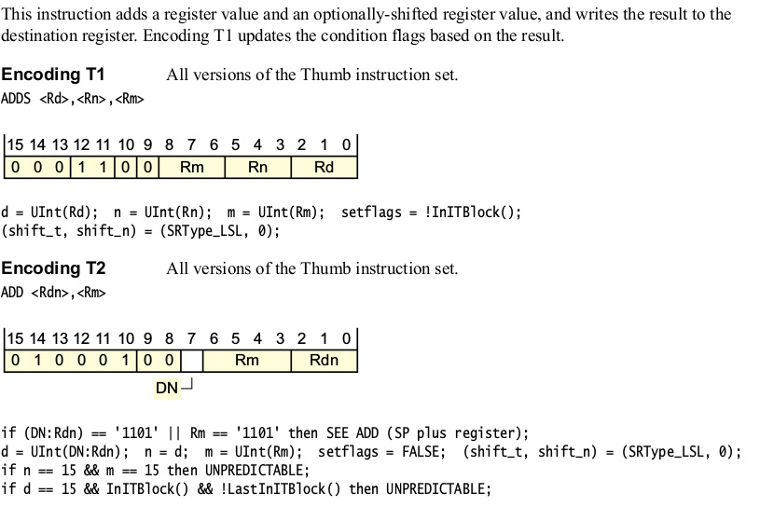
ADD (Register)

Slide 8
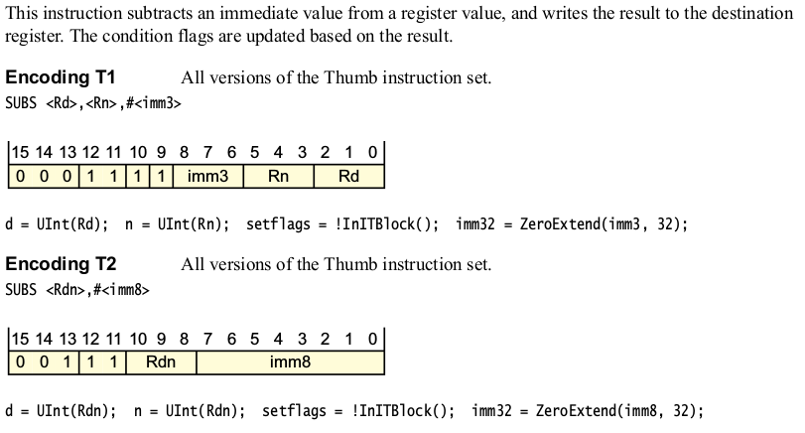
SUB (Immediate)

Slide 9
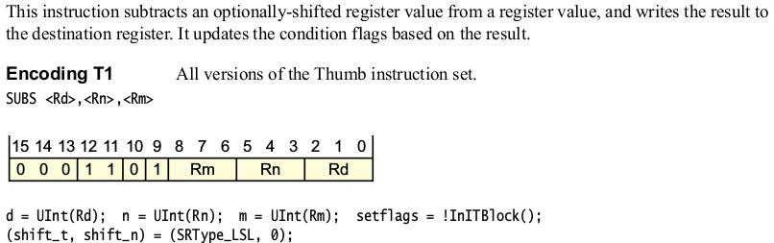
SUB (Register)

Slide 10
Data Processing Instructions
opcode | Instruction class
010000 | Data processing

Slide 11

ORR e AND
opcode | Instruction
0000 | Bitwise And
1100 | Logical or

Slide 12
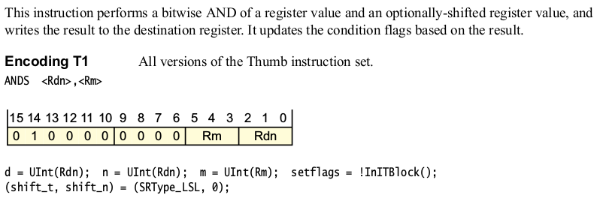
AND (Register)

Slide 13
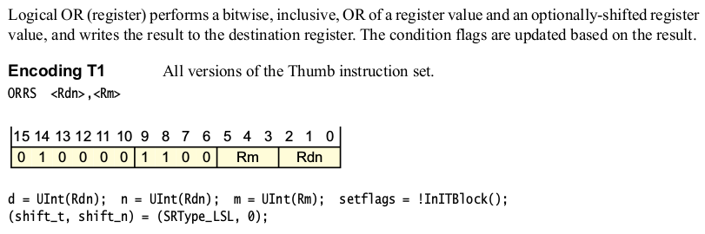
ORR (Register)

Slide 14
Branch and Exchange
opcode | Instruction class
010001 | Branch and Exchange

Slide 15

BLX and BX
opcode | Instruction
110x | BX
111x | BLX

Slide 16
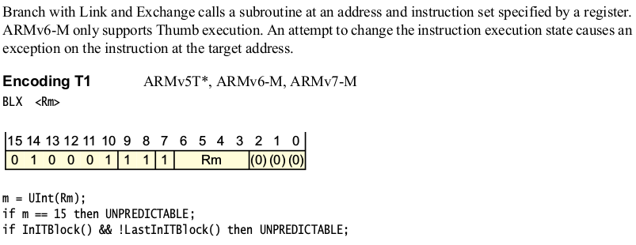
BLX (Register)

Slide 17
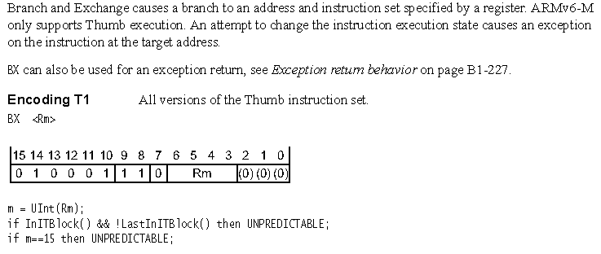
BX (Register)

Slide 18
Load/store single data item
opcode | Instruction class
0101xx 011xxx 100xxx | Load/store single data item

Slide 19

LDR e STR
opA | opB | Instruction
0101 | 000 | STR (Register)
0101 | 100 | LDR (Register)
0110 | 0xx | STR Imm
0110 | 1xx | LDR Imm

Slide 20
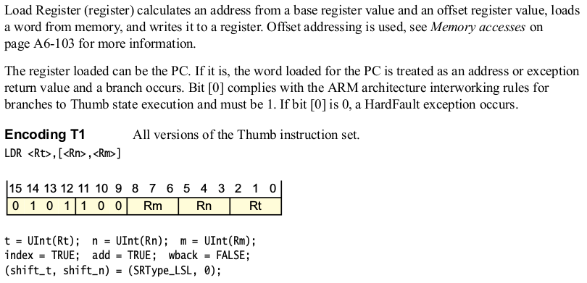
LDR (Register)

Slide 21
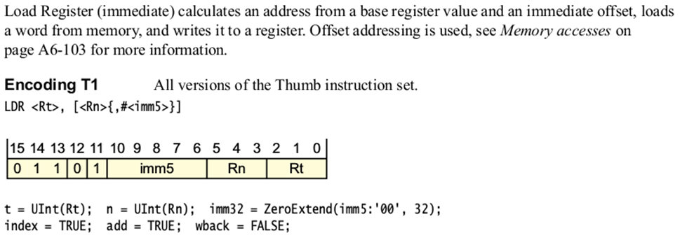
LDR (Immediate)

Slide 22
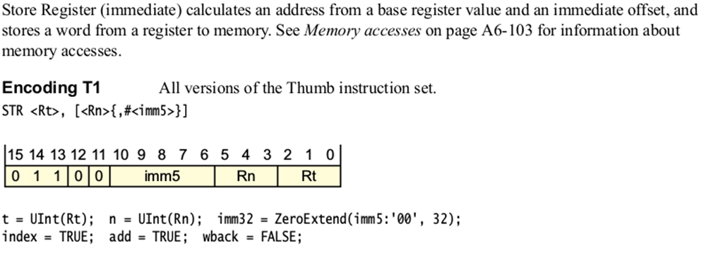
STR (Immediate)

Slide 23
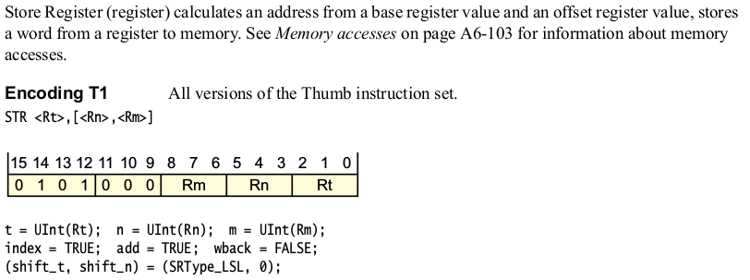
STR (Register)

Slide 24
Conditional branch
opcode | Instruction class
1101xx | Conditional branch

Slide 25

B

Slide 26
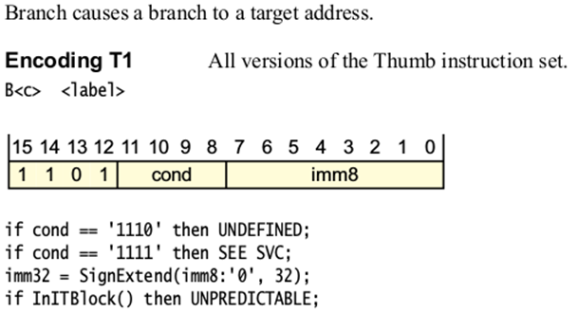
B

Slide 27
Unconditional Branch
opcode | Instruction class
11100x | Unconditional Branch

Slide 28
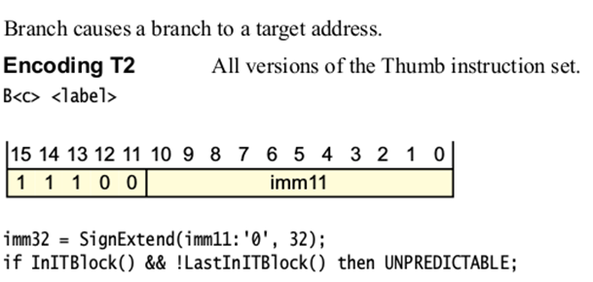
B

Slide 29
References
ARMv6-M Architecture Reference Manual
http://infocenter.arm.com/help/index.jsp?topic=/com.arm.doc.ddi0419c/index.html
https://imagecraft.com/pub/ARM/DDI0419C.pdf
http://pages.hmc.edu/harris/class/e85/arm_single.sv
http://pages.hmc.edu/harris/class/e85/DDCAarm_Ch7.pptx

