Slide 1
Adaptive Particle Swarm Clustering

Slide 2
K-Means Clustering
Procedure
Initialize population of random centroids
Cluster each data point to nearest centroid
Move centroid to the center of its cluster
Repeat until motion stops
Very fast convergence
Often sub-par results

Slide 3
Particle Swarm Clustering
Create several populations of centroids
Update centroids using PSO procedure
Each centroid corresponds to positional information of respective centroid from other populations
E.g. centroid stored in first position for a given centroid population corresponds to the centroid stored in first position for other populations
Return best population when populations converge
Often takes a long time to converge but yields better results than K-means

Slide 4
K Means Seeded Variation
Method for increasing convergence discussed in paper by DW van der Merwe and AP Engelbrecht
Seed the PSO clustering algorithm by running k-means on one of the populations
Increases convergence rate and still yields results comparable to normal particle swarm clustering
Still takes a while to converge

Slide 5
C value’s effects on convergence
C values, when combined with a intertial weight or constriction coefficient, selected for PSO can have a large effect on how quickly the algorithm converges
Selecting these values can become problematic
One of the disadvantages of using constriction coefficients is having a fixed multiplier can cause unwanted fluctuations
Convergence rates are suboptimal

Slide 6
Dynamically Adjusted c values
Proposed solution: Dynamically adjust c values to foster convergence using genetic algorithms
Begin with random set of c values for each particle
Attempt to minimize velocity vector by adapting c values

Slide 7
PSO Implementation
v[] = x * (w * v[] + c1 * next(rand) * (pbest[] - present[]) + c2 * next(rand) * (gbest[] - present[]))
present[] += v[]
c1 + c2 <= 4
x = 1
w = (c1+ c2) / 4
Else
x = 2.0 / (c - 2 + sqrt(c^2 - 4 * c))
w = 1
Gbest is the set of centroids with the best swarm fitness
Pbest is the best position of each centroid population

Slide 8
Implementational Details
Values mostly based on ones used in Merwe and Engelbrecht paper
Uses c1 = c2 = 1.49
Paper uses w = .72 which is very close to (c1 + c2) / 4
This equation also creates a nice continuous function with the constriction coefficient equation (both equal 1 where c1 + c2 = 4)
c1 = c2 = 2 found to occasionally cause runaway velocities
Possibly due to attribute domain used
Attribute domains shifted to range [-1, 1]
Fitness determined using sum of square means
Paper uses sum of means rather than sum of square means
Set of 10 centroid populations
Convergence where change in population fitness less than 2 percent for 5 generations, or stop after 300 generations

Slide 9
GA Implementation Used for Adaptive Particle Swarm Clustering
All c values initialized to random value between 0 and 5
At each iteration c values recalculated using genetic algorithms on c values within local centroid group
Also attempted to perform GA over corresponding centroids between groups, but yielded worse results

Slide 10
GA Operations
Fitness function
Magnitude of velocity vector of corresponding particle
Attempting to minimize
Selection
Tournament selection with replacement
Select 3 individuals
Crossover
Generate random integer between 0 and 3 (inclusive)
0: replace c1 of each parent by random value between the current c1 values of the parents
1: perform crossover on c2
2: perform crossover on both c values
3: perform no crossover
Mutation
Replace c value with new random value between 0 and 5
1% chance

Slide 11
Data Sets
All Clustering algorithms were ran against 4 data sets
Iris data set
BUPA Data Set
Car Data Set
Wine Data Set
K = 4
Average interclustular distance, intraclustular distance, convergence iteration and final clustering fitness recorded over 30 iterations

Slide 12
General Results
K-Means
Converges very quickly
Provides a decent clustering
Particle Swarm Clustering
Slow convergence
Clustering often comparable to K-Means
Depends on data set
Similar to results achieved by Merwe and Engelbrecht
Adaptive Particle Swarm Clustering
Moderate convergence rate
Much worse clustering

Slide 13
General Results
K-Means Seeded Particle Swarm Clustering
Moderate convergence rate
Good clustering
K-Means Seeded Adaptive Particle Swarm Clustering
Fast to moderate convergence rate
Consistently faster than seeded PSO
Good clustering

Slide 14
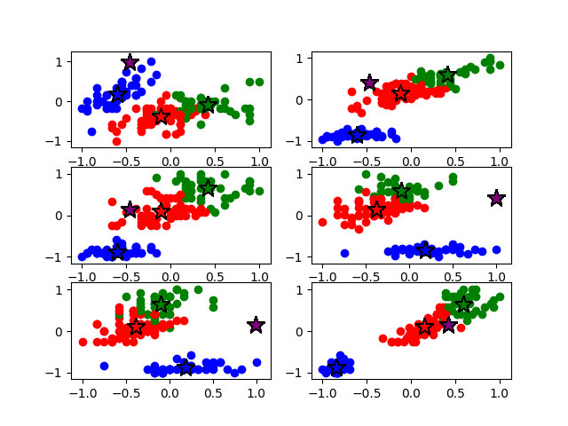
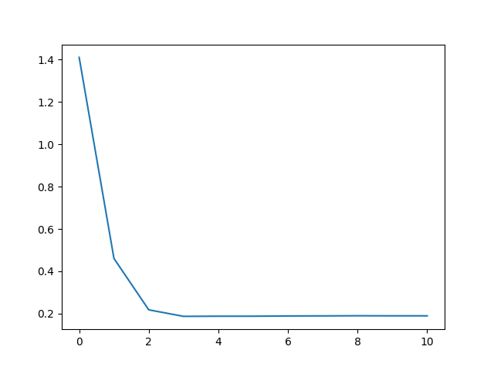
K-Means

Slide 15
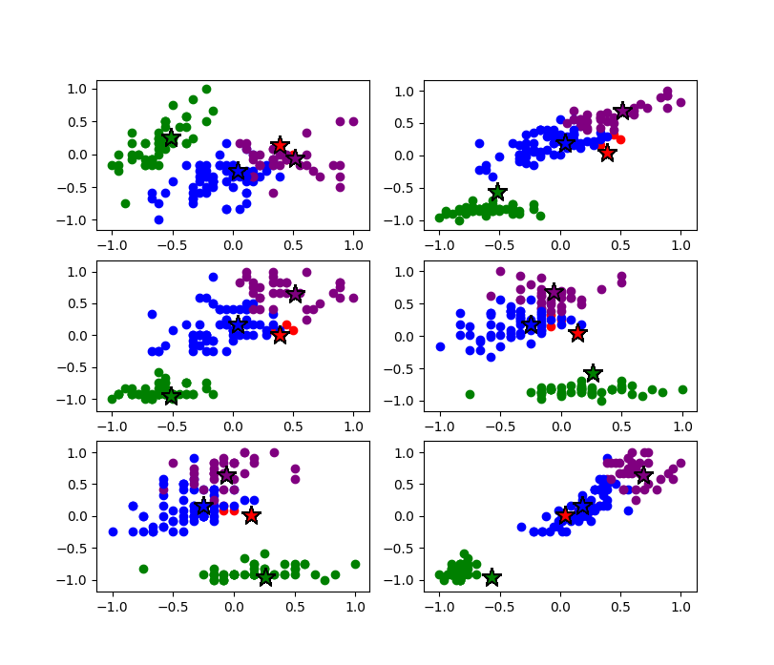
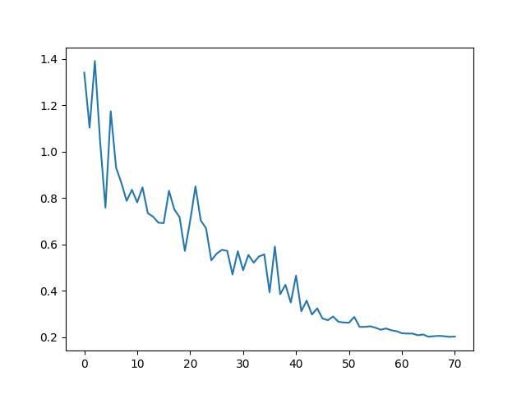
PSO

Slide 16
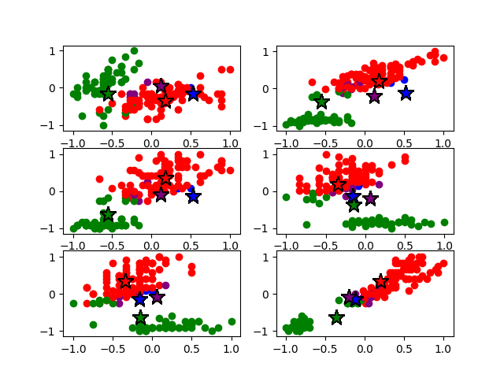
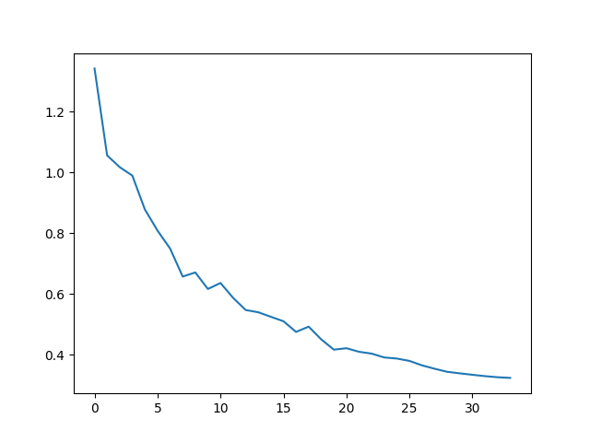
Adaptive

Slide 17
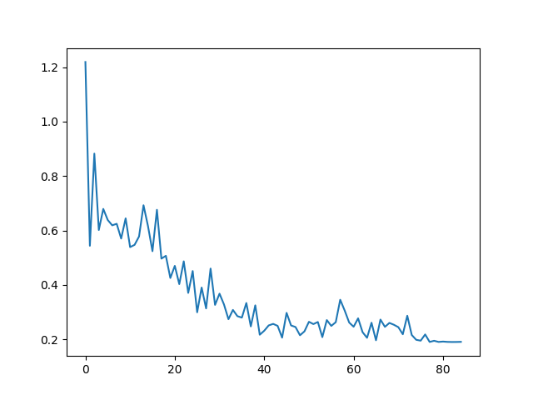
Seeded PSO

Slide 18
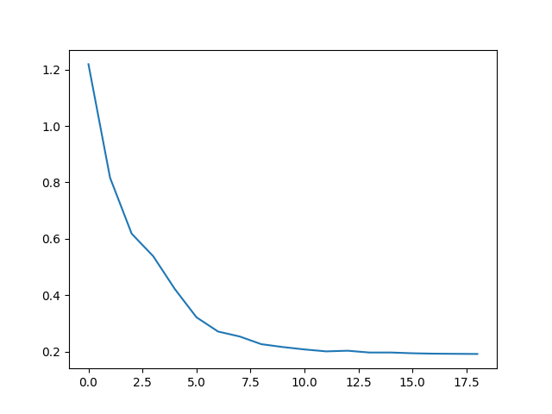
Seeded Adaptive

Slide 19
Iris Dataset
K Means:
Average Intradistance: 0.36686911919857595 +/- 0.02992332914628612
Average Interdistance: 1.5042910685108886 +/- 0.11354041676223023
Average Convergence Iteration: 9.933333333333334 +/- 2.9992591677871974
Average Best Fitness: 0.16038352849254867 +/- 0.028698249805282787
PSO:
Average Intradistance: 0.4064830863149433 +/- 0.04263898482414914
Average Interdistance: 1.4940518030328982 +/- 0.1671370466681281
Average Convergence Iteration: 116.5 +/- 43.51225880906054
Average Best Fitness: 0.18249843946975478 +/- 0.037521023799538755
Adaptive PSO:
Average Intradistance: 0.5741560181988249 +/- 0.08454540540357448
Average Interdistance: 1.3024781655641313 +/- 0.25186717705180817
Average Convergence Iteration: 78.1 +/- 73.87166800156426
Average Best Fitness: 0.34642573199105187 +/- 0.08675018282517878
Seeded PSO:
Average Intradistance: 0.36715496649420015 +/- 0.029487857112286575
Average Interdistance: 1.486081426297133 +/- 0.09641606071352303
Average Convergence Iteration: 79.1 +/- 45.01433105134408
Average Best Fitness: 0.1574120776287936 +/- 0.019641920091662535
Seeded Adaptive PSO:
Average Intradistance: 0.3668847410014177 +/- 0.029999564571498022
Average Interdistance: 1.5017936499844957 +/- 0.11545001998217923
Average Convergence Iteration: 55.3 +/- 57.51414318814692
Average Best Fitness: 0.1602263384486463 +/- 0.02871122976031806

Slide 20
BUPA Dataset
K Means:
Average Intradistance: 0.4773215493450503 +/- 0.01706820554094675
Average Interdistance: 1.0632995333463875 +/- 0.19687710207576212
Average Convergence Iteration: 15.6 +/- 6.750802421440974
Average Best Fitness: 0.4055474314519239 +/- 0.03695450337552676
PSO:
Average Intradistance: 0.5836688089809727 +/- 0.04031351056590361
Average Interdistance: 0.7680537064316598 +/- 0.5178184729275063
Average Convergence Iteration: 135.63333333333333 +/- 73.35006627278685
Average Best Fitness: 0.38642401238652524 +/- 0.0768614876827758
Adaptive PSO:
Average Intradistance: 0.7553025972459746 +/- 0.11191483629917459
Average Interdistance: 1.0984665188178062 +/- 0.4554519897222369
Average Convergence Iteration: 78.16666666666667 +/- 79.9850333222132
Average Best Fitness: 0.6833011946069811 +/- 0.12881502139877857
Seeded PSO:
Average Intradistance: 0.47889722627432296 +/- 0.0174454909329435
Average Interdistance: 1.0418901863172598 +/- 0.23745507571715876
Average Convergence Iteration: 84.6 +/- 46.53786988392715
Average Best Fitness: 0.3830224903628103 +/- 0.03414152952818456
Seeded Adaptive PSO:
Average Intradistance: 0.47825589304217436 +/- 0.017543016546358967
Average Interdistance: 1.0603673825995314 +/- 0.19910333845643516
Average Convergence Iteration: 47.43333333333333 +/- 39.46701857951213
Average Best Fitness: 0.39883701196722676 +/- 0.03478977872293728

Slide 21
Car Dataset
K Means:
Average Intradistance: 1.5896241335181274 +/- 0.008560107946942636
Average Interdistance: 1.6731451513584878 +/- 0.026637705857444356
Average Convergence Iteration: 20.233333333333334 +/- 5.245209454561585
Average Best Fitness: 2.616548134632532 +/- 0.029858272334579217
PSO:
Average Intradistance: 1.6489748909214172 +/- 0.029643375267715055
Average Interdistance: 1.7112843225196708 +/- 0.16808107242360265
Average Convergence Iteration: 45.46666666666667 +/- 25.246429890624583
Average Best Fitness: 2.7144966012963776 +/- 0.08678899908416403
Adaptive PSO:
Average Intradistance: 1.6541554257437856 +/- 0.024835896566086358
Average Interdistance: 1.548148699385192 +/- 0.1447378808614093
Average Convergence Iteration: 23.833333333333332 +/- 25.419262162558706
Average Best Fitness: 2.7693236395423515 +/- 0.049643934085839676
Seeded PSO:
Average Intradistance: 1.590127834313939 +/- 0.00861848285391794
Average Interdistance: 1.6769304333113 +/- 0.03434869054231797
Average Convergence Iteration: 27.2 +/- 9.689857240090449
Average Best Fitness: 2.6156691904469103 +/- 0.030131694739331454
Seeded Adaptive PSO:
Average Intradistance: 1.5895979793678991 +/- 0.008538753228991908
Average Interdistance: 1.67160346697044 +/- 0.02978750560157981
Average Convergence Iteration: 19.366666666666667 +/- 20.626008392857354
Average Best Fitness: 2.6145477567684994 +/- 0.02821705821532357

Slide 22
Wine Dataset
K Means:
Average Intradistance: 0.9696285141955782 +/- 0.013450401554651121
Average Interdistance: 1.6610629507743073 +/- 0.05744911278866882
Average Convergence Iteration: 11.233333333333333 +/- 3.639444402042097
Average Best Fitness: 1.0626744699900954 +/- 0.03214402894241444
PSO:
Average Intradistance: 1.3290779934996337 +/- 0.09704612508228473
Average Interdistance: 1.4494029092119358 +/- 0.6677807392003811
Average Convergence Iteration: 124.46666666666667 +/- 49.40832138640436
Average Best Fitness: 1.6476677945389395 +/- 0.27759026214829235
Adaptive PSO:
Average Intradistance: 1.5527265922995501 +/- 0.10169886838564851
Average Interdistance: 1.701639303640627 +/- 0.4056375802638811
Average Convergence Iteration: 62.3 +/- 42.763029203585035
Average Best Fitness: 2.339504987522921 +/- 0.2970096366217503
Seeded PSO:
Average Intradistance: 0.970456694091919 +/- 0.013824010082619468
Average Interdistance: 1.6681872449645097 +/- 0.06997102719642145
Average Convergence Iteration: 60.6 +/- 17.88593488377576
Average Best Fitness: 1.0573722213686831 +/- 0.026255938773130958
Seeded Adaptive PSO:
Average Intradistance: 0.9700845930148934 +/- 0.013288500889394287
Average Interdistance: 1.664335567975143 +/- 0.05760456669812304
Average Convergence Iteration: 57.46666666666667 +/- 59.95650275176349
Average Best Fitness: 1.0604970183226796 +/- 0.03222618212910561

Slide 23
Conclusion
Without seeding, the adaptive algorithm performs poorly
Likely converging too quickly to find good solution
Seeded algorithm yields good clusters and converges relatively quickly
Convergence rate and cluster fitness often somewhere in between non-adaptive approaches and normal k-means

Slide 24
References
http://files.matlabsite.com/docs/papers/sp/pso-paper-120.pdf
http://www.cs.tufts.edu/comp/150GA/homeworks/hw3/_reading6%201995%20particle%20swarming.pdf
https://www.researchgate.net/profile/Siti_Mariyam_Shamsuddin/publication/49607433_Particle_Swarm_Optimization_Technique_System_and_Challenges/links/00b7d5230fdae9e511000000.pdf
https://www.tutorialspoint.com/genetic_algorithms/genetic_algorithms_parent_selection.htm

