Slide 1
CCIThink
• CCIT information chatbot + explainable FAQ classification
• Boncajes, Rhian Jared D.
• Marcos, Maricar N.
• Carandang, Jamie Pearl U.
• Principles of Artificial Intelligence and Data Science · November 2026
Notes:
Introduce the approved topic and team. Explain that this is a small educational prototype, not a student-record or grade-prediction system. About 45 seconds.

Slide 2
Problem and objectives
• Find answers within 22 documented department FAQs.
• Preserve the existing chat UI and source-support checks.
• Demonstrate data preparation, learning, evaluation and interpretation.
Notes:
Frame information access as the project problem. Do not claim measured workload reduction or student satisfaction. About 1 minute.

Slide 3
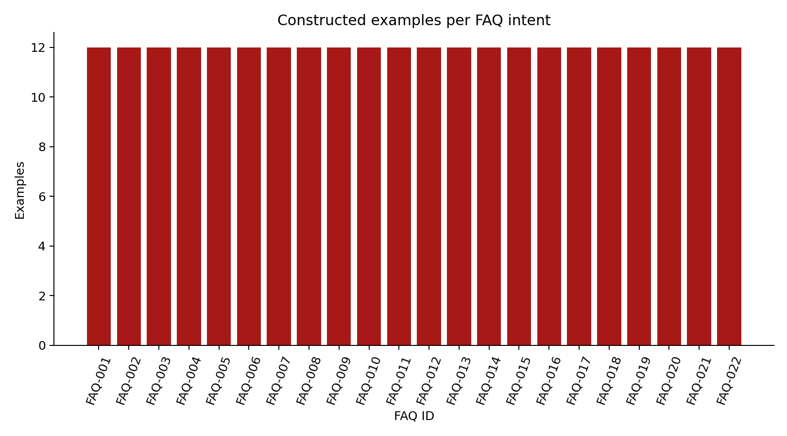
Dataset and provenance
• 264 AI-assisted constructed questions; 22 FAQ target labels.
• 176 training / 44 validation / 44 test; fixed assignments.
• Not real student conversations; no private records.
• Eight training, two validation and two test questions per label.
Notes:
Show question_dataset.csv and the data dictionary. Explain why a small corpus can demonstrate the workflow but cannot establish real-world effectiveness. About 1 minute.

Slide 4
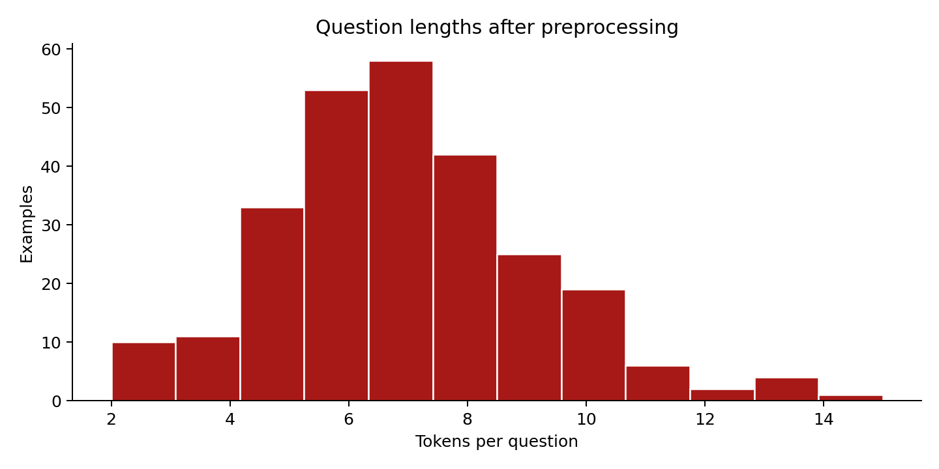
Preprocessing and EDA
• Validate schema, label IDs, split membership and input limits.
• Reject label conflicts and cross-split duplicates.
• 264 normalized; 0 missing, duplicate or invalid rows removed.
• Mean length 7.08 tokens; 7 longer valid questions retained.
Notes:
Demonstrate actual cleaning statistics, not synthetic claims of dirty real data. Explain why outlier lengths were retained and why labels/language metadata are not features. About 1 minute.

Slide 5
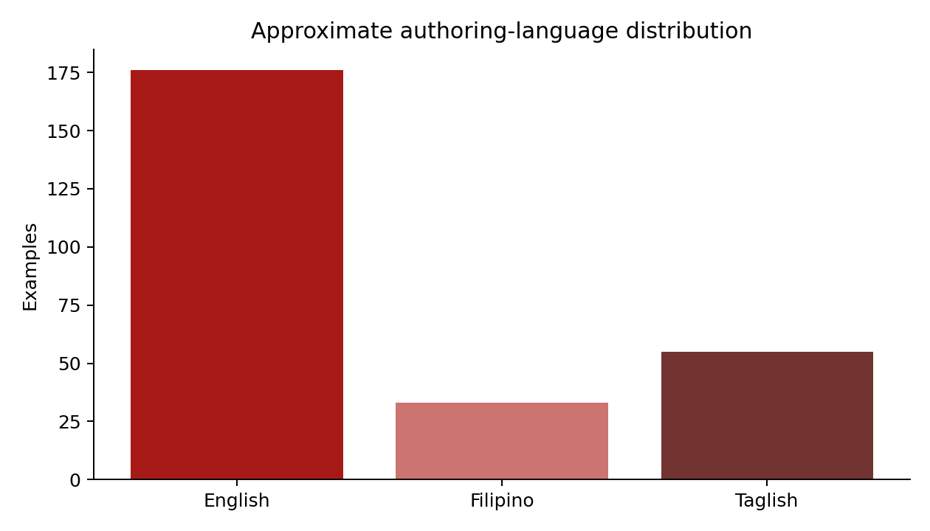
Language coverage
• 176 English / 33 Filipino / 55 Taglish authoring tags.
• Tags are approximate, not independently annotated.
• The corpus is balanced by FAQ, not sampled from student demand.
Notes:
This is the third EDA visualization. Discuss representativeness and language bias, and distinguish designed counts from observed real student behavior. About 45 seconds.

Slide 6
Implemented algorithm
• Multinomial Naive Bayes, implemented in standard Python.
• Count unigrams or unigrams plus adjacent bigrams.
• Learn vocabulary and class-feature counts on training data only.
• Additive smoothing avoids zero likelihoods; scores are uncalibrated.
Notes:
Open chatbot/intent_model.py. Explain the log-prior plus feature-count-weighted log-likelihood equation. State the conditional-independence assumption and why it is imperfect for language. About 90 seconds.

Slide 7
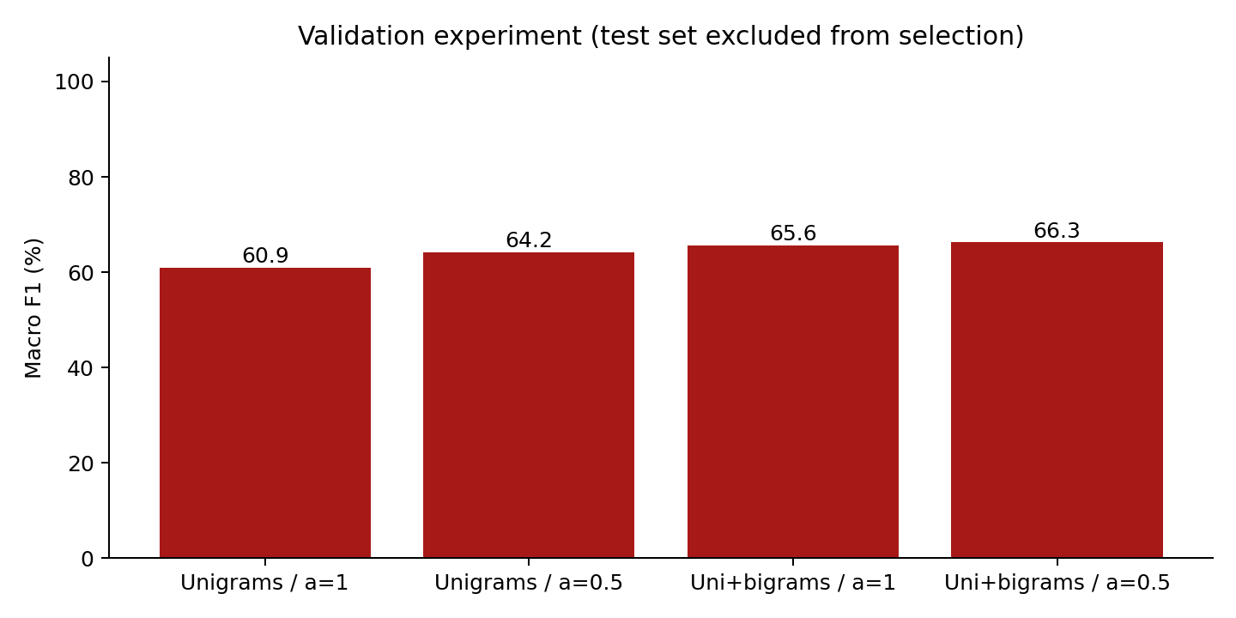
Validation experiment
• Four fixed feature/smoothing configurations.
• Choose using validation macro F1, not test accuracy.
• Selected: unigrams + bigrams, alpha = 0.5.
• Validation: 31/44 correct; macro F1 = 0.663.
Notes:
Explain each axis and the tie-breaking rule. Training and validation remain separate; the selected model was not refitted on validation data. About 1 minute.

Slide 8
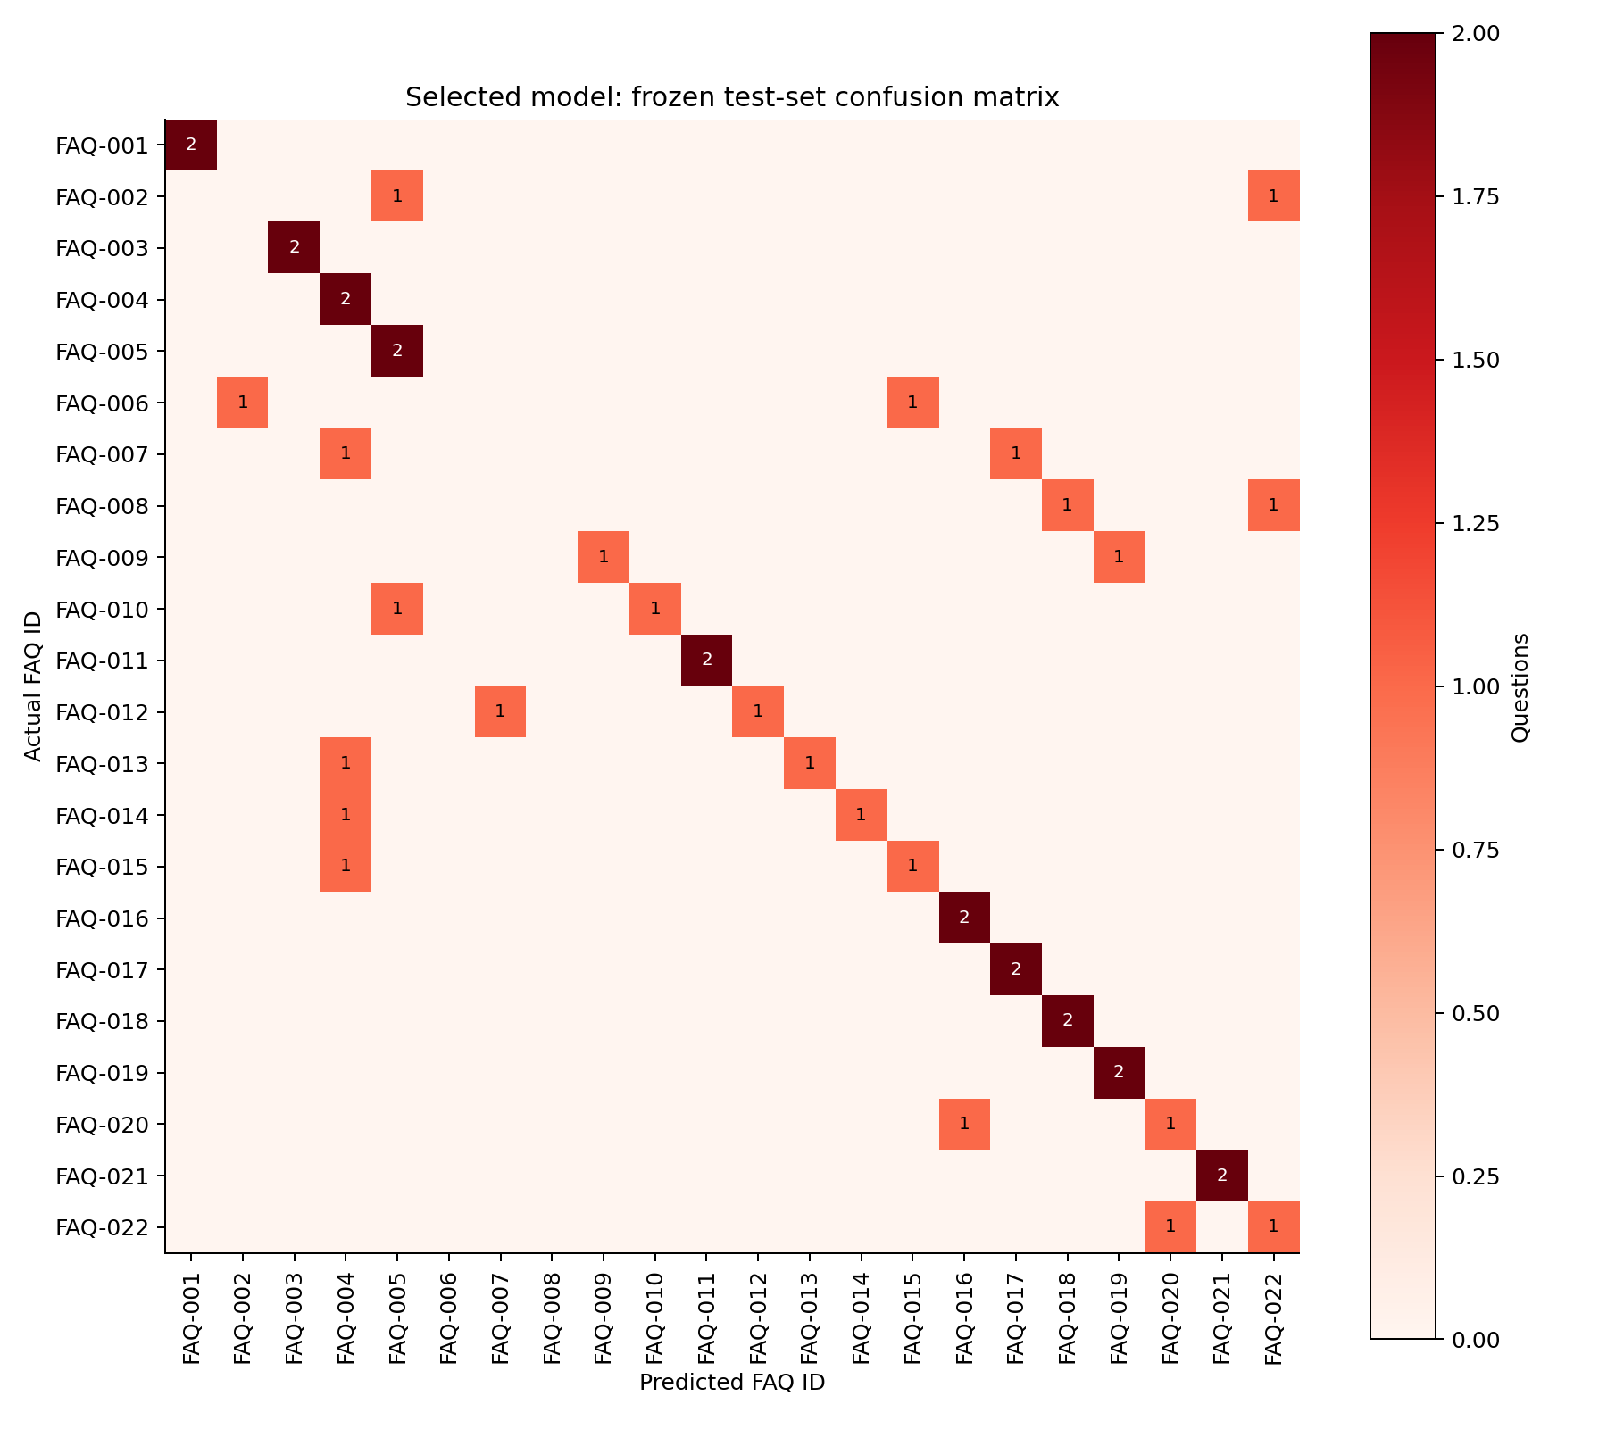
Frozen-test results
• 28/44 correct: 63.6% accuracy.
• Macro F1 = 0.595; macro precision = 0.629.
• Majority-class baseline: 2/44 correct (4.5%).
• 16 mistakes; only two test questions per label.
Notes:
Interpret the confusion matrix and the limits of the baseline. Do not call the classifier perfect or generalize its percentage to all users. About 1 minute.

Slide 9
Error analysis
• English-tagged test: 16/22 correct.
• Filipino-tagged test: 3/8; Taglish: 9/14.
• Overview, offerings and IT/CS definitions were difficult.
• Small constructed groups do not establish population differences.
Notes:
Open test_predictions.csv and show an actual mistake. Explain sparse wording and overlapping intents as plausible, untested explanations. About 1 minute.

Slide 10
Working demonstration
• Run python analyze.py, then python app.py.
• Use /analysis for charts, cleaning, metrics and predictions.
• Use / for the preserved chat interface and short bold answers.
• ML only adds a bounded ranking bonus after source checks.
• 263 automated tests; 26 browser scenarios; 95/95 chat checks.
Notes:
Demonstrate Who teaches BSCS? on the analysis page and the chat. Then show an unsupported detail falling back. Explain that the 95 checks are regression tests, not classifier hold-out accuracy. About 90 seconds.

Slide 11
Ethics and limitations
• No private student records; no stored chat transcript.
• Department facts and source permissions still need appropriate review.
• AI assistance is disclosed; every author must understand the code.
• No participant study, production-load result or successful live LLM claim.
Notes:
Discuss language bias, source currency and provider privacy. Note that optional AI answer mode sends selected information to the chosen provider. About 1 minute.

Slide 12
Conclusion and next steps
• A reproducible AI/Data Science workflow now supports the chatbot.
• The classifier outperformed a weak baseline but needs improvement.
• Next: confirmed facts, permissioned student examples, independent labels and a fresh test set.
• Questions and defense discussion
Notes:
Answer the three research questions briefly. Reserve the professor-required 5 minutes after the 10–15 minute presentation for questions. Do not claim field effectiveness. About 45 seconds.

