Slide 1
IRC AdminBot Chat Application
A presentation by Team J.I.T.
May 09, 2013
Jared Hess, Taylor Russell and Ife Ify
Notes:
Jared - present through iteration goals

Slide 2
Project Description
To create an administrator bot that connects to an IRC chat channel and monitors users. The bot will automatically log sign on and sign off times and notify the supervisor of late or absent employees. The bot will also be configurable by sending it various commands via private messages.

Slide 3
Iteration goals
Iteration 1:
User List
Bot should be configurable to keep a list of current valid employees.
Time estimate: 6 days
Timekeeping
Bot should monitor what users are currently logged into the IRC chat room and be able to display them in a list.
Time estimate: 7 days
Recording
Bot should record times users log in and out of the chat.
Time estimate: 6 days

Slide 4
Iteration goals
Iteration 2:
Pay Period
Admin should be able to configure pay period end date via command
Time estimate: 7 days
Schedule Input
Admin should be able to configure a schedule for each employee
Time estimate: 5 days
Late notification
Bot should notify the supervisor when an employee is late for their shift.
Time estimate: 4 days
Absent Notification
Bot should notify the supervisor when an employee is absent from work
Time estimate: 2 days

Slide 5
Iteration goals
Milestone 1.0:
Output Format
Bot should be able to write any output in various formats, such as flat text files or to an online wiki.
Time estimate: 10 days
Check Pay Period
Employees should be able to view hours worked for the current pay period
Time estimate: 7 days

Slide 6
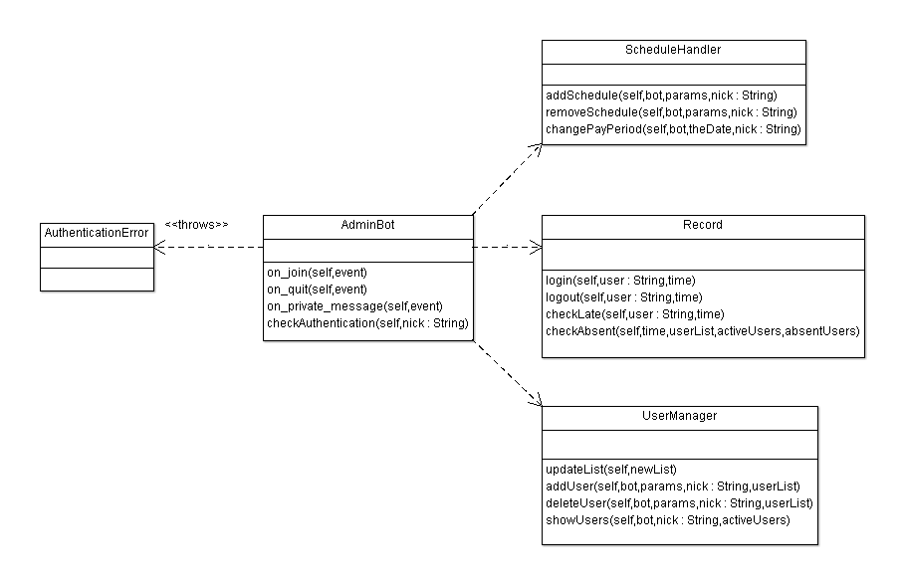
UML Class Diagram

Slide 7
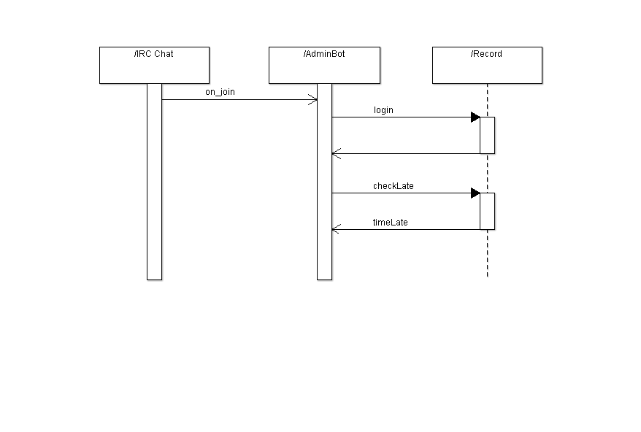
Sequence Diagram

Slide 8
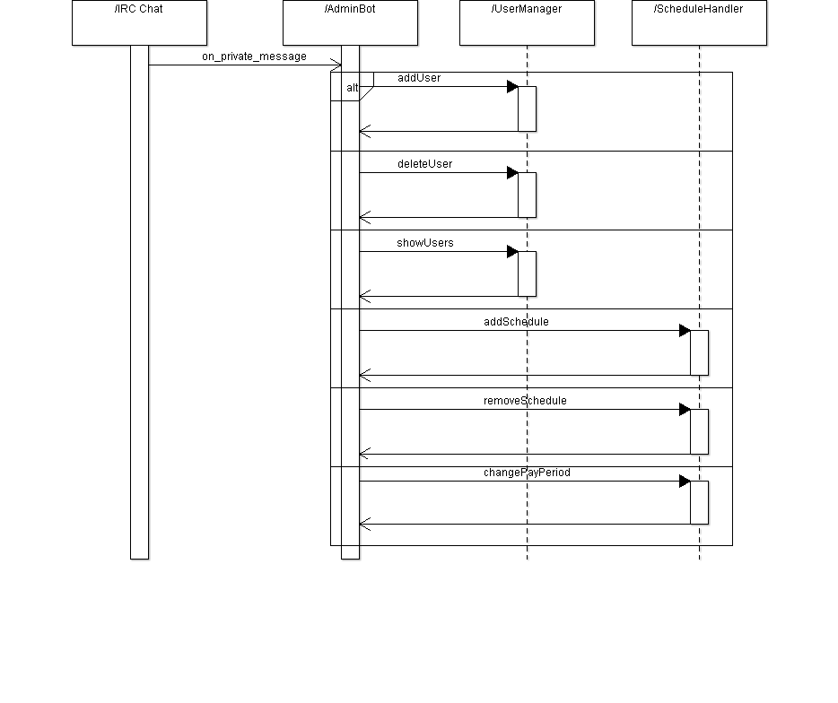
Sequence Diagram

Slide 9
Cohesion and Coupling
Originally used common coupling (and some instances of content coupling)
Common: Global Setting variables
Content: Bot methods passed the bot object into corresponding message handler functions to facilitate responses, and these handlers relied on the Bot send methods (IE: pathological coupling.This is pretty bad)
Notes:
Jared

Slide 10
Cohesion and Coupling (continued..)
Refactored to use data coupling
Only passing the necessary data to appropriate functions
Have message handlers return info to the Bot methods to have the Bot methods handle responses
Cohesion is now mostly communicational

Slide 11
Test Units
Test Driven Development used in iteration 2
Forces you to think deeply about the requirements and the possible scenarios that will cause an error
Consider the changePayPeriodEndDate user story

Slide 12
Four Scenarios that will cause an exception
The user is not authorized/not a supervisor
Date is not in the correct format
e.g mm/dd/yy
Date is not valid e.g 99/99/99
The new date has already passed/is less than today's date

Slide 13
Project Demo
www.github.com/jared-hess/adminbot

Slide 14
Challenges we faced...
Setting up a Wiki site
Cohesion/Coupling

Slide 15
Lessons Learned
Git/eGit
PyUnit
PyDev
Iteration Planning/Feature Tracking
Enhancement - use a MySQL database

Slide 16
Conclusion
Shoot for lower coupling from the beginning, makes things much less frustrating.
Eclipse was useful in some cases, but overall was not ideal. Something simpler would mean less time trying to figure out problems with the IDE and more time coding.
Notes:
Jared

Slide 17
Questions...

