Slide 1

Getting Started with HashiCorp
Jared Holgate
29 July 2021

Slide 2
Agenda
Introduction and Goals
The First Use Case
HashiCorp Products High Level Overview
High Level Architectural Design Overview
Continuous Delivery Pipeline Overview
Demos
Packer
Terraform Cloud
Vault
Questions

Slide 3
Introduction
About me
17 years of Software Engineering and 12 of Continuous Delivery.
Delivered working software at Enterprise scale.
Goals For Today
A high level understanding of the HashiCorp products in use.
A proposed solution to the Vault deployment use case.
A deep dive knowledge share on the technical implementation.
Provide lots of artifacts and a working set of code samples.
Opportunity for questions and getting clarification.
Decide on next steps.

Slide 4
Use Case: Vault on IaaS in Microsoft Azure
Automated deployment of Vault onto Azure Linux IaaS
Production ready HA cluster.
Backed by Consul, also in a HA cluster.
Test, Acceptance and Production environments.
Provide on demand Azure Secrets for Custom Apps.
Production like Test environments on demand.

Slide 5





HashiCorp Products we will use today
Virtual Machine Images as Code
Value: Standardised, re-usable, repeatable, fast and secure virtual machine deployments.
Infrastructure as Code
Value: Re-usable modules, multi-platform, fast and secure infrastructure deployments.
Infrastructure as Code SaaS Platform (Software as a Service)
Value: Zero maintenance management of modules, state and secrets for Terraform.
Service Discovery and State Management
Value: Dynamic infrastructure networking, centralised policies and zero trust.
Advanced Secrets Management
Value: Dynamic secrets management across multiple cloud and on prem platforms.

Slide 6

Packer Overview
Vendor Virtual Machine Image
Packer Configuration File
Vendor Virtual Machine Image
(e.g. Windows, Ubuntu, Azure, AWS, Etc)
Info Sec Team
Packer Configuration File
Secured Virtual Machine Image
Packer Configuration File
Platform Team
Standard Virtual Machine Image
Custom Virtual Machine Image
Packer Configuration File
Product Team
Custom Virtual Machine Image

Slide 7




High Level Design – HA Vault Cluster
Vault Cluster
VM: Ubuntu 18.04
VM: Ubuntu 18.04
VM: Ubuntu 18.04
Azure Key Vault for Auto Unseal
Vault Server
Vault Server
Vault Server
Consul Agent vault-server-0
10.1.1.10
Consul Agent vault-server-1
10.1.1.11
Consul Agent vault-server-2
10.1.1.12
Consul Cluster
VM: Ubuntu 18.04
VM: Ubuntu 18.04
VM: Ubuntu 18.04
Consul Server consul-server-0
10.1.0.10
Consul Server
consul-server-1
10.1.0.11
Consul Server
consul-server-2
10.1.0.12

Slide 8






High Level Design –Vault Azure Secrets
VM: Ubuntu 18.04
Application Requests a Secret at run time
Vault Server
Vault Creates a Service Principal In AzureAD using the Managed Identity Credentials
Azure Active Directory
Application
Application uses the Secret
Managed Identity
Service Principal
Vault Sends the Client ID and Client Secret back to the Application
Vault stores the secret and manages the lifecycle of the Service Principal. Create, Delete and Rotate.

Slide 9
High Level Design – Features of Note
Fully Automated: Auto Unseal of HashiCorp Vault using Azure Key Vault
Secure: Use of Azure Managed Identity for Azure Authentication from HashiCorp Vault
Fast: Use HashiCorp Packer to pre-install HashiCorp Vault and HashiCorp Consul in the VM template.
Reuse: Use Terraform Modules to provide re-usable building blocks
Visibility: Use Terraform Cloud to provide central state management and secure secrets

Slide 10




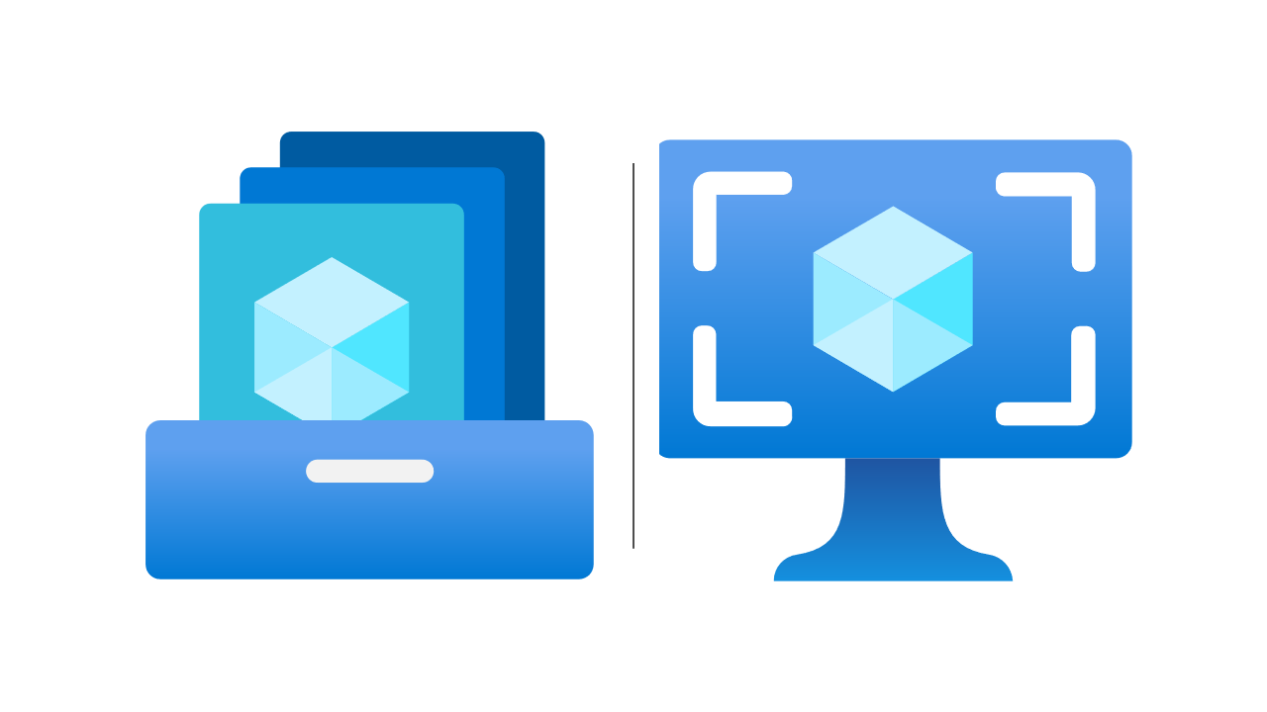




Continuous Delivery Pipeline
Virtual Machine Definitions
Build
Templates
Shared Image Gallery
Bootstrap Workspace
Consul VM Template
Variables
State
Agent
Vault VM Template
IaC to Bootstrap Terraform Cloud, GitHub and Azure
Deploy Bootstrap
Test Workspace
Test Resource Group
Variables
State
Agent
Acceptance Workspace
IaC to Deploy the Vault Stack
to Azure
Deploy Infrastructure
Virtual Network
Key Vault
Variables
State
Agent
Production Workspace
Consul
Cluster
Vault Cluster
GitHub Repository
GitHub Actions
Variables
State
Agent

Slide 11
Demos
HashiCorp Packer
Bootstrap Environments
Terraform Deployment
Vault Configuration and Azure Credential Automation

Slide 12
Next Steps and Questions
Arrange follow up session(s) to deep dive with the technical team.
Provide further examples and PoC as needed.
Here to help you succeed, please ask me anything.
Things to do for a production ready cluster;
Configure Vault Azure Authentication and IAM
Configure SSL and IAM for Consul
Configure Network with NSG / Firewall
Configure DNS / Load Balancer
Expose end point and / or peer networks

Slide 13
Appendix: Artifacts
All the source code from the demo is available to you here;
https://github.com/jared-holgate-hashicorp

Slide 14
Appendix: Reference Material
https://learn.hashicorp.com/tutorials/vault/deployment-guide
https://learn.hashicorp.com/tutorials/vault/ha-with-consul
https://learn.hashicorp.com/tutorials/vault/autounseal-azure-keyvault
https://github.com/hashicorp/vault-guides/blob/master/operations/azure-keyvault-unseal/setup.tpl
https://www.vaultproject.io/docs/secrets/azure
https://registry.terraform.io/providers/hashicorp/vault/latest/docs
https://www.vaultproject.io/docs/configuration/ui
https://www.consul.io/docs/agent/options#example-configuration-file-with-tls
https://learn.hashicorp.com/tutorials/consul/tls-encryption-secure
https://www.vaultproject.io/docs/configuration/listener/tcp

Slide 15
Appendix: Continuous Delivery Steps
Create VM Templates with HashiCorp Packer, install Consul and Vault. Push them to Shared Image Gallery.
Bootstrap Terraform Cloud and Azure Resource Groups. Share credentials with Terraform Cloud and GitHub without exposing them.
Deploy the Network, Key Vault and Virtual Machines.
Create Managed Identity for Vault VM’s and grant it permissions to create Service Principals.
Configure the Virtual Machines using Cloud Init.
Configure Consul
Run Consul as a Service
Create SSL Cert
Configure Vault
Run Vault as a Service
Wait to Auto Unseal and for Vault to be available
Get Vault Root Token
Login to Vault
Configure Azure Secrets Engine

