Slide 1

Excess Deaths in United States Counties 2/1/2020-10/31/2020
Project By: Jared Michael murphy
Jared.m.murphy@protonmail.com
linkedin.com/in/jared-m-murphy/
github.com/jared-m-murphy

Slide 2
Background
It’s the Height of Covid-19 first wave
Many start to believe reported death counts due to Covid-19 are being inflated
Elon Musk goes on Joe Rogan Podcast and supports the inflated numbers claim
Is this true?
Are the reported deaths due to Covid-19 from Johns Hopkins University and the CDC accurate?
How do we test this?

Slide 3
How to Test Inflated Death Count Theory
Estimate excess deaths in U.S. counties from 2/1/2020 – 10/31/2020
If reported deaths due to Covid-19 are not significantly different than the estimated excess deaths, then there is no reason to suspect that the numbers are being inflated

Slide 4
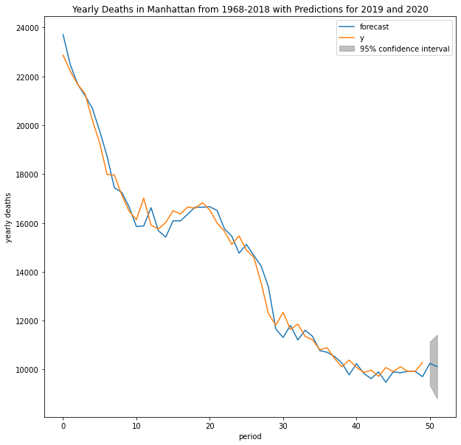
Step 1: Estimate Expected Deaths in US Counties for 2020
Using historical mortality data from the CDC, we used an ARI(5,1) model to predict the expected number of deaths in all U.S. counties for 2020. 95% Confidence Intervals were obtained for each estimate.

Slide 5
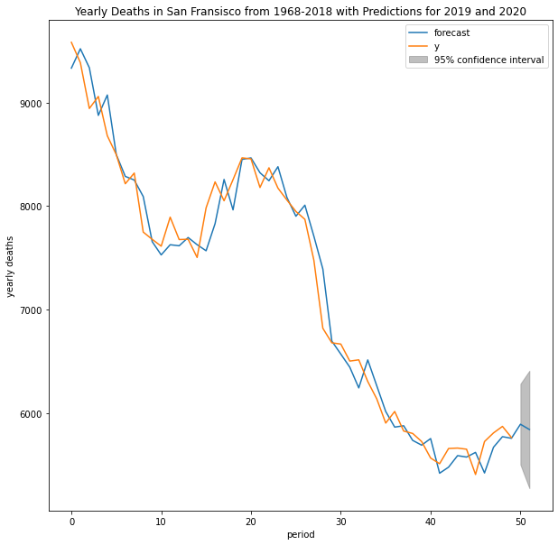
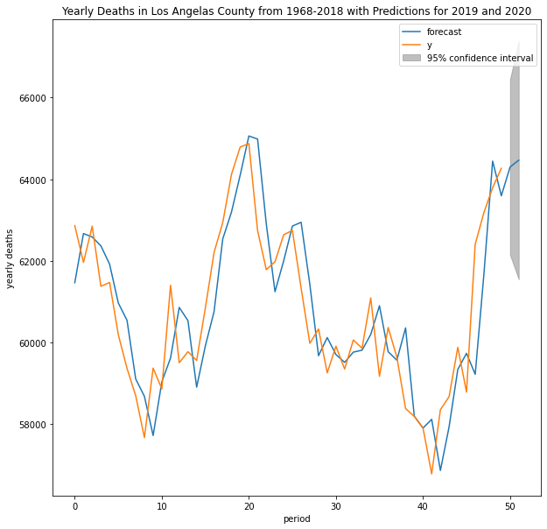

Slide 6
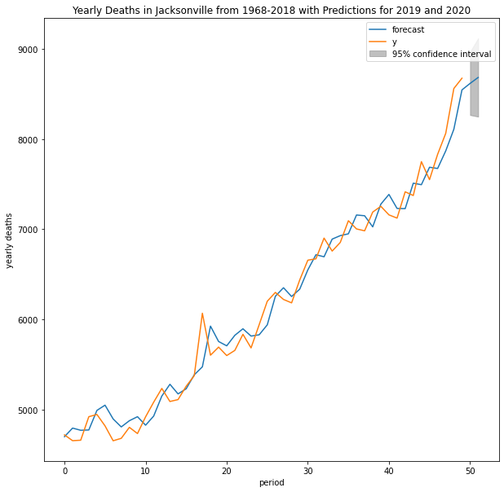
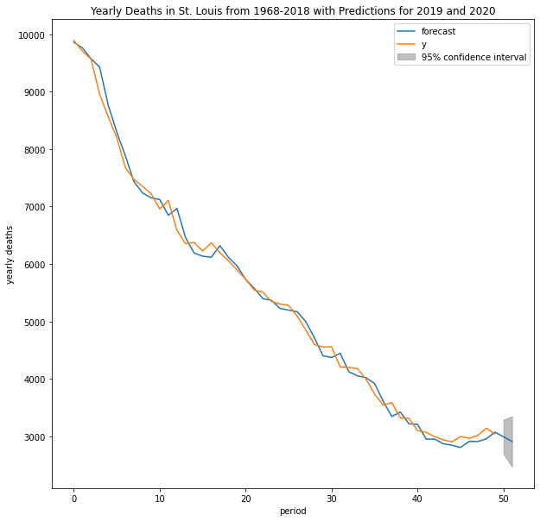

Slide 7
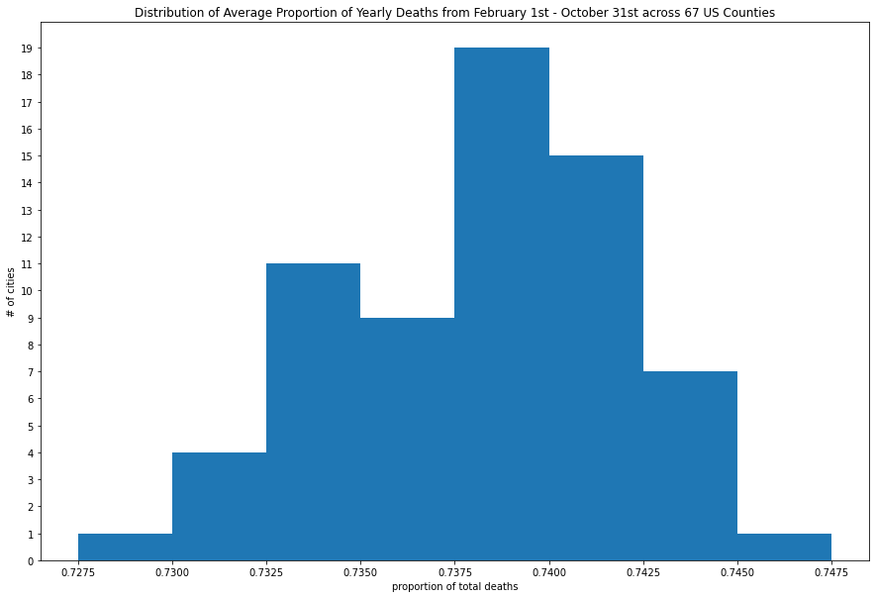
Step 2: Estimate Proportion of Yearly Deaths to Happen Between 2/1/2020 – 10/31/2020
We used weekly historical weekly mortality data from 67 U.S. cities to estimate the average proportion of yearly deaths to happen between February and October. On average, approximately 73.82% of yearly deaths are likely to occur in a US county between February 1st and October 31st

Slide 8
Step 3: Estimate Expected Deaths for Each US County for 2/1/2020-10/31/2020
Let 2020_Death_Estimate = Estimated Total Deaths for 2020 in US County
Let Death_Proportion_Estimate = Estimated Proportion of Total Deaths to Occur Between 2/1/2020 – 10/31/2020
Estimated_Deaths = 2020_Death_Estimate x Death_Proportion_Estimate
This equation was then applied to all US Counties

Slide 9
Step 4: Estimate Excess Deaths for US Counties
Using CDC total death counts for select US counties released throughout 2020, we can compare the actual deaths with the expected deaths to find the estimated excess
Let Actual_Deaths = Total death counts for US counties released by CDC for 2/1/2020-10/31/2020
Estimated_Excess_Deaths = Actual_Deaths – Estimated_Deaths
Some counties reported significantly less deaths this year than expected

Slide 10
Step 5: Sum Across Counties and Compare With Reported Deaths Due to Covid-19
CDC total reported deaths for 2/1/2020-10/31/2020 were only available for 1221 out of 3006 US counties. The results do not map to national death totals but do remain internally consistent.
When the counties with excess deaths were summed with the counties with negative deaths
Estimated_Excess_Deaths = 210,900
Johns Hopkins University Reported Deaths Due to Covid-19 = 210,533
CDC Reported Deaths Due to Covid-19 = 211,106

Slide 11
Conclusion
As we can see from our results, the differences between Estimated_Excess_Deaths and reported deaths due to Covid-19 from both the CDC and JHU are negligible
This indicates that from 2/1/2020-10/31/2020 the suspicion that the death counts due to Covid-19 were inflated is likely unfounded
Elon Musk was most likely incorrect in his assessment back in May 2020 on the Joe Rogan Podcast
The virus has most likely been responsible for most of the deaths that it has been reported to be responsible for

Slide 12
Sources and Contact Information
All sources are methods are listed in the Jupyter Notebook found at https://github.com/jared-m-murphy/Springboard/blob/main/Capstone_1/Capstone_Final.ipynb
Jared.m.murphy@protonmail.com
https://www.linkedin.com/in/jared-m-murphy/
https://github.com/jared-m-murphy
@jaredmmurphy on Twitter

Slide 13
Fin

