Slide 1

Is there any reason to doubt the cDC and JHU covid-19 death count?

Slide 2
Based on estimates of excess deaths between February 1st and October 31st of this year, the answer is no.

Slide 3
Let’s describe how we arrived at this conclusion

Slide 4
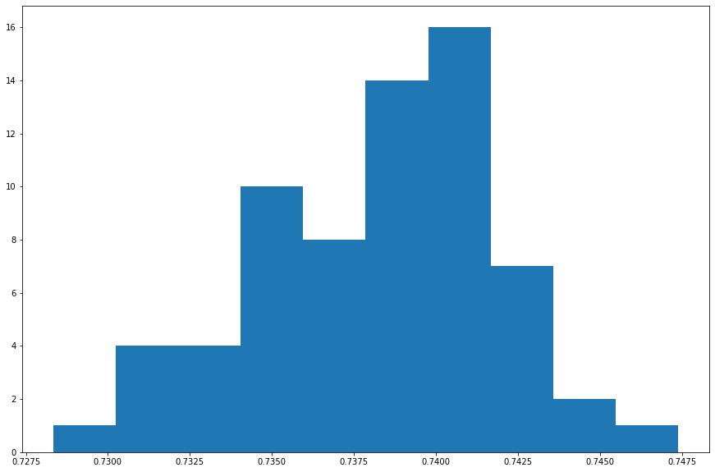
First, we used weekly mortality data released by the CDC for 122 US cities, and found that the average percentage of yearly deaths to occur between February 1st and October 31st likely lay somewhere between 72% and 75%

Slide 5
After bootstrapping our sample, it was reasonable to conclude that, on average, approximately 73.82% of yearly deaths in a US municipality were likely to occur between February 1st and October 31st
Death Propotion=73.82%

Slide 6

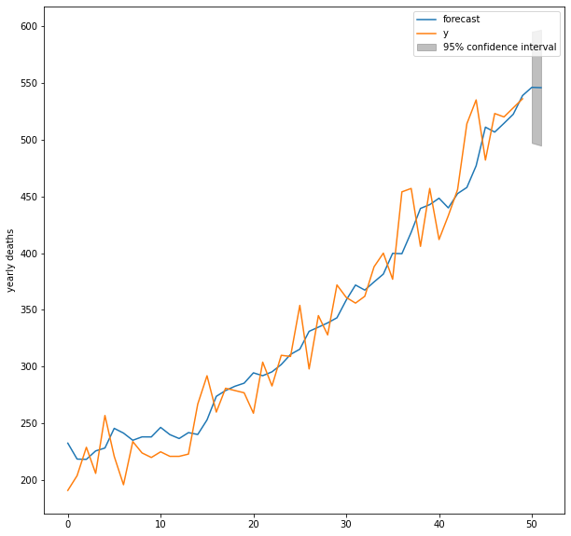
Next we used an ARIMA(5,1) model on yearly CDC mortality data to estimate the expected Total deaths for 1221 US counties in the year 2020

Slide 7
Multiplying the Death Proporion for February 1st – October 31st by Expected Deaths for 2020, we obtain the Expected Deaths for each county for the time period
Death Proportion * Expected Deaths 2020 = Expected Deaths Feb 1st through Oct 31st

Slide 8
The estimated expected deaths during this time period were then compared to the actual deaths reported by the CDC, and the difference between these two values was marked as Estimated Excess Deaths
Estimated Expected Deaths – Total Reported Deaths = Estimated Excess Deaths

Slide 9
Estimated Excess Deaths for these 1221 US counties were then combined and compared to the deaths due to Covid-19 released by the CDC and Johns Hopkins University

Slide 10
Here is what was found

Slide 11
Estimated Excess Deaths: 210,900
Johns Hopkins Provisional Deaths Due to Covid-19: 210,533
CDC Provisional Deaths Due to Covid-19: 211,106

Slide 12
As can be seen, Estimated Excess Deaths are within a small margin of both the CDC’s and JHU’s provisional deaths due to Covid-19

Slide 13
Based on our model of Excess Deaths, we can conclude that there is currently no reason to doubt the Covid-19 death count reported by the CDC.

Slide 14
For sources and full in-depth technical analysis, please visit https://github.com/jared-m-murphy/Springboard/blob/main/Capstone_1/Capstone_Final.ipynb

