Slide 1
METRIX: Multi-Objective Explanation Tuning for Robust Interpretability eXploration
Jared Ni, Sezim Yertanatov, Dennis Du

Slide 2
How would we generalize metrics optimization for explanation methods where there are two or more target metrics to optimize?

Slide 3
For a model f and a given input x₀, want to produce an explanation vector φ₀
Sample N more points x₁, …, x_{N} that are near x₀, and produce explanations φ₁, …, φ_{N} for each one
We want each explanation φ_{n} to be faithful to the model f (low INFD) and yet be close to each other (low SENS)
At the end return φ₀, which is the explanation for the actual input x₀ that we care about
Sampling Nearby Inputs

Slide 4
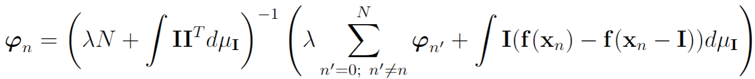
Optimization objective:
Solution: For each n ∈ {0, …, N},
Each φ_{n}’s optimal value is in terms of the others → optimize iteratively by coordinate descent: cycle through the φ_{n}, optimizing each one in turn based on the current values of the others
Math

Slide 5
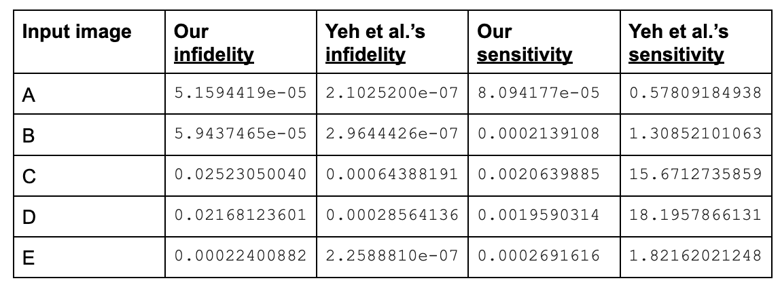
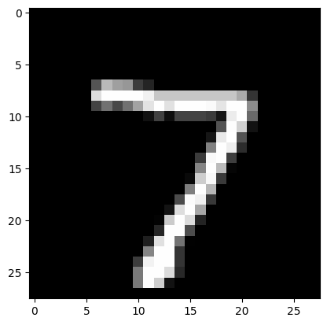
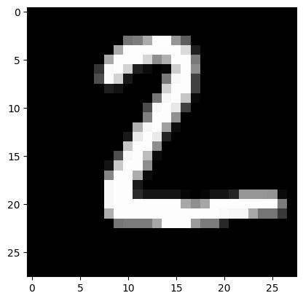
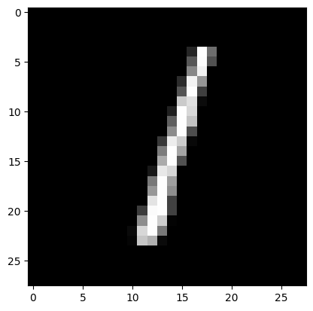
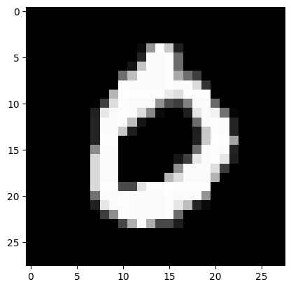
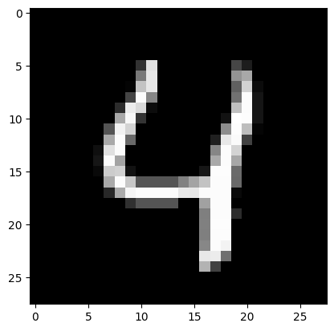
Comparison of Infidelity / Sensitivity

Slide 6
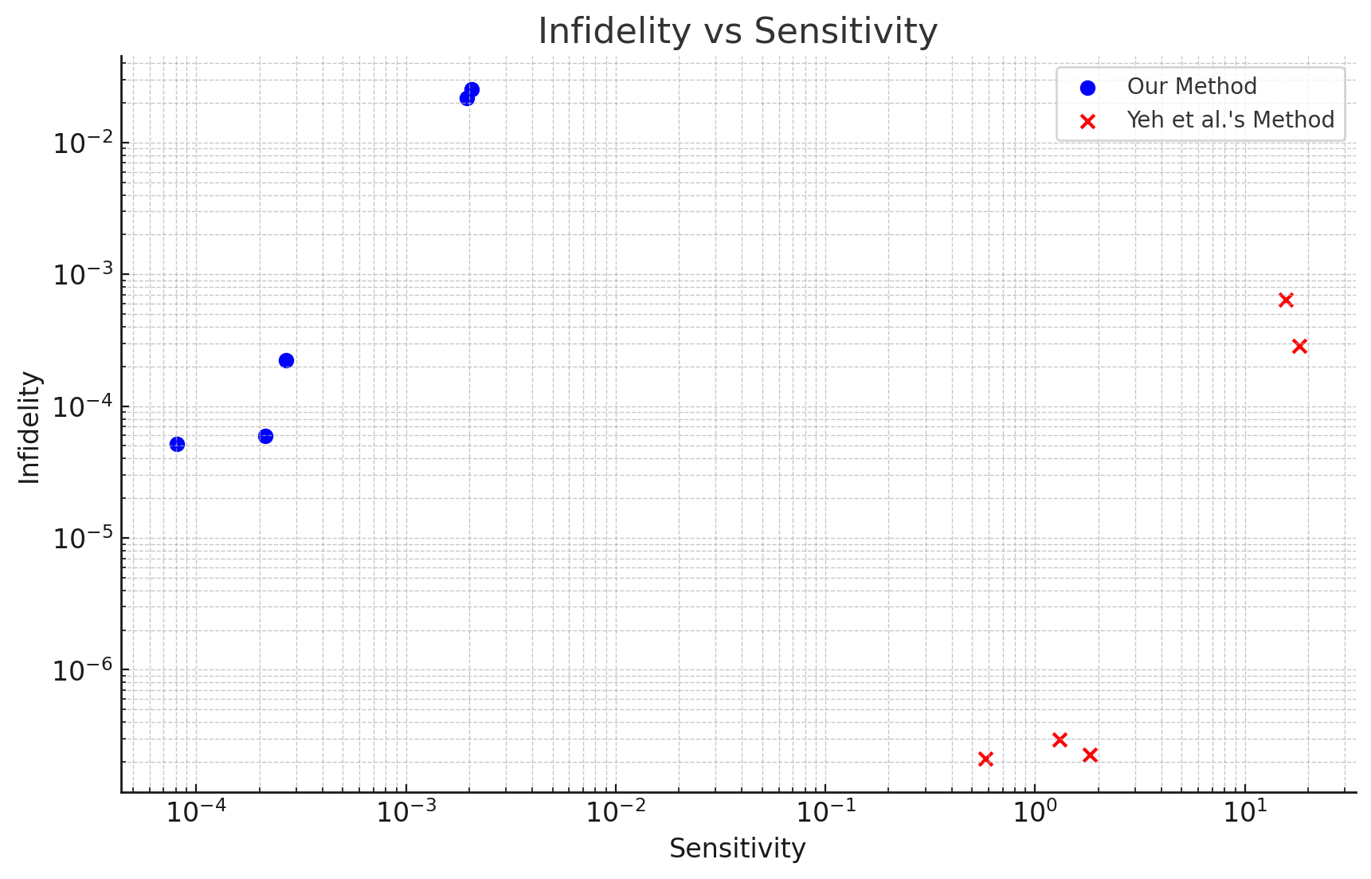

Slide 7
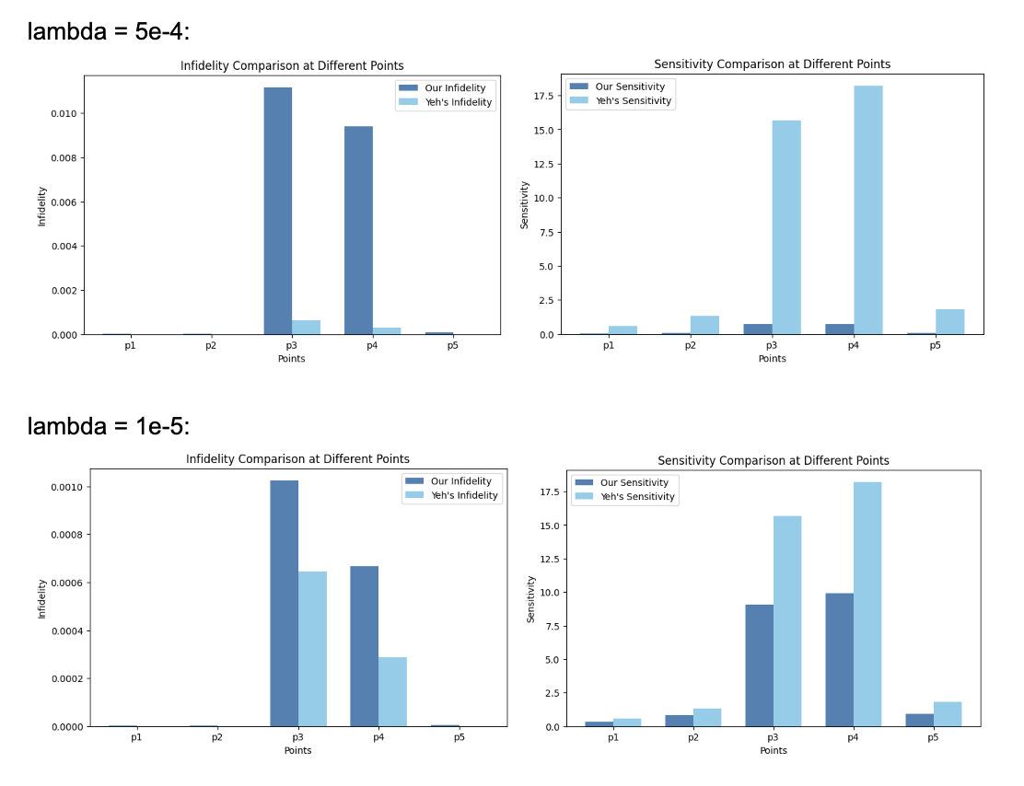
Notes:
Your results suggest that the relationship between sensitivity and infidelity isn't linear but exponential in certain cases. There’s probably a better lambda somewhere out there that minimizes the infidelity and sensitivity, we just need to find it.

Slide 8
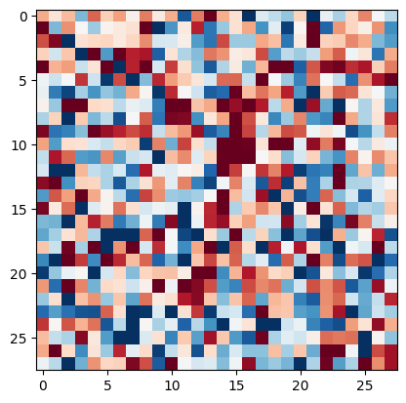
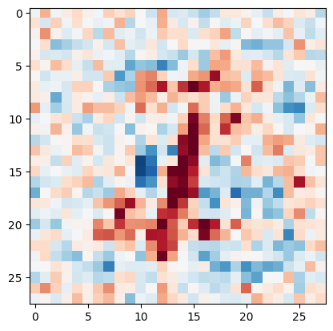
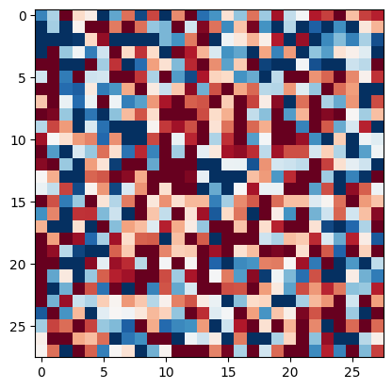
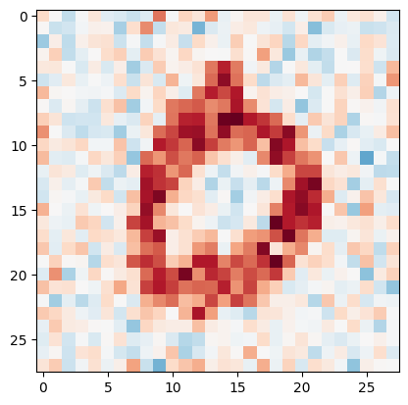
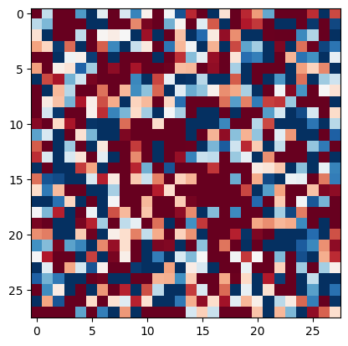
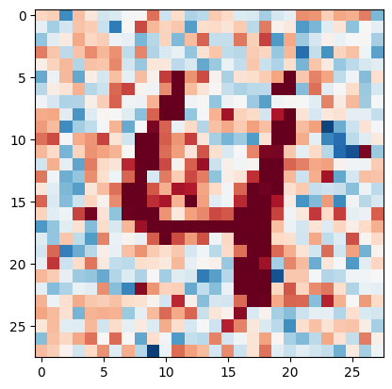
Original
Yeh’s
Ours

Slide 9
Yeh’s method uses more extreme values, represented by darker red (more positive) and darker blue (more negative)
By reducing sensitivity, our method reduces the magnitude of the explanations overall, making it more clear which pixels are most important
Trade Offs are inevitable: Our method ensures greater flexibility in optimizing the balance between infidelity and sensitivity due to hyperparameter tuning (λ)
The relationship between infidelity and sensitivity approaches exponential and is heavily dependent on the dataset (we will further explore this in the paper)
Insights

