Slide 1
INTELLIGENT LOAD TESTING
Jared O’Reilly
Entelect
06/07/2018

Slide 2
LOAD TESTING
Load testing is performed on a system to determine a its behaviour under both normal and anticipated peak load conditions.
It helps to identify the maximum operating capacity of an application, as well as any bottlenecks and determine which element is causing degradation.
However, to perform realistic and effective load testing, the actions of users on a website (user flows) need to be realistically replicated.
This would allow us to simulate the load on a website without any users being involved, so we can eliminate problems before they even become problems.
However, the realistic replication of user flows is a complex task.
The solution?

Slide 3

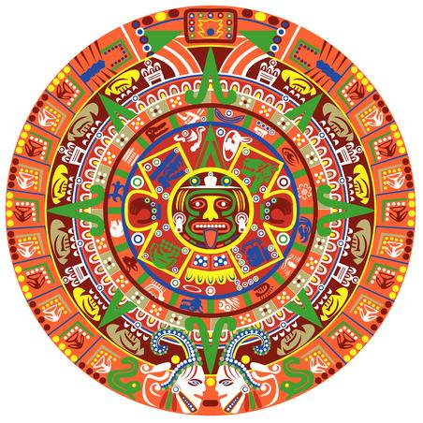
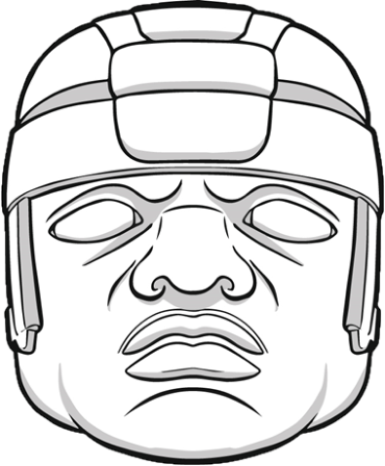
The
A M O
Software Suite
Aztec
Mayan
Olmec

Slide 4
SUMMARY OF COMPONENTS
Aztec will be able to crawl through the source code of a website (and possibly the access logs of a webpage) and generate a probabilistic NFA representing the website.
Mayan, given a probabilistic NFA representing a website, can generate realistic user flows/scenarios, and convert these directly into Artillery scripts, which can be run immediately.
Olmec, given text files containing the execution output of an Artillery run, processes and outputs various statistical measures and graphs illustrating possible lag in a website.

Slide 5
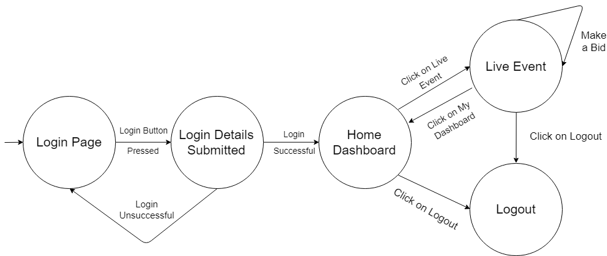
Aztec
0.6
+QUIT
Probabilistic NFA
0.9
1
0.8
0.1
0.3
0.1
0.2
Mayan

Slide 6
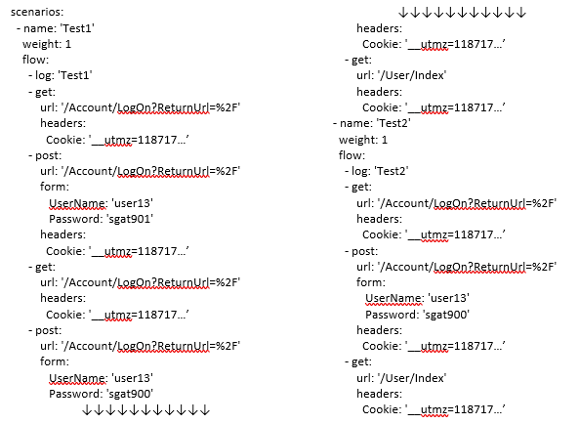
Mayan
Artillery Scripts
Olmec

Slide 7
Aztec
Aztec has not been developed yet (lowest priority at the moment, as eDiamond is the focus).
Aztec will be able to parse and crawl through the source code and access logs of a website, and create the probabilistic NFA that Mayan requires to generate the user flows.
For the moment, entering the NFA is a UI process.

Slide 8
Mayan
Mayan is complete, some additional features can be added (i.e. more validating for UI, more feedback on what is taking place behind the scenes), but the basic functionality of it is there, and is very solid.
Mayan, given the NFA (which is entered through it’s UI), generates a custom number of scenarios, with probable scenarios being generated more, and less probable scenarios being generated less (random number generation imposed on a probabilistic setup). Then, a realistic simulation script can be run, as well as individual scenario scripts, and also the choice of using averages for each individual scenario script is given.
See the Mayan demo/code review.

Slide 9
Olmec
Olmec, given text files containing the executions of Artillery scripts, extracts reports and phases information from the text files, stores them, and graphs them. Almost all the stored data is graphed/displayed, but further display/feedback/summaries can be added.
There is some solid and customizable graphing of various measures of the time in milliseconds that requests take to return with a response after they have sent, for the realistic simulation run, as well as graphing and info on individual scenario runs, which throw warnings when a certain scenario causes particular lag. Even though Olmec performs some formidable statistical analysis, it still has room for slight statistical tweaking.
See the Olmec demo/code review.

Slide 10
EXPANSION
Aztec
(website to NFA)
Given the source code of a website (e.g. in a MVC design), the NFA will be generated.
Using the access logs of the web server, the probabilities can be dynamically calculated and stored in the respective edges of the NFA.
…
Mayan
(NFA to tests)
Allow the user to select the number of times each scenario must be run to calculate the average (currently 3)
Create one special settings text file, specifies info about scripts generated, which Olmec can parse (averages, # scenarios)
…
Olmec
(tests to reports)
Increase the rigor of the statistics used to detect lag (research)
Add ‘Info’ buttons for each option, which explains what that report is
Change single lag report design (graph link), late reports cause another flag
…

Slide 11

THANK YOU

Slide 12
REFERENCES
Aztec logo:
https://www.ancient-origins.net/sites/default/files/field/image/aztec.png
Mayan logo:
https://us.123rf.com/450wm/sateda/sateda1509/sateda150900049/46107575-stock-vector-vector-of-aztec-calendar-on-white-background.jpg?ver=6
Olmec logo:
http://static1.squarespace.com/static/5549495ce4b04cef2f6c9a75/t/554ebf46e4b04c602813a6ca/1431224134903/Logo+with+Olmec+Foods+name.jpg?format=1000w

