Slide 1


Project 3
The Web Scrape-kings
Jarred Roussel, ben montague, Edmund annobil, alain Toussaint, charley hilgeman

Slide 2

Project purpose
Goal: demonstrate team’s knowledge of databases, APIs, Python, JavaScript, Flask, HTML, etc.
Use-Case: Find the correlation between population over time and the cost of living in various cities in the United States
Deliverable: Develop an interactive view of our visualizations to be able to tell a story about our data

Slide 3
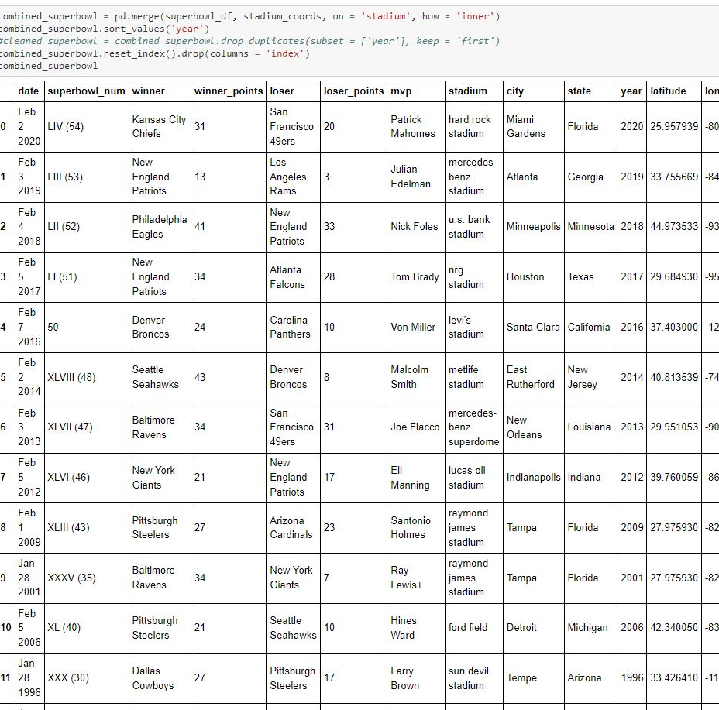

Initial stages
Start up/Data clean up
Python api
Finding Data
US Census Data (data.gov)
Cost of Living API
Super Bowl Host Cities (Kaggle)
Fortune 500 Corporate Headquarters
World Cities (Kaggle)
Use of Python to form DataFrames
Initialize for API calls
Clean and Merge for usability
Set up to populate database
Data Gathering
Pull in US Census Data
Use of API Key and Call
Creation of Final DataFrame
To be used for SQL Database

Slide 4
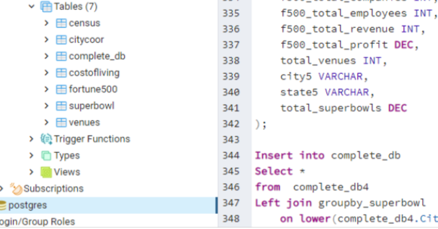


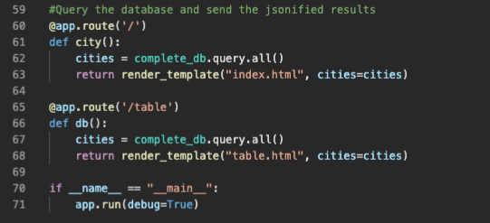
database construction and flask api
SQL Database
FLASK API
Formation of database to be used
Compilation of all data into Postgresql
Connecting datasets/tables
Use of Primary and Foreign Keys
Connect Data to HTML/CSS
Use of calls to develop visualizations
Query the Database
Send Jsonified results to index template

Slide 5
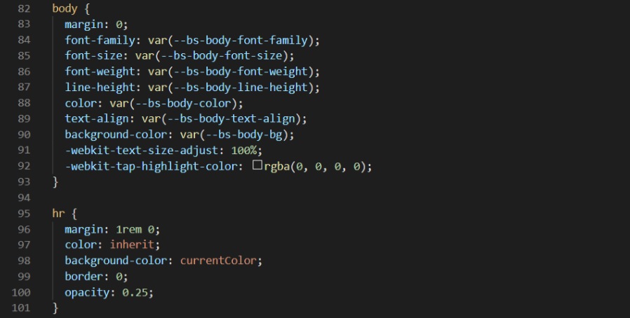


Web
Index html
Css styling
Web Design
Bootstrap Templates
Creation of Interactive Page
Formatting and Styling
Add flair/attractiveness to page

Slide 6
Visualizations

Slide 7
Visualizations cont’d

Slide 8
Thank you!

