Slide 1



Project 3
The Web Scrape-kings
Jarred Roussel, ben montague, Edmund annoubil, alain Toussaint, charley hilgeman

Slide 2

Project purpose
Goal: demonstrate team’s knowledge of databases, APIs, Python, JavaScript, Flask, HTML, etc.
Use-Case: Find the correlation between population over time and the cost of living in various cities in the United States
Deliverable: Develop an interactive view of our visualizations to be able to tell a story about our data

Slide 3
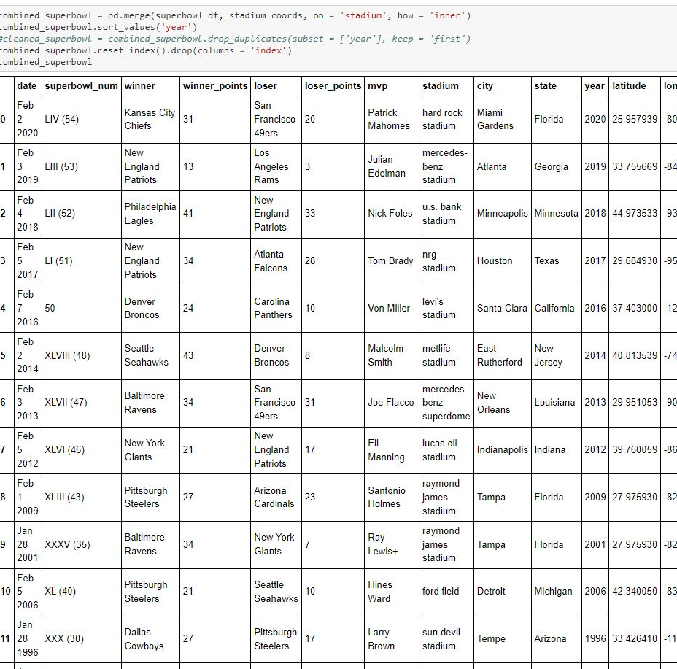


Initial stages
Start up
Data clean up
Brainstorming and Research
Determined project theme
Deciding on routes to find best data
Finding Data
US Census Data (data.gov)
Cost of Living API
Super Bowl Host Cities (Kaggle)
Fortune 500 Corporate Headquarters
World Cities (Kaggle)
Importing CSVs
Set up to populate database
Use of Python to form DataFrames
Initialize for API calls
Clean and Merge for usability

Slide 4
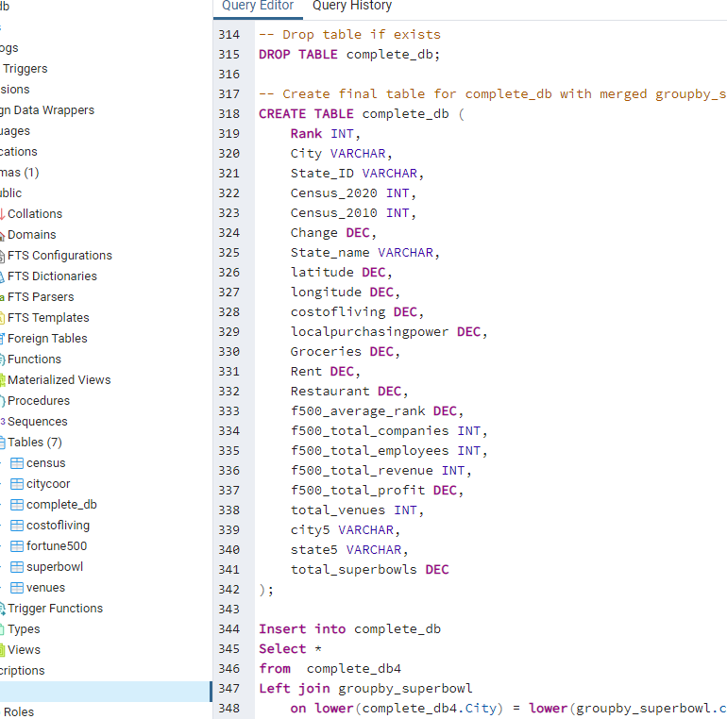

Api calling and database construction
Python api
SQl Database
Data Gathering
Pull in US Census Data
Use of API Key and Call
Creation of Final DataFrame
To be used for SQL Database
Formation of database to be used
Compilation of all data into Postgresql
Connecting datasets
Use of Primary and Foreign Keys

Slide 5
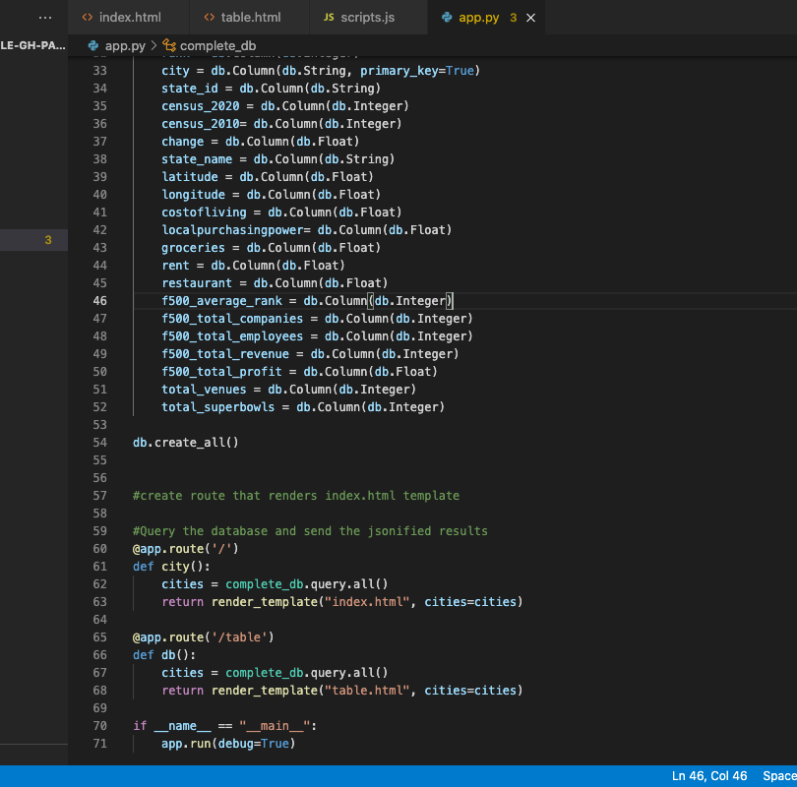


Flask app
Flask Server
Flask is a micro web framework written in Python. Extensions exist for object-relational mappers, form validation, upload handling, various open authentication technologies and several common framework related tools.
Flask & HTML
Flask provides a render_template() helper function that allows use of the Jinja template engine. This will make managing HTML much easier by writing your HTML code in . html files as well as using logic in your HTML code.

Slide 6
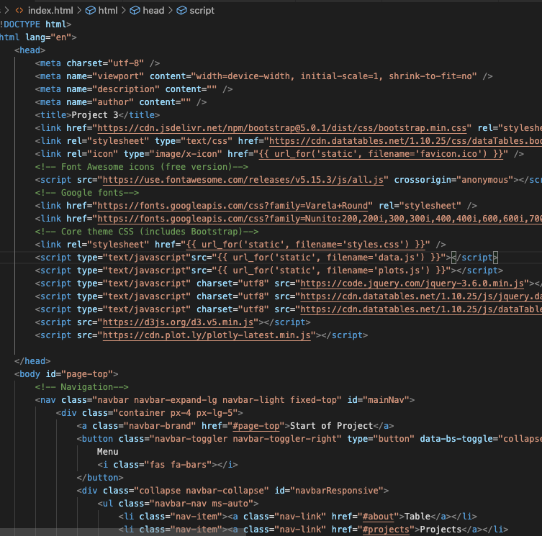


Web
Index html
Css styling
Web Design
Bootstrap Templates
Creation of Interactive Page
Formatting and Styling
Add flair to page

Slide 7
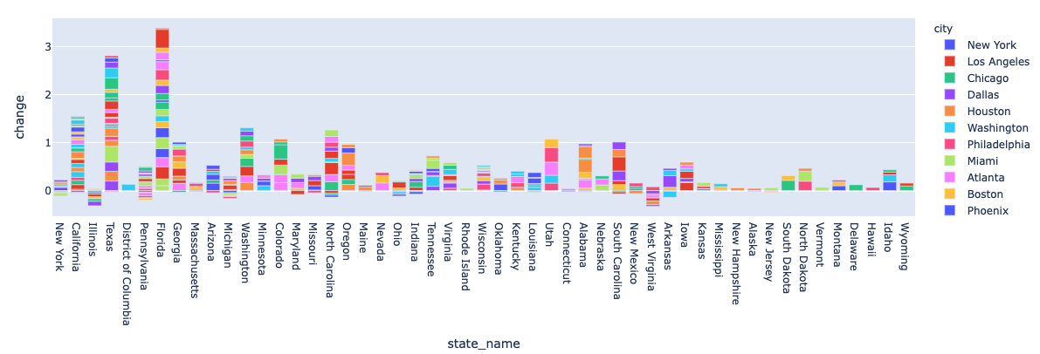
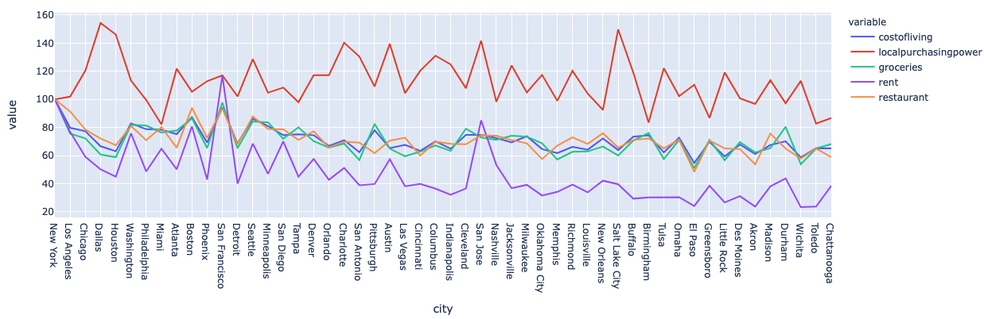
Plotly visualizations
Population Change
Family Finances Metrics

Slide 8
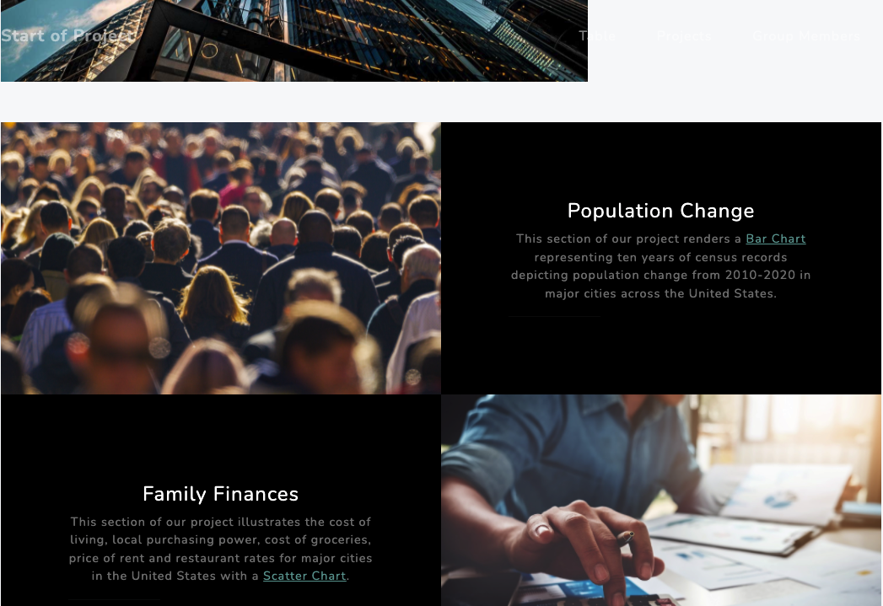
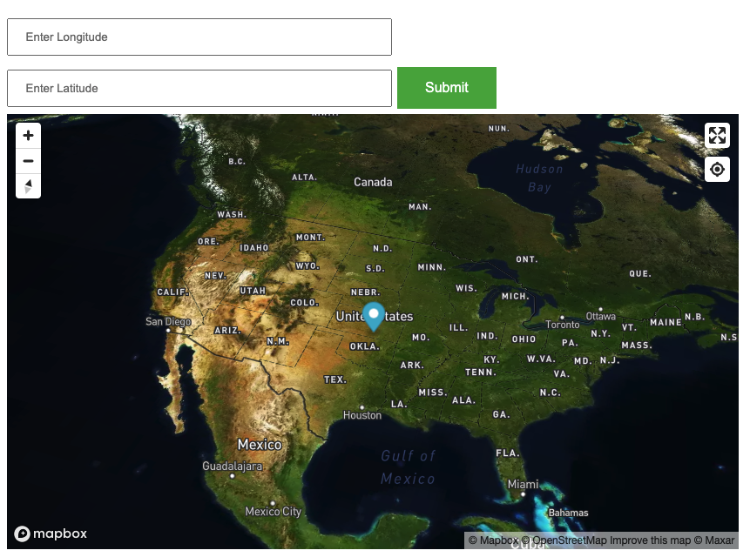
Dashboard and mapping

Slide 9
Thank you!

