Slide 1
Introduction to
Embedded Computer System
Chapter 1

Slide 2
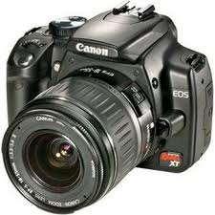
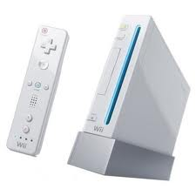
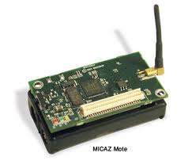
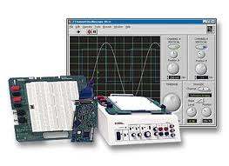
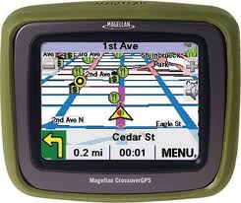
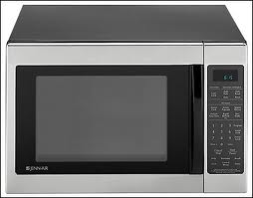
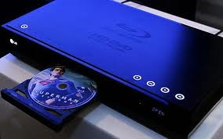
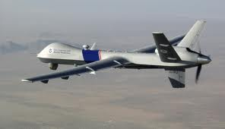
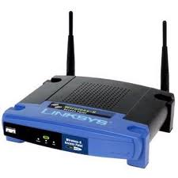
They are Embedded Systems

Slide 3
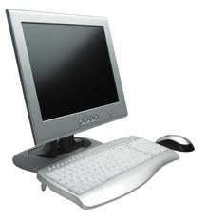
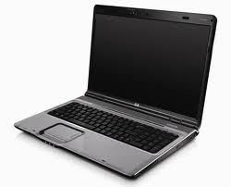
Is it an embedded system?

Slide 4
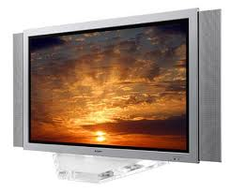
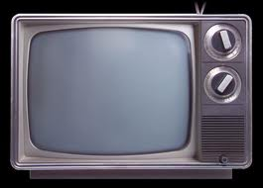
Is it an embedded system?

Slide 5
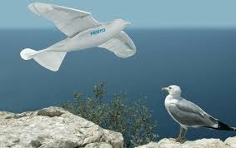
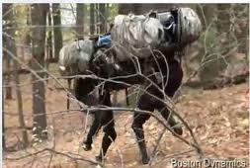
Is it an embedded system?
Smartbird
Big dog

Slide 6
Definition
No clear definition !!!
  Non-computer, small, regular, big, super
Non-computer : no computation
  The transmitter of car remote controller
Small computer : embedded system
  The receiver of car remote controller
Regular computer : 1 CPU (a few cores)
Big computer : a few CPUs
  Servers
Super computer : thousands of CPUs
  IBM Roadrunner, 1.105 PFLOPS

Slide 7
Characteristics
More limited in hardware and software functionality.
  Sensor
  Hardware : 4KByte ram, 1MIPS CPU
  Voice recording
    8 bit per sample
    9.6K samples per second (only fair quality)
    Without compression : 0.41 seconds of recording
    With compression, each sample should be compressed within 104 instructions.
  But, not always so resource constrained

Slide 8
Characteristics
Designed to perform dedicated functions
  Digital LCD
  A remote controller, a signal receiver, a panel
  Although the controller has many buttons, the TV only has a fixed menu with a fixed set of functions.
    Change channel
    Recording
    Video on demand
    Change color
  So, it is feasible to have a manual with a TV, which describes all functions provided by the TV.

Slide 9
Characteristics
Designed with specific quality requirements
  Car's brake controller
    ABS, ESC, ...
    60 mph = 87.5 feet per second
    A response time of 0.1 second in the brake system means a distance of 8.75 feet.
    High real-time requirement
  Car's engine controller
    Gas and ignition control in response to current speed
    High reliability requirement : cannot fail over years
  Airplane : higher
  TV : lower

Slide 10
Characteristics
Modern general purpose embedded systems
  PDAs, cell phones, ...
  They were NOT general purpose embedded systems, but are now.
  Limited resources
    ?
  Dedicated functionality
    ?
  Specific quality requirements
    ?

Slide 11
Market
Automotive
  Engine, ignition, brake, stability
Consumer electronics
  TV, DVD, PDA, refrigerator, oven, camera
Industrial control
  Robot
Medical
  Monitor, analyzer, pump
Networking
  Router, access point
Office automation
  Fax, printer, copier, scanner

Slide 12
Market
Defined in the following order
Dedicated functionality
  Each device is designed for a particular market.
Specific quality requirement
  Each device satisfies a particular needs.
Limited resources
  Resources are trimmed to save cost.

Slide 13
System Design
Same as software engineering principles
Big-bang
  Beginners
Code-and-fix
  Small applications
Waterfall
  Large applications
Spiral
  For a continuous business
Examples in the book

Slide 14
System Design
Marketability
  Who need it?
Functionality
  Does it provide what people need?
Cost limitation
  Can people afford it?
  Does it only provide what people need?
System's quality
  How does it provide what people need?
Performance limitation: computation power, memory size, battery life
  Finally, we, computer professionals, start to design a system to answer the four questions.

Slide 15
System Architecture
A system is composed of interacting elements.
  Elements/functionality
  Relationship/interaction
Every embedded system has an architecture.
  Why?
  Except all good reasons, it is hard to apply the design of one system on another.
Defining and understanding the architecture is the essential component of good system design.

Slide 16
System Architecture
System model
  Figure 1-2
  Application software layer (required)‏
    Application programs, common libraries
  System software layer (optional)
    OS, system libraries, system calls‏
  Hardware layer (required)‏
    CPU, memory, peripherals,

