Slide 1
Hardware and Board
Chapter 3

Slide 2
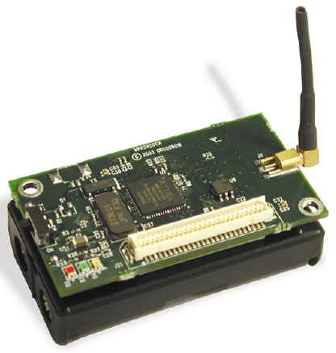
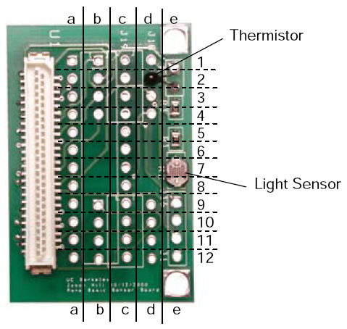
Circuit Board

Slide 3
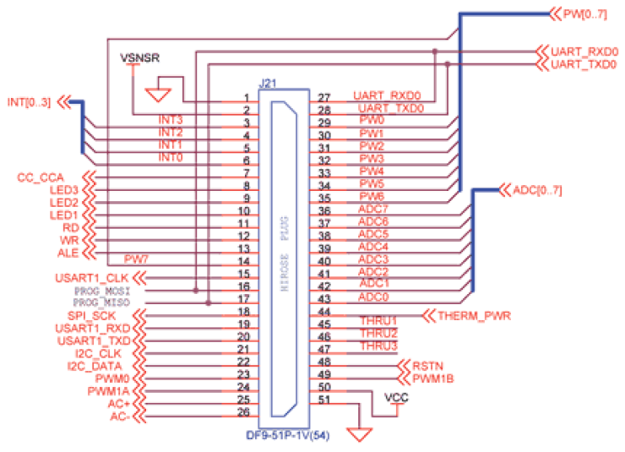
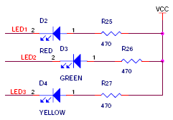
Schematic of Circuit Board
Connector and LED

Slide 4
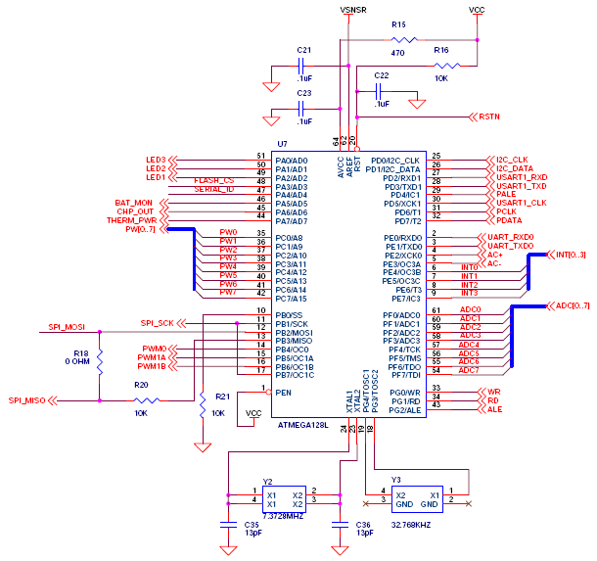
Schematic of Circuit Board
CPU

Slide 5
Schematic of LEDs
How does CPU control LEDs
  LEDs' wiring with power
    With a resister to Vcc
    0 on, 1 off
  LEDs' wiring with CPU's IO pins
    CPU IO Pins: PA2-PA0
  LEDs' wiring with extended ports
    Socket Pins: 10-8
  The circuit of LEDs?

Slide 6
Circuit Materials
Conductors
Insulators
Semiconductors
Physical properties of materials
  What signals can be utilized?
  How are signals generated and affected by materials?
Power supply and ground

Slide 7
Circuit Components
Resistor (ohm): Fig. 3-12b, how to use them?
  Potentiometer
  Photo resistor
  Thermistor
Factors
  Tolerance (precision)
  Power rating
  Temperature coefficient
Resistance
  10K-10M ohm in ICs (low power consumption)

Slide 8
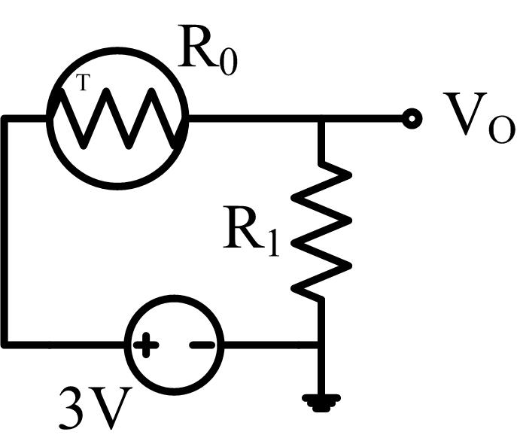
Sensor
How does a photo resistor work
  Make a serial circuit of a photo resistor (R0) and a regular resistor (R1=10KΩ), and then measure the voltage on the regular resistor.
  Assume the resistance of the photo resistor is
  R0 = 10-L*c (KΩ)
  I = V/(R0+R1) = V/(20-L*c)
  Vo = I*R1 = V*10/(20-L*c)
  L = (20-V*10/Vo)/c

Slide 9
Circuit Components
Capacitor (farad): Fig. 3-14b
  Electric field
  Bipolar/non-polarized
  Polarized
  Variable
Factors
  Tolerance (precision)
  Temperature coefficient
Capacitance
  10pf-100uf in ICs (high frequency)
  10mf-1f in big systems (appliance, camera, high energy reservation)

Slide 10
Circuit Components
Inductor (henry) : Fig. 3-16b
  Magnetic field
  Air core
  Iron core
Factors
  Tolerance (precision)
  Power rating (inertial resistance, heat)
  Size (hard to be made in ICs)
Inductance
  1nh-10uh

Slide 11
Circuit Components
Diode : Fig. 3-17b
  LED
  Photo diode (reverse connection with power)
  Zener (reverse connection with power)
Transistor
  BJT : Fig. 3-21b, 3-22b
  JFET : Fig. 3-28
  MOSFET : Fig. 3-25
  CMOS

Slide 12
Circuit Components
Sensors
  Changes in voltage or current, then detected by a sampling circuit as raw data.
  Light, temperature, magnetic
  Microphone (acoustic)
    Vibration -> change in resistance or capacitance or inductance
  Accelerometer (motion)
    Force -> change in capacitance or resistance

Slide 13
Design a Roomba
Google “roomba video”
How it bumps off the wall?
How it moves along a spiral?
How it prevents falling from a stair?
How it detects if a part is missing?
Must the data be accurate?
  Does the data require precise resister or any circuit components?

Slide 14
Circuit Components
Oscillator : http://en.wikipedia.org/wiki/Electronic_oscillator
  Clock, frequency generator (100KHz-100MHz), frequency filter
  Precision
    Atomic, 10⁻⁹ or better
    Quaz, 10⁻⁵-10⁻⁷
    Circuit, 10⁻²-10⁻⁴
Connector : http://en.wikipedia.org/wiki/Electrical_connector
Switch : http://en.wikipedia.org/wiki/Switch

Slide 15
Circuit Components
IC
  Scale (number of gates)
    SSI: 100
      74xx chips
    MSI: 100-10K
    LSI: 10K-100K
    VLSI: 100K-1M
    ULSI: >1M
  Power consumption
  Speed

Slide 16
Circuit Components
IC
  Functionality
    CPU
    ADC, DAC
    RAM, ROM
    Power
    Amplifier
    IO
  Reliability
  Debugging

Slide 17
Packages
Packages : http://en.wikipedia.org/wiki/Category:Chip_carriers
  Factors: size, heat, frequency
  SIP, single in-line package
  DIP, dual in-line package
  ZIP, zig-zag in-line package
  QIP, quadruple in-line package
  QFP, quad flat package
  PGA, pin grid array
  BGA, ball grid array
  LGA, land grid array

