Slide 1
DAC and ADC

Slide 2
All about data
Embedded systems
  Need to process data
    Sample status of the environment
    But, raw data is analogous
  Need to display data
    Control devices
    But, control signal is analogous
Chips
  Amplifier/Comparator
  DAC
  ADC

Slide 3
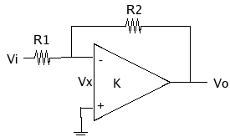
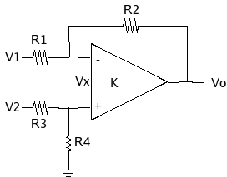
Circuit model
Amplifier model
Comparator model

Slide 4
Amplifier
INA2128
  How to determine gain
  What is the power supply
  What is the output range (for sample)
  What is the input range (for control)
  How does it respond to input signals with various frequencies (for control)
  Example circuit: acoustic, temperature, ...

Slide 5
Amplifier/Comparator
For comparator,
  If all resistors are the same,
Negation and addition circuits
  Negation?
  Addition?

Slide 6
DAC
Digital-to-Analog Converter
Circuit model
  Reference voltage
  Amplifier
  Analog adder
  Analog switch

Slide 7
DAC
Principle
  Input : 0110
  Output = 0*8 + 1*4 + 1*2 + 0*1
  Reference voltage ?
  Amplifier ?
  Anolog adder ?
  Analog switch ?

Slide 8
DAC
Performance
  Resolution
    2^{number_of_bits}
  Total harmonic distortion
    Rectangle output vs. smooth output
  Noise
  Dynamic output range

Slide 9
DAC
Example, AD7304
  Electrical features
    Resolution : 8 bits
    Input resistance : 28KOhm
    Reference : <5V, from outside
    Output voltage range : <5V
    Output current drive : 3mA
    Logic voltage : 0.8V as low, 2.4V as high
    Timing : around 50 ns, so safe time is 100ns
    Operating Temperature Range

Slide 10
DAC (AD7304)
Example
  Input
    Serial :
      SPI-compatible serial data interface
      12-bit data-word format, table 5
      MSB bits are loaded first
      Timing
      How fast is the data rate after all (Bps, not bps)?
    No parallel

Slide 11
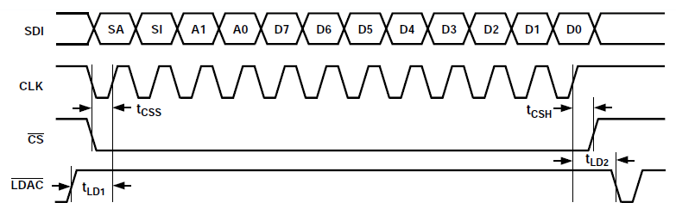
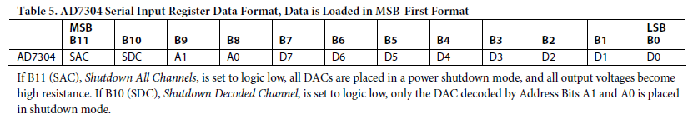
DAC (AD7304)
Example of control

Slide 12
DAC (AD7304)
Control by embedded software
  1. Configure four IO pins to output
    SDI, CLK, CS, LDAC
  2. Prepare 12-bit data (SDI)
  3. Output 1 to the LDAC pin
  4. Output 0 to the CS pin
  5. Repeat 12 times
    5.1. Output the MSB of SDI to the SDI pin
    5.2. Output a clock (CLK) to the CLK pin
      A low and a high
    5.3. Left shift SDI
  6. Output 1 to the CS pin
  7. Output 0 to the LDAC pin

Slide 13
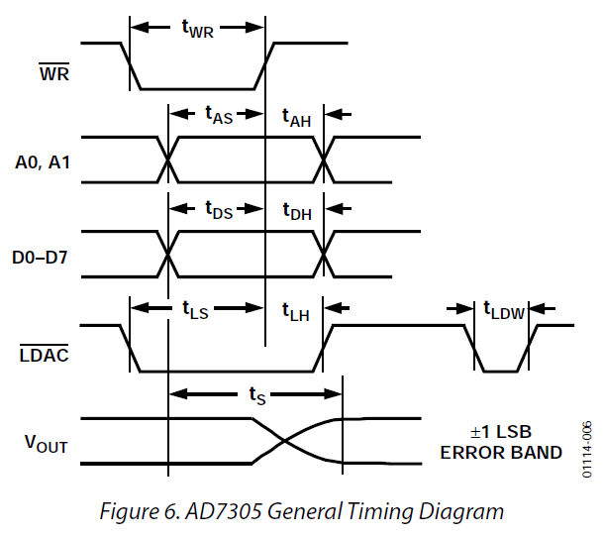
DAC (AD7305)
Control
  How many pins
  Control logic

Slide 14
ADC
Analog-to-Digital Converter
Operation theory
  Sampling (too low vs too fast)
  Nyquist theory (proper sampling rate)
    The sampling rate should at least double the highest frequency of the signal.
  Sound : 10 Hz to 10KHz
    Sampling rate? Data rate?
  Ultrasound for diagnose : 200KHz to 2MHz

Slide 15
ADC
Performance
  Resolution
  Maximum sampling frequency
  Noise
  Dynamic input range

Slide 16
ADC
Type
  Linear ADC
    Output = c * Input
    Distortion = σ²/2, where σ is the interval of resolution
  Non-linear ADC
    Ouput = c * log₂(input)
    Distortion = ?

Slide 17
ADC
Implementation
  Direct conversion ADC
    A voltage ladder producing (2^n-1) voltages
    (2^n-1) comparators
    An encoder
      How?
    Extremely fast, but hard to have a very high resolution
      8 bits, OK; 12 bits ?; 16 bits NO
  Example, a 2-bit ADC

Slide 18
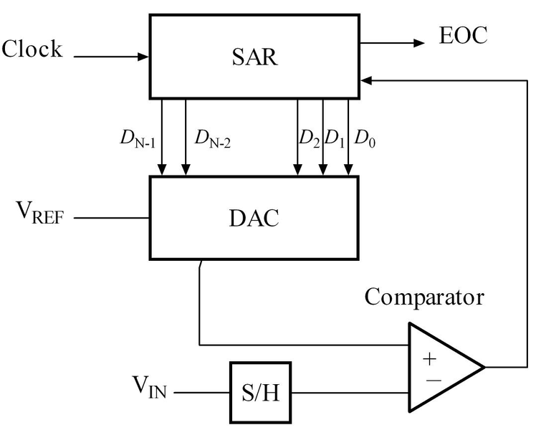
ADC
Implementation
  Successive-approximation ADC
    A comparator
    A DAC
    A shift register
    Procedure
      MSB 1, all others 0
      Compare V_{in}>V_{DAC}?
      Yes, 1->MSB; No, 0->MSB
      Next bit, ...
    How fast?

Slide 19
ADC (AD7476)
Example
  Electricity features
    Throughput : 1MSPS
    f_{SCLK} : 10M or 20M
    12 bits
  Output
    Serial
    Timing ?
    Interface to CPUs ?

Slide 20
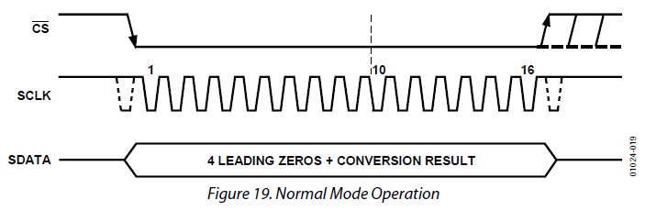
ADC (AD7476)
Control
  The conversion is initiated on the falling edge of CS as de-scribed in the Serial Interface section.
  To ensure the part remains fully powered up at all times, CS must remain low until at least 10 SCLK falling edges have elapsed after the falling edge of CS.
  16 serial clock cycles are required to complete the conversion and access the complete conversion result.

Slide 21
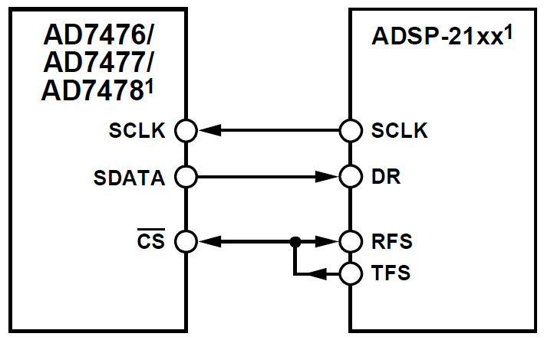
ADC (AD7476)
Control logic
  Output low to CS
  Output 16 clocks
  to SCLK
  Output high to CS
  Read DR

Slide 22
Design with ADC (AD7476)
Sample a signal of 20KHz
  Can AD7476 work on this?
    Sample rate?
    Resolution?
  Can the CPU ATMega128 (8MHz) work on this?
    Time for each reading?
    What is the duty cycle (percentage of working time)?
  What is the minimum requirement on ADC and CPU for this application?
    Speed
    Power

Slide 23
ADC (in chip)
Example, ATmega128, in chip
  Electrical features
    15KSPS
    10 bits
    8 input channels (multiplexed single end)
    Internal adjustable gains
  Output
    Parallel
    16-bit output register
    Two configuration registers

Slide 24
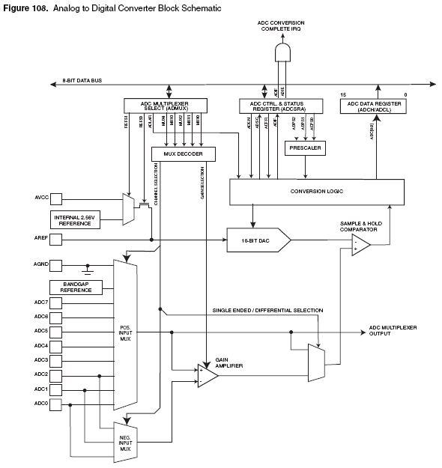
ADC
Circuit
model

Slide 25
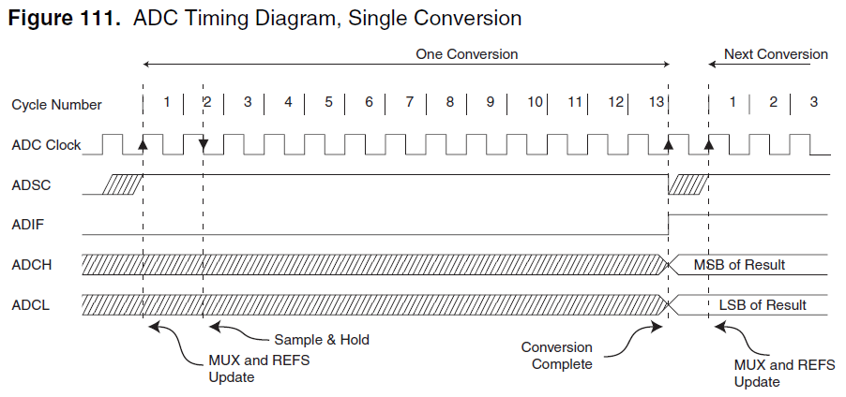
ADC (in chip)
Control

Slide 26
Now,
We have binary data!

