Slide 1
Board I/O
Chapter 6 & 7

Slide 2
Board I/O
System is a body, board is the head, CPU is the brain, and IO is the eyes, mouth, and limbs.
Input
  Bring information from an input device to the processor
Output
  Take information out of the processor to an output device
Topics
  Interface
  Performance

Slide 3
I/O Devices
Networking I/O
  NICs
Input
  Keyboard, mouse, remote, switch
Graphics
  Touch screen, printer, LED, LCD
Storage
  Hard drive, CD/DVDROM, flash driver
Debugging and program loading
  JTAG, UISP, GDB
Others
  ADC, DAC

Slide 4
I/O Hardware Model
Transmission medium
  Wired or wireless or light or sound
  Between IO devices and IO ports
Communication port
  COM/UART, USB
Communication interface
  Between CPU and I/O ports
I/O Controller
  Slave I/O processor

Slide 5
I/O Hardware Model
Simple example,
  Figure 6-3b
  Direct connection from CPU to LED
  No controller, no port
Complex example
  Figure 6-3a
  Monitor display
  Video control and video port

Slide 6
CPU Control
No port, no controller
  Driver and control (API) over the device
  Data format and transmission with the device
Have port, but no controller
  Driver and control (API) over the port
  Data format and transmission through the port
Have both port and controller
  Driver and control (API) over the controller
  Data format and transmission with the controller

Slide 7
I/O Hardware
Features
  Expandability
  Functionality
  EM compatibility
  Power consumption
  Performance
    Reliability
    Throughput
    Response

Slide 8
Serial I/O
Communication mode
  Simplex : Figure 6-4a
    One direction only
    Examples ?
  Half duplex : Figure 6-4b
    Two direction over time
    One direction on any particular time point
  Full duplex : Figure 6-4c
    Two direction on any time point
  How about an Ethernet NIC? (UTP vs. Co-axial)

Slide 9
Serial I/O
Communication type
  Synchronous
    One : sender and receiver are using the same clock.
    Two : sender and receiver are using the same states.
  Asynchronous
    One : sender and receiver are using different clocks.
    Two : sender and receiver are using different states.
  Example : UART
    Same clock? Same state?

Slide 10
Serial I/O Protocol
UART protocol, Figure 6-5
  Universal Asynchronous Receiver/Transmitter
  Idle state : voltage ? logic ?
  Start bit : voltage ? logic ?
  Stop bits
  Parity bit
  Data size
  Data rate
    Baud rate : raw data rate, including control and data bits
    Bit rate : actual data rate, including only data bits
  Frame vs bits

Slide 11
Serial I/O Protocol
UART protocol
  If a sender uses a clock of 1MHz
  If a receiver uses a clock of 1.2MHz, but thinks it is using a clock of 1MHz
  How can they communicate at 10Kbps?
    |t*fs - t*fr| < 1 ⇒ t < 1/|fs-fr|
    frame_size = t*fs < fs/|fs-fr|
  Generally, what is the allowed difference of their clocks?
    frame_size < f/|Δf|
    |Δf|/f < 1/frame_size

Slide 12
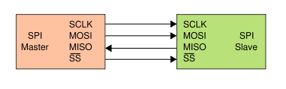
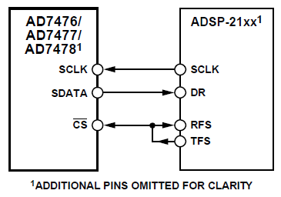
Serial I/O Protocol
SPI protocol
  Serial Peripheral Interface
  Master provides
    Clock (clock is synced)
    Slave selection (state is synced)
  Master output/slave in
  Slave output/master in
  Example : AD7476
    Who is master or slave?

Slide 13
Serial I/O Example
RS232
  OSI model
    Medium (PHY)
    Interface (control or signalling, PHY and MAC)
    UART (data format, PHY)
  DTE (Data Terminal Equipment) : sender
  DCE (Data Circuit-terminating Equipment) : receiver
  DB9 connector : at the DTE side, output is italic
    1. Carrier Detect (phone), 2. Received Data, 3. Transmitted Data, 4. DTE Ready, 5. Common Ground,
    6. DCE Ready, 7. Request To Send, 8. Clear To Send, 9. Ring Indicator (modem)‏

Slide 14
RS232
Communication process
  Start from power on ( DTE -> DCE ) :
  Simple mode
    4->, 6<-, 3->
  Handshaking mode
    4->, 6<-, 7->, 8<-, 3->
  Data transmission
    UART
  What is control logic?

Slide 15
Serial I/O Example
Small communication range
802.15.1 : Bluetooth
802.15.4 : Zigbee
  10-meter communication range
  Lower data rate than WiFi : 20, 40, 100, 250 kbps
  Simpler than Bluetooth
  30 channels in 902-928 MHz
  Point-to-point or star networks
    Coordinator: full-function device (FFD)‏
    Peers: reduced-function devices (RFD)‏

Slide 16
Another Serial I/O Example
Ethernet
  IEEE 802.3/u/z
  Thick or thin coax : 500 meters or 200 meters
    10Base-5 or 10Base-2 : 10Mbps
  Twisted pair
    10Base-T or 100Base-F : 10Mbps or 100Mbps
  CSMA/CD
  OSI model and Ethernet controller

Slide 17
Parallel I/O
Transmit multiple-bit data in parallel
I/O hardware model
  Transmission medium
  Communication parallel port
  Communication parallel interface
  I/O Controller

Slide 18
Parallel I/O Example
IEEE 1284
  LPT (Line Print Terminal) : printers
  Enhanced Parallel Port (EPP), Extended Capability Port (ECP) : half-duplex, bi-directional
  Data rate: 2-2.5Mbps
  Port: DB-25, Micro ribbon (36 pins)‏
  8-bit data pins and other signalling pins

Slide 19
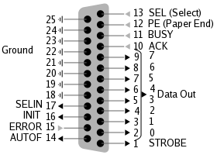
Parallel I/O Example
Pin schematics

Slide 20
USB
Replace all types of serial and parallel IOs
Extended to support multiple devices (physical and logical)
USB 1.0 : 12Mbps; USB 2.0 : 480Mbps; USB 3.0 : 5.0Gbps
Pins : 1 VCC, 2 data+, 3 data-, 4 GND
Cable length : <5meter for 1500ns RTT
More details are online.

Slide 21
I/O Controller and CPU
An ability of the master CPU to initialize and monitor the I/O controller
  Registers in I/O controller
  Control register for configuration
  Status register for monitoring
A way for the master CPU to request I/O
  Signalling registers
  Signalling instructions, not data instructions

Slide 22
I/O Controller and CPU
A way for the I/O controller to contact the master CPU
  Interrupt
  Data cache in I/O controller
A mechanism for both to exchange data
  Data I/O instructions and data registers
  Memory-mapped
Check the manual of I/O controller

Slide 23
I/O Performance
Performance factors
  The data rates of the I/O devices
    Variety of I/O speeds
  The speed of the master processor
    Possible application bottleneck in embedded system
  Communication between them
    Data loss or hang or interrupt priority ...
Performance metrics
  Throughput
  Processing time
  Response time

Slide 24
Bus
Master and slave devices
  Master : can initiate a bus transaction
  Slave : can only respond to a master's request
Buses
  System bus : specific to CPU and memory
  Backplane bus : shared with on board components
  IO bus : extended to external components

Slide 25
Bus
Bus and bus bridges : north and south
  Bridge : connection among buses
  Northbridge : connect faster buses
    memory controller hub
    handle communications among CPU, memory, video cards, and southbridge
  Southbridge : connect slower buses
    I/O controller Hub
    handle communications among slower devices (IO) on the motherboard

Slide 26
Bus
Arbitration
  Dynamic central parallel, Fig. 7-3a
    FIFO
    Priority-based
  Centralized serial, Fig. 7-4
    Daisy chain
  Distributed, Fig. 7-5

Slide 27
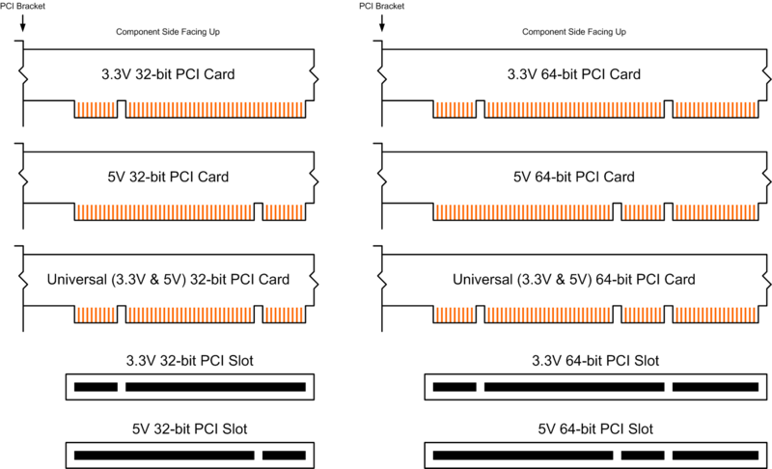
Bus Example : PCI
Peripheral Component Interconnection
  Data size : 32-bit or 64-bit
  Data rate : 33MHz or 66 MHz or 133MHz

Slide 28
PCI
Dynamic centralized parallel arbitration
Five steps
  Request to the central arbitrator
  Be granted
  Send address and set transfer type
  Transfer data and set transfer status
  Terminate

