Slide 1
CPU I
Overview
Chapter 4

Slide 2
CPU
CPU components
  General
    Processor : ALU
    Memory : code and data
    IO
  Instructions
    Opcodes and oprands
    Addressing

Slide 3
Embedded System Architecture
von Neumann
  A processing unit
  A memory to hold both instructions and data
  CPU can either read an instruction or access data from the memory, but not at the same time
Harvard
  A processing unit
  Two memories to hold instructions and data separately
  CPU can both read an instruction and access data at the same time

Slide 4
IO Architecture
Port IO
  IO address is not memory address
  IO data path is separated from memory data path
  Special IO instructions
  Simultaneous access to IO and memory
Memory mapped IO
  IO address is a part of memory address
  IO and memory share the same data path
  No special IO instructions
  Exclusive access to IO or memory

Slide 5
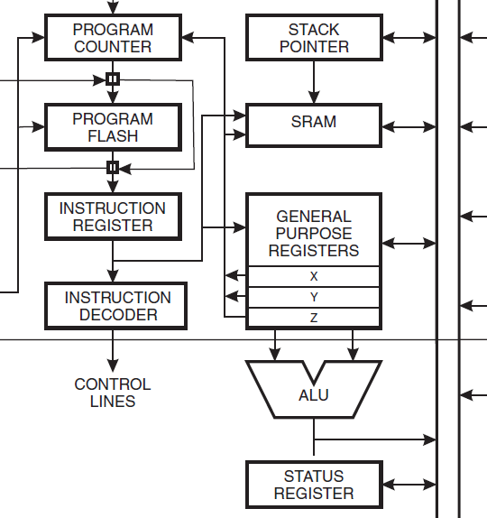
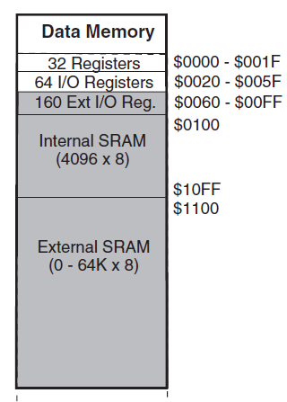
Example: ATmega128
CPU architecture
  Harvard
IO architecture
  Both port and memory IO spaces

Slide 6
Master Processor
Integrated processor
  Smaller IO latency
  Simpler board layout
  Less power consumption
Two categories
  Microprocessor
    Minimum IO components and on-chip memory
    Specialized for processing (computing)
  Microcontroller
    Maximum IO components and on-chip memory
    Specialized for controlling

Slide 7
Power Management
Enery consumption (CMOS property)
Dynamic Voltage Scaling (DVS)
Example
  V is in range of 1.8V-3.3V, and C is 2.75 W/V²
  F is 3.8GHz, and c is 1.563V
  If V is 3.3V, E is 29.95W, and f is 2GHz
  If V is 1.8V, E is 8.91W, and f is 500MHz

Slide 8
ACPI
Advanced Configuration and Power Interface
Global states
  G0 (S0): on
  G1: sleeping
    S1: CPU stops executing instructions, but power to CPU and memory is on. Other devices may be powered down.
    S2: CPU is powered off
    S3: Standby. Everything goes off except memory and what can wake up the computer.
    S4: Hibernation. Data in memory is saved to non-volatile memory such as a hard drive, and is powered down.
  G2 (S5): soft off: Everything goes off except what can wake up computer, such as keyboard, NIC, USB.
  G3: shutdown

Slide 9
ACPI
Processor states:
  C0: on
  C1: halt. Processor is not executing instructions, but can return to an executing state essentially instantaneously.
  C2: stop-clock. Processor maintains all software-visible state, but may take longer to wake up.
  C3: sleep. Processor does not need to keep its cache coherent, but maintains other state.

Slide 10
ACPI
Device states
  D0: on
  D1: less power consumption (e.g. slower)
  D2: even less power consumption (e.g. partially off)
  D3: off
Performance states
  P0: max power and frequency
  Pn: less than P(n-1), voltage/frequency scaled

Slide 11
Example: Atmega128
Instruction: sleep
MCU Control Register
  SE: sleep enable
  SM2, SM1, and SM0: sleep modes
    Idle
    ADC noise reduction
    Power-down
    Power-save
    Standby
    Extended standby

Slide 12
Example: Atmega128
Example: Enable sleep
  How to configure the sleep control register
  The meaning of different sleep modes
Example: hello.avr.asm
  How it handle return from main
  How to sleep

Slide 13
Instruction Set Architecture
ISA
  Operation / opcode / instruction
    The format and types of instructions
  Operand
    Data in instructions
  Storage
    How instructions and data are stored
  Addressing mode
    How to access memory
  Interrupt handling
    Handling of hardware and software interrupts

Slide 14
ISA
Functionality
  What can the instructions do?
Performance
  How fast can a program be executed?
  How much power can a program consume?
Design time
  How much time is needed to implement?
Cost
  How much do a processor and peripherals cost?

Slide 15
Opcodes
Types
  Computation
  Movement
  Branch
  I/O
  Context switch
Formats in machine
  Fixed size
  Variant
A for loop
  for (i=0; i<10; i++)

Slide 16
Operands
Types
  Bits, smaller than one byte
  Byte, 8 bits
  Halfword, 16 bits
  Word, 32 bits
Interpretation
  Integer
  Character
  Floating point
Formats in assembly
  Binary
  Decimal
  Hex

Slide 17
Operands
High level: nesc
  int16_t
  uint16_t
  int8_t
  uint8_t
  char
  * : void*, char*, uint8_t*, int16_t*
Low level: avr
  constant
  register
  memory address

Slide 18
Storage
Organization of address space
  Linear
  Segmented
Byte order (not bit order in a byte)
  Big-endian : MSB in lower address, 68000
  Little-endian : MSB in higher address, x86
  Configurable : ARM, MIPS, PowerPC

Slide 19
Byte Ordering
Little-endian : LSB in lower address
int foo=0x0A0B0C0D;
*(((char*)&foo)+2)=?
struct _foo {
char a='A';
int b=0x0A0B0C0D;
} foo;
*(((char*)&foo)+2)=?

Slide 20
Storage
Register set
  Fast programmable memory used to store operands that are immediately or frequently used.
Types
  General purpose
  I/O
  Program counter
  Status
  Stack pointer

Slide 21
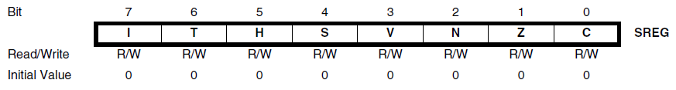
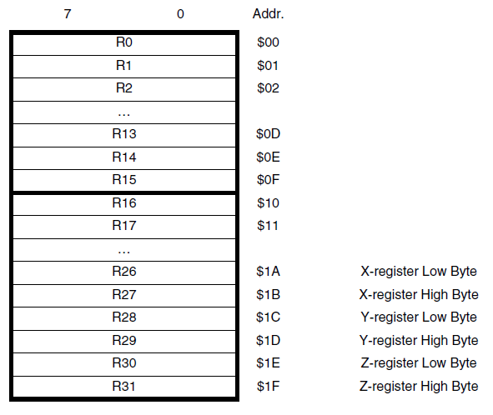
Storage
Example: registers
  Status register
  General purpose registers
    X, Y, Z
  Others
    Stack pointer
    IO registers

Slide 22
Addressing Modes
Hypothetical instructions.
Implied mode : push
Immediate mode : ldi r1, 0x10
Register modes : ldi r1, 0x10
Direct mode : lds r1, 0x10
Indirect mode : lds r1, (0x10)‏
Register indirect modes : lds r1, (r2)‏
Relative mode : rjmp 0x10
Indexed mode : ldx r1, (r2)[4]

Slide 23
Data Addressing Modes
Register direct
  Single register Rd
  Two registers Rd and Rr
IO direct
Data direct
Data indirect with displacement
Data indirect
Data indirect with pre-decrement
Data indirect with post-decrement

Slide 24
Program Addressing Modes
Program memory constant addressing
  LPM, ELPM, SPM
Program memory with post-increment
  LPM, ELPM, SPM
Direct program addressing
  JMP, CALL
Indirect program addressing
  IJMP, ICALL
Relative program addressing
  RJMP, RCALL

Slide 25
Interrupt Handling
Interrupt
  Mechanism to stop the current flow of the program in order to execute another set of code in response to some event.
Events
  Reset
  I/O
  Timer
  Computation error
  Execution error

Slide 26
ISA Model
Application-specific ISA models
  Designed for specific embedded applications
General purpose ISA models
  Designed to be used in various systems
Instructional-level Parallelism ISA models
  Designed to execute instructions in parallel

Slide 27
Application-specific ISA Models
Controller model
  No complex data manipulation
  Audio and video sampling I/O controller (ASIC)‏
Datapath model
  Repeatedly perform fixed computations
  Fourier transformation in DSP
  Multimedia computation in GPU
  Float point computation in FPU
FSM with datapath model
  ASIC + DSP
JVM model
  JME application-specific professor

Slide 28
General-purpose ISA Models
CISC model
  Complex instructions of several low-level operations
  E.g., load + compute + store
  Intel x86, Motorola 68000
RISC model
  Simple instructions of reduced low-level operations
  Single cycle per low-level operation / instruction
  ARM, SPARC, MIPS

Slide 29
Instruction-level Parallelism ISA Models
Single instruction multiple data model
  Data level parallelism : scalar vs. vector
  Multimedia computation: Intel MMX
    E.g., brightness adjust
  SISD, SIMD, MISD, MIMD
Superscalar machine model
  Instruction-level parallelism : scalar vs. superscalar
  Multiple functional units (ALUs)‏
  PowerPC 970: 4 ALUs, 2 FPUs, and 2 SIMD units
Very long instruction word computing model
  One instruction encodes multiple operations
  Each operation uses one functional unit of the processor
  Compiler decides the instructions : VLIW vs. superscalar
    E.g., f12=f0*f4, f8=f8+f12, f0=dm(i0,m3)‏

