Slide 1
CPU II
Design
Chapter 4

Slide 2
CPU Model
Processor pins
  Power supply
  Ground
  Clock
  Address pins
  Data pins
  IO pins
  Read pin (to memory)
  Write pin (to memory)
  Interrupt pins

Slide 3
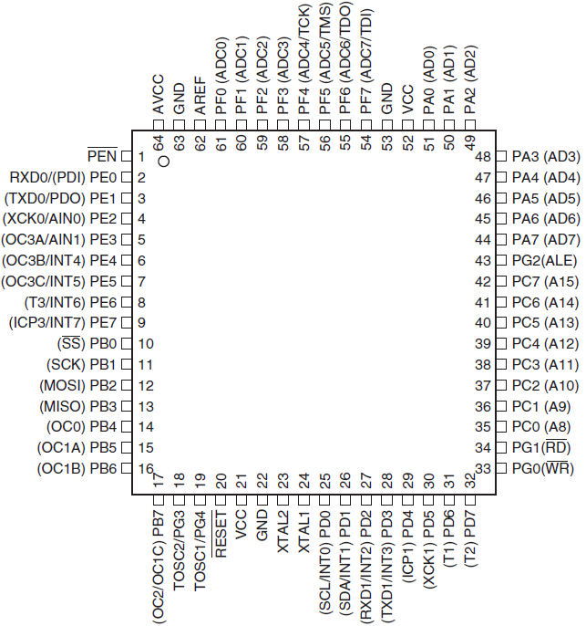
CPU Model

Slide 4
Execution Cycle
Determine instruction
Fetch instruction
Decode instruction
Fetch operands
Execute
Store result
...

Slide 5
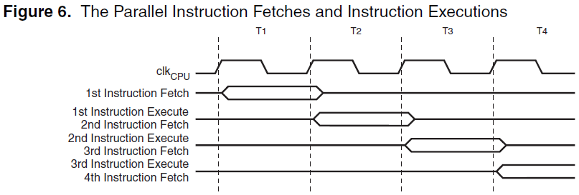
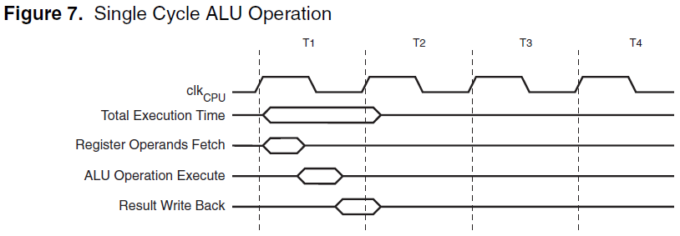
Execution Cycle

Slide 6
CPU Core Components
ALU
  Computation unit
Register
  Fast data storage
Control unit
  Management unit
Internal bus
  Connect the three components

Slide 7
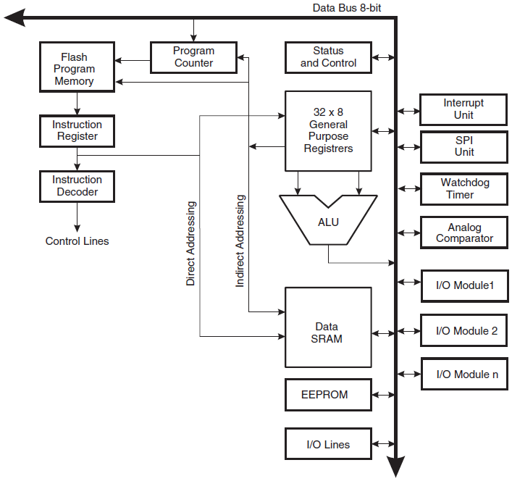
CPU Core Components

Slide 8
Internal Bus
Control signals + tri-state gates
Types
  Data bus
    Data mem, registers, IOs
  Address bus
    Program counter (to code mem)
    Registers (to data mem)
  Control bus
    Instruction decoder

Slide 9
ALU
Arithmetic instructions
  Integer and floating arithmetic computation
  Signed and unsigned addition and subtraction
  Multiplication? (*)
  Division? (/ %)
  Logarithm, exponentiation, ??
Logic instructions
  AND, OR, XOR
  NOT : 1's and 2's complements

Slide 10
ALU
Branch instructions
  Conditional branch
  Jump : direct, indirect, relative, absolute
  Call, return : direct, indirect, relative, absolute
Data transfer instructions
  Mem to and from reg
  Reg to reg, mem to mem
  Mem and reg to and from IO
  Code mem to and from data mem

Slide 11
ALU
Bit and bit testing instructions
  Set, clear
  Swap, shift
  Test
MCU and MMU control instructions
  NOP
  Sleep (pause)
  Soft interrupt
  Memory control and map

Slide 12
Registers
Store operands and results
Made by flip-flop or SRAM
Storage register vs. shift register
Special registers
  Status register
    State of a processor
  Timer
  Program counter

Slide 13
Control Unit
Fetch instruction
  Sequential
  Branch
Fetch operands
  Pipeline
Control execution
  Select functional unit
  Signal functional unit

Slide 14
CPU Clock
External clock
Internal clocks
  Generation
    How? (RC delay)
  Divide
    How? (Counter)

Slide 15
On-chip Memory
Non-volatile memory
  Data in memory will not disappear
  Read-only memory (ROM) : Figure 4-39
  Programmable link/fuse : Figure 4-40
  Types
    MROM
    PROM
    EPROM
    EEPROM
    Flash

Slide 16
Volatile Memory
Random-access memory (RAM)‏
Types
  SRAM : flip-flop
  DRAM : capacitor
    Discharge when read or overtime
    Need recharge / refresh
    Refresh is controlled by memory controller

Slide 17
Cache
Level-1 cache
  Inside CPU
    Cache vs. on-chip main memory
  Snapshot of a part of main memory
  Directly interact with the CPU
  Most code only access code and data within a range
  Cache hit vs. cache miss

Slide 18
Cache
Data transfer between cache and main memory
  Consistency
  Read criteria : high hit rate and low miss rate
  Write strategies
    Write through
    Write back
  CPU and memory architecture
    CPU↔cache↔MMU↔memory↔DMA↔HD

Slide 19
On-chip Memory Management
Functionalities
  Control multiple physical memories
  Translate logical address to physical address
  Handle memory security
  Control cache
  Handle bus arbitration between CPU and memory
Memory organization
  Code and data memory
  Memory mapping

Slide 20
Example: Memory and IO Mapping
256 IOs
1 64KB ROM (flash)
3 64KB RAMs
Von-Nueman architecture
Mapping (20-bit address space)
  0x00 - 0xFF IOs (share space with ROM)
  0x100 - 0xFFFF code in ROM
  0x10000 - 0x3FFFF data in RAMs
  A selection signal on 0x000XX

Slide 21
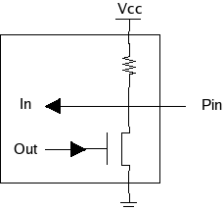
Processor I/O
Most concepts are the same as board I/O
  because the boundary of a board and a processor in an embedded system is not as clear as in a regular computer.
I/O pin
  Unidirectional (in or out)‏
  Bidirectional (in and out)‏
  Programmable

Slide 22
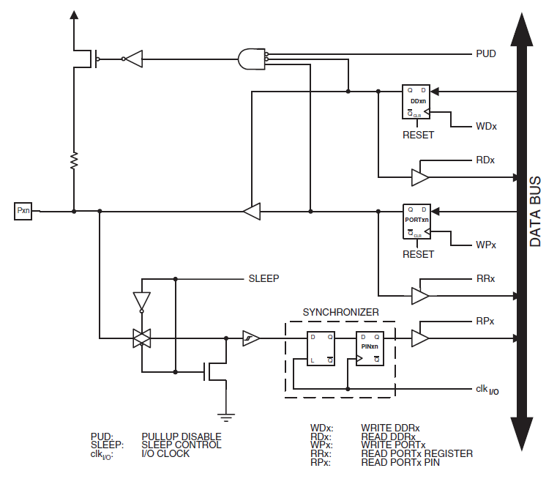
IO Pin Example

Slide 23
IO Pin Example
LEDs
  Connected to pin set A: 0, 1, 2
  Two registers control pin set A
    DDRA ($1A ($3A)) : direction control
      0 : input
      1 : output
    PORTA ($1B ($3B)) : data output
    PINA ($19 ($39)) : data input

Slide 24
Embedded I/O Components
Serial I/O
  USART ( example in sensor)
    Universal Synchronous Asynchronous Receiver Transmitter
  SPI
    Serial Peripheral Interface
  JTAG
    Joint Test Action Group, IEEE 1149.1
    Diagnose software and hardware of embedded system

Slide 25
JTAG
Debug support is for many software developers the main reason to be interested in JTAG.
Debugging architectures built up using JTAG, such as ARM CoreSight, Nexus, ...
Processors can normally be halted, single stepped, or let run freely.
Code breakpoints are supported, both for code in RAM and in ROM/flash.
Data breakpoints are often available, as is bulk data download to RAM.

Slide 26
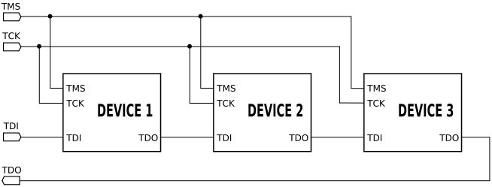
JTAG
JTAG pins
  TDI (Test Data In) : input JTAG instructions
  TDO (Test Data Out) : obtain scanned data
  TCK (Test Clock) : clock, SPI
  TMS (Test Mode Select) : state control
  TRST (Test Reset) optional

Slide 27
JTAG
Examples of JTAG instructions
  EXTEST : for external testing, such as using pins to probe board-level behaviors
  INTEST : for internal testing, such as using pins to probe on-chip behaviors
  PRELOAD : loading pin output values before EXTEST
  SAMPLE : reading pin values into the boundary scan register
  HIGHZ : deactivates the outputs of all pins
  RUNBIST : places the chip in a self-test mode
  SCAN_N : configures a scan path select register (SCREG) affecting the signals to which other boundary scan operations apply
  USERCODE : returns a user-defined code, for example to identify which FPGA image is active
  HALT, RESTART : halts or restarts the CPU.

Slide 28
JTAG Example
Boundary-scan Capabilities
Debugger Access to:
  All Internal Peripheral Units
  Internal and External RAM
  The Internal Register File
  Program Counter
  EEPROM and Flash Memories
Extensive On-chip Debug Support for Break
  AVR Break Instruction
  Break on Change of Program Memory Flow
  Single Step Break
  4 : Program Memory Breakpoints + Data Memory Breakpoints
Programming of Flash, EEPROM, Fuses, and Lock Bits
On-chip Debugging Supported by AVR Studio

Slide 29
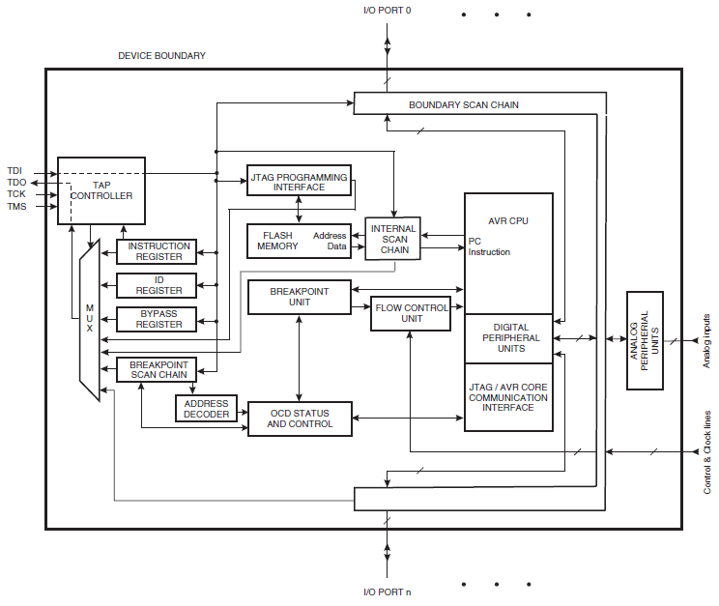
JTAG Example

Slide 30
Interrupts
Hardware interrupt
  Internal
    Timer, MMU, ADC, operation error, debugging
  External
    Hard drive, reset,
Software interrupt
  INT instruction
    Trigger a special routine to change context or mode
Interrupt vector

Slide 31
Interrupt Service
Service routine (pseudo-code)
  When an interrupt is triggered, normally the interrupt flag is cleared to disable other interrupts.
  Save context
  Enable other interrupts (optional, set the interrupt flag)‏
  Execute the interrupt routine
  Disable other interrupts (clear the interrupt flag)‏
  Restore context
  Return (normally the interrupt flag is set by the return)‏
Example : case8.interrupt

Slide 32
External Interrupt
Trigger hardware
  Interrupt pins (IRQs)‏
  Interrupt controller
Trigger mechanism
  Level-trigger
  Edge-trigger
Interrupt controller
  Slave processor + I/O device

Slide 33
Processor Performance
Computational performance
  Throughput : instructions per second (MIPS)‏
  Reliability : mean time between two failures
  Recoverability : mean time from fail to normal
  Availability : mean time from normal to fail
Power performance
  Duty percentage : mean percentage of execution
  Idle-mode power consumption

