Slide 1
Embedded Operating Systems
Chapters 5 & 9

Slide 2
OS Components
Kernel mode vs. user mode
Memory management
  Logic vs. physical memory
  Memory allocation
  Cache management
Process management
  Multi-process / multi-task scheduling
  Interrupt and error handling
I/O system management
  Shared I/O devices

Slide 3
CPU Mode
CPU mode
  A set of restrictions determine the resources that the instructions can access.
  x86 CPUs have 4 privilege levels.
Kernel mode
  Privilege level 0 : a program can do anything with the system
User mode
  Privilege level 3

Slide 4
OS Kernel
A user program has no privilege to directly access any resource.
The failure of a user program do not impact the rest of the computer system.
Mode switch
  When a user program needs to access a resource, the program should get permission from the OS kernel following the required procedure.
  Then, the OS switches from the user mode to the kernel mode.
  Example, system calls (device access).

Slide 5
OS Kernel Model
Monolithic
  All components are integrated into the kernel.
  All components provide interfaces to others.
Layered
  All components are organized in layers.
  A component only provides interfaces to its adjacent upper layer.
Microkernel
  The kernel is stripped off to include the minimum necessary functions: memory management, process management, and inter-process communication.
  All other components provide OS services in user space.

Slide 6
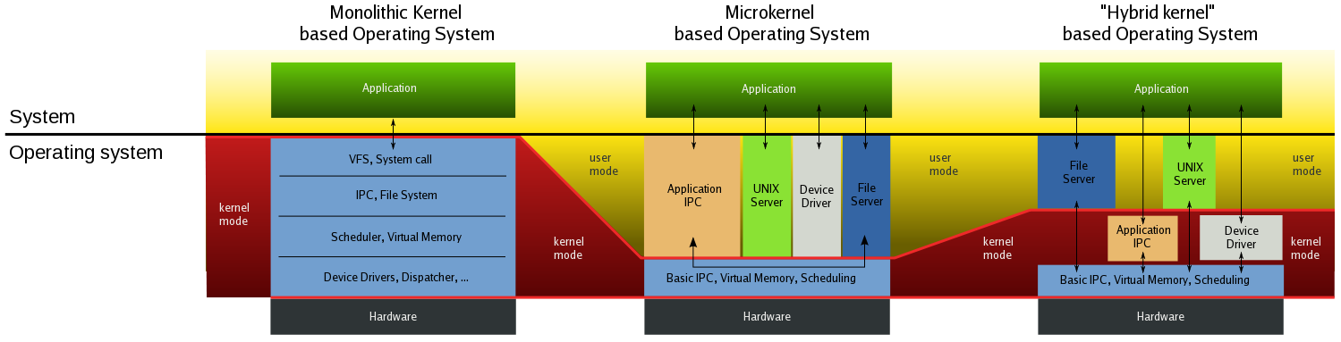
OS Kernel Model

Slide 7
OS Components
Kernel mode vs. user mode
Memory management
  Logic vs. physical memory
  Memory allocation
  Cache management
Process management
  Multi-process / multi-task scheduling
  Interrupt and error handling
I/O system management
  Shared I/O devices

Slide 8
Memory Management
Manage the mapping between logical (physical) memory and task memory references
Determine which tasks to load into the available memory space.
Allocate and deallocate of memory for kernel tasks.
Support memory allocation and deallocation of application tasks.
Track the memory usage of system components.
Ensure cache coherency.
Ensure task and system memory protection.

Slide 9
User Memory Space
Segmentation (per process)
  Segment base address + segment offset
  Functionality and type of memory area
  Assigned accessibility : read-only, executable
  Segments : text, data, stack, heap
Pages (per process within each segment)
  Page base address + page offset
  Contain actual data (code)‏

Slide 10
Logical and Physical Memory
Logical address : 32 bits
  20 bits : page base address
    1 million pages
  12 bits : offset
    4KB in each page
Mapping table
  1M entries and 4 bytes in each entry
  A page base address is the index of the table.
  Each entry is the actual physical address.
Example:
  1GB physical memory
  LA: 0xBF8AD73A
  Base address: BF8AD
  Offset: 73A
  Mapping table
    E[BF8AD]=1D90A000
  PA: 0x1D90A73A

Slide 11
User Memory Space
Stack management
Heap management
  Algorithms
    First fit
    Next fit
    Best fit
    Worst fit
    Quick fit
      using a more complicated data structure for quick search
  Fragmentation
    External : unused after deallocation
    Internal : unused with over allocation

Slide 12
Heap management
Example
  Put 150 bytes into the heap now.
  Gray area has been allocated.
  First fit
  Next fit
  Best fit
  Worst fit

Slide 13
Case 17: Heap in TinyOS
Data structure
  A free list : single linked list
  Free node :
    size (2 bytes)‏
    next pointer (2 bytes)‏
    free memory (size-2 bytes)‏
  Allocated node :
    size (2 bytes)‏
    allocated memory (size bytes)‏
Algorithm
  Exact match (first round)
  Worst fit (second round)
  Allocate and release
struct __freelist {
size_t sz;
point_t nx;
}

Slide 14
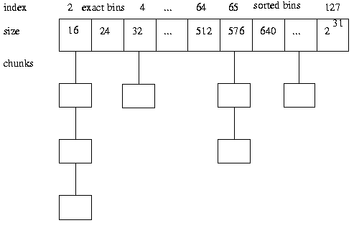
Heap in Linux
Memory blocks are called chunks
Free chunks are grouped in bins.
Each bin is a double linked list.
Best-fit

Slide 15
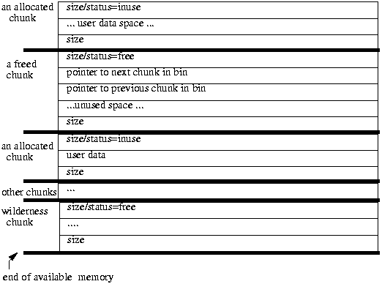
Heap in Linux

Slide 16
Kernel Memory Space
Kernel code
  System calls
  Scheduler
  Kernel management modules
  Driver modules
Kernel data
  TCBs
  System call tables
  Management
    Sizes of most system data structures are known.
    Pre-determined stack
    Buddy system or slab system for dynamic data

Slide 17
Kernel Memory Management
Buddy system
  No external fragmentation
  Easy to implement, for systems without MMU (286)
  The total memory size is a power of 2.
  The memory is divided as a binary tree.
  If n bytes are requested, search in the binary tree such that a free node best fits the request.
  When a node is released, it will be merged with its buddies upward as much as possible.

Slide 18
Kernel Memory Management
Buddy system
  Total 128B
  Smallest block 16B
  Request 1: 19B
  Request 2: 7B
  Release 1
  Request 3: 9B

Slide 19
Kernel Memory Management
Slab system
  Some kernel data objects that are frequently created and destroyed
    semaphores, file descriptors, task control blocks
  Retain an allocated memory that used to contain a data object of certain type
  Reuse that memory for the next allocations for another object of the same type
  Others: SLOB and SLUB

Slide 20
Cache
For systems that have a good locality of references
  Access most of their data (and code) from a limited section of memory
Cache stores snapshots of mostly accessed parts of the memory
Data access
  Cache hit
  Cache miss

Slide 21
Cache
Given (no page replace on miss)
  The time to access an external address is 10ns.
  The time to access an internal address is 1ns.
  The cache miss rate is 1e-3 or 1e-4.
What is the average access time?
  1*0.999+(1+10)*0.001=1.01ns
  1*0.9999+(1+10)*0..0001=1.001ns

Slide 22
Cache Page Replace
Given (page replace on miss)
  The time to access an internal address is 1ns.
  The time to replace a page is 4us.
  The cache miss rate is 1e-3 or 1e-4.
What is the average accessing time?
  1*0.999 + (1+4000+1)*0.001 = 5.001ns
  1*0.9999 + (1+4000+1)*0.0001 = 1.4001ns

Slide 23
Cache Management
Address mapping for accessing and replacing
  16-bit main memory, 10-bit cache page, 4 pages
  An address is divided into tag bits, index bits and offset bits.
  If a page is in cache, its tag bits are stored in the cache as well as the page itself.
  Search process, given a virtual memory address:
    Use the index bits to locate the pages in cache.
    Search if any located page has the tag bits.
    If yes, the page is in cache and access the page
    If no, access the page in memory or swap if needed.

Slide 24
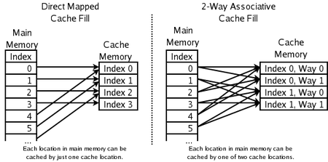
Cache Management
Direct mapped : tag(4) + index(2) + offset(10)
Set associative : tag(5) + index(1) + offset(10)
Full associative : tag(6) + offset(10)

Slide 25
Cache Management
Cache swapping/replacement
  Least recently used (LRU)
    Each page has a record of the last time‏ it was accessed.
    The page of the furthest last time will be replaced.
  First in first out (FIFO)‏
    The indexes of all pages are put in a FIFO queue.
    The header of the queue will be replaced.
    The first in does not mean the least recently used.

Slide 26
Cache Management
Cache swapping/replacement
  Not recently used (NRU)‏
    Each page has a timer that is reset whenever it was accessed.
    A page with an expired timer will be replaced.
  Second chance FIFO
    Each page has a bit set to 1 when being accessed.
    The bit is set to 0 when being checked.
    A check is triggered by a cache miss.
    The page with a 0 bit when being checked will be replaced.

Slide 27
OS Components
Kernel mode vs. user mode
Memory management
  Logic vs. physical memory
  Memory allocation
  Cache management
Process management
  Multi-process / multi-task scheduling
  Interrupt and error handling
I/O system management
  Shared I/O devices

Slide 28
Task
Task : process
A running program in CPU
  Defined and identified by its context : code and data
  The kernel maintains a record for each task
In general computers, a process is normally the execution of an executable file.
In embedded system, a task is normally the execution of a block of code in memory triggered by an event.

Slide 29
Task
A CPU can only execute one task at one time.
Uni-task OS
  At any time, only one of the task is being executed. A new task will not be processed until the current task is completed.
Multi-task OS
  Multiple tasks are processed concurrently.
  Require complicated task management
    Task context management
    Task memory management (only possible with MMU)‏
    Task scheduling

Slide 30
Thread
A task may have multiple threads
  Threads share inside the task : address space, program code, heap, global data, I/O resources.
  Each thread has its own : PC, SP, stack, register, scheduling information.
  Benefits:
    No special inter-thread communication mechanism is needed.
    No special shared resource management mechanism is needed.

Slide 31
Multi-task
The kernel must allocate a certain amount of time in the CPU to execute a task and switch the CPU among tasks.
Task management
  Task implementation
  Task scheduling
  Task synchronization
  Inter-task communicaiton

Slide 32
Task Implementation
Task components
  In kernel space: TCB (task control block)‏
    ID, state, priority, CPU context, allocated memory, ...
  In user space: code and data
    Text, BSS, Heap, Stack
Task hierarchy
  OS initial task
  Parent task
  Child task

Slide 33
Task Creation
Fork/exec
  Fork creates a child task as the copy of the parent task.
  Exec loads a program in the child task to replace the program of the parent task.
  Changes in kernel space.
  Changes in user space.
Spawn
  Spawn creates a child task as a brand new task.
  Spawn needs to specify the context of the child task.

Slide 34
Example
How many tasks for a program foo?
  What is the graph of tasks in the system?
for (i=0;i<3;i++)
{
fork();
}
for (i=0;i<3;i++)
{
fork();
exec(“foo”);
}

Slide 35
Task States
Ready
  The task is ready to be executed at any time.
Running
  The task is being executed.
Waiting
  The task is not ready and waits for some event to make it ready.
State transition: Figure 9-16
  Two minor states: new and exit

Slide 36
Task Queues
Ready queue
  All ready tasks
Waiting queue
  All waiting tasks
  For each type of event, the waiting queue is divided into sub queues.
    A waiting queue for key board
    A waiting queue for flash drive
Queue management

Slide 37
Examples
TinyOS task scheduler
  Only has a ready queue, no other queues
  tos.system.SchedulerBasicP
    Task queue
      uint8_t m_next[NUM_TASKS];
    Task dispatch
      Scheduler.taskLoop()
  What does an interrupt do to task management?
    What happens when a packet is received?
    What happens when two packets are received?
  “In TinyOS 2.x, a basic post will only fail if and only if the task has already been posted and has not started execution.” (TEP106)

Slide 38
Task Scheduling
Scheduler
  An endless loop dispatches ready tasks to the CPU according to some scheduling algorithms.
Scheduling criteria (per task)
  Response time
    From the time the task is created to the time the task is being executed.
    States: time from new to running

Slide 39
Task Scheduling
Scheduling criteria (per task)
  Turnaround time
    From the time the task is created to the time the task is completed.
    States: time from new to exit
  Waiting time
    The sum of time of a task spent waiting in the ready queue.
    States: time in ready (not waiting)

Slide 40
Task Scheduling
Scheduling criteria (per system)
  Overhead
    The time and data needed to determine which task will run next.
    It is a cost on scheduler, not on a particular task.
  Throughput
    The number of tasks completed per unit time.
  Fairness
    The time percentage of running allocated to a task.
    Starvation : a task never gets a splice of running time.

Slide 41
Task Scheduling Algorithms
Given a sequence of tasks
  The time a task is created
  The duration a task needs
  The priority a task has
Given a configuration of a scheduler
  The time slice for each task
  The scheduling algorithm
Show how the tasks are executed!!!

Slide 42
Task Scheduling Algorithms
Assume three tasks T1, T2 and T3
  T1 needs 20s
  T2 needs 10s
  T3 needs 7s
  At t=0, T1 comes to the system
  At t=7, T2 comes to the system
  At t=14, T3 comes to the system

Slide 43
Non-preemptive Scheduling
Non-preemption
  A tasks is not forced to give up the control of the CPU before it is finished.
FCFS (first come first serve)‏
  Only ready queue, no waiting queue
  State transition
SPN (shortest process next)
How tasks are executed and what are the performance of the two algorithms?

Slide 44
Preemptive Scheduling
Preemption
  A tasks is forced to give up the control of the CPU before it is finished.
Round Robin/FIFO
  Each task in the ready queue is allocated an equal time slice.
  A running task is preempted at the end of its time slice by a timer interrupt.
  The preempted task is added to the end of the ready queue.
  The algorithm has a constant overhead for context switch.

Slide 45
Preemptive Scheduling
Priority Scheduling
  Basic algorithm
    All tasks are assigned priorities.
    A task with a higher priority will be executed first when ready.
    Tasks with lower priority will be preempted.
  Starvation
    A task with lower priority will age as its time in the ready queue grows.

Slide 46
Real Time Operating System
General idea: a task has a deadline to meet.
A task missing the deadline is as bad as the task is wrong or not finished.
Examples
  Periodic sampling : the processing of the current sample must finish before the start of the next sampling.
  ABS : the control signal must be sent out to the brake within 0.1s to release the brake after the pedal is pressed. (If a car is at 60mph, 0.1s means about 9 feet.)‏
  Chess game : the player (computer) must decide the next step before time is out.

Slide 47
RTOS vs. General OS
RTOS is deterministic in that the worst case response time to an event is known.
When an event happens, an interrupt is raised.
  In GenOS, the interrupt maybe deterred for an unknown period by an ongoing uninterruptable execution of code.
  Example
    A normal process is waiting for reading a file.
    An emergency happens that must read a patient information and the normal process cannot block the emergency process.

Slide 48
RTOS
When an event happens, an interrupt is raised.
  In GenOS, the latency of interrupt handling and task context switching may exceed the deadline requirement of a task.
  Example
    When an interrupt happens, is it necessary to save all information of a running process?
    Optimize the information of a running process.
    Optimize the interrupt routine to use least resource that may conflict with a running process.
    Make each interrupt routine deterministic.

Slide 49
RTOS Characteristics
When an event happens, an interrupt is raised and a task is scheduled for processing.
  The task with higher priority can preempt other tasks at any time.
  The worst case execution time of the task is known.
  The interrupt latency is minimum and known.
  The task context switching time is minimum and known.
Although it is called RTOS, it is not guaranteed a task will be completed in real-time (before deadline).
  A system is dealing with multiple tasks at the same time.
  Tasks can be preempted by other tasks.

Slide 50
RTOS Scheduling
Earliest deadline first (EDF)
  OS knows the deadline of all tasks.
  The task with the closest deadline has the highest priority.
  Figure 9-25
EDF with dynamic voltage scaling
  Assume all tasks are known with worst execution time Ci and period Pi.
  Tasks are schedulable without DVS if
  Tasks are schedulable with DVS if

Slide 51
RTOS Examples
vxWorks
  Preemptive priority and round robin
  Applications (wiki): BMW iDrive system, Linksys WRT54G wireless routers, Apache Longbow attack helicopter, Deep Impact space probe, Phoenix Mars Lander
  Bought by Intel for its embeded system product line in 2009.
Jbet
  EDF
Linux
  Similar to VxWorks
  The book is out of date

Slide 52
Application Examples
BMW iDrive (wiki)‏
  The first generation iDrive system is based on Microsoft's Windows CE for Automotive. This can easily be seen when the system reboots or restarts after a software crash displaying a "Windows CE" logo.
  However, starting with the second generation (first seen in the 2004 5-series), Microsoft Windows CE was replaced with Wind River's VxWorks, a real-time operating system.
  The third generation will employ Internet Protocol networking, using off-the-shelf IP components to replace proprietary networking systems.

Slide 53
Inter-task Communication
ITC, also called IPC in general OS
Mechanisms
  Without MMU
    Global data area
  With MMU
    Memory sharing
    Message passing
    Signaling

Slide 54
ITC
Memory sharing (with virtual memory spaces)
  All tasks are given pointers pointing to the same memory area.
  Race condition :
    Task A writes data and then is preempted by task B.
    Task B writes data and then finishes.
    Task A reads the data.
  Mutex/semaphore : at any time, if a task is accessing the memory, it locks the memory such that other tasks cannot access the memory.
    The task requests a mutex/semaphore from the system that provides hardware-support to prevent race condition on mutex/semaphore.

Slide 55
ITC
Semaphore
  An integer s: if s==0, the share memory is locked.
  Opertions to the integer s is atomic (neither interruptable nor preemptable)‏
  General operations
    Init (sem_init()): s=1
    Wait and acquire (sem_wait()): wait if s==0, then s--
    Release (sem_post()): s++
  Only the task that is owning s can access the share memory.

Slide 56
ITC
Dead lock among tasks
  Example
    Task A writes data and then is preempted by task B that has a higher priority.
    The data area is locked by A.
    Task B needs to write data to the memory, but has to wait for A to release.
    Task A has to wait for B to complete, because A's priority is lower than B.
  Various mechanisms developed in OS

Slide 57
ITC
Message passing
  Two processes work as a client and a server.
  OS specifies the addressing and communication protocols.
Signalling
  A process registers signals and signal handlers.
  Upon receiving a signal from another process, the corresponding signal handler will be invoked by the OS to process the signal.
  Signals are not necessarily interrupts.

Slide 58
OS Components
Kernel mode vs. user mode
Memory management
  Logic vs. physical memory
  Memory allocation
  Cache management
Process management
  Multi-process / multi-task scheduling
  Interrupt and error handling
I/O system management
  Shared I/O devices

Slide 59
I/O and File Management
Storages : flash or hard drive
Memory mapped storage
  Map file systems onto memory.
  Support primitives for manipulating files and directories.
    File attributes : name, type, size, access permission, ...
    File operations : create, open, read, write, close, ...
    File access methods : sequential and random

Slide 60
OS Standards
Standards for the interface between OS and applications (API)‏
POSIX (Portable Operating System Interface)‏
  Specify the APIs that an OS should provide to any application.
    Functions : arguments, return, errors, exceptions
    Functionality of functions
  Do not specify how a system function is implemented.

Slide 61
POSIX
Functions
  Thread management
  Semaphore management
  Priority management
  Scheduling management
  Process management
  Memory management
  I/O management

Slide 62
POSIX
Published by IEEE
http://www.opengroup.org/onlinepubs/009695399/mindex.html
Base definition
System service functions
Other rationales

Slide 63
Final Notes
Application development
  No major difference to application development in general computer system
    Software life cycle : design, implement, test, ...
  Factors to be considered
    Resource : memory, CPU time
      Don't simply declare local variables or dynamic arrays.
      Don't assume something should happen by now.
    Design of OS and drivers
    Cost : $

Slide 64
Final Notes
foo() {
int a[200];
}
Problem in sensor?
foo() {
call Packet.send(p1);
call Packet.send(p2);
}
Problem in TinyOS?

