Slide 1
TinyOS Programming II

Slide 2
Tips in TinyOS Programming
Always use interfaces in wiring explicitly.
  Optional, but make the code more clear.
Always declare all local variables at the beginning of each command, event, or function.
  Required by old C standard.
Always avoid using int, /, %
  Use uint8_t or uint16_t, signed vs. unsigned.
Always avoid using large arrays.
  Data memory is tiny.

Slide 3
Compilation Procedure
Cross-compilation
Source code : .nc
After “make micaz”
C code : app.c
Executable on host : main.exe
Executable on target : main.ihex (or main.srec)
Example : Blink (lab1)

Slide 4
Compilation Procedure
What if errors occur?
Compilation error
  error message?
Loading error
  error message?
Execution error
  error message?

Slide 5
API and Documentation
“An application programming interface (API) is a set of functions, procedures or classes that an operating system, library or service provides to support requests made by computer programs.”
Well known APIs
  Windows API (MSDN)
  Java API
  IEEE POSIX
  Iphone API
  OpenGL

Slide 6
Good APIs
Easy to learn
  With sufficient descriptive information
Easy to use
  Good user interface, organization, and navigation
Hard to misuse
  Clear descriptions on all use scenarios
Easy to extend
  Easy to add more for new and revised code

Slide 7
Bad APIs
You may most likely find them in non-popular embedded systems
  Systems used by small communities
Open APIs may be bad APIs
  APIs of commercial products could be bad too.
You may have to read source code
You may have to stop working
Good APIs are indispensable to promote your products in the market

Slide 8
API Quality
Description
  Function: arguments, return, errors, exceptions, ...
  Class: members, heritages, ...
Categorization
Code examples
Document layout
  JDK
  MSDN
  POSIX

Slide 9
API Examples
Good
  Java SE API : http://java.sun.com/javase/6/docs/
  MSDN : http://msdn.microsoft.com/en-us/default.aspx
Bad vs. Good
  Linux kernel API
  The best I could find
  http://www.gnugeneration.com/

Slide 10
API Generation
API standardization
  Output format : file and style
  Content
  Language specific : Java
API tools
  Public and open tools : http://en.wikipedia.org/wiki/Comparison_of_documentation_generators
  Many are integrated in development toolkits.

Slide 11
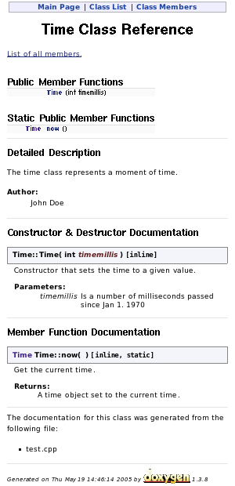
Doxygen
/**
* The time class represents a moment of time.
* @author John Doe
*/
class Time {
public:
/**
* Constructor that sets the time to a
* given value.
* @param timemillis is a number of
* milliseconds passed since Jan 1. 1970
*/
Time(int timemillis) {}
/**
* Get the current time.
* @return A time object set to the
* currenttime.
*/
static Time now() {}
};

Slide 12
TinyOS API
http://www.tinyos.net/tinyos-2.x/doc/nesdoc/micaz/
Java style
Description of components
Description of interfaces
Wiring of components
Categories
A few example codes

Slide 13
Examples
Build APIs and documentation
  Make micaz docs
Structure
  Package
  Interface
  Component
Description
  LedsC
  MainC

Slide 14
TinyOS Kernel API
TEP (TinyOS Enhancement Proposals)
  1. TEP Structure and Keywords
  2. Hardware Abstraction Architecture
  3. Coding Conventions (not there yet)
  102. Timers
    Three timer precisions
  117. Low-Level I/O
    General Purpose I/O (GPIO) pins
  ...

Slide 15
TinyOS Kernel API
Is it good?
  It is just OK to help read the source code of TinyOS and understand how the kernel is designed.
  It is not good to help design and add a new component into TinyOS kernel.
  Overall, it is not as good to kernel developers as the APIs to application developers.
  But, no truly good documentation for any kernel. (Really personal opinions.)

