Slide 1
AVR Programming I

Slide 2
Tools : IDE
Integrated Development Environment
  Chip/manufacture specific
  Editing
  Compilation and linking
  Debugging (software and/or hardware)‏
  Uploading
  Documentation
Otherwise
  Text editor
  Command line compilation
  Debug as a mind game

Slide 3
AVR Studio
Coding and compilation
Debugging
  Code memory view
  Data memory view
  Register view
  I/O view
Documentation
  Assembly language help
  Hardware and software help

Slide 4
Assembly vs. C
Difference
  No variable
  Any value is either a constant or in a register or at a memory address
  Any function is a code address
  Hardware-specific routines must be followed
Relation via compiler
  Variable
  Function

Slide 5
Assembly
Hardware-specific
  Register structure
  I/O structure
  Addressing
  Code memory layout
  Data memory layout
  Key registers
Language-specific
  Directives
  Expressions
  ISA

Slide 6
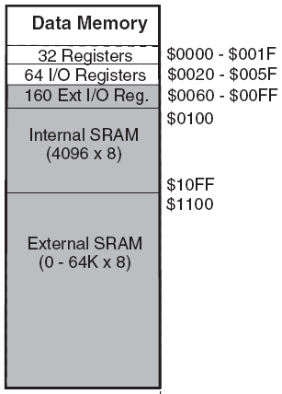
Register Structure
Also for I/O structure
32 general registers
  Mem address : 0x00-0x1F
64 I/O registers
  Mem address : 0x20-0x5F
  I/O address : 0x00-0x3F
160 Extended I/O registers
  Mem address : 0x60-0xFF

Slide 7
Data Memory Layout
4Kx1 Internal SRAM
  Mem address : 0x100-0x10FF
64Kx1 Extended SRAM
  Mem address : 0x1100-0xFFFF
Layout
  Structured by the application
  BSS for global variables
  Heap for dynamic allocated variables
  Stack for local variables

Slide 8
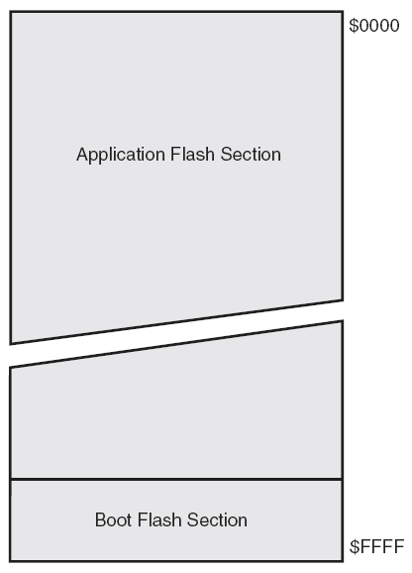
Code Memory Layout
Boot flash section
  For boot loader
Application flash section
  Interrupt vector
  Configuration data
    Peripheral initialization
    Data memory initialization
  Application code

Slide 9
Key Registers
Status register (SREG) : 1 byte
  I/O address 0x3F, mem address 0x5F
Stack pointer (SP) : 2 bytes
  I/O address 0x3D-3E, mem address 0x5D-5E
X register : R27:R26
Y register : R29:R28
Z register : R31:R30
R0 : temporary register
R1 : zero register

Slide 10
Assembly Code
Mnemonic instructions
Labels
  [label:] directive [operands] [Comment]
  [label:] instruction [operands] [Comment]
Comments
  ; [Text]
Directives
Expressions and functions

Slide 11
Directives
Directives are NOT opcodes
Directives are used to
  Adjust the location of the program in memory
  Define macros
  Set data in memory
  ...
Directives are used for
  Convenience
  Compilation

Slide 12
Directives
Code memory
  .CSEG : define the start of a code Segment
  .DB : define constant byte(s)
  .DW : define constant word(s)
Data memory
  .DSEG : define the start of a data Segment
  .BYTE : reserve byte(s) to a variable
Others
  .SET : set a symbol equal to an expression
  .DEF : set a symbolic name on a register

Slide 13
Expressions and Functions
Expressions and functions are constant and evaluated before compilation.
Expressions can consist of operands, operators and functions.
Functions
  LOW(expression): the low byte
  HIGH(expression): the second byte
  EXP2(expression): 2 to the power
  LOG2(expression): the integer part of log2

Slide 14
Example: case9.directive
Move configuration data from code memory to a table in data memory
  How to use labels, comments, directives, expressions, and functions.
  How to watch code and data memory
  How to watch registers
  How to debug code

