Slide 1
2031 priority areas: growth from applications
19 areas · growth since the 2021 Census
Peel Growth Pipeline app · 2026-10-19

Slide 2
87,352 homes of growth; 31% of it by 2031
2021–2026
2026–2031
Total to 2031
Final growth
5,207
21,692
26,899
87,352
units · 15,234 people
368 jobs · built since census day
units · 68,951 people
12,569 jobs · forecast in the period
units · 84,185 people
12,937 jobs · 2021–2026 + 2026–2031
units · 268,054 people
28,209 jobs · full build-out of applications
• Growth is counted on top of the 2021 Census (census day 2021-05-11), from 221 planning applications in the app. Homes built before census day are already in the census and are not counted.
• The applications add 268,054 residents at full build-out: 68% of the 393,164 people printed on the Region map. Where the Region is higher, the land has no application yet.
• Boundaries were reviewed against every secondary plan, MTSA and precinct the app holds (slides 3–4). Macville uses the Region's blue applications, and Steeles uses the whole MTSA.
• Cross-references: area A08 = Excel sheet A08 = slide 18 (slide 10 + area no.) = app-screens/A08_SP47_app.png. Development A08-012 is label 12 in the screenshot.
Peel Growth Pipeline app · snapshot 2026-10-19 · growth since the 2021 Census · screening estimate
2

Slide 3
How growth and boundaries are set
Four growth figures
One boundary rule
2021–2026: built since census day (permits completed; Brampton and Caledon dates estimated from issue date).
2026–2031: the app Forecast's share of what is left to build, placed in 2026–2031.
Total to 2031: the two added.
Final growth: full build-out of the applications.
People at Peel persons per unit by type. Jobs from the floor area on the applications.
1. Your direction first: A01 Macville = the Region's blue applications (ArgoMcville, Bolton North Hill Op 1 and 2, Solmar). A15 = the whole Steeles at Mississauga MTSA.
2. An existing boundary where its size matches the Region's: A06 = Brookvalley (Mayfield West Phase 2) Secondary Plan, 438 ha vs 435.7 ha.
3. Otherwise the app's application parcels with at least half their land in the Region box. These match the Region's hectares best (e.g. North American Lands 27.6 vs 25.8 ha).
Peel Growth Pipeline app · snapshot 2026-10-19 · growth since the 2021 Census · screening estimate
3

Slide 4
Boundary review for each area
Area | Boundary used | Used (ha) | Region (ha) | Best existing boundary checked (size vs Region ha)
A01 Macville | Region blue applications | 372 | 32.0 | Secondary plan: Caledon Station · 186 ha (5.82×)
A02 Humber Station | App parcels | 95 | 128.3 | Secondary plan: Coleraine West Employment Area · 283 ha (2.2×)
A03 Mayfield/Gore | App parcels | 198 | 120.0 | Precinct: Precinct 50-2 · 165 ha (1.38×)
A04 Dixie Road | App parcels | 270 | 163.8 | Secondary plan: Dixie Road · 79 ha (0.48×)
A05 Airport Road | App parcels | 414 | 107.8 | Secondary plan: Tullamore · 299 ha (2.78×)
A06 McLaughlin Road | Brookvalley Secondary Plan | 438 | 435.7 | Secondary plan: Brookvalley (Mayfield West Phase 2 · 438 ha (1.01×)
A07 Alloa Phase One | App parcels | 161 | 263.0 | Secondary plan: Alloa · 734 ha (2.79×)
A08 SP47 | App parcels | 450 | 585.4 | Secondary plan: 47: Highway 427 Industrial · 1,304 ha (2.23×)
A09 Heritage Heights | App parcels | 495 | 224.7 | Secondary plan: 52: Heritage Heights · 1,560 ha (6.94×)
A10 North American Lands | App parcels | 28 | 25.8 | MTSA: Mount Pleasant GO (Kitchener GO) · 48 ha (1.86×)
A11 McVean and Gore | App parcels | 20 | 9.9 | MTSA: The Gore (Queen St. BRT) · 104 ha (10.51×)
A12 Kennedy | App parcels | 10 | 10.1 | MTSA: Kennedy (Queen St. BRT) · 98 ha (9.71×)
A13 DT Brampton | App parcels | 47 | 13.5 | Secondary plan: 7: Downtown Brampton · 305 ha (22.64×)
A14 Bram West | App parcels | 211 | 45.1 | Secondary plan: 40 (d): Bram West · 473 ha (10.49×)
A15 Steeles MTSA | Steeles at Mississauga MTSA | 56 | 13.8 | MTSA: Steeles at Mississauga (Transit Hu · 56 ha (4.04×)
A16 Shoppers World | App parcels | 32 | 23.6 | MTSA: Gateway Terminal (Hurontario LRT) · 56 ha (2.39×)
A17 Ninth Line | App parcels | 28 | 38.5 | Secondary plan: Ninth Line NHD · 349 ha (9.09×)
A18 Lakeshore | App parcels | 16 | 62.1 | Secondary plan: Lakeview Waterfront MN · 106 ha (1.71×)
A19 Port Credit | App parcels | 13 | 22.0 | Secondary plan: Port Credit CN · 81 ha (3.67×)
Peel Growth Pipeline app · snapshot 2026-10-19 · growth since the 2021 Census · screening estimate
4

Slide 5
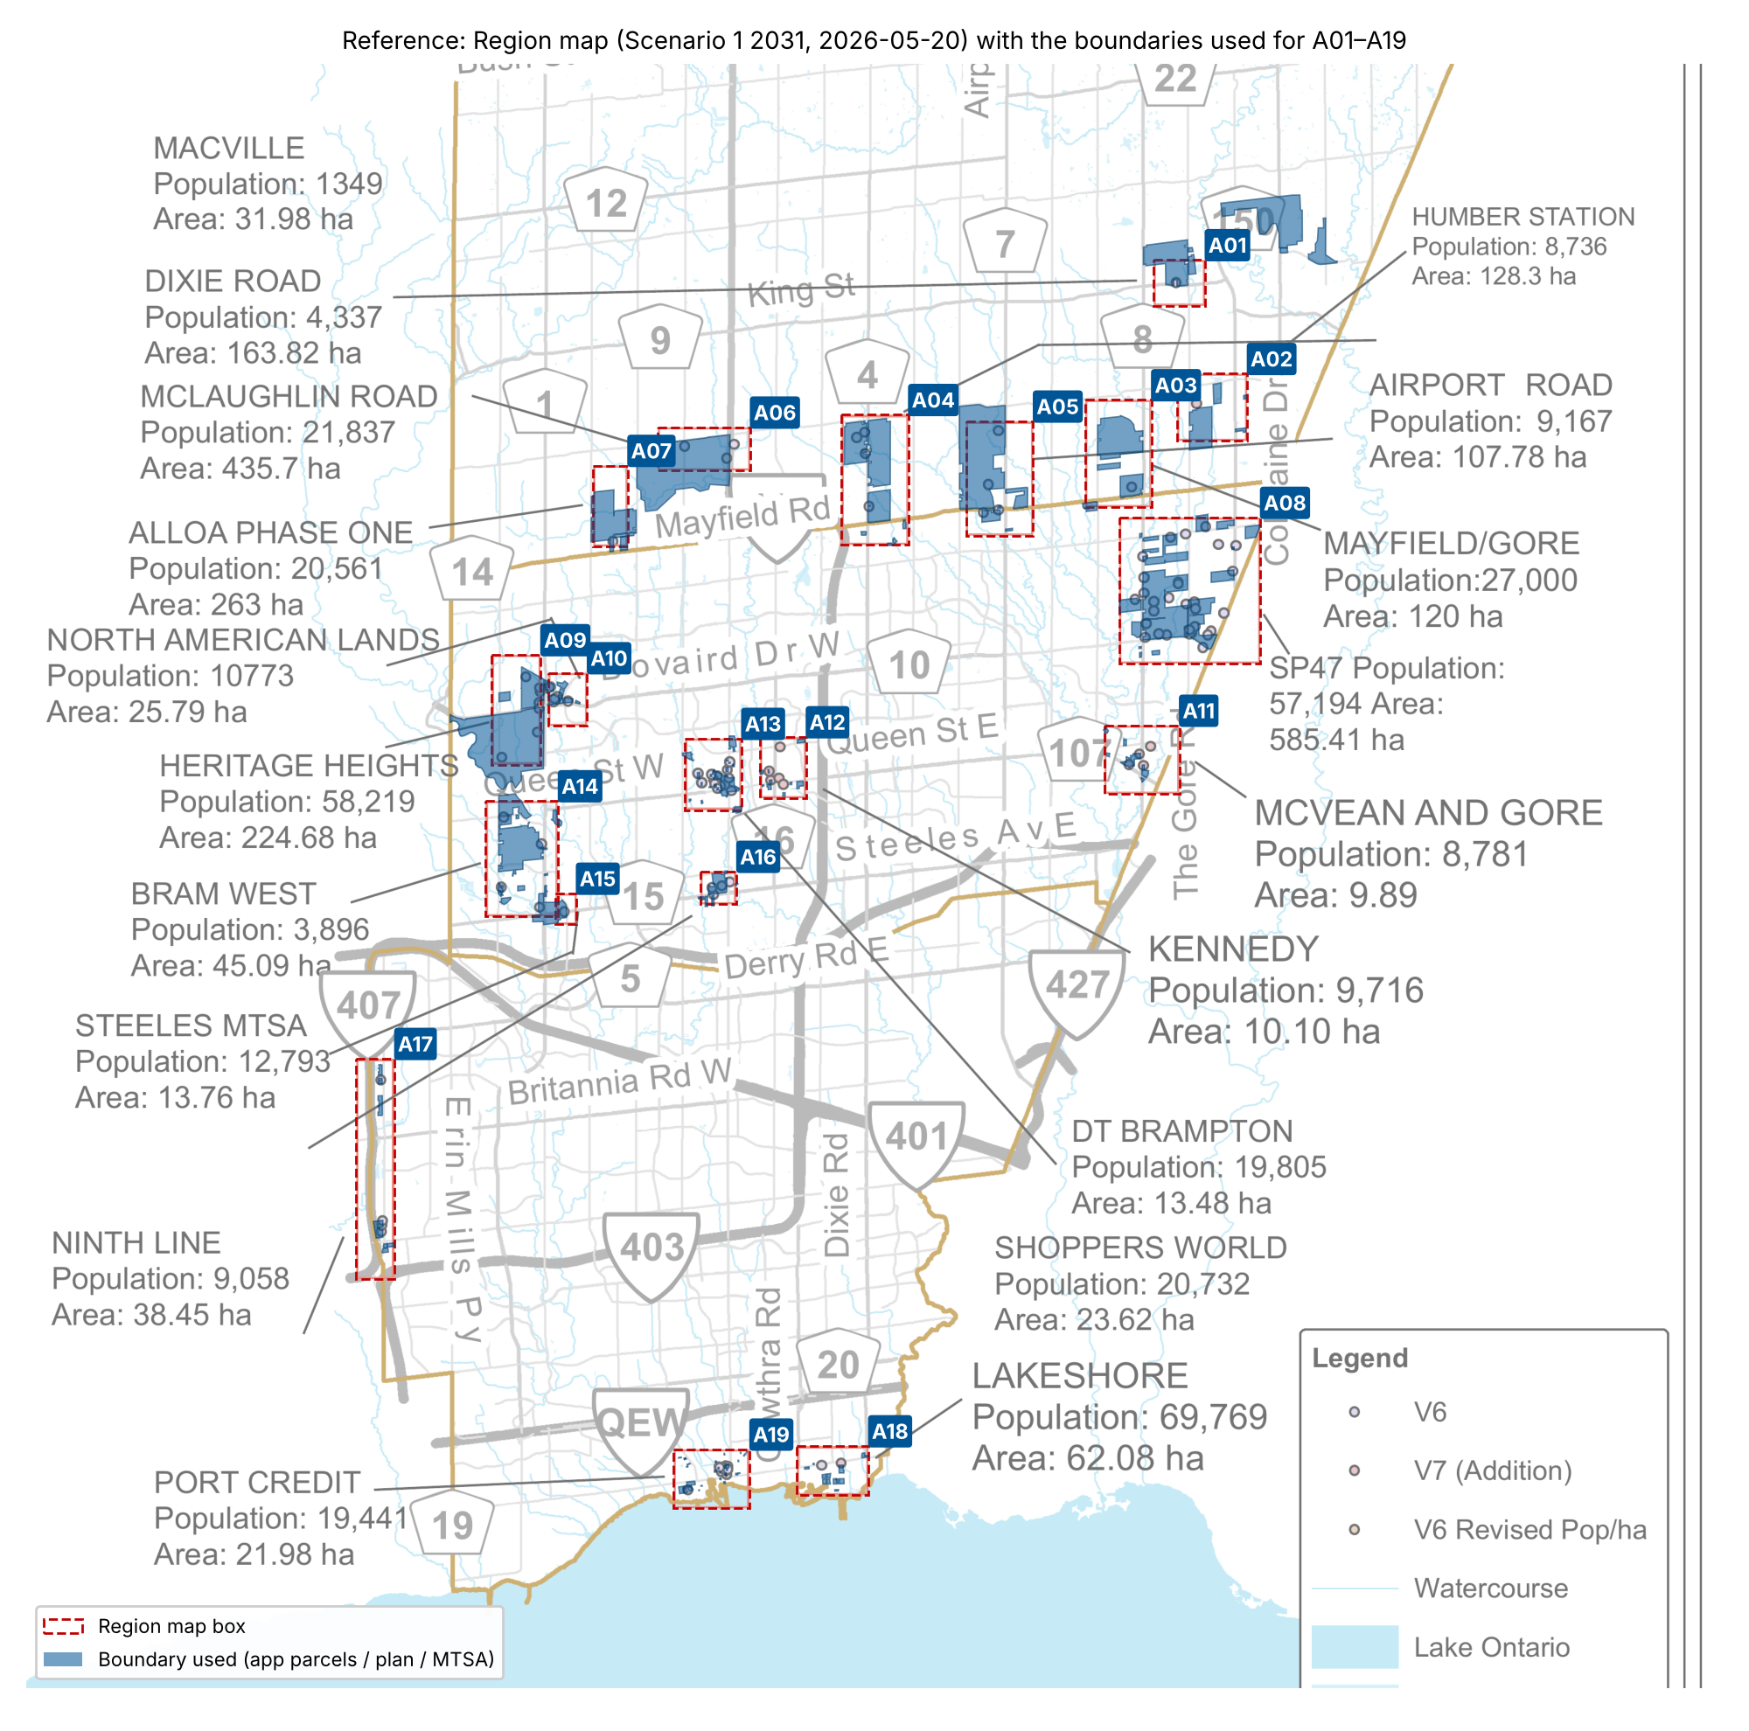
Reference: Region map and boundaries
• Red dashed: the Region map boxes, georeferenced from the PDF (the map is rotated about 45°).
• Blue: the boundary used for each area, either application parcels, the Brookvalley Secondary Plan or the Steeles MTSA.
• Macville (A01) reaches past its box to take in the Region's blue Bolton North Hill and Solmar applications.
• Per-area reference maps: maps/Axx_<name>.png, numbered like the app screenshots.
Peel Growth Pipeline app · snapshot 2026-10-19 · growth since the 2021 Census · screening estimate
5

Slide 6
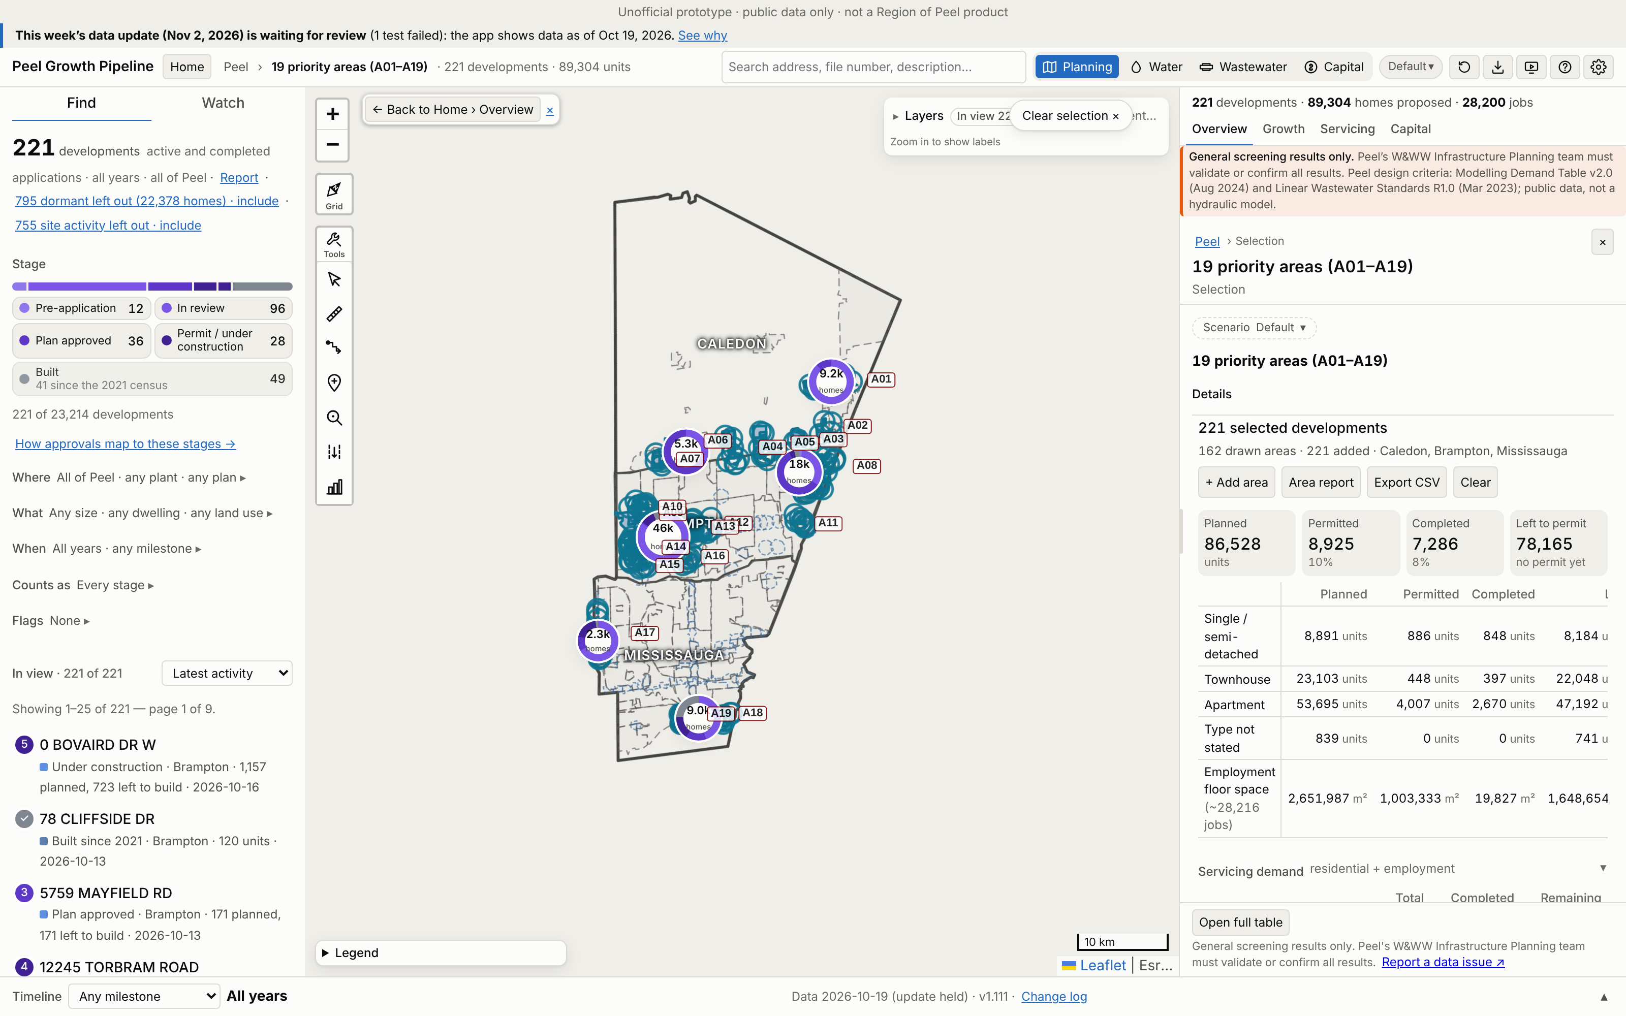
The 19 areas drawn in the app
• The Peel Growth Pipeline full map, with each boundary drawn as the app's own selection and every counted application selected.
• The app's panel totals the applications' full build-out.
• No basemap: the tile servers could not be reached when this was captured.
Peel Growth Pipeline app · snapshot 2026-10-19 · growth since the 2021 Census · screening estimate
6

Slide 7
Growth by area: units and people
Area | Units 2021–26 | Units 2026–31 | Units to 2031 | Units final | Pop 2021–26 | Pop 2026–31 | Pop to 2031 | Pop final | Region map pop
A01 Macville | 0 | 2,801 | 2,801 | 9,231 | 0 | 9,965 | 9,965 | 31,946 | 1,349
A02 Humber Station | 0 | 19 | 19 | 27 | 0 | 58 | 58 | 84 | 8,736
A03 Mayfield/Gore | 57 | 1,461 | 1,518 | 3,552 | 239 | 5,578 | 5,818 | 13,413 | 27,000
A04 Dixie Road | 12 | 67 | 79 | 156 | 41 | 222 | 263 | 506 | 4,337
A05 Airport Road | 1 | 172 | 173 | 409 | 3 | 585 | 587 | 1,318 | 9,167
A06 McLaughlin Road | 0 | 822 | 822 | 1,973 | 0 | 3,056 | 3,056 | 7,331 | 21,837
A07 Alloa Phase One | 0 | 1,807 | 1,807 | 3,371 | 0 | 6,770 | 6,770 | 12,374 | 20,561
A08 SP47 | 51 | 1,944 | 1,995 | 9,542 | 214 | 6,641 | 6,855 | 30,782 | 57,194
A09 Heritage Heights | 438 | 0 | 438 | 15,393 | 1,314 | 0 | 1,314 | 48,559 | 58,219
A10 North American Lands | 972 | 999 | 1,971 | 4,589 | 2,845 | 3,012 | 5,857 | 12,928 | 10,773
A11 McVean and Gore | 461 | 701 | 1,162 | 4,180 | 1,377 | 1,938 | 3,314 | 11,534 | 8,781
A12 Kennedy | 109 | 418 | 527 | 4,731 | 294 | 1,139 | 1,433 | 12,824 | 9,716
A13 DT Brampton | 16 | 1,703 | 1,719 | 7,010 | 50 | 4,598 | 4,648 | 18,935 | 19,805
A14 Bram West | 389 | 637 | 1,026 | 2,399 | 1,362 | 1,950 | 3,312 | 7,414 | 3,896
A15 Steeles MTSA | 0 | 0 | 0 | 4,549 | 0 | 0 | 0 | 12,282 | 12,793
A16 Shoppers World | 379 | 466 | 845 | 4,992 | 1,023 | 1,259 | 2,282 | 13,479 | 20,732
A17 Ninth Line | 144 | 1,700 | 1,844 | 2,254 | 489 | 5,555 | 6,043 | 7,421 | 9,058
A18 Lakeshore | 762 | 3,404 | 4,166 | 4,793 | 2,057 | 9,617 | 11,675 | 13,410 | 69,769
A19 Port Credit | 1,416 | 2,571 | 3,987 | 4,201 | 3,925 | 7,009 | 10,934 | 11,514 | 19,441
Total | 5,207 | 21,692 | 26,899 | 87,352 | 15,234 | 68,951 | 84,185 | 268,054 | 393,164
Peel Growth Pipeline app · snapshot 2026-10-19 · growth since the 2021 Census · screening estimate
7

Slide 8
Jobs, and the app against the Region
Area | Jobs 2021–26 | 2026–31 | To 2031 | Final
A01 Macville | 0 | 108 | 108 | 168
A02 Humber Station | 0 | 59 | 59 | 1,840
A03 Mayfield/Gore | 0 | 0 | 0 | 0
A04 Dixie Road | 0 | 4,030 | 4,030 | 11,368
A05 Airport Road | 0 | 4,168 | 4,168 | 6,036
A06 McLaughlin Road | 0 | 0 | 0 | 0
A07 Alloa Phase One | 0 | 0 | 0 | 0
A08 SP47 | 0 | 2,110 | 2,110 | 3,263
A09 Heritage Heights | 0 | 113 | 113 | 113
A10 North American Lands | 0 | 187 | 187 | 265
A11 McVean and Gore | 0 | 190 | 190 | 806
A12 Kennedy | 0 | 78 | 78 | 302
A13 DT Brampton | 0 | 1,142 | 1,142 | 1,864
A14 Bram West | 0 | 33 | 33 | 1,027
A15 Steeles MTSA | 0 | 93 | 93 | 181
A16 Shoppers World | 0 | 19 | 19 | 93
A17 Ninth Line | 125 | 10 | 135 | 380
A18 Lakeshore | 33 | 42 | 75 | 93
A19 Port Credit | 210 | 187 | 397 | 410
Total | 368 | 12,569 | 12,937 | 28,209
Peel Growth Pipeline app · snapshot 2026-10-19 · growth since the 2021 Census · screening estimate
8

Slide 9
Crosswalk: Region map points
Area | Region points | Matched ≤400 m | Inside boundary | Applications counted | Main app plan
A01 Macville | 1 | 1 | 0 | 9 | Caledon Station
A02 Humber Station | 1 | 1 | 0 | 4 | South Simpson Industrial
A03 Mayfield/Gore | 1 | 1 | 1 | 5 | 50: Vales Of Humber
A04 Dixie Road | 4 | 4 | 3 | 8 | 48 (b): Countryside Vill
A05 Airport Road | 4 | 4 | 3 | 9 | 49: Vales Of Castlemore
A06 McLaughlin Road | 3 | 3 | 2 | 1 | Brookvalley (Mayfield We
A07 Alloa Phase One | 1 | 1 | 1 | 5 | Alloa
A08 SP47 | 28 | 27 | 18 | 34 | 47: Highway 427 Industri
A09 Heritage Heights | 4 | 4 | 4 | 5 | 51: Mount Pleasant
A10 North American Lands | 3 | 3 | 3 | 7 | 51: Mount Pleasant
A11 McVean and Gore | 4 | 4 | 3 | 9 | 41: Bram East
A12 Kennedy | 5 | 4 | 1 | 9 | 36: Queen Street Corrido
A13 DT Brampton | 10 | 10 | 5 | 21 | 7: Downtown Brampton
A14 Bram West | 4 | 4 | 2 | 25 | 40 (d): Bram West
A15 Steeles MTSA | 1 | 1 | 1 | 4 | 40 (c): Bram West
A16 Shoppers World | 4 | 4 | 2 | 7 | 55: Hurontario-Main Corr
A17 Ninth Line | 3 | 3 | 2 | 12 | Ninth Line NHD
A18 Lakeshore | 2 | 2 | 0 | 13 | Lakeview Waterfront MN
A19 Port Credit | 3 | 3 | 0 | 34 | Port Credit CN
• 84 of 86 Region points sit within 400 m of a counted application.
• "Inside boundary" is lower where the Region's point sits beside the parcel rather than on it.
• Point-by-point detail: Excel sheet "Crosswalk".
Peel Growth Pipeline app · snapshot 2026-10-19 · growth since the 2021 Census · screening estimate
9

Slide 10
Area by area
Each area: the app screenshot, its growth and its largest applications
Peel Growth Pipeline app · snapshot 2026-10-19 · growth since the 2021 Census · screening estimate
10

Slide 11
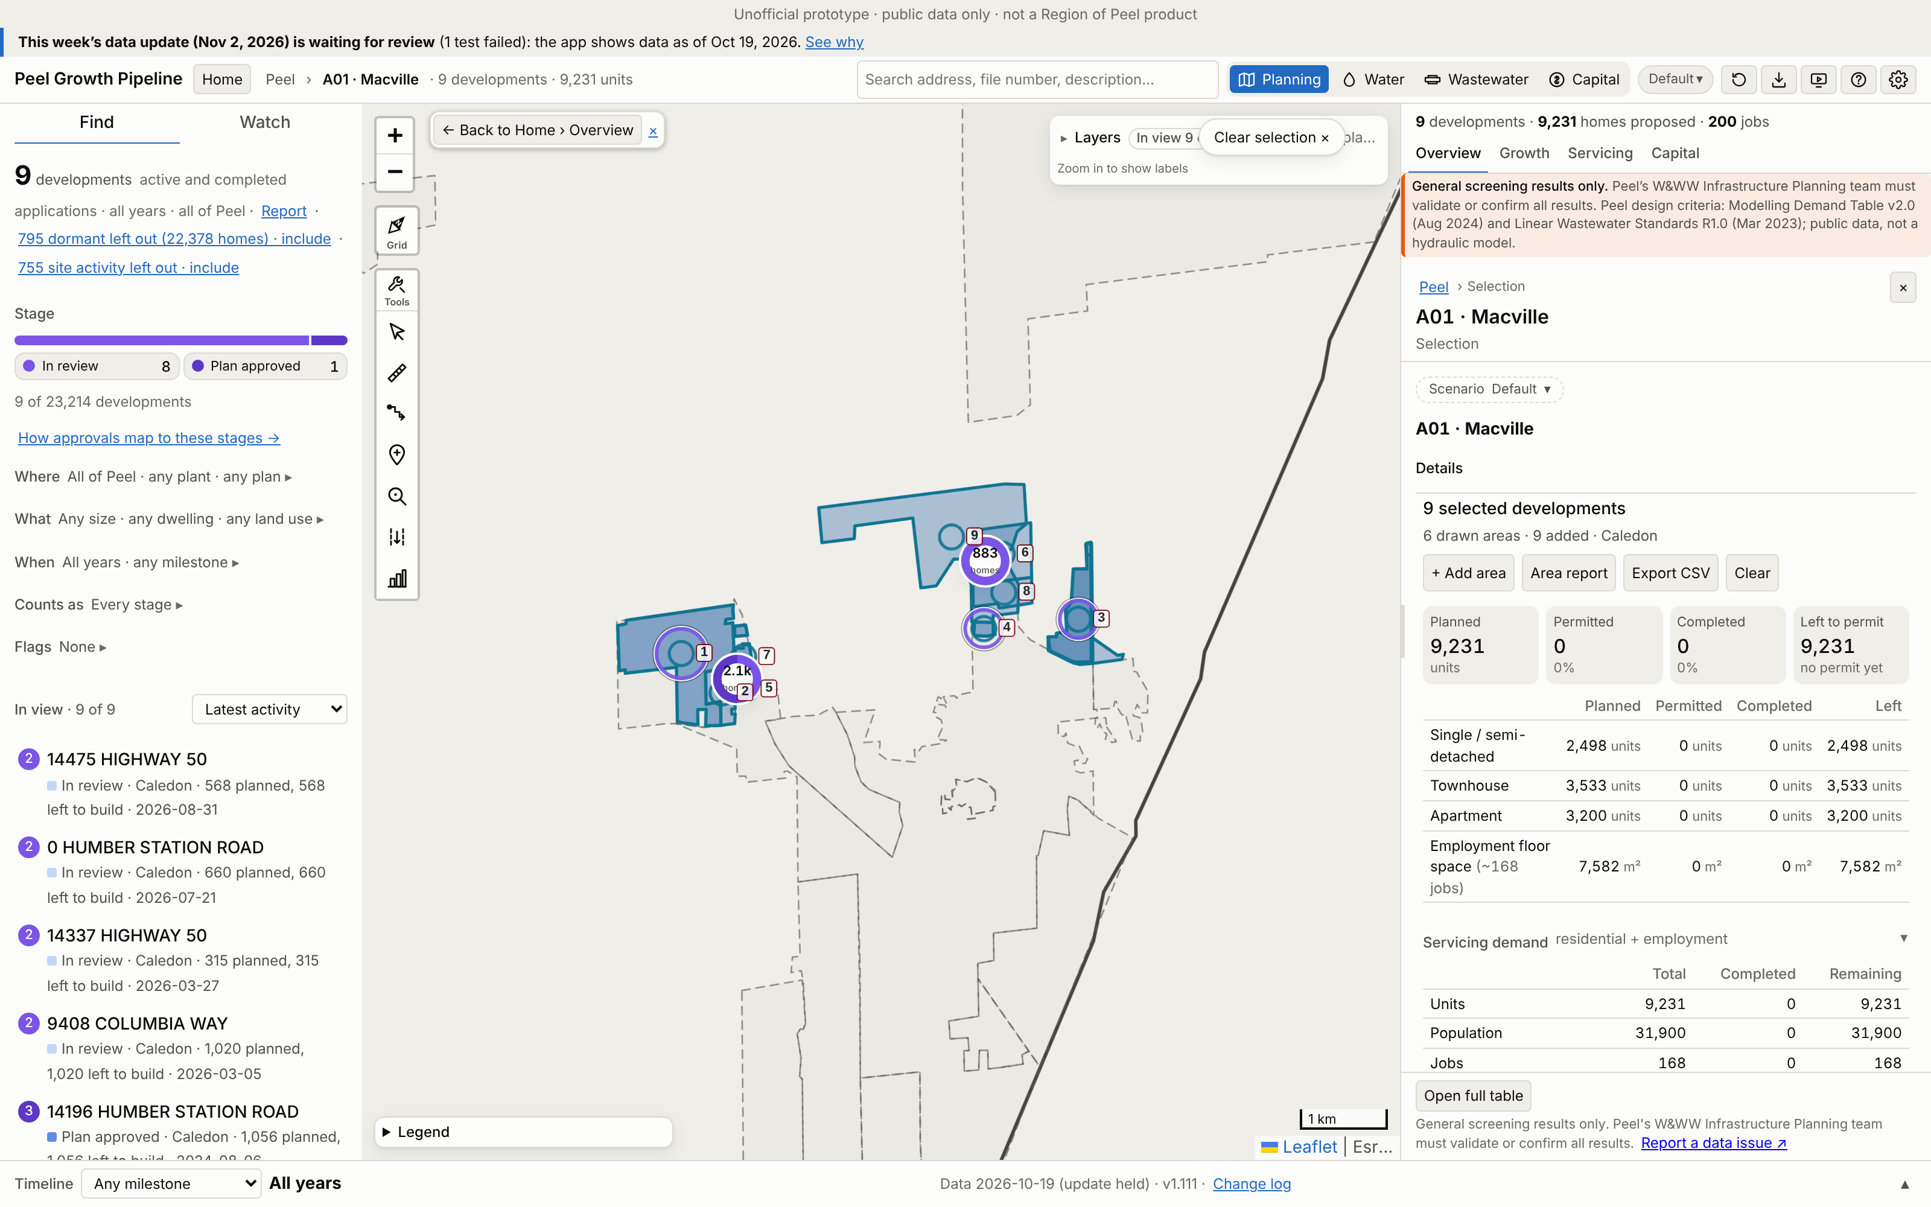
A01 · Macville
Growth | 2021–26 | 2026–31 | To 2031 | Final
Units | 0 | 2,801 | 2,801 | 9,231
People | 0 | 9,965 | 9,965 | 31,946
Jobs | 0 | 108 | 108 | 168
Boundary: the Region's blue applications plus the two in its box, 372 ha (Region map 31.98 ha).
Region map: 1,349 people. App final growth = 2368% of that. 1 of 1 Region points matched.
No. / development | Stage | Final | 2031
1 14275 THE GORE ROAD | In review | 4,456 | 548
2 14196 HUMBER STATIO | Plan approved | 1,056 | 797
3 9408 COLUMBIA WAY | In review | 1,020 | 402
4 14245 HIGHWAY 50 | In review | 762 | 292
5 0 HUMBER STATION RO | In review | 660 | 248
App screenshot: the boundary used is drawn as an app selection, with each application labelled (A01-###). Region map reference: maps/A01_Macville.png
Largest 5 of 9 applications (units). All: Excel sheet A01.
Peel Growth Pipeline app · snapshot 2026-10-19 · growth since the 2021 Census · screening estimate
11
Notes:
A01 Macville: Region map applications shown in blue (ArgoMcville, Bolton North Hill Op 1 and 2, Solmar) plus the two applications in the Region box; user direction
A01-001 14275 THE GORE ROAD | In review | final 4,456 units, to 2031 548 | 21T-22001C (Appeal Period); 2022-0002 (Appealed)
A01-002 14196 HUMBER STATION ROAD | Plan approved | final 1,056 units, to 2031 797 | 21T-24006C (Draft Approved (parent))
A01-003 9408 COLUMBIA WAY | In review | final 1,020 units, to 2031 402 | 2026-0005 (Circulation); 21T-25003C (Circulation); 2025-0004 (Finalize)
A01-004 14245 HIGHWAY 50 | In review | final 762 units, to 2031 292 | 2022-0001 (Circulation); 2022-0002 (Adoption)
A01-005 0 HUMBER STATION ROAD | In review | final 660 units, to 2031 248 | 2026-0010 (New); 2026-0014 (Circulation)
A01-006 14475 HIGHWAY 50 | In review | final 568 units, to 2031 124 | 21T-26011 (Circulation)
A01-007 14275 THE GORE ROAD | In review | final 394 units, to 2031 230 | 21T-22002C (Circulation); 2022-0003 (Appealed)
A01-008 14337 HIGHWAY 50 | In review | final 315 units, to 2031 158 | 21T-26004C (Circulation)
A01-009 14685 HIGHWAY 50 | In review | final 0 units, to 2031 0 | 2022-0001 (Adoption)

Slide 12
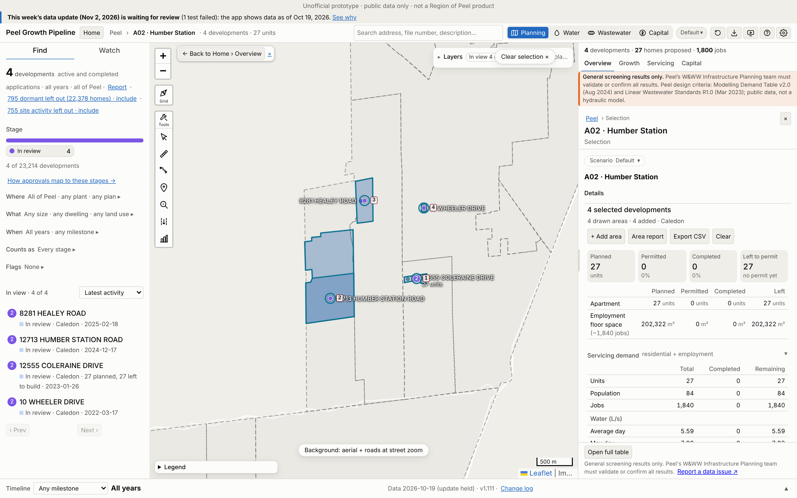
A02 · Humber Station
Growth | 2021–26 | 2026–31 | To 2031 | Final
Units | 0 | 19 | 19 | 27
People | 0 | 58 | 58 | 84
Jobs | 0 | 59 | 59 | 1,840
Boundary: app application parcels (≥50% in the Region box), 95 ha (Region map 128.3 ha).
Region map: 8,736 people. App final growth = 1% of that. 1 of 1 Region points matched.
No. / development | Stage | Final | 2031
1 12555 COLERAINE DRI | In review | 27 | 19
2 12713 HUMBER STATIO | In review | 0 | 0
3 8281 HEALEY ROAD | In review | 0 | 0
4 10 WHEELER DRIVE | In review | 0 | 0
App screenshot: the boundary used is drawn as an app selection, with each application labelled (A02-###). Region map reference: maps/A02_Humber_Station.png
Largest 4 of 4 applications (units). All: Excel sheet A02.
Peel Growth Pipeline app · snapshot 2026-10-19 · growth since the 2021 Census · screening estimate
12
Notes:
A02 Humber Station: Application parcels: the app's planning applications with at least half their land in the Region box
A02-001 12555 COLERAINE DRIVE | In review | final 27 units, to 2031 19 | 21CDM-22001C (Circulation)
A02-002 12713 HUMBER STATION ROAD | In review | final 0 units, to 2031 0 | 21T-24014C (Circulation); 2024-0100 (Recirculation)
A02-003 8281 HEALEY ROAD | In review | final 0 units, to 2031 0 | 2021-0097 (Satisfactory)
A02-004 10 WHEELER DRIVE | In review | final 0 units, to 2031 0 | 2022-0012 (Satisfactory)

Slide 13
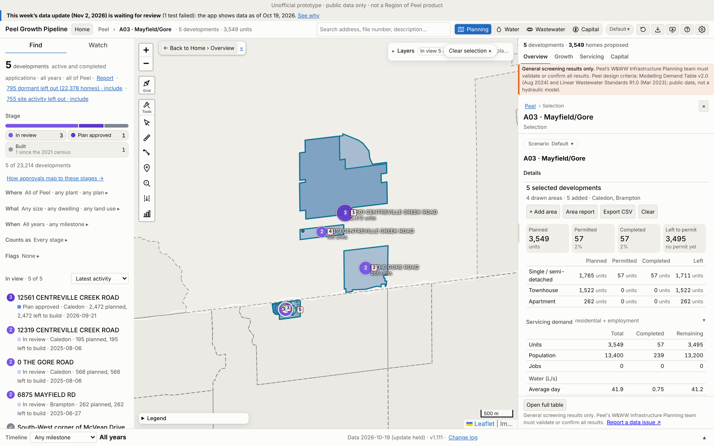
A03 · Mayfield/Gore
Growth | 2021–26 | 2026–31 | To 2031 | Final
Units | 57 | 1,461 | 1,518 | 3,552
People | 239 | 5,578 | 5,818 | 13,413
Jobs | 0 | 0 | 0 | 0
Boundary: app application parcels (≥50% in the Region box), 198 ha (Region map 120 ha).
Region map: 27,000 people. App final growth = 50% of that. 1 of 1 Region points matched.
No. / development | Stage | Final | 2031
1 12561 CENTREVILLE C | Plan approved | 2,472 | 1,042
2 0 THE GORE ROAD | In review | 566 | 305
3 6875 MAYFIELD RD | In review | 262 | 0
4 12319 CENTREVILLE C | In review | 195 | 114
5 South-West corner o | Built | 57 | 57
App screenshot: the boundary used is drawn as an app selection, with each application labelled (A03-###). Region map reference: maps/A03_Mayfield-Gore.png
Largest 5 of 5 applications (units). All: Excel sheet A03.
Peel Growth Pipeline app · snapshot 2026-10-19 · growth since the 2021 Census · screening estimate
13
Notes:
A03 Mayfield/Gore: Application parcels: the app's planning applications with at least half their land in the Region box
A03-001 12561 CENTREVILLE CREEK ROAD | Plan approved | final 2,472 units, to 2031 1,042 | 2026-0016 (Circulation); 21T-25001C (Draft Approval)
A03-002 0 THE GORE ROAD | In review | final 566 units, to 2031 305 | 21T-25010C (Circulation)
A03-003 6875 MAYFIELD RD | In review | final 262 units, to 2031 0 | OZS-2025-0029 (Under Appeal); OZS-2019-0014 (Registration); PRE-2024-0066 (Verification of Documents); PRE18.055 (Closed)
A03-004 12319 CENTREVILLE CREEK ROAD | In review | final 195 units, to 2031 114 | 21T-25009C (Circulation)
A03-005 South-West corner of McVean Drive and Mayfield Road | Built | final 57 units, to 2031 57 | C08E17.011 (Closed Approved); PRE17.084 (PRE - Closed)

Slide 14
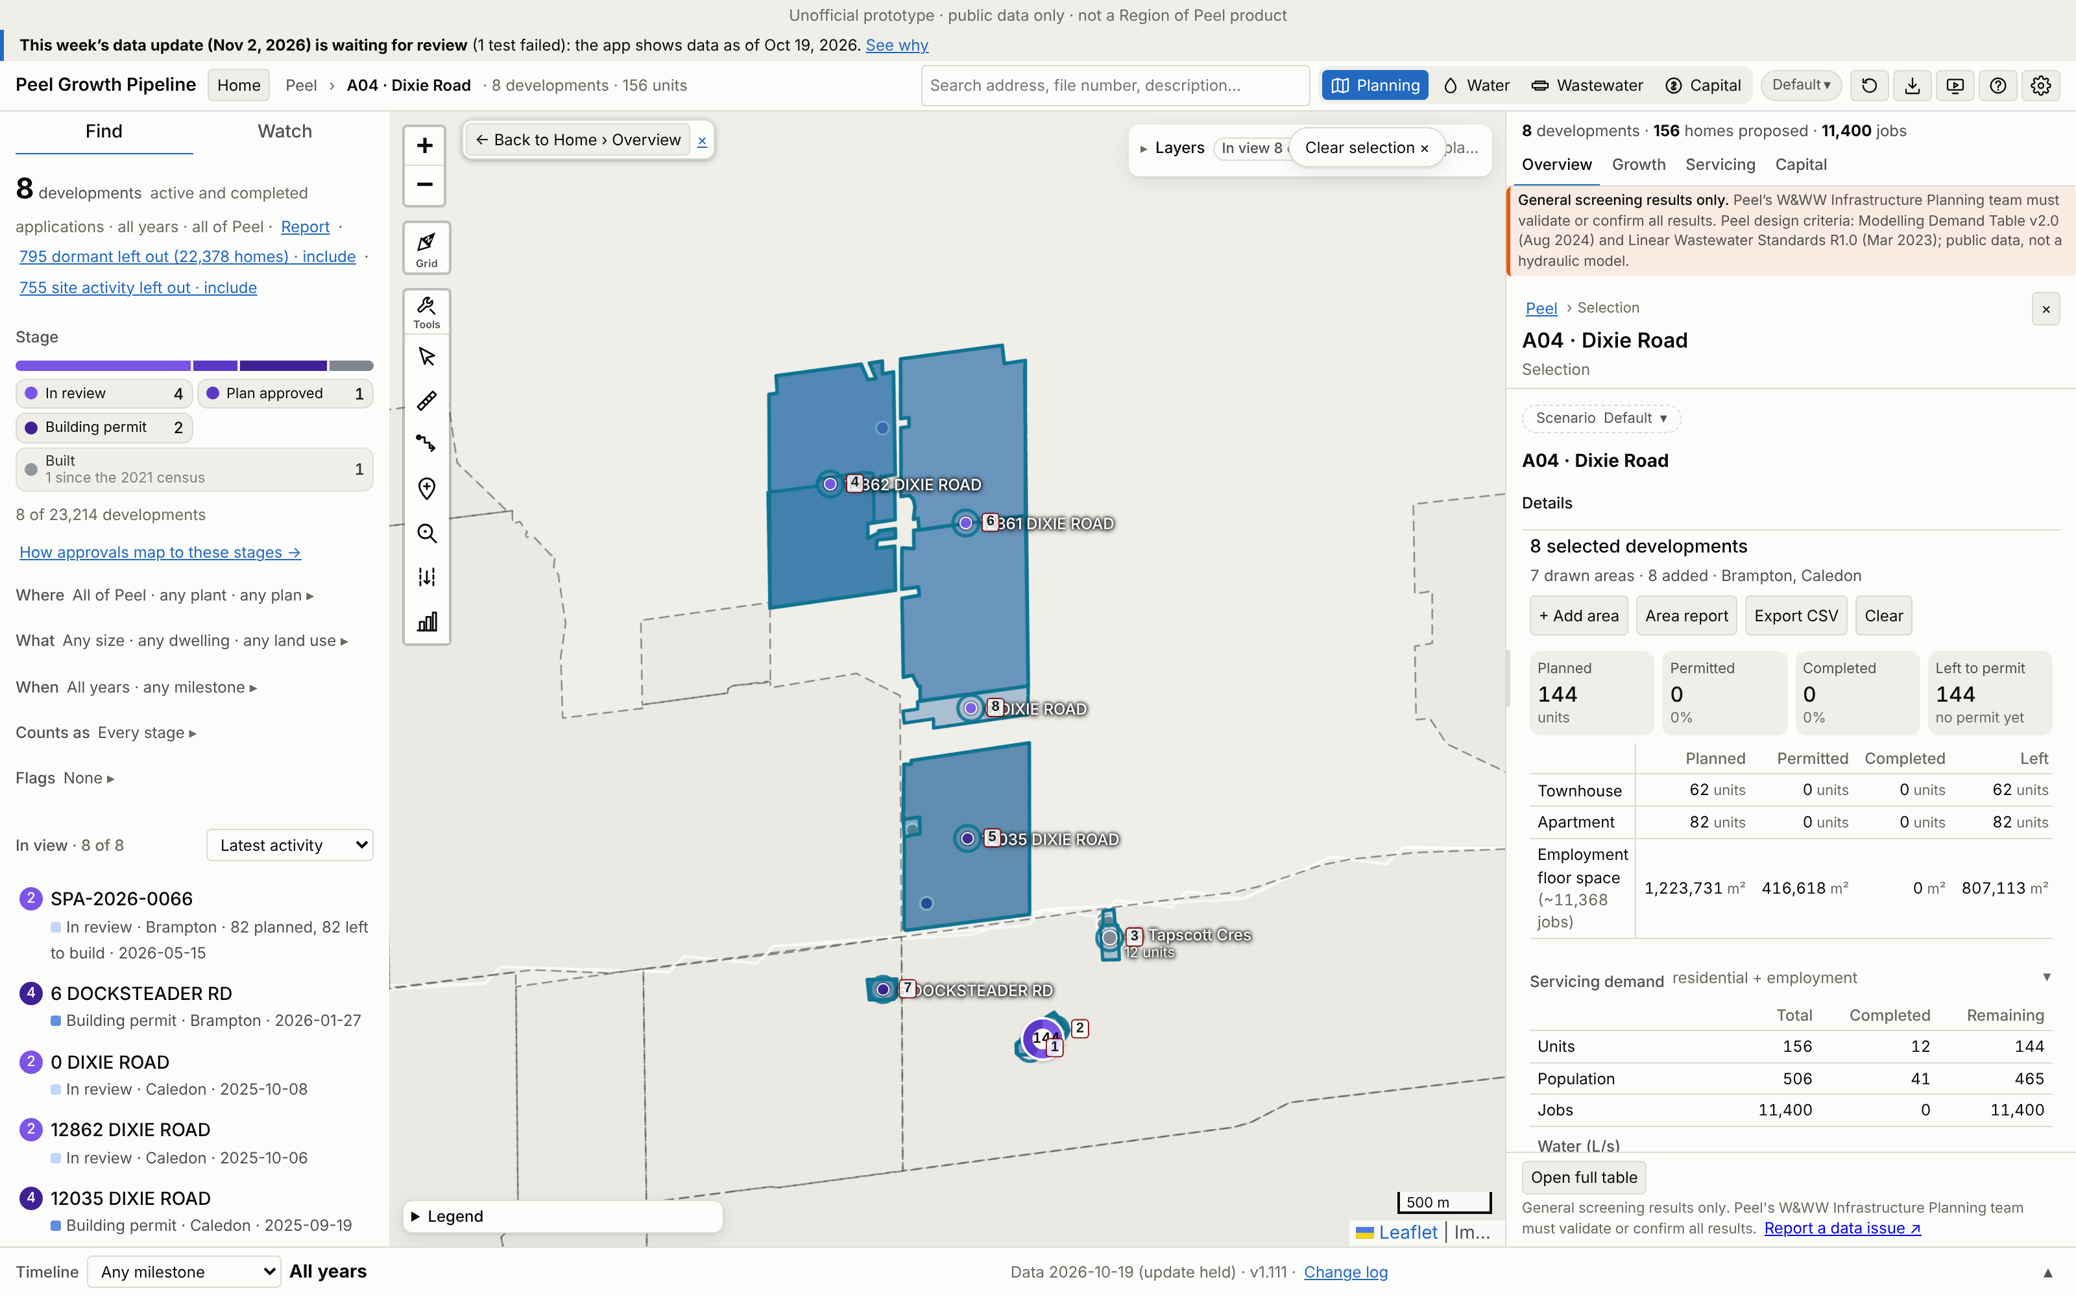
A04 · Dixie Road
Growth | 2021–26 | 2026–31 | To 2031 | Final
Units | 12 | 67 | 79 | 156
People | 41 | 222 | 263 | 506
Jobs | 0 | 4,030 | 4,030 | 11,368
Boundary: app application parcels (≥50% in the Region box), 270 ha (Region map 163.82 ha).
Region map: 4,337 people. App final growth = 12% of that. 4 of 4 Region points matched.
No. / development | Stage | Final | 2031
1 SPA-2026-0066 | In review | 82 | 23
2 SPA-2025-0020 | Plan approved | 62 | 45
3 45 Tapscott Cres | Built | 12 | 12
4 12862 DIXIE ROAD | In review | 0 | 0
5 12035 DIXIE ROAD | Building permit | 0 | 0
App screenshot: the boundary used is drawn as an app selection, with each application labelled (A04-###). Region map reference: maps/A04_Dixie_Road.png
Largest 5 of 8 applications (units). All: Excel sheet A04.
Peel Growth Pipeline app · snapshot 2026-10-19 · growth since the 2021 Census · screening estimate
14
Notes:
A04 Dixie Road: Application parcels: the app's planning applications with at least half their land in the Region box
A04-001 SPA-2026-0066 | In review | final 82 units, to 2031 23 | SPA-2026-0066 (Deemed Complete); PRE-2025-0074 (Closed)
A04-002 SPA-2025-0020 | Plan approved | final 62 units, to 2031 45 | SPA-2025-0020 (Site Plan Approved); PRE-2024-0047 (Verification of Documents)
A04-003 45 Tapscott Cres | Built | final 12 units, to 2031 12 | SP88-021.000 (Transferred)
A04-004 12862 DIXIE ROAD | In review | final 0 units, to 2031 0 | 2021-0006 (Circulation); 2021-0004 (Adoption); 2021-0012 (Circulation); 2025-0036 (Circulation); 2025-0003 (Circulation)
A04-005 12035 DIXIE ROAD | Building permit | final 0 units, to 2031 0 | 2021-0013 (Recirculation); 2021-0007 (Circulation); 2021-0005 (Circulation)
A04-006 12861 DIXIE ROAD | In review | final 0 units, to 2031 0 | 2025-0017 (Circulation); 2025-0016 (Circulation); 2024-0011 (New); 2024-0034 (Circulation)
A04-007 6 DOCKSTEADER RD | Building permit | final 0 units, to 2031 0 | SPA-2026-0012 (Site Plan Approved); SPA-2024-0088 (Site Plan Approved); PRE-2023-0077 (Closed)
A04-008 0 DIXIE ROAD | In review | final 0 units, to 2031 0 | 2025-0021 (Circulation)

Slide 15
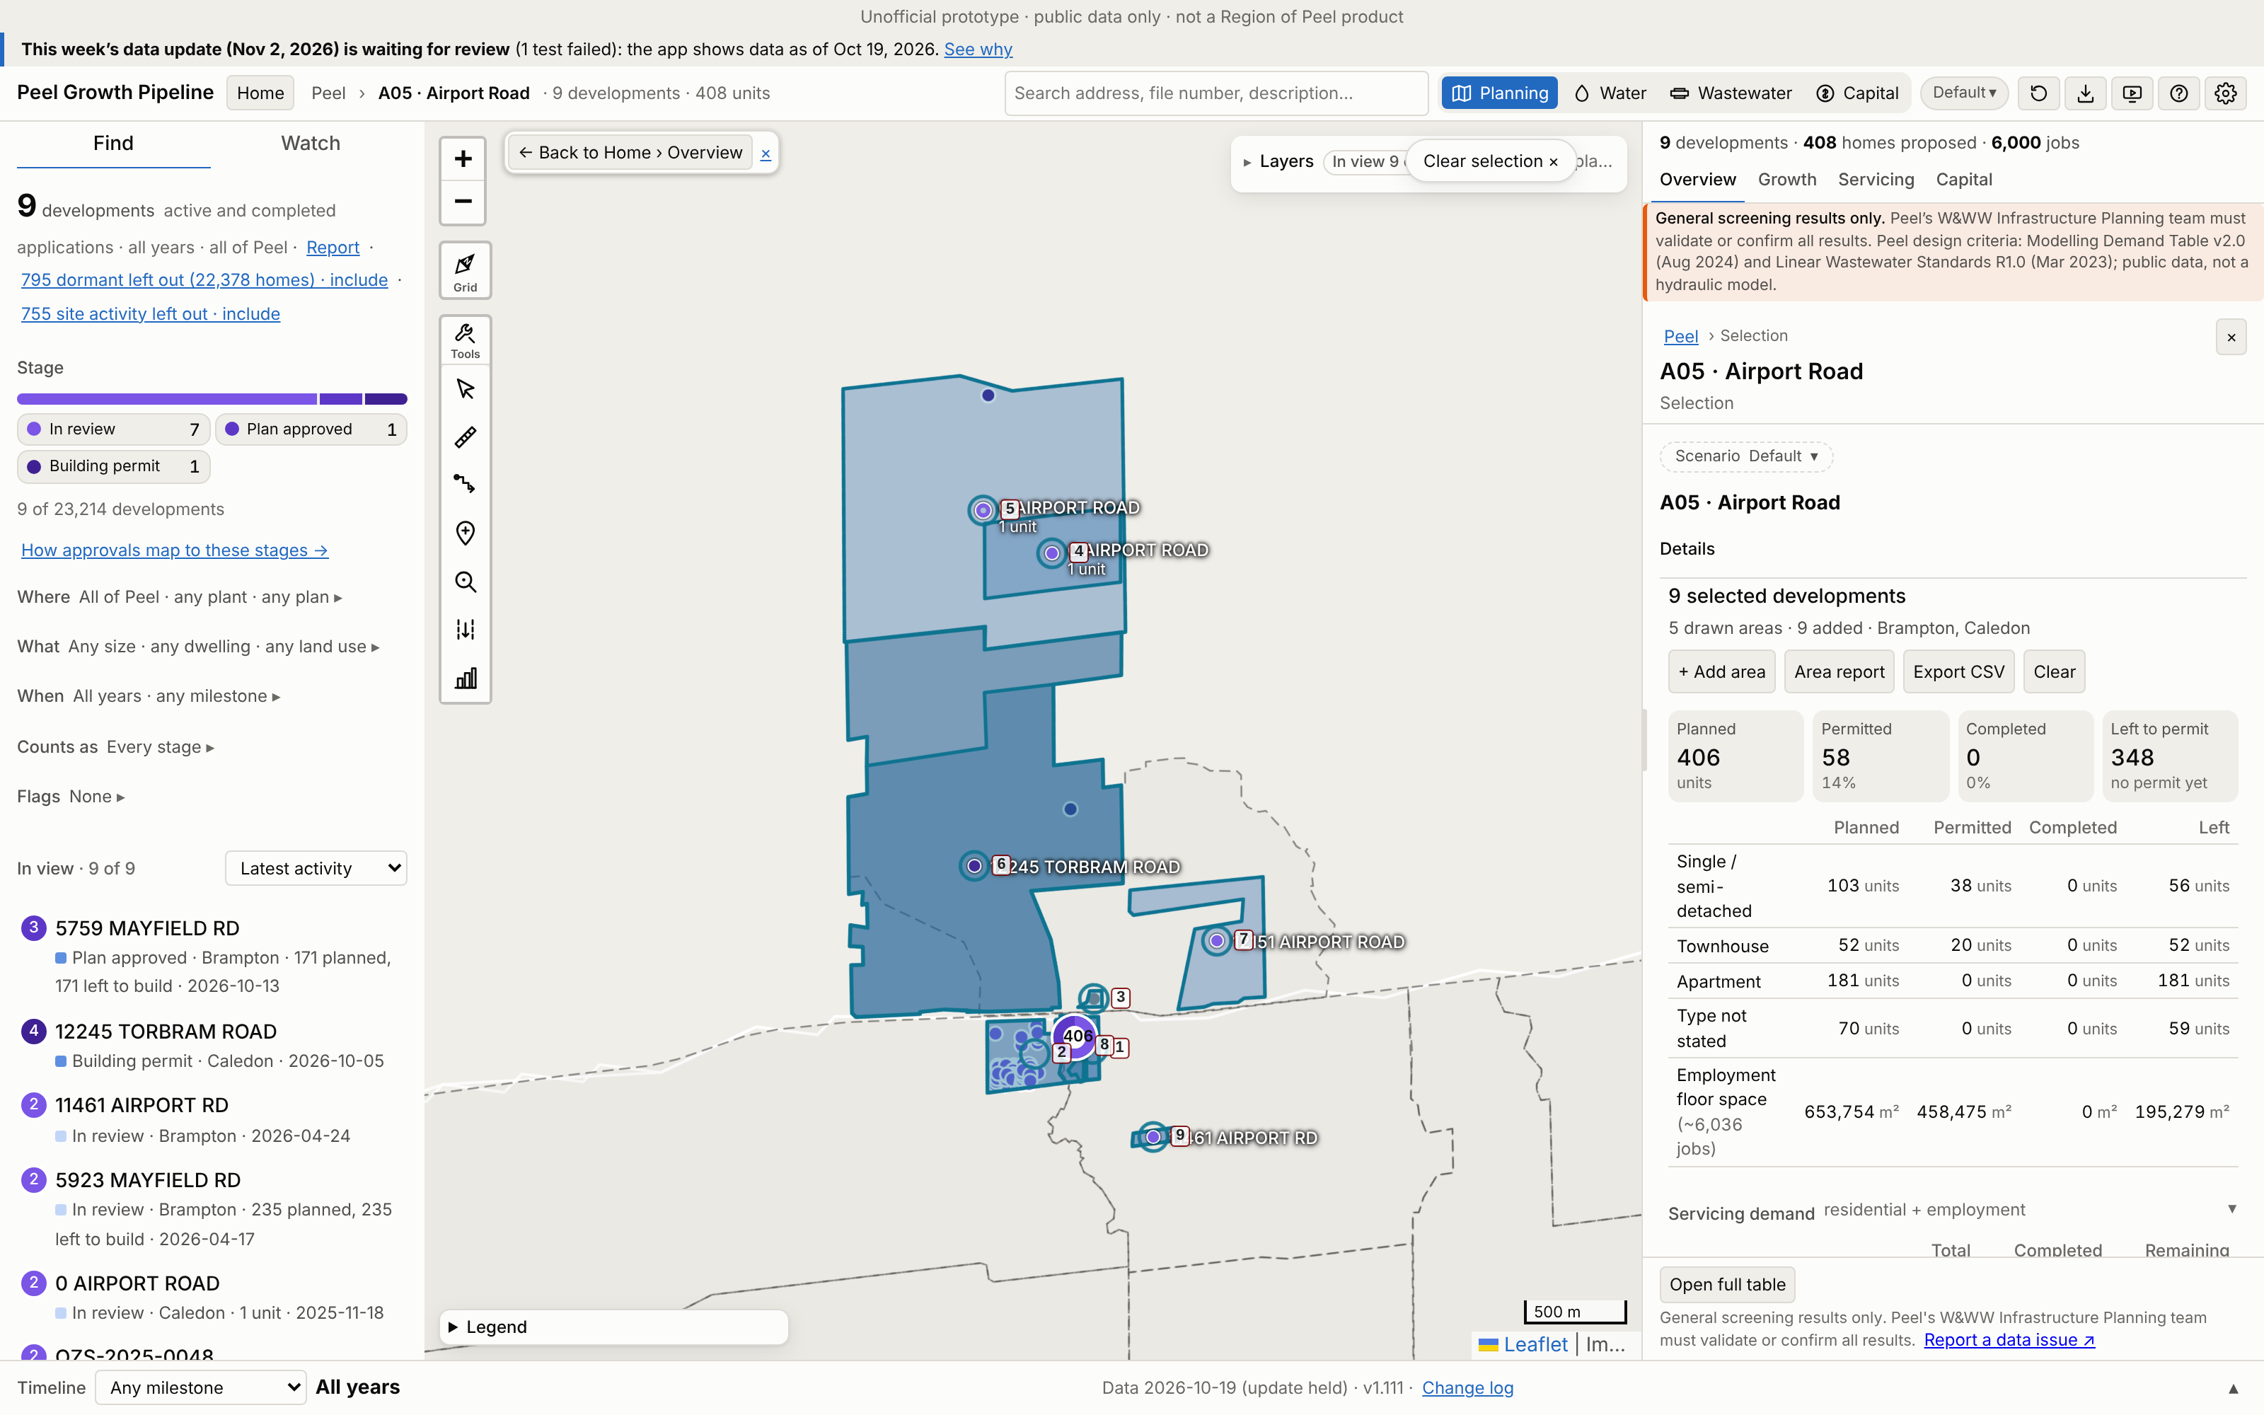
A05 · Airport Road
Growth | 2021–26 | 2026–31 | To 2031 | Final
Units | 1 | 172 | 173 | 409
People | 3 | 585 | 587 | 1,318
Jobs | 0 | 4,168 | 4,168 | 6,036
Boundary: app application parcels (≥50% in the Region box), 414 ha (Region map 107.78 ha).
Region map: 9,167 people. App final growth = 14% of that. 4 of 4 Region points matched.
No. / development | Stage | Final | 2031
1 5923 MAYFIELD RD | In review | 235 | 0
2 5759 MAYFIELD RD | Plan approved | 171 | 171
3 5866 MAYFIELD ROAD | In review | 1 | 1
4 0 AIRPORT ROAD | In review | 1 | 1
5 0 AIRPORT ROAD | In review | 1 | 1
App screenshot: the boundary used is drawn as an app selection, with each application labelled (A05-###). Region map reference: maps/A05_Airport_Road.png
Largest 5 of 9 applications (units). All: Excel sheet A05.
Peel Growth Pipeline app · snapshot 2026-10-19 · growth since the 2021 Census · screening estimate
15
Notes:
A05 Airport Road: Application parcels: the app's planning applications with at least half their land in the Region box
A05-001 5923 MAYFIELD RD | In review | final 235 units, to 2031 0 | OZS-2026-0012 (In Review-Public Mtg Complete); PRE-2021-0099 (Closed); PRE-2019-0057 (Closed)
A05-002 5759 MAYFIELD RD | Plan approved | final 171 units, to 2031 171 | OZS-2022-0034 (Closed Approved); PRE-2022-0013 (Closed); PRE-2023-0133 (Closed)
A05-003 5866 MAYFIELD ROAD | In review | final 1 units, to 2031 1 | 2025-0053 (Recirculation)
A05-004 0 AIRPORT ROAD | In review | final 1 units, to 2031 1 | 2025-0024 (Circulation)
A05-005 0 AIRPORT ROAD | In review | final 1 units, to 2031 1 | 2025-0012 (Circulation)
A05-006 12245 TORBRAM ROAD | Building permit | final 0 units, to 2031 0 | 2024-0055 (Recirculation); 21T-21002C (Circulation); 2021-0013 (Circulation)
A05-007 12151 AIRPORT ROAD | In review | final 0 units, to 2031 0 | 21T-25006C (Circulation)
A05-008 OZS-2025-0048 | In review | final 0 units, to 2031 0 | OZS-2025-0048 (In Review-Public Mtg Complete)
A05-009 11461 AIRPORT RD | In review | final 0 units, to 2031 0 | SPA-2026-0063 (In Review); PRE-2022-0126 (Closed)

Slide 16
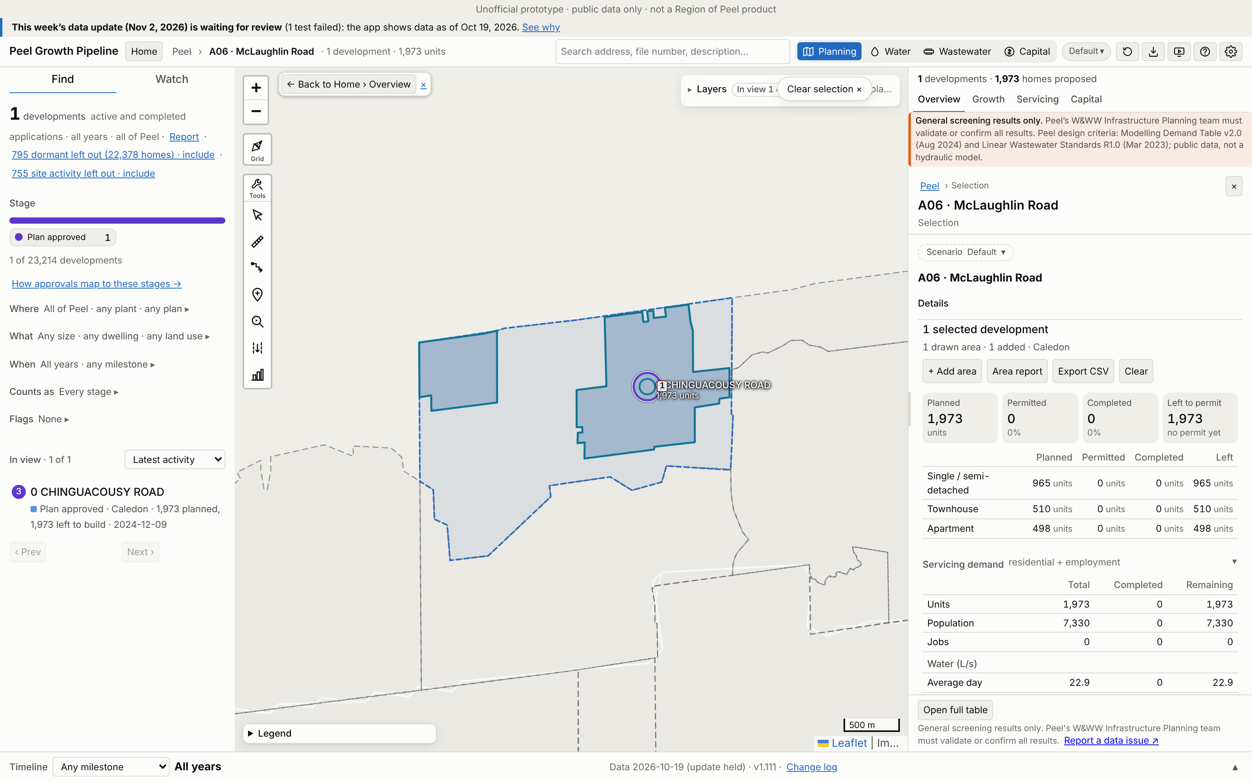
A06 · McLaughlin Road
Growth | 2021–26 | 2026–31 | To 2031 | Final
Units | 0 | 822 | 822 | 1,973
People | 0 | 3,056 | 3,056 | 7,331
Jobs | 0 | 0 | 0 | 0
Boundary: the Brookvalley Secondary Plan, 438 ha (Region map 435.7 ha).
Region map: 21,837 people. App final growth = 34% of that. 3 of 3 Region points matched.
No. / development | Stage | Final | 2031
1 0 CHINGUACOUSY ROAD | Plan approved | 1,973 | 822
App screenshot: the boundary used is drawn as an app selection, with each application labelled (A06-###). Region map reference: maps/A06_McLaughlin_Road.png
Largest 1 of 1 applications (units). All: Excel sheet A06.
Peel Growth Pipeline app · snapshot 2026-10-19 · growth since the 2021 Census · screening estimate
16
Notes:
A06 McLaughlin Road: Existing boundary: Brookvalley (Mayfield West Phase 2 Secondary Plan Stage 3), 438.1 ha vs 435.7 ha on the Region map
A06-001 0 CHINGUACOUSY ROAD | Plan approved | final 1,973 units, to 2031 822 | 21T-24011C (Draft Approval)

Slide 17
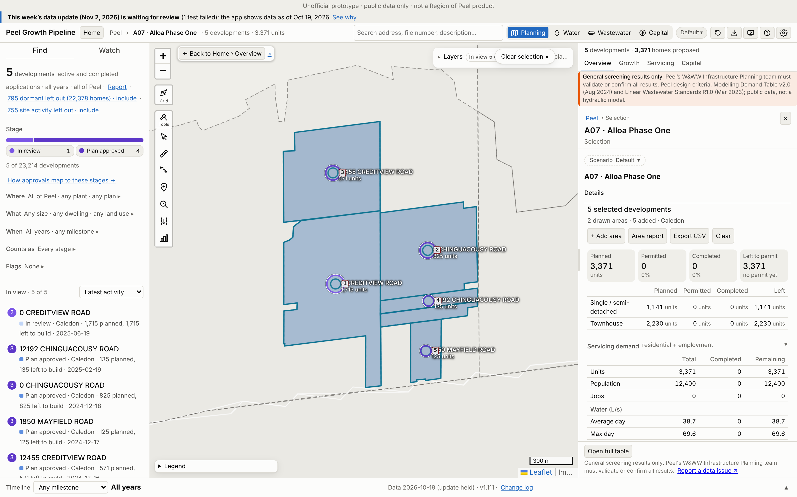
A07 · Alloa Phase One
Growth | 2021–26 | 2026–31 | To 2031 | Final
Units | 0 | 1,807 | 1,807 | 3,371
People | 0 | 6,770 | 6,770 | 12,374
Jobs | 0 | 0 | 0 | 0
Boundary: app application parcels (≥50% in the Region box), 161 ha (Region map 263 ha).
Region map: 20,561 people. App final growth = 60% of that. 1 of 1 Region points matched.
No. / development | Stage | Final | 2031
1 0 CREDITVIEW ROAD | In review | 1,715 | 402
2 0 CHINGUACOUSY ROAD | Plan approved | 825 | 682
3 12455 CREDITVIEW RO | Plan approved | 571 | 495
4 12192 CHINGUACOUSY | Plan approved | 135 | 118
5 1850 MAYFIELD ROAD | Plan approved | 125 | 110
App screenshot: the boundary used is drawn as an app selection, with each application labelled (A07-###). Region map reference: maps/A07_Alloa_Phase_One.png
Largest 5 of 5 applications (units). All: Excel sheet A07.
Peel Growth Pipeline app · snapshot 2026-10-19 · growth since the 2021 Census · screening estimate
17
Notes:
A07 Alloa Phase One: Application parcels: the app's planning applications with at least half their land in the Region box
A07-001 0 CREDITVIEW ROAD | In review | final 1,715 units, to 2031 402 | 21T-25008C (Circulation)
A07-002 0 CHINGUACOUSY ROAD | Plan approved | final 825 units, to 2031 682 | 21T-24016C (Draft Approved (parent))
A07-003 12455 CREDITVIEW ROAD | Plan approved | final 571 units, to 2031 495 | 21T-24013C (Draft Approved (parent))
A07-004 12192 CHINGUACOUSY ROAD | Plan approved | final 135 units, to 2031 118 | 21T-25004C (Draft Approved (parent))
A07-005 1850 MAYFIELD ROAD | Plan approved | final 125 units, to 2031 110 | 21T-24015C (Draft Approved (parent))

Slide 18
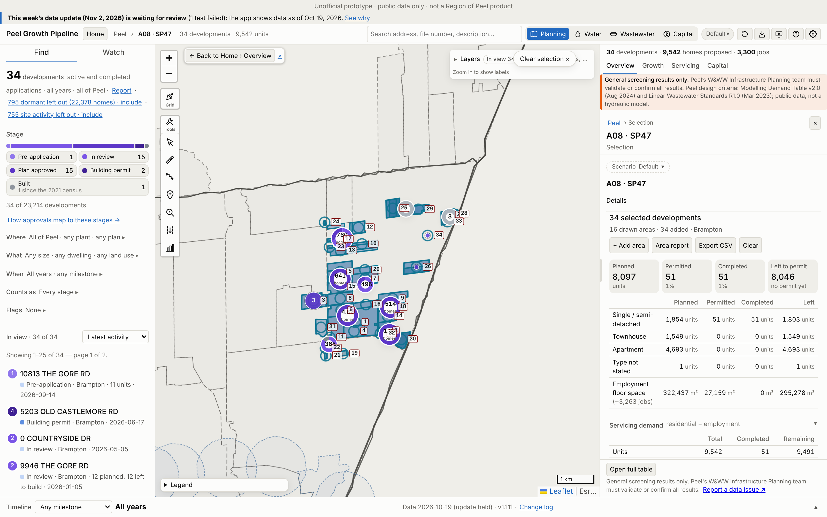
A08 · SP47
Growth | 2021–26 | 2026–31 | To 2031 | Final
Units | 51 | 1,944 | 1,995 | 9,542
People | 214 | 6,641 | 6,855 | 30,782
Jobs | 0 | 2,110 | 2,110 | 3,263
Boundary: app application parcels (≥50% in the Region box), 450 ha (Region map 585.41 ha).
Region map: 57,194 people. App final growth = 54% of that. 27 of 28 Region points matched.
No. / development | Stage | Final | 2031
1 10159 THE GORE RD | Plan approved | 3,239 | 323
2 5076 OLD CASTLEMORE | Plan approved | 1,333 | 181
3 10300 THE GORE RD | Plan approved | 791 | 568
4 4784 CASTLEMORE RD | In review | 685 | 0
5 10647 THE GORE RD | Plan approved | 471 | 181
App screenshot: the boundary used is drawn as an app selection, with each application labelled (A08-###). Region map reference: maps/A08_SP47.png
Largest 5 of 34 applications (units). All: Excel sheet A08.
Peel Growth Pipeline app · snapshot 2026-10-19 · growth since the 2021 Census · screening estimate
18
Notes:
A08 SP47: Application parcels: the app's planning applications with at least half their land in the Region box
A08-001 10159 THE GORE RD | Plan approved | final 3,239 units, to 2031 323 | OZS-2021-0038 (Draft Approved); PRE-2020-0108 (Closed)
A08-002 5076 OLD CASTLEMORE RD | Plan approved | final 1,333 units, to 2031 181 | OZS-2024-0049 (Closed Approved); OZS-2021-0050 (M-Plan/Condition Clearance); PRE-2024-0052 (Comments Released); PRE-2020-0124 (Closed); PRE-2021-0103 (Closed)
A08-003 10300 THE GORE RD | Plan approved | final 791 units, to 2031 568 | OZS-2024-0065 (Registration); PRE-2023-0142 (Closed)
A08-004 4784 CASTLEMORE RD | In review | final 685 units, to 2031 0 | OZS-2023-0008 (Staff Review Complete); PRE-2021-0009 (Closed)
A08-005 10647 THE GORE RD | Plan approved | final 471 units, to 2031 181 | OZS-2023-0001 (M-Plan/Condition Clearance); PRE-2021-0196 (Closed); PRE-2020-0120 (Closed)
A08-006 10263 THE GORE RD | Plan approved | final 423 units, to 2031 181 | OZS-2021-0041 (Draft Approved); PRE-2020-0115 (Closed)
A08-007 10484 CLARKWAY DR | In review | final 328 units, to 2031 0 | OZS-2024-0035 (In Review-Public Mtg Complete); PRE-2020-0106 (Closed)
A08-008 10365 THE GORE RD | Plan approved | final 295 units, to 2031 0 | OZS-2021-0039 (Draft Approved); PRE-2020-0117 (Closed)
A08-009 10307 CLARKWAY DR | Plan approved | final 275 units, to 2031 181 | OZS-2021-0057 (Draft Approved); PRE-2020-0126 (Closed)
A08-010 10778 CLARKWAY DR | In review | final 273 units, to 2031 0 | OZS-2022-0015 (Application Complete); PRE-2020-0121 (Closed); PRE-2021-0113 (Comments Released)
A08-011 4538 CASTLEMORE RD | In review | final 271 units, to 2031 0 | OZS-2022-0045 (Closed Approved); PRE-2020-0110 (Closed)
A08-012 0 COUNTRYSIDE DR | In review | final 205 units, to 2031 0 | OZS-2023-0023 (In Review-Public Mtg Complete); PRE-2020-0122 (Closed)
A08-013 10797 THE GORE RD | Plan approved | final 202 units, to 2031 146 | OZS-2023-0002 (Draft Approved)
A08-014 OZS-2021-0060 | Plan approved | final 183 units, to 2031 132 | OZS-2021-0060 (Draft Approved); PRE-2020-0125 (Closed)
A08-015 10431 THE GORE RD | Plan approved | final 170 units, to 2031 6 | OZS-2021-0047 (Draft Approved); PRE-2020-0118 (Closed)
A08-016 10308 CLARKWAY DR | Plan approved | final 121 units, to 2031 0 | OZS-2021-0019 (Draft Approved); PRE-2020-0116 (Closed)
A08-017 10877 THE GORE RD | In review | final 65 units, to 2031 0 | OZS-2024-0010 (In Review-Public Mtg Complete); PRE-2021-0101 (Closed)
A08-018 10201 CLARKWAY DR | Plan approved | final 56 units, to 2031 40 | OZS-2022-0025 (Draft Approved); PRE-2021-0093 (Verification of Documents)
A08-019 LITERACY DR | Built | final 51 units, to 2031 51 | OZS-2021-0036 (Closed Approved); PRE-2021-0119 (Closed)
A08-020 0 CLARKWAY DR | In review | final 47 units, to 2031 0 | OZS-2024-0005 (In Review-Public Mtg Complete); PRE-2020-0175 (Closed)
A08-021 9874 THE GORE RD | In review | final 31 units, to 2031 0 | OZS-2023-0017 (Closed Approved); PRE-2022-0089 (Comments Released)
A08-022 9946 THE GORE RD | In review | final 12 units, to 2031 0 | OZS-2026-0001 (Deemed Complete); PRE-2024-0082 (Closed); PRE16.005 (PRE - Closed)
A08-023 10813 THE GORE RD | Pre-application | final 11 units, to 2031 3 | PRE-2026-0036 (Submitted)
A08-024 11038 THE GORE RD | Plan approved | final 4 units, to 2031 3 | OZS-2024-0004 (Draft Approved); PRE-2021-0198 (Closed); PRE17.135 (Closed)
A08-025 5200 COUNTRYSIDE DR | Plan approved | final 0 units, to 2031 0 | OZS-2025-0007 (Closed Approved); SPA-2024-0096 (Site Plan Approved); PRE-2023-0014 (Closed); OZS-2022-0029 (Closed Approved); SPA-2023-0079 (Agreement Execution); PRE-2022-0165 (Closed); PRE-2021-0061 (Closed)
A08-026 0 COLERAINE DR | Plan approved | final 0 units, to 2031 0 | OZS-2024-0061 (In Review-Public Mtg Complete); PRE19.017 (Closed); PRE-2023-0035 (Closed); PRE-2020-0113 (Closed)
A08-027 0 COUNTRYSIDE DR | In review | final 0 units, to 2031 0 | SPA-2025-0048 (In Review); PRE-2024-0094 (Closed)
A08-028 0 COUNTRYSIDE DR | In review | final 0 units, to 2031 0 | OZS-2025-0003 (Closed Approved)
A08-029 0 COUNTRYSIDE DR | In review | final 0 units, to 2031 0 | OZS-2026-0014 (Submitted); OZS-2022-0005 (Closed Approved); PRE-2020-0128 (Closed); PRE19.014 (Closed)
A08-030 5203 OLD CASTLEMORE RD | Building permit | final 0 units, to 2031 0 | OZS-2023-0038 (Closed Approved); OZS-2020-0010 (M-Plan/Condition Clearance); SPA-2022-0051 (Substantially Complete); PRE-2021-0199 (Meeting Scheduled); PRE18.038 (Closed)
A08-031 10150 THE GORE RD | Building permit | final 0 units, to 2031 0 | PRE-2020-0137 (Closed)
A08-032 10015 CLARKWAY DR | In review | final 0 units, to 2031 0 | OZS-2025-0010 (In Review-Public Mtg Complete); PRE-2021-0227 (Closed)
A08-033 0 HIGHWAY 50 | In review | final 0 units, to 2031 0 | OZS-2024-0008 (In Review); PRE-2023-0048 (Verification of Documents)
A08-034 10810 COLERAINE DR | In review | final 0 units, to 2031 0 | OZS-2021-0051 (Closed Approved); PRE-2024-0147 (Verification of Documents); PRE-2020-0091 (Closed)

Slide 19
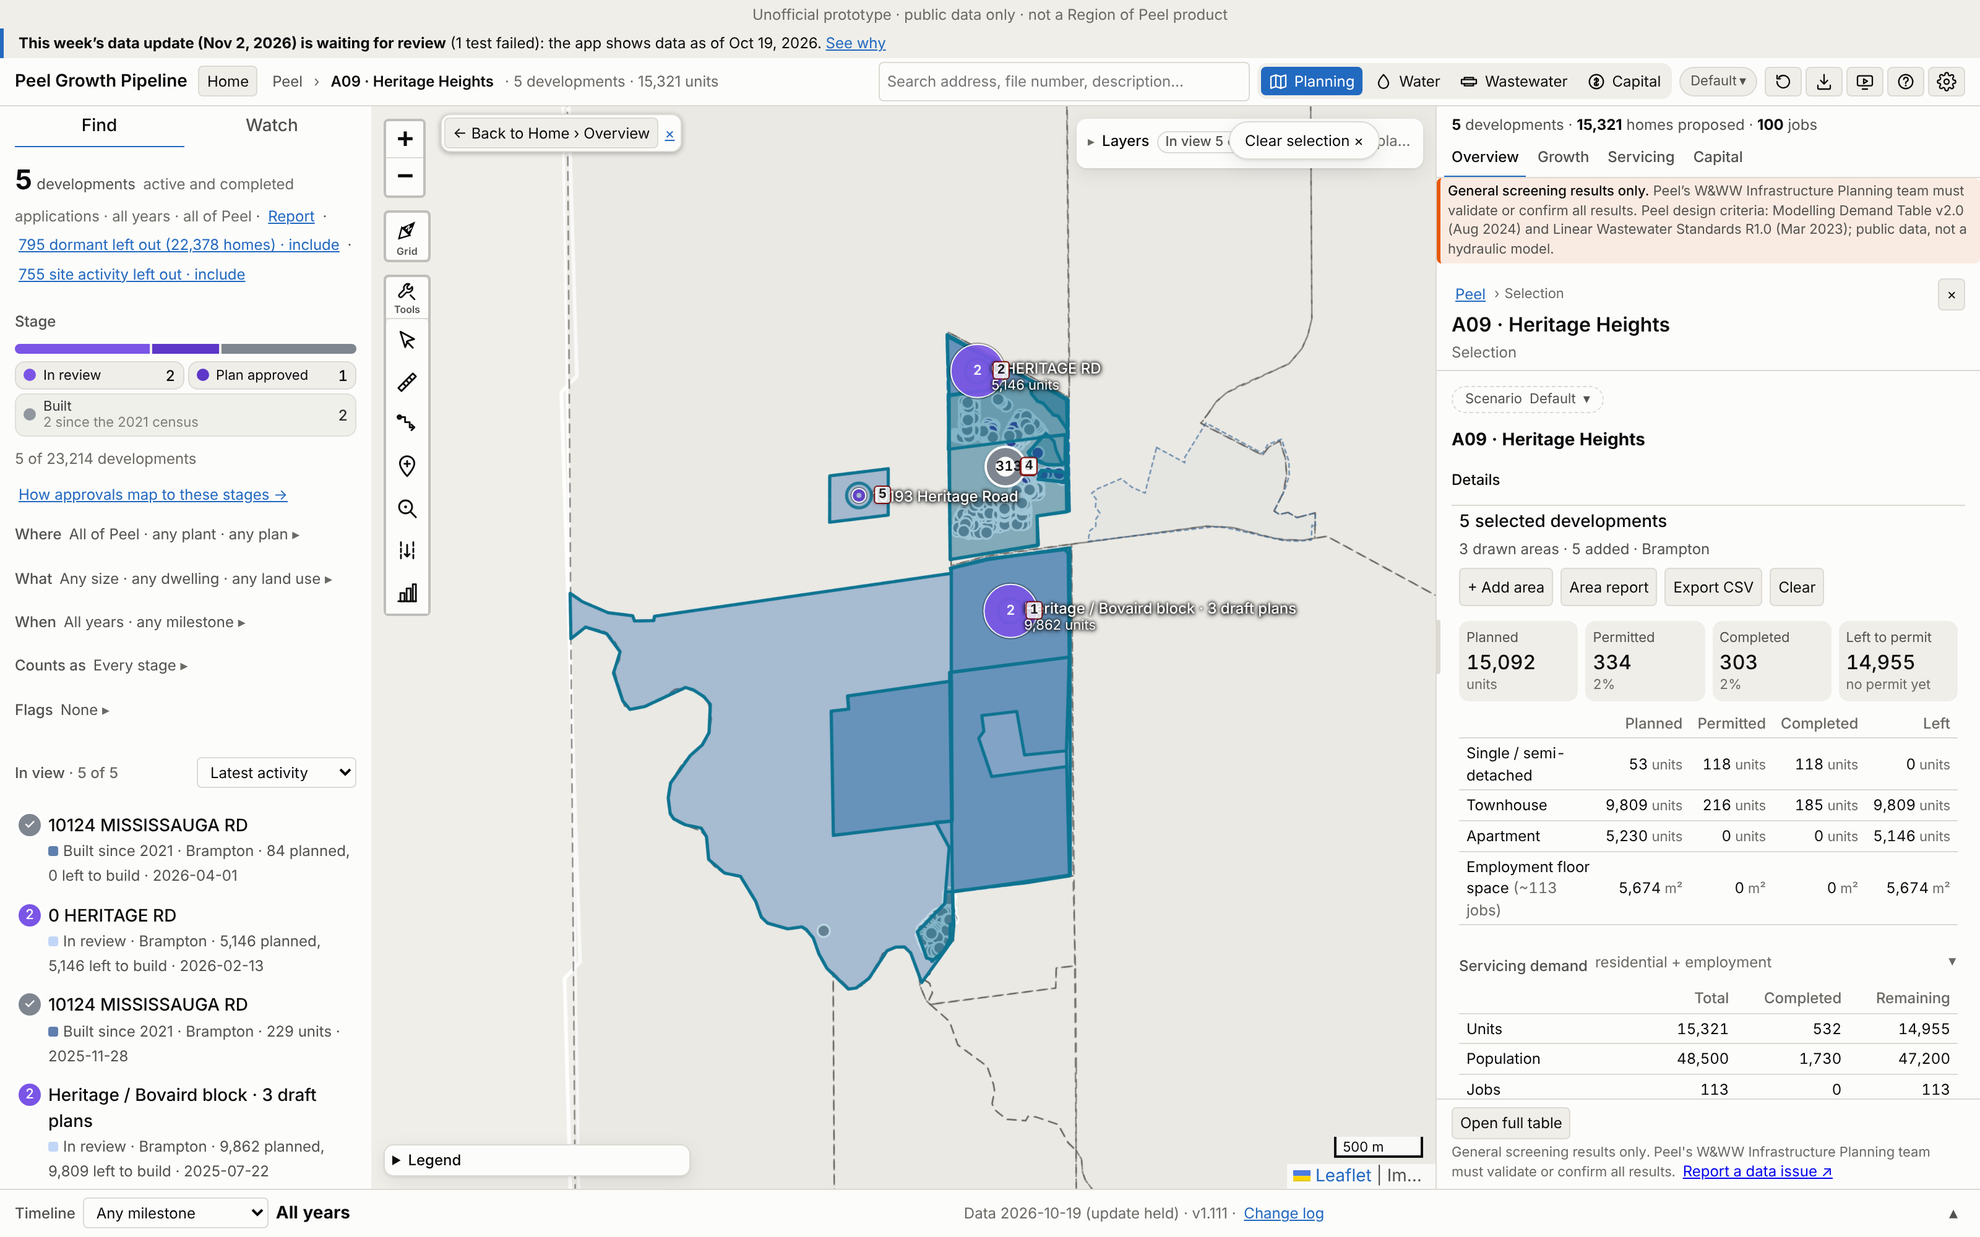
A09 · Heritage Heights
Growth | 2021–26 | 2026–31 | To 2031 | Final
Units | 438 | 0 | 438 | 15,393
People | 1,314 | 0 | 1,314 | 48,559
Jobs | 0 | 113 | 113 | 113
Boundary: app application parcels (≥50% in the Region box), 495 ha (Region map 224.68 ha).
Region map: 58,219 people. App final growth = 83% of that. 4 of 4 Region points matched.
No. / development | Stage | Final | 2031
1 Heritage / Bovaird | In review | 9,862 | 53
2 0 HERITAGE RD | In review | 5,146 | 0
3 10124 MISSISSAUGA R | Built | 250 | 250
4 10124 MISSISSAUGA R | Built | 135 | 135
5 10193 Heritage Road | Plan approved | 0 | 0
App screenshot: the boundary used is drawn as an app selection, with each application labelled (A09-###). Region map reference: maps/A09_Heritage_Heights.png
Largest 5 of 5 applications (units). All: Excel sheet A09.
Peel Growth Pipeline app · snapshot 2026-10-19 · growth since the 2021 Census · screening estimate
19
Notes:
A09 Heritage Heights: Application parcels: the app's planning applications with at least half their land in the Region box
A09-001 Heritage / Bovaird block · 3 draft plans | In review | final 9,862 units, to 2031 53 | OZS-2025-0032 (Staff Review Complete); PRE-2024-0100 (Closed); OZS-2024-0051 (Staff Review Complete); PRE-2023-0067 (Comments Released); C05W07.006 (Closed Approved); PRE17.126 (Closed); OZS-2025-0034 (In Review-Public Mtg Complete); PRE-2024-0087 (Closed); PRE-2023-0100 (Closed)
A09-002 0 HERITAGE RD | In review | final 5,146 units, to 2031 0 | OZS-2026-0007 (In Review-Public Mtg Complete); C05W12.005 (Closed Approved); PRE-2023-0167 (Comments Released)
A09-003 10124 MISSISSAUGA RD | Built | final 250 units, to 2031 250 | OZS-2021-0052 (Closed Approved); SPA-2023-0101 (Site Plan Approved); PRE-2024-0109 (Closed); PRE-2021-0065 (Closed); SPA-2025-0022 (Closed); DPC-2026-0002 (Deemed Complete); PRE-2023-0049 (Closed)
A09-004 10124 MISSISSAUGA RD | Built | final 135 units, to 2031 135 | PRE-2023-0034 (Closed); C05W12.004 (Closed Approved); SPA-2024-0055 (Site Plan Agreement Prep)
A09-005 10193 Heritage Road | Plan approved | final 0 units, to 2031 0 | SP90-015.000 (Approved)

Slide 20
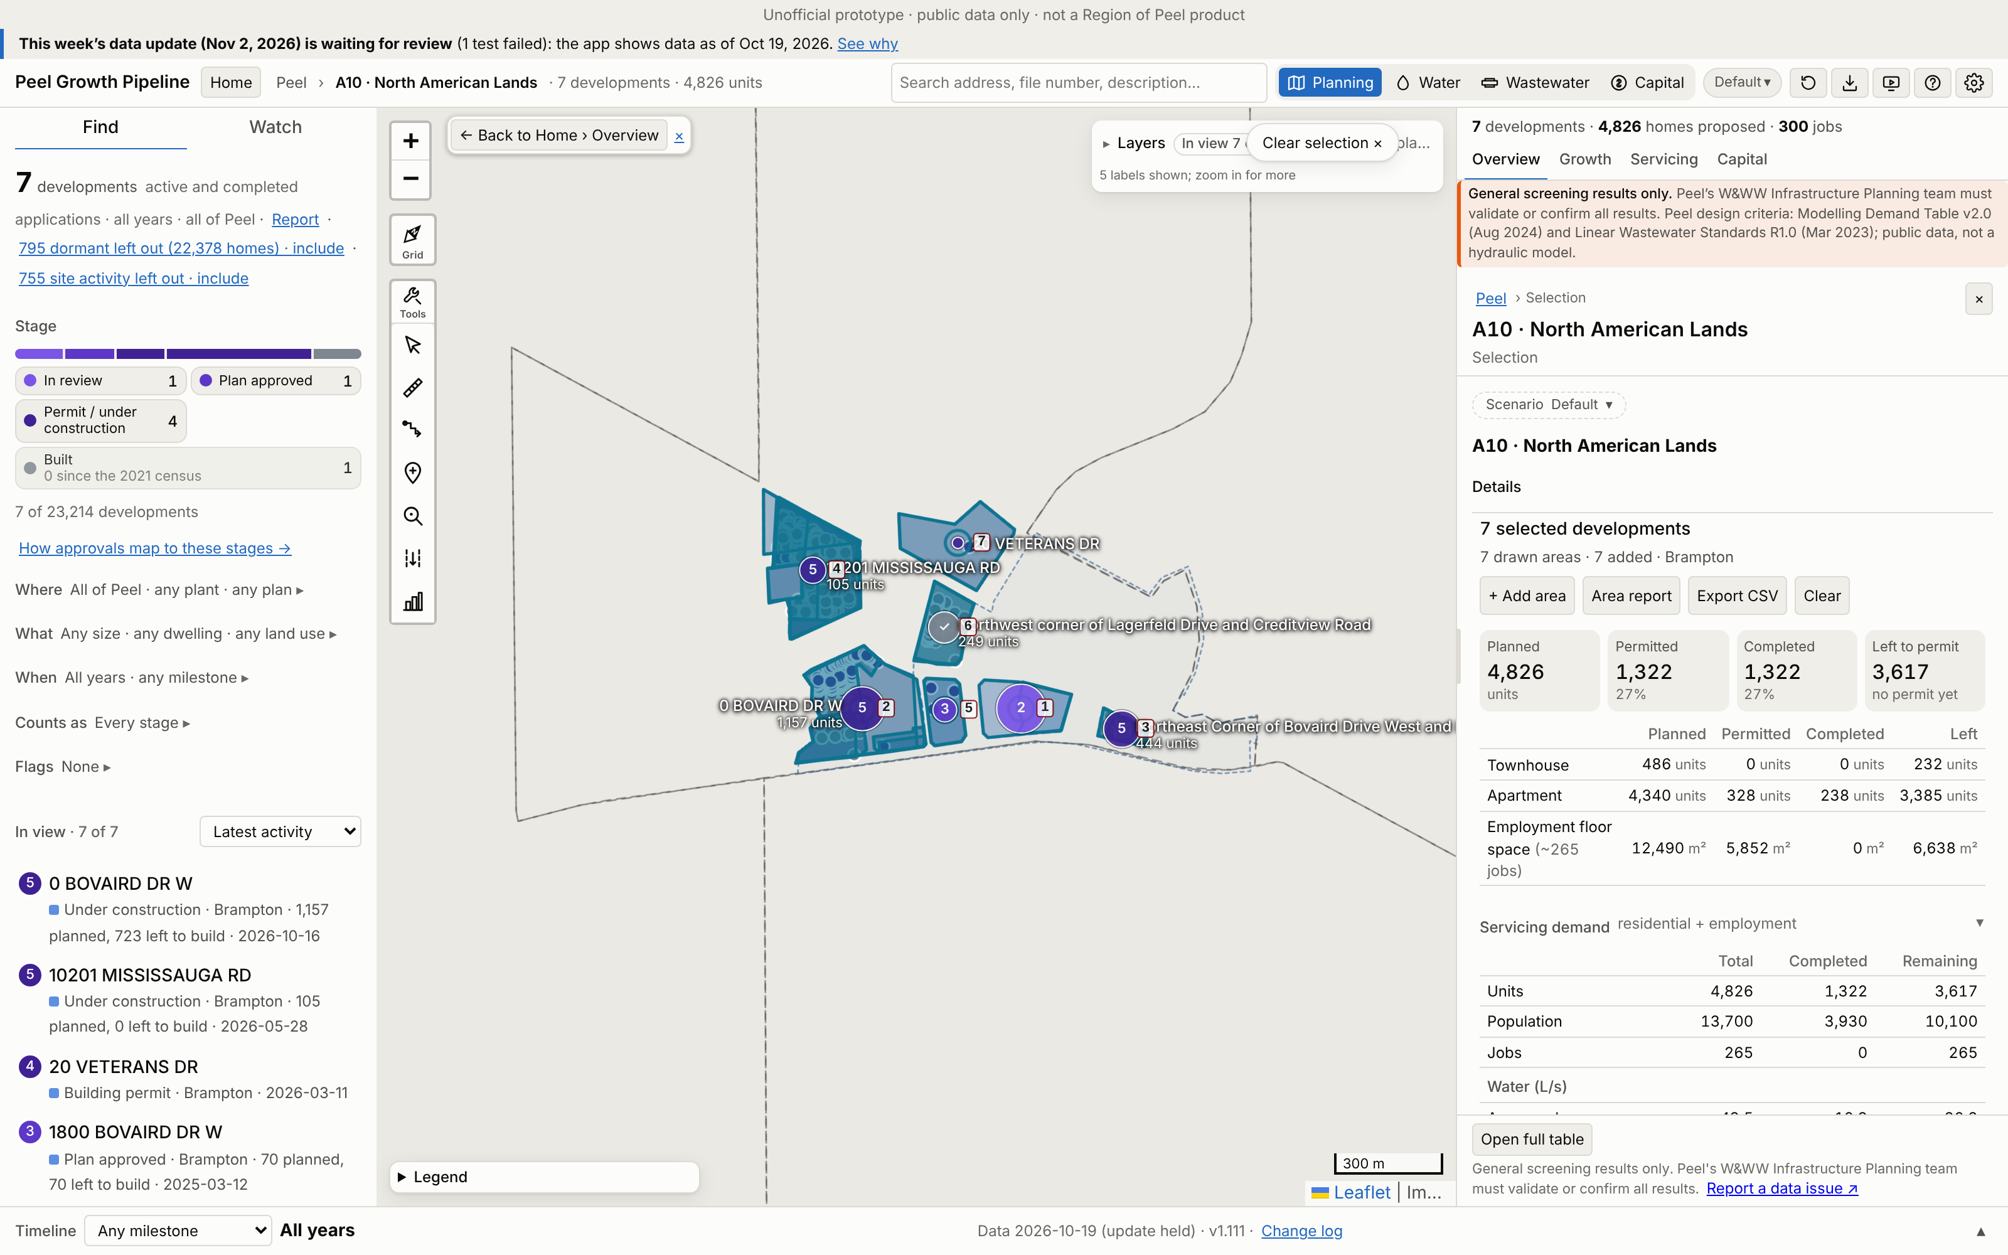
A10 · North American Lands
Growth | 2021–26 | 2026–31 | To 2031 | Final
Units | 972 | 999 | 1,971 | 4,589
People | 2,845 | 3,012 | 5,857 | 12,928
Jobs | 0 | 187 | 187 | 265
Boundary: app application parcels (≥50% in the Region box), 28 ha (Region map 25.79 ha).
Region map: 10,773 people. App final growth = 120% of that. 3 of 3 Region points matched.
No. / development | Stage | Final | 2031
1 0 LAGERFELD DR | In review | 2,801 | 189
2 0 BOVAIRD DR W | Under constr. | 1,011 | 1,011
3 Northeast Corner of | Under constr. | 444 | 444
4 10201 MISSISSAUGA R | Under constr. | 202 | 202
5 1800 BOVAIRD DR W | Plan approved | 70 | 64
App screenshot: the boundary used is drawn as an app selection, with each application labelled (A10-###). Region map reference: maps/A10_North_American_Lands.png
Largest 5 of 7 applications (units). All: Excel sheet A10.
Peel Growth Pipeline app · snapshot 2026-10-19 · growth since the 2021 Census · screening estimate
20
Notes:
A10 North American Lands: Application parcels: the app's planning applications with at least half their land in the Region box
A10-001 0 LAGERFELD DR | In review | final 2,801 units, to 2031 189 | OZS-2023-0039 (Under Appeal); PRE-2023-0003 (Closed)
A10-002 0 BOVAIRD DR W | Under construction | final 1,011 units, to 2031 1,011 | OZS-2019-0007 (Registration); SPA-2024-0097 (Site Plan Approved); PRE-2023-0131 (Closed); PRE18.050 (Closed); SPA-2025-0167 (In Review); SPA-2021-0266 (Substantially Complete); PRE-2021-0006 (Closed); SPA-2025-0106 (Site Plan Approved); DPC-2024-0009 (Registered); SPA-2021-0168 (Site Plan Approved); PRE-2021-0046 (Closed)
A10-003 Northeast Corner of Bovaird Drive West and Lagerfeld Drive | Under construction | final 444 units, to 2031 444 | SPA-2021-0074 (Site Plan Approved); SP18-002.000 (Site Plan Approved); PRE-2023-0022 (Closed); DPC-2023-0002 (Registered)
A10-004 10201 MISSISSAUGA RD | Under construction | final 202 units, to 2031 202 | OZS-2024-0056 (Closed Approved); OZS-2020-0004 (Closed Approved); SPA-2020-0190 (Site Plan Approved); DPC-2025-0004 (Registered); PRE-2025-0022 (Closed); PRE-2023-0093 (Closed); PRE-2020-0134 (Closed); PRE-2019-0028 (Closed); PRE17.063 (PRE - Closed); OZS-2024-0030 (Closed Approved); PRE-2023-0008 (Closed)
A10-005 1800 BOVAIRD DR W | Plan approved | final 70 units, to 2031 64 | SPA-2023-0007 (Site Plan Approved); PRE-2021-0221 (Closed); DPC-2024-0010 (Draft Approved)
A10-006 Northwest corner of Lagerfeld Drive and Creditview Road | Built | final 61 units, to 2031 61 | C04W11.013 (Approved); SP17-087.000 (Site Plan Approved); PRE16.054 (PRE - Closed); DPC-2020-0003 (Plan of Condo Registered); PRE-2020-0063 (Closed)
A10-007 20 VETERANS DR | Building permit | final 0 units, to 2031 0 | SPA-2024-0105 (Site Plan Agreement Prep); PRE-2023-0141 (Closed)

Slide 21
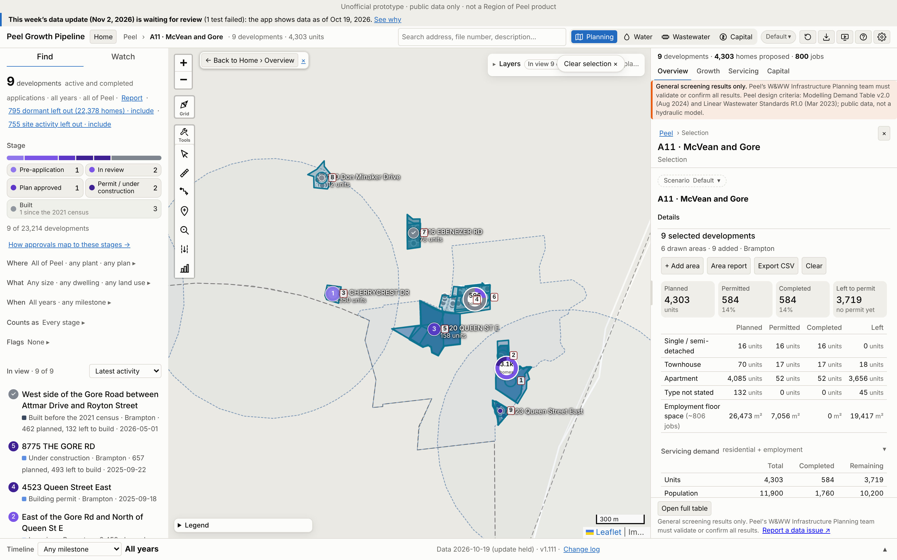
A11 · McVean and Gore
Growth | 2021–26 | 2026–31 | To 2031 | Final
Units | 461 | 701 | 1,162 | 4,180
People | 1,377 | 1,938 | 3,314 | 11,534
Jobs | 0 | 190 | 190 | 806
Boundary: app application parcels (≥50% in the Region box), 20 ha (Region map 9.89 ha).
Region map: 8,781 people. App final growth = 131% of that. 4 of 4 Region points matched.
No. / development | Stage | Final | 2031
1 East of the Gore Rd | In review | 2,452 | 0
2 8775 THE GORE RD | Under constr. | 657 | 657
3 35 CHERRYCREST DR | Pre-application | 350 | 94
4 West side of the Go | Built | 339 | 207
5 4320 QUEEN ST E | Plan approved | 158 | 114
App screenshot: the boundary used is drawn as an app selection, with each application labelled (A11-###). Region map reference: maps/A11_McVean_and_Gore.png
Largest 5 of 9 applications (units). All: Excel sheet A11.
Peel Growth Pipeline app · snapshot 2026-10-19 · growth since the 2021 Census · screening estimate
21
Notes:
A11 McVean and Gore: Application parcels: the app's planning applications with at least half their land in the Region box
A11-001 East of the Gore Rd and North of Queen St E | In review | final 2,452 units, to 2031 0 | OZS-2025-0040 (Deemed Complete); OZS-2024-0037 (Under Appeal); SPA-2020-0013 (In Review); PRE-2023-0080 (Verification of Documents); PRE-2019-0014 (Closed)
A11-002 8775 THE GORE RD | Under construction | final 657 units, to 2031 657 | PRE-2020-0088 (Closed); OZS-2020-0032 (Closed Approved); SPA-2021-0227 (Site Plan Approved); SPA-2024-0174 (Site Plan Approved); DPC-2025-0008 (Draft Approved); PRE-2025-0005 (Closed); PRE-2021-0086 (Closed)
A11-003 35 CHERRYCREST DR | Pre-application | final 350 units, to 2031 94 | PRE-2024-0133 (Meeting Scheduled)
A11-004 West side of the Gore Road between Attmar Drive and Royton Street | Built | final 339 units, to 2031 207 | C09E04.017 (Approved); SP18-118.000 (Site Plan Approved); DPC-2022-0005 (Draft Approved); OZS-2025-0055 (Closed Approved); PRE-2026-0021 (Comments Released); SP18-081.000 (Site Plan Approved); DPC-2020-0002 (Registered); PRE-2020-0037 (Closed); PRE18.013 (Closed)
A11-005 4320 QUEEN ST E | Plan approved | final 158 units, to 2031 114 | OZS-2021-0021 (Closed Approved); SPA-2022-0096 (Site Plan Agreement Prep); SPA-2022-0097 (In Review); PRE-2023-0159 (Closed); PRE-2021-0159 (Closed); PRE-2021-0158 (Closed); PRE-2020-0071 (Closed)
A11-006 8888 THE GORE RD | In review | final 134 units, to 2031 0 | OZS-2024-0052 (In Review-Public Mtg Complete); PRE-2020-0135 (Closed)
A11-007 4316 EBENEZER RD | Built | final 78 units, to 2031 78 | OZS-2020-0012 (Closed Approved); SPA-2021-0025 (Site Plan Approved); DPC-2024-0004 (Draft Approved); PRE-2023-0137 (Closed); PRE-2020-0129 (Closed); PRE-2019-0032 (Closed)
A11-008 150 Don Minaker Drive | Built | final 12 units, to 2031 12 | C09E06.008 (Registration)
A11-009 4523 Queen Street East | Building permit | final 0 units, to 2031 0 | SP18-064.000 (Site Plan Approved); PRE-2022-0096 (Meeting Scheduled); PRE17.038 (PRE - Closed)

Slide 22
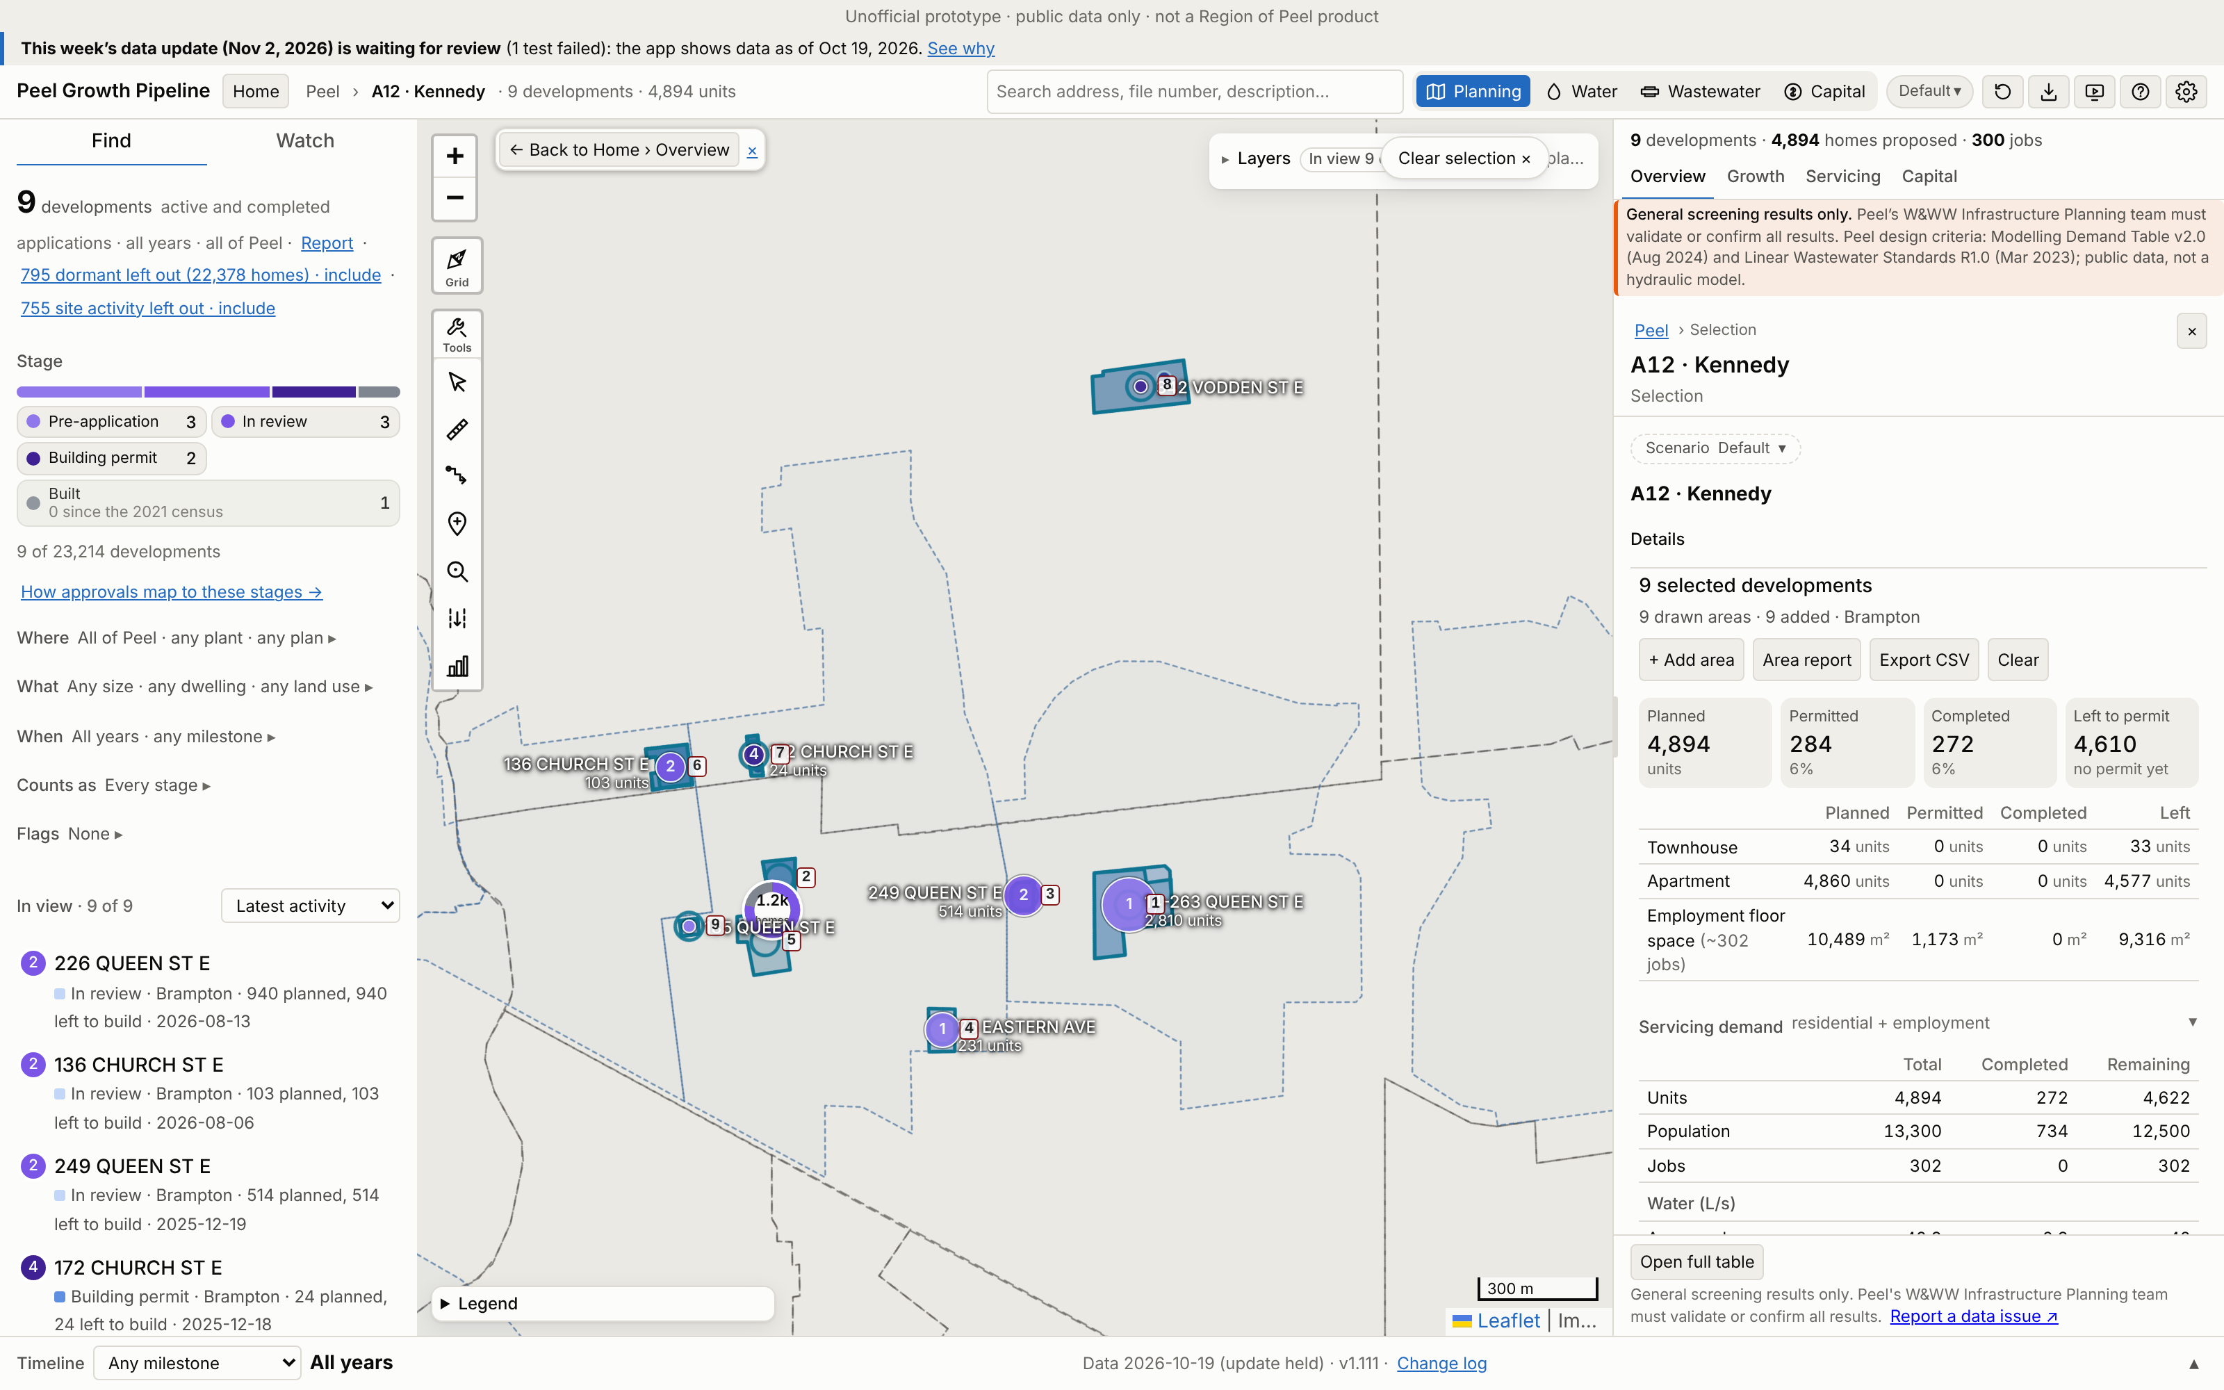
A12 · Kennedy
Growth | 2021–26 | 2026–31 | To 2031 | Final
Units | 109 | 418 | 527 | 4,731
People | 294 | 1,139 | 1,433 | 12,824
Jobs | 0 | 78 | 78 | 302
Boundary: app application parcels (≥50% in the Region box), 10 ha (Region map 10.1 ha).
Region map: 9,716 people. App final growth = 132% of that. 4 of 5 Region points matched.
No. / development | Stage | Final | 2031
1 14-263 QUEEN ST E | Pre-application | 2,810 | 189
2 226 QUEEN ST E | In review | 940 | 0
3 249 QUEEN ST E | In review | 514 | 141
4 75 EASTERN AVE | Pre-application | 231 | 64
5 209 Queen Street Ea | Built | 109 | 109
App screenshot: the boundary used is drawn as an app selection, with each application labelled (A12-###). Region map reference: maps/A12_Kennedy.png
Largest 5 of 9 applications (units). All: Excel sheet A12.
Peel Growth Pipeline app · snapshot 2026-10-19 · growth since the 2021 Census · screening estimate
22
Notes:
A12 Kennedy: Application parcels: the app's planning applications with at least half their land in the Region box
A12-001 14-263 QUEEN ST E | Pre-application | final 2,810 units, to 2031 189 | PRE-2025-0048 (Comments Released); PRE-2022-0158 (Closed)
A12-002 226 QUEEN ST E | In review | final 940 units, to 2031 0 | OZS-2022-0028 (Closed Approved); PRE-2026-0034 (Meeting Scheduled); PRE-2022-0002 (Closed); PRE-2021-0108 (Closed)
A12-003 249 QUEEN ST E | In review | final 514 units, to 2031 141 | OZS-2023-0040 (Closed Approved); SPA-2025-0196 (In Review); PRE-2025-0067 (Closed); PRE-2022-0023 (Closed)
A12-004 75 EASTERN AVE | Pre-application | final 231 units, to 2031 64 | PRE-2024-0055 (Comments Released)
A12-005 209 Queen Street East | Built | final 109 units, to 2031 109 | C01E05.061 (OMB - Approved)
A12-006 136 CHURCH ST E | In review | final 103 units, to 2031 0 | OZS-2021-0011 (Closed Approved); SPA-2026-0090 (Submitted); PRE-2023-0075 (Comments Released); PRE-2020-0026 (Closed); OZS-2026-0016 (Approved)
A12-007 172 CHURCH ST E | Building permit | final 24 units, to 2031 24 | OZS-2020-0026 (Closed Approved); SPA-2021-0257 (Site Plan Approved); PRE-2023-0163 (Meeting Scheduled); PRE-2021-0089 (Closed); PRE-2019-0023 (Closed)
A12-008 342 VODDEN ST E | Building permit | final 0 units, to 2031 0 | SPA-2022-0201 (Site Plan Approved); PRE-2022-0108 (Closed)
A12-009 185 QUEEN ST E | Pre-application | final 0 units, to 2031 0 | PRE-2025-0071 (Comments Released); PRE19.009 (Closed)

Slide 23
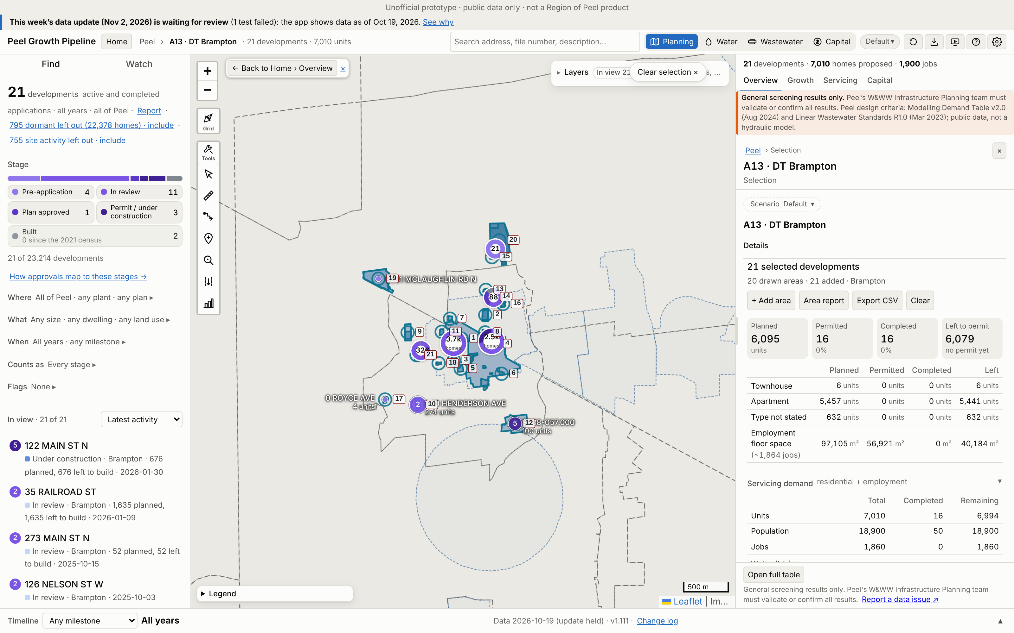
A13 · DT Brampton
Growth | 2021–26 | 2026–31 | To 2031 | Final
Units | 16 | 1,703 | 1,719 | 7,010
People | 50 | 4,598 | 4,648 | 18,935
Jobs | 0 | 1,142 | 1,142 | 1,864
Boundary: app application parcels (≥50% in the Region box), 47 ha (Region map 13.48 ha).
Region map: 19,805 people. App final growth = 96% of that. 10 of 10 Region points matched.
No. / development | Stage | Final | 2031
1 35 RAILROAD ST | In review | 1,635 | 258
2 199 MAIN ST N | In review | 1,149 | 0
3 29 MILL ST N | In review | 915 | 232
4 122 MAIN ST N | Under constr. | 676 | 676
5 104 QUEEN ST W | In review | 551 | 150
App screenshot: the boundary used is drawn as an app selection, with each application labelled (A13-###). Region map reference: maps/A13_DT_Brampton.png
Largest 5 of 21 applications (units). All: Excel sheet A13.
Peel Growth Pipeline app · snapshot 2026-10-19 · growth since the 2021 Census · screening estimate
23
Notes:
A13 DT Brampton: Application parcels: the app's planning applications with at least half their land in the Region box
A13-001 35 RAILROAD ST | In review | final 1,635 units, to 2031 258 | OZS-2026-0002 (Deemed Complete); OZS-2024-0032 (In Review-Public Mtg Complete); PRE-2023-0089 (Closed)
A13-002 199 MAIN ST N | In review | final 1,149 units, to 2031 0 | OZS-2022-0011 (Closed Approved); DPS-2022-0004 (In Review); PRE-2022-0086 (Closed); PRE-2021-0135 (Closed)
A13-003 29 MILL ST N | In review | final 915 units, to 2031 232 | OZS-2024-0033 (Closed Approved); PRE-2023-0101 (Closed)
A13-004 122 MAIN ST N | Under construction | final 676 units, to 2031 676 | OZS-2025-0011 (Closed Approved); SPA-2021-0269 (Substantially Complete); PRE-2021-0127 (Closed); C01E06.056 (Closed Approved); PRE-2020-0079 (Closed); PRE17.065 (PRE - Closed); OZS-2021-0053 (Closed Approved); SPA-2022-0122 (Agreement Execution); PRE-2022-0024 (Closed); PRE-2020-0033 (Closed); PRE18.036 (Closed); PRE16.090 (PRE - Closed); SPA-2026-0013 (Site Plan Approved); SPA-2026-0002 (In Review); SPA-2025-0083 (Site Plan Approved); SPA-2025-0056 (Site Plan Approved); SPA-2021-0176 (Site Plan Approved); SPA-2020-0124 (Site Plan Approved); SP86-001.000 (Transferred); SPA-2020-0128 (Site Plan Approved); SPA-2020-0087 (Site Plan Approved); SP81-016.000 (Transferred); SP17-018.000 (Approved); CI18.002
A13-005 104 QUEEN ST W | In review | final 551 units, to 2031 150 | OZS-2024-0034 (In Review-Public Mtg Complete); PRE-2023-0081 (Closed)
A13-006 22 JOHN ST | In review | final 362 units, to 2031 100 | OZS-2022-0035 (Closed Approved); PRE-2022-0035 (Closed)
A13-007 80 JOSEPH ST | Pre-application | final 345 units, to 2031 95 | PRE-2024-0136 (Closed); PRE-2023-0065 (Closed)
A13-008 151 MAIN ST N | In review | final 324 units, to 2031 0 | OZS-2021-0003 (Closed Approved); PRE-2022-0128 (Closed); PRE-2020-0043 (Closed); PRE17.052 (PRE - Closed)
A13-009 125 RAILROAD ST | In review | final 322 units, to 2031 89 | OZS-2024-0002 (In Review-Public Mtg Complete); PRE-2022-0147 (Closed); PRE-2021-0235 (Closed)
A13-010 1-10 HENDERSON AVE | In review | final 274 units, to 2031 0 | OZS-2024-0047 (In Review-Public Mtg Complete); PRE-2021-0028 (Closed)
A13-011 65 PARK ST | In review | final 240 units, to 2031 0 | OZS-2024-0001 (Closed Approved); PRE-2020-0103 (Closed); PRE-2022-0145 (Comments Released)
A13-012 SP88-057.000 | Under construction | final 100 units, to 2031 72 | SP88-057.000 (Transferred)
A13-013 273 MAIN ST N | In review | final 52 units, to 2031 14 | DPS-2025-0007 (In Review); PRE-2025-0004 (Closed)
A13-014 85 SPROULE DR | Plan approved | final 24 units, to 2031 16 | OZS-2024-0038 (Closed Approved); DPS-2023-0001 (Agreement Execution); PRE-2021-0228 (Closed)
A13-015 350 MAIN ST N | Pre-application | final 21 units, to 2031 0 | PRE-2024-0071 (Meeting Scheduled); PRE-2022-0046 (Comments Released)
A13-016 25 William Street | Built | final 12 units, to 2031 12 | C01E07.037 (Closed Approved); SPA-2023-0114 (Site Plan Approved); SPA-2019-0076 (Site Plan Approved); DPC-2024-0008 (Registration); PRE-2024-0072 (Comments Released); PRE17.069 (PRE - Closed); SP19-042.000 (Closed)
A13-017 0 ROYCE AVE | Pre-application | final 4 units, to 2031 1 | PRE-2024-0023 (Comments Released); PRE16.116 (PRE - Closed)
A13-018 20 West St, Unit 1 | Built | final 4 units, to 2031 4 | SP18-041.000 (Site Plan Approved)
A13-019 9381 MCLAUGHLIN RD N | Pre-application | final 0 units, to 2031 0 | PRE-2025-0056 (Meeting Scheduled); PRE-2024-0127 (Meeting Scheduled)
A13-020 125-370 MAIN ST N | Building permit | final 0 units, to 2031 0 | OZS-2020-0003 (Closed Approved); SPA-2021-0104 (Site Plan Approved); SPA-2020-0053 (Site Plan Approved); PRE-2019-0004 (Closed); PRE19.004 (Closed)
A13-021 126 NELSON ST W | In review | final 0 units, to 2031 0 | OZS-2025-0044 (Staff Review Complete); PRE-2023-0066 (Closed)

Slide 24
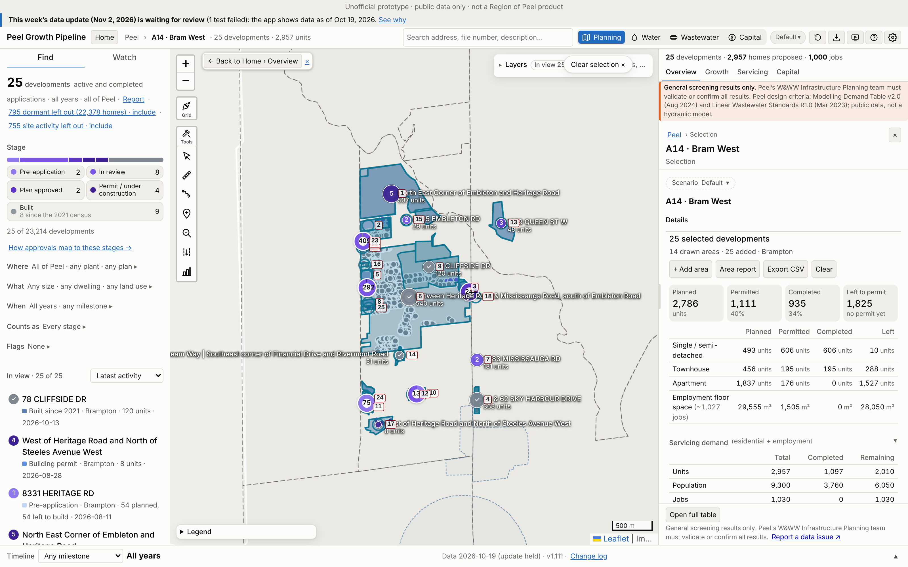
A14 · Bram West
Growth | 2021–26 | 2026–31 | To 2031 | Final
Units | 389 | 637 | 1,026 | 2,399
People | 1,362 | 1,950 | 3,312 | 7,414
Jobs | 0 | 33 | 33 | 1,027
Boundary: app application parcels (≥50% in the Region box), 211 ha (Region map 45.09 ha). 1750 STEELES AVE W counted in A15.
Region map: 3,896 people. App final growth = 190% of that. 4 of 4 Region points matched.
No. / development | Stage | Final | 2031
1 North East Corner o | Under constr. | 537 | 537
2 8957 HERITAGE RD | In review | 398 | 106
3 8654 MISSISSAUGA RD | Plan approved | 243 | 0
4 58 & 62 SKY HARBOUR | Built | 229 | 0
5 8799 HERITAGE RD | In review | 162 | 0
App screenshot: the boundary used is drawn as an app selection, with each application labelled (A14-###). Region map reference: maps/A14_Bram_West.png
Largest 5 of 25 applications (units). All: Excel sheet A14.
Peel Growth Pipeline app · snapshot 2026-10-19 · growth since the 2021 Census · screening estimate
24
Notes:
A14 Bram West: Application parcels: the app's planning applications with at least half their land in the Region box
A14-001 North East Corner of Embleton and Heritage Road | Under construction | final 537 units, to 2031 537 | C05W06.007 (Draft Approved); SPA-2025-0194 (Site Plan Approved); SPA-2022-0078 (Closed); PRE17.025 (PRE - Closed); PRE-2021-0215 (Closed)
A14-002 8957 HERITAGE RD | In review | final 398 units, to 2031 106 | OZS-2025-0004 (In Review); PRE-2022-0109 (Verification of Documents)
A14-003 8654 MISSISSAUGA RD | Plan approved | final 243 units, to 2031 0 | OZS-2025-0046 (Closed Approved); OZS-2025-0009 (Closed Approved); PRE-2024-0093 (Closed); PRE-2021-0144 (Closed); OZS-2022-0017 (Closed Approved); SPA-2025-0014 (Site Plan Agreement Prep)
A14-004 58 & 62 SKY HARBOUR DRIVE | Built | final 229 units, to 2031 0 | SPA-2021-0231 (Site Plan Approved); DPC-2022-0007 (Registered); PRE-2021-0111 (Closed); PRE-2025-0031 (Closed); SP18-019.000 (Site Plan Approved); SPA-2021-0165 (In Review)
A14-005 8799 HERITAGE RD | In review | final 162 units, to 2031 0 | OZS-2026-0006 (In Review-Public Mtg Complete); PRE-2022-0172 (Closed); PRE16.035 (PRE - Closed)
A14-006 Between Heritage Road & Mississauga Road, south of Embleton Road | Built | final 154 units, to 2031 154 | PRE17.071 (PRE - Closed)
A14-007 8383 MISSISSAUGA RD | In review | final 131 units, to 2031 0 | OZS-2023-0007 (Under Appeal); PRE-2022-0034 (Closed); PRE-2020-0083 (Closed); PRE-2019-0056 (Closed)
A14-008 8671 HERITAGE RD | In review | final 122 units, to 2031 0 | OZS-2022-0002 (In Review-Public Mtg Complete); PRE-2019-0070 (Closed); PRE17.013 (PRE - Closed); PRE16.076 (PRE - Closed)
A14-009 78 CLIFFSIDE DR | Built | final 88 units, to 2031 88 | OZS-2020-0011 (Closed Approved); PRE17.070 (PRE - Closed)
A14-010 OZS-2026-0019 | In review | final 76 units, to 2031 21 | OZS-2026-0019 (In Review-Pre Public Meeting); PRE-2026-0003 (Closed)
A14-011 8273 HERITAGE RD | Pre-application | final 75 units, to 2031 21 | PRE-2024-0028 (Comments Released)
A14-012 8331 HERITAGE RD | Pre-application | final 54 units, to 2031 13 | PRE-2026-0033 (Comments Released)
A14-013 1879 QUEEN ST W | Plan approved | final 48 units, to 2031 35 | OZS-2020-0036 (Draft Approved); PRE-2020-0020 (Closed)
A14-014 1-39 Summerbeam Way | Southeast corner of Financial Drive and Rivermont Road | Built | final 31 units, to 2031 31 | SP18-035.000 (Site Plan Approved); DPC-2021-0004 (Registered); PRE-2021-0069 (Closed); PRE16.094 (PRE - Closed)
A14-015 2305 EMBLETON RD | In review | final 29 units, to 2031 0 | OZS-2025-0021 (In Review-Public Mtg Complete); PRE-2022-0055 (Closed)
A14-016 8821 Heritage Road | Under construction | final 8 units, to 2031 8 | C05W05.010 (Closed Approved); PRE17.136 (Closed)
A14-017 West of Heritage Road and North of Steeles Avenue West | Building permit | final 8 units, to 2031 8 | PRE18.026 (Submitted)
A14-018 8627 MISSISSAUGA RD | In review | final 1 units, to 2031 0 | OZS-2023-0037 (Closed Approved); PRE-2022-0083 (Closed)
A14-019 8885 HERITAGE RD | Built | final 1 units, to 2031 1 | SPA-2021-0155 (Site Plan Approved)
A14-020 8889 HERITAGE RD | Built | final 1 units, to 2031 1 | SPA-2021-0154 (Site Plan Approved)
A14-021 8893 HERITAGE RD | Built | final 1 units, to 2031 1 | SPA-2021-0153 (Site Plan Approved)
A14-022 8897 HERITAGE RD | Built | final 1 units, to 2031 1 | SPA-2021-0152 (Site Plan Approved)
A14-023 8901 HERITAGE RD | Built | final 1 units, to 2031 1 | SPA-2021-0151 (Site Plan Approved)
A14-024 Heritage block · 2 draft / site plans | In review | final 0 units, to 2031 0 | OZS-2024-0031 (Closed Approved); SPA-2025-0171 (In Review); PRE-2025-0006 (Closed); SPA-2025-0170 (In Review)
A14-025 8645 HERITAGE RD | Building permit | final 0 units, to 2031 0 | SPA-2023-0054 (Site Plan Approved); PRE-2022-0100 (Closed)

Slide 25
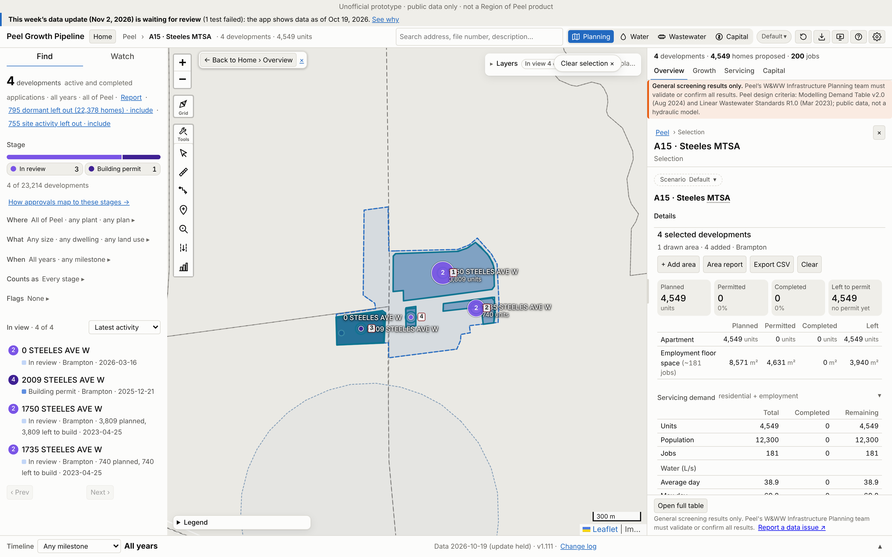
A15 · Steeles MTSA
Growth | 2021–26 | 2026–31 | To 2031 | Final
Units | 0 | 0 | 0 | 4,549
People | 0 | 0 | 0 | 12,282
Jobs | 0 | 93 | 93 | 181
Boundary: the whole Steeles at Mississauga MTSA, 56 ha (Region map 13.76 ha).
Region map: 12,793 people. App final growth = 96% of that. 1 of 1 Region points matched.
No. / development | Stage | Final | 2031
1 1750 STEELES AVE W | In review | 3,809 | 0
2 1735 STEELES AVE W | In review | 740 | 0
3 2009 STEELES AVE W | Building permit | 0 | 0
4 0 STEELES AVE W | In review | 0 | 0
App screenshot: the boundary used is drawn as an app selection, with each application labelled (A15-###). Region map reference: maps/A15_Steeles_MTSA.png
Largest 4 of 4 applications (units). All: Excel sheet A15.
Peel Growth Pipeline app · snapshot 2026-10-19 · growth since the 2021 Census · screening estimate
25
Notes:
A15 Steeles MTSA: Whole MTSA: "Steeles at Mississauga (Transit Hub)" from the app (Brampton Plan MTSA layer); user direction
A15-001 1750 STEELES AVE W | In review | final 3,809 units, to 2031 0 | OZS-2023-0014 (Closed Approved); PRE-2021-0105 (Closed)
A15-002 1735 STEELES AVE W | In review | final 740 units, to 2031 0 | OZS-2023-0015 (Closed Approved); PRE-2021-0106 (Closed)
A15-003 2009 STEELES AVE W | Building permit | final 0 units, to 2031 0 | OZS-2025-0006 (M-Plan/Condition Clearance); SPA-2025-0175 (In Review); DPC-2025-0010 (In Review); PRE-2021-0013 (Closed); T05W15.004 (Closed Approved); SPA-2021-0065 (Agreement Execution); PRE-2024-0061 (Meeting Scheduled)
A15-004 0 STEELES AVE W | In review | final 0 units, to 2031 0 | SPA-2026-0038 (In Review); PRE-2022-0012 (Closed); SP17-101.000 (Submitted)

Slide 26
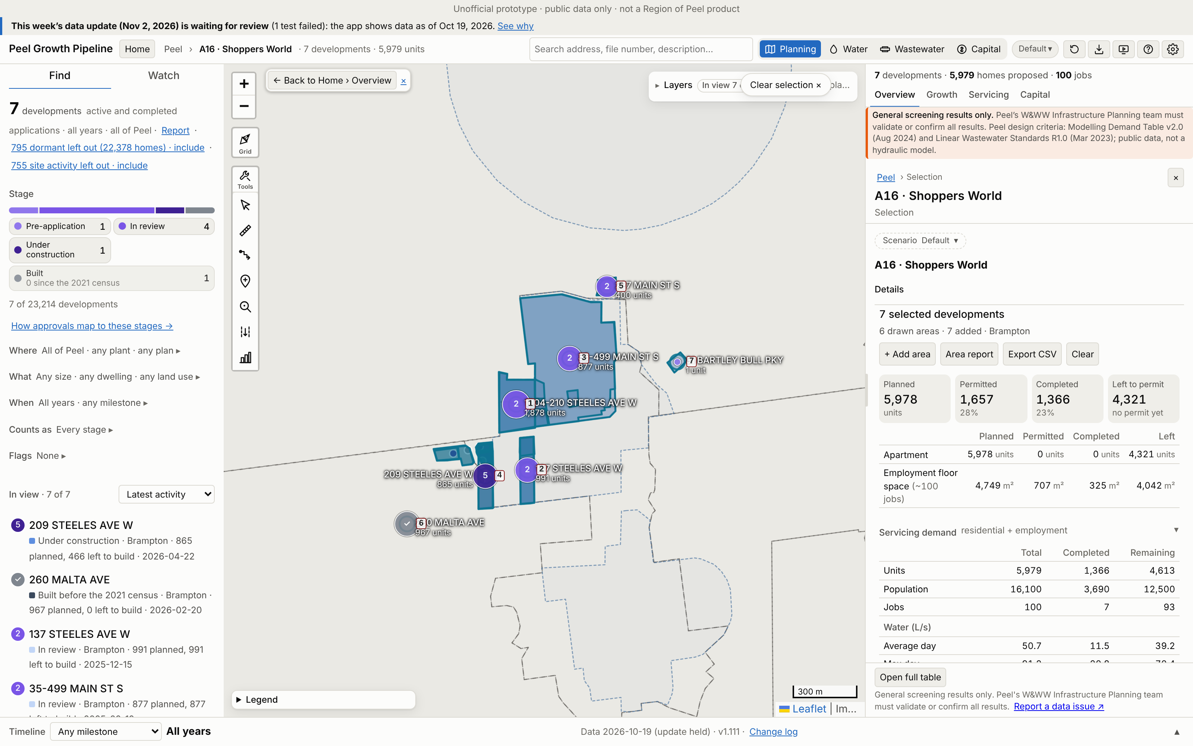
A16 · Shoppers World
Growth | 2021–26 | 2026–31 | To 2031 | Final
Units | 379 | 466 | 845 | 4,992
People | 1,023 | 1,259 | 2,282 | 13,479
Jobs | 0 | 19 | 19 | 93
Boundary: app application parcels (≥50% in the Region box), 32 ha (Region map 23.62 ha).
Region map: 20,732 people. App final growth = 65% of that. 4 of 4 Region points matched.
No. / development | Stage | Final | 2031
1 1004-210 STEELES AV | In review | 1,878 | 0
2 137 STEELES AVE W | In review | 991 | 0
3 35-499 MAIN ST S | In review | 877 | 0
4 209 STEELES AVE W | Under constr. | 496 | 496
5 227 MAIN ST S | In review | 400 | 0
App screenshot: the boundary used is drawn as an app selection, with each application labelled (A16-###). Region map reference: maps/A16_Shoppers_World.png
Largest 5 of 7 applications (units). All: Excel sheet A16.
Peel Growth Pipeline app · snapshot 2026-10-19 · growth since the 2021 Census · screening estimate
26
Notes:
A16 Shoppers World: Application parcels: the app's planning applications with at least half their land in the Region box
A16-001 1004-210 STEELES AVE W | In review | final 1,878 units, to 2031 0 | OZS-2022-0023 (Closed Approved); SPA-2024-0169 (In Review); PRE-2024-0078 (Verification of Documents); PRE-2020-0048 (Closed)
A16-002 137 STEELES AVE W | In review | final 991 units, to 2031 0 | OZS-2025-0019 (Deemed Complete); OZS-2024-0040 (Closed Approved); PRE-2024-0032 (Closed); PRE-2021-0088 (Closed); OZS-2023-0018 (Closed Approved); SPA-2025-0193 (In Review)
A16-003 35-499 MAIN ST S | In review | final 877 units, to 2031 0 | OZS-2019-0009 (In Review); SPA-2025-0024 (Site Plan Approved); SPA-2024-0104 (In Review); SPA-2022-0120 (In Review); PRE-2020-0032 (Closed); PRE18.049 (Closed)
A16-004 209 STEELES AVE W | Under construction | final 496 units, to 2031 496 | OZS-2021-0032 (Closed Approved); SPA-2026-0056 (In Review); SPA-2025-0059 (Site Plan Approved); SPA-2025-0026 (Site Plan Approved); SPA-2024-0129 (Site Plan Approved); SPA-2021-0230 (Site Plan Approved); SP16-091.000 (Approved); DPC-2025-0009 (Registration); PRE-2021-0029 (Closed); PRE-2021-0026 (Closed); PRE16.072 (PRE - Closed); T01W15.038 (Registered); PRE19.026 (Closed); OZS-2020-0028 (Closed Approved); OZS-2019-0005 (Withdrawn); SPA-2023-0140 (Site Plan Approved); SPA-2020-0152 (Site Plan Approved); DPC-2024-0002 (Registered); PRE-2020-0053 (Closed); PRE-2020-0054 (Closed); SP19-031.000 (Withdrawn); SP18-010.000 (Withdrawn)
A16-005 227 MAIN ST S | In review | final 400 units, to 2031 0 | OZS-2021-0056 (Closed Approved); PRE-2020-0074 (Closed); PRE-2024-0095 (Meeting Scheduled)
A16-006 260 MALTA AVE | Built | final 349 units, to 2031 349 | SPA-2024-0085 (In Review); SPA-2021-0143 (Site Plan Approved); DPC-2023-0005 (Registered); PRE-2023-0103 (Closed); PRE-2021-0076 (Closed); PRE17.131 (Closed)
A16-007 31 BARTLEY BULL PKY | Pre-application | final 1 units, to 2031 0 | PRE-2024-0134 (Comments Released)

Slide 27
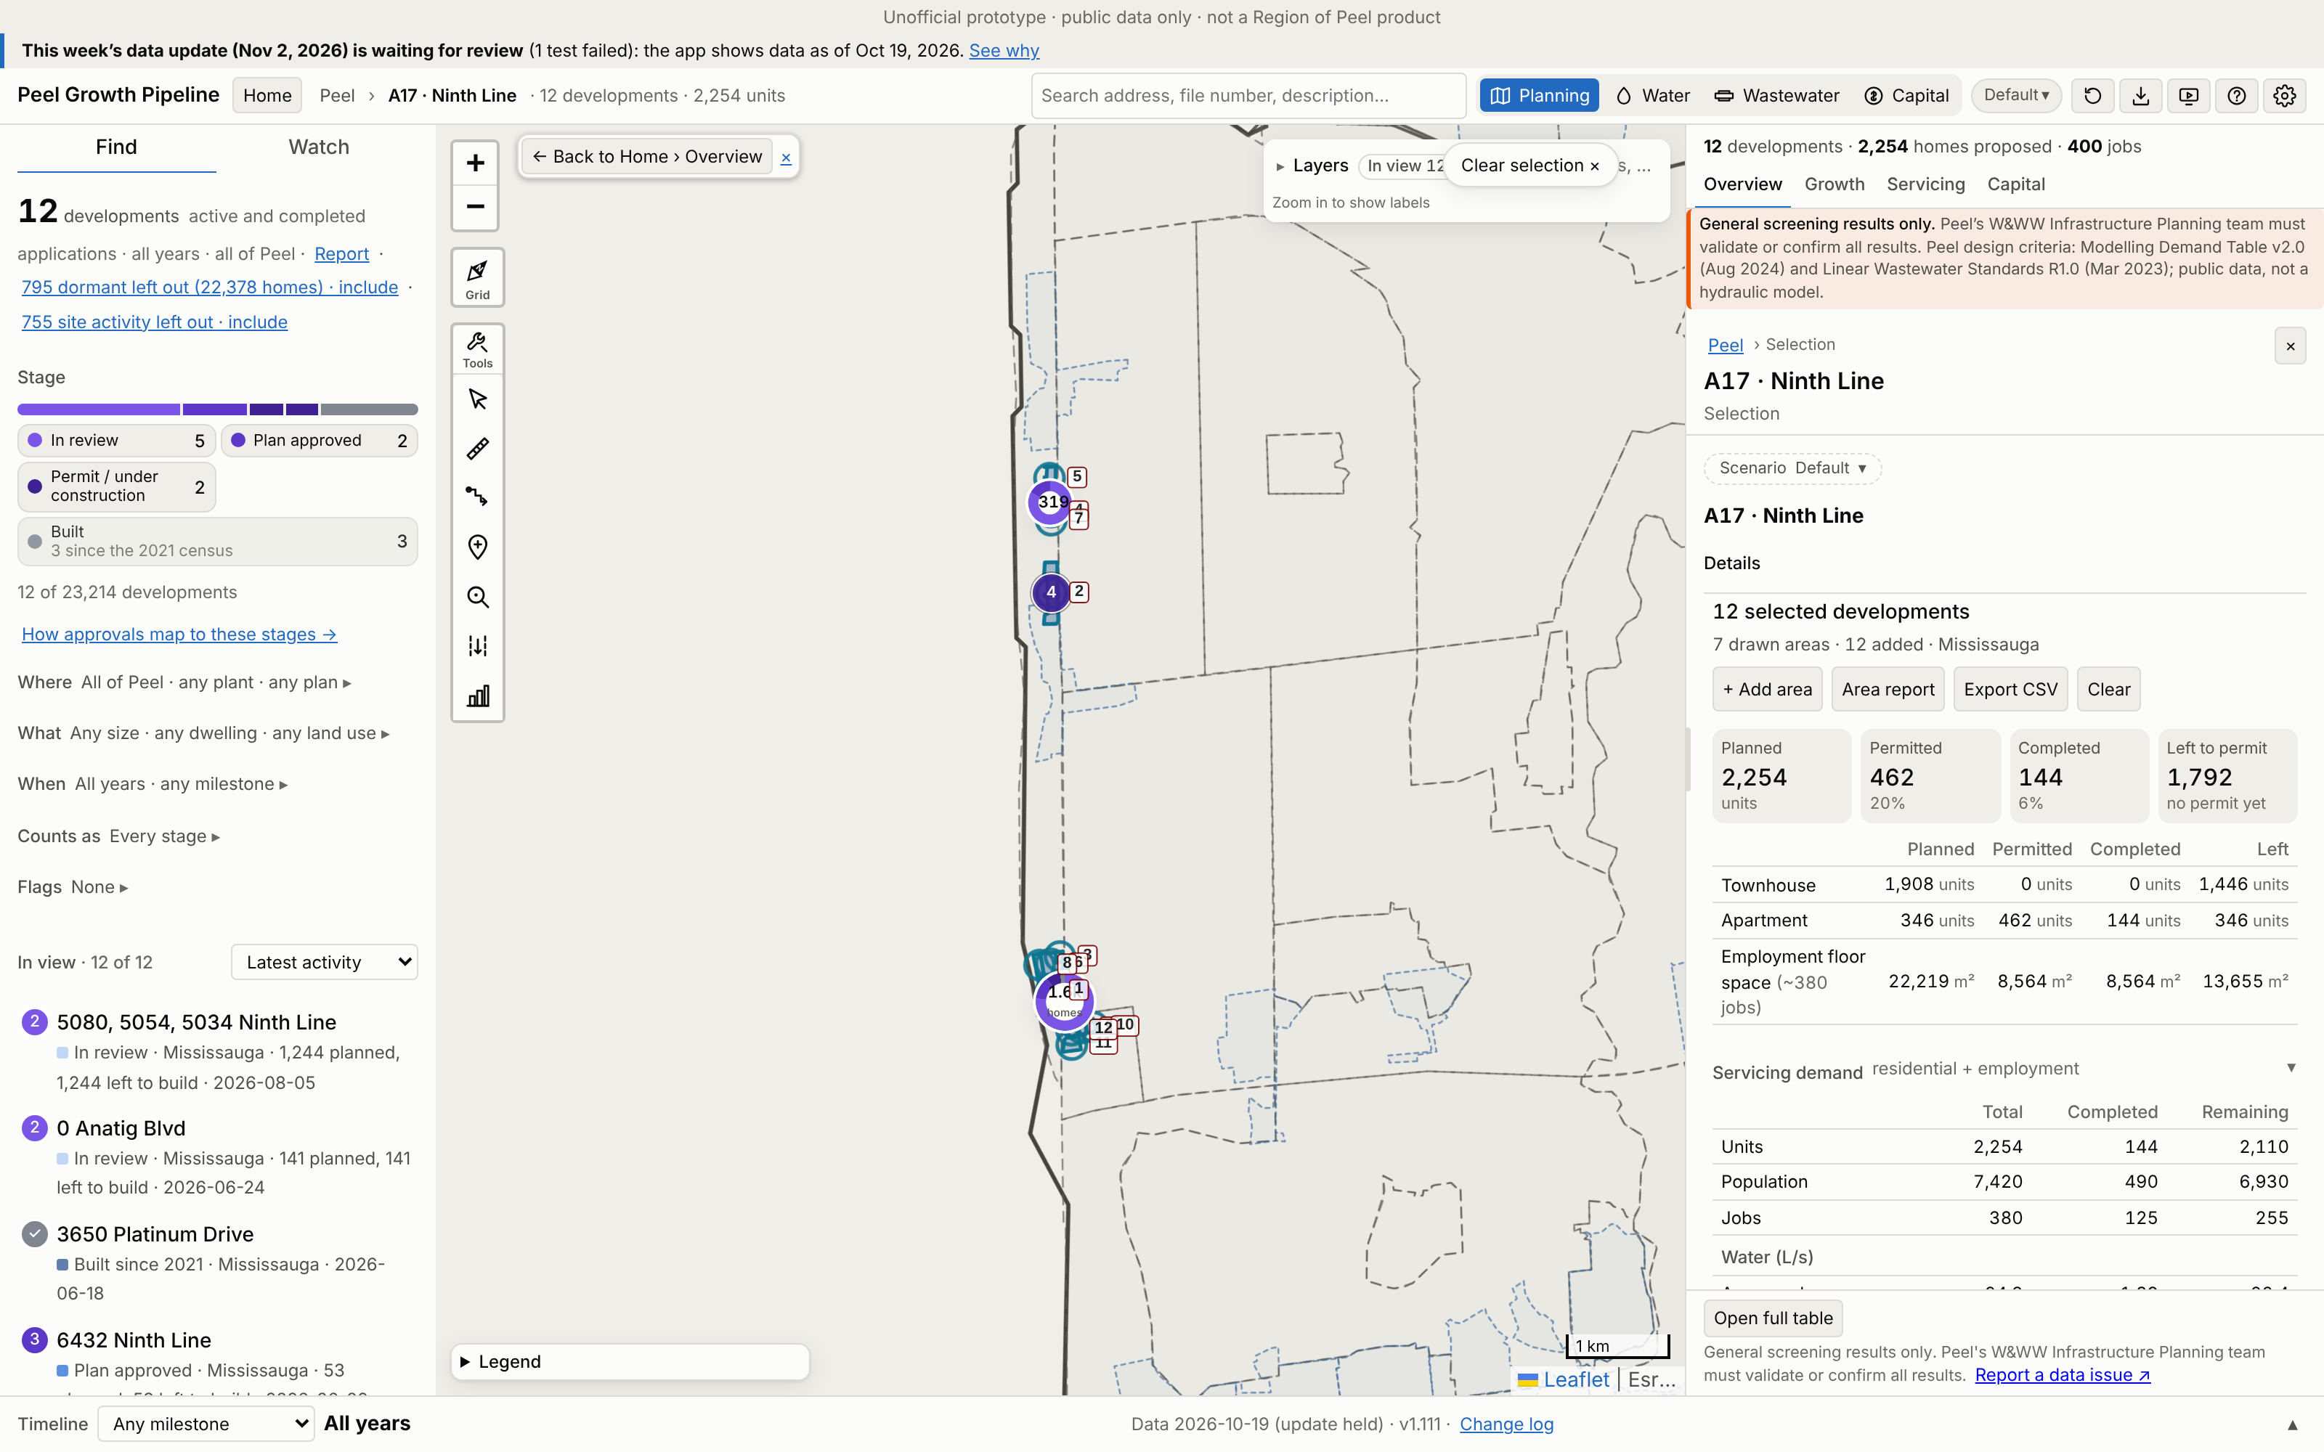
A17 · Ninth Line
Growth | 2021–26 | 2026–31 | To 2031 | Final
Units | 144 | 1,700 | 1,844 | 2,254
People | 489 | 5,555 | 6,043 | 7,421
Jobs | 125 | 10 | 135 | 380
Boundary: app application parcels (≥50% in the Region box), 28 ha (Region map 38.45 ha).
Region map: 9,058 people. App final growth = 82% of that. 3 of 3 Region points matched.
No. / development | Stage | Final | 2031
1 5080, 5054, 5034 Ni | In review | 1,244 | 903
2 6432 Ninth Line | Building permit | 318 | 292
3 5160 Ninth Line, 0 | Plan approved | 205 | 199
4 0 Anatig Blvd | In review | 141 | 122
5 6578 and 6432 Ninth | In review | 125 | 108
App screenshot: the boundary used is drawn as an app selection, with each application labelled (A17-###). Region map reference: maps/A17_Ninth_Line.png
Largest 5 of 12 applications (units). All: Excel sheet A17.
Peel Growth Pipeline app · snapshot 2026-10-19 · growth since the 2021 Census · screening estimate
27
Notes:
A17 Ninth Line: Application parcels: the app's planning applications with at least half their land in the Region box
A17-001 5080, 5054, 5034 Ninth Line | In review | final 1,244 units, to 2031 903 | 21T-M 21-4 (WITHHELD); OZ/OPA 21-15 (WITHHELD); SP 26-27 (APPLICATION IN PROCESS)
A17-002 6432 Ninth Line | Building permit | final 318 units, to 2031 292 | SP 24-50 (APPROVED); 21CDM-M 26-9 (APPLICATION IN PROCESS)
A17-003 5160 Ninth Line, 0 Ninth Line and 5170 Ninth Line | Plan approved | final 205 units, to 2031 199 | OZ 22-4 (APPROVED); SP 24/20 (Approved)
A17-004 0 Anatig Blvd | In review | final 141 units, to 2031 122 | SP 26-8 (WITHHELD); OZ 26-11 (APPLICATION IN PROCESS)
A17-005 6578 and 6432 Ninth Line | In review | final 125 units, to 2031 108 | SP 26-1 (WITHHELD); OZ 26-6 (APPLICATION IN PROCESS)
A17-006 5150 Ninth Line | Under construction | final 122 units, to 2031 121 | SP 20/084 (Approved)
A17-007 6432 Ninth Line | Plan approved | final 53 units, to 2031 52 | SP 25-39 (APPROVED)
A17-008 5150 Ninth Line | Built | final 46 units, to 2031 46 | SP 22/158 (Approved)
A17-009 3645 PLATINUM DR | In review | final 0 units, to 2031 0 | SP 24-49 (WITHHELD)
A17-010 3575 Platinum Drive | In review | final 0 units, to 2031 0 | SP 25-40 (WITHHELD)
A17-011 3650 Platinum Drive | Built | final 0 units, to 2031 0 | SP 21/096 (Approved)
A17-012 3663 Platinum Drive | Built | final 0 units, to 2031 0 | SP 16/029 (Approved)

Slide 28
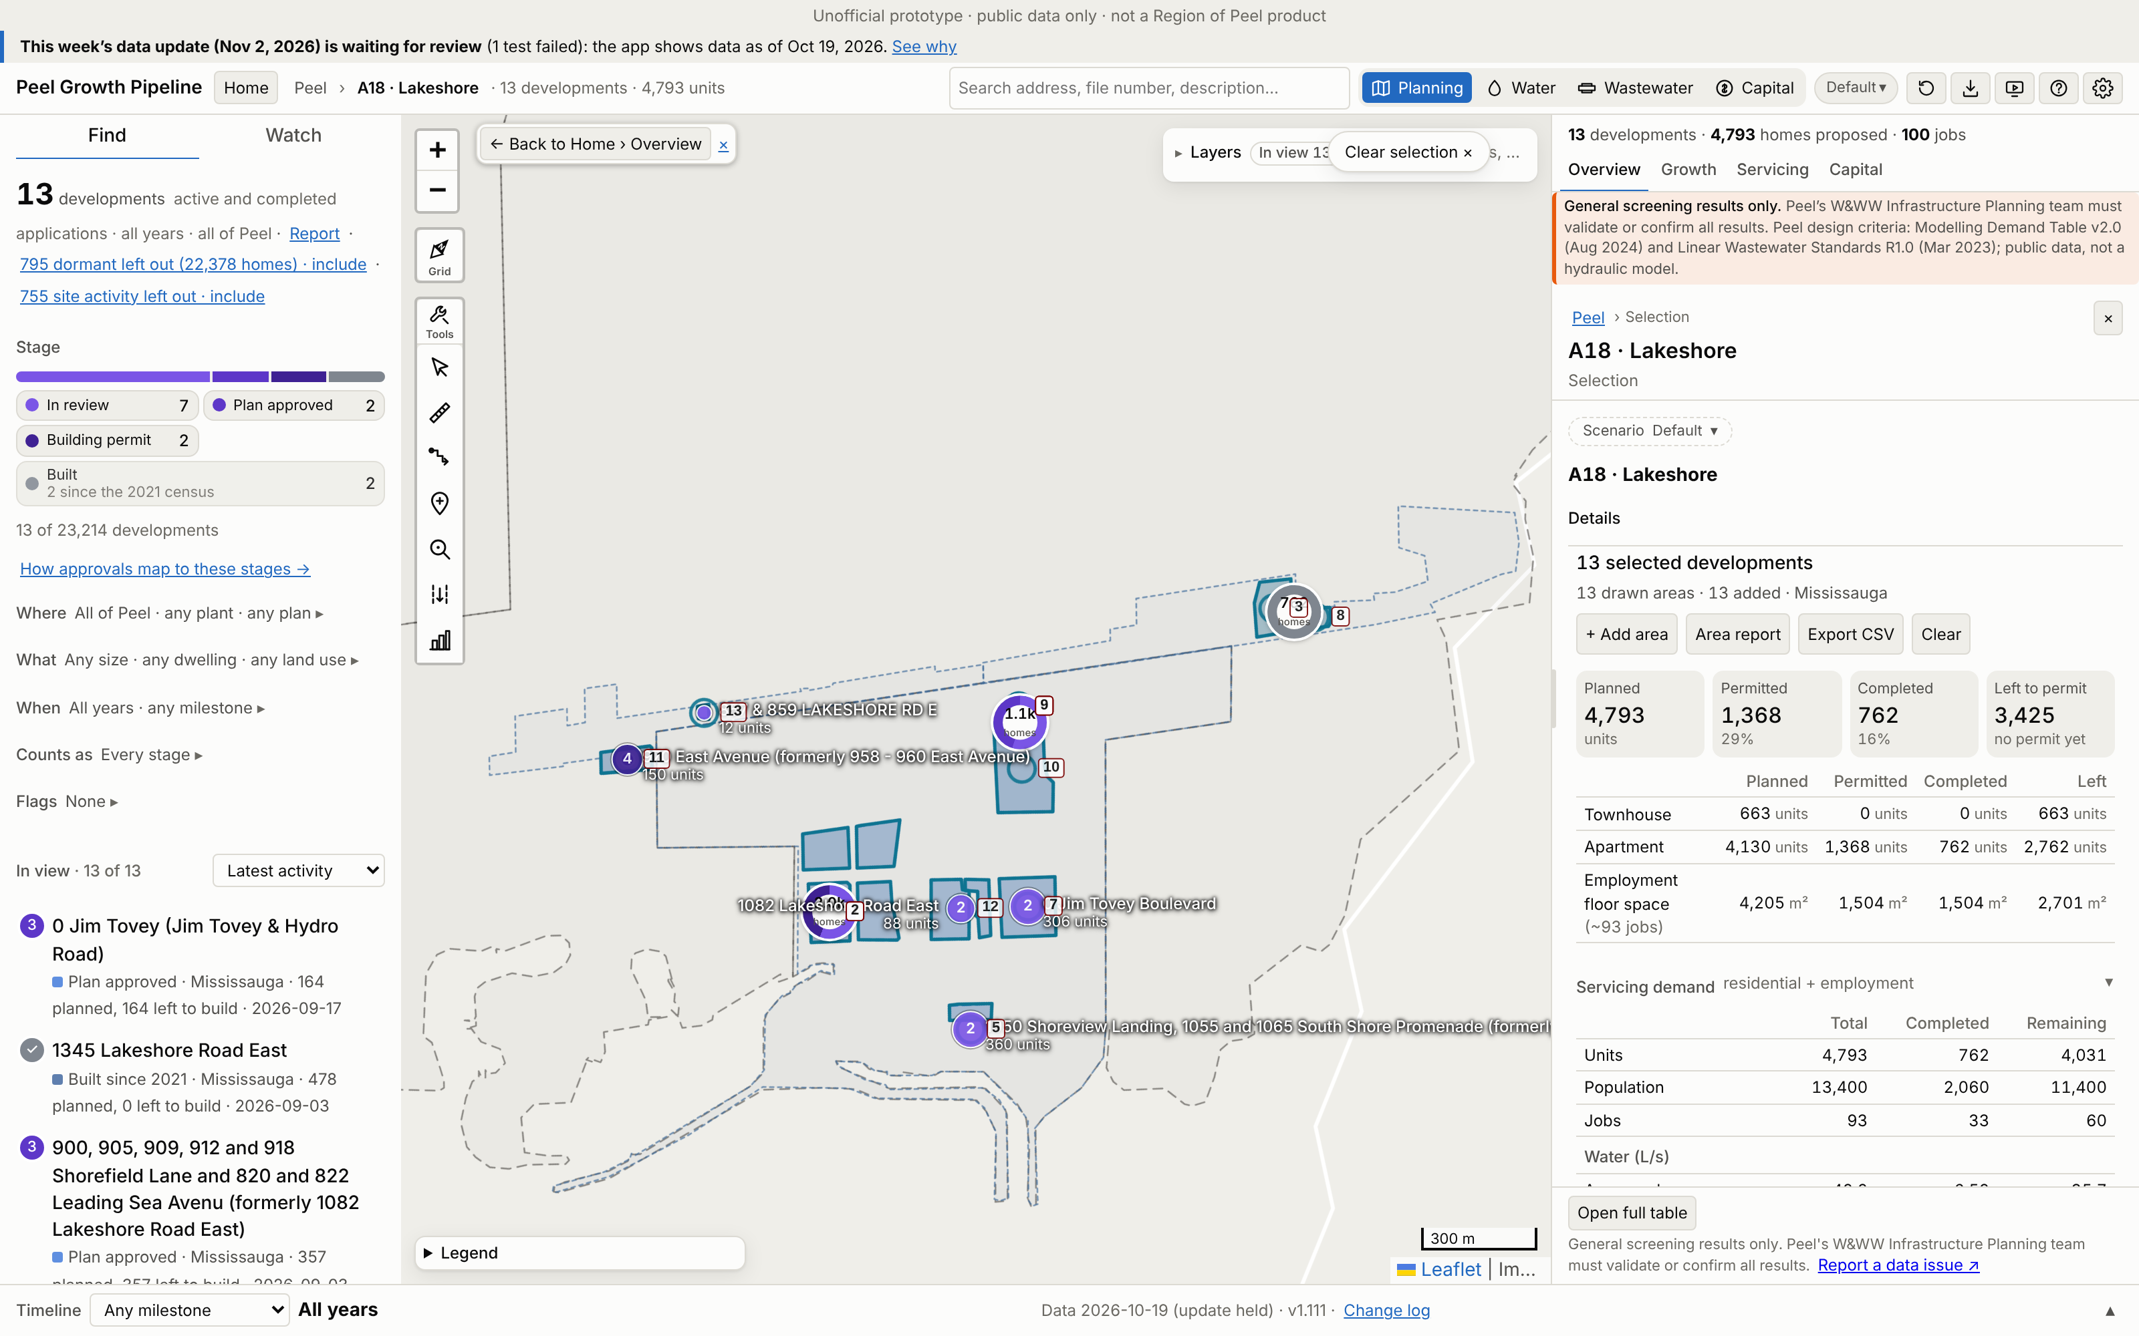
A18 · Lakeshore
Growth | 2021–26 | 2026–31 | To 2031 | Final
Units | 762 | 3,404 | 4,166 | 4,793
People | 2,057 | 9,617 | 11,675 | 13,410
Jobs | 33 | 42 | 75 | 93
Boundary: app application parcels (≥50% in the Region box), 16 ha (Region map 62.08 ha).
Region map: 69,769 people. App final growth = 19% of that. 2 of 2 Region points matched.
No. / development | Stage | Final | 2031
1 950 Aerodrome Avenu | In review | 1,100 | 663
2 910 Aerodrome Avenu | Building permit | 865 | 830
3 1345 Lakeshore Road | Built | 478 | 478
4 830 Cove View, 821 | In review | 365 | 341
5 1050 Shoreview Land | In review | 360 | 336
App screenshot: the boundary used is drawn as an app selection, with each application labelled (A18-###). Region map reference: maps/A18_Lakeshore.png
Largest 5 of 13 applications (units). All: Excel sheet A18.
Peel Growth Pipeline app · snapshot 2026-10-19 · growth since the 2021 Census · screening estimate
28
Notes:
A18 Lakeshore: Application parcels: the app's planning applications with at least half their land in the Region box
A18-001 950 Aerodrome Avenue,750 Cove View, 705 Leading Sea Ave and 975 Marina Vista (formerly 985 Hydro Road) | In review | final 1,100 units, to 2031 663 | SP 24-15 (WITHHELD)
A18-002 910 Aerodrome Avenue and 700 Leading Sea Avenue (formerly 1082 Lakeshore Road East) | Building permit | final 865 units, to 2031 830 | SP 21/168 (Approved)
A18-003 1345 Lakeshore Road East | Built | final 478 units, to 2031 478 | SP 21-143 (APPROVED); 21CDM-M 26-3 (WITHHELD)
A18-004 830 Cove View, 821 & 823 Leading Sea Avenue, 930, 940, 955 & 965 Headwind Lane, 830 Cove View (formerly 1082 Lakeshore Road East) | In review | final 365 units, to 2031 341 | SP 22-82 (WITHHELD)
A18-005 1050 Shoreview Landing, 1055 and 1065 South Shore Promenade (formerly 1082 Lakeshore Rd E) | In review | final 360 units, to 2031 336 | SP 24-19 (WITHHELD)
A18-006 900, 905, 909, 912 and 918 Shorefield Lane and 820 and 822 Leading Sea Avenu (formerly 1082 Lakeshore Road East) | Plan approved | final 357 units, to 2031 347 | SP 22-56 (APPROVED)
A18-007 0 Jim Tovey Boulevard | In review | final 306 units, to 2031 255 | SP 26-2 (WITHHELD)
A18-008 1381 Lakeshore Road East | Built | final 284 units, to 2031 284 | 21CDM-M 25-6 (APPROVED); SP 22/157 (Approved)
A18-009 1082 Lakeshore Road East | In review | final 264 units, to 2031 226 | SP 26-24 (WITHHELD)
A18-010 0 Jim Tovey (Jim Tovey & Hydro Road) | Plan approved | final 164 units, to 2031 164 | SP 25-48 (APPROVED); 21CDM-M 26-12 (APPLICATION IN PROCESS)
A18-011 970 East Avenue (formerly 958 - 960 East Avenue) | Building permit | final 150 units, to 2031 146 | SP 24-35 (APPROVED)
A18-012 1082 Lakeshore Road East | In review | final 88 units, to 2031 85 | SP 25-68 (WITHHELD)
A18-013 857 & 859 LAKESHORE RD E | In review | final 12 units, to 2031 12 | SP 24-51 (WITHHELD)

Slide 29
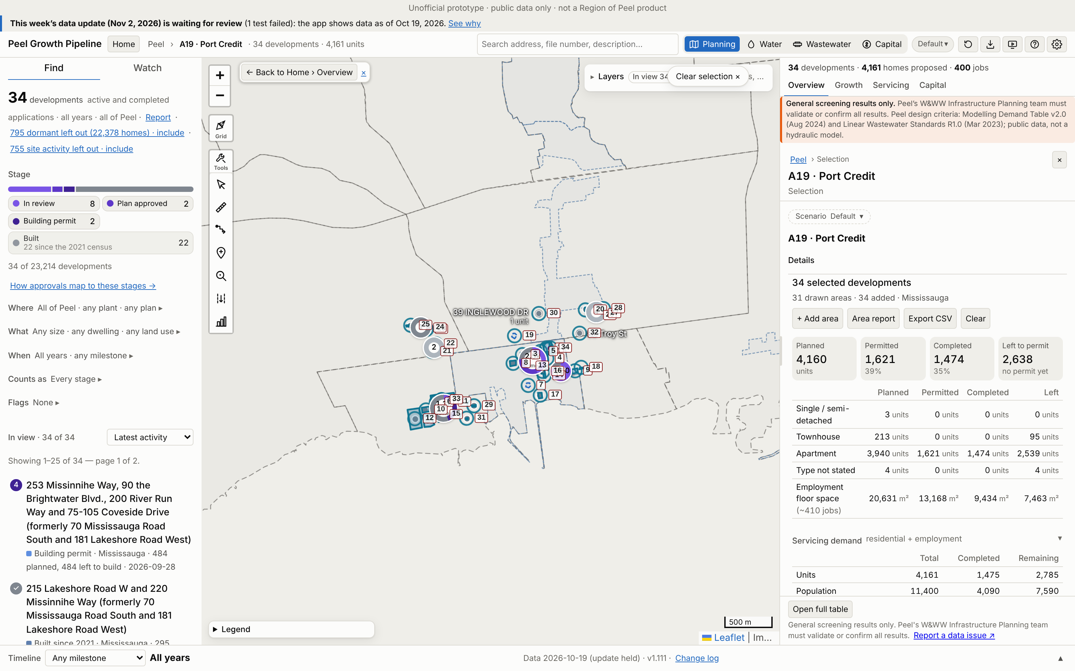
A19 · Port Credit
Growth | 2021–26 | 2026–31 | To 2031 | Final
Units | 1,416 | 2,571 | 3,987 | 4,201
People | 3,925 | 7,009 | 10,934 | 11,514
Jobs | 210 | 187 | 397 | 410
Boundary: app application parcels (≥50% in the Region box), 13 ha (Region map 21.98 ha).
Region map: 19,441 people. App final growth = 59% of that. 3 of 3 Region points matched.
No. / development | Stage | Final | 2031
1 88 Park Street East | Plan approved | 819 | 752
2 253 Missinnihe Way, | Building permit | 484 | 445
3 46 Park Street East | In review | 444 | 409
4 19 Ann Street | In review | 362 | 338
5 28 Ann Street (form | Built | 359 | 359
App screenshot: the boundary used is drawn as an app selection, with each application labelled (A19-###). Region map reference: maps/A19_Port_Credit.png
Largest 5 of 34 applications (units). All: Excel sheet A19.
Peel Growth Pipeline app · snapshot 2026-10-19 · growth since the 2021 Census · screening estimate
29
Notes:
A19 Port Credit: Application parcels: the app's planning applications with at least half their land in the Region box
A19-001 88 Park Street East | Plan approved | final 819 units, to 2031 752 | SP 25-5 (Active); OZ/OPA 22-10 (APPROVED)
A19-002 253 Missinnihe Way, 90 the Brightwater Blvd., 200 River Run Way and 75-105 Coveside Drive (formerly 70 Mississauga Road South and 181 Lakeshore Road West) | Building permit | final 484 units, to 2031 445 | SP 21-130 (WITHHELD)
A19-003 46 Park Street East | In review | final 444 units, to 2031 409 | SP 25-10 (WITHHELD); OZ/OPA 25-10 (APPROVED)
A19-004 19 Ann Street | In review | final 362 units, to 2031 338 | SP 25-6 (WITHHELD); OZ/OPA 22-3 (APPROVED)
A19-005 28 Ann Street (formerly 78 Park Street East and 22-28 Ann Street) | Built | final 359 units, to 2031 359 | SP 20/051 (Approved)
A19-006 215 Lakeshore Road W and 220 Missinnihe Way (formerly 70 Mississauga Road South and 181 Lakeshore Road West) | Built | final 311 units, to 2031 311 | SP 19/155 (Approved)
A19-007 91,93 & 99 Lakeshore Rd E and 42 Port St and 0 Port St E | In review | final 221 units, to 2031 213 | OZ/OPA 22-30 (WITHHELD)
A19-008 21, 25, 29 Park Street East | Built | final 204 units, to 2031 204 | SP 18/073 (Approved)
A19-009 170 Lakeshore Rd E | In review | final 184 units, to 2031 160 | SP 26-21 (APPLICATION IN PROCESS); OZ/OPA 21-16 (OMB APPEAL)
A19-010 55 Coveside Drive (formerly 70 Mississauga Road South) | Built | final 174 units, to 2031 174 | SP 21/021 (Approved); 21CDM-M 24-16 (REGISTERED)
A19-011 200 Missinnihe Way (formerly 70 Mississauga Road South) | Built | final 150 units, to 2031 150 | SP 21/187 (Approved)
A19-012 10 - 60 Lou Parsons Way (formerly Masonry Way ) | Built | final 106 units, to 2031 106 | SP 20/048 (Approved); 21CDM-M 23-16 (REGISTERED)
A19-013 50 High Street East | In review | final 96 units, to 2031 93 | SP 26-6 (WITHHELD); OZ 25-19 (APPROVED)
A19-014 128 Lakeshore Rd East | In review | final 70 units, to 2031 61 | SP 26-20 (WITHHELD); OZ/OPA 22-5 (APPROVED)
A19-015 1, 2, 8, 10, 11 and 18 Ships Landing Place and 20 and 30 Pierview Way (formerly 215-231 Missinnihe Way) | In review | final 70 units, to 2031 67 | SP 22-103 (WITHHELD)
A19-016 8 Ann St, 77 & 81 High St E (formerly 6, 8 and 10 Ann St) | Built | final 68 units, to 2031 68 | SP 16/036 (Approved)
A19-017 55 Port Street East | Built | final 31 units, to 2031 31 | SP 20/025 (Approved)
A19-018 7 Elmwood Avenue North | In review | final 25 units, to 2031 24 | SP 26-12 (WITHHELD)
A19-019 1148 Mona Road | Plan approved | final 10 units, to 2031 10 | OZ/OPA 25-2 (APPROVED); H-OZ 25 5 (Withheld)
A19-020 109 Angelene St | Built | final 1 units, to 2031 1 | SPI 17/032 (Approved)
A19-021 1143 KANE RD | Built | final 1 units, to 2031 1 | SPI 21/057 (Approved)
A19-022 1174 Mississauga Rd | Built | final 1 units, to 2031 1 | SPI 19/005 (Approved)
A19-023 1216 MISSISSAUGA ROAD | Built | final 1 units, to 2031 1 | SPI 17/098 (Approved)
A19-024 1222 Mississauga Road | Built | final 1 units, to 2031 1 | SPI 17/101 (Approved)
A19-025 1234 Kane Rd | Built | final 1 units, to 2031 1 | SP 20/60 (Approved)
A19-026 141 EAGLEWOOD BLVD | Built | final 1 units, to 2031 1 | SPI 21/070 (Approved)
A19-027 158 Angelene Street | Built | final 1 units, to 2031 1 | SPI 18/030 (Approved)
A19-028 169 ANGELENE ST | Built | final 1 units, to 2031 1 | SP 22/54 (Approved)
A19-029 24 John St S | Built | final 1 units, to 2031 1 | SPI 20/144 (Approved)
A19-030 39 INGLEWOOD DR | Built | final 1 units, to 2031 1 | SPI 21/175 (Approved)
A19-031 40 PETER ST S | Built | final 1 units, to 2031 1 | SPI 21/194 (Approved)
A19-032 86 Troy St | Built | final 1 units, to 2031 1 | SPI 20/030 (Approved)
A19-033 215 Lakeshore Rd W and 220 Missinihe Way (formerly 70 Mississauga Road South) | Built | final 0 units, to 2031 0 | SP 19/138 (Approved)
A19-034 50 Hurontario Street | Building permit | final 0 units, to 2031 0 | SP 21/120 (Approved)

Slide 30
Method and caveats
Every figure comes from the Peel Growth Pipeline app's own modules, run on its published snapshot.
2021 Census base: only growth from census day (2021-05-11) is counted.
Region boxes were georeferenced from the PDF by fitting municipal boundaries (~160 m).
Each development counts in one area. Building-permit-only infill is not counted.
Unofficial screening estimate from public data, not the Region's capacity ledger.
Lands with no application in the app are not counted, so the Region's figures can be higher.
Untimed applications (e.g. the Heritage / Bovaird block) add nothing by 2031.
Jobs exist only where applications state floor area.
Peel Growth Pipeline app · snapshot 2026-10-19 · growth since the 2021 Census · screening estimate
30

Slide 31
Thank you
2031 priority areas
Growth analysis
Details: the Excel workbook
Peel Growth Pipeline app · snapshot 2026-10-19 · growth since the 2021 Census · screening estimate
31

