Slide 1
Scenario 1 2031 Priority Areas: population analysis
19 areas from the Region map "4507-WW Development Application Modelling Update" (2026-05-20), crossed with the Peel Growth Pipeline app
Growth on top of the 2021 Census: units · residential population · jobs, existing 2021–2026, anticipated 2031, build-out · app snapshot 2026-10-19
Companion files: Priority_Areas_2031_Population_Analysis.xlsx · maps/A00–A19 PNG

Slide 2
81,200 units of growth since 2021; a third by 2031
81,223
247,116
28,079
units at build-out
residents at build-out
jobs at build-out
6,290 built 2021–26 · 26,522 by 2031
19,085 added 2021–26 · 83,005 by 2031
368 added 2021–26 · 12,883 by 2031
Every figure is growth on top of the 2021 Census (census day 2021-05-11). "Existing" is what was built from census day to October 2026. The 4,602 units these developments finished before census day are already in the census and are left out.
2,872 app developments fall inside the 19 boxes: 250 planning applications and 2,622 building-permit-only sites (mostly infill and lots in older registered subdivisions).
The app's build-out population is 63% of the 393,164 people printed on the Region map. The gaps are lands with no application yet: Lakeshore, SP47, McLaughlin Road and Steeles MTSA.
74 of 86 Region map points sit within 400 m of an app planning application (slide 7). The unmatched points show where the Region models growth that has no application on file.
How the files connect: area A08 = Excel sheet "A08" = slide 15 (slide 7 + area no.) = app-screens/A08_SP47_app.png. Development A08-012 is label 12 in that app screenshot. Region map reference: maps/A08_SP47.png.

Slide 3
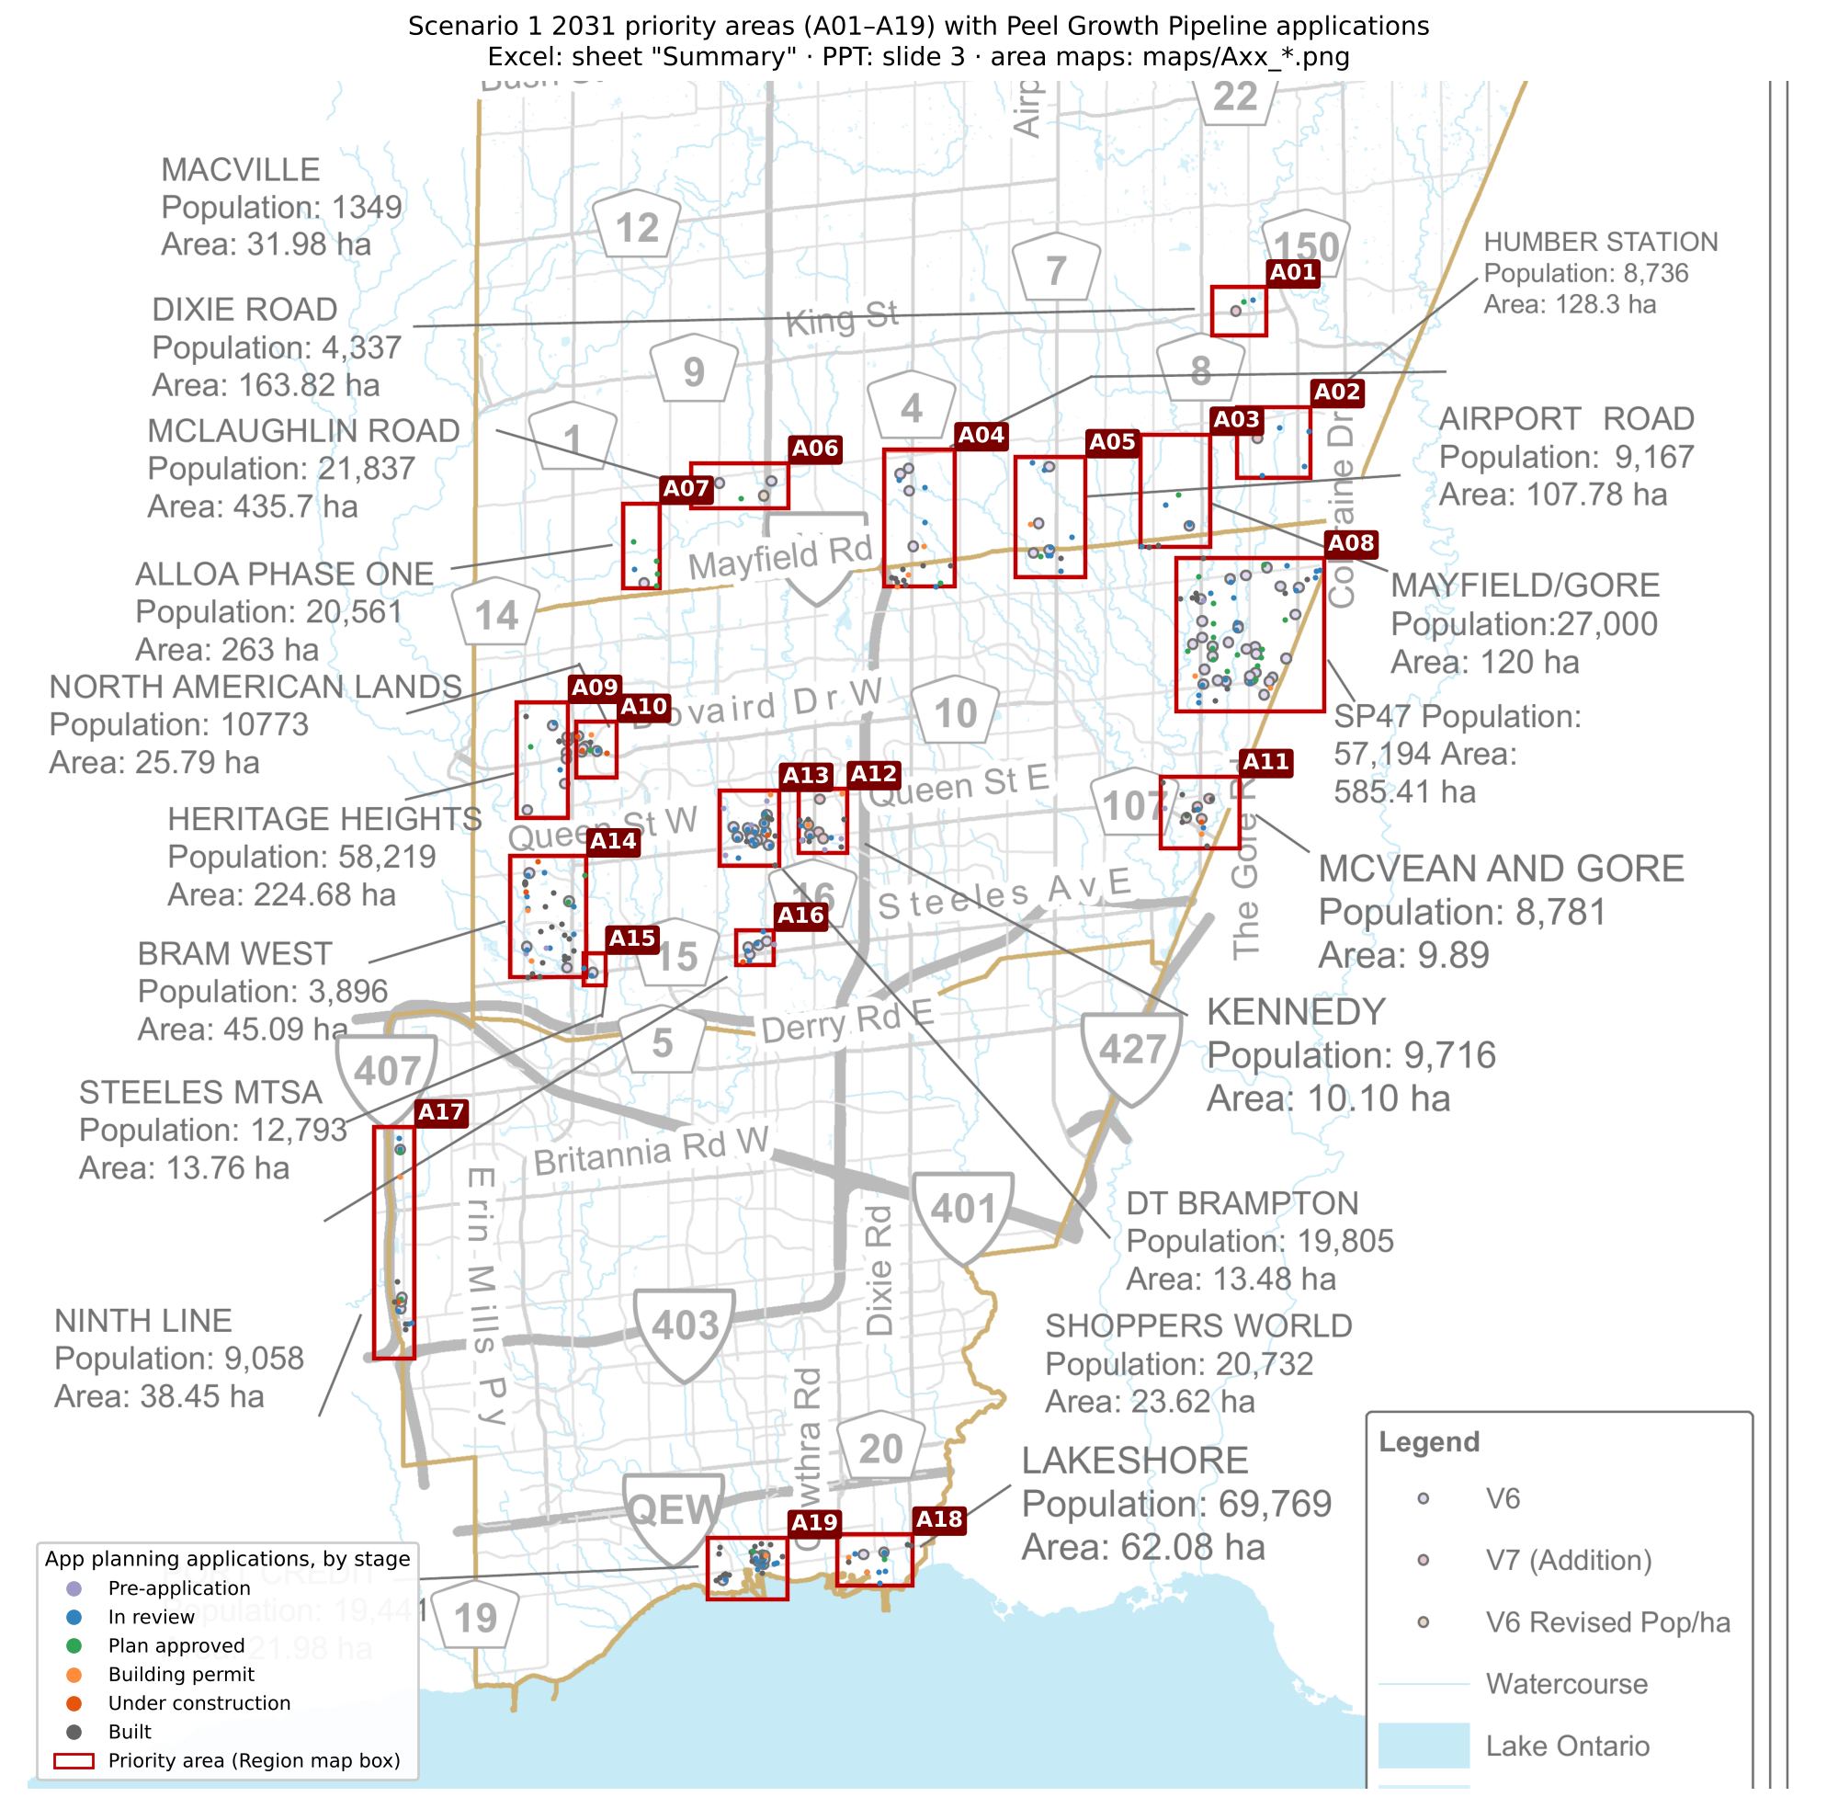
Reference: the Region map, with the app's applications plotted on it
Red boxes are the Region map boxes, georeferenced to the ground (the map is rotated about 45°, so north points up-left).
Dots are the app's planning applications, coloured by stage. Slide 4 shows the same areas in the app. Area slides 8–26 are app screenshots, with every application numbered.
A box's area in hectares is larger than the Region's stated area, because the boxes frame the sites rather than trace planning boundaries.
Names follow the map's labels and leader lines, checked against the app's plan names. Where the leader lines cross (Macville, Dixie Road, Humber Station, Airport Road), areas were named by geography.
Excel: sheet "Summary" · map file: maps/A00_overview.png

Slide 4
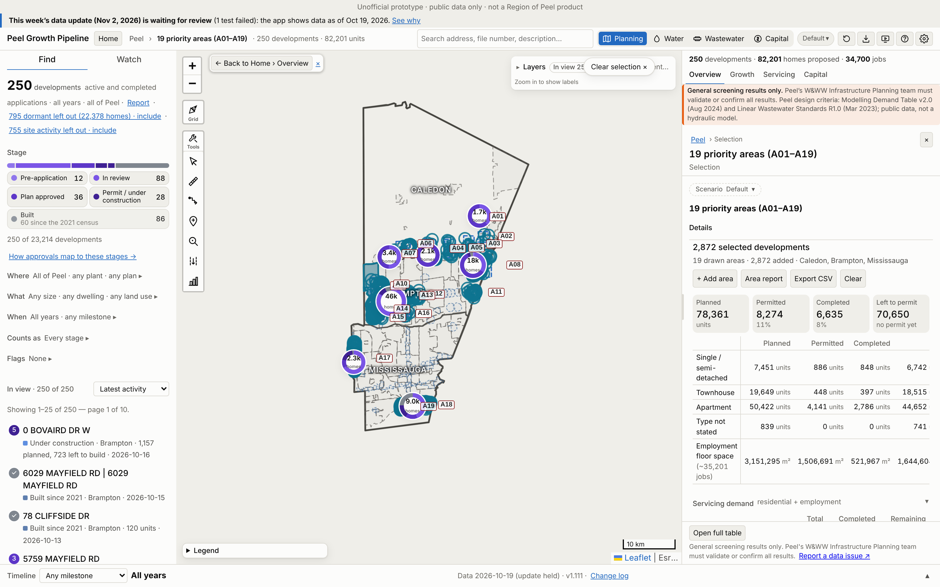
The 19 areas drawn in the app
This is the Peel Growth Pipeline's full map. Each Region box is drawn as the app's own selected area (dashed), and every development inside is selected.
The app's panel (right) shows the developments' full size, including homes built before 2021.
The figures in this deck are growth on top of the 2021 Census, worked out from the same developments.
Basemap tiles were unavailable when these were captured, so only the app's own layers show.
File: app-screens/A00_all_areas_app.png

Slide 5
Summary: growth since the 2021 Census, by area
Area | Units |  |  | Residential population |  |  | Jobs |  |  | Region map pop. | Slide
 | 2021–26 | 2021–31 | Build-out | 2021–26 | 2021–31 | Build-out | 2021–26 | 2021–31 | Build-out
A01 Macville | 0 | 1,045 | 1,716 | 0 | 4,017 | 6,217 | 0 | 94 | 130 | 1,349 | 8
A02 Humber Station | 0 | 19 | 27 | 0 | 58 | 84 | 0 | 59 | 1,840 | 8,736 | 9
A03 Mayfield/Gore | 59 | 1,520 | 3,554 | 248 | 5,826 | 13,421 | 0 | 0 | 0 | 27,000 | 10
A04 Dixie Road | 302 | 440 | 517 | 1,172 | 1,648 | 1,892 | 0 | 4,083 | 11,421 | 4,337 | 11
A05 Airport Road | 1 | 173 | 409 | 3 | 587 | 1,318 | 0 | 4,168 | 6,036 | 9,167 | 12
A06 McLaughlin Road | 127 | 974 | 2,128 | 346 | 3,476 | 7,762 | 0 | 0 | 0 | 21,837 | 13
A07 Alloa Phase One | 0 | 1,807 | 3,371 | 0 | 6,770 | 12,374 | 0 | 0 | 0 | 20,561 | 14
A08 SP47 | 51 | 1,995 | 9,542 | 214 | 6,855 | 30,782 | 0 | 2,110 | 3,263 | 57,194 | 15
A09 Heritage Heights | 518 | 518 | 15,473 | 1,650 | 1,650 | 48,895 | 0 | 113 | 113 | 58,219 | 16
A10 North American Lands | 972 | 1,971 | 4,589 | 2,845 | 5,857 | 12,928 | 0 | 187 | 265 | 10,773 | 17
A11 McVean and Gore | 773 | 1,531 | 4,549 | 2,528 | 4,659 | 12,879 | 0 | 190 | 806 | 8,781 | 18
A12 Kennedy | 109 | 527 | 4,731 | 294 | 1,433 | 12,825 | 0 | 78 | 302 | 9,716 | 19
A13 DT Brampton | 16 | 1,719 | 7,010 | 50 | 4,648 | 18,935 | 0 | 1,142 | 1,864 | 19,805 | 20
A14 Bram West | 496 | 1,134 | 6,316 | 1,794 | 3,748 | 18,134 | 0 | 33 | 1,056 | 3,896 | 21
A15 Steeles MTSA | 0 | 0 | 740 | 0 | 0 | 1,998 | 0 | 0 | 7 | 12,793 | 22
A16 Shoppers World | 30 | 496 | 4,643 | 81 | 1,340 | 12,537 | 0 | 19 | 93 | 20,732 | 23
A17 Ninth Line | 241 | 2,019 | 2,431 | 751 | 6,515 | 7,899 | 125 | 135 | 380 | 9,058 | 24
A18 Lakeshore | 817 | 4,238 | 4,866 | 2,206 | 11,875 | 13,612 | 33 | 75 | 93 | 69,769 | 25
A19 Port Credit | 1,778 | 4,396 | 4,611 | 4,904 | 12,042 | 12,626 | 210 | 397 | 410 | 19,441 | 26
Total, 19 areas | 6,290 | 26,522 | 81,223 | 19,085 | 83,005 | 247,116 | 368 | 12,883 | 28,079 | 393,164
Growth on top of the 2021 Census. 2021–26 = built from census day (2021-05-11) to Oct 2026. 2021–31 = that plus the app Forecast's 2026–2031 share of what is left to build. Build-out = 2021–26 plus everything left to build. Units finished before census day are excluded (Excel "Summary", grey columns). Blue = as printed on the Region map.

Slide 6
Most areas: the app counts fewer people than the Region map
Largest gaps (Region map minus app build-out)
A18 Lakeshore: 56,157 people
A08 SP47: 26,412 people
A06 McLaughlin Road: 14,075 people
A03 Mayfield/Gore: 13,579 people
A15 Steeles MTSA: 10,795 people
App exceeds the map
A14 Bram West: +14,238
A01 Macville: +4,868
A11 McVean and Gore: +4,098
A12 Kennedy: +3,109

Slide 7
Crosswalk: how many Region map points have an app application
Area | Region points | Matched ≤ 400 m | App planning applications | Permit-only sites | Main app plan
A01 Macville | 1 | 1 | 2 | 0 | Caledon Station
A02 Humber Station | 1 | 0 | 4 | 0 | South Simpson Industrial
A03 Mayfield/Gore | 1 | 1 | 6 | 48 | 50: Vales Of Humber
A04 Dixie Road | 4 | 2 | 16 | 920 | 48 (b): Countryside Villages
A05 Airport Road | 4 | 4 | 10 | 0 | 49: Vales Of Castlemore North
A06 McLaughlin Road | 3 | 0 | 1 | 257 | Mayfield West
A07 Alloa Phase One | 1 | 1 | 5 | 0 | Alloa
A08 SP47 | 28 | 25 | 43 | 48 | 50: Vales Of Humber
A09 Heritage Heights | 4 | 2 | 6 | 0 | 52: Heritage Heights
A10 North American Lands | 3 | 3 | 7 | 222 | 12: Credit Valley
A11 McVean and Gore | 4 | 4 | 13 | 413 | 41: Bram East
A12 Kennedy | 5 | 4 | 14 | 2 | 36: Queen Street Corridor
A13 DT Brampton | 10 | 10 | 24 | 11 | 7: Downtown Brampton
A14 Bram West | 4 | 4 | 37 | 331 | 40 (d): Bram West
A15 Steeles MTSA | 1 | 1 | 1 | 0 | 40 (c): Bram West
A16 Shoppers World | 4 | 4 | 6 | 0 | 55: Hurontario-Main Corridor
A17 Ninth Line | 3 | 3 | 13 | 179 | Churchill Meadows NHD
A18 Lakeshore | 2 | 2 | 14 | 95 | Lakeview NHD
A19 Port Credit | 3 | 3 | 28 | 96 | Port Credit NHD (West)
Region points were read off the PDF map. Where points overlap they are split by size, so counts in dense clusters are approximate.
Red = some points have no app planning application within 400 m. For those, the Region models lands that have no file in the app's open data (A06 McLaughlin Road and A02 Humber Station have none near any point).
Point-by-point detail, with each matched development ID: Excel sheet "Crosswalk". Points are the black rings on each area map.

Slide 8
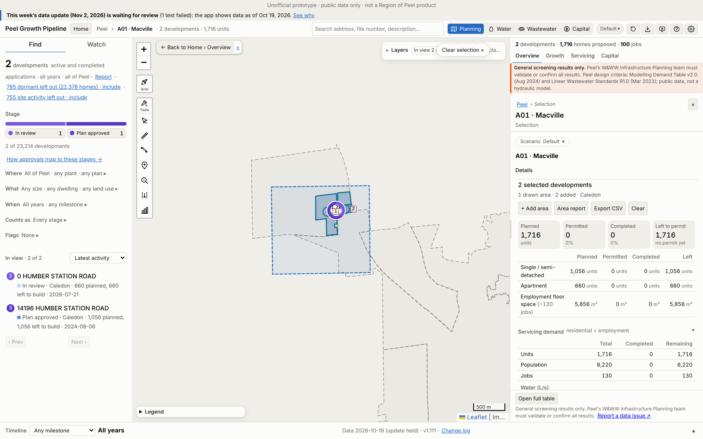
A01 · Macville
Growth | 2021–26 | 2021–31 | Build-out | Pre-2021*
Units | 0 | 1,045 | 1,716 | 0
Res. pop. | 0 | 4,017 | 6,217 | 0
Jobs | 0 | 94 | 130 | 0
*Pre-2021 = built before census day 2021-05-11, already in the 2021 Census (not added).
Region map: 1,349 people on 31.98 ha. App build-out = 461% of that.
2 developments: 2 planning applications and 0 permit-only (Caledon 2). 1 of 1 Region points matched.
No. / development | Stage | Units | 2021–31
1 14196 HUMBER STATION RO… | Plan approved | 1,056 | 797
2 0 HUMBER STATION ROAD | In review | 660 | 248
App screenshot: Peel Growth Pipeline full map. Dashed = the area as an app selection; labels = development no. (A01-###). The app's panel shows the developments' full size, pre-2021 included. Region map reference: maps/A01_Macville.png
Largest 2 of 2 applications by units, as growth since 2021. Every development: Excel sheet "A01"
Notes:
A01 Macville. Planning applications in the area (ID, title, stage, units build-out, files):
A01-001 14196 HUMBER STATION ROAD | Plan approved | 1,056 units | 21T-24006C (Draft Approved (parent))
A01-002 0 HUMBER STATION ROAD | In review | 660 units | 2026-0010 (New); 2026-0014 (Circulation)

Slide 9
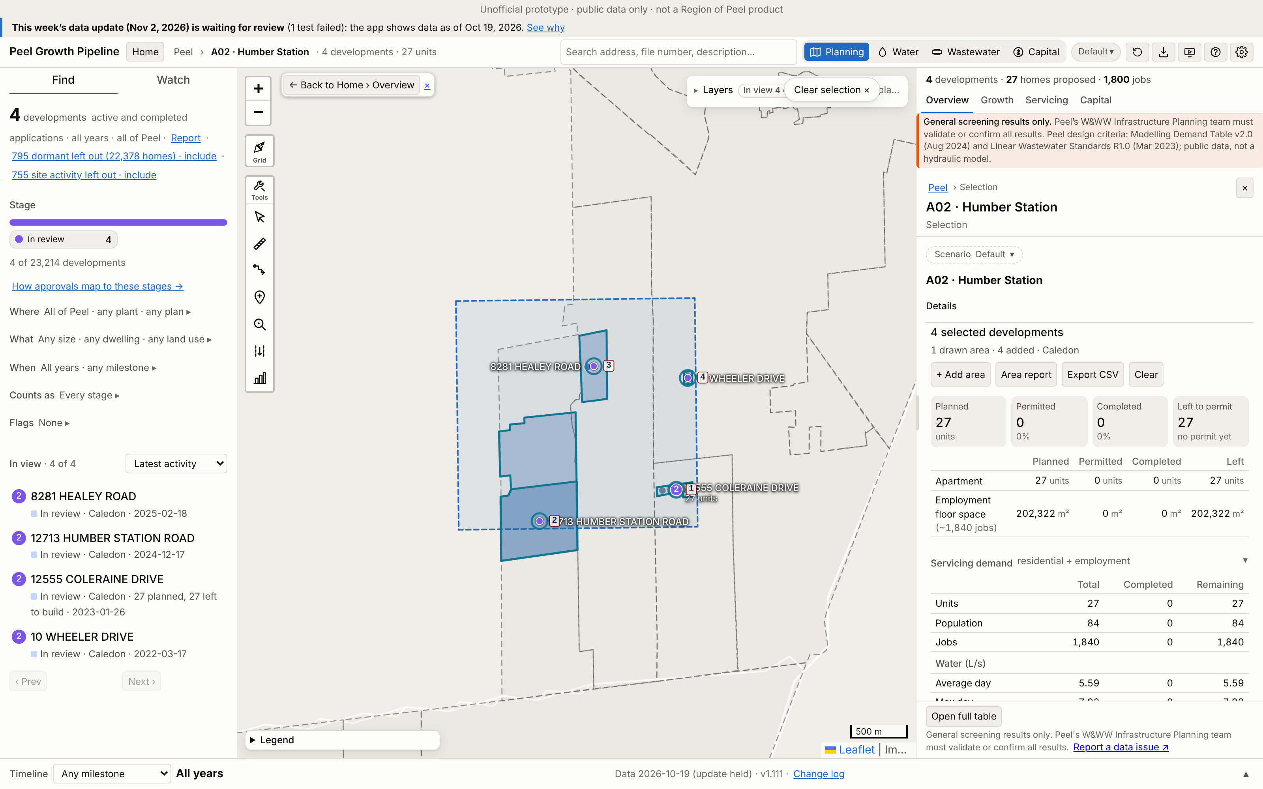
A02 · Humber Station
Growth | 2021–26 | 2021–31 | Build-out | Pre-2021*
Units | 0 | 19 | 27 | 0
Res. pop. | 0 | 58 | 84 | 0
Jobs | 0 | 59 | 1,840 | 0
*Pre-2021 = built before census day 2021-05-11, already in the 2021 Census (not added).
Region map: 8,736 people on 128.3 ha. App build-out = 1% of that.
4 developments: 4 planning applications and 0 permit-only (Caledon 4). 0 of 1 Region points matched.
No. / development | Stage | Units | 2021–31
1 12555 COLERAINE DRIVE | In review | 27 | 19
2 12713 HUMBER STATION RO… | In review | 0 | 0
3 8281 HEALEY ROAD | In review | 0 | 0
4 10 WHEELER DRIVE | In review | 0 | 0
App screenshot: Peel Growth Pipeline full map. Dashed = the area as an app selection; labels = development no. (A02-###). The app's panel shows the developments' full size, pre-2021 included. Region map reference: maps/A02_Humber_Station.png
Largest 4 of 4 applications by units, as growth since 2021. Every development: Excel sheet "A02"
Notes:
A02 Humber Station. Planning applications in the area (ID, title, stage, units build-out, files):
A02-001 12555 COLERAINE DRIVE | In review | 27 units | 21CDM-22001C (Circulation)
A02-002 12713 HUMBER STATION ROAD | In review | 0 units | 21T-24014C (Circulation); 2024-0100 (Recirculation)
A02-003 8281 HEALEY ROAD | In review | 0 units | 2021-0097 (Satisfactory)
A02-004 10 WHEELER DRIVE | In review | 0 units | 2022-0012 (Satisfactory)

Slide 10
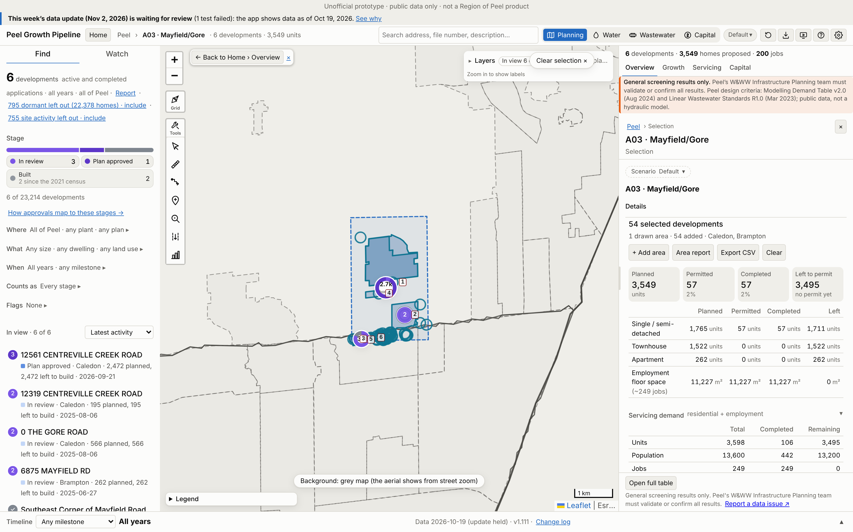
A03 · Mayfield/Gore
Growth | 2021–26 | 2021–31 | Build-out | Pre-2021*
Units | 59 | 1,520 | 3,554 | 47
Res. pop. | 248 | 5,826 | 13,421 | 194
Jobs | 0 | 0 | 0 | 249
*Pre-2021 = built before census day 2021-05-11, already in the 2021 Census (not added).
Region map: 27,000 people on 120 ha. App build-out = 50% of that.
54 developments: 6 planning applications and 48 permit-only (Caledon 7, Brampton 47). 1 of 1 Region points matched.
No. / development | Stage | Units | 2021–31
1 12561 CENTREVILLE CREEK… | Plan approved | 2,472 | 1,042
2 0 THE GORE ROAD | In review | 566 | 305
3 6875 MAYFIELD RD | In review | 262 | 0
4 12319 CENTREVILLE CREEK… | In review | 195 | 114
5 South-West corner of Mc… | Built | 57 | 57
6 Southeast Corner of May… | Built | 0 | 0
App screenshot: Peel Growth Pipeline full map. Dashed = the area as an app selection; labels = development no. (A03-###). The app's panel shows the developments' full size, pre-2021 included. Region map reference: maps/A03_Mayfield-Gore.png
Largest 6 of 6 applications by units, as growth since 2021. Every development: Excel sheet "A03"
Notes:
A03 Mayfield/Gore. Planning applications in the area (ID, title, stage, units build-out, files):
A03-001 12561 CENTREVILLE CREEK ROAD | Plan approved | 2,472 units | 2026-0016 (Circulation); 21T-25001C (Draft Approval)
A03-002 0 THE GORE ROAD | In review | 566 units | 21T-25010C (Circulation)
A03-003 6875 MAYFIELD RD | In review | 262 units | OZS-2025-0029 (Under Appeal); OZS-2019-0014 (Registration); PRE-2024-0066 (Verification of Documents); PRE18.055 (Closed)
A03-004 12319 CENTREVILLE CREEK ROAD | In review | 195 units | 21T-25009C (Circulation)
A03-005 South-West corner of McVean Drive and Mayfield Road | Built | 57 units | C08E17.011 (Closed Approved); PRE17.084 (PRE - Closed)
A03-006 Southeast Corner of Mayfield Road and McVean Drive | Built | 0 units | SP19-003.000 (Site Plan Approved); SP18-122.000 (Closed); PRE16.001 (PRE - Closed); SPA-2024-0027 (Site Plan Approved); PRE-2022-0188 (Closed); DPC-2023-0003 (Registered)

Slide 11
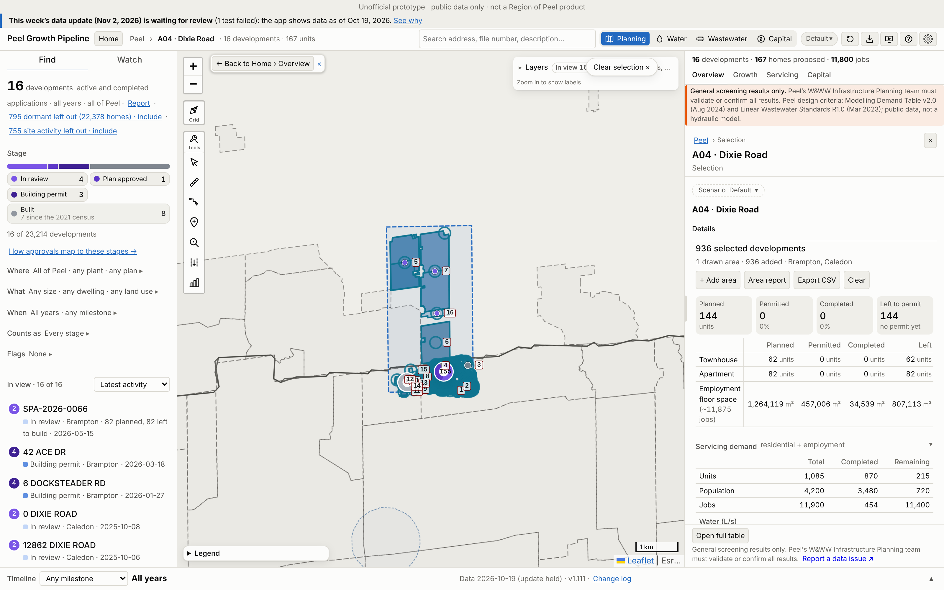
A04 · Dixie Road
Growth | 2021–26 | 2021–31 | Build-out | Pre-2021*
Units | 302 | 440 | 517 | 568
Res. pop. | 1,172 | 1,648 | 1,892 | 2,310
Jobs | 0 | 4,083 | 11,421 | 454
*Pre-2021 = built before census day 2021-05-11, already in the 2021 Census (not added).
Region map: 4,337 people on 163.82 ha. App build-out = 44% of that.
936 developments: 16 planning applications and 920 permit-only (Brampton 931, Caledon 5). 2 of 4 Region points matched.
No. / development | Stage | Units | 2021–31
1 SPA-2026-0066 | In review | 82 | 23
2 SPA-2025-0020 | Plan approved | 62 | 45
3 45 Tapscott Cres | Built | 12 | 12
4 4615 & 4819 Mayfield Ro… | Built | 0 | 0
5 12862 DIXIE ROAD | In review | 0 | 0
6 12035 DIXIE ROAD | Building permit | 0 | 0
7 12861 DIXIE ROAD | In review | 0 | 0
App screenshot: Peel Growth Pipeline full map. Dashed = the area as an app selection; labels = development no. (A04-###). The app's panel shows the developments' full size, pre-2021 included. Region map reference: maps/A04_Dixie_Road.png
Largest 7 of 16 applications by units, as growth since 2021. Every development: Excel sheet "A04"
Notes:
A04 Dixie Road. Planning applications in the area (ID, title, stage, units build-out, files):
A04-001 SPA-2026-0066 | In review | 82 units | SPA-2026-0066 (Deemed Complete); PRE-2025-0074 (Closed)
A04-002 SPA-2025-0020 | Plan approved | 62 units | SPA-2025-0020 (Site Plan Approved); PRE-2024-0047 (Verification of Documents)
A04-003 45 Tapscott Cres | Built | 12 units | SP88-021.000 (Transferred)
A04-004 4615 & 4819 Mayfield Road - South side of Mayfield Road, approximately 300 metres east of Dixie Road | Built | 0 units | C04E17.004 (Approved)
A04-005 12862 DIXIE ROAD | In review | 0 units | 2021-0006 (Circulation); 2021-0004 (Adoption); 2021-0012 (Circulation); 2025-0036 (Circulation); 2025-0003 (Circulation)
A04-006 12035 DIXIE ROAD | Building permit | 0 units | 2021-0013 (Recirculation); 2021-0007 (Circulation); 2021-0005 (Circulation)
A04-007 12861 DIXIE ROAD | In review | 0 units | 2025-0017 (Circulation); 2025-0016 (Circulation); 2024-0011 (New); 2024-0034 (Circulation)
A04-008 6 DOCKSTEADER RD | Building permit | 0 units | SPA-2026-0012 (Site Plan Approved); SPA-2024-0088 (Site Plan Approved); PRE-2023-0077 (Closed)
A04-009 0 INSPIRE BLVD | Built | 0 units | OZS-2020-0035 (Closed Approved); SPA-2021-0101 (Site Plan Approved); PRE-2020-0094 (Closed); C03E17.005 (Closed Approved); PRE-2020-0007 (Verification of Documents); PRE17.130 (Closed)
A04-010 25 Coachworks Crescent | Built | 0 units | SP15-079.000 (Approved)
A04-011 42 ACE DR | Building permit | 0 units | SPA-2026-0036 (In Review); SPA-2022-0037 (Site Plan Approved); PRE-2019-0016 (Closed); PRE17.098 (PRE - Closed)
A04-012 Southeast of Highway 410 and Mayfield Road | Built | 0 units | SP18-104.000 (Approved); PRE16.120 (PRE - Closed)
A04-013 85 ACE DR | Built | 0 units | SPA-2023-0036 (Site Plan Approved); SPA-2021-0132 (Site Plan Approved); SPA-2020-0002 (Site Plan Approved); SP19-026.000 (Closed)
A04-014 70 COACHWORKS CRES | Built | 0 units | SPA-2021-0175 (Site Plan Approved); SPA-2020-0131 (Site Plan Approved); PRE-2019-0020 (Closed)
A04-015 SOUTHEAST CORNER OF MAYFIELD ROAD AND ACE DRIVE | Built | 0 units | SP16-090.000 (Approved)
A04-016 0 DIXIE ROAD | In review | 0 units | 2025-0021 (Circulation)

Slide 12
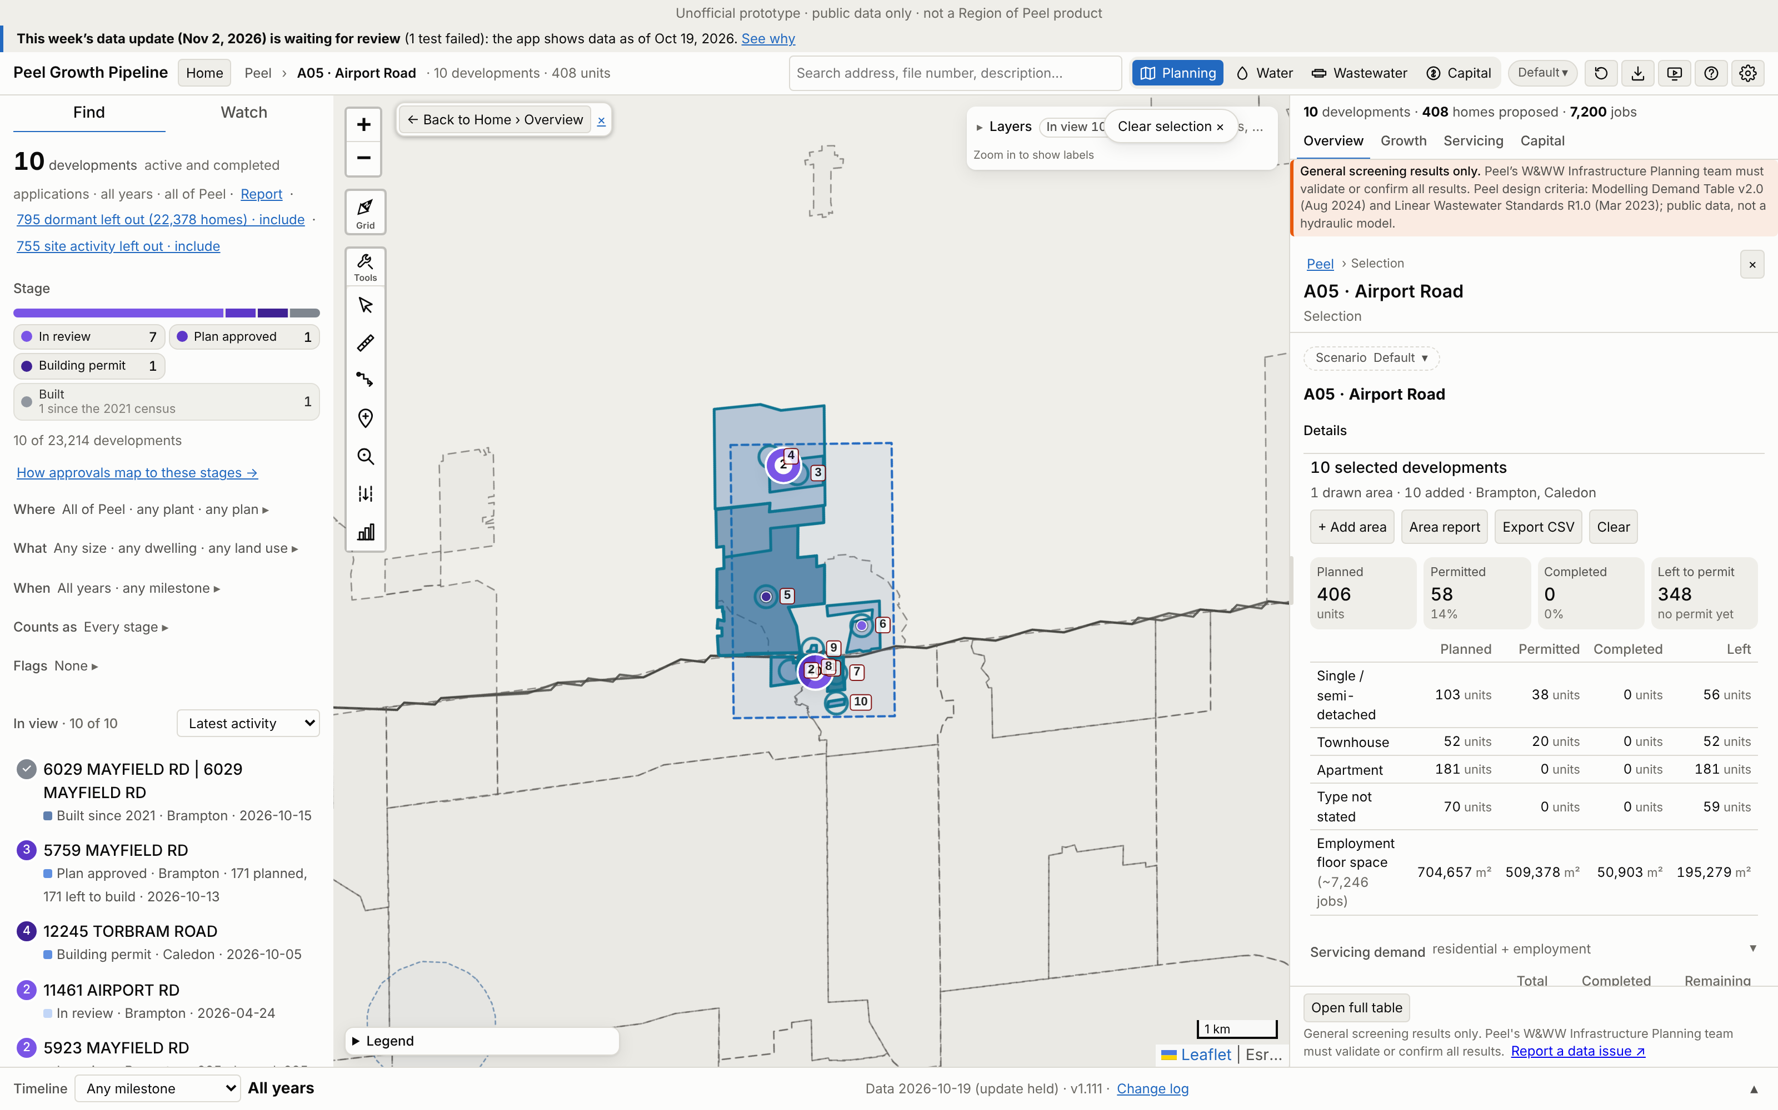
A05 · Airport Road
Growth | 2021–26 | 2021–31 | Build-out | Pre-2021*
Units | 1 | 173 | 409 | 0
Res. pop. | 3 | 587 | 1,318 | 0
Jobs | 0 | 4,168 | 6,036 | 1,210
*Pre-2021 = built before census day 2021-05-11, already in the 2021 Census (not added).
Region map: 9,167 people on 107.78 ha. App build-out = 14% of that.
10 developments: 10 planning applications and 0 permit-only (Brampton 5, Caledon 5). 4 of 4 Region points matched.
No. / development | Stage | Units | 2021–31
1 5923 MAYFIELD RD | In review | 235 | 0
2 5759 MAYFIELD RD | Plan approved | 171 | 171
3 0 AIRPORT ROAD | In review | 1 | 1
4 0 AIRPORT ROAD | In review | 1 | 1
5 12245 TORBRAM ROAD | Building permit | 0 | 0
6 12151 AIRPORT ROAD | In review | 0 | 0
7 6029 MAYFIELD RD | 6029… | Built | 0 | 0
App screenshot: Peel Growth Pipeline full map. Dashed = the area as an app selection; labels = development no. (A05-###). The app's panel shows the developments' full size, pre-2021 included. Region map reference: maps/A05_Airport_Road.png
Largest 7 of 10 applications by units, as growth since 2021. Every development: Excel sheet "A05"
Notes:
A05 Airport Road. Planning applications in the area (ID, title, stage, units build-out, files):
A05-001 5923 MAYFIELD RD | In review | 235 units | OZS-2026-0012 (In Review-Public Mtg Complete); PRE-2021-0099 (Closed); PRE-2019-0057 (Closed)
A05-002 5759 MAYFIELD RD | Plan approved | 171 units | OZS-2022-0034 (Closed Approved); PRE-2022-0013 (Closed); PRE-2023-0133 (Closed)
A05-003 0 AIRPORT ROAD | In review | 1 units | 2025-0024 (Circulation)
A05-004 0 AIRPORT ROAD | In review | 1 units | 2025-0012 (Circulation)
A05-005 12245 TORBRAM ROAD | Building permit | 0 units | 2024-0055 (Recirculation); 21T-21002C (Circulation); 2021-0013 (Circulation)
A05-006 12151 AIRPORT ROAD | In review | 0 units | 21T-25006C (Circulation)
A05-007 6029 MAYFIELD RD | 6029 MAYFIELD RD | Built | 0 units | OZS-2024-0026 (Closed Approved); OZS-2020-0005 (Closed Approved); SPA-2025-0124 (In Review); SPA-2021-0161 (Site Plan Approved); DPC-2021-0010 (Draft Approved); PRE-2024-0077 (Comments Released); PRE-2020-0144 (Closed); PRE19.031 (Closed)
A05-008 OZS-2025-0048 | In review | 0 units | OZS-2025-0048 (In Review-Public Mtg Complete)
A05-009 5866 MAYFIELD ROAD | In review | 1 units | 2025-0053 (Recirculation)
A05-010 11461 AIRPORT RD | In review | 0 units | SPA-2026-0063 (In Review); PRE-2022-0126 (Closed)

Slide 13
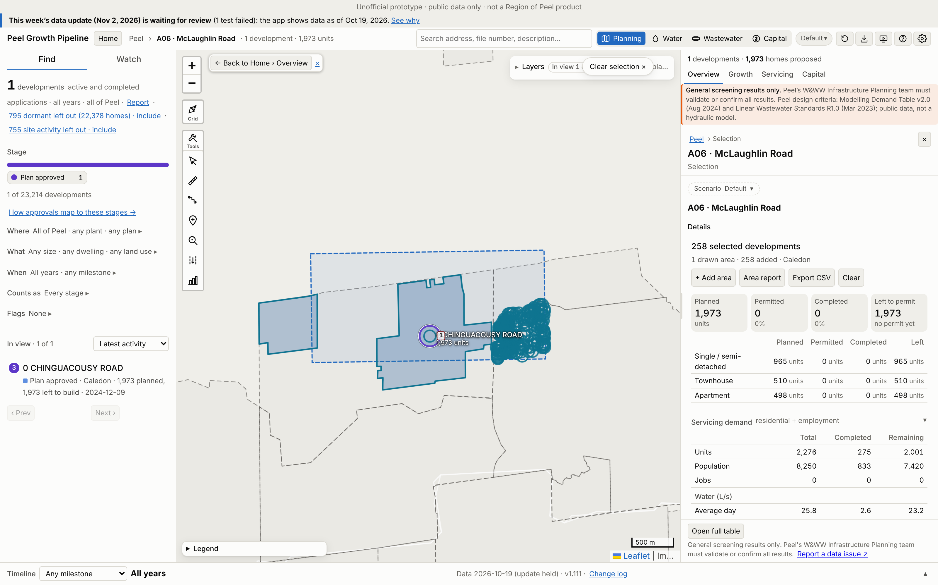
A06 · McLaughlin Road
Growth | 2021–26 | 2021–31 | Build-out | Pre-2021*
Units | 127 | 974 | 2,128 | 148
Res. pop. | 346 | 3,476 | 7,762 | 487
Jobs | 0 | 0 | 0 | 0
*Pre-2021 = built before census day 2021-05-11, already in the 2021 Census (not added).
Region map: 21,837 people on 435.7 ha. App build-out = 36% of that.
258 developments: 1 planning applications and 257 permit-only (Caledon 258). 0 of 3 Region points matched.
No. / development | Stage | Units | 2021–31
1 0 CHINGUACOUSY ROAD | Plan approved | 1,973 | 822
App screenshot: Peel Growth Pipeline full map. Dashed = the area as an app selection; labels = development no. (A06-###). The app's panel shows the developments' full size, pre-2021 included. Region map reference: maps/A06_McLaughlin_Road.png
Largest 1 of 1 applications by units, as growth since 2021. Every development: Excel sheet "A06"
Notes:
A06 McLaughlin Road. Planning applications in the area (ID, title, stage, units build-out, files):
A06-001 0 CHINGUACOUSY ROAD | Plan approved | 1,973 units | 21T-24011C (Draft Approval)

Slide 14
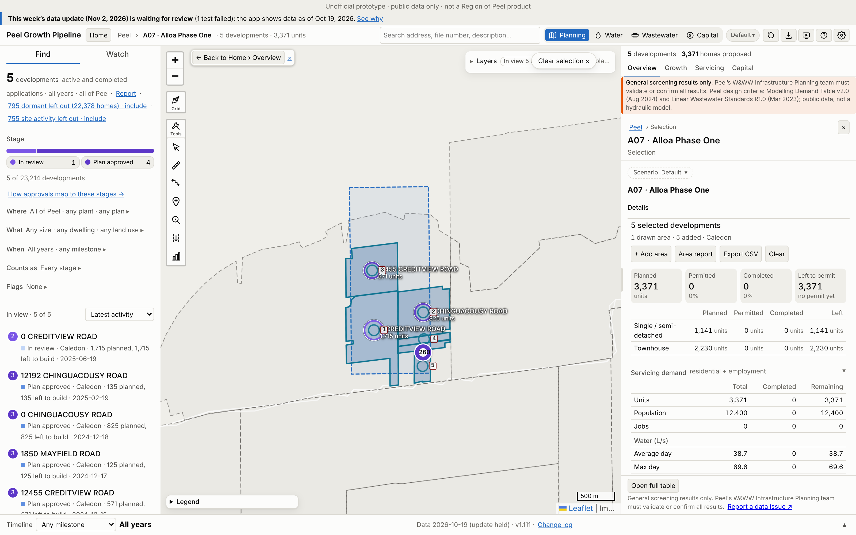
A07 · Alloa Phase One
Growth | 2021–26 | 2021–31 | Build-out | Pre-2021*
Units | 0 | 1,807 | 3,371 | 0
Res. pop. | 0 | 6,770 | 12,374 | 0
Jobs | 0 | 0 | 0 | 0
*Pre-2021 = built before census day 2021-05-11, already in the 2021 Census (not added).
Region map: 20,561 people on 263 ha. App build-out = 60% of that.
5 developments: 5 planning applications and 0 permit-only (Caledon 5). 1 of 1 Region points matched.
No. / development | Stage | Units | 2021–31
1 0 CREDITVIEW ROAD | In review | 1,715 | 402
2 0 CHINGUACOUSY ROAD | Plan approved | 825 | 682
3 12455 CREDITVIEW ROAD | Plan approved | 571 | 495
4 12192 CHINGUACOUSY ROAD | Plan approved | 135 | 118
5 1850 MAYFIELD ROAD | Plan approved | 125 | 110
App screenshot: Peel Growth Pipeline full map. Dashed = the area as an app selection; labels = development no. (A07-###). The app's panel shows the developments' full size, pre-2021 included. Region map reference: maps/A07_Alloa_Phase_One.png
Largest 5 of 5 applications by units, as growth since 2021. Every development: Excel sheet "A07"
Notes:
A07 Alloa Phase One. Planning applications in the area (ID, title, stage, units build-out, files):
A07-001 0 CREDITVIEW ROAD | In review | 1,715 units | 21T-25008C (Circulation)
A07-002 0 CHINGUACOUSY ROAD | Plan approved | 825 units | 21T-24016C (Draft Approved (parent))
A07-003 12455 CREDITVIEW ROAD | Plan approved | 571 units | 21T-24013C (Draft Approved (parent))
A07-004 12192 CHINGUACOUSY ROAD | Plan approved | 135 units | 21T-25004C (Draft Approved (parent))
A07-005 1850 MAYFIELD ROAD | Plan approved | 125 units | 21T-24015C (Draft Approved (parent))

Slide 15
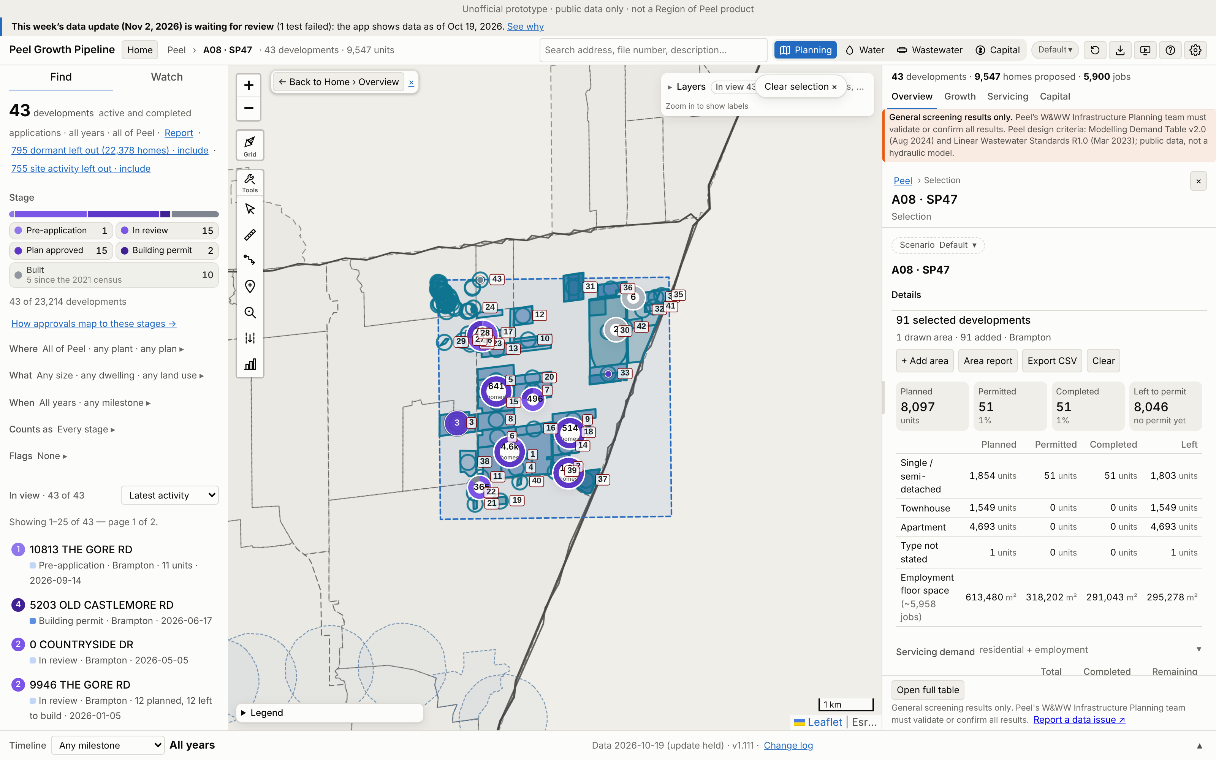
A08 · SP47
Growth | 2021–26 | 2021–31 | Build-out | Pre-2021*
Units | 51 | 1,995 | 9,542 | 52
Res. pop. | 214 | 6,855 | 30,782 | 215
Jobs | 0 | 2,110 | 3,263 | 2,695
*Pre-2021 = built before census day 2021-05-11, already in the 2021 Census (not added).
Region map: 57,194 people on 585.41 ha. App build-out = 54% of that.
91 developments: 43 planning applications and 48 permit-only (Brampton 91). 25 of 28 Region points matched.
No. / development | Stage | Units | 2021–31
1 10159 THE GORE RD | Plan approved | 3,239 | 323
2 5076 OLD CASTLEMORE RD | Plan approved | 1,333 | 181
3 10300 THE GORE RD | Plan approved | 791 | 568
4 4784 CASTLEMORE RD | In review | 685 | 0
5 10647 THE GORE RD | Plan approved | 471 | 181
6 10263 THE GORE RD | Plan approved | 423 | 181
7 10484 CLARKWAY DR | In review | 328 | 0
App screenshot: Peel Growth Pipeline full map. Dashed = the area as an app selection; labels = development no. (A08-###). The app's panel shows the developments' full size, pre-2021 included. Region map reference: maps/A08_SP47.png
Largest 7 of 43 applications by units, as growth since 2021. Every development: Excel sheet "A08"
Notes:
A08 SP47. Planning applications in the area (ID, title, stage, units build-out, files):
A08-001 10159 THE GORE RD | Plan approved | 3,239 units | OZS-2021-0038 (Draft Approved); PRE-2020-0108 (Closed)
A08-002 5076 OLD CASTLEMORE RD | Plan approved | 1,333 units | OZS-2024-0049 (Closed Approved); OZS-2021-0050 (M-Plan/Condition Clearance); PRE-2024-0052 (Comments Released); PRE-2020-0124 (Closed); PRE-2021-0103 (Closed)
A08-003 10300 THE GORE RD | Plan approved | 791 units | OZS-2024-0065 (Registration); PRE-2023-0142 (Closed)
A08-004 4784 CASTLEMORE RD | In review | 685 units | OZS-2023-0008 (Staff Review Complete); PRE-2021-0009 (Closed)
A08-005 10647 THE GORE RD | Plan approved | 471 units | OZS-2023-0001 (M-Plan/Condition Clearance); PRE-2021-0196 (Closed); PRE-2020-0120 (Closed)
A08-006 10263 THE GORE RD | Plan approved | 423 units | OZS-2021-0041 (Draft Approved); PRE-2020-0115 (Closed)
A08-007 10484 CLARKWAY DR | In review | 328 units | OZS-2024-0035 (In Review-Public Mtg Complete); PRE-2020-0106 (Closed)
A08-008 10365 THE GORE RD | Plan approved | 295 units | OZS-2021-0039 (Draft Approved); PRE-2020-0117 (Closed)
A08-009 10307 CLARKWAY DR | Plan approved | 275 units | OZS-2021-0057 (Draft Approved); PRE-2020-0126 (Closed)
A08-010 10778 CLARKWAY DR | In review | 273 units | OZS-2022-0015 (Application Complete); PRE-2020-0121 (Closed); PRE-2021-0113 (Comments Released)
A08-011 4538 CASTLEMORE RD | In review | 271 units | OZS-2022-0045 (Closed Approved); PRE-2020-0110 (Closed)
A08-012 0 COUNTRYSIDE DR | In review | 205 units | OZS-2023-0023 (In Review-Public Mtg Complete); PRE-2020-0122 (Closed)
A08-013 10797 THE GORE RD | Plan approved | 202 units | OZS-2023-0002 (Draft Approved)
A08-014 OZS-2021-0060 | Plan approved | 183 units | OZS-2021-0060 (Draft Approved); PRE-2020-0125 (Closed)
A08-015 10431 THE GORE RD | Plan approved | 170 units | OZS-2021-0047 (Draft Approved); PRE-2020-0118 (Closed)
A08-016 10308 CLARKWAY DR | Plan approved | 121 units | OZS-2021-0019 (Draft Approved); PRE-2020-0116 (Closed)
A08-017 10877 THE GORE RD | In review | 65 units | OZS-2024-0010 (In Review-Public Mtg Complete); PRE-2021-0101 (Closed)
A08-018 10201 CLARKWAY DR | Plan approved | 56 units | OZS-2022-0025 (Draft Approved); PRE-2021-0093 (Verification of Documents)
A08-019 LITERACY DR | Built | 51 units | OZS-2021-0036 (Closed Approved); PRE-2021-0119 (Closed)
A08-020 0 CLARKWAY DR | In review | 47 units | OZS-2024-0005 (In Review-Public Mtg Complete); PRE-2020-0175 (Closed)
A08-021 9874 THE GORE RD | In review | 31 units | OZS-2023-0017 (Closed Approved); PRE-2022-0089 (Comments Released)
A08-022 9946 THE GORE RD | In review | 12 units | OZS-2026-0001 (Deemed Complete); PRE-2024-0082 (Closed); PRE16.005 (PRE - Closed)
A08-023 10813 THE GORE RD | Pre-application | 11 units | PRE-2026-0036 (Submitted)
A08-024 11038 THE GORE RD | Plan approved | 4 units | OZS-2024-0004 (Draft Approved); PRE-2021-0198 (Closed); PRE17.135 (Closed)
A08-025 13 Grafton Crescent | Built | 0 units | SP19-019.000 (Site Plan Approved)
A08-026 15 Grafton Crescent | Built | 0 units | SP18-004.000 (Approved)
A08-027 16 GRAFTON CRES | Built | 0 units | SPA-2020-0080 (Site Plan Approved)
A08-028 4 Saint Lukes Court | Built | 0 units | SP17-102.000 (Approved)
A08-029 6 ANGELBLUFF COURT | Built | 0 units | SP17-108.000 (Closed)
A08-030 10900 COLERAINE DR | Built | 0 units | OZS-2023-0030 (Closed Approved); PRE-2020-0002 (Closed); SPA-2022-0228 (Site Plan Approved); PRE-2022-0148 (Comments Released)
A08-031 5200 COUNTRYSIDE DR | Plan approved | 0 units | OZS-2025-0007 (Closed Approved); SPA-2024-0096 (Site Plan Approved); PRE-2023-0014 (Closed); OZS-2022-0029 (Closed Approved); SPA-2023-0079 (Agreement Execution); PRE-2022-0165 (Closed); PRE-2021-0061 (Closed)
A08-032 0 HIGHWAY 50 | Built | 0 units | SPA-2021-0209 (Site Plan Approved); PRE-2021-0063 (Closed)
A08-033 0 COLERAINE DR | Plan approved | 0 units | OZS-2024-0061 (In Review-Public Mtg Complete); PRE19.017 (Closed); PRE-2023-0035 (Closed); PRE-2020-0113 (Closed)
A08-034 0 COUNTRYSIDE DR | In review | 0 units | SPA-2025-0048 (In Review); PRE-2024-0094 (Closed)
A08-035 0 COUNTRYSIDE DR | In review | 0 units | OZS-2025-0003 (Closed Approved)
A08-036 0 COUNTRYSIDE DR | In review | 0 units | OZS-2026-0014 (Submitted); OZS-2022-0005 (Closed Approved); PRE-2020-0128 (Closed); PRE19.014 (Closed)
A08-037 5203 OLD CASTLEMORE RD | Building permit | 0 units | OZS-2023-0038 (Closed Approved); OZS-2020-0010 (M-Plan/Condition Clearance); SPA-2022-0051 (Substantially Complete); PRE-2021-0199 (Meeting Scheduled); PRE18.038 (Closed)
A08-038 10150 THE GORE RD | Building permit | 0 units | PRE-2020-0137 (Closed)
A08-039 10015 CLARKWAY DR | In review | 0 units | OZS-2025-0010 (In Review-Public Mtg Complete); PRE-2021-0227 (Closed)
A08-040 4781 CASTLEMORE ROAD | Built | 0 units | SP16-094.000 (Approved); DPC-2019-0005 (Plan of Condo Registered); PRE19.035 (Closed)
A08-041 0 HIGHWAY 50 | In review | 0 units | OZS-2024-0008 (In Review); PRE-2023-0048 (Verification of Documents)
A08-042 10810 COLERAINE DR | In review | 0 units | OZS-2021-0051 (Closed Approved); PRE-2024-0147 (Verification of Documents); PRE-2020-0091 (Closed)
A08-043 11499 THE GORE RD | Built | 0 units | OZS-2022-0024 (Closed Approved); SPA-2025-0023 (Site Plan Approved); SPA-2022-0226 (Site Plan Approved); SP17-061.000 (Approved); PRE-2022-0164 (Closed); PRE-2020-0142 (Closed); PRE16.039 (PRE - Closed)

Slide 16
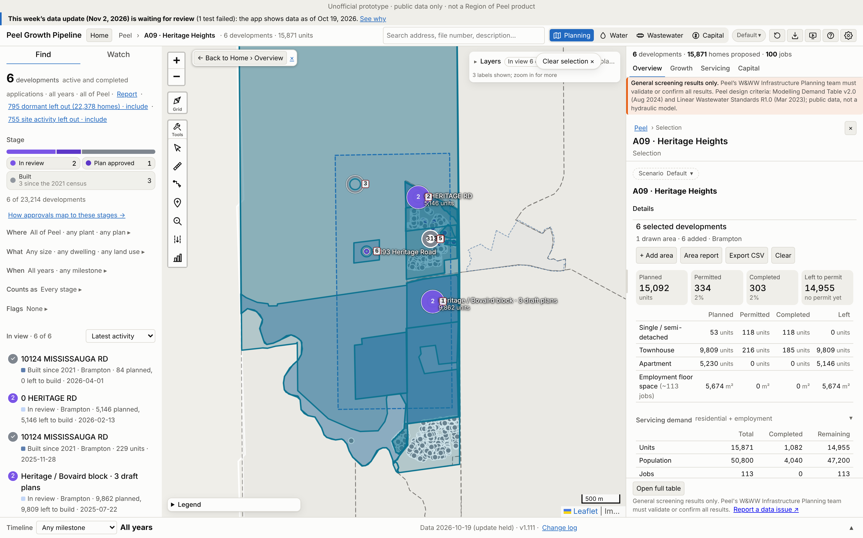
A09 · Heritage Heights
Growth | 2021–26 | 2021–31 | Build-out | Pre-2021*
Units | 518 | 518 | 15,473 | 564
Res. pop. | 1,650 | 1,650 | 48,895 | 2,394
Jobs | 0 | 113 | 113 | 0
*Pre-2021 = built before census day 2021-05-11, already in the 2021 Census (not added).
Region map: 58,219 people on 224.68 ha. App build-out = 84% of that.
6 developments: 6 planning applications and 0 permit-only (Brampton 6). 2 of 4 Region points matched.
No. / development | Stage | Units | 2021–31
1 Heritage / Bovaird bloc… | In review | 9,862 | 53
2 0 HERITAGE RD | In review | 5,146 | 0
3 East of Mississauga Roa… | Built | 80 | 80
4 10124 MISSISSAUGA RD | Built | 135 | 135
5 10124 MISSISSAUGA RD | Built | 250 | 250
6 10193 Heritage Road | Plan approved | 0 | 0
App screenshot: Peel Growth Pipeline full map. Dashed = the area as an app selection; labels = development no. (A09-###). The app's panel shows the developments' full size, pre-2021 included. Region map reference: maps/A09_Heritage_Heights.png
Largest 6 of 6 applications by units, as growth since 2021. Every development: Excel sheet "A09"
Notes:
A09 Heritage Heights. Planning applications in the area (ID, title, stage, units build-out, files):
A09-001 Heritage / Bovaird block · 3 draft plans | In review | 9,862 units | OZS-2025-0032 (Staff Review Complete); PRE-2024-0100 (Closed); OZS-2024-0051 (Staff Review Complete); PRE-2023-0067 (Comments Released); C05W07.006 (Closed Approved); PRE17.126 (Closed); OZS-2025-0034 (In Review-Public Mtg Complete); PRE-2024-0087 (Closed); PRE-2023-0100 (Closed)
A09-002 0 HERITAGE RD | In review | 5,146 units | OZS-2026-0007 (In Review-Public Mtg Complete); C05W12.005 (Closed Approved); PRE-2023-0167 (Comments Released)
A09-003 East of Mississauga Road, West of Winston Churchill, North of Mayfield Road and South of the Provincial Greenbelt Area | Built | 80 units | PRE17.129 (Closed); PRE17.114 (Closed)
A09-004 10124 MISSISSAUGA RD | Built | 135 units | PRE-2023-0034 (Closed); C05W12.004 (Closed Approved); SPA-2024-0055 (Site Plan Agreement Prep)
A09-005 10124 MISSISSAUGA RD | Built | 250 units | OZS-2021-0052 (Closed Approved); SPA-2023-0101 (Site Plan Approved); PRE-2024-0109 (Closed); PRE-2021-0065 (Closed); SPA-2025-0022 (Closed); DPC-2026-0002 (Deemed Complete); PRE-2023-0049 (Closed)
A09-006 10193 Heritage Road | Plan approved | 0 units | SP90-015.000 (Approved)

Slide 17
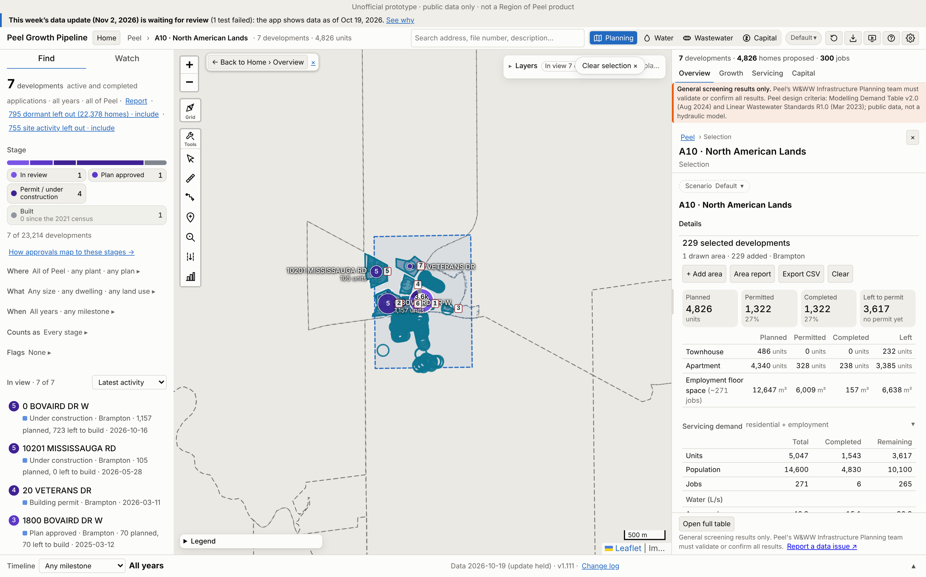
A10 · North American Lands
Growth | 2021–26 | 2021–31 | Build-out | Pre-2021*
Units | 972 | 1,971 | 4,589 | 571
Res. pop. | 2,845 | 5,857 | 12,928 | 1,984
Jobs | 0 | 187 | 265 | 6
*Pre-2021 = built before census day 2021-05-11, already in the 2021 Census (not added).
Region map: 10,773 people on 25.79 ha. App build-out = 120% of that.
229 developments: 7 planning applications and 222 permit-only (Brampton 229). 3 of 3 Region points matched.
No. / development | Stage | Units | 2021–31
1 0 LAGERFELD DR | In review | 2,801 | 189
2 0 BOVAIRD DR W | Under construction | 1,011 | 1,011
3 Northeast Corner of Bov… | Under construction | 444 | 444
4 Northwest corner of Lag… | Built | 61 | 61
5 10201 MISSISSAUGA RD | Under construction | 202 | 202
6 1800 BOVAIRD DR W | Plan approved | 70 | 64
7 20 VETERANS DR | Building permit | 0 | 0
App screenshot: Peel Growth Pipeline full map. Dashed = the area as an app selection; labels = development no. (A10-###). The app's panel shows the developments' full size, pre-2021 included. Region map reference: maps/A10_North_American_Lands.png
Largest 7 of 7 applications by units, as growth since 2021. Every development: Excel sheet "A10"
Notes:
A10 North American Lands. Planning applications in the area (ID, title, stage, units build-out, files):
A10-001 0 LAGERFELD DR | In review | 2,801 units | OZS-2023-0039 (Under Appeal); PRE-2023-0003 (Closed)
A10-002 0 BOVAIRD DR W | Under construction | 1,011 units | OZS-2019-0007 (Registration); SPA-2024-0097 (Site Plan Approved); PRE-2023-0131 (Closed); PRE18.050 (Closed); SPA-2025-0167 (In Review); SPA-2021-0266 (Substantially Complete); PRE-2021-0006 (Closed); SPA-2025-0106 (Site Plan Approved); DPC-2024-0009 (Registered); SPA-2021-0168 (Site Plan Approved); PRE-2021-0046 (Closed)
A10-003 Northeast Corner of Bovaird Drive West and Lagerfeld Drive | Under construction | 444 units | SPA-2021-0074 (Site Plan Approved); SP18-002.000 (Site Plan Approved); PRE-2023-0022 (Closed); DPC-2023-0002 (Registered)
A10-004 Northwest corner of Lagerfeld Drive and Creditview Road | Built | 61 units | C04W11.013 (Approved); SP17-087.000 (Site Plan Approved); PRE16.054 (PRE - Closed); DPC-2020-0003 (Plan of Condo Registered); PRE-2020-0063 (Closed)
A10-005 10201 MISSISSAUGA RD | Under construction | 202 units | OZS-2024-0056 (Closed Approved); OZS-2020-0004 (Closed Approved); SPA-2020-0190 (Site Plan Approved); DPC-2025-0004 (Registered); PRE-2025-0022 (Closed); PRE-2023-0093 (Closed); PRE-2020-0134 (Closed); PRE-2019-0028 (Closed); PRE17.063 (PRE - Closed); OZS-2024-0030 (Closed Approved); PRE-2023-0008 (Closed)
A10-006 1800 BOVAIRD DR W | Plan approved | 70 units | SPA-2023-0007 (Site Plan Approved); PRE-2021-0221 (Closed); DPC-2024-0010 (Draft Approved)
A10-007 20 VETERANS DR | Building permit | 0 units | SPA-2024-0105 (Site Plan Agreement Prep); PRE-2023-0141 (Closed)

Slide 18
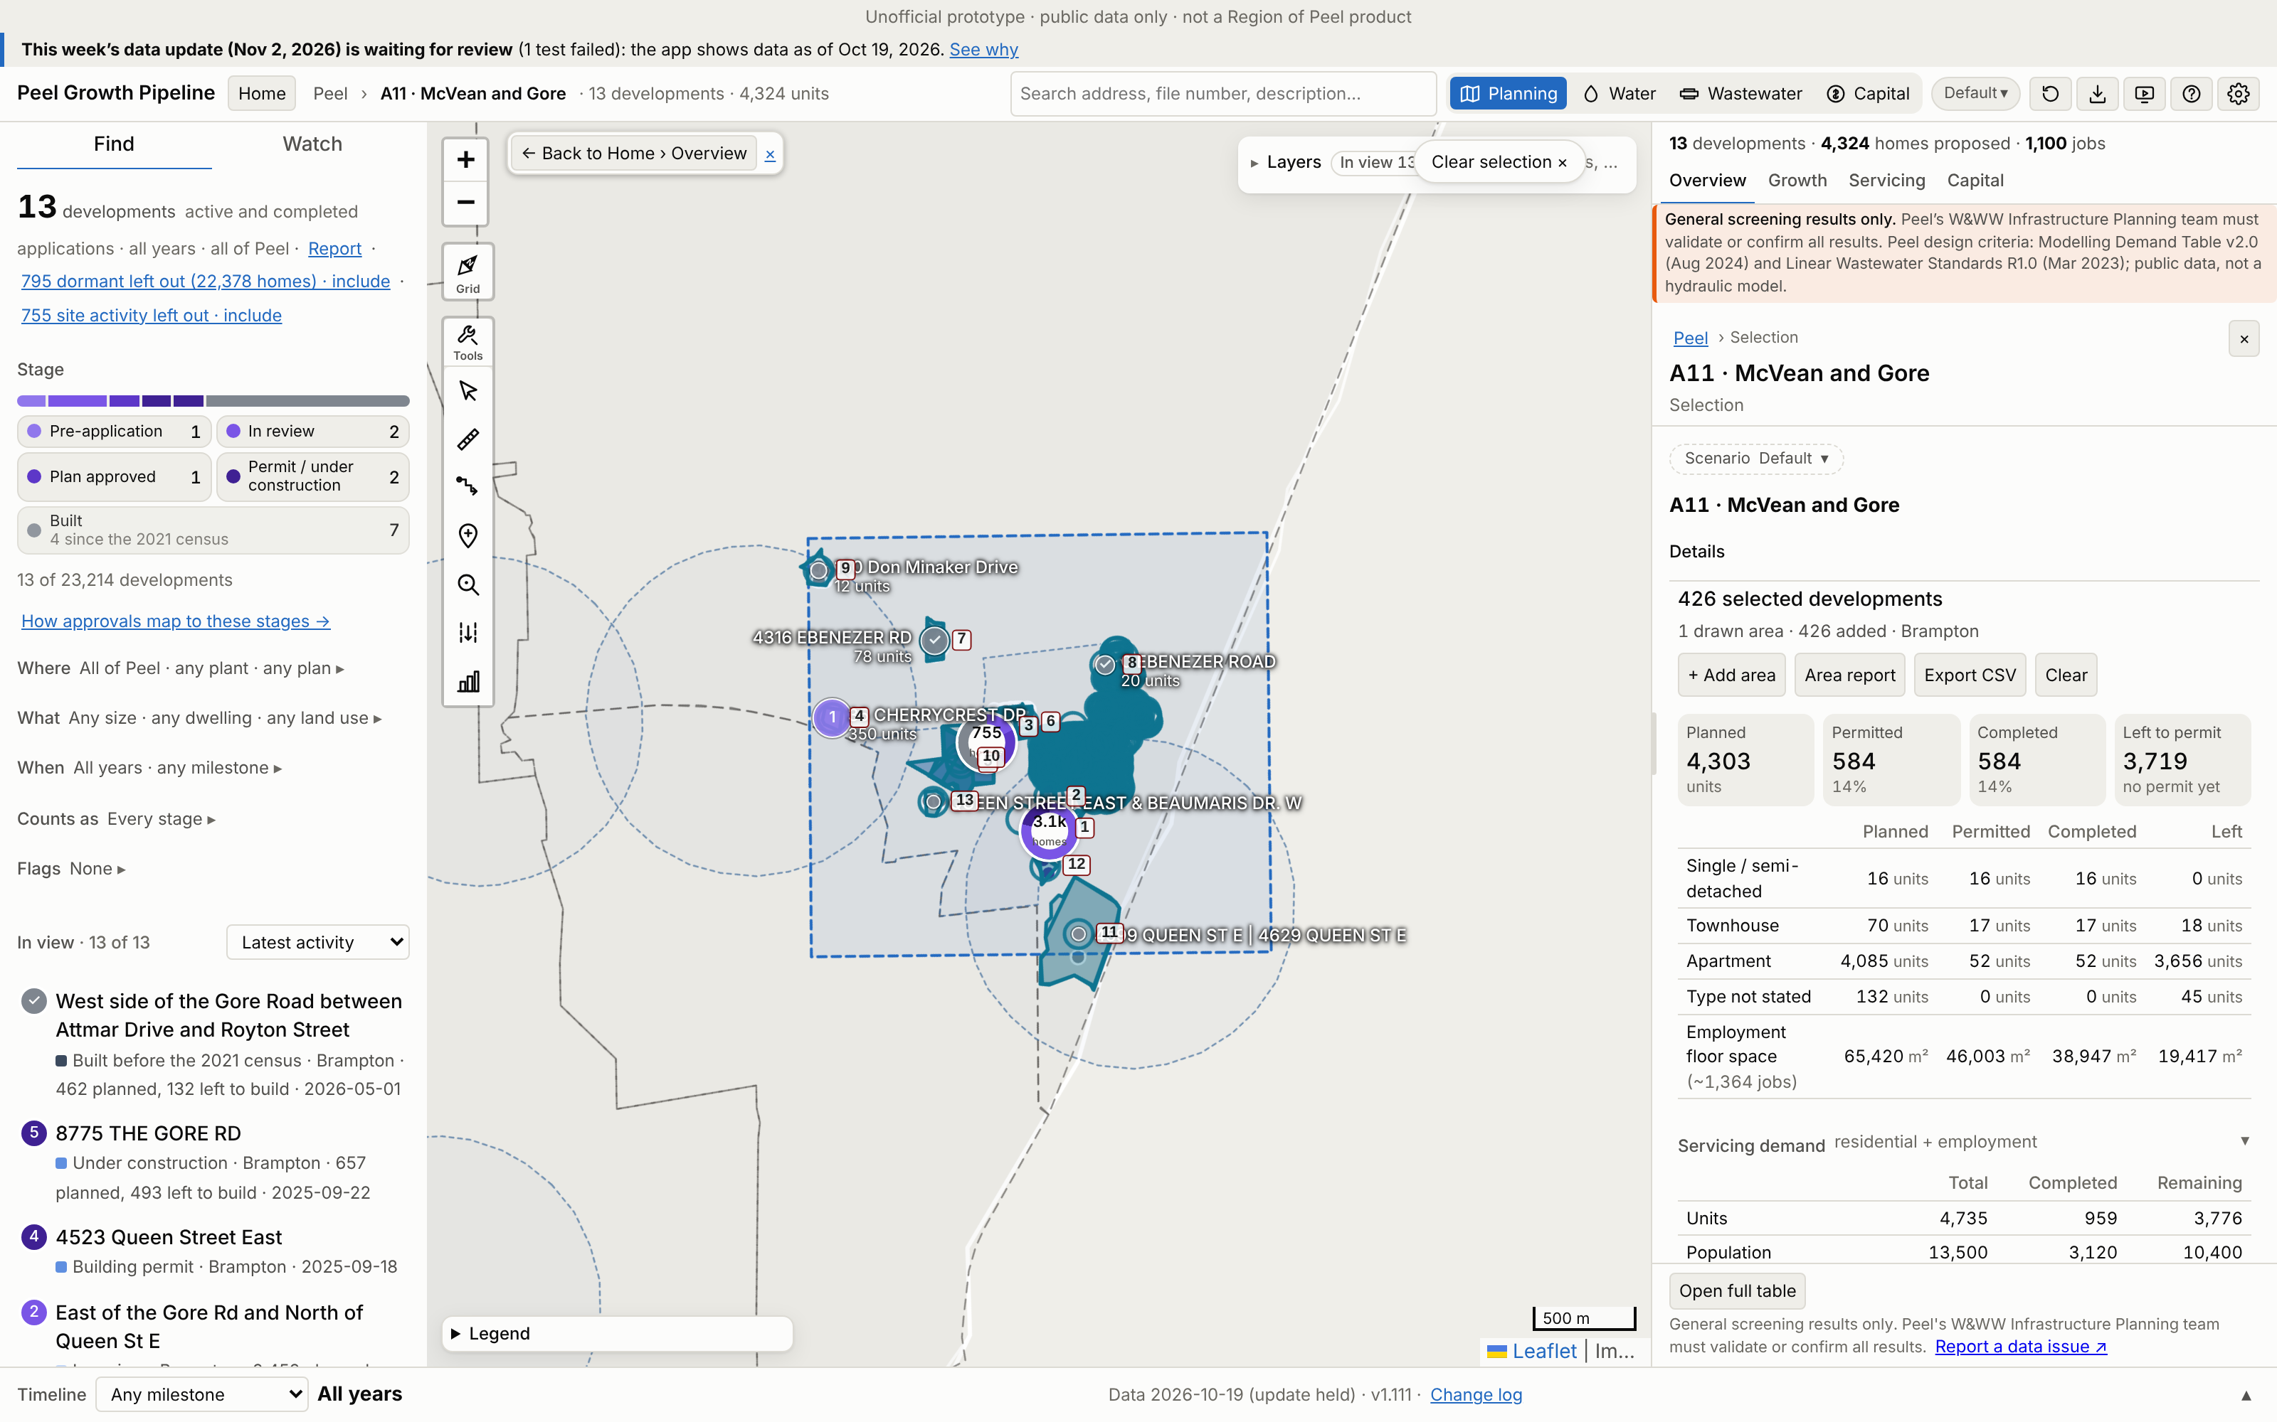
A11 · McVean and Gore
Growth | 2021–26 | 2021–31 | Build-out | Pre-2021*
Units | 773 | 1,531 | 4,549 | 186
Res. pop. | 2,528 | 4,659 | 12,879 | 595
Jobs | 0 | 190 | 806 | 558
*Pre-2021 = built before census day 2021-05-11, already in the 2021 Census (not added).
Region map: 8,781 people on 9.89 ha. App build-out = 147% of that.
426 developments: 13 planning applications and 413 permit-only (Brampton 426). 4 of 4 Region points matched.
No. / development | Stage | Units | 2021–31
1 East of the Gore Rd and… | In review | 2,452 | 0
2 8775 THE GORE RD | Under construction | 657 | 657
3 West side of the Gore R… | Built | 339 | 207
4 35 CHERRYCREST DR | Pre-application | 350 | 94
5 4320 QUEEN ST E | Plan approved | 158 | 114
6 8888 THE GORE RD | In review | 134 | 0
7 4316 EBENEZER RD | Built | 78 | 78
App screenshot: Peel Growth Pipeline full map. Dashed = the area as an app selection; labels = development no. (A11-###). The app's panel shows the developments' full size, pre-2021 included. Region map reference: maps/A11_McVean_and_Gore.png
Largest 7 of 13 applications by units, as growth since 2021. Every development: Excel sheet "A11"
Notes:
A11 McVean and Gore. Planning applications in the area (ID, title, stage, units build-out, files):
A11-001 East of the Gore Rd and North of Queen St E | In review | 2,452 units | OZS-2025-0040 (Deemed Complete); OZS-2024-0037 (Under Appeal); SPA-2020-0013 (In Review); PRE-2023-0080 (Verification of Documents); PRE-2019-0014 (Closed)
A11-002 8775 THE GORE RD | Under construction | 657 units | PRE-2020-0088 (Closed); OZS-2020-0032 (Closed Approved); SPA-2021-0227 (Site Plan Approved); SPA-2024-0174 (Site Plan Approved); DPC-2025-0008 (Draft Approved); PRE-2025-0005 (Closed); PRE-2021-0086 (Closed)
A11-003 West side of the Gore Road between Attmar Drive and Royton Street | Built | 339 units | C09E04.017 (Approved); SP18-118.000 (Site Plan Approved); DPC-2022-0005 (Draft Approved); OZS-2025-0055 (Closed Approved); PRE-2026-0021 (Comments Released); SP18-081.000 (Site Plan Approved); DPC-2020-0002 (Registered); PRE-2020-0037 (Closed); PRE18.013 (Closed)
A11-004 35 CHERRYCREST DR | Pre-application | 350 units | PRE-2024-0133 (Meeting Scheduled)
A11-005 4320 QUEEN ST E | Plan approved | 158 units | OZS-2021-0021 (Closed Approved); SPA-2022-0096 (Site Plan Agreement Prep); SPA-2022-0097 (In Review); PRE-2023-0159 (Closed); PRE-2021-0159 (Closed); PRE-2021-0158 (Closed); PRE-2020-0071 (Closed)
A11-006 8888 THE GORE RD | In review | 134 units | OZS-2024-0052 (In Review-Public Mtg Complete); PRE-2020-0135 (Closed)
A11-007 4316 EBENEZER RD | Built | 78 units | OZS-2020-0012 (Closed Approved); SPA-2021-0025 (Site Plan Approved); DPC-2024-0004 (Draft Approved); PRE-2023-0137 (Closed); PRE-2020-0129 (Closed); PRE-2019-0032 (Closed)
A11-008 0 EBENEZER ROAD | Built | 0 units | SP16-054.000 (Approved); PRE16.058 (PRE - Closed)
A11-009 150 Don Minaker Drive | Built | 12 units | C09E06.008 (Registration)
A11-010 SP91-010.000 | Built | 0 units | SP91-010.000 (Transferred)
A11-011 4599 QUEEN ST E | 4629 QUEEN ST E | Built | 0 units | SP19-045.000 (Site Plan Approved); PRE17.103 (PRE - Closed)
A11-012 4523 Queen Street East | Building permit | 0 units | SP18-064.000 (Site Plan Approved); PRE-2022-0096 (Meeting Scheduled); PRE17.038 (PRE - Closed)
A11-013 QUEEN STREET EAST & BEAUMARIS DR. W | Built | 0 units | SP17-040.000 (Approved); PRE16.084 (PRE - Closed)

Slide 19
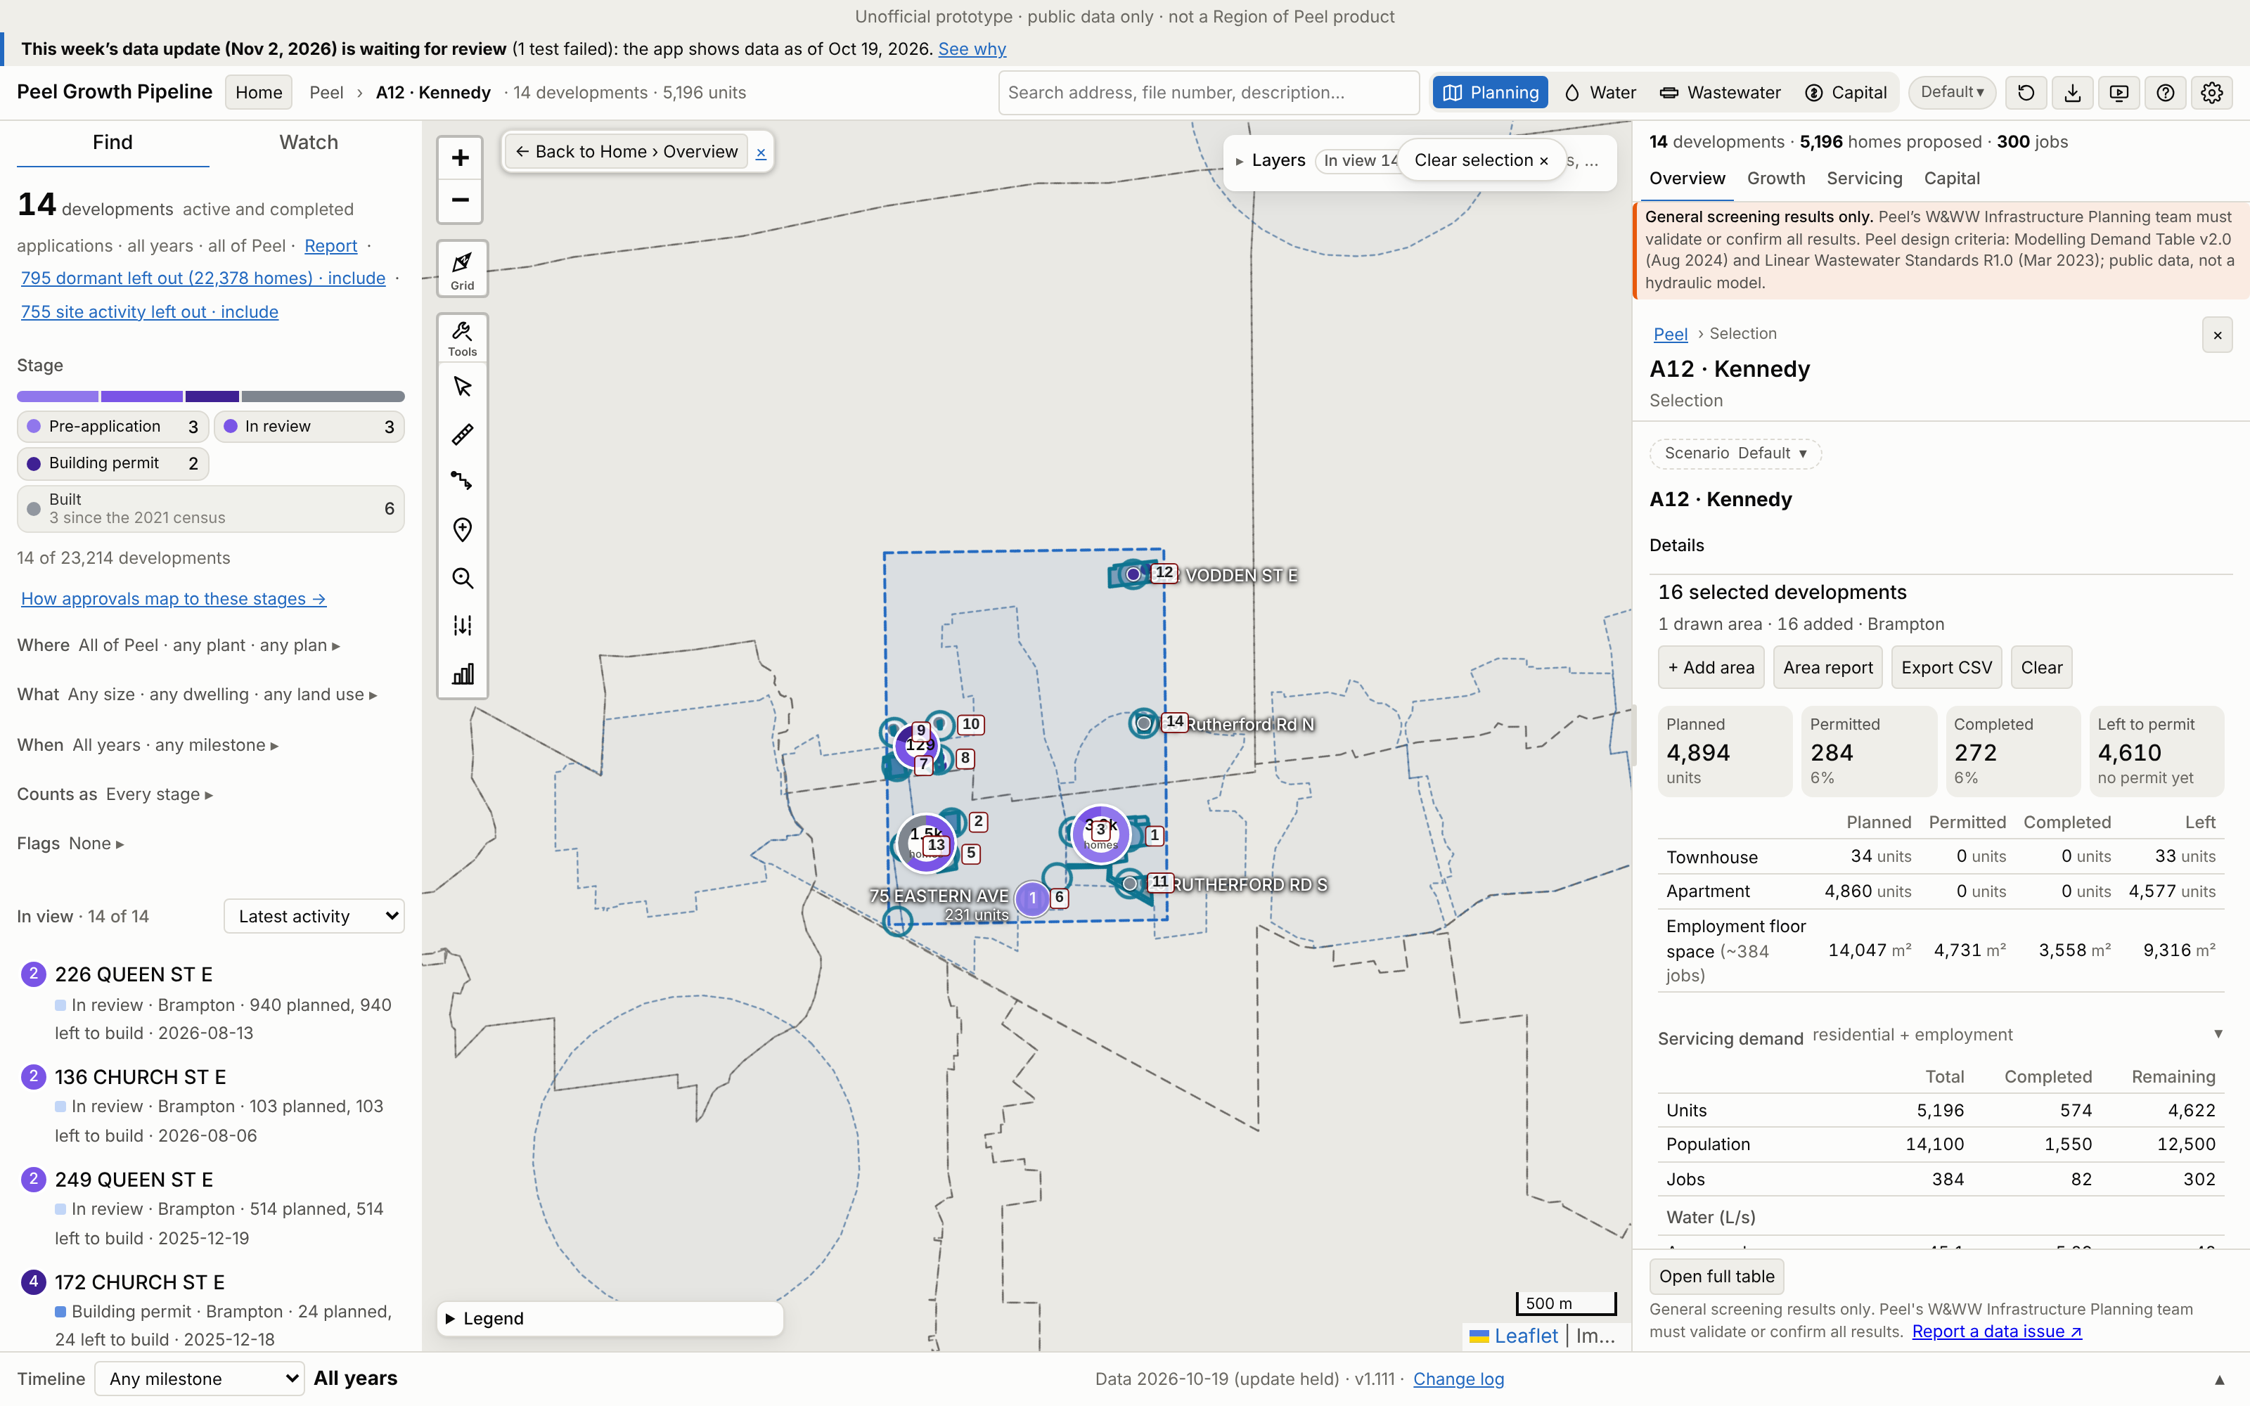
A12 · Kennedy
Growth | 2021–26 | 2021–31 | Build-out | Pre-2021*
Units | 109 | 527 | 4,731 | 465
Res. pop. | 294 | 1,433 | 12,825 | 1,257
Jobs | 0 | 78 | 302 | 82
*Pre-2021 = built before census day 2021-05-11, already in the 2021 Census (not added).
Region map: 9,716 people on 10.1 ha. App build-out = 132% of that.
16 developments: 14 planning applications and 2 permit-only (Brampton 16). 4 of 5 Region points matched.
No. / development | Stage | Units | 2021–31
1 14-263 QUEEN ST E | Pre-application | 2,810 | 189
2 226 QUEEN ST E | In review | 940 | 0
3 249 QUEEN ST E | In review | 514 | 141
4 SP81-041.000 | Built | 0 | 0
5 209 Queen Street East | Built | 109 | 109
6 75 EASTERN AVE | Pre-application | 231 | 64
7 136 CHURCH ST E | In review | 103 | 0
App screenshot: Peel Growth Pipeline full map. Dashed = the area as an app selection; labels = development no. (A12-###). The app's panel shows the developments' full size, pre-2021 included. Region map reference: maps/A12_Kennedy.png
Largest 7 of 14 applications by units, as growth since 2021. Every development: Excel sheet "A12"
Notes:
A12 Kennedy. Planning applications in the area (ID, title, stage, units build-out, files):
A12-001 14-263 QUEEN ST E | Pre-application | 2,810 units | PRE-2025-0048 (Comments Released); PRE-2022-0158 (Closed)
A12-002 226 QUEEN ST E | In review | 940 units | OZS-2022-0028 (Closed Approved); PRE-2026-0034 (Meeting Scheduled); PRE-2022-0002 (Closed); PRE-2021-0108 (Closed)
A12-003 249 QUEEN ST E | In review | 514 units | OZS-2023-0040 (Closed Approved); SPA-2025-0196 (In Review); PRE-2025-0067 (Closed); PRE-2022-0023 (Closed)
A12-004 SP81-041.000 | Built | 0 units | SP81-041.000 (Transferred)
A12-005 209 Queen Street East | Built | 109 units | C01E05.061 (OMB - Approved)
A12-006 75 EASTERN AVE | Pre-application | 231 units | PRE-2024-0055 (Comments Released)
A12-007 136 CHURCH ST E | In review | 103 units | OZS-2021-0011 (Closed Approved); SPA-2026-0090 (Submitted); PRE-2023-0075 (Comments Released); PRE-2020-0026 (Closed); OZS-2026-0016 (Approved)
A12-008 172 CHURCH ST E | Building permit | 24 units | OZS-2020-0026 (Closed Approved); SPA-2021-0257 (Site Plan Approved); PRE-2023-0163 (Meeting Scheduled); PRE-2021-0089 (Closed); PRE-2019-0023 (Closed)
A12-009 57 WOODWARD AVE | Built | 0 units | SPA-2019-0050 (Site Plan Approved)
A12-010 85 WOODWARD AVE | Built | 0 units | SPA-2022-0035 (Closed)
A12-011 25 RUTHERFORD RD S | Built | 0 units | SPA-2021-0032 (Site Plan Approved); PRE-2020-0169 (Closed)
A12-012 342 VODDEN ST E | Building permit | 0 units | SPA-2022-0201 (Site Plan Approved); PRE-2022-0108 (Closed)
A12-013 185 QUEEN ST E | Pre-application | 0 units | PRE-2025-0071 (Comments Released); PRE19.009 (Closed)
A12-014 68 Rutherford Rd N | Built | 0 units | SP88-142.000 (Transferred)

Slide 20
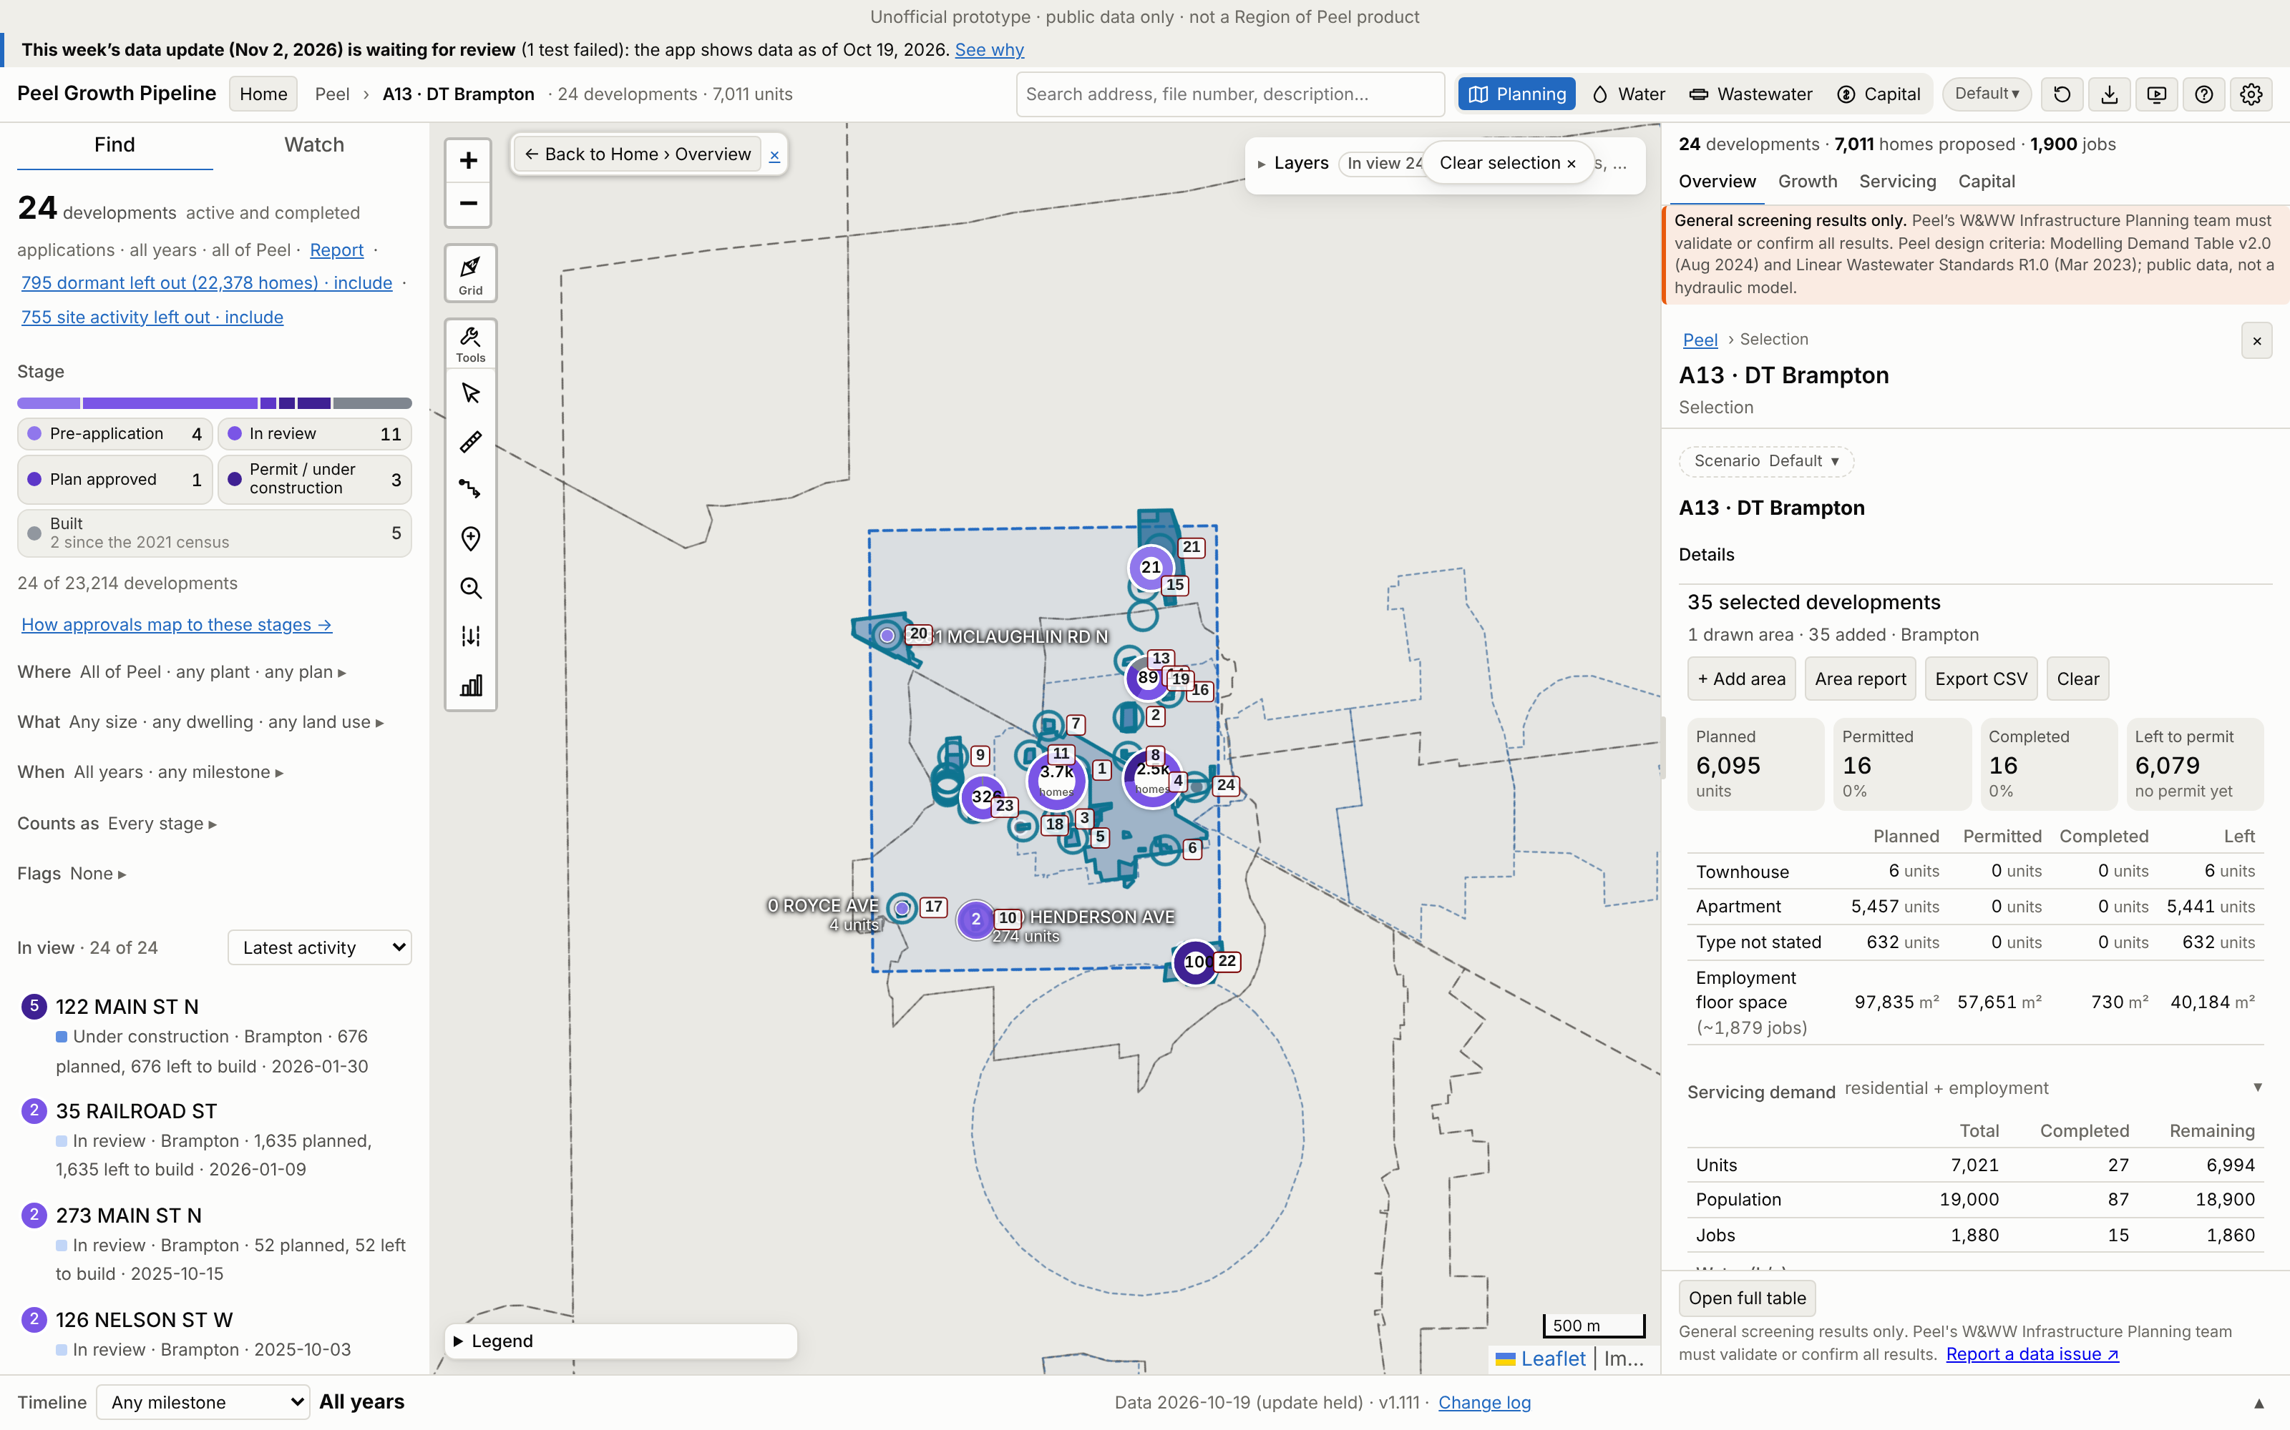
A13 · DT Brampton
Growth | 2021–26 | 2021–31 | Build-out | Pre-2021*
Units | 16 | 1,719 | 7,010 | 11
Res. pop. | 50 | 4,648 | 18,935 | 37
Jobs | 0 | 1,142 | 1,864 | 15
*Pre-2021 = built before census day 2021-05-11, already in the 2021 Census (not added).
Region map: 19,805 people on 13.48 ha. App build-out = 96% of that.
35 developments: 24 planning applications and 11 permit-only (Brampton 35). 10 of 10 Region points matched.
No. / development | Stage | Units | 2021–31
1 35 RAILROAD ST | In review | 1,635 | 258
2 199 MAIN ST N | In review | 1,149 | 0
3 29 MILL ST N | In review | 915 | 232
4 122 MAIN ST N | Under construction | 676 | 676
5 104 QUEEN ST W | In review | 551 | 150
6 22 JOHN ST | In review | 362 | 100
7 80 JOSEPH ST | Pre-application | 345 | 95
App screenshot: Peel Growth Pipeline full map. Dashed = the area as an app selection; labels = development no. (A13-###). The app's panel shows the developments' full size, pre-2021 included. Region map reference: maps/A13_DT_Brampton.png
Largest 7 of 24 applications by units, as growth since 2021. Every development: Excel sheet "A13"
Notes:
A13 DT Brampton. Planning applications in the area (ID, title, stage, units build-out, files):
A13-001 35 RAILROAD ST | In review | 1,635 units | OZS-2026-0002 (Deemed Complete); OZS-2024-0032 (In Review-Public Mtg Complete); PRE-2023-0089 (Closed)
A13-002 199 MAIN ST N | In review | 1,149 units | OZS-2022-0011 (Closed Approved); DPS-2022-0004 (In Review); PRE-2022-0086 (Closed); PRE-2021-0135 (Closed)
A13-003 29 MILL ST N | In review | 915 units | OZS-2024-0033 (Closed Approved); PRE-2023-0101 (Closed)
A13-004 122 MAIN ST N | Under construction | 676 units | OZS-2025-0011 (Closed Approved); SPA-2021-0269 (Substantially Complete); PRE-2021-0127 (Closed); C01E06.056 (Closed Approved); PRE-2020-0079 (Closed); PRE17.065 (PRE - Closed); OZS-2021-0053 (Closed Approved); SPA-2022-0122 (Agreement Execution); PRE-2022-0024 (Closed); PRE-2020-0033 (Closed); PRE18.036 (Closed); PRE16.090 (PRE - Closed); SPA-2026-0013 (Site Plan Approved); SPA-2026-0002 (In Review); SPA-2025-0083 (Site Plan Approved); SPA-2025-0056 (Site Plan Approved); SPA-2021-0176 (Site Plan Approved); SPA-2020-0124 (Site Plan Approved); SP86-001.000 (Transferred); SPA-2020-0128 (Site Plan Approved); SPA-2020-0087 (Site Plan Approved); SP81-016.000 (Transferred); SP17-018.000 (Approved); CI18.002
A13-005 104 QUEEN ST W | In review | 551 units | OZS-2024-0034 (In Review-Public Mtg Complete); PRE-2023-0081 (Closed)
A13-006 22 JOHN ST | In review | 362 units | OZS-2022-0035 (Closed Approved); PRE-2022-0035 (Closed)
A13-007 80 JOSEPH ST | Pre-application | 345 units | PRE-2024-0136 (Closed); PRE-2023-0065 (Closed)
A13-008 151 MAIN ST N | In review | 324 units | OZS-2021-0003 (Closed Approved); PRE-2022-0128 (Closed); PRE-2020-0043 (Closed); PRE17.052 (PRE - Closed)
A13-009 125 RAILROAD ST | In review | 322 units | OZS-2024-0002 (In Review-Public Mtg Complete); PRE-2022-0147 (Closed); PRE-2021-0235 (Closed)
A13-010 1-10 HENDERSON AVE | In review | 274 units | OZS-2024-0047 (In Review-Public Mtg Complete); PRE-2021-0028 (Closed)
A13-011 65 PARK ST | In review | 240 units | OZS-2024-0001 (Closed Approved); PRE-2020-0103 (Closed); PRE-2022-0145 (Comments Released)
A13-012 SP88-057.000 | Under construction | 100 units | SP88-057.000 (Transferred)
A13-013 273 MAIN ST N | In review | 52 units | DPS-2025-0007 (In Review); PRE-2025-0004 (Closed)
A13-014 85 SPROULE DR | Plan approved | 24 units | OZS-2024-0038 (Closed Approved); DPS-2023-0001 (Agreement Execution); PRE-2021-0228 (Closed)
A13-015 350 MAIN ST N | Pre-application | 21 units | PRE-2024-0071 (Meeting Scheduled); PRE-2022-0046 (Comments Released)
A13-016 25 William Street | Built | 12 units | C01E07.037 (Closed Approved); SPA-2023-0114 (Site Plan Approved); SPA-2019-0076 (Site Plan Approved); DPC-2024-0008 (Registration); PRE-2024-0072 (Comments Released); PRE17.069 (PRE - Closed); SP19-042.000 (Closed)
A13-017 0 ROYCE AVE | Pre-application | 4 units | PRE-2024-0023 (Comments Released); PRE16.116 (PRE - Closed)
A13-018 20 West St, Unit 1 | Built | 4 units | SP18-041.000 (Site Plan Approved)
A13-019 8 WILLIAM STREET | Built | 0 units | SP16-014.000 (Approved)
A13-020 9381 MCLAUGHLIN RD N | Pre-application | 0 units | PRE-2025-0056 (Meeting Scheduled); PRE-2024-0127 (Meeting Scheduled)
A13-021 125-370 MAIN ST N | Building permit | 0 units | OZS-2020-0003 (Closed Approved); SPA-2021-0104 (Site Plan Approved); SPA-2020-0053 (Site Plan Approved); PRE-2019-0004 (Closed); PRE19.004 (Closed)
A13-022 66 Main St S | Built | 0 units | SP93-048.000 (Transferred)
A13-023 126 NELSON ST W | In review | 0 units | OZS-2025-0044 (Staff Review Complete); PRE-2023-0066 (Closed)
A13-024 30 UNION ST | Built | 0 units | PRE-2021-0007 (Closed)

Slide 21
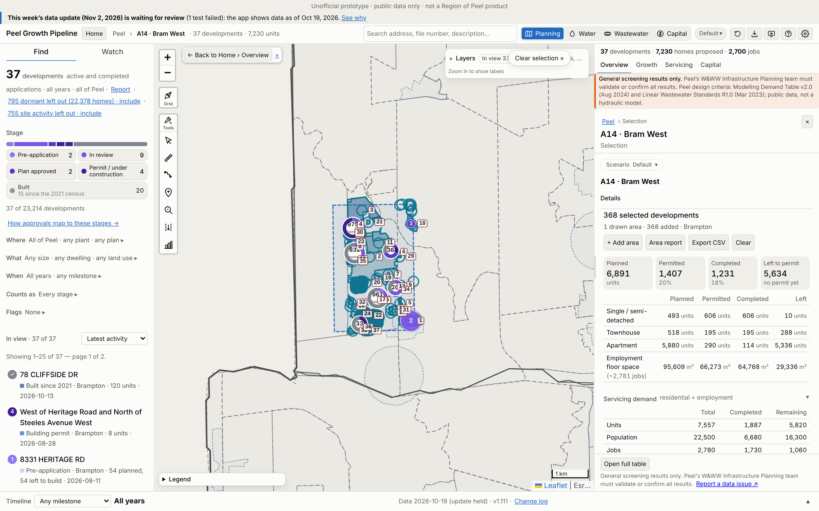
A14 · Bram West
Growth | 2021–26 | 2021–31 | Build-out | Pre-2021*
Units | 496 | 1,134 | 6,316 | 1,391
Res. pop. | 1,794 | 3,748 | 18,134 | 4,885
Jobs | 0 | 33 | 1,056 | 1,725
*Pre-2021 = built before census day 2021-05-11, already in the 2021 Census (not added).
Region map: 3,896 people on 45.09 ha. App build-out = 465% of that.
368 developments: 37 planning applications and 331 permit-only (Brampton 368). 4 of 4 Region points matched.
No. / development | Stage | Units | 2021–31
1 1750 STEELES AVE W | In review | 3,809 | 0
2 Between Heritage Road &… | Built | 154 | 154
3 North East Corner of Em… | Under construction | 537 | 537
4 8957 HERITAGE RD | In review | 398 | 106
5 58 & 62 SKY HARBOUR DRI… | Built | 229 | 0
6 8654 MISSISSAUGA RD | Plan approved | 243 | 0
7 West side of Mississaug… | Built | 0 | 0
App screenshot: Peel Growth Pipeline full map. Dashed = the area as an app selection; labels = development no. (A14-###). The app's panel shows the developments' full size, pre-2021 included. Region map reference: maps/A14_Bram_West.png
Largest 7 of 37 applications by units, as growth since 2021. Every development: Excel sheet "A14"
Notes:
A14 Bram West. Planning applications in the area (ID, title, stage, units build-out, files):
A14-001 1750 STEELES AVE W | In review | 3,809 units | OZS-2023-0014 (Closed Approved); PRE-2021-0105 (Closed)
A14-002 Between Heritage Road & Mississauga Road, south of Embleton Road | Built | 154 units | PRE17.071 (PRE - Closed)
A14-003 North East Corner of Embleton and Heritage Road | Under construction | 537 units | C05W06.007 (Draft Approved); SPA-2025-0194 (Site Plan Approved); SPA-2022-0078 (Closed); PRE17.025 (PRE - Closed); PRE-2021-0215 (Closed)
A14-004 8957 HERITAGE RD | In review | 398 units | OZS-2025-0004 (In Review); PRE-2022-0109 (Verification of Documents)
A14-005 58 & 62 SKY HARBOUR DRIVE | Built | 229 units | SPA-2021-0231 (Site Plan Approved); DPC-2022-0007 (Registered); PRE-2021-0111 (Closed); PRE-2025-0031 (Closed); SP18-019.000 (Site Plan Approved); SPA-2021-0165 (In Review)
A14-006 8654 MISSISSAUGA RD | Plan approved | 243 units | OZS-2025-0046 (Closed Approved); OZS-2025-0009 (Closed Approved); PRE-2024-0093 (Closed); PRE-2021-0144 (Closed); OZS-2022-0017 (Closed Approved); SPA-2025-0014 (Site Plan Agreement Prep)
A14-007 West side of Mississauga Road , North of Financial Drive | Built | 0 units | PRE16.018 (PRE - Closed)
A14-008 8799 HERITAGE RD | In review | 162 units | OZS-2026-0006 (In Review-Public Mtg Complete); PRE-2022-0172 (Closed); PRE16.035 (PRE - Closed)
A14-009 8383 MISSISSAUGA RD | In review | 131 units | OZS-2023-0007 (Under Appeal); PRE-2022-0034 (Closed); PRE-2020-0083 (Closed); PRE-2019-0056 (Closed)
A14-010 8671 HERITAGE RD | In review | 122 units | OZS-2022-0002 (In Review-Public Mtg Complete); PRE-2019-0070 (Closed); PRE17.013 (PRE - Closed); PRE16.076 (PRE - Closed)
A14-011 78 CLIFFSIDE DR | Built | 88 units | OZS-2020-0011 (Closed Approved); PRE17.070 (PRE - Closed)
A14-012 1 Beckenrose Court | Built | 0 units | C05W01.011 (Registered)
A14-013 50 Edinburgh Drive | Built | 0 units | C05W02.007 (Registered); PRE18.037 (Closed)
A14-014 1 Beckenrose Crt, Unit 140-151 | Built | 0 units | C05W01.012 (Registered)
A14-015 OZS-2026-0019 | In review | 76 units | OZS-2026-0019 (In Review-Pre Public Meeting); PRE-2026-0003 (Closed)
A14-016 8273 HERITAGE RD | Pre-application | 75 units | PRE-2024-0028 (Comments Released)
A14-017 8331 HERITAGE RD | Pre-application | 54 units | PRE-2026-0033 (Comments Released)
A14-018 1879 QUEEN ST W | Plan approved | 48 units | OZS-2020-0036 (Draft Approved); PRE-2020-0020 (Closed)
A14-019 100 Knotsberry Circle and 96 Oakmore Lane | Built | 0 units | C05W03.009 (Registered)
A14-020 1-39 Summerbeam Way | Southeast corner of Financial Drive and Rivermont Road | Built | 31 units | SP18-035.000 (Site Plan Approved); DPC-2021-0004 (Registered); PRE-2021-0069 (Closed); PRE16.094 (PRE - Closed)
A14-021 2305 EMBLETON RD | In review | 29 units | OZS-2025-0021 (In Review-Public Mtg Complete); PRE-2022-0055 (Closed)
A14-022 Rivermont Road and Steeles Ave. W. | Built | 0 units | C05W01.010 (Registered)
A14-023 8821 Heritage Road | Under construction | 8 units | C05W05.010 (Closed Approved); PRE17.136 (Closed)
A14-024 West of Heritage Road and North of Steeles Avenue West | Building permit | 8 units | PRE18.026 (Submitted)
A14-025 8885 HERITAGE RD | Built | 1 units | SPA-2021-0155 (Site Plan Approved)
A14-026 8889 HERITAGE RD | Built | 1 units | SPA-2021-0154 (Site Plan Approved)
A14-027 8897 HERITAGE RD | Built | 1 units | SPA-2021-0152 (Site Plan Approved)
A14-028 8901 HERITAGE RD | Built | 1 units | SPA-2021-0151 (Site Plan Approved)
A14-029 8627 MISSISSAUGA RD | In review | 1 units | OZS-2023-0037 (Closed Approved); PRE-2022-0083 (Closed)
A14-030 8893 HERITAGE RD | Built | 1 units | SPA-2021-0153 (Site Plan Approved)
A14-031 8000 MISSISSAUGA RD | Built | 0 units | SPA-2022-0219 (Site Plan Approved)
A14-032 Heritage block · 2 draft / site plans | In review | 0 units | OZS-2024-0031 (Closed Approved); SPA-2025-0171 (In Review); PRE-2025-0006 (Closed); SPA-2025-0170 (In Review)
A14-033 Northeast Corner of Heritage Road and Steeles Avenue West | Built | 0 units | SP17-106.000 (Approved); PRE19.029 (Closed); PRE17.080 (PRE - Closed); DPC-2019-0003 (Registered)
A14-034 45 MONTPELIER ST | Built | 0 units | SPA-2025-0097 (Site Plan Approved); SPA-2020-0048 (Site Plan Approved); PRE-2025-0012 (Closed); SPA-2024-0045 (Site Plan Approved); SPA-2023-0034 (Site Plan Approved); SPA-2023-0008 (Site Plan Approved); SP16-017.000 (Approved)
A14-035 8645 HERITAGE RD | Building permit | 0 units | SPA-2023-0054 (Site Plan Approved); PRE-2022-0100 (Closed)
A14-036 30 LIGHTBEAM TERR | Built | 0 units | SPA-2025-0103 (Site Plan Approved); SPA-2023-0098 (Site Plan Approved); SPA-2024-0133 (Site Plan Approved); SP18-120.000 (Site Plan Approved); PRE17.092 (PRE - Closed)
A14-037 10 - 80 Rivermont Road | Built | 0 units | SP13-045.003 (Site Plan Approved); SP13-045.004 (Verification of Documents)

Slide 22
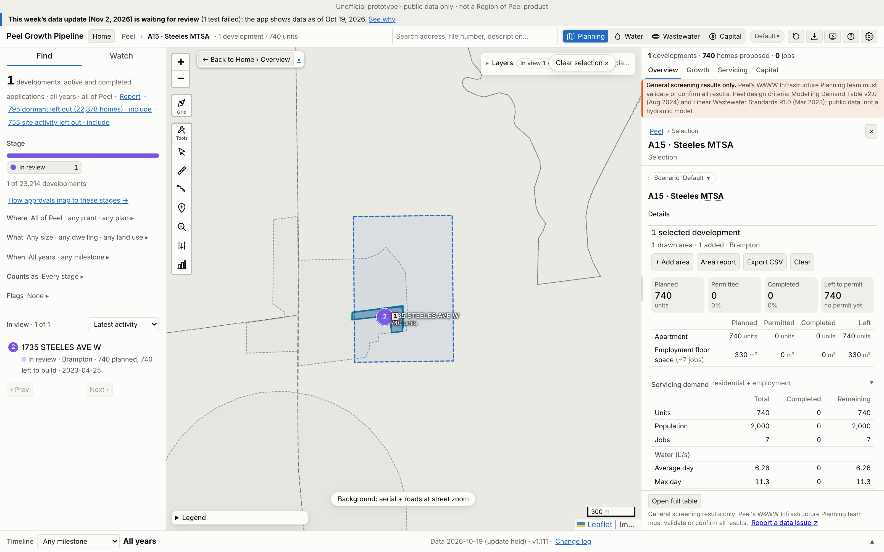
A15 · Steeles MTSA
Growth | 2021–26 | 2021–31 | Build-out | Pre-2021*
Units | 0 | 0 | 740 | 0
Res. pop. | 0 | 0 | 1,998 | 0
Jobs | 0 | 0 | 7 | 0
*Pre-2021 = built before census day 2021-05-11, already in the 2021 Census (not added).
Region map: 12,793 people on 13.76 ha. App build-out = 16% of that.
1 developments: 1 planning applications and 0 permit-only (Brampton 1). 1 of 1 Region points matched.
No. / development | Stage | Units | 2021–31
1 1735 STEELES AVE W | In review | 740 | 0
App screenshot: Peel Growth Pipeline full map. Dashed = the area as an app selection; labels = development no. (A15-###). The app's panel shows the developments' full size, pre-2021 included. Region map reference: maps/A15_Steeles_MTSA.png
Largest 1 of 1 applications by units, as growth since 2021. Every development: Excel sheet "A15"
Notes:
A15 Steeles MTSA. Planning applications in the area (ID, title, stage, units build-out, files):
A15-001 1735 STEELES AVE W | In review | 740 units | OZS-2023-0015 (Closed Approved); PRE-2021-0106 (Closed)

Slide 23
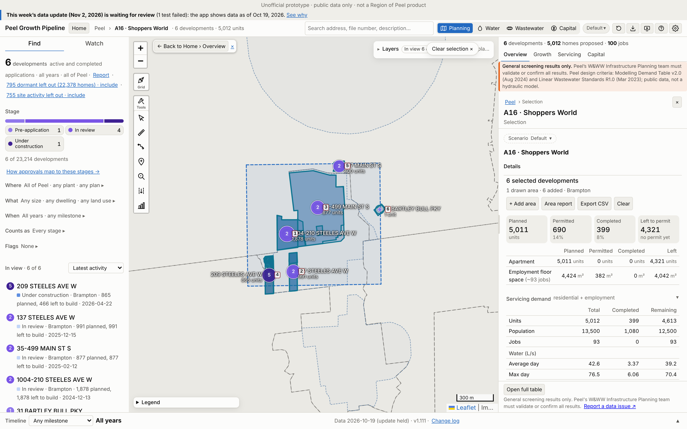
A16 · Shoppers World
Growth | 2021–26 | 2021–31 | Build-out | Pre-2021*
Units | 30 | 496 | 4,643 | 369
Res. pop. | 81 | 1,340 | 12,537 | 996
Jobs | 0 | 19 | 93 | 0
*Pre-2021 = built before census day 2021-05-11, already in the 2021 Census (not added).
Region map: 20,732 people on 23.62 ha. App build-out = 60% of that.
6 developments: 6 planning applications and 0 permit-only (Brampton 6). 4 of 4 Region points matched.
No. / development | Stage | Units | 2021–31
1 1004-210 STEELES AVE W | In review | 1,878 | 0
2 137 STEELES AVE W | In review | 991 | 0
3 35-499 MAIN ST S | In review | 877 | 0
4 209 STEELES AVE W | Under construction | 496 | 496
5 227 MAIN ST S | In review | 400 | 0
6 31 BARTLEY BULL PKY | Pre-application | 1 | 0
App screenshot: Peel Growth Pipeline full map. Dashed = the area as an app selection; labels = development no. (A16-###). The app's panel shows the developments' full size, pre-2021 included. Region map reference: maps/A16_Shoppers_World.png
Largest 6 of 6 applications by units, as growth since 2021. Every development: Excel sheet "A16"
Notes:
A16 Shoppers World. Planning applications in the area (ID, title, stage, units build-out, files):
A16-001 1004-210 STEELES AVE W | In review | 1,878 units | OZS-2022-0023 (Closed Approved); SPA-2024-0169 (In Review); PRE-2024-0078 (Verification of Documents); PRE-2020-0048 (Closed)
A16-002 137 STEELES AVE W | In review | 991 units | OZS-2025-0019 (Deemed Complete); OZS-2024-0040 (Closed Approved); PRE-2024-0032 (Closed); PRE-2021-0088 (Closed); OZS-2023-0018 (Closed Approved); SPA-2025-0193 (In Review)
A16-003 35-499 MAIN ST S | In review | 877 units | OZS-2019-0009 (In Review); SPA-2025-0024 (Site Plan Approved); SPA-2024-0104 (In Review); SPA-2022-0120 (In Review); PRE-2020-0032 (Closed); PRE18.049 (Closed)
A16-004 209 STEELES AVE W | Under construction | 496 units | OZS-2021-0032 (Closed Approved); SPA-2026-0056 (In Review); SPA-2025-0059 (Site Plan Approved); SPA-2025-0026 (Site Plan Approved); SPA-2024-0129 (Site Plan Approved); SPA-2021-0230 (Site Plan Approved); SP16-091.000 (Approved); DPC-2025-0009 (Registration); PRE-2021-0029 (Closed); PRE-2021-0026 (Closed); PRE16.072 (PRE - Closed); T01W15.038 (Registered); PRE19.026 (Closed); OZS-2020-0028 (Closed Approved); OZS-2019-0005 (Withdrawn); SPA-2023-0140 (Site Plan Approved); SPA-2020-0152 (Site Plan Approved); DPC-2024-0002 (Registered); PRE-2020-0053 (Closed); PRE-2020-0054 (Closed); SP19-031.000 (Withdrawn); SP18-010.000 (Withdrawn)
A16-005 227 MAIN ST S | In review | 400 units | OZS-2021-0056 (Closed Approved); PRE-2020-0074 (Closed); PRE-2024-0095 (Meeting Scheduled)
A16-006 31 BARTLEY BULL PKY | Pre-application | 1 units | PRE-2024-0134 (Comments Released)

Slide 24
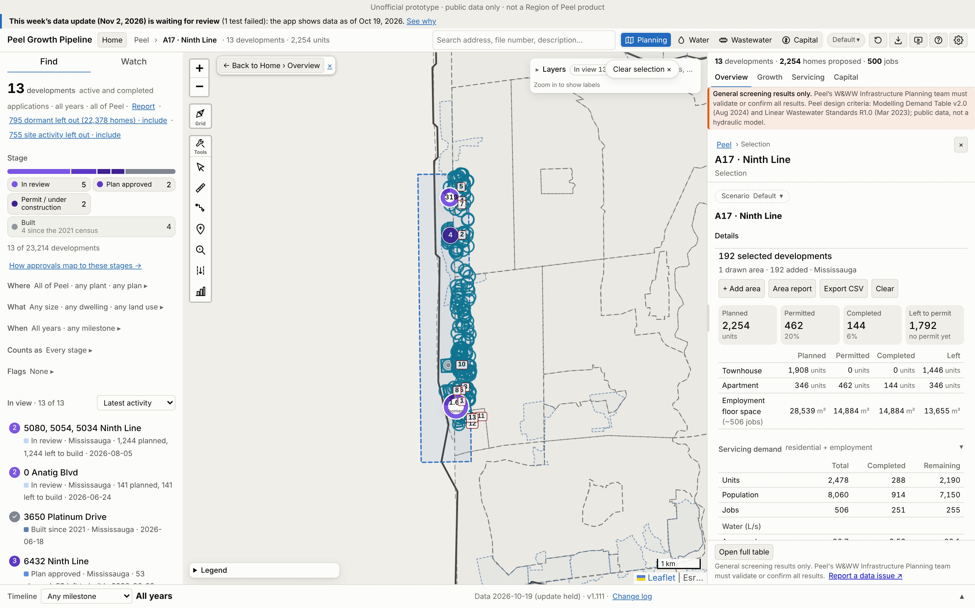
A17 · Ninth Line
Growth | 2021–26 | 2021–31 | Build-out | Pre-2021*
Units | 241 | 2,019 | 2,431 | 47
Res. pop. | 751 | 6,515 | 7,899 | 164
Jobs | 125 | 135 | 380 | 126
*Pre-2021 = built before census day 2021-05-11, already in the 2021 Census (not added).
Region map: 9,058 people on 38.45 ha. App build-out = 87% of that.
192 developments: 13 planning applications and 179 permit-only (Mississauga 192). 3 of 3 Region points matched.
No. / development | Stage | Units | 2021–31
1 5080, 5054, 5034 Ninth … | In review | 1,244 | 903
2 6432 Ninth Line | Building permit | 318 | 292
3 5160 Ninth Line, 0 Nint… | Plan approved | 205 | 199
4 0 Anatig Blvd | In review | 141 | 122
5 6578 and 6432 Ninth Line | In review | 125 | 108
6 5150 Ninth Line | Under construction | 122 | 121
7 6432 Ninth Line | Plan approved | 53 | 52
App screenshot: Peel Growth Pipeline full map. Dashed = the area as an app selection; labels = development no. (A17-###). The app's panel shows the developments' full size, pre-2021 included. Region map reference: maps/A17_Ninth_Line.png
Largest 7 of 13 applications by units, as growth since 2021. Every development: Excel sheet "A17"
Notes:
A17 Ninth Line. Planning applications in the area (ID, title, stage, units build-out, files):
A17-001 5080, 5054, 5034 Ninth Line | In review | 1,244 units | 21T-M 21-4 (WITHHELD); OZ/OPA 21-15 (WITHHELD); SP 26-27 (APPLICATION IN PROCESS)
A17-002 6432 Ninth Line | Building permit | 318 units | SP 24-50 (APPROVED); 21CDM-M 26-9 (APPLICATION IN PROCESS)
A17-003 5160 Ninth Line, 0 Ninth Line and 5170 Ninth Line | Plan approved | 205 units | OZ 22-4 (APPROVED); SP 24/20 (Approved)
A17-004 0 Anatig Blvd | In review | 141 units | SP 26-8 (WITHHELD); OZ 26-11 (APPLICATION IN PROCESS)
A17-005 6578 and 6432 Ninth Line | In review | 125 units | SP 26-1 (WITHHELD); OZ 26-6 (APPLICATION IN PROCESS)
A17-006 5150 Ninth Line | Under construction | 122 units | SP 20/084 (Approved)
A17-007 6432 Ninth Line | Plan approved | 53 units | SP 25-39 (APPROVED)
A17-008 5150 Ninth Line | Built | 46 units | SP 22/158 (Approved)
A17-009 3645 PLATINUM DR | In review | 0 units | SP 24-49 (WITHHELD)
A17-010 5320 Ninth Line | Built | 0 units | SP 17/001 (Approved)
A17-011 3575 Platinum Drive | In review | 0 units | SP 25-40 (WITHHELD)
A17-012 3650 Platinum Drive | Built | 0 units | SP 21/096 (Approved)
A17-013 3663 Platinum Drive | Built | 0 units | SP 16/029 (Approved)

Slide 25
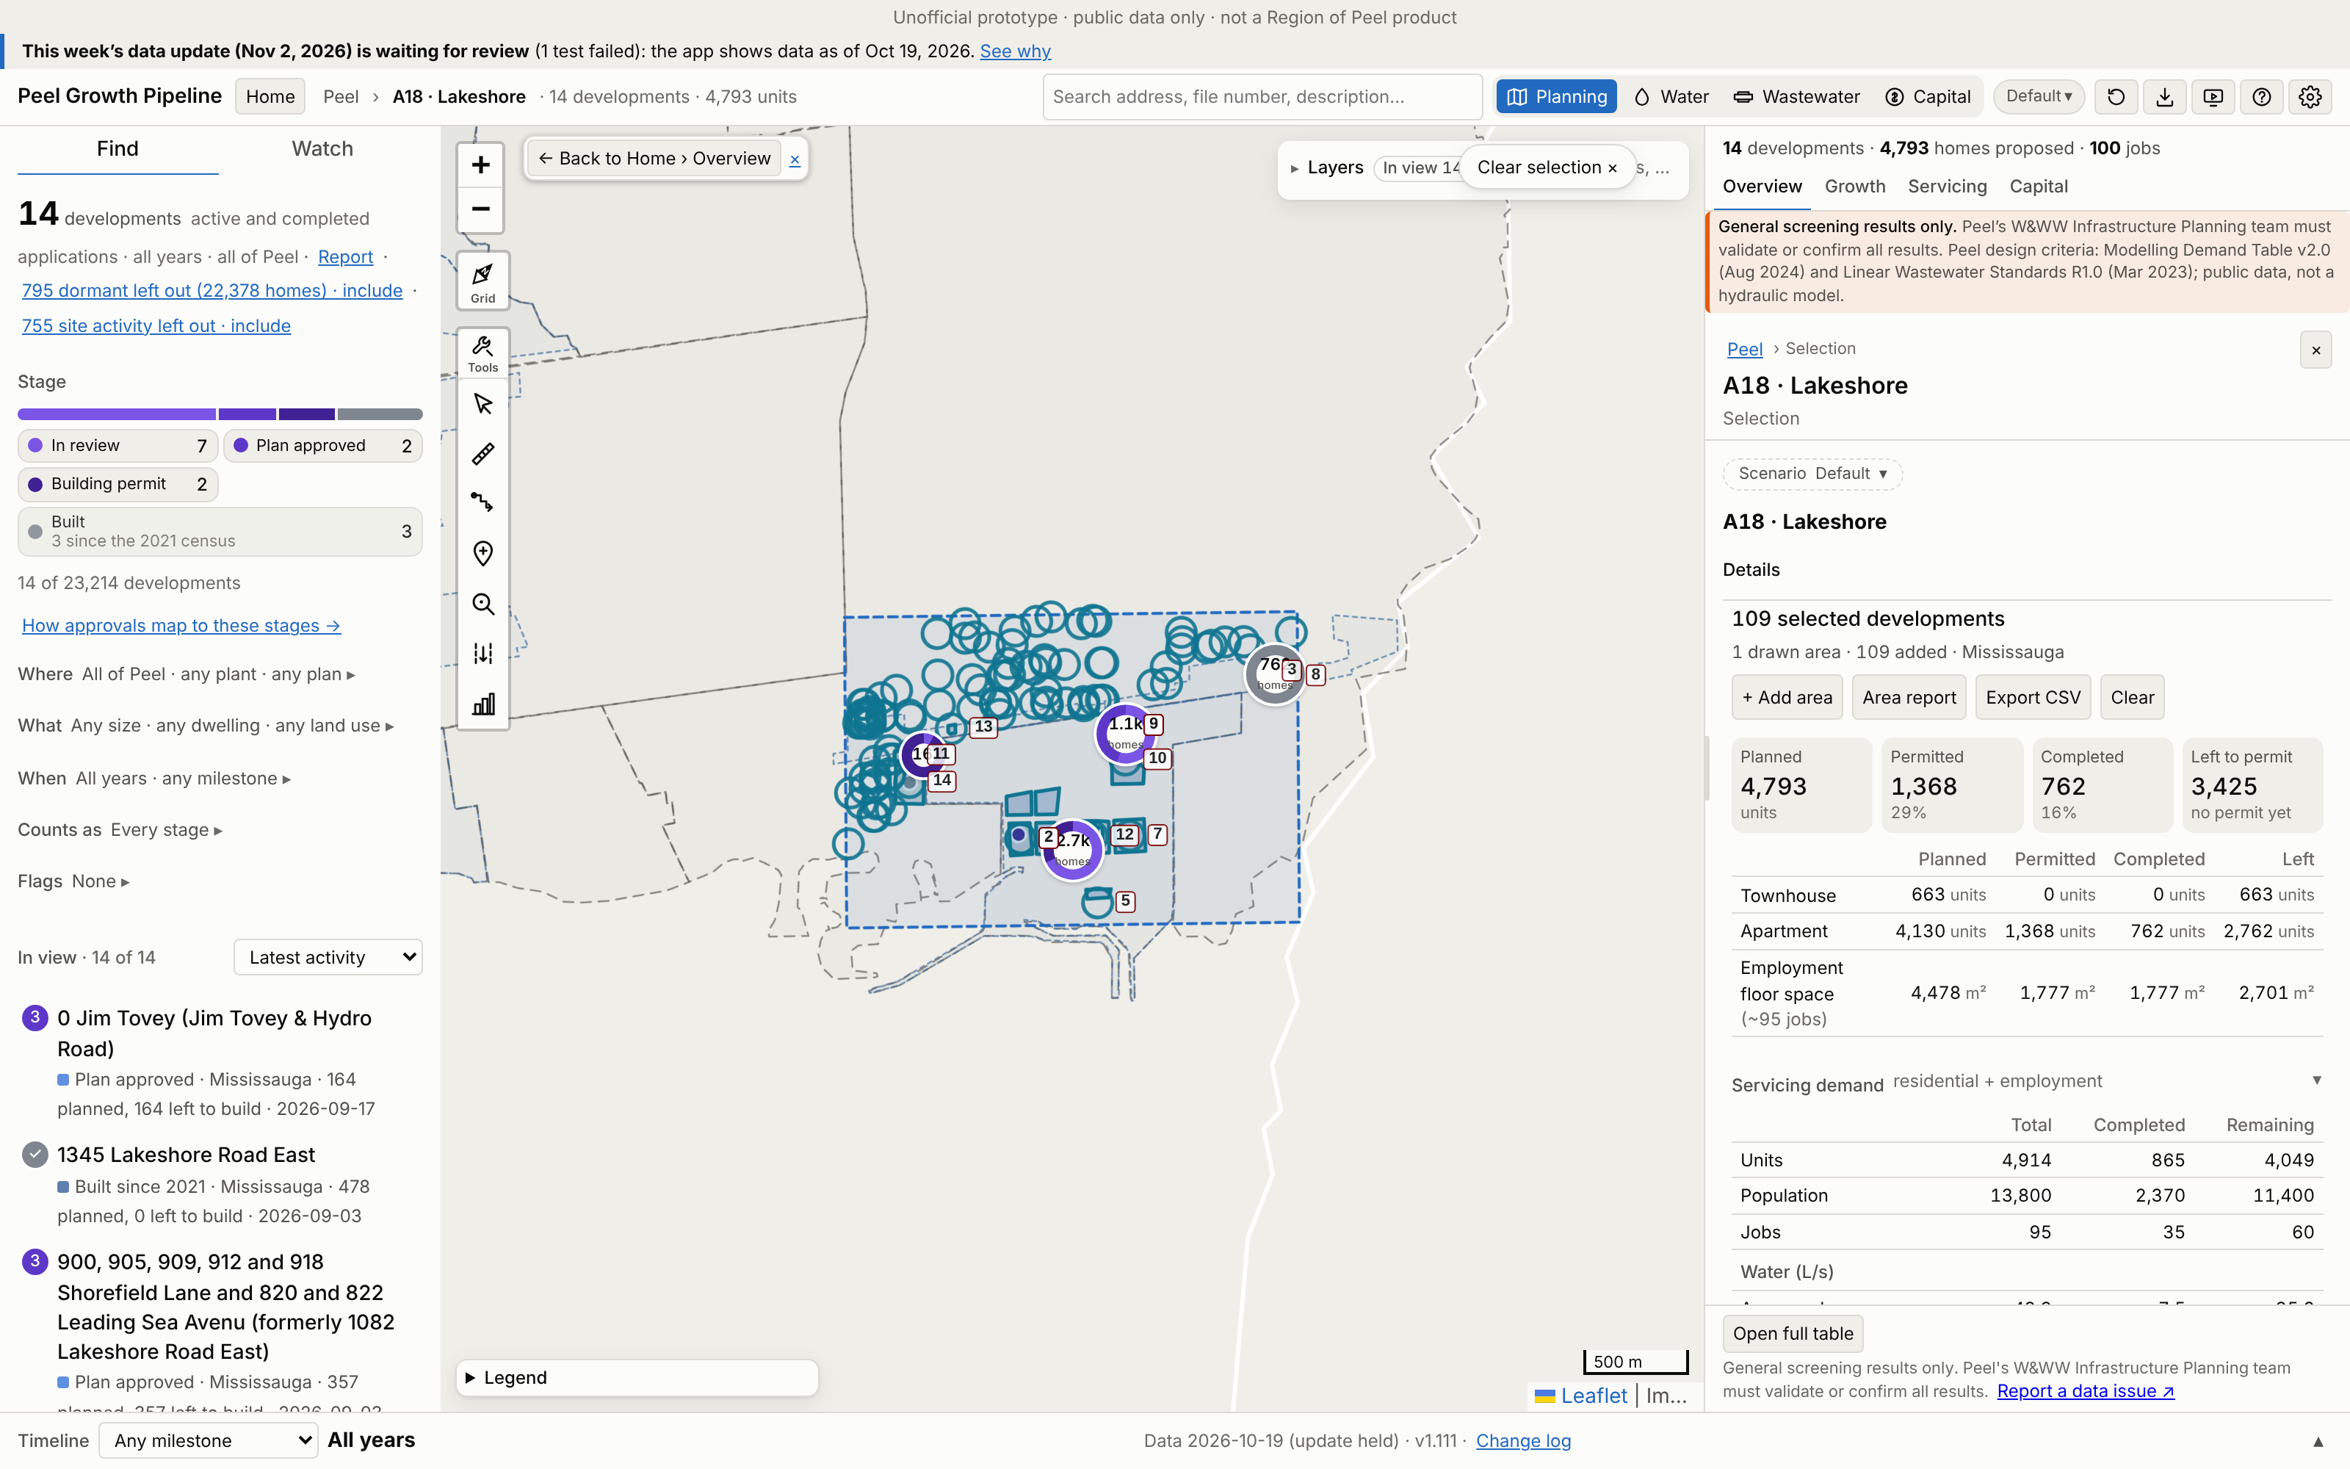
A18 · Lakeshore
Growth | 2021–26 | 2021–31 | Build-out | Pre-2021*
Units | 817 | 4,238 | 4,866 | 53
Res. pop. | 2,206 | 11,875 | 13,612 | 176
Jobs | 33 | 75 | 93 | 2
*Pre-2021 = built before census day 2021-05-11, already in the 2021 Census (not added).
Region map: 69,769 people on 62.08 ha. App build-out = 20% of that.
109 developments: 14 planning applications and 95 permit-only (Mississauga 109). 2 of 2 Region points matched.
No. / development | Stage | Units | 2021–31
1 950 Aerodrome Avenue,75… | In review | 1,100 | 663
2 910 Aerodrome Avenue an… | Building permit | 865 | 830
3 1345 Lakeshore Road East | Built | 478 | 478
4 830 Cove View, 821 & 82… | In review | 365 | 341
5 1050 Shoreview Landing,… | In review | 360 | 336
6 900, 905, 909, 912 and … | Plan approved | 357 | 347
7 0 Jim Tovey Boulevard | In review | 306 | 255
App screenshot: Peel Growth Pipeline full map. Dashed = the area as an app selection; labels = development no. (A18-###). The app's panel shows the developments' full size, pre-2021 included. Region map reference: maps/A18_Lakeshore.png
Largest 7 of 14 applications by units, as growth since 2021. Every development: Excel sheet "A18"
Notes:
A18 Lakeshore. Planning applications in the area (ID, title, stage, units build-out, files):
A18-001 950 Aerodrome Avenue,750 Cove View, 705 Leading Sea Ave and 975 Marina Vista (formerly 985 Hydro Road) | In review | 1,100 units | SP 24-15 (WITHHELD)
A18-002 910 Aerodrome Avenue and 700 Leading Sea Avenue (formerly 1082 Lakeshore Road East) | Building permit | 865 units | SP 21/168 (Approved)
A18-003 1345 Lakeshore Road East | Built | 478 units | SP 21-143 (APPROVED); 21CDM-M 26-3 (WITHHELD)
A18-004 830 Cove View, 821 & 823 Leading Sea Avenue, 930, 940, 955 & 965 Headwind Lane, 830 Cove View (formerly 1082 Lakeshore Road East) | In review | 365 units | SP 22-82 (WITHHELD)
A18-005 1050 Shoreview Landing, 1055 and 1065 South Shore Promenade (formerly 1082 Lakeshore Rd E) | In review | 360 units | SP 24-19 (WITHHELD)
A18-006 900, 905, 909, 912 and 918 Shorefield Lane and 820 and 822 Leading Sea Avenu (formerly 1082 Lakeshore Road East) | Plan approved | 357 units | SP 22-56 (APPROVED)
A18-007 0 Jim Tovey Boulevard | In review | 306 units | SP 26-2 (WITHHELD)
A18-008 1381 Lakeshore Road East | Built | 284 units | 21CDM-M 25-6 (APPROVED); SP 22/157 (Approved)
A18-009 1082 Lakeshore Road East | In review | 264 units | SP 26-24 (WITHHELD)
A18-010 0 Jim Tovey (Jim Tovey & Hydro Road) | Plan approved | 164 units | SP 25-48 (APPROVED); 21CDM-M 26-12 (APPLICATION IN PROCESS)
A18-011 970 East Avenue (formerly 958 - 960 East Avenue) | Building permit | 150 units | SP 24-35 (APPROVED)
A18-012 1082 Lakeshore Road East | In review | 88 units | SP 25-68 (WITHHELD)
A18-013 857 & 859 LAKESHORE RD E | In review | 12 units | SP 24-51 (WITHHELD)
A18-014 938 East Avenue | Built | 0 units | SP 16/155 (Approved)

Slide 26
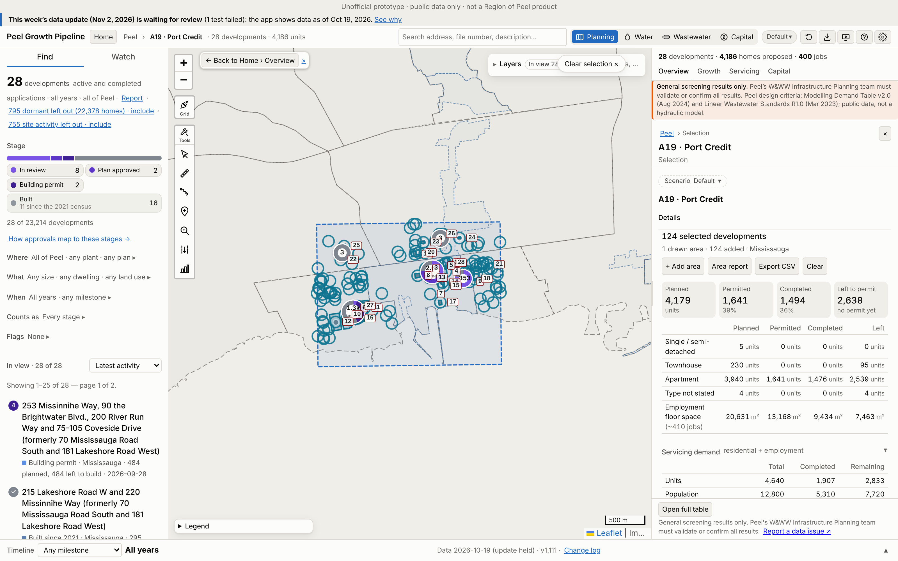
A19 · Port Credit
Growth | 2021–26 | 2021–31 | Build-out | Pre-2021*
Units | 1,778 | 4,396 | 4,611 | 130
Res. pop. | 4,904 | 12,042 | 12,626 | 411
Jobs | 210 | 397 | 410 | 0
*Pre-2021 = built before census day 2021-05-11, already in the 2021 Census (not added).
Region map: 19,441 people on 21.98 ha. App build-out = 65% of that.
124 developments: 28 planning applications and 96 permit-only (Mississauga 124). 3 of 3 Region points matched.
No. / development | Stage | Units | 2021–31
1 88 Park Street East | Plan approved | 819 | 752
2 253 Missinnihe Way, 90 … | Building permit | 484 | 445
3 46 Park Street East | In review | 444 | 409
4 19 Ann Street | In review | 362 | 338
5 28 Ann Street (formerly… | Built | 359 | 359
6 215 Lakeshore Road W an… | Built | 311 | 311
7 91,93 & 99 Lakeshore Rd… | In review | 221 | 213
App screenshot: Peel Growth Pipeline full map. Dashed = the area as an app selection; labels = development no. (A19-###). The app's panel shows the developments' full size, pre-2021 included. Region map reference: maps/A19_Port_Credit.png
Largest 7 of 28 applications by units, as growth since 2021. Every development: Excel sheet "A19"
Notes:
A19 Port Credit. Planning applications in the area (ID, title, stage, units build-out, files):
A19-001 88 Park Street East | Plan approved | 819 units | SP 25-5 (Active); OZ/OPA 22-10 (APPROVED)
A19-002 253 Missinnihe Way, 90 the Brightwater Blvd., 200 River Run Way and 75-105 Coveside Drive (formerly 70 Mississauga Road South and 181 Lakeshore Road West) | Building permit | 484 units | SP 21-130 (WITHHELD)
A19-003 46 Park Street East | In review | 444 units | SP 25-10 (WITHHELD); OZ/OPA 25-10 (APPROVED)
A19-004 19 Ann Street | In review | 362 units | SP 25-6 (WITHHELD); OZ/OPA 22-3 (APPROVED)
A19-005 28 Ann Street (formerly 78 Park Street East and 22-28 Ann Street) | Built | 359 units | SP 20/051 (Approved)
A19-006 215 Lakeshore Road W and 220 Missinnihe Way (formerly 70 Mississauga Road South and 181 Lakeshore Road West) | Built | 311 units | SP 19/155 (Approved)
A19-007 91,93 & 99 Lakeshore Rd E and 42 Port St and 0 Port St E | In review | 221 units | OZ/OPA 22-30 (WITHHELD)
A19-008 21, 25, 29 Park Street East | Built | 204 units | SP 18/073 (Approved)
A19-009 170 Lakeshore Rd E | In review | 184 units | SP 26-21 (APPLICATION IN PROCESS); OZ/OPA 21-16 (OMB APPEAL)
A19-010 55 Coveside Drive (formerly 70 Mississauga Road South) | Built | 174 units | SP 21/021 (Approved); 21CDM-M 24-16 (REGISTERED)
A19-011 200 Missinnihe Way (formerly 70 Mississauga Road South) | Built | 150 units | SP 21/187 (Approved)
A19-012 10 - 60 Lou Parsons Way (formerly Masonry Way ) | Built | 106 units | SP 20/048 (Approved); 21CDM-M 23-16 (REGISTERED)
A19-013 50 High Street East | In review | 96 units | SP 26-6 (WITHHELD); OZ 25-19 (APPROVED)
A19-014 8 Ann St, 77 & 81 High St E (formerly 6, 8 and 10 Ann St) | Built | 68 units | SP 16/036 (Approved)
A19-015 128 Lakeshore Rd East | In review | 70 units | SP 26-20 (WITHHELD); OZ/OPA 22-5 (APPROVED)
A19-016 1, 2, 8, 10, 11 and 18 Ships Landing Place and 20 and 30 Pierview Way (formerly 215-231 Missinnihe Way) | In review | 70 units | SP 22-103 (WITHHELD)
A19-017 55 Port Street East | Built | 31 units | SP 20/025 (Approved)
A19-018 7 Elmwood Avenue North | In review | 25 units | SP 26-12 (WITHHELD)
A19-019 1130, 1136 & 1138 Mona Road (formerly 1142 Mona Rd) | Built | 0 units | 21CDM-M 23-12 (REGISTERED); SP 20/092 (Approved)
A19-020 1148 Mona Road | Plan approved | 10 units | OZ/OPA 25-2 (APPROVED); H-OZ 25 5 (Withheld)
A19-021 32 Forest Avenue | Built | 0 units | SPM 16/009 (Approved)
A19-022 1174 KANE RD | Built | 0 units | SPI 18/142 (Approved)
A19-023 1201 MONA RD | Built | 0 units | SPI 18/128 (Approved)
A19-024 1204 Argreen Road | Built | 0 units | SPI 17/117 (Approved)
A19-025 1222 Mississauga Road | Built | 1 units | SPI 17/101 (Approved)
A19-026 39 INGLEWOOD DR | Built | 1 units | SPI 21/175 (Approved)
A19-027 215 Lakeshore Rd W and 220 Missinihe Way (formerly 70 Mississauga Road South) | Built | 0 units | SP 19/138 (Approved)
A19-028 50 Hurontario Street | Building permit | 0 units | SP 21/120 (Approved)

Slide 27
Method, definitions and caveats
Areas
Figures (the app's)
Caveats
Red boxes from the Region PDF, georeferenced by fitting its municipal boundary to the app's (scale within 0.02% of 1:192,036; ~160 m fit).
A development counts in an area when its site point is inside the box.
Names follow the map labels, checked against app plan names.
Base: the 2021 Census. Everything is growth from census day (2021-05-11).
Existing 2021–26 = permits completed since census day (Growth › 2021 existing, "Built since"). Brampton and Caledon completion dates are estimated from issue dates.
2021–31 = that plus the Forecast's 2026–2031 share (Growth › Forecast › By period).
Build-out = 2021–26 plus everything left to build.
People = units × persons per unit by type (4.2 / 3.4 / 3.1 or 2.7 / 2.7).
Jobs = non-residential floor area on the applications; employment counts by 2031 when approved to under construction.
Unofficial screening estimate from public open data, not the Region's capacity ledger.
Sites at a box edge may belong to a neighbouring area.
Lands with no application yet are not in the app, so the Region's figures can be higher.
Untimed developments (e.g. the 9,862-unit Heritage / Bovaird block) count nothing by 2031.

