Slide 1
Recursion and Induction
  For advanced algorithm development,
  recursion is an essential design technique
Recursive Procedures
What is a Proof?
Induction Proofs
Proving Correctness of Procedures
Recurrence Equations
Recursion Trees

Slide 2
Recurrence Equations vs.
Recursive Procedures
Recurrence Equations:
  defines a function over the natural numbers, say T(n), in terms of its own value at one or more integers
  smaller than n.
  T(n) is defined inductively.
  There are base cases to be defined separately.
  Recurrence equation applies for n larger than
  the base cases
Recursive Procedures:
  a procedure calls a unique copy of itself
  converging to a base case (stopping the recursion)

Slide 3
e.g. Fibonacci Function
Recurrence Equation: e.g. Fibonacci Function
  fib(0) = 0; fib(1) = 1; // base cases
  fib(n) = fib(n-1) + fib(n-2) // all n>2
Recursive Procedure:
int fib(int n)
  int f, f1, f2;
  1. if (n < 2)
  2. f = n; // base cases
  3. else
  4. f1 = fib( n-1 );
  5. f2 = fib( n-2 );
  6. f = f1 + f2;
  7. return f;

Slide 4
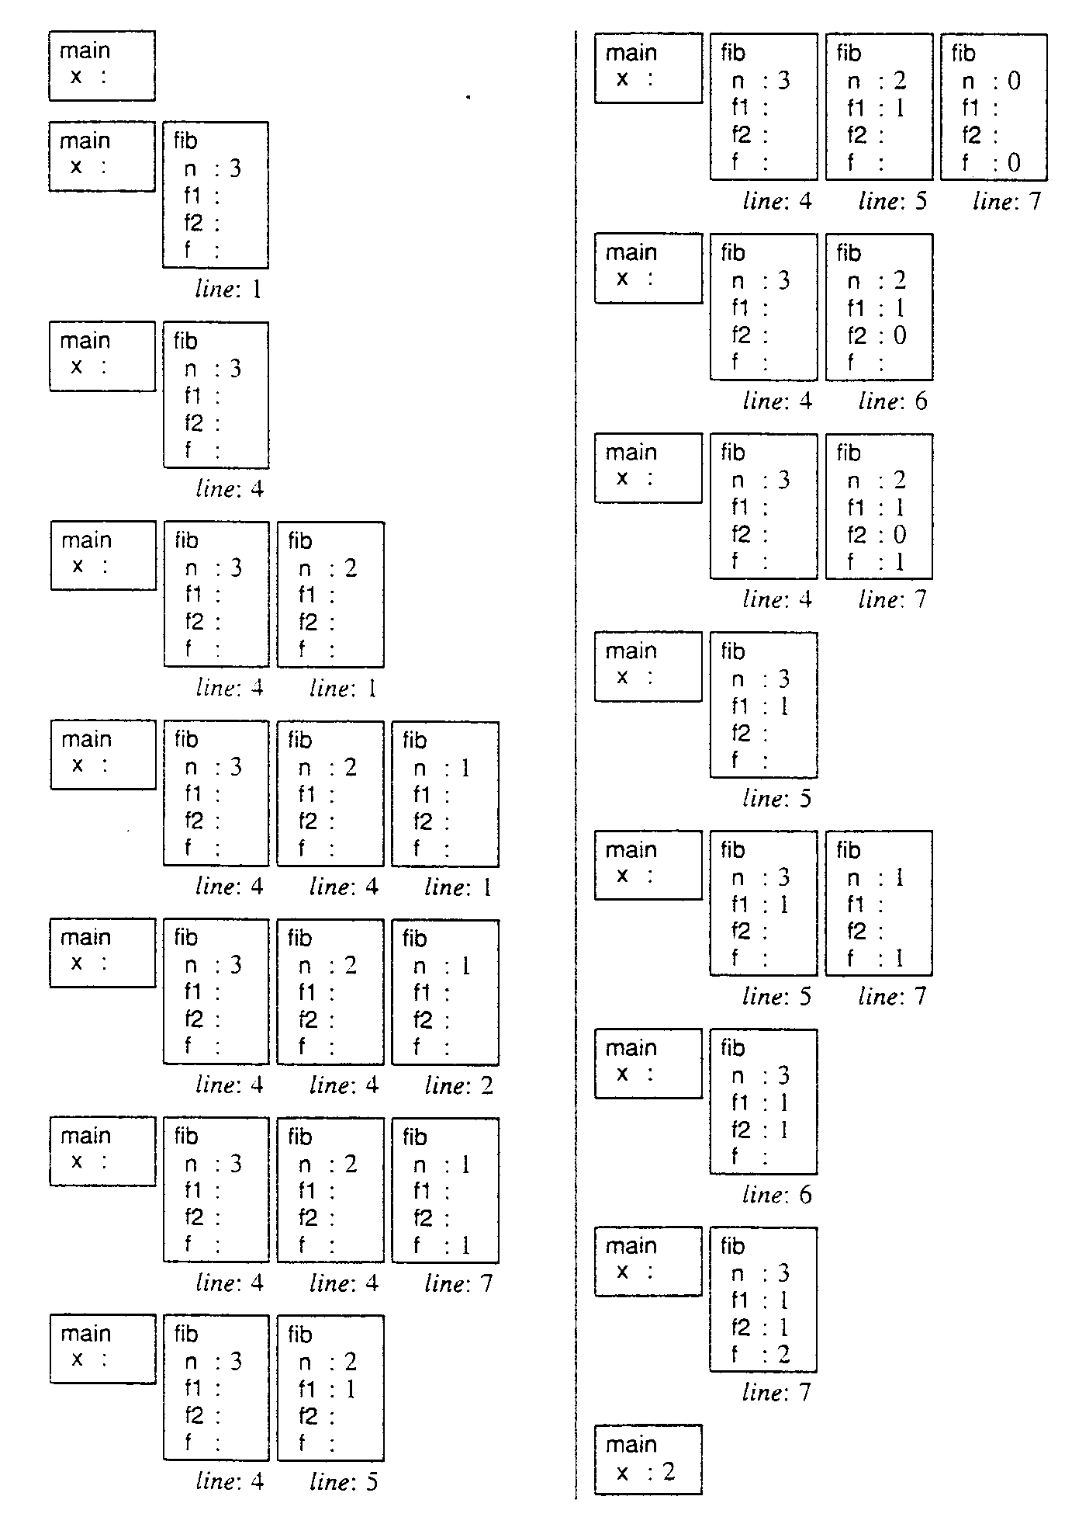
The working of recursive procedure
a unique copy for each call to itself
  individual procedure invocation at run time
  i.e. activation frame
e.g. The working of fib(n)
  main ()
  int x = fib(3);

Slide 5
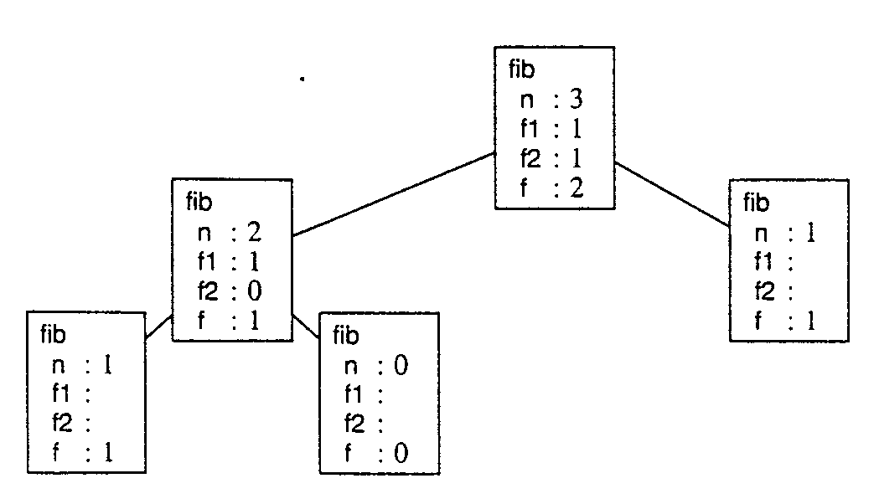
Activation Tree
  Each node corresponds to a different procedure invocation, just at the point when it is about to return.
  A preorder traversal visits each activation frame in order of its creation

Slide 6
Analysis for algorithm without loops
In a computation without loops, but possible with recursive procedure calls:
  The time that any particular activation frame is on the top of the frame stack is O(L),
  where L is the number of lines in the procedure that contain either a simple statement or a procedure call.
  The total computation time is θ(C),
  where C is the total number of procedure calls that occur during the computation.

Slide 7
Designing Recursive Procedures
// Think Inductively
converging to a base case (stopping the recursion)
  identify some unit of measure (running variable)
  identify base cases
assume p solves all sizes 0 through 100
  assume p99 solve sub-problem all sizes 0 through 99
  if p detect a case that is not base case it calls p99
p99 satisfies:
  1. The sub-problem size is less than p’s problem size
  2. The sub-problem size is not below the base case
  3. The sub-problem satisfies all other preconditions of p99 (which are the same as the preconditions of p)

Slide 8
Recursive Procedure design e.g.
Problem:
  write a delete(L, x) procedure for a list L
  which is supposed to delete the first occurrence of x.
  Possibly x does not occur in L.
Strategy:
  Use recursive Procedure
  The size of the problem is
  the number of elements in list L
  Use IntList ADT
  Base cases: ??
  Running variable (converging number): ??

Slide 9
ADT for IntList
IntList cons(int newElement, IntList oldList)
  Precondition: None.
  Postconditions: If x = cons(newElement, oldList) then
  1. x refers to a newly created object;
  2. x != nil;
  3. first(x) = newElement;
  4. rest(x) = oldList
int first(IntList aList) // access function
  Precondition: aList != nil
IntList rest(IntList aList) // access function
  Precondition: aList != nil
IntList nil //constant denoting the empty list.

Slide 10
Recurrence Equation for delete(L, x) from list L
  Think Inductively
delete(nil, x) = nil
delete(L, x) = rest(L) /; x == first(L)
delete(L, x) = cons(first(L), delete(rest(L), x))

Slide 11
Algorithm for Recursive delete(L, x) from list //
IntList delete(IntList L, int x)
IntList newL, fixedL;
if (L == nil)
newL = L;
else if (x == first(L))
newL = rest(L);
else
fixedL = delete99(rest(L), x);
newL = cons(first(L), fixedL);
return newL;

Slide 12
Algorithm for non-recursive delete(L, x)
IntList delete(IntList L, int x)
IntList newL, tempL;
tempL = L; newL = nil;
while (tempL != nil && x != first(tempL)) //copy elements
newL = cons(first(tempL), newL);
tempL = rest(tempL)
If (tempL != nil) // x == first(tempL)
tempL = rest(tempL) // remove x
while (tempL != nil) // copy the rest elements
newL = cons(first(tempL), newL);
tempL = rest(tempL)
return newL;

Slide 13
Convert a non-recursive procedure to a recursive procedure
Convert procedure with loop
  to recursive procedure without loop
Recursive Procedure acting like WHILE loop
  While(Not Base Case)
  Setting up Sub-problem
  Recursive call to continue
The recursive function may need an additional parameter
  which replaces an index in a FOR loop of the
  non-recursive procedure.

Slide 14
Transforming loop into a recursive procedure
Local variable with the loop body
  give the variable only one value in any one pass
  for variable that must be updated, do all the updates at the end of the loop body
Re-expressing a while loop with recursion
  Additional parameters
    Variables updated in the loop become procedure input parameters. Their initial values at loop entry correspond to the actual parameters in the top-level call of the recursive procedure.
    Variables referenced in the loop but not updated may also become parameters
  The recursive procedure begins by mimicking the while condition and returns if while condition is false
    a break also corresponds to a procedure return
  Continue by updating variable and make recursive call

Slide 15
Removing While loop, e.g.
int factLoop(int n)
int k=1; int f = 1
while (k <= n)
int fnew = f*k;
int knew = k+1
k = knew; f = fnew;
return f;
int factLoop(int n)
return factRec(n, 1, 1);
int factRec(int n, int k, int f)
if (k <= n)
int fnew = f*k;
int knew = k+1
return factRec(n, knew, fnew)
return f;

Slide 16
Removing For loop, e.g.
Convert the following seqSearch
  to recursive procedure without loop
int seqSearch(int[] E, int num, int K)
1. int ans, index;
2. ans = -1; // Assume failure.
3. for (index = 0; index < num; index++)
4. if (K == E[index])
5. ans = index; // Success!
6. break; // Done!
7. return ans;

Slide 17
Recursive Procedure without loops e.g.
Call with: seqSearchRec(E, 0, num, K)
seqSearchRec(E, index, num, K)
  1: if (index >= num)
  2: ans = -1;
  3: else if (E[index] == K) // index < num
  4: ans = index;
  5: else
  6: ans = seqSearchRec(E, index+1, num, K);
  7: return ans;
Compare to: for (index = 0; index < num; index++)

Slide 18
Analyzing Recursive Procedure using Recurrence Equations
Let n be the size of the problem
Worst-Case Analysis (for procedure with no loops)
T(n) =
  the individual cost for a sequence of blocks
  add the maximum cost for an alternation of blocks
  add the cost of subroutine call, S( f(n) )
  add the cost of recursive procedure call, T( g(n) )
e.g. seqSearchRec,
  Basic operation is comparison of array element, cost 1
  statement: 1: + max(2:, (3: + max(4:, (5: + 6:))) + (7:)
  Cost: 0 + max(0, (1 + max(0, (0+T(n-1))) + 0
T(n) = T(n-1) + 1; T(0) = 0
=> T(n) = n; T(n) ∈ θ(n)

Slide 19
Evaluate recursive equation using Recursion Tree
Evaluate: T(n) = T(n/2) + T(n/2) + n
  Work copy: T(k) = T(k/2) + T(k/2) + k
  For k=n/2, T(n/2) = T(n/4) + T(n/4) + (n/2)
[size|cost]

Slide 20
Recursion Tree e.g.
To evaluate the total cost of the recursion tree
  sum all the non-recursive costs of all nodes
  = Sum (rowSum(cost of all nodes at the same depth))
Determine the maximum depth of the recursion tree:
  For our example, at tree depth d
  the size parameter is n/(2^{d})
  the size parameter converging to base case, i.e. case 1
  such that, n/(2^{d}) = 1,
  d = lg(n)
  The rowSum for each row is n
Therefore, the total cost, T(n) = n lg(n)

Slide 21
Proving Correctness of Procedures: Proof
What is a Proof?
  A Proof is a sequence of statements that form a logical argument.
  Each statement is a complete sentence in the normal grammatical sense.
Each statement should draw a new conclusion from:
  axiom: well known facts
  assumptions: premises of the theorem you are proving or inductive hypothesis
  intermediate conclusions: statements established earlier
To arrive at the last statement of a proof that must be the conclusion of the proposition being proven

Slide 22
Format of Theorem, Proof Format
A proposition (theorem, lemma, and corollary) is represented as:
∀x ∈ W ( A(x) => C(x) )
for all x in W, if A(x) then C(x)
  the set W is called world,
  A(x) represents the assumptions
  C(x) represents the conclusion, the goal statement
  => is read as “implies”
Proof sketches provides outline of a proof
  the strategy, the road map, or the plan.
Two-Column Proof Format
  Statement : Justification (supporting facts)

Slide 23
Induction Proofs
Induction proofs are a mechanism, often the only mechanism, for proving a statement about an infinite set of objects.
  Inferring a property of a set based on the property of its objects
Induction is often done over the set of natural numbers {0,1,2,…}
  starting from 0, then 1, then 2, and so on
Induction is valid over a set, provided that:
  The set is partially ordered;
    i.e. an order relationship is defined between some pairs of elements, but perhaps not between all pairs.
  There is no infinite chain of decreasing elements in the set. (e.g. cannot be set of all integers)

Slide 24
Induction Proof Schema
0: Prove: ∀x ∈ W ( A(x) => C(x) )
Proof:
  1: The Proof is by induction on x, <description of x>
  2: The base case is, cases are, <base-case>
  3: <Proof of goal statement with base-case substituted into it, that is, C(base-case)>
  4: For <x> greater than <base-case>,
  assume that A(y) => C(y)
  holds for all y ∈ W
  such that y < x.
  5: <Proof of the goal statement, C(x), exactly as it appears in the proposition>.

Slide 25
Induction Proof e.g.
Prove:
For all n >= 0,
∑_{i=0}^{n} i(i+1)/2 = n(n+1)(n+2)/6
Proof: …

Slide 26
Proving Correctness of Procedures
Things should be made as simple as possible –
but not simpler
  Albert Einstein
Proving Correctness of procedures is a difficult task in general; the trick is to
make it as simple as possible.
  No loops is allowed in the procedure!
  Variable is assigned a value only once!
Loops are converted into Recursive procedures.
Additional variables are used to make single-assignment (write-once read many) possible.
  x = y+1 does imply the equation x = y+1 for entire time

Slide 27
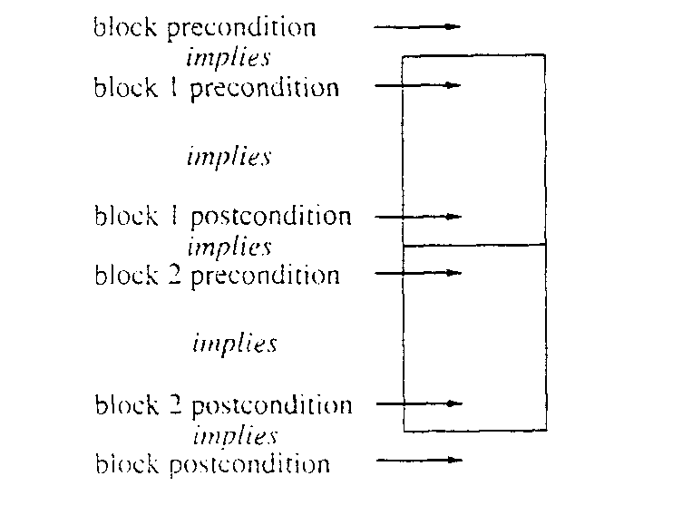
General Correctness Lemma
If all preconditions hold when the block is entered,
  then all postconditions hold when the block exits
And, the procedure will terminate!
  Chains of Inference: Sequence

Slide 28
Proving Correctness of Binary Search, e.g.
int binarySearch(int[] E, int first, int last, int K)
1. if (last < first)
2. index = -1;
3. else
4. int mid = (first + last)/2
5. if (K == E[mid])
6. index = mid;
7. else if (K < E[mid])
8. index = binarySearch(E, first, mid-1, K)
9. else
10. index = binarySearch(E, mid+1, last, K);
11. return index

Slide 29
Proving Correctness of Binary Search
Lemma (preconditions => postconditions)
  if binarySearch(E, first, last, K) is called, and
  the problem size is n = (last – first + 1),
  for all n >= 0, and
  E[first], … E[last] are in nondecreasing order,
  then it returns –1 if K does not occur in E within the range first, …, last, and
  it returns index such that K=E[index] otherwise
Proof
  The proof is by induction on n, the problem size.
  The base case in n = 0.
  In this case, line 1 is true, line 2 is reached, and –1 is returned. (the postcondition is true)

Slide 30
Inductive Proof, continue
For n > 0, assume that binarySearch(E, first, last, K) satisfies the lemma on problems of size k, such that 0 <= k < n, and first and last are any indexes such that k = last – first + 1
  For n > 0, line 1 is false, … mid is within the search range
  (first <= mid <= last).
  If line 5 is true, the procedure terminates with
  index = mid. (the postcondition is true)
  If line 5 is false, from (first <= mid <= last) and def. of n,
  (mid – 1) – first + 1 <= (n – 1)
  last – (mid + 1) + 1 <= (n – 1)
  so the inductive hypothesis applies for both recursive calls,
  If line 7 is true, … the preconditions of binarySearch are satisfied, we can assume that the call accomplishes the objective.
  If line 8 return positive index, done.
  If line 8 returns –1, this implies that K is not in E in the first … mid-1, also since line 7 is true, K is not in E in range min… last, so returning – 1 is correct (done).
  If line 7 is false, … similar the postconditions are true. (done!)

