Slide 1
Problem: Selection
Design and Analysis: Adversary Arguments
The selection problem
<< Ranking elements of a set in nondecreasing order, find an element rank K >>
  Finding max and min
Designing against an adversary
<< An algorithm playing Information game
against an adversary >>

Slide 2
Design and Analysis using
Adversary arguments
An algorithm is playing an Information game against an adversary.
  The algorithm wants to get as much Information as possible in order to get as much work done as effective as possible.
  The adversary wants to give as least Information as possible to give the algorithm the worst case.
  The rule of the game is Consistency.
  The adversary can trick but cannot cause inconsistency in the given information.
e.g. your algorithm needs to guess a date (a month and day) and your adversary gives yes/no answers.
  Let’s play!

Slide 3
Strategy for Designing against an adversary
Assume a strong adversary!
  the adversary will give as least information as possible
Choose questions (or operations) as balance as possible
  e.g. for comparison of two keys, x > y
  Yes: x > y and
  No: x not > y
  should provide about the same amount information

Slide 4
The Selection Problem
Find an element with rank k
  in an array E using indexes 1 through n
  the elements in E are assumed to be unsorted
  where 1 <= k <= n
Finding an element with rank k is equivalent to answering the question:
  If the array were sorted in nondecreasing order
  which element would be in E[k]?
The largest key (called max) should be k = n
The smallest key (called min) should be k = 1
The median key should be k = Ceiling[n/2]

Slide 5
Finding min, finding max, finding min and max
Finding min in an unsorted array of n elements
  require at least n-1 comparisons
Finding max in an unsorted array of n elements
  require at least n-1 comparisons
Now we want to find both min and max
  can we do better than 2(n-1) ?
  What is the lower bound?
Theorem: Any algorithm to find both min and max of n keys by comparison of keys must do
at least 3n/2 – 2 key comparisons in the worst case.

Slide 6
Proof by adversary arguments and units of information
To know that a key v is max, an algorithm must know that every key other than v has lost some comparison
  To know that a key u is min , an algorithm must know that every key other than u has won some comparison.
If we count each win as one unit of information
and each loss as one unit of information
  Then an algorithm must have at least 2(n-1) units of information for finding both min and max
We need to determine how many comparison are required (in the worst case) to get total 2(n-1) units of information.
  The adversary to give us the worst case will provide as few information as possible.

Slide 7
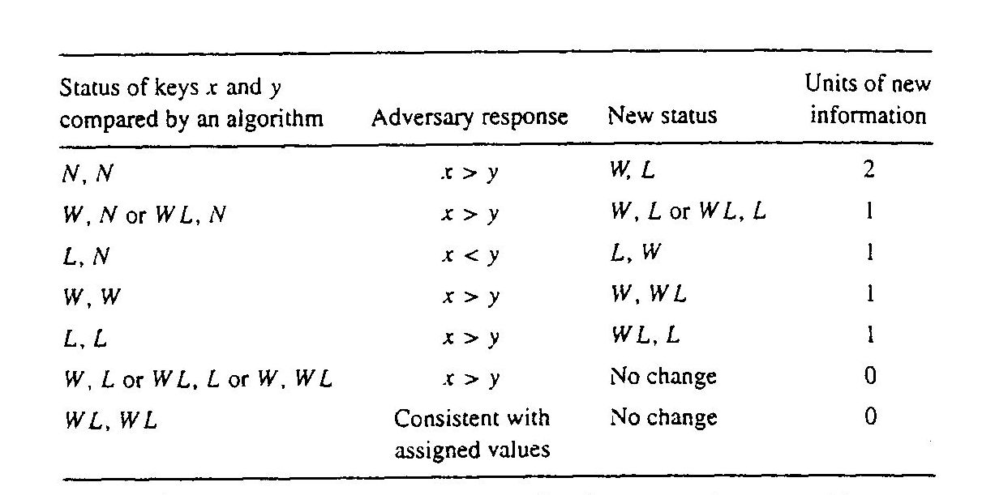
The adversary strategy to give us the worst case

Slide 8
Our strategy to gain as must information
Our algorithm can do at most n/2 comparisons of previously unseen keys
  suppose for the moment that n is even
  each of these comparison give us 2 units of information
  now we have n units of information
Our algorithm need total 2(n-1) = 2n – 2, so now we need n – 2 additional units of information
  for each other comparison we gain at most one unit of information
  so we need at least n – 2 additional comparisons
In total our algorithm requires at least n/2 + n – 2 comparisons. For n is odd, 3n/2 – 3/2 comparisons are needed. QED

Slide 9
Design an algorithm to find min and max
Now we know the lower bound (in the worst case)
  Can we design an algorithm to reach the lower bound?
Exercise
  design an algorithm to find both min and max
  the algorithm should do at most (about) 3n/2 comparison (in the worst case) for a problem size of n elements

