Slide 1
Graphs and Graph Traversals
  // From Tree to Graph
  // Many programs can be cast as problems on graph
Definitions and Representations
Traversing Graphs
Depth-First Search on Directed Graphs
Strongly Connected Components of a Directed Graph
Depth-First Search on Undirected Graphs
Biconnected Components of an
Undirected Graph

Slide 2
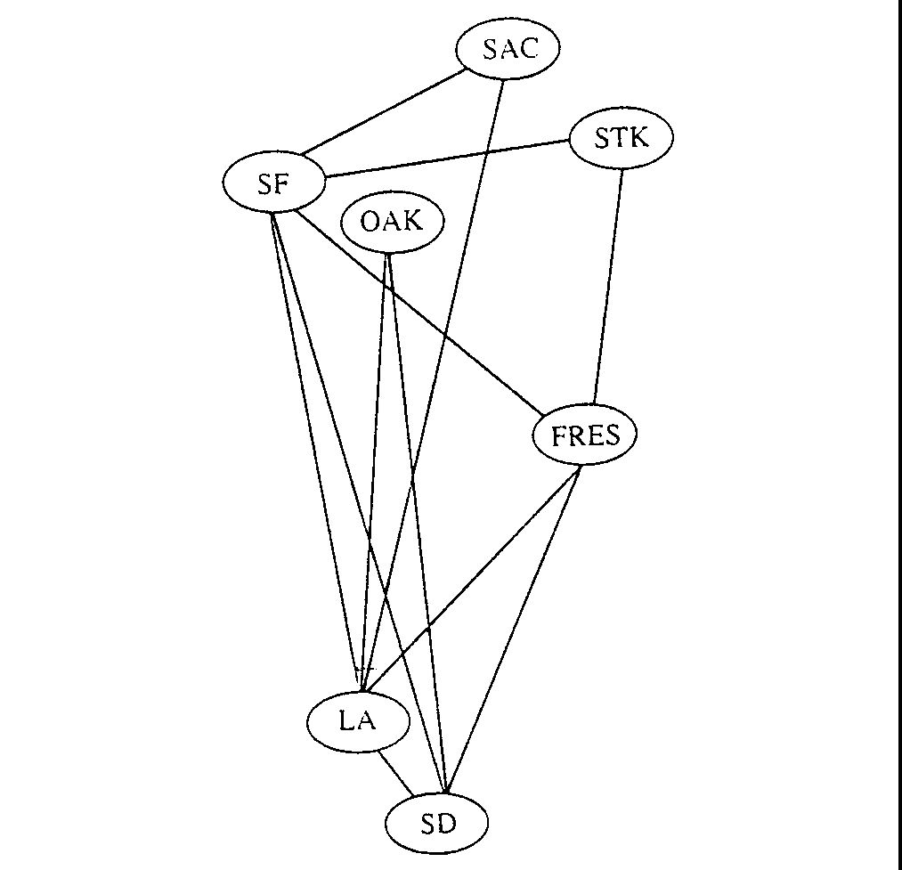
Problems: e.g. Airline Routes

Slide 3
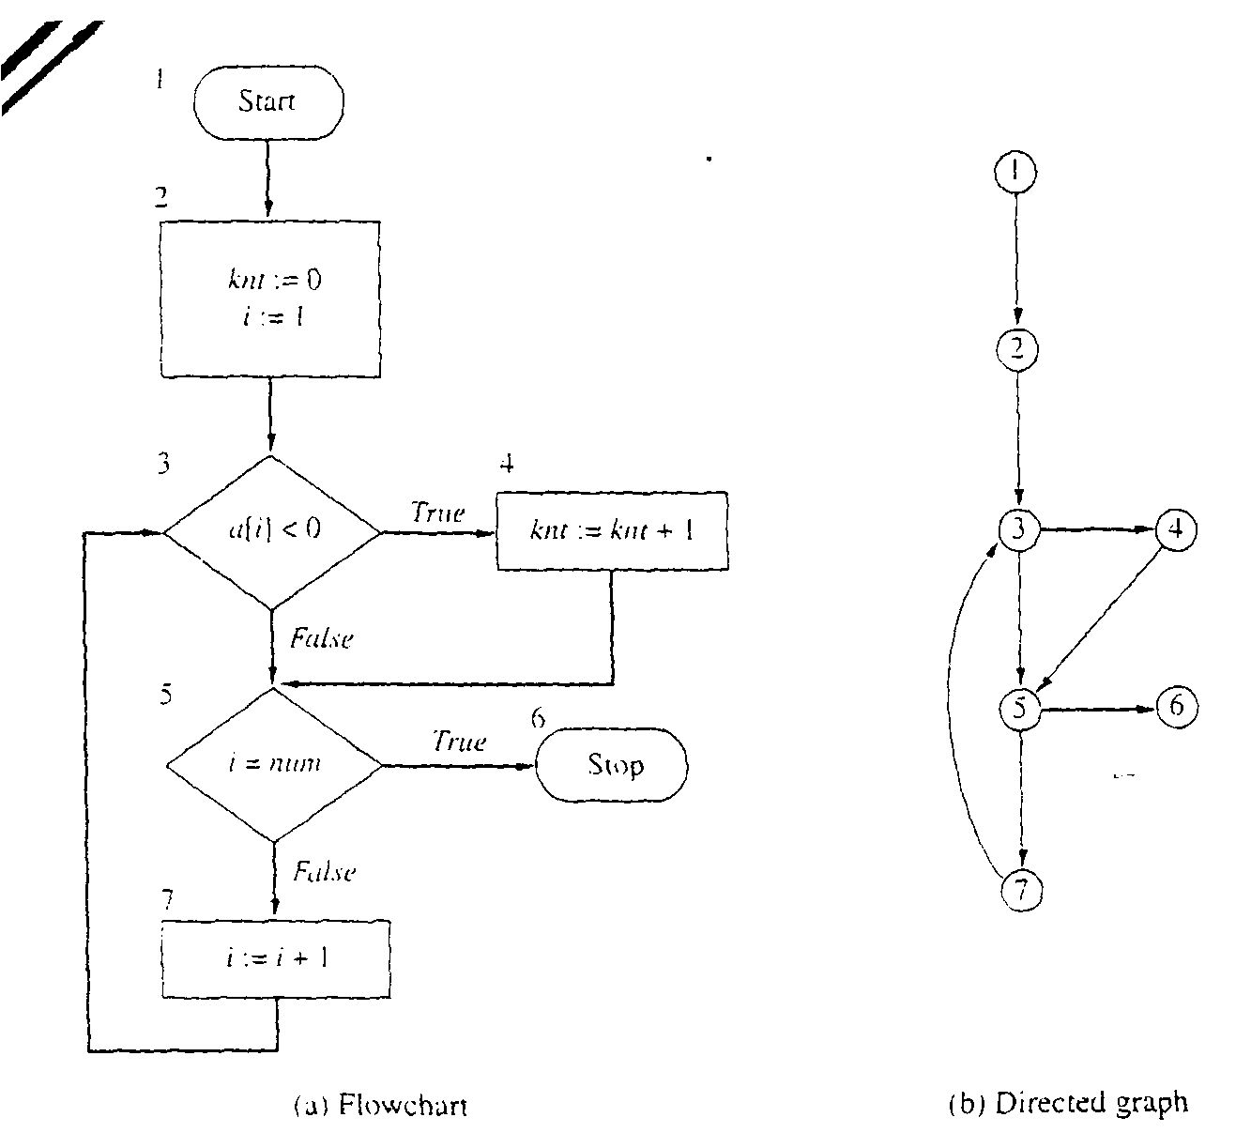
Problems: e.g. Flowcharts

Slide 4
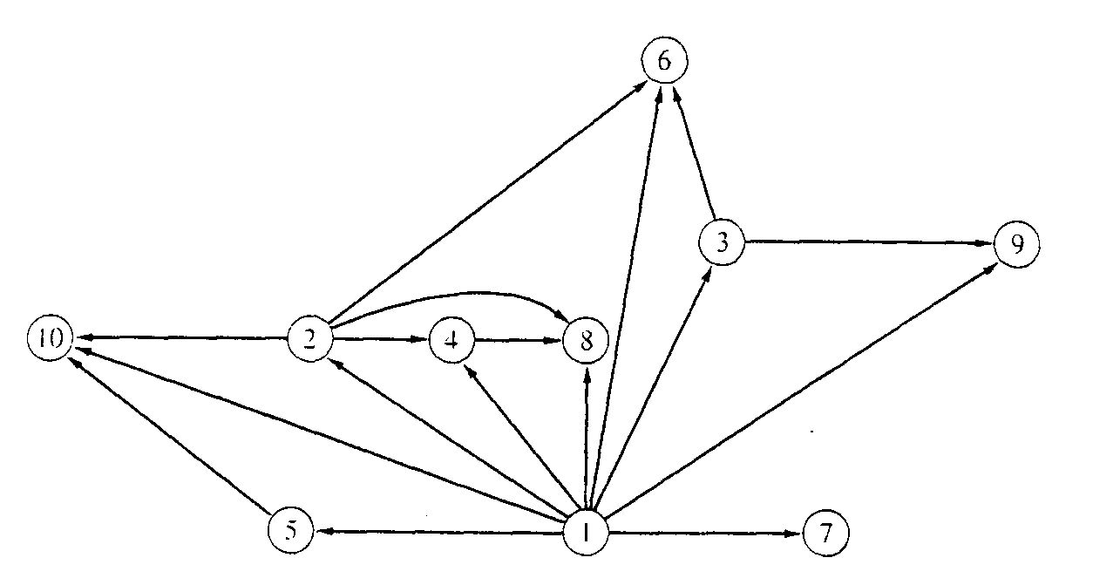
Problems: e.g. Binary relation
x is a proper factor of y

Slide 5
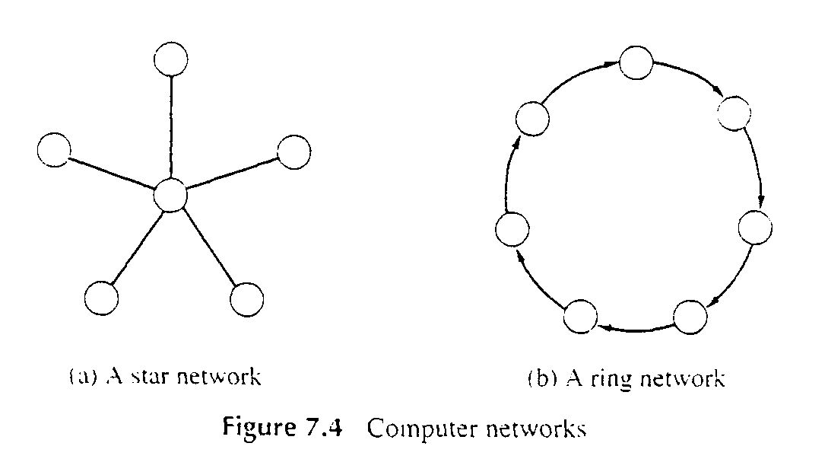
Problems: e.g. Computer Networks

Slide 6
Definition: Directed graph
Directed Graph
  A directed graph, or digraph, is a pair
  G = (V, E)
  where V is a set whose elements are called vertices, and
  E is a set of ordered pairs of elements of V.
    Vertices are often also called nodes.
    Elements of E are called edges, or directed edges, or arcs.
    For directed edge (v, w) in E, v is its tail and w its head;
    (v, w) is represented in the diagrams as the arrow, v -> w.
    In text we simple write vw.

Slide 7
Definition: Undirected graph
Undirected Graph
  A undirected graph is a pair
  G = (V, E)
  where V is a set whose elements are called vertices, and
  E is a set of unordered pairs of distinct elements of V.
    Vertices are often also called nodes.
    Elements of E are called edges, or undirected edges.
    Each edge may be considered as a subset of V containing two elements,
    {v, w} denotes an undirected edge
    In diagrams this edge is the line v---w.
    In text we simple write vw, or wv
    vw is said to be incident upon the vertices v and w

Slide 8
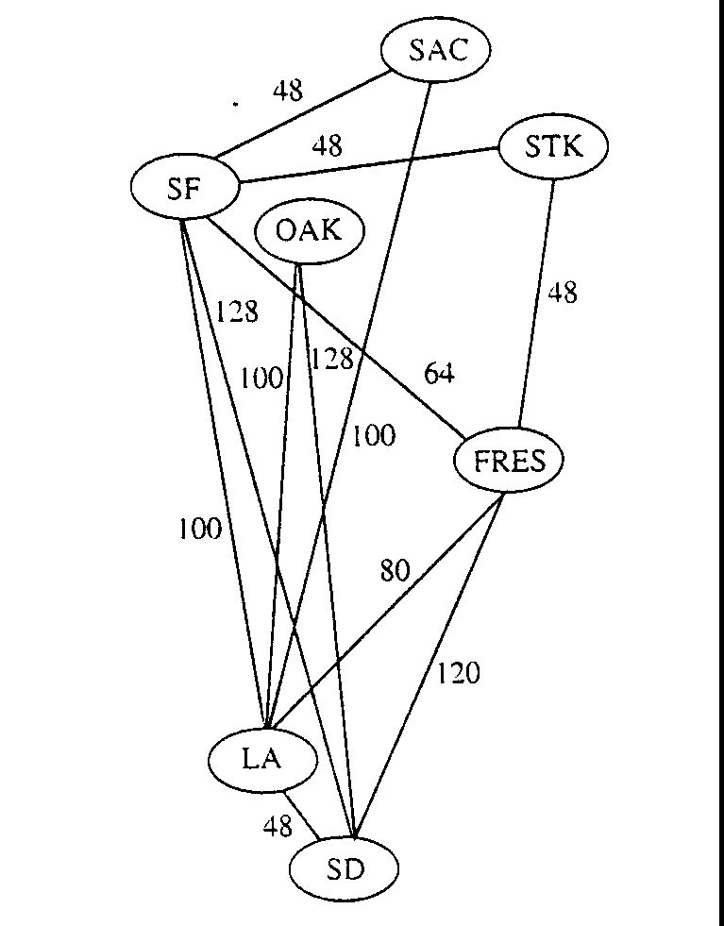
Definitions: Weighted Graph
A weighted graph is a triple (V, E, W)
  where (V, E) is a graph (directed or undirected) and
  W is a function from E into R, the reals (integer or rationals).
  For an edge e, W(e) is called the weight of e.

Slide 9
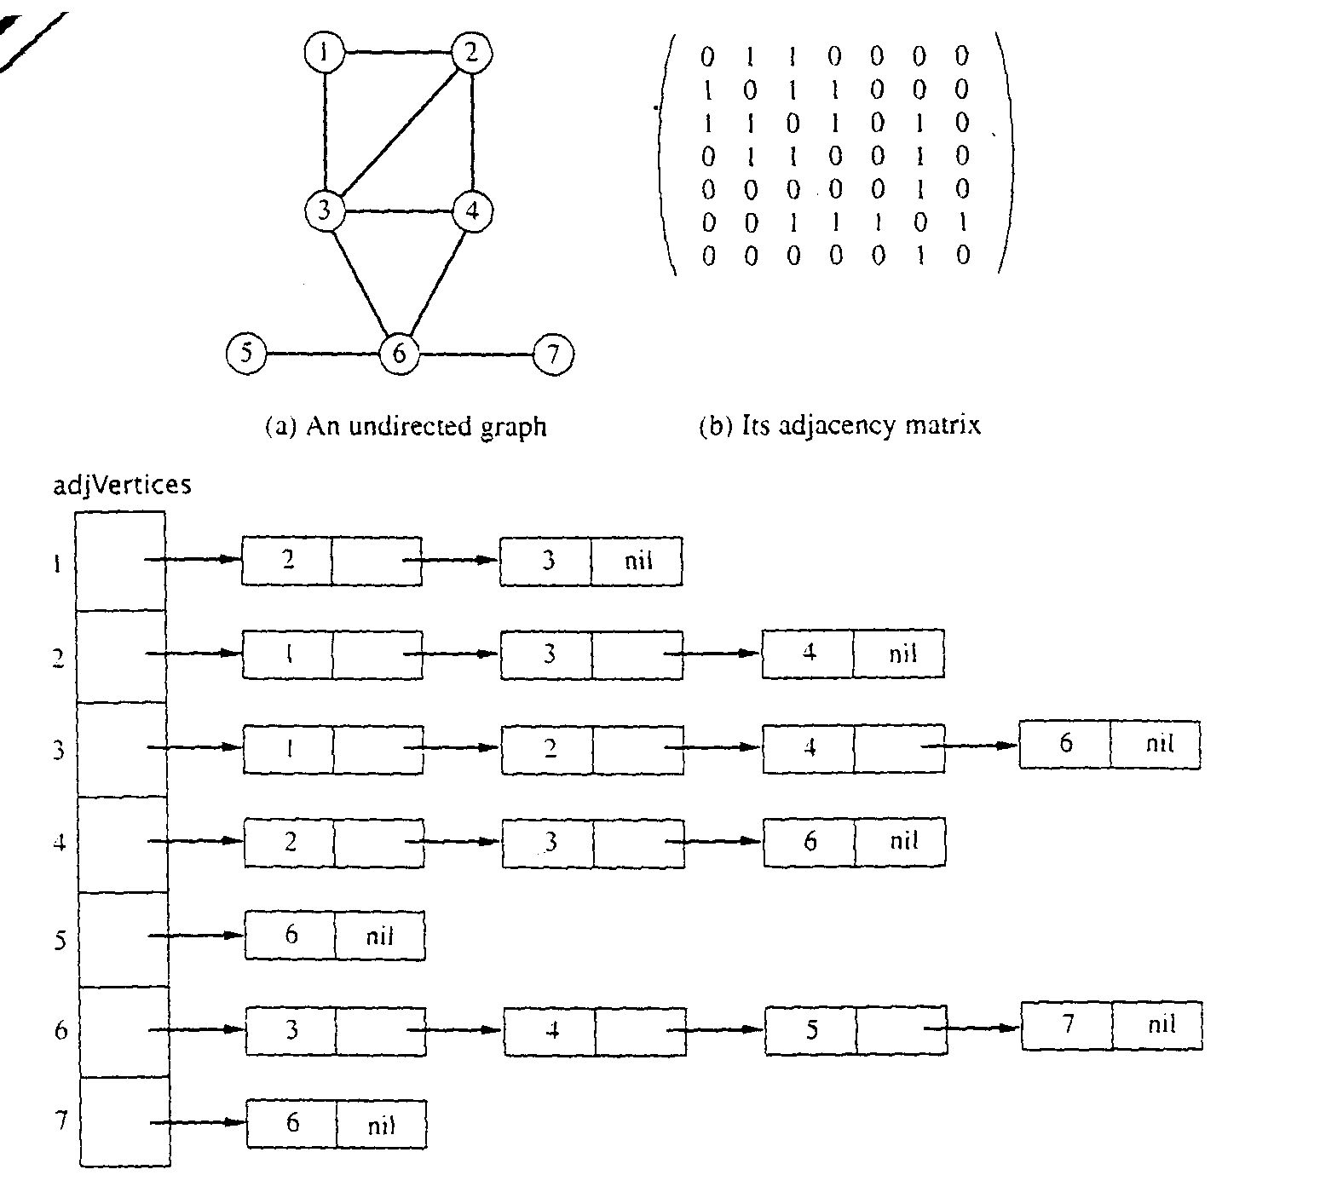
Graph Representations using Data Structures
Adjacency Matrix Representation
  Let G = (V,E), n = |V|, m = |E|, V = {v1, v2, …, vn)
  G can be represented by an n × n matrix

Slide 10
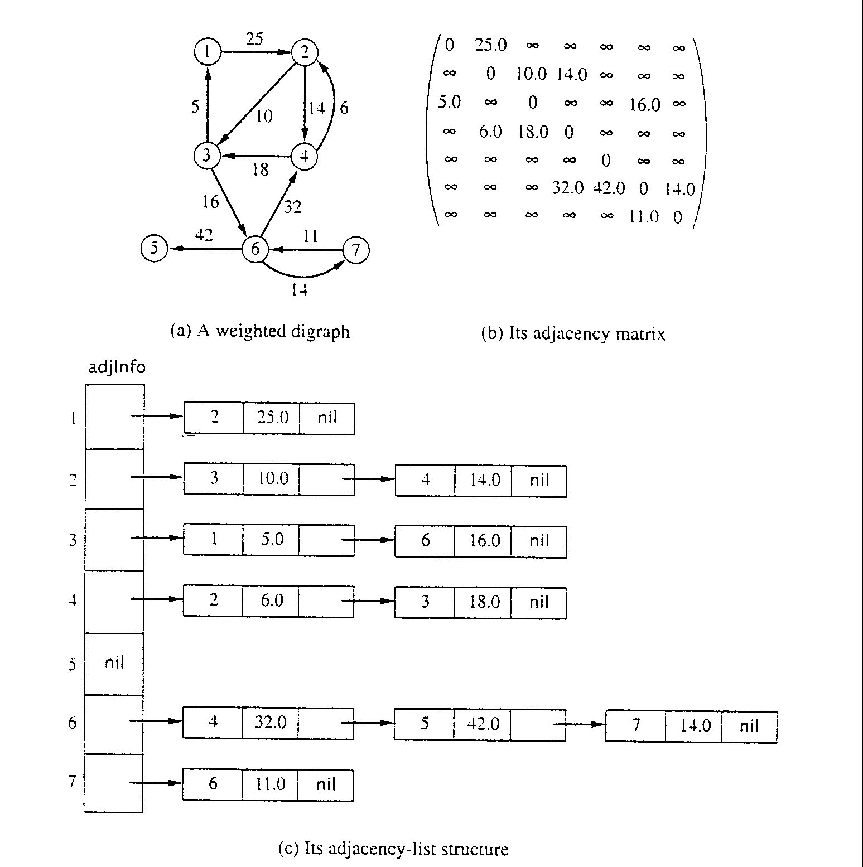
Adjacency Matrix for weight digraph

Slide 11
Array of Adjacency Lists Representation
From
  to

Slide 12
Array of Adjacency Lists Representation
from -> to, weight

Slide 13
More Definitions
Subgraph
Symmetric digraph
complete graph
Adjacency relation
Path, simple path, reachable
Connected, Strongly Connected
Cycle, simple cycle
acyclic
undirected forest
free tree, undirected tree
rooted tree
Connected component

Slide 14
Traversing Graphs
Most algorithms for solving problems on a graph examine or process each vertex and each edge.
Breadth-first search and depth-first search
  are two traversal strategies that provide an efficient way to “visit” each vertex and edge edge exactly once.
Breadth-first search: Strategy (for digraph)
  choose a starting vertex, distance d = 0
  vertices are visited in order of increasing distance from the starting vertex,
  examine all edges leading from vertices (at distance d) to adjacent vertices (at distance d+1)
  then, examine all edges leading from vertices at distance d+1 to distance d+2, and so on,
  until no new vertex is discovered

Slide 15
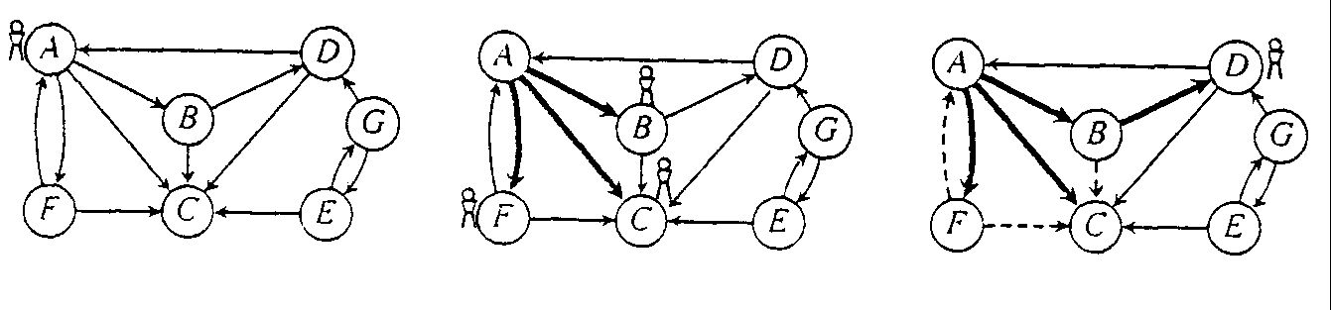
Breath-first search, e.g.
e.g. Start from vertex A, at d = 0
  visit B, C, F; at d = 1
  visit D; at d = 2
e.g. Start from vertex E, at d = 0
  visit G; at d = 1

Slide 16
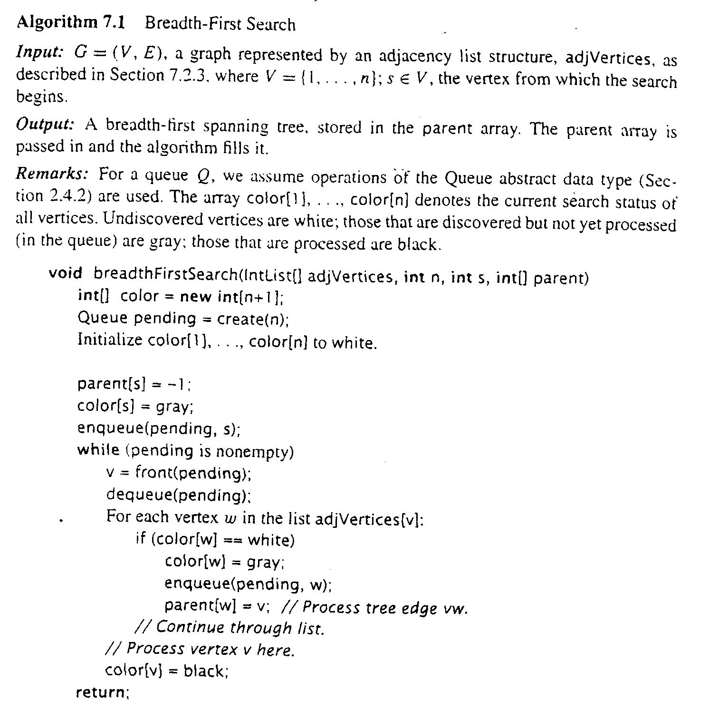
Breadth-first search: I/O Data Structures

Slide 17
Breadth-first search: Algorithm

Slide 18
Breadth-first search: Analysis
For a digraph having n vertices and m edges
  Each edge is processed once in the while loop for a cost of θ(m)
  Each vertex is put into the queue once and removed from the queue and processed once, for a cost θ(n)
  Extra space is used for color array and queue, there are θ(n)
From a tree (breadth-first spanning tree)
  the path in the tree from start vertex to any vertex contains the minimum possible number of edges
Not all vertices are necessarily reachable from a selected starting vertex

Slide 19
Depth-first search for Digraph
Depth-first search: Strategy (for digraph)
  choose a starting vertex, distance d = 0
  vertices are visited in order of increasing distance from the starting vertex,
  examine One edges leading from vertices (at distance d) to adjacent vertices (at distance d+1)
  then, examine One edges leading from vertices at distance d+1 to distance d+2, and so on,
  until no new vertex is discovered, or dead end
  then, backtrack one distance back up, and try other edges, and so on
  until finally backtrack to starting vertex, with no more new vertex to be discovered.

Slide 20
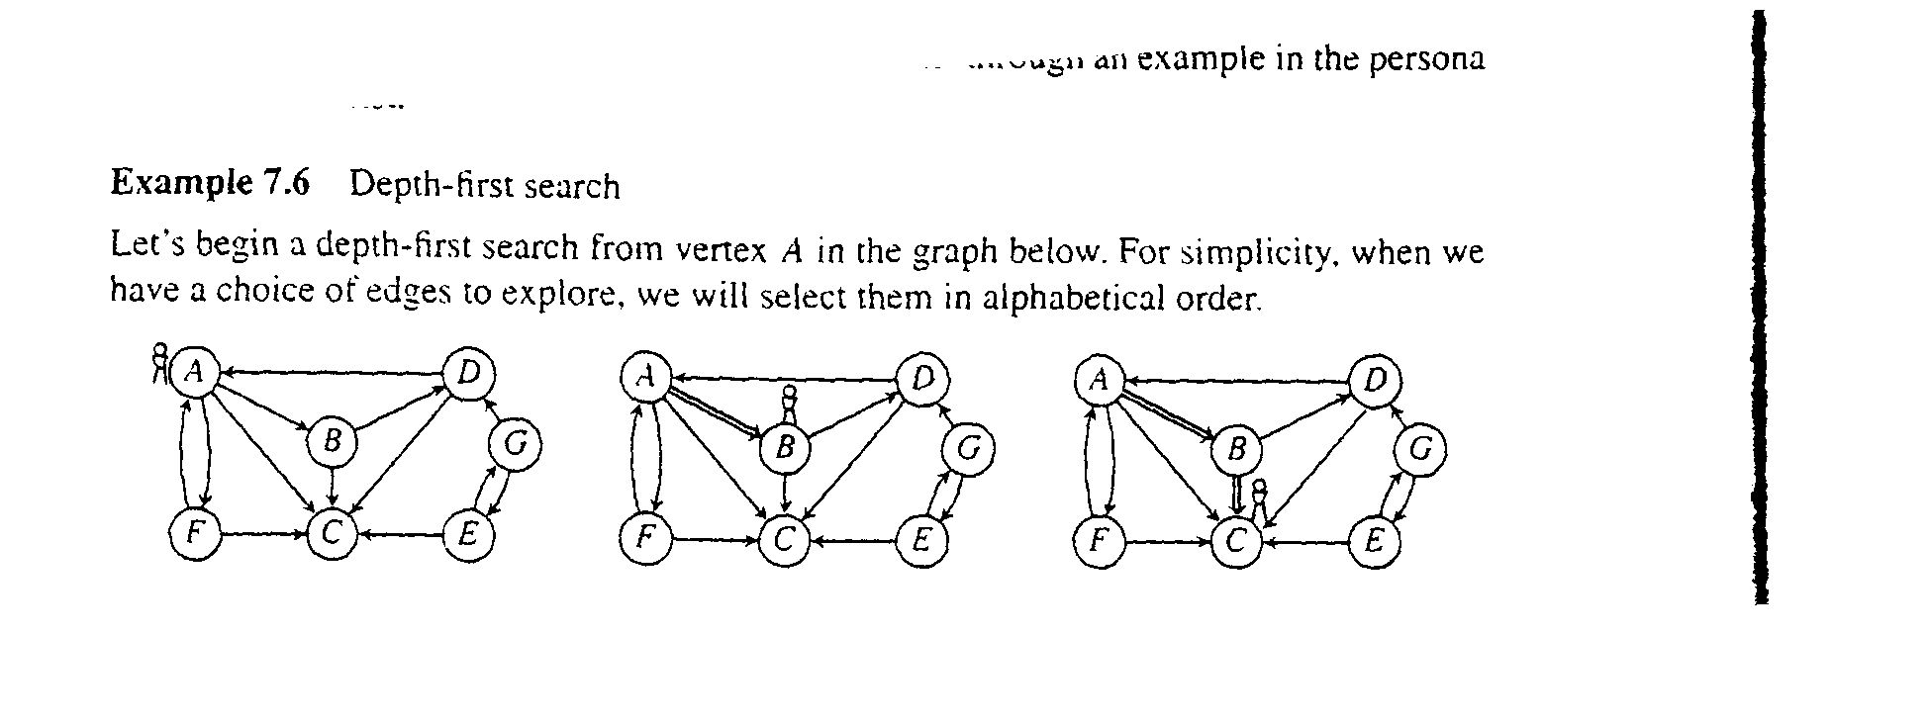
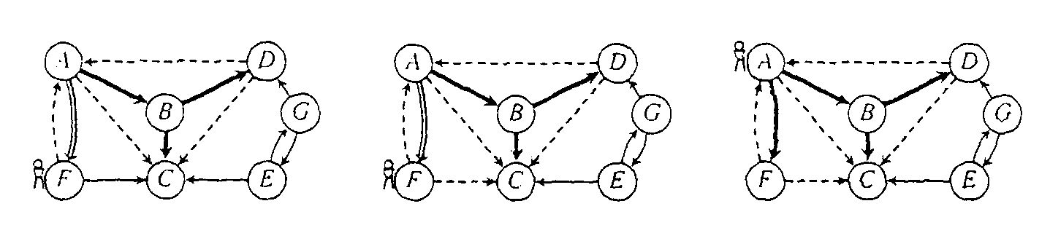
Depth-first search for digraph, e.g. from a tree, remember where we have been
and so on…

Slide 21
Depth-first Search, e.g. trace it, in order
Vertex status: undiscovered, discovered, finished
Edge status: exploring, backtrack, checked

Slide 22
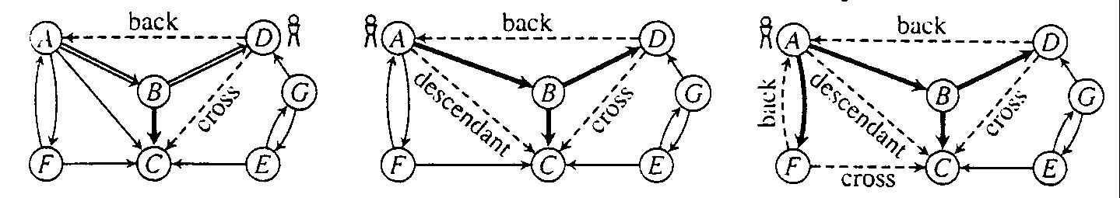
Depth-first search tree
edges classified:
  tree edge, back edge, descendant edge, and cross edge

Slide 23
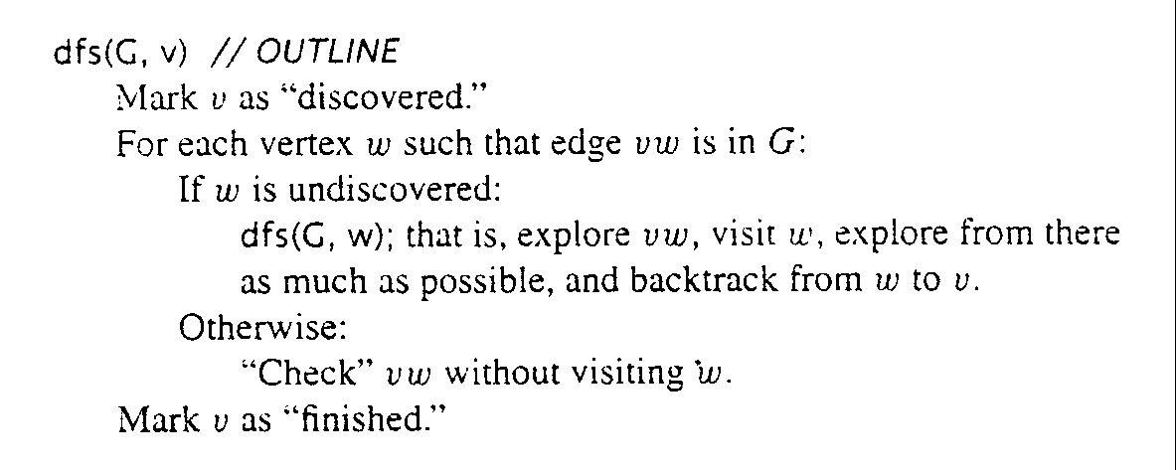
Depth-first search algorithm: outline

Slide 24
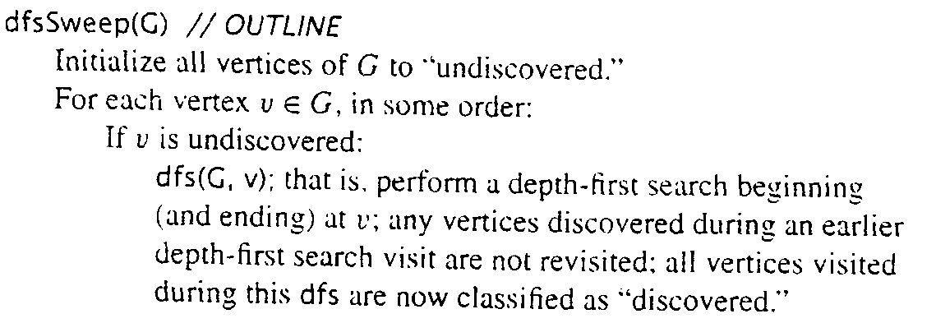
Reaching all vertices

Slide 25
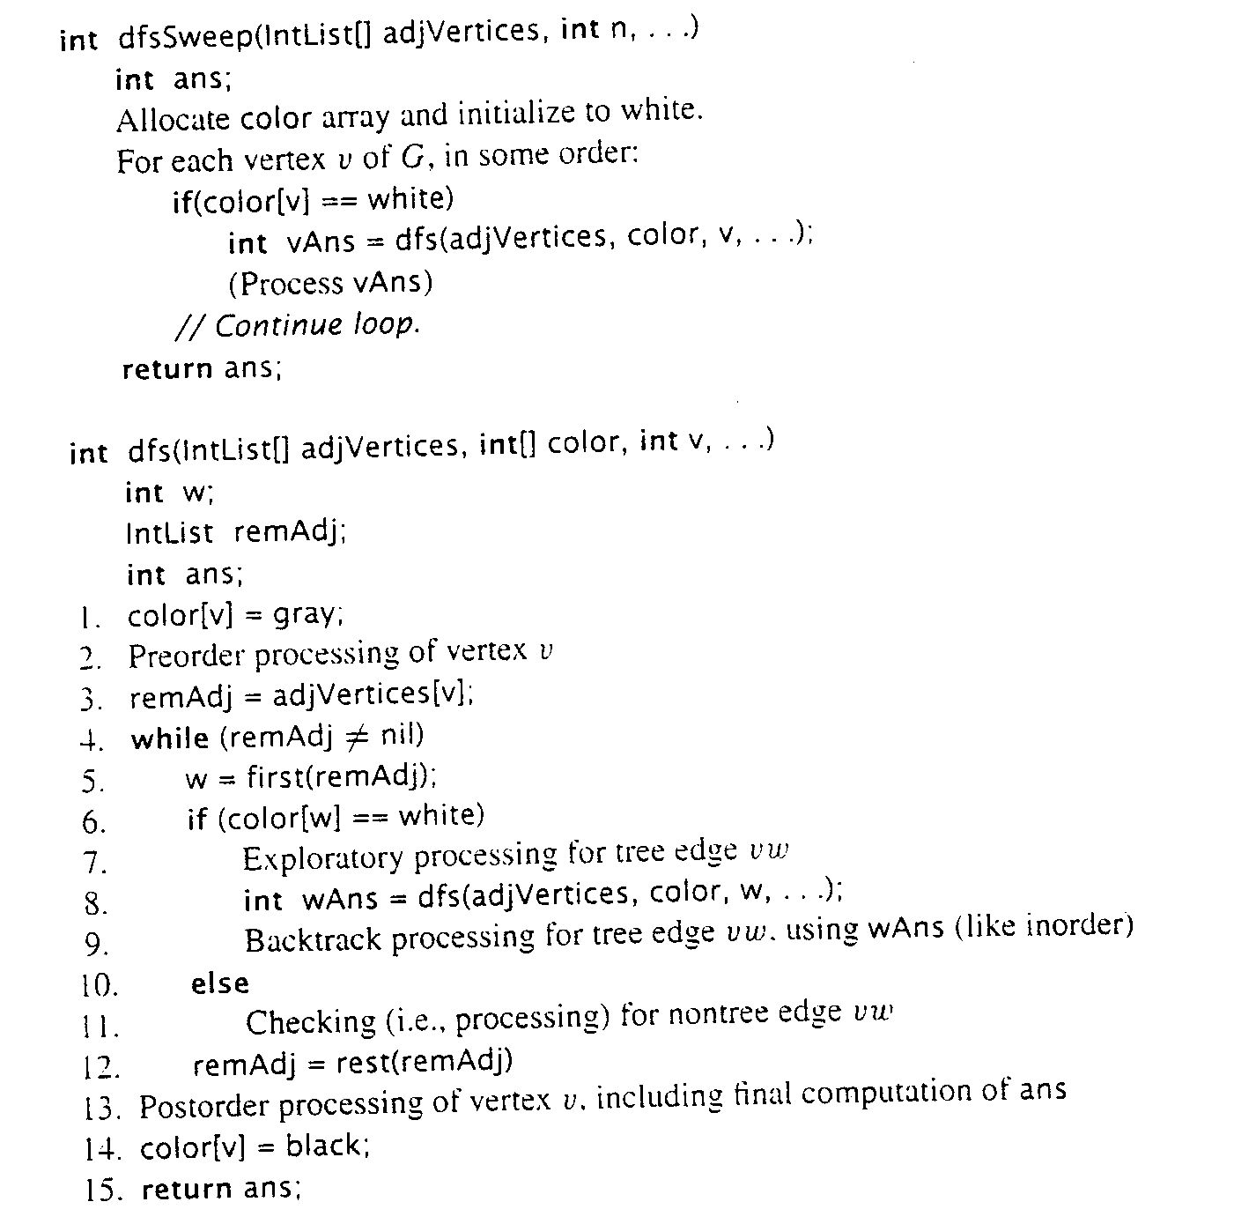
Depth-first search algorithm

Slide 26
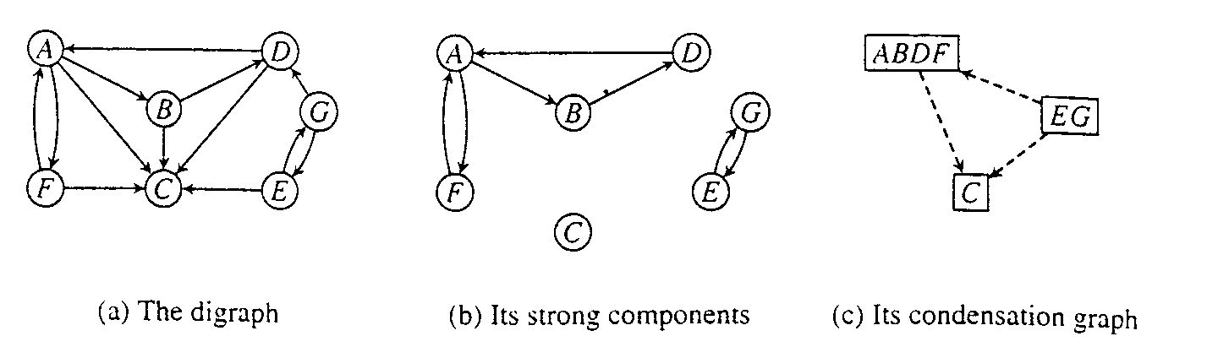
Strongly Connected Components of a Digraph
Strongly connected:
  A directed graph is strongly connected if and only if, for each pair of vertices v and w, there is a path from v to w.
Strongly connected component:
  A strongly connected component of a digraph G is a maximal strongly connected subgraph of G.

Slide 27
Strongly connected Components and Equivalence Relations
Strongly Connected Components may be defined in terms of an equivalence relation, S, on the vertices
  vSw iff there is a path from v to w and
  a path from w to v
Then, a strongly connected component consists of one equivalence class, C, along with all edges vw such that v and w are in C.

Slide 28
Condensation graph
  The strongly connected components of a digraph can each be collapsed to a single vertex yielding a new digraph that has no cycles.
Condensation graph:
  Let S₁,S₂,...S_{p} be the strong components of G.
  The condensation graph of G denoted as G↓, is the digraph G↓ = (V',E'),
  where V' has p elements s₁,s₂,...s_{p} and
  s_{i}s_{j} is in E' if and only if i≠j and
  there is an edge in E from some vertex in S_{i} to some vertex in S_{j}.

Slide 29
Condensation graph and its strongly connected components
Condensation Graph is acyclic.

Slide 30
Algorithm to Find
Strongly Connected Component
Strategy:
  Phase 1:
  A standard depth-first search on G is performed,
  and the vertices are put in a stack at their finishing times
  Phase 2:
  A depth-first search is performed on G^{T}, the transpose graph.
  To start a search, vertices are popped off the stack.
  A strongly connected component in the graph is identified by the name of its starting vertex (call leader).

Slide 31
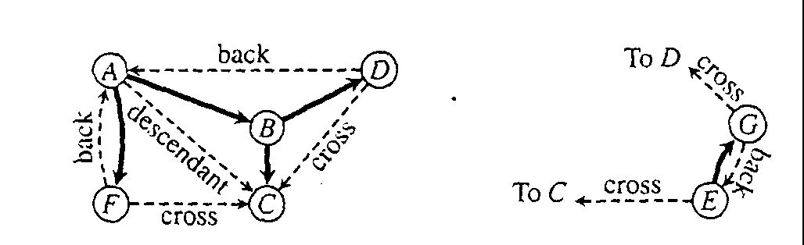
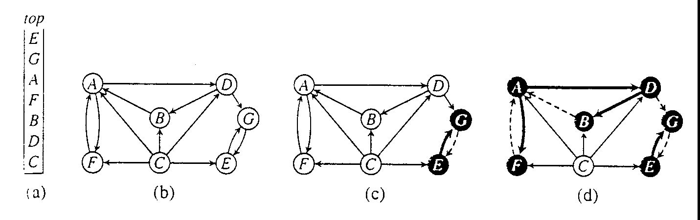
The strategy in Action, e.g.

Slide 32
Depth-First Search on Undirected Graphs
Depth-first search on an undirected graph is complicated by the fact that edges should by explored in one direction only,
but they are represented twice in the data structure (symmetric digraph equivalence)
Depth-first search provides an orientation for each of its edges
  they are oriented in the direction in which they are first encountered (during exploring)
  the reverse direction is then ignored.

Slide 33
Algorithm for depth-first search on undirected graph
int dfs(IntList[] adjVertices,int[] color,int v,int p,...)
int w;
IntList remAdj;
int ans;
1. color[v]=gray;
2. Preorder processing of vertex v
3. remAdj=adjVetices[v];
4. while(remAdj<>nil)
5. w=first(remAdj);
6. if(color[w]==white)
7. Explratory processing for tree edge vw.
8. int wAns=dfs(adjVetices,color, w, v,....)
9. BackTrack processing for tree edge vw using wAns(like inorder)
10. else if(color[w]==gray && w<>p)
11. Checking back edge vw
//else wv was traversed, so ignore vw.
12. remAdj=rest(remAdj)
13.Postorder processing of vertex v, including final computation of ans
14.color[v]=black;
15.return ans;

Slide 34
Breadth-first Search on Undirected Graph
Simply treat the undirected graph as symmetric digraph
  in fact undirected graph is represented in adjacency list as symmetric digraph
Each edge is processed once in the “forward” direction
  whichever direction is encountered (explored) first is considered “forward” for the duration of the search

Slide 35
Bi-connected components of an
Undirected graph
Problem:
  If any one vertex (and the edges incident upon it) are removed from a connected graph,
  is the remaining subgraph still connected?
Biconnected graph:
  A connected undirected graph G is said to be biconnected if it remains connected after removal of any one vertex and the edges that are incident upon that vertex.
Biconnected component:
  A biconnected component of a undirected graph is a maximal biconnected subgraph, that is, a binconnected subgraph not contained in any larger binconnected subgraph.
Articulation point:
  A vertex v is an articulation point for an undirected graph G if there are distinct vertices w and x (distinct from v also) such that v is in every path from w to x.

Slide 36
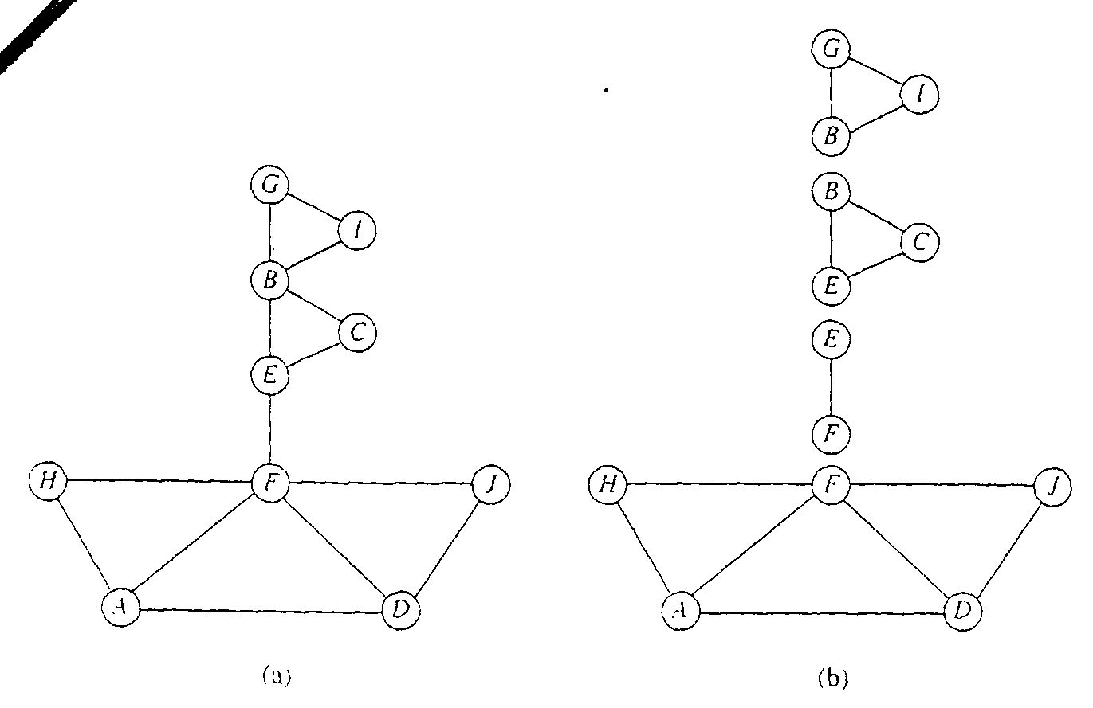
Bi-connected components, e.g.
Some vertices are in more than one component (which vertices are these?)

